Slide 1
Addison Elementary Career Day!
Let’s Build a Website
May 1, 2015
Christopher Ward Kennesaw State University Director of Web Services and Mobile Development

Slide 2
I work at Kennesaw State University

Slide 3
Does anyone here know anything about KSU?

Slide 4
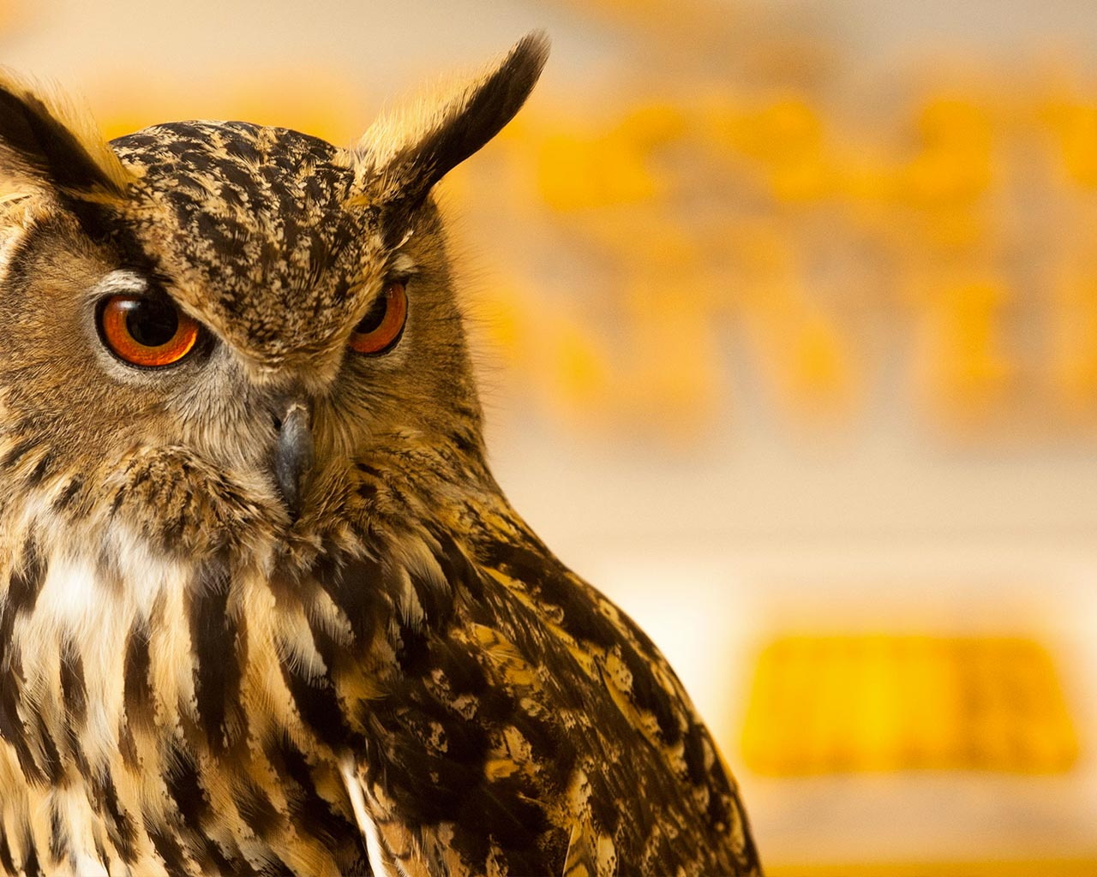
32,000 Students
Over 2,800 employees
Top 50 largest public universities in the U.S.
OwlNation!

Slide 5
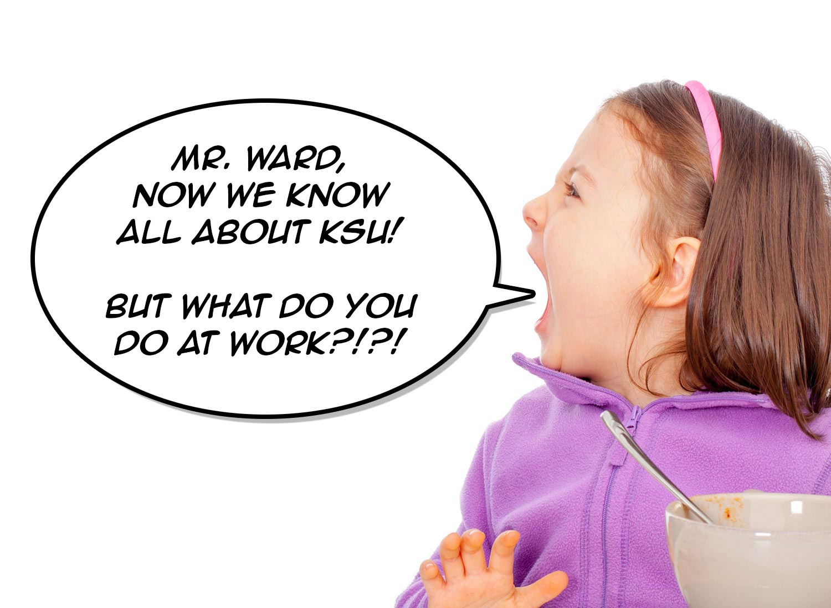

Slide 6
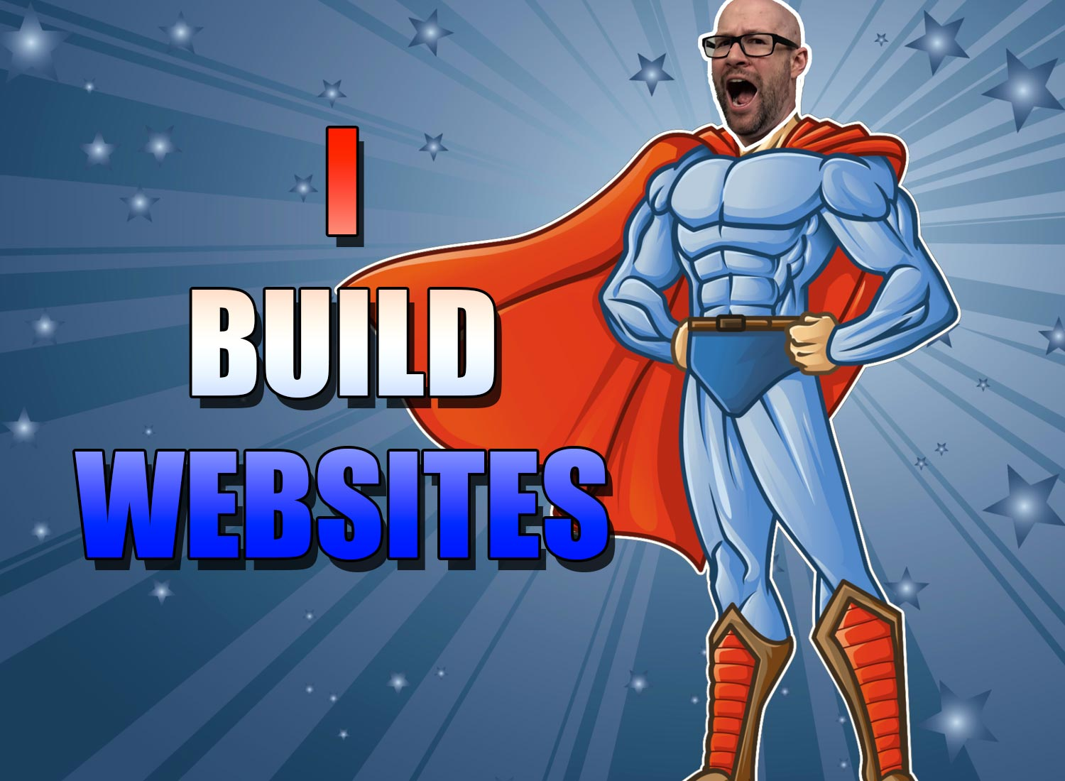

Slide 7
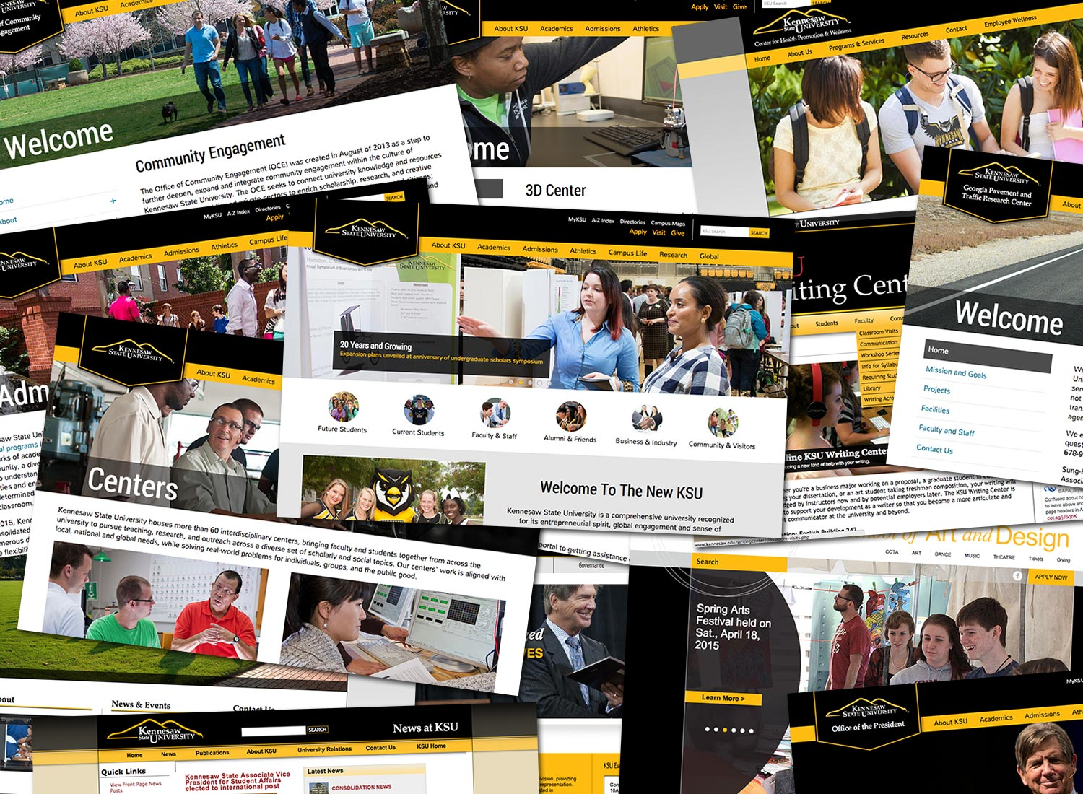
lots. of. sites.

Slide 8
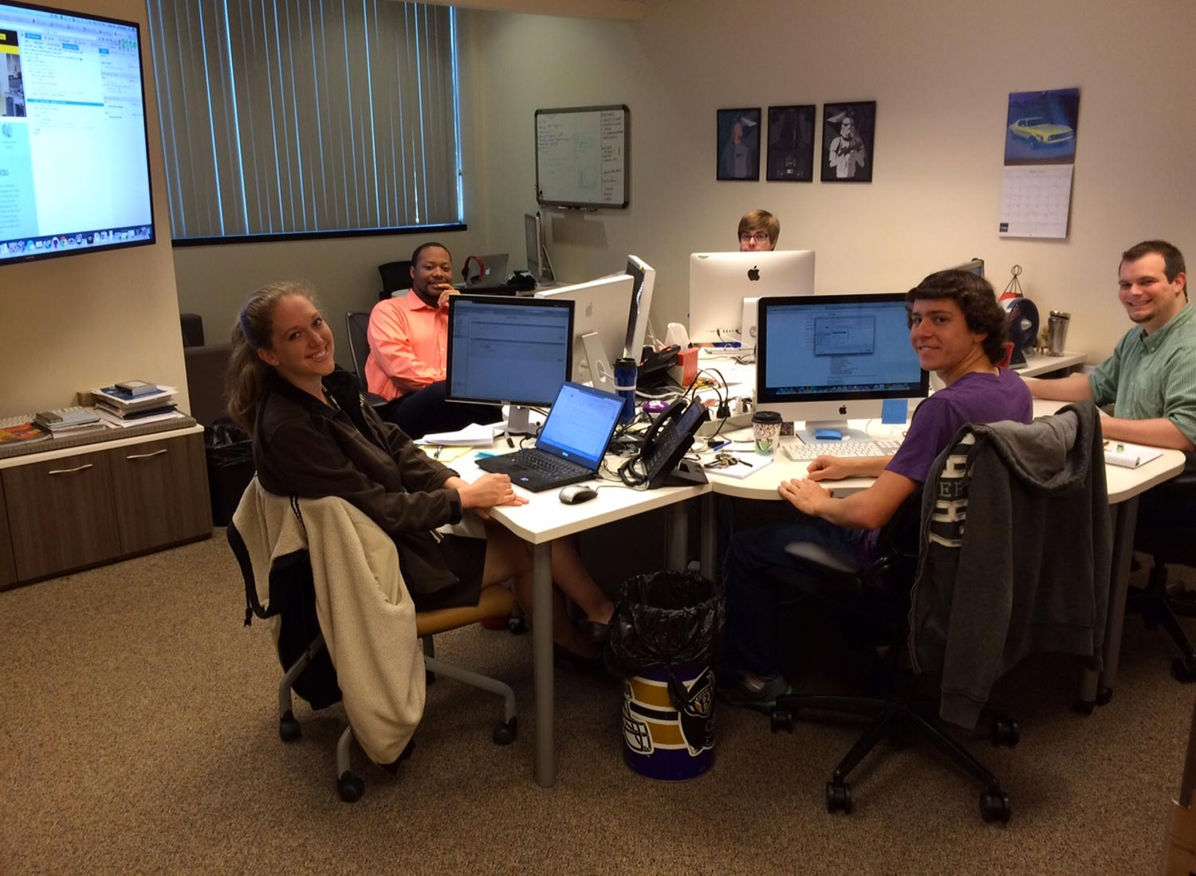

Slide 9
Let’s learn about how we go about building a website.

Slide 10
We Need Four Things Before We Can Start Building a Website
A Site Map
Branding (Colors and Logos)
Content (Words, Pictures, Stuff)
A Wireframe (Blueprint)

Slide 11
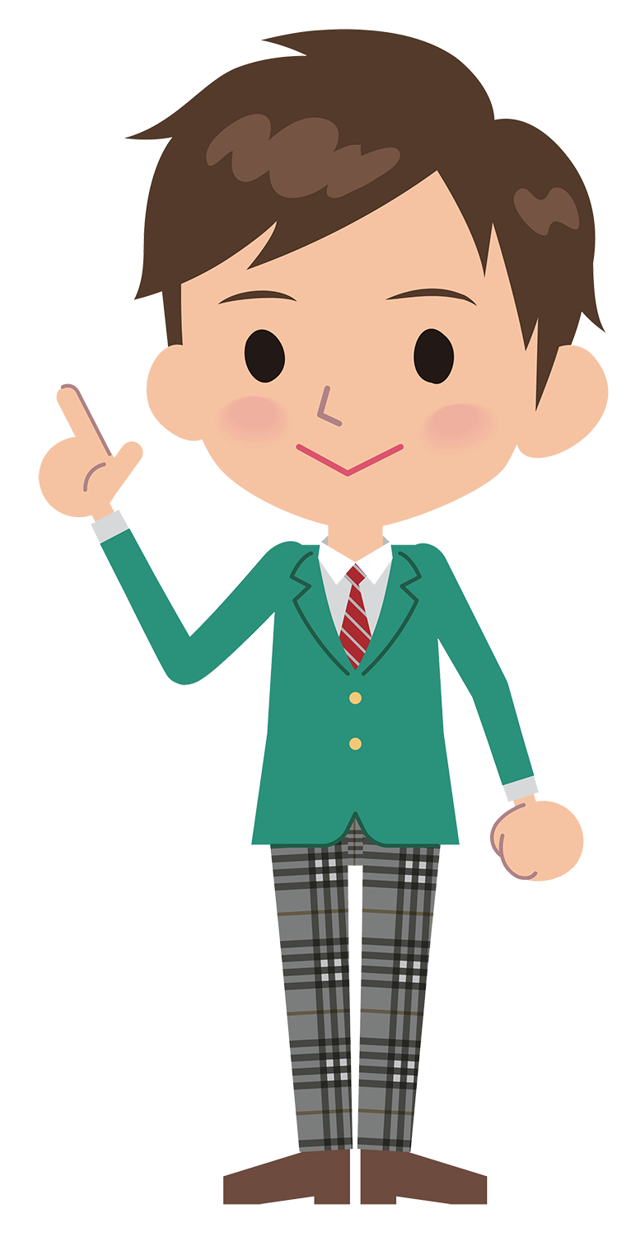
Let’s try it!

Slide 12
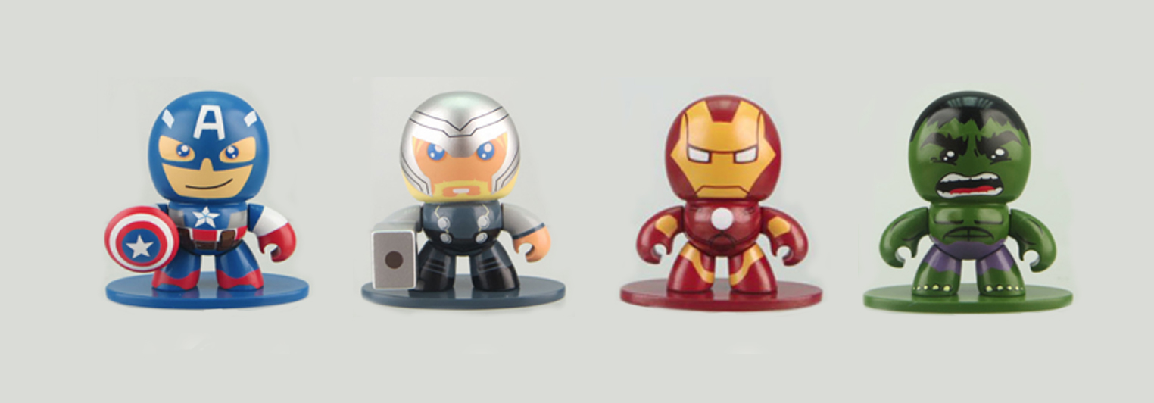
The Avengers Need a New Website!

Slide 13
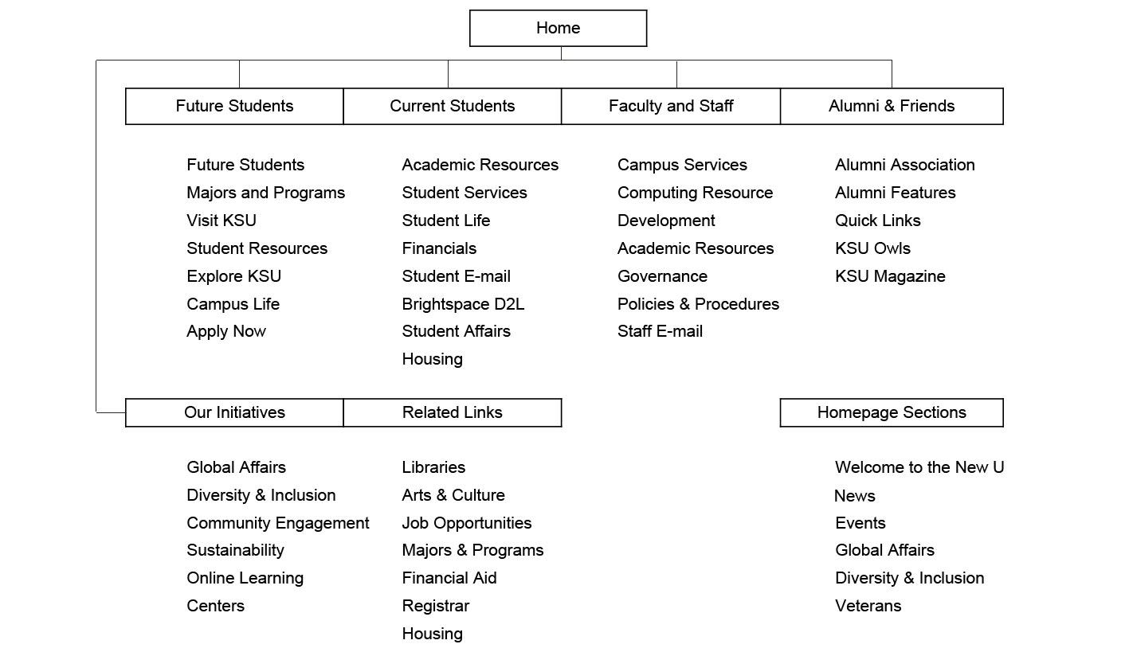
Site Map

Slide 14
Branding (Colors and Logos)

Slide 15
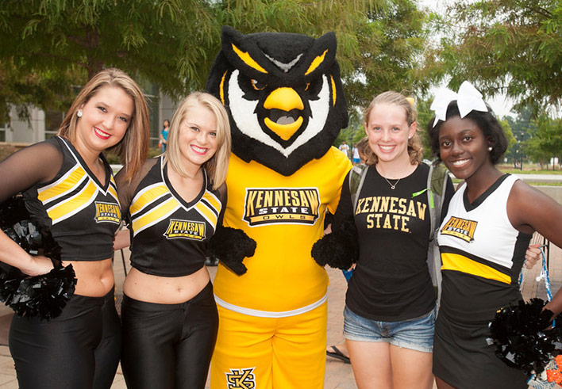
Photos
Content
Text
Welcome To The New KSU
Kennesaw State University is a comprehensive university recognized for its entrepreneurial spirit, global engagement and sense of community. As Georgia’s third-largest university and one of the fifty largest public universities in the country, Kennesaw State offers more than 100 undergraduate and graduate degrees, including an increasing number of doctoral programs. Kennesaw State is committed to becoming a world-class academic institution positioned to broaden its academic and research missions and expand its scope on a local, national and global level.

Slide 16
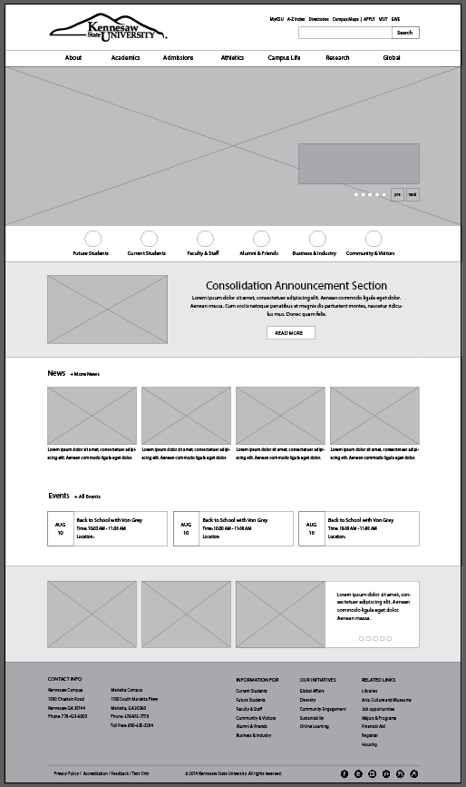
Wireframe

Slide 17
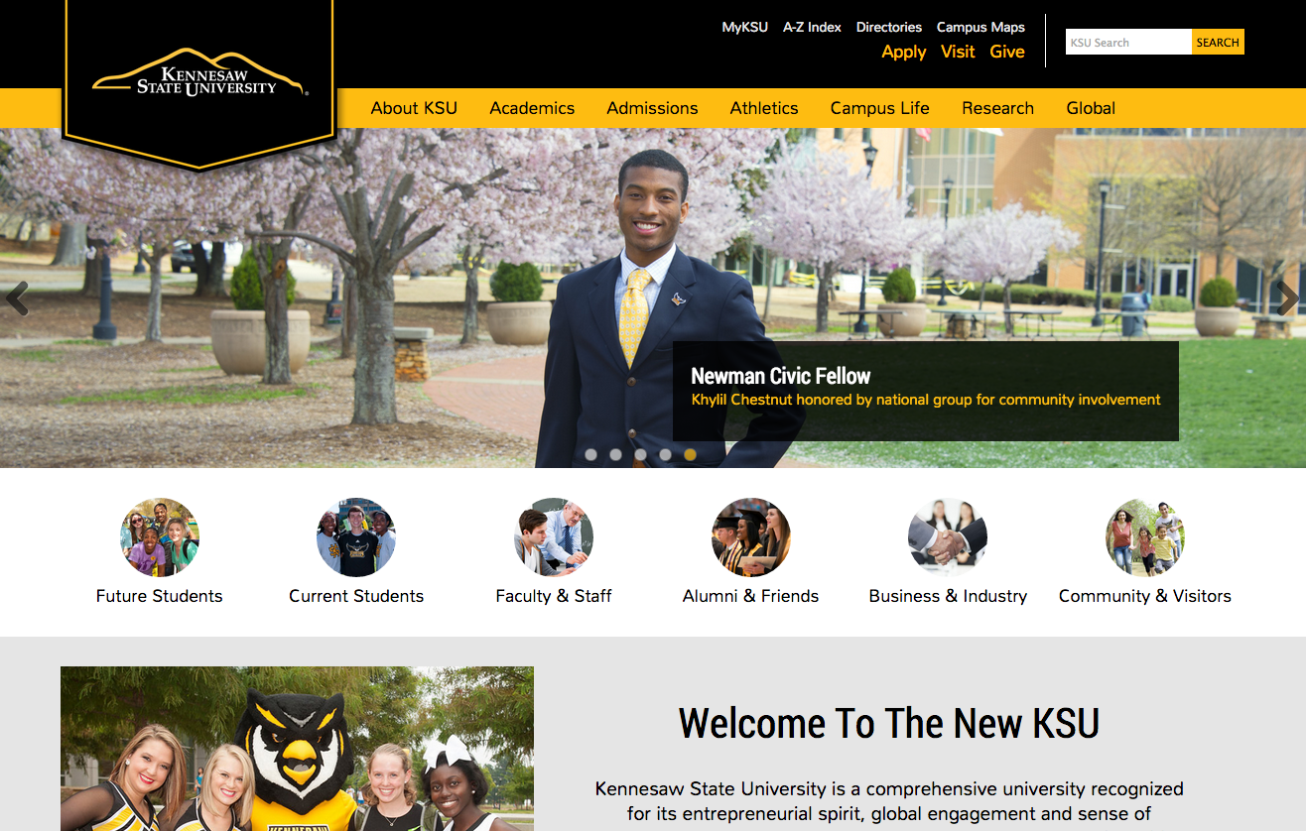

Slide 18
But, we aren’t done quite yet…

Slide 19
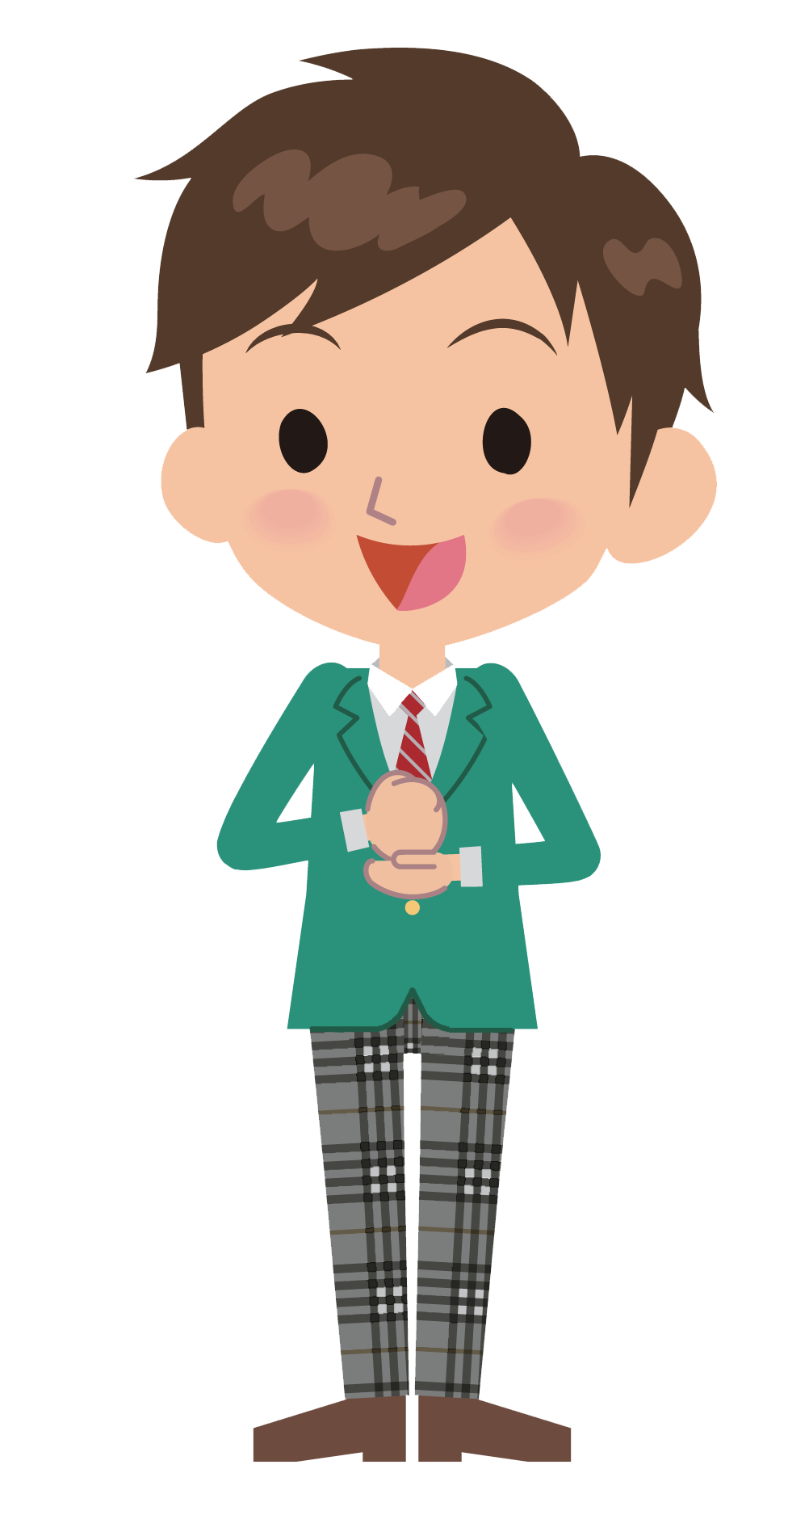
What about phones and tablets?

Slide 20
RESPONSIVE WEB DESIGN:
The goal of responsive design is to build web pages that detect the visitor’s screen size and orientation and change the layout accordingly.

Slide 22
Why do you think it would be important for websites to work well on phones?

Slide 24
Mobile Devices That Visit Kennesaw.edu
Kennesaw.edu receives over one million visits per month.
25% of all visits to KSU’s website are on phones! (That’s 250,000 visits/month!!!)
Over 1,450 DIFFERENT kinds of phones and tablets have visited KSU over the last six months.

Slide 25
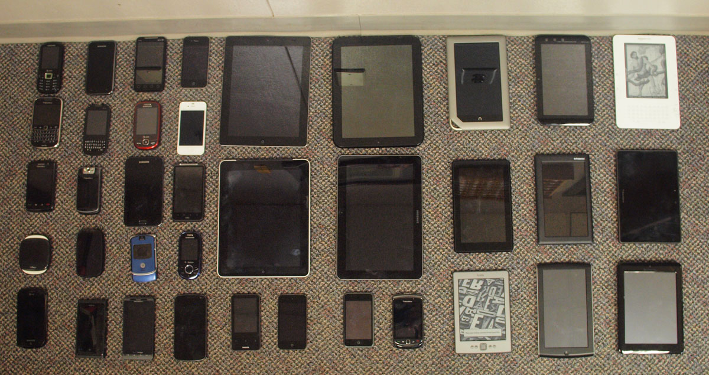
That’s A LOT of different devices!

Slide 26
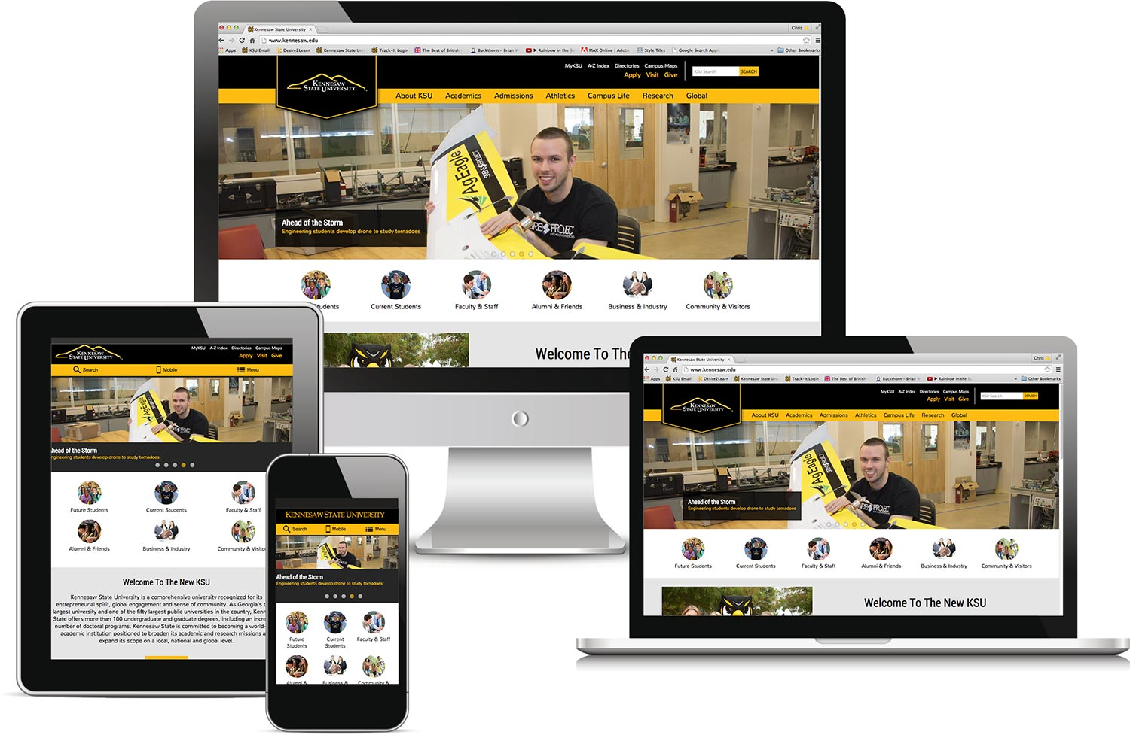
Everyone gets a great website!!

Slide 27
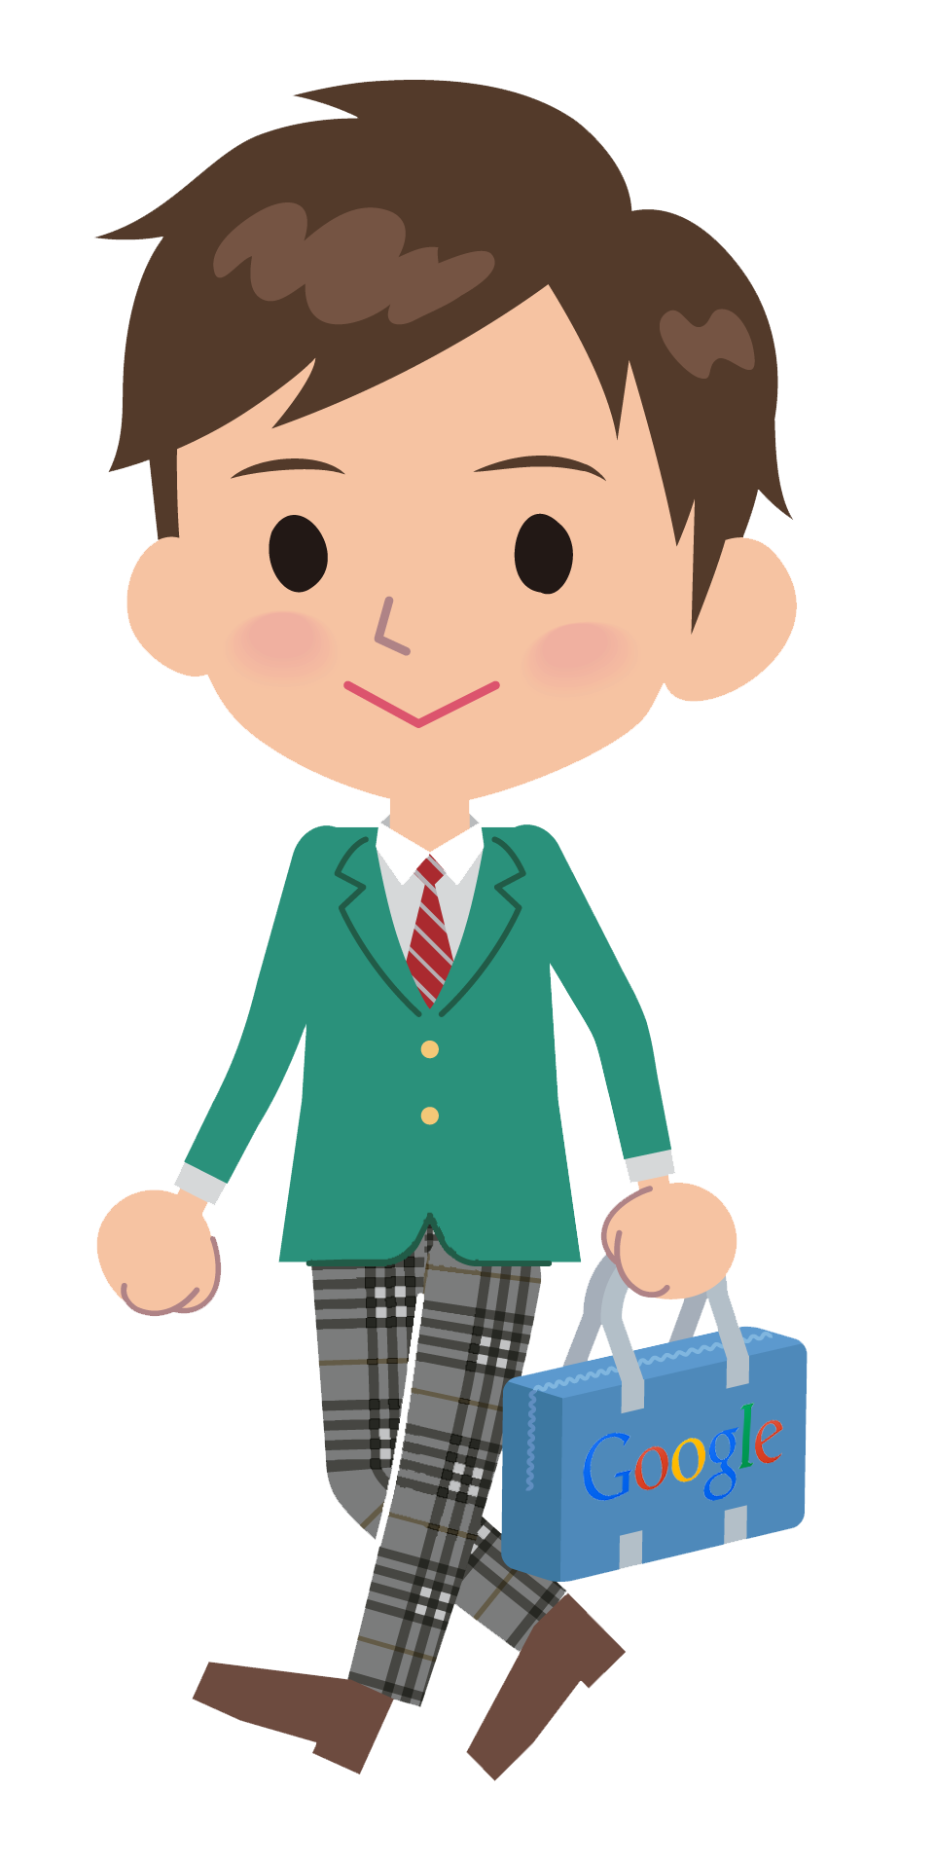
What kind of people do we hire to build websites?

Slide 28
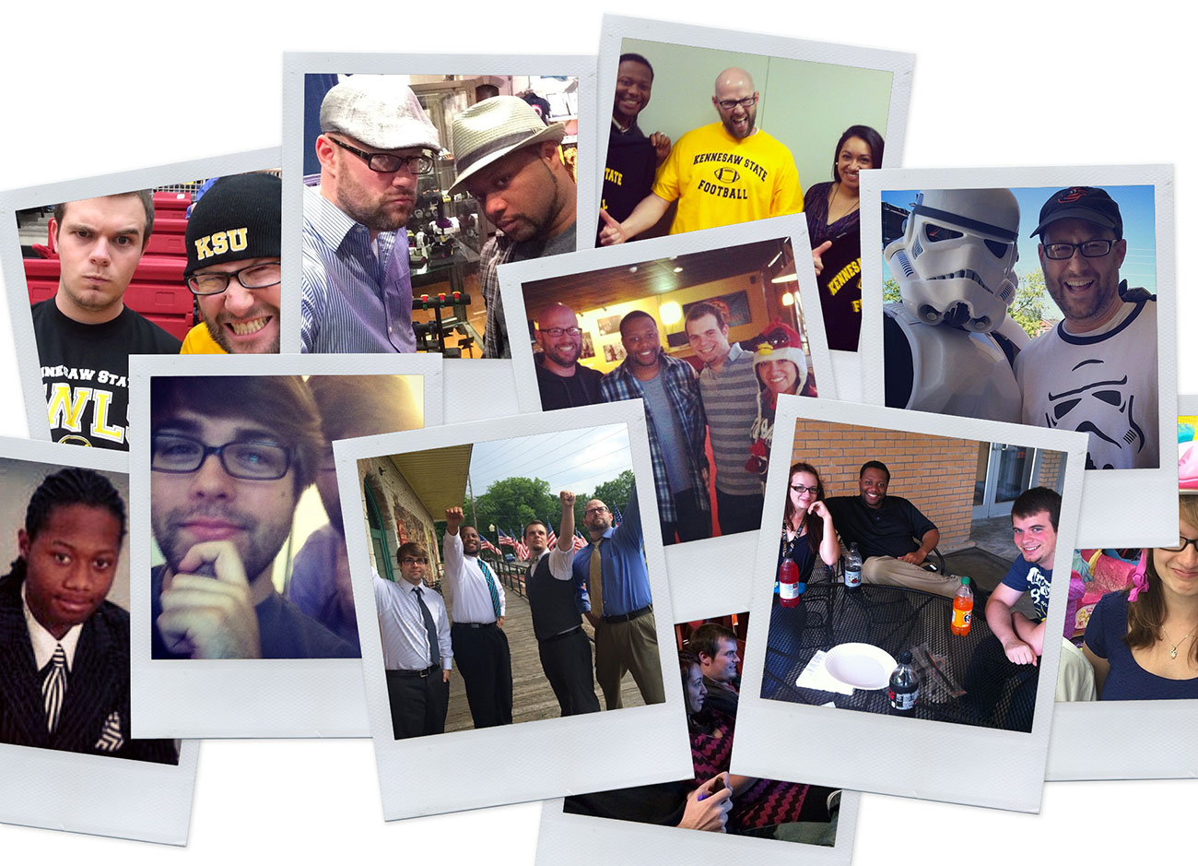
We’re fun, talented and creative!

Slide 29
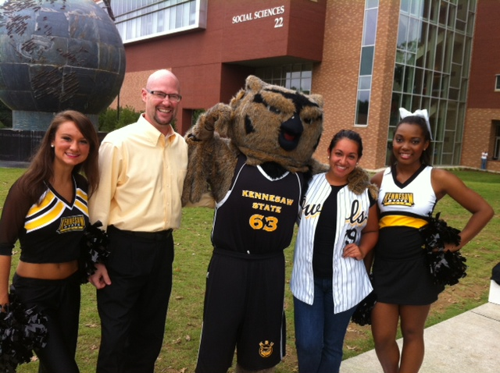
And we LOVE to share what we do…

Slide 30
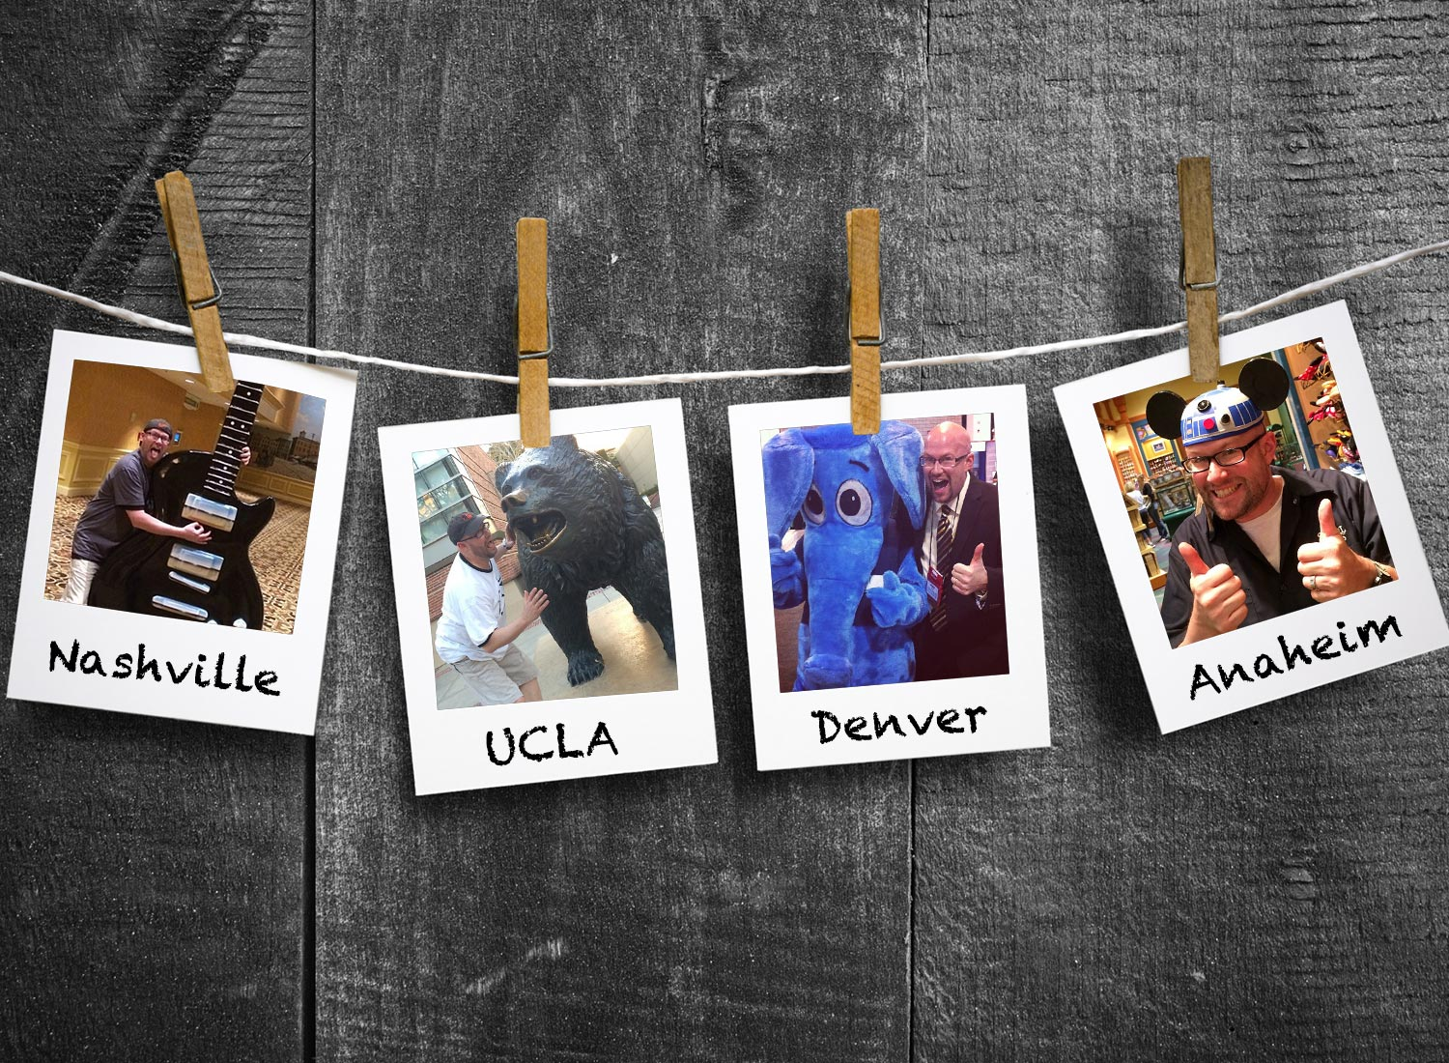
We get to travel to different places

Slide 31
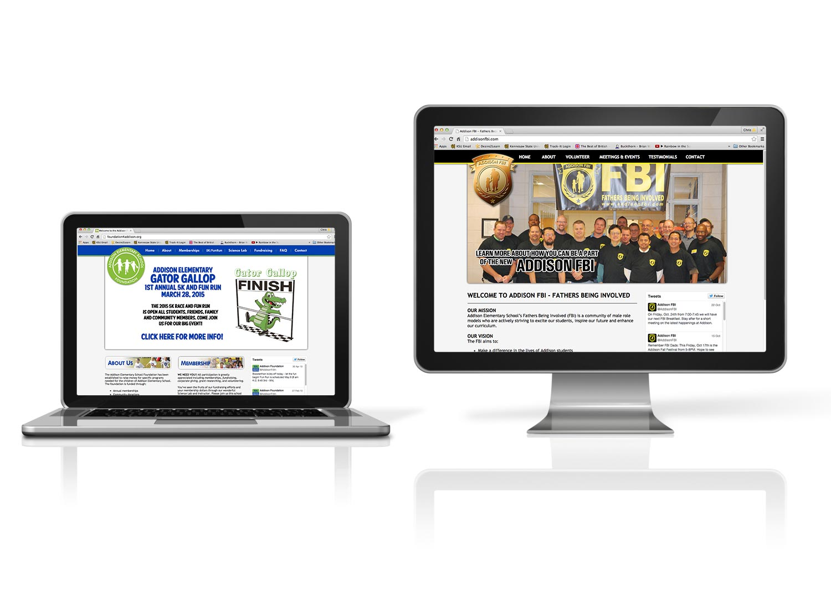
We get to help our community.

