Slide 1
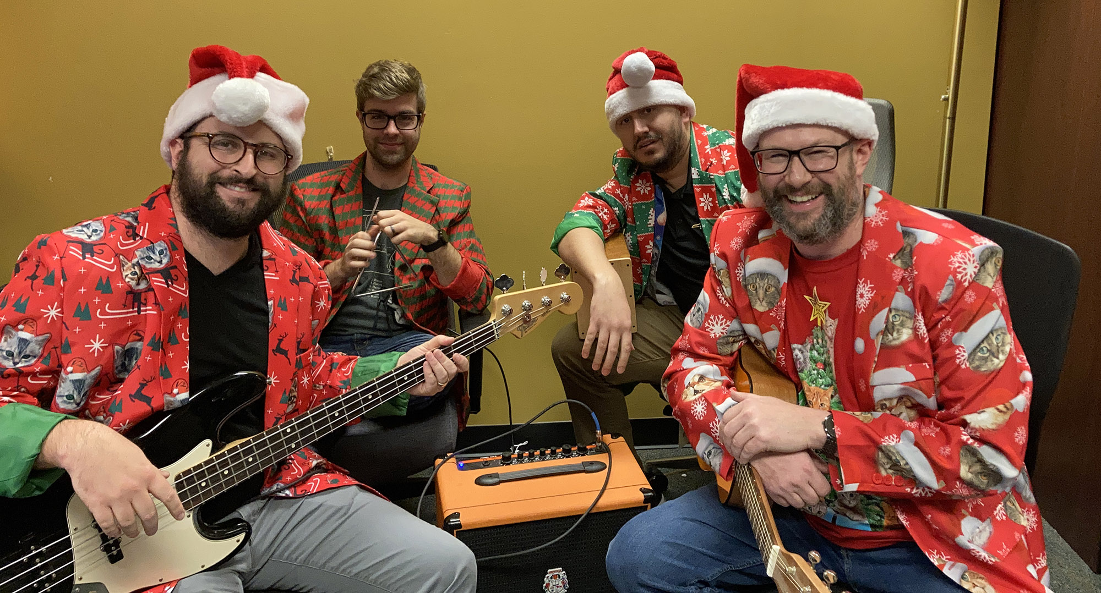
The UITS-EAS WebGroup Your Best Friend & Partner for All Things KSU Website-Related

Slide 2
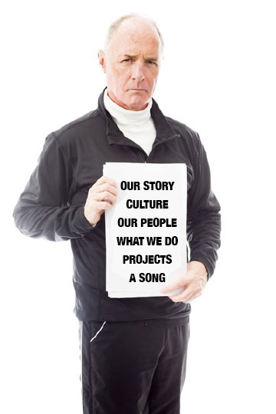
Higher Ed Responsive Web Design is more than putting a Web site on a phone. It is a complicated process that requires complex practices and solutions.
So,…what exactly are we going to be talking about today?

Slide 3
Let’s start with a story.

Slide 4
Once upon a time,
Kennesaw State University hired this guy…

Slide 5
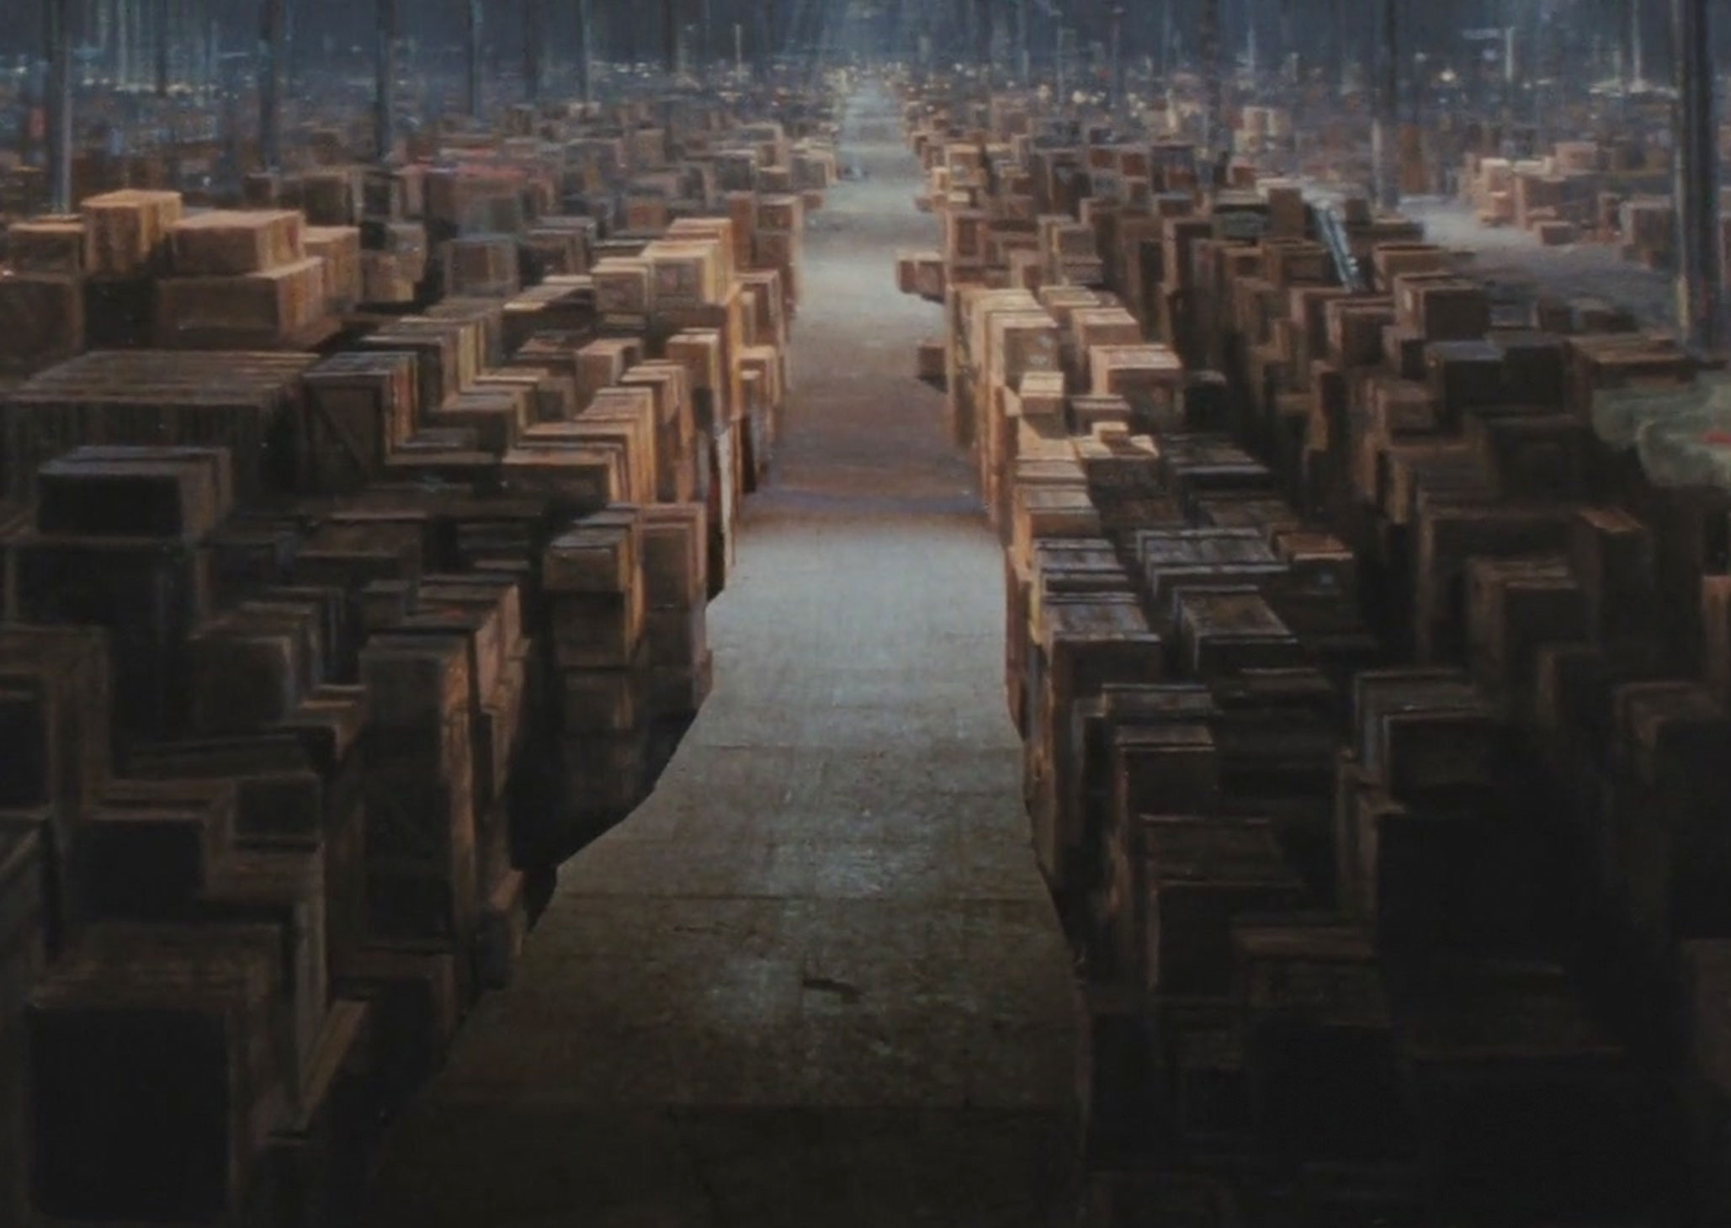
…to manage Kennesaw.edu

Slide 6
After a few years, the Web started to get REALLY hard. It required a whole new set of coding skills.

Slide 7
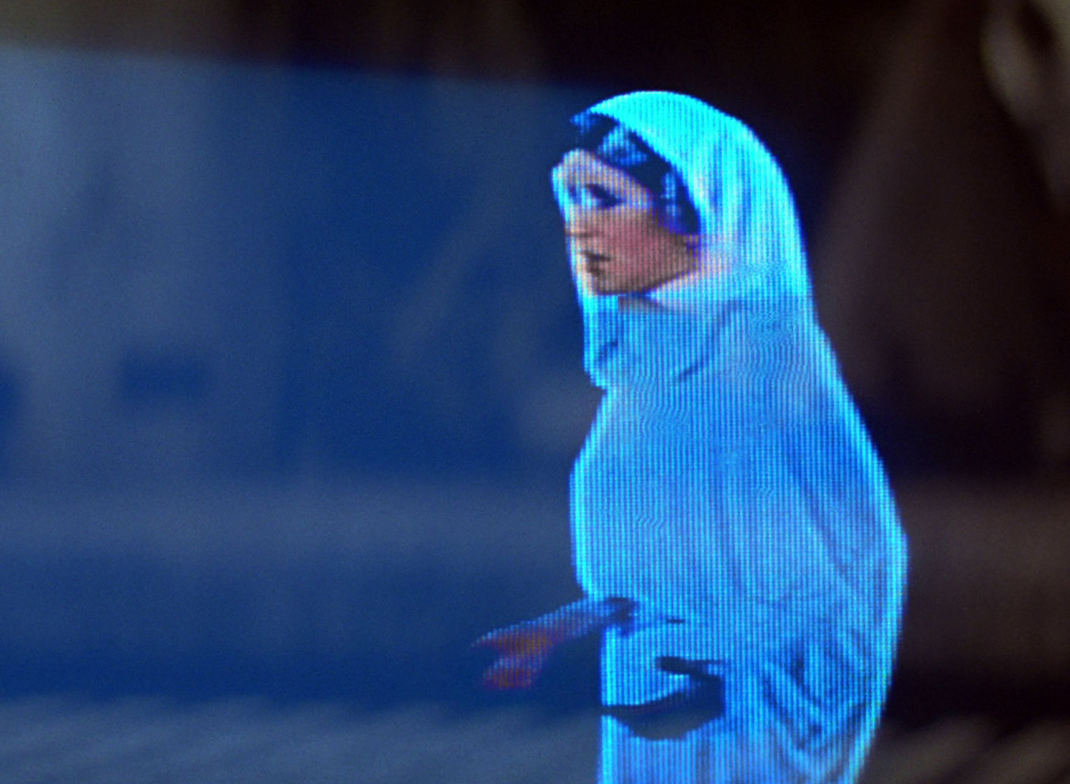
Help me, direct
supervisor…I need a real web developer.

Slide 9
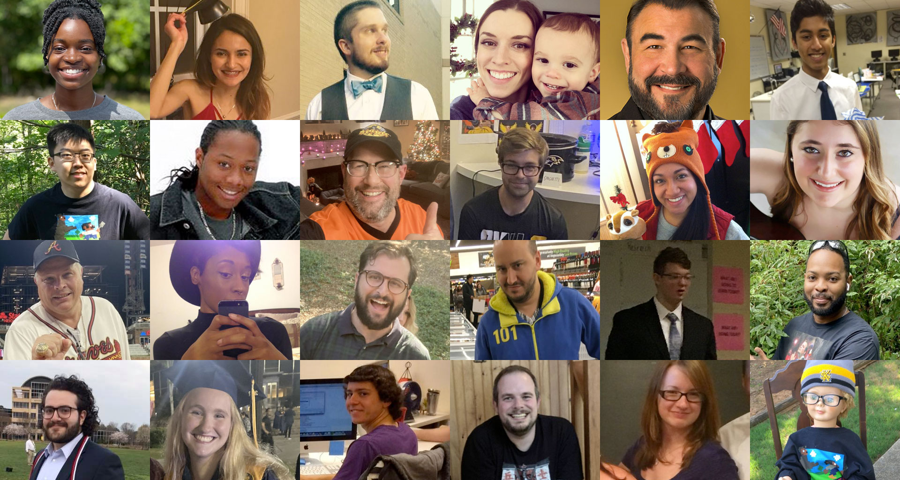

Slide 10
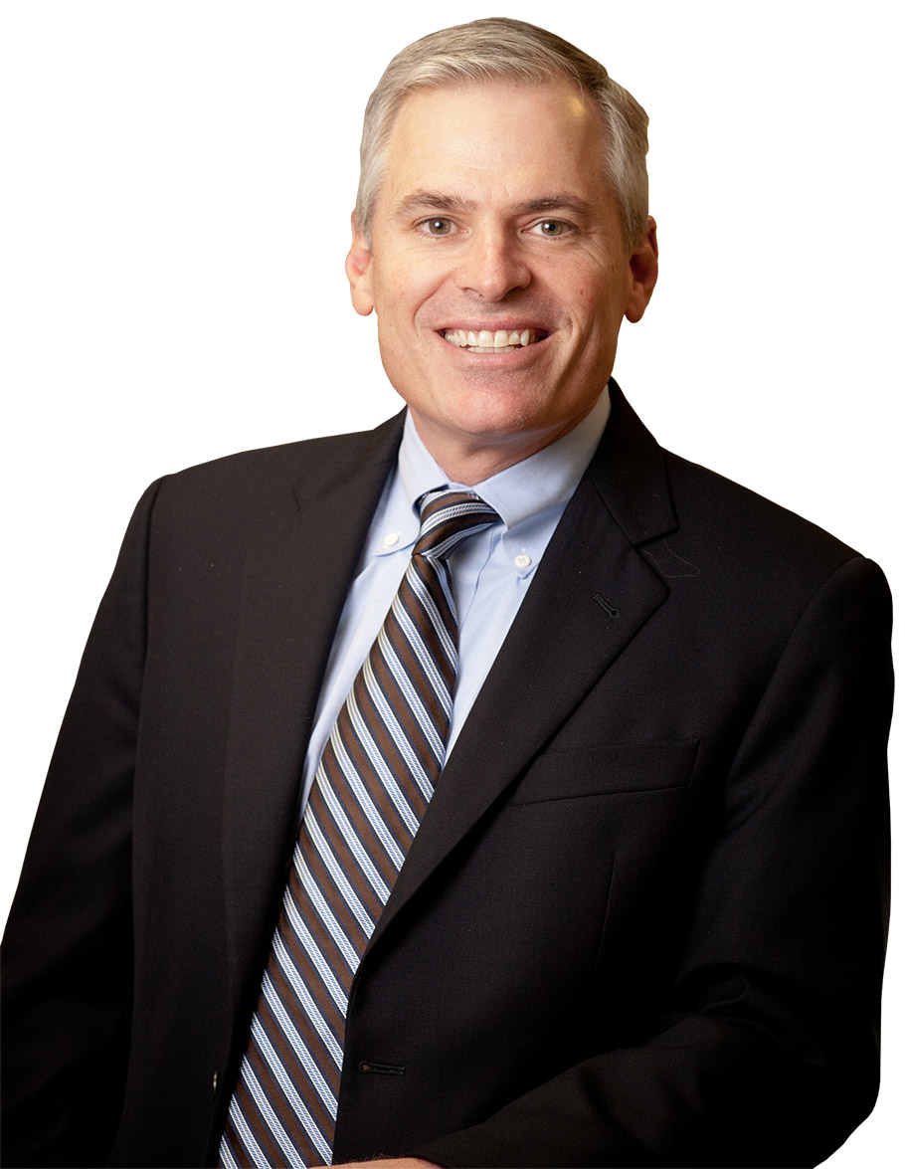
Build Amazing Culture
Patrick
Lencioni

Slide 11
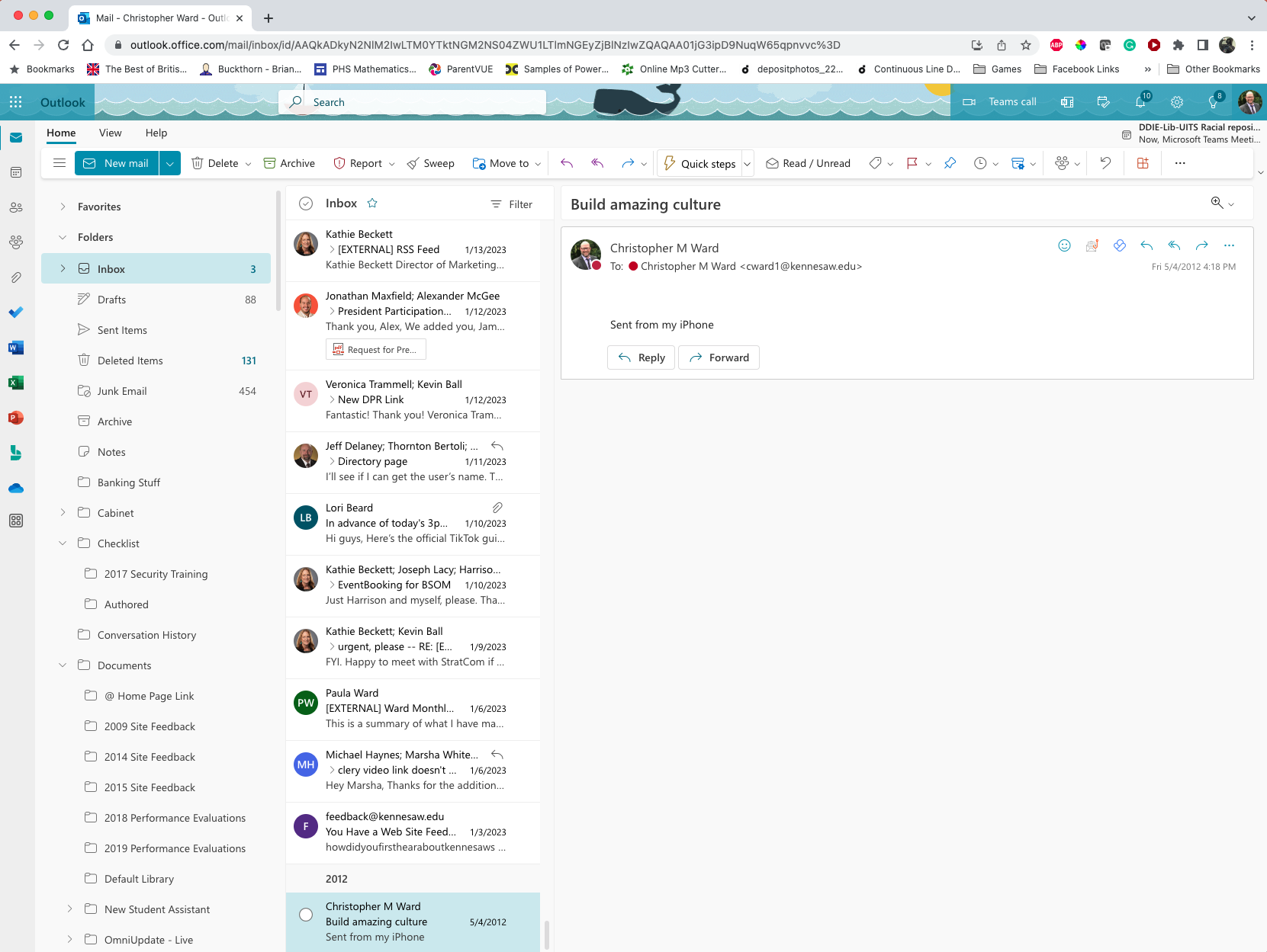

Slide 13
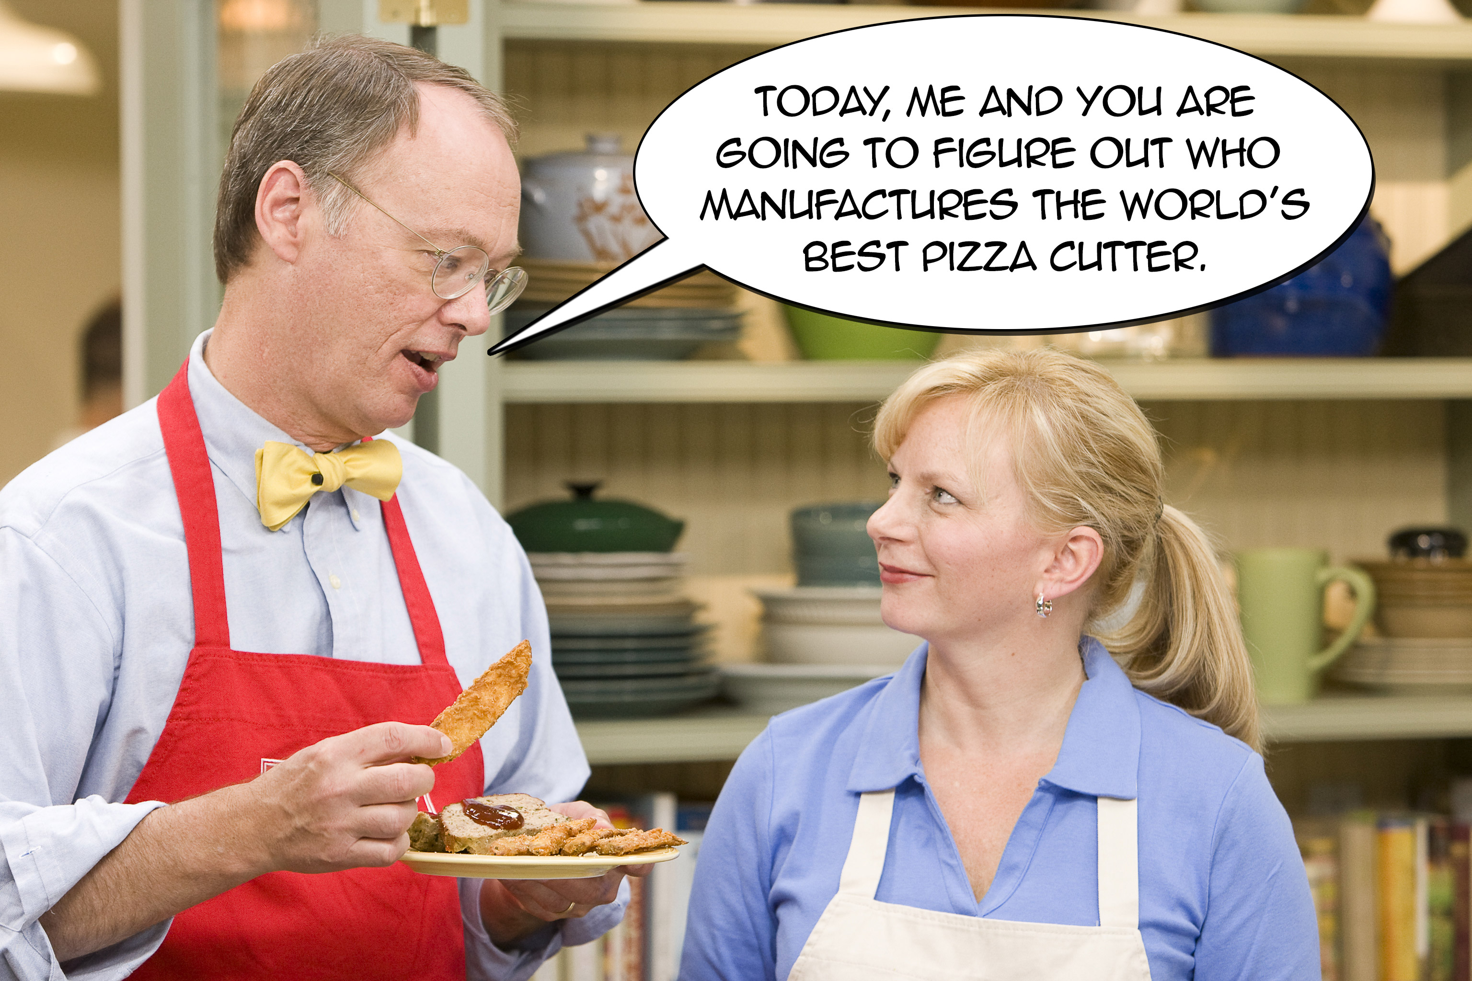

Slide 14
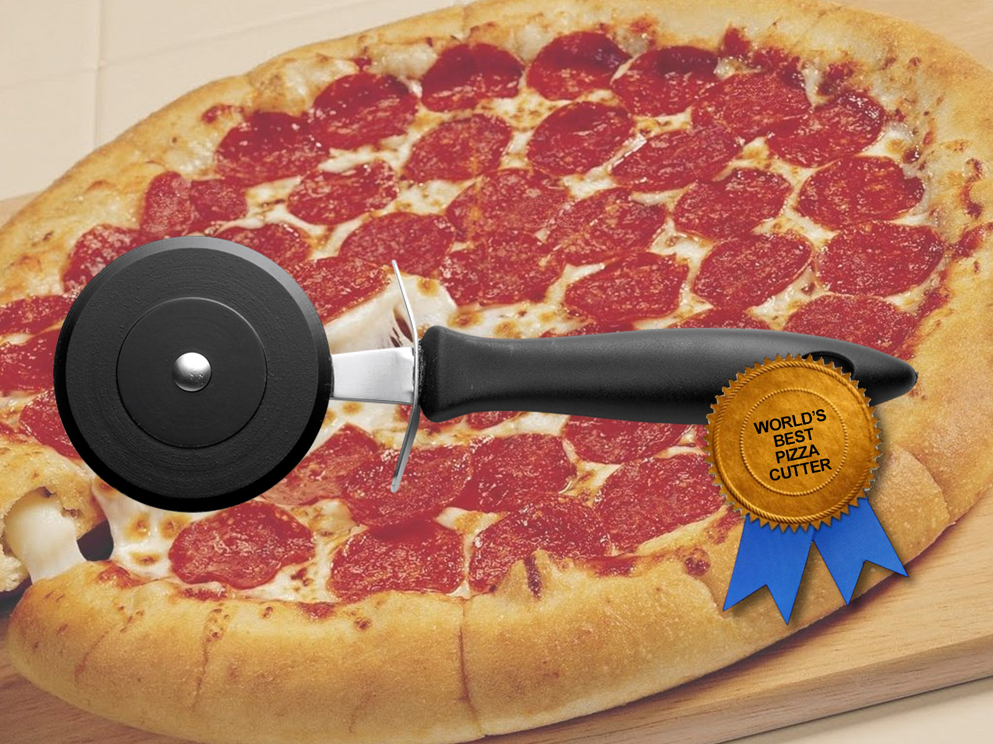
World’s Best Pizza Cutter

Slide 15
Solutions for Developing a Team…
Are NOT LIKE pizza cutters.

Slide 16
Stay honest.
Be authentic.
There is no perfect model for teamwork…only perfect practices that fit your profile.

Slide 17
Our WebGroup Culture
Our relationships are built on trust
We foster a learning environment where our expertise helps grow others and where we are always learning from the people around us
We are invested in each other personally and professionally
We have a definitive sociology where individuals not only compliment our team but also thrive in a collaborative group setting
We have an incredible amount of fun

Slide 18
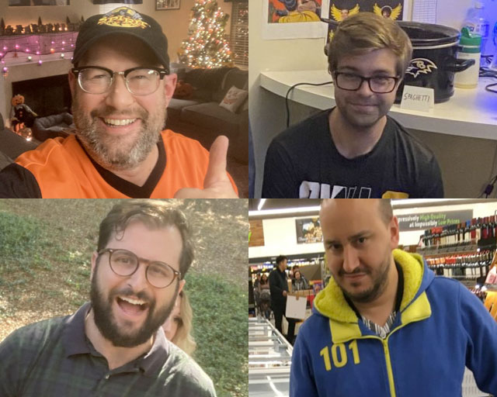
Our People.

Slide 19
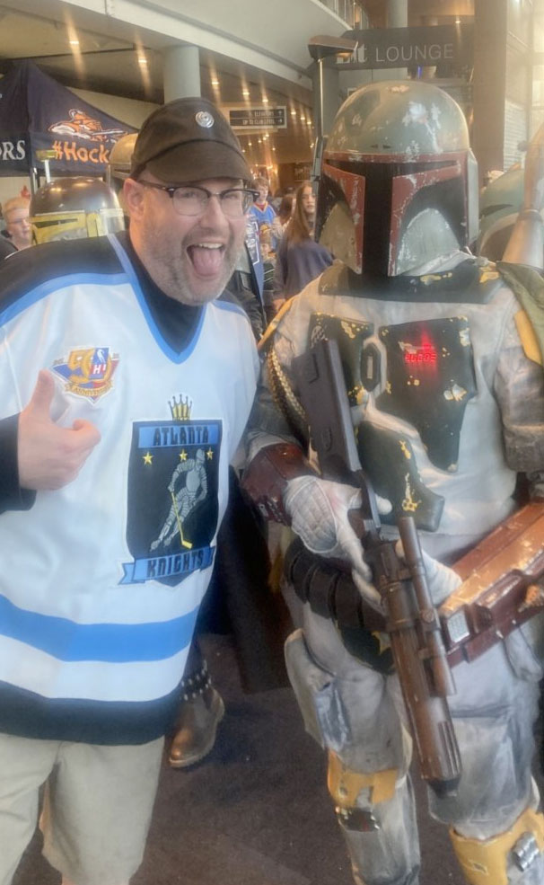
Chris Ward
Director of Web Services
Been at KSU for 21 years
Degrees from KSU (PoliSci, ’95; MAPW, 11’)
Obsessed with Star Wars
Halloween is a 24/7/365 endeavor
Married to Paula and has four kids

Slide 20
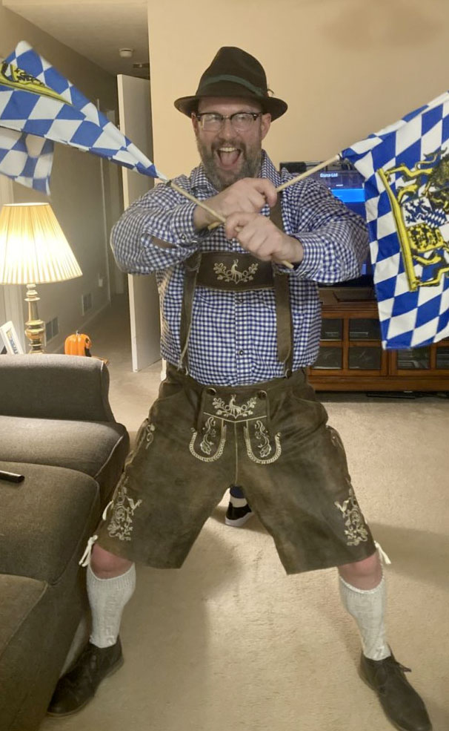
Great Reasons to Contact Chris:
WORK THINGS
Questions about KSU Websites
Accessibility
KSU Style and Logo Questions
Adobe Stock Photos
Teambuilding
PERSONAL THINGS
Star Wars
Guitars, 80s Music, Sports
Horror Movies
Halloween Stuff
Retro Video Games

Slide 21
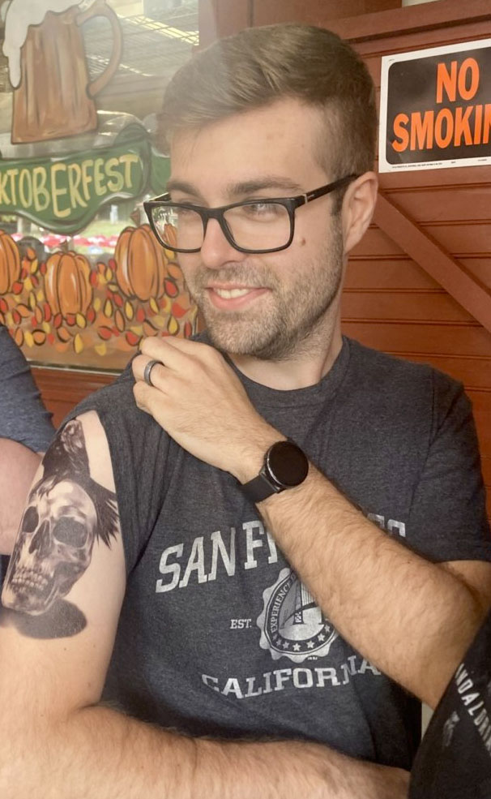
Kevin Ball
Lead Web Developer
Been at KSU for 10 years
Degree from KSU (Computer Sci, ’16)
Knows more about cars than all of you
Logged 1000s of hours in video games
Married to Elizabeth and LOTS fur babies

Slide 22
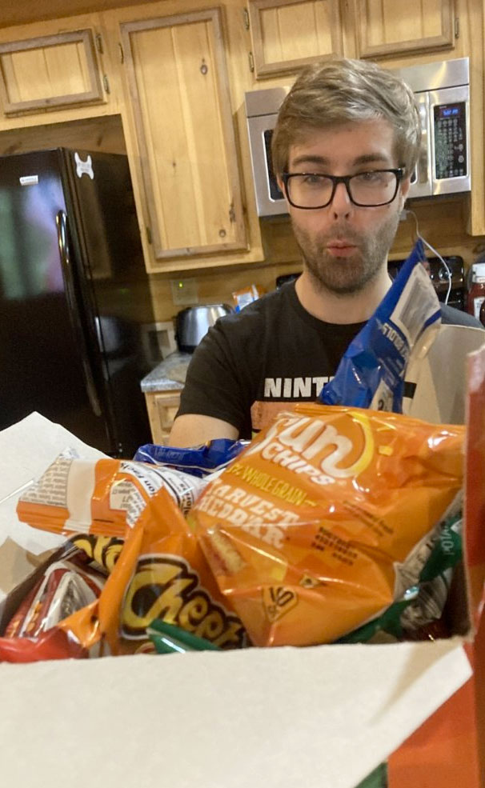
Great Reasons to Contact Kevin:
WORK THINGS
Questions about Web Development, particularly HTML, CSS, PHP
Integrations with Web Apps
Accessibility (WCAG)
Mobile Web and Apps
PERSONAL THINGS
Car Problems
Animal Care (Dogs, Cats, Rabbits)
MMORPG Video Games

Slide 23
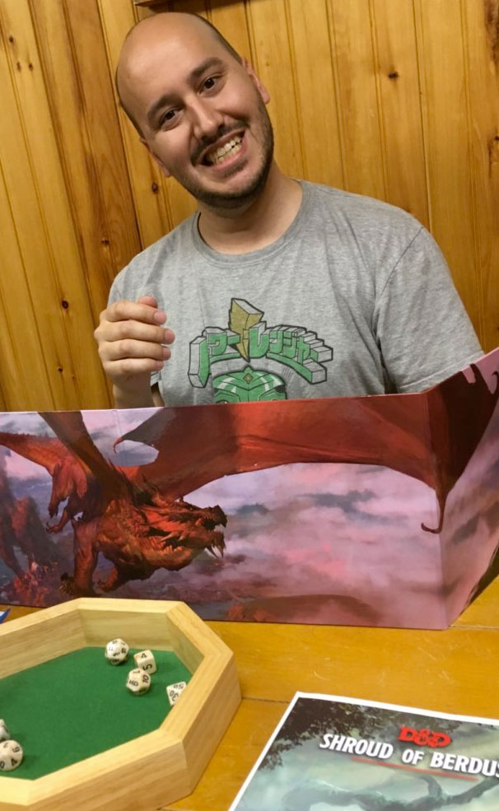
Jonathan Maxfield
Web Specialist
Been at KSU for 10 years
Degree from KSU (History, ’12)
Is an elite D&D Dungeon Master
Is insanely good at World of Warships
Married to Milya and has one daughter

Slide 24
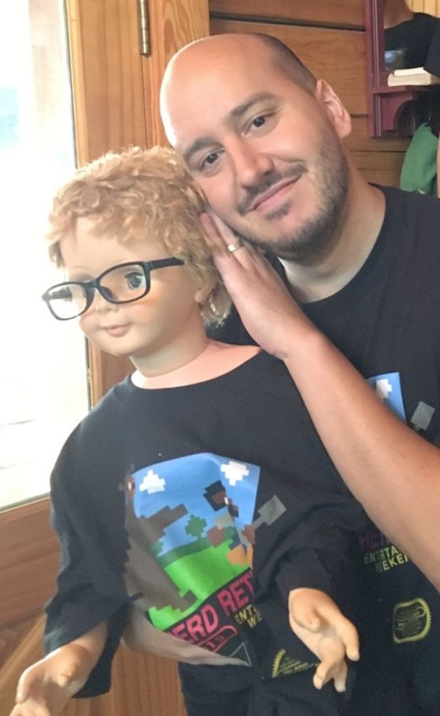
Great Reasons to Contact Jonathan:
WORK THINGS
Questions about Omni CMS Website Service Tickets
FacultyWeb
Formstack
Writing and Proofreading
PERSONAL THINGS
Fantasy Gaming, Especially Building D&D Characters
“Old-Tyme” Movies and Entertainment History
Renaissance Festival

Slide 25
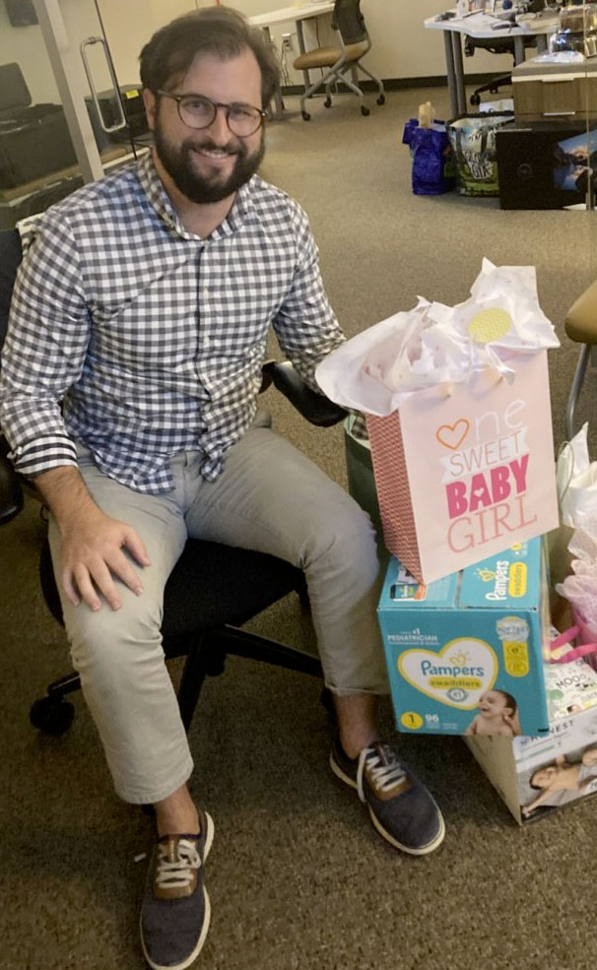
Michael Cahal
Web Developer
Been at KSU for almost 2 years
Two degrees from UGA (Music Ed, ’10; M-Music Ed, ‘12)
Plays five instruments (Primary: saxophone)
Says he likes to “work in the yard”
Married to Mia and has one daughter

Slide 26
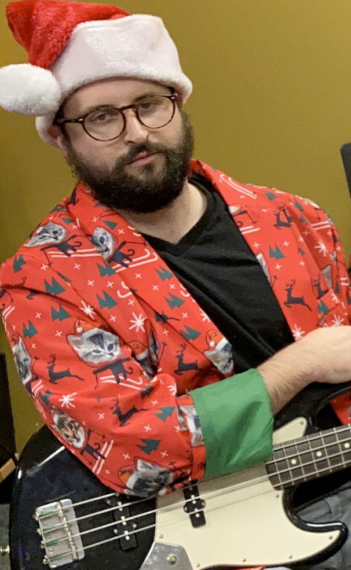
Great Reasons to Contact Michael:
WORK THINGS
Questions about Web Development, specifically HTML, CSS, PHP
Training in Omni CMS (New Templates and Snippets)
PERSONAL THINGS
Music
Working in the Yard
Paddleboarding
Golf Carts
Living in Acworth

Slide 27
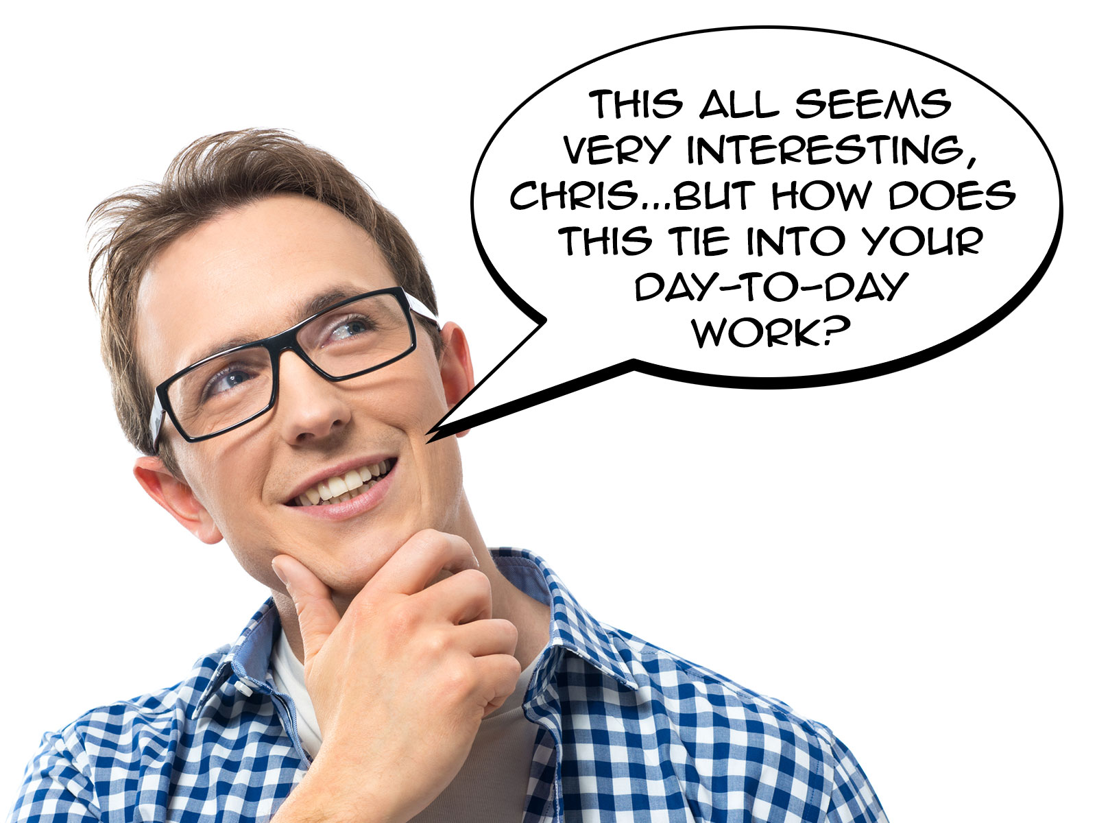

Slide 28
What We Do
(rocket science)

Slide 29
WebGroup Responsibilities
Omni CMS
University Content Management Systems with Over 300+ Sites
Develop and Maintain All Code in the System (Templates, Snippets)
Manage Users and Permissions
Support Administrative Sites
FacultyWeb
CMS for over 1000 Faculty Sites
Manage Users and Permissions
Formstack
Form Building Solution
Manage Users and Permissions
Support Form Development and Management
Siteimprove
Online Tool That Evaluates KSU Websites for Quality Assurance and Accessibility
Funnelback
University Search Engine
Student Inform
Develop and maintain all code in the system (templates, snippets)
Web App Integrations
Development Integrations with Omni CMS including IntWeb, Emergency Alerts, OwlTV, Email Signature

Slide 30
What we are working on.

Slide 31
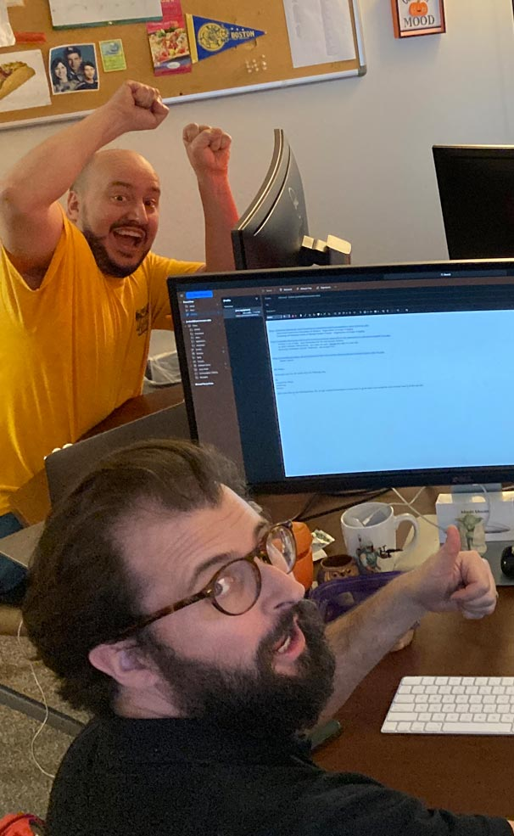
WebGroup 2023 Projects
Website Builds
Student Affairs (38)
Campus Services (12)
CETL (Summer)
Curriculum, Instruction, and Assessment (Summer)
Human Resources (Summer/Fall)
Museums, Archives and Rare Books (Summer/Fall)
UITS (Fall)
Development Projects
RAVE Emergency Notification Integration with Omni CMS
Omni CS Dynamic Site Map Generation Tool
Library Hours Management App (Spring)
Rapid-Development Framework (Spring)
IntWeb Upgrade (Summer)
CETL Journal & Conference Management (Summer)

Slide 32
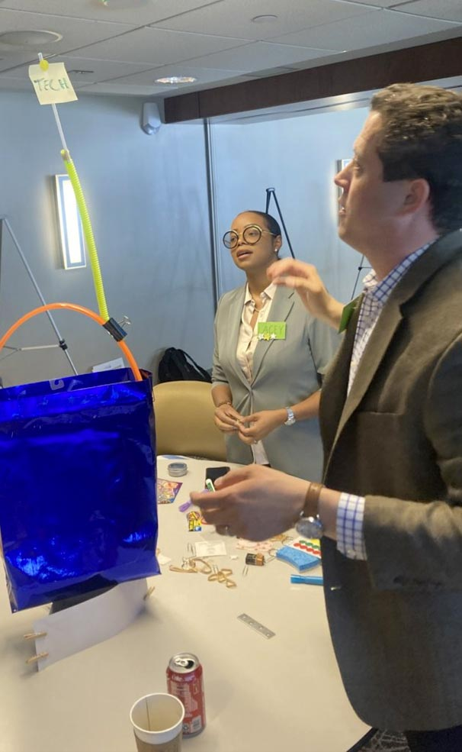
WebGroup 2023 Projects
Siteimprove
Implement Site Enhancements and Corrections to Achieve 90& Scoring for Quality Assurance and Accessibility
Teambuilding and Presentations
Continue Teambuilding Work with Georgia Tech Project Management Team | Exploring “Getting Comfortable with the Uncomfortable” and “Developing Teams in Virtual Environments”
USG Interact Presentation | “The Future Is Coming: A Discussion On the Inevitable Collision of AI and Your University's Website”

Slide 33
Lastly…we have an incredible amount of fun.

Slide 34
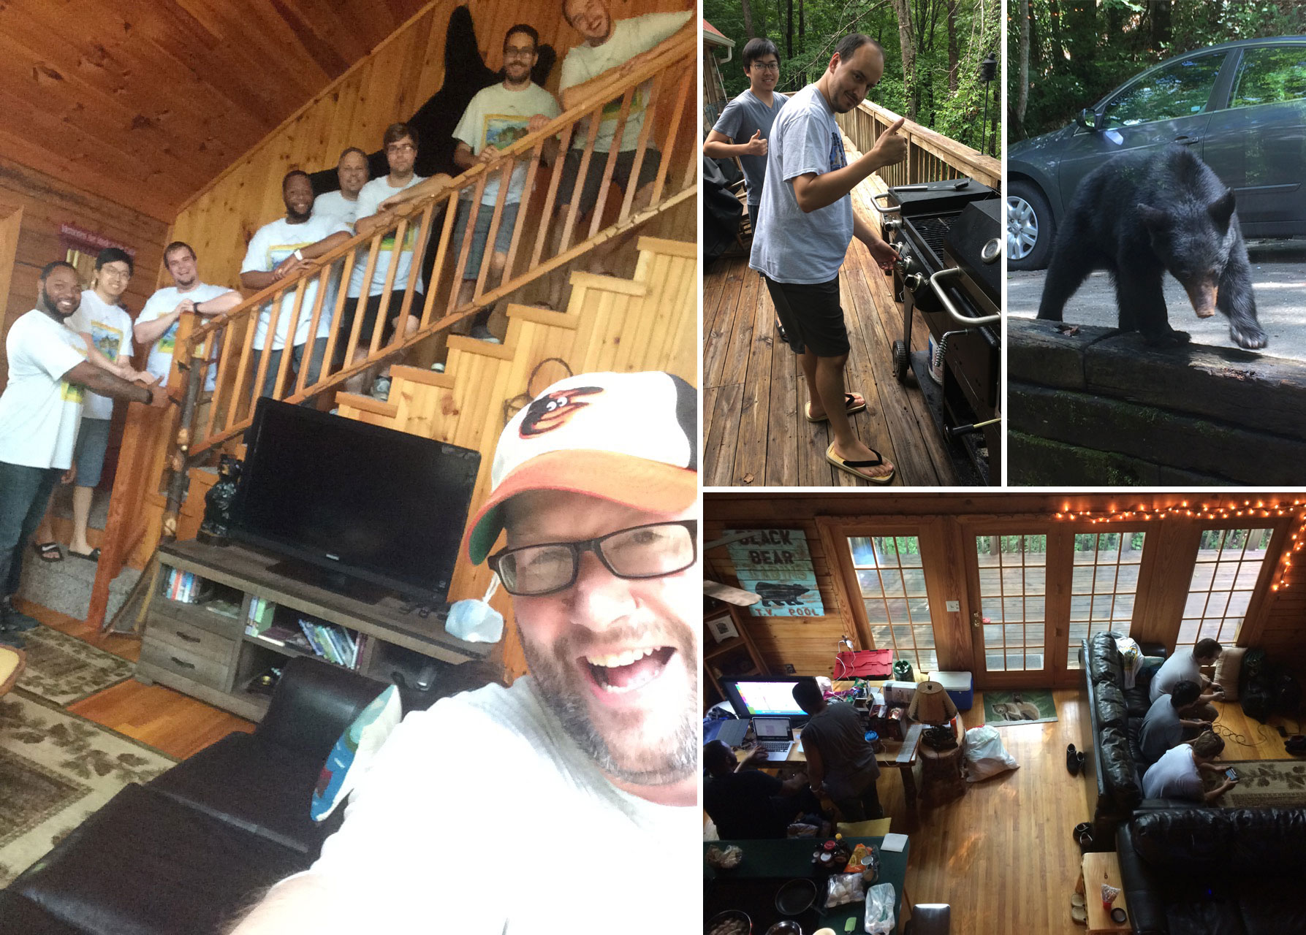
Nerd Retreat

Slide 35
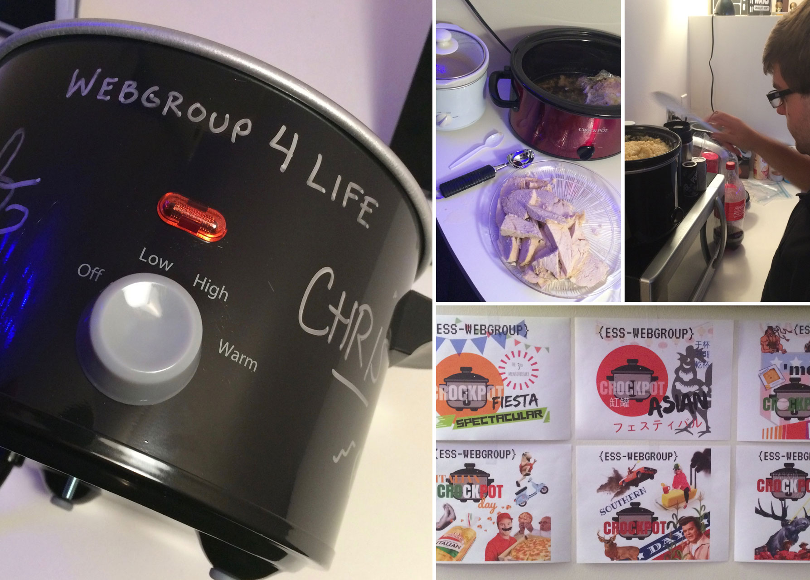
Crockpot Day

Slide 36
Ladies and gentlemen…
The WebGroup Family Band.

