Slide 2
Eric Bollens Lead Software Architect, UCLA
Brett Pollak Director, Campus Web Office, UC San Diego
Rose Rocchio OIT Director of Academic Applications, UCLA
Chris Ward Assistant Director of Web Services, Kennesaw State University
Amos Williams Lead Web Developer, Kennesaw State University
About Us

Slide 3
Understanding the Mobile Web
Planning and Organization
Introduction to Responsive Web Components
Responsive Web Site Design & Patterns
Developing Responsive Web Sites
Managing Responsive Web Sites in Higher Ed.
Today’s Workshop Agenda

Slide 4
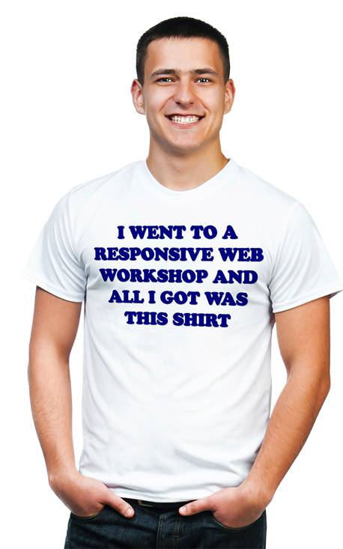
This Workshop today is all about YOU learning. If at anytime you have any questions, please feel free to ask.

Slide 5
Question #1
Question #2
Question #3
Question #4
Question #5
Question #6
Question #7
Question #8
What Are YOU Wanting To Learn Today?

Slide 6
#rwdedu
Notes:
By stakeholder we mean the campus unit that that owns, manages or curates the data
Once you have priorities to focus on you can begin to advocate for a strategic approach to mobility
Focus on the stakeholders that can supply the data that your prioritized audiences most want

Slide 7
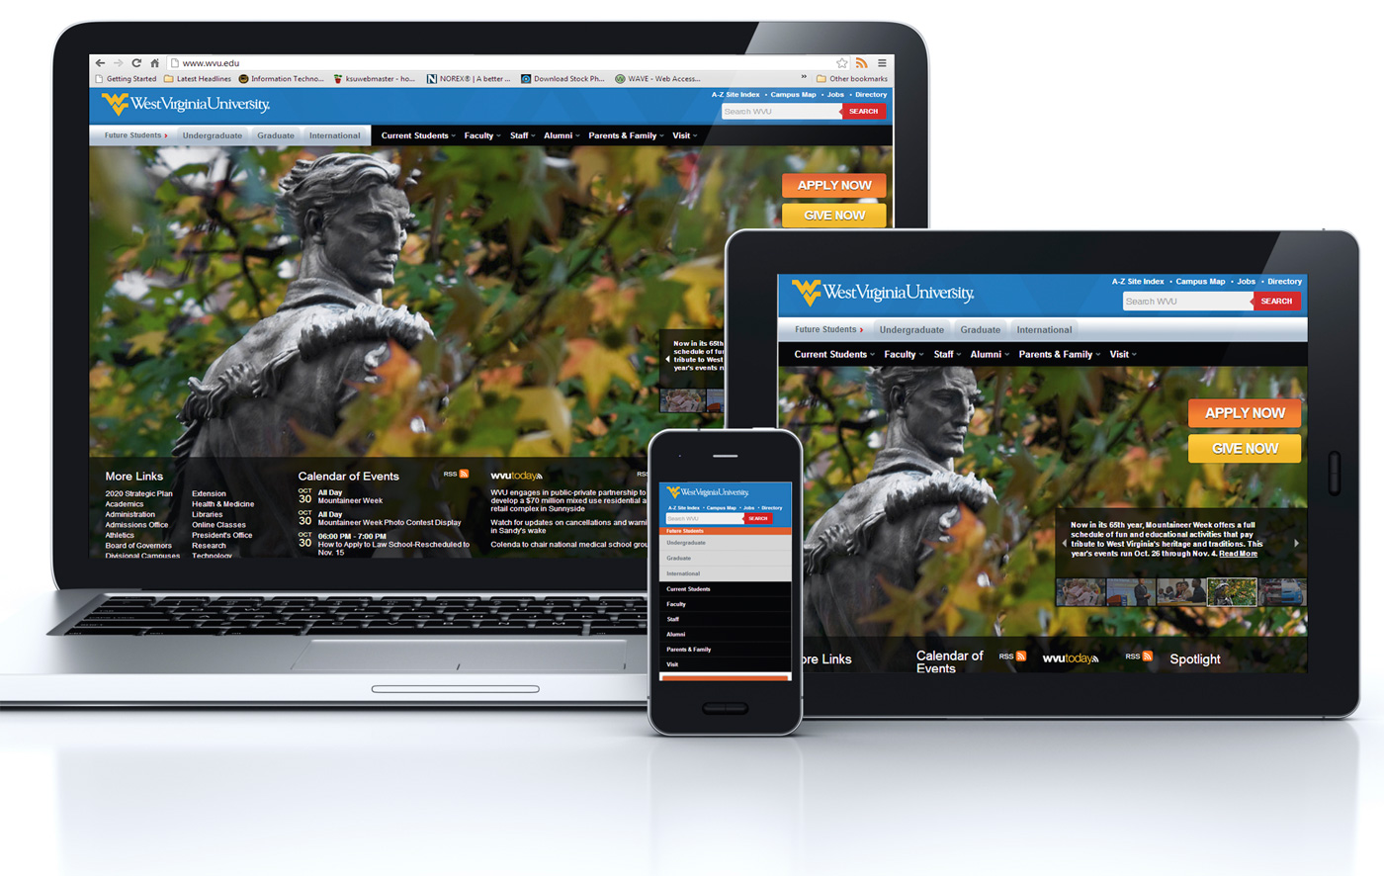
Responsive Web Design

Slide 8
Responsive Web design is the approach that suggests that design and development should respond to the user’s behavior and environment based on screen size, platform and orientation.
The practice consists of a mix of flexible grids and layouts, images and an intelligent use of CSS media queries.
As the user switches from their laptop to tablet, the website should automatically switch to accommodate for resolution, image size and scripting abilities.
http://coding.smashingmagazine.com/2011/01/12/guidelines-for-responsive-web-design/

Slide 9
Media queries, flexible grids, say what?!?!?
Notes:
By stakeholder we mean the campus unit that that owns, manages or curates the data
Once you have priorities to focus on you can begin to advocate for a strategic approach to mobility
Focus on the stakeholders that can supply the data that your prioritized audiences most want

Slide 10
The phrase responsive web design doesn’t have any meaning whatsoever to anyone outside of our field.
http://speckyboy.com/2013/08/07/why-clients-dont-care-about-responsive-web-design/

Slide 11
As IT professionals, we should not only be able to explain what responsive web design is, but also why it should be implemented

Slide 12
So, how did we get to this point?
Notes:
By stakeholder we mean the campus unit that that owns, manages or curates the data
Once you have priorities to focus on you can begin to advocate for a strategic approach to mobility
Focus on the stakeholders that can supply the data that your prioritized audiences most want

Slide 13
Pre-June 29, 2007
Notes:
By stakeholder we mean the campus unit that that owns, manages or curates the data
Once you have priorities to focus on you can begin to advocate for a strategic approach to mobility
Focus on the stakeholders that can supply the data that your prioritized audiences most want

Slide 14
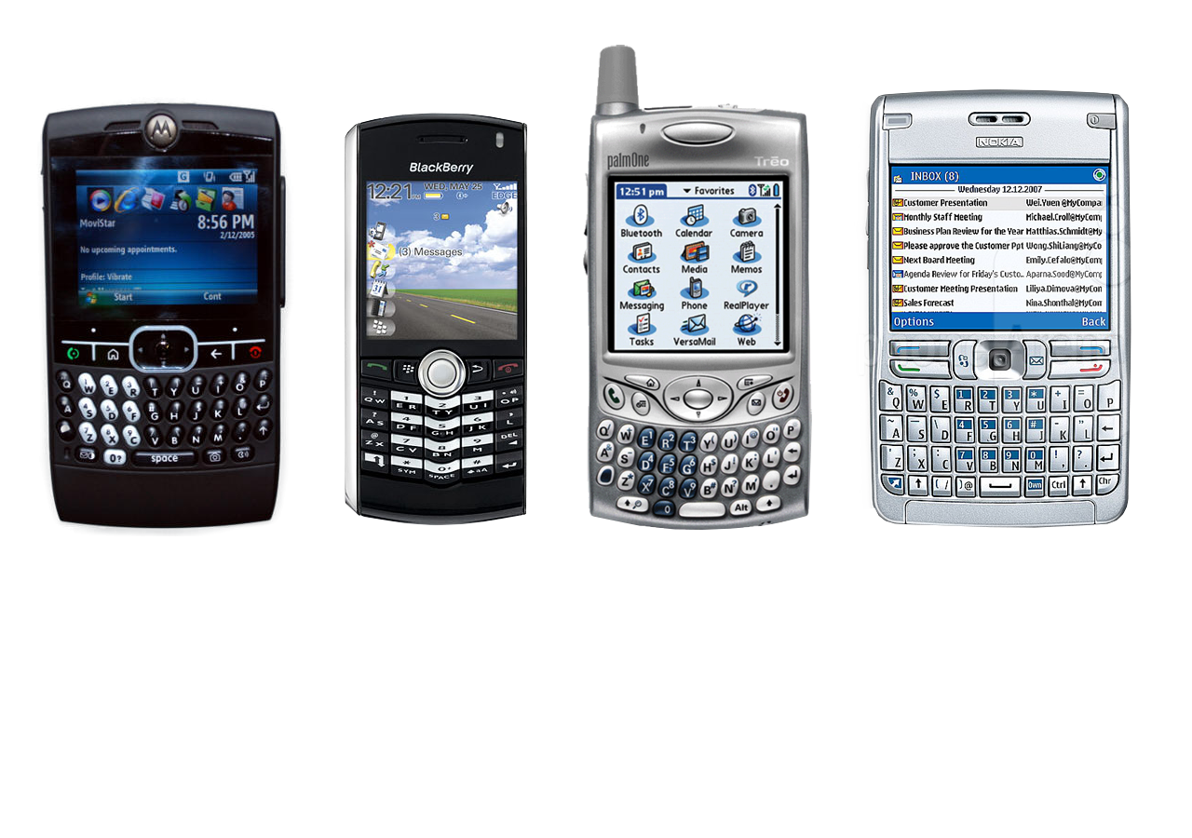
Moto G
Blackberry Pearl
Palm Treo
Nokia E62
No, really. Pre-June 27, 2007 awesome phones.

Slide 15
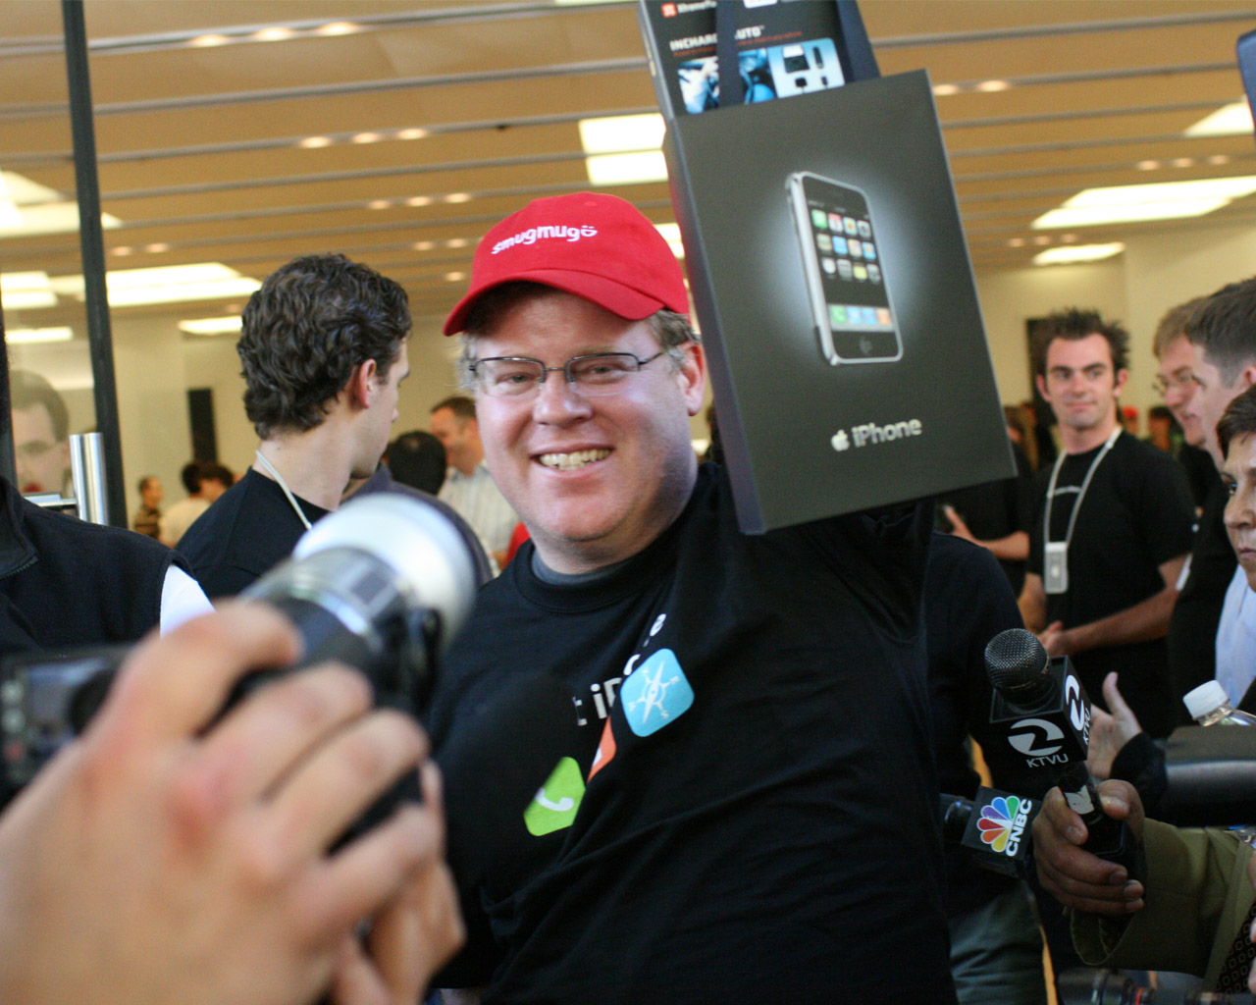
http://farm2.staticflickr.com/1260/665917039_f293d499c0_o.jpg

Slide 16
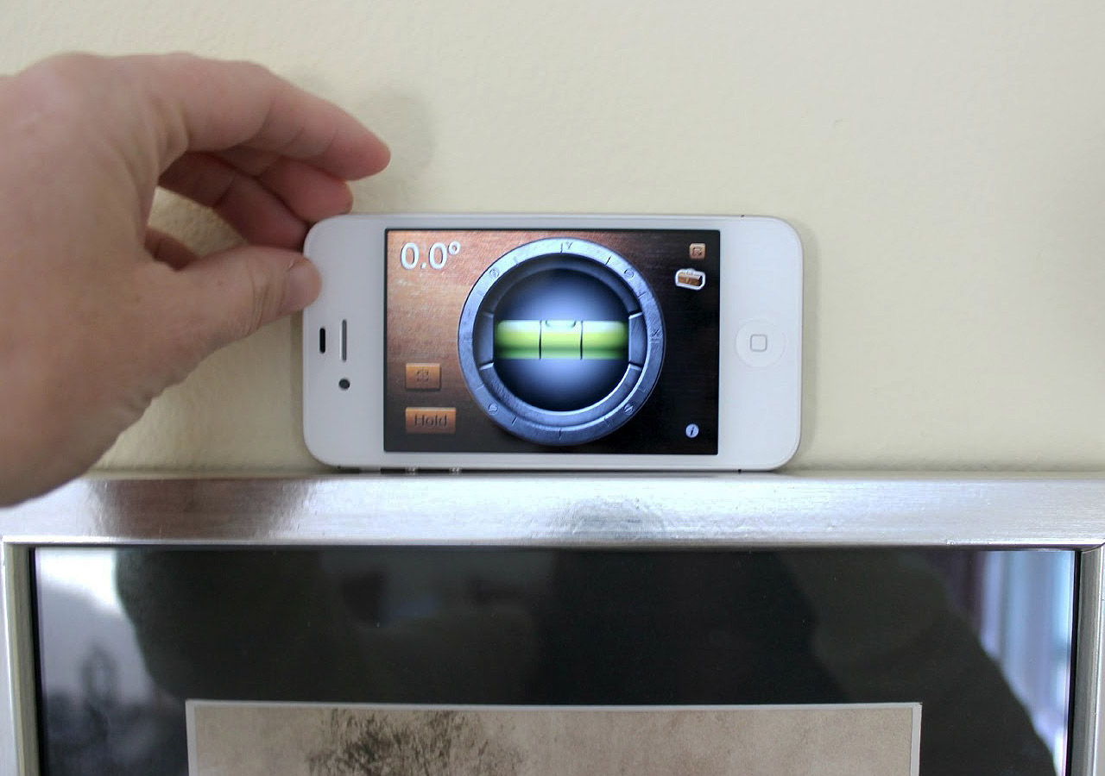
This phone is a level AND a flashlight.
Notes:
By stakeholder we mean the campus unit that that owns, manages or curates the data
Once you have priorities to focus on you can begin to advocate for a strategic approach to mobility
Focus on the stakeholders that can supply the data that your prioritized audiences most want

Slide 17
There’s an app for that.
Notes:
By stakeholder we mean the campus unit that that owns, manages or curates the data
Once you have priorities to focus on you can begin to advocate for a strategic approach to mobility
Focus on the stakeholders that can supply the data that your prioritized audiences most want

Slide 18
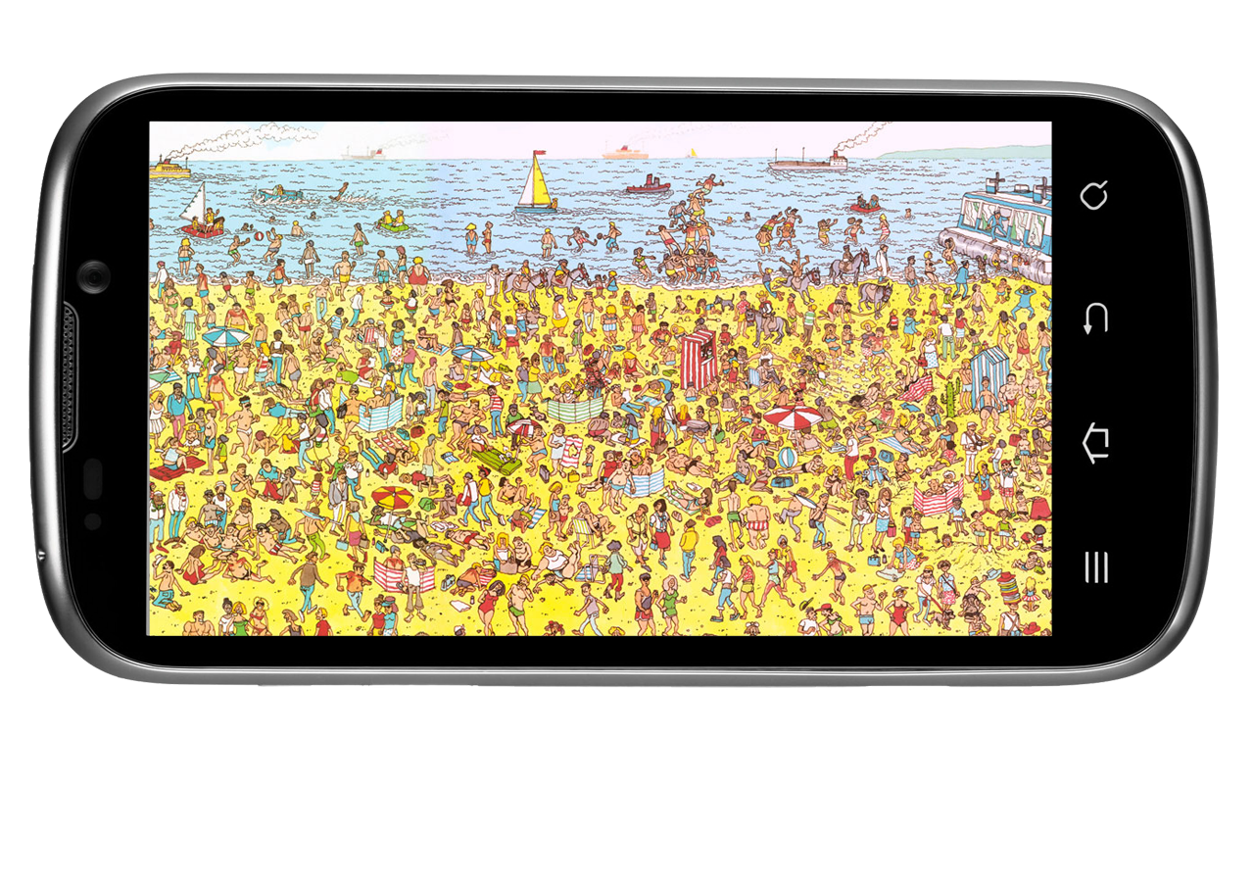
A smartphone home screen.

Slide 19
And somewhere in all those apps is a browser.

Slide 20
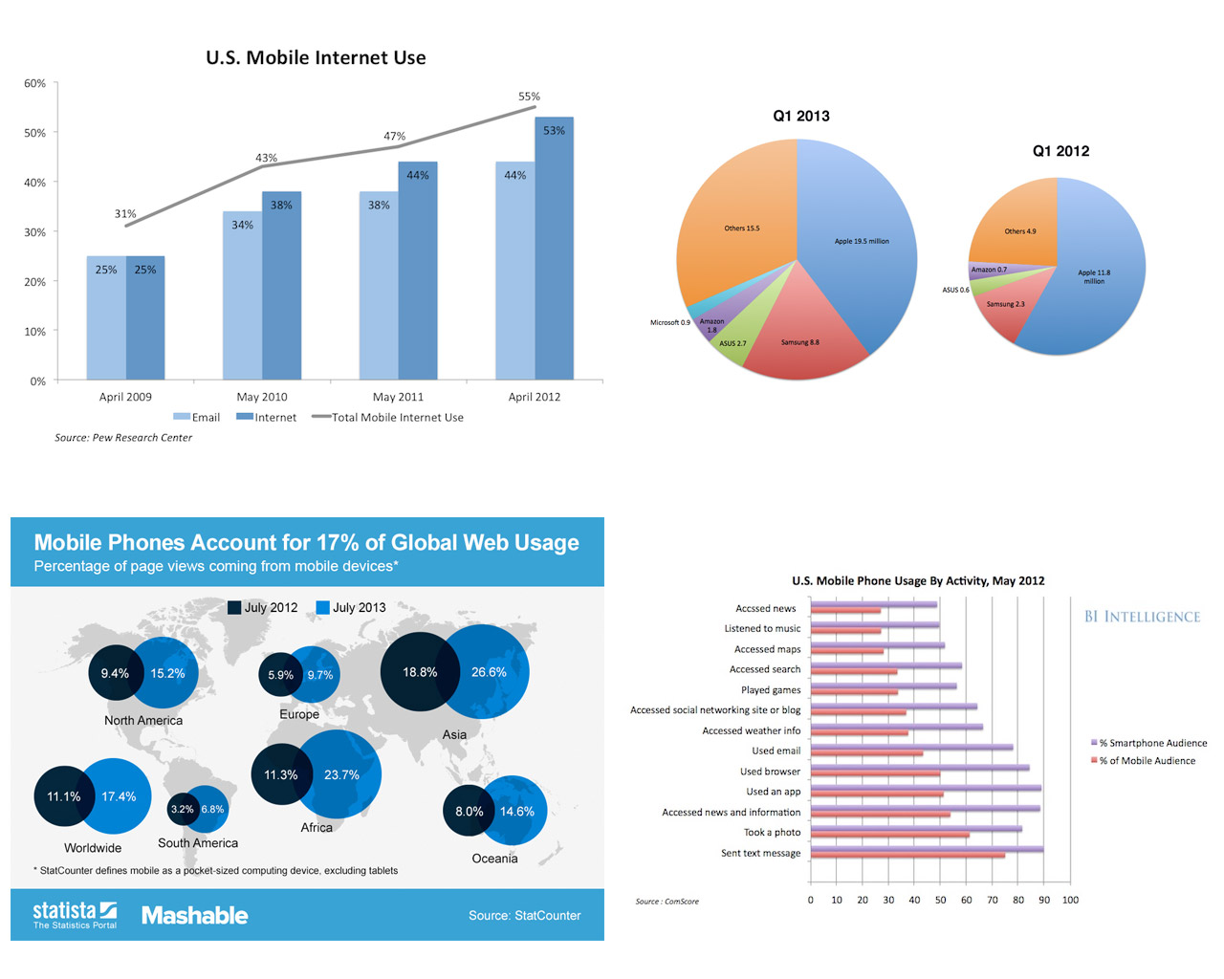
We are all aware of mobile usage…

Slide 21
…and then a
funny thing happened.

Slide 22
http://www.scmp.com/sites/default/files/styles/980w/public/2013/08/21/smartphone.jpg?itok=OdKbU4tP

Slide 23
55% of mobile phone owners say they use their phone to access the internet. http://www.pewinternet.org/Reports/2012/Cell-Internet-Use-2012/Main-Findings/Cell-Internet-Use.aspx
31% of current mobile internet users mostly go online using their phone. That’s 17% of all mobile phone owners. http://www.pewinternet.org/Reports/2012/Cell-Internet-Use-2012/Key-Findings/Overview.aspx
Blacks, Hispanics, low-income Americans, high school educated are more likely to be mobile-only users. http://www.pewinternet.org/Reports/2012/Cell-Internet-Use-2012/Main-Findings/Cell-Internet-Use.aspx
77% of mobile searches take place at home or work, only 17% on-the-go, according to Google. http://www.google.com/think/research-studies/creating-moments-that-matter.html
86% of mobile internet users (and 92% of mobile internet users aged 13-24) say they use their mobile devices while watching television. http://advertising.yahoo.com/article/the-role-of-mobile-devices-in-shopping-process.html

Slide 24
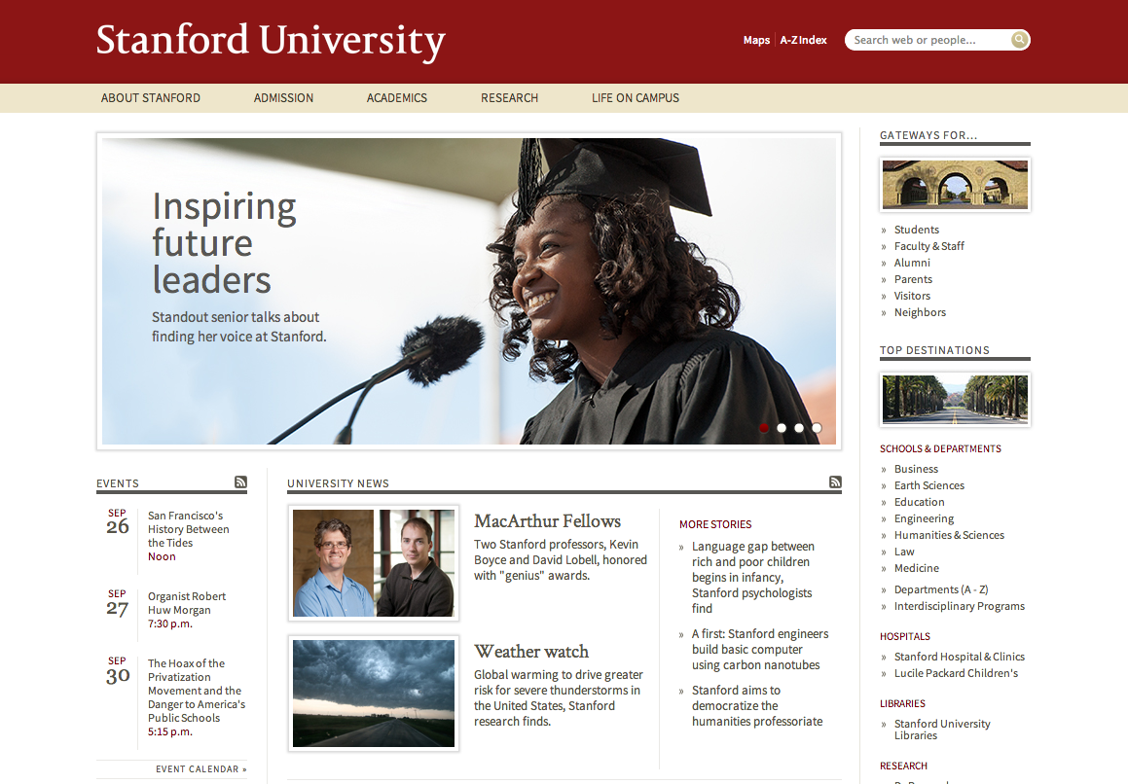
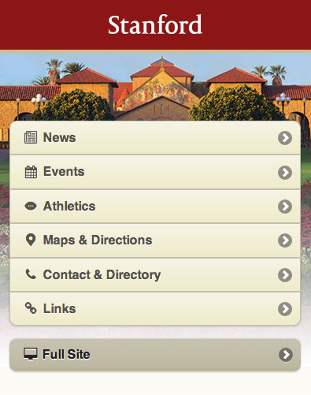
We could just make an m-dot site.

Slide 25
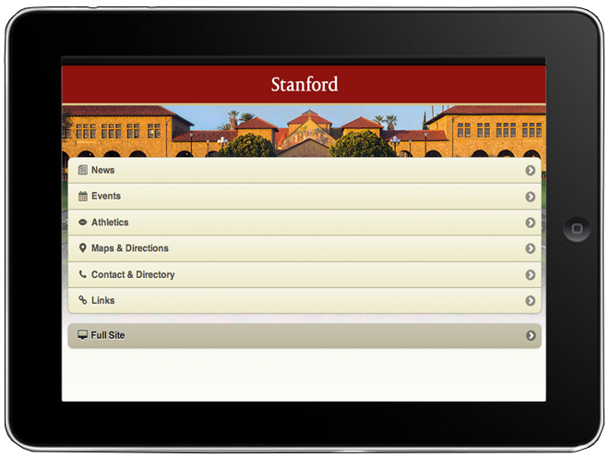
Let’s think about a tablet site too.

Slide 26
And one for the Internet-powered toaster.

Slide 27
Rather than tailoring disconnected designs to each of an ever-increasing number of web devices, we can treat them as facets of the same experience.
We can design for an optimal viewing experience, but embed standards-based technologies into our designs to make them not only more flexible, but more adaptive to the media that renders them.
http://alistapart.com/article/responsive-web-design

Slide 28
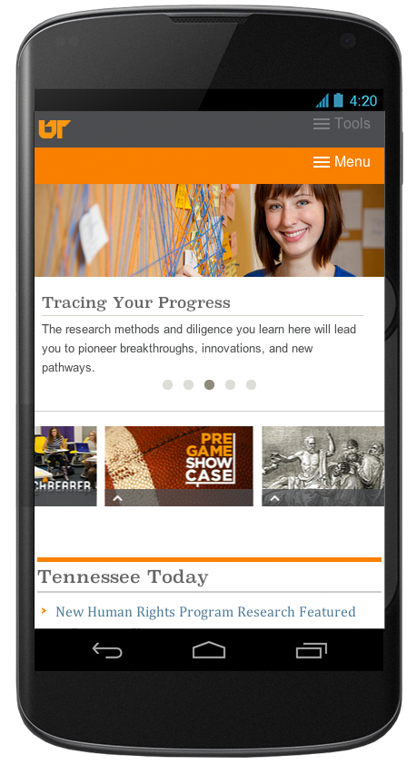
=

Slide 29
Future friendly
Notes:
By stakeholder we mean the campus unit that that owns, manages or curates the data
Once you have priorities to focus on you can begin to advocate for a strategic approach to mobility
Focus on the stakeholders that can supply the data that your prioritized audiences most want

Slide 30
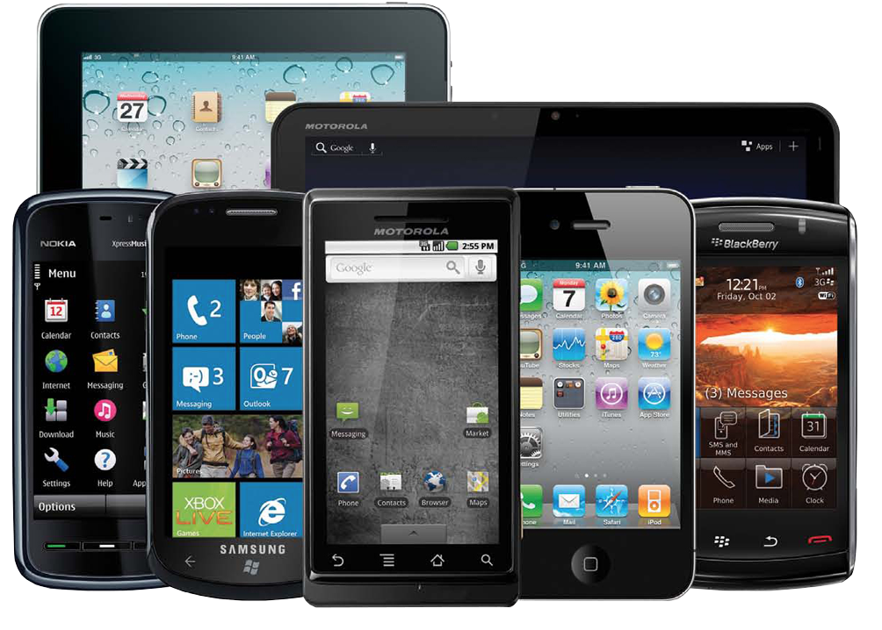
Device diversity

Slide 31
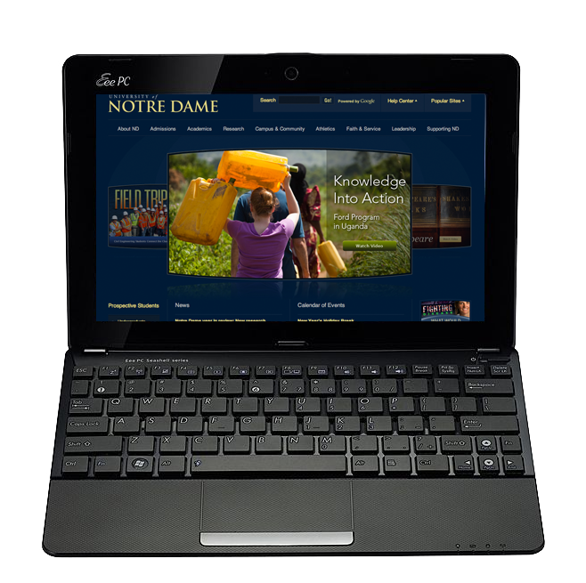
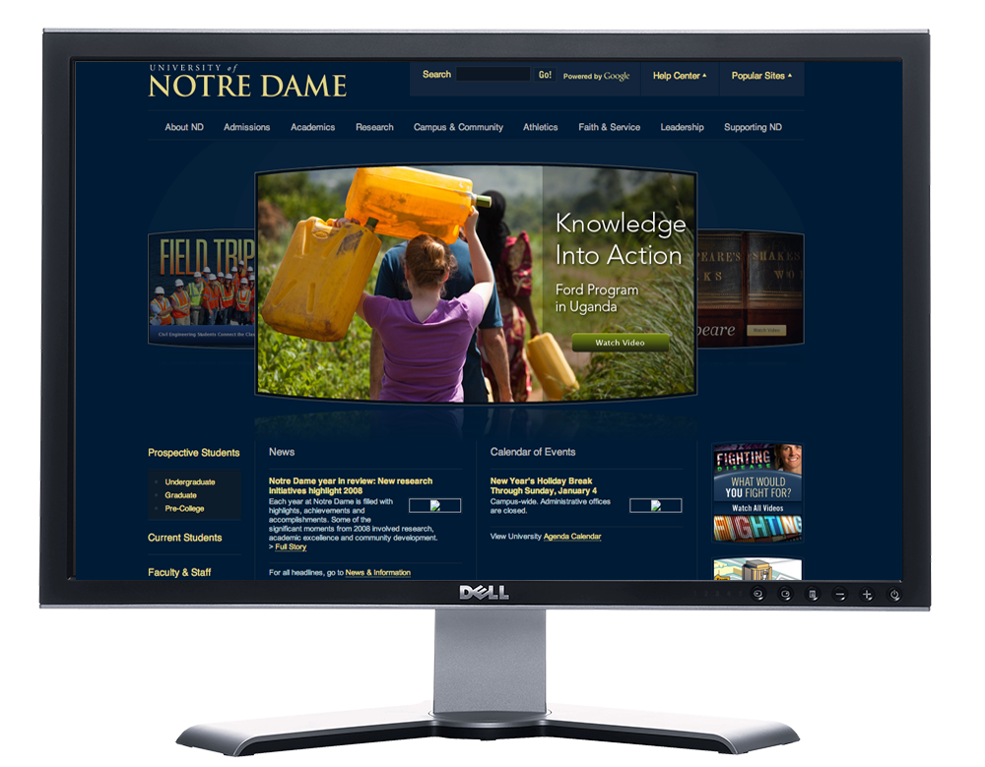
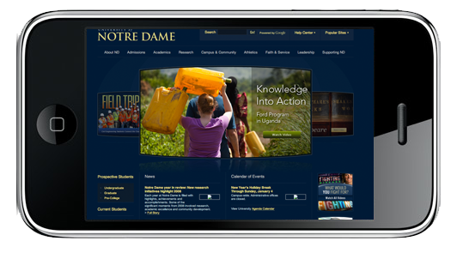
2009

Slide 32
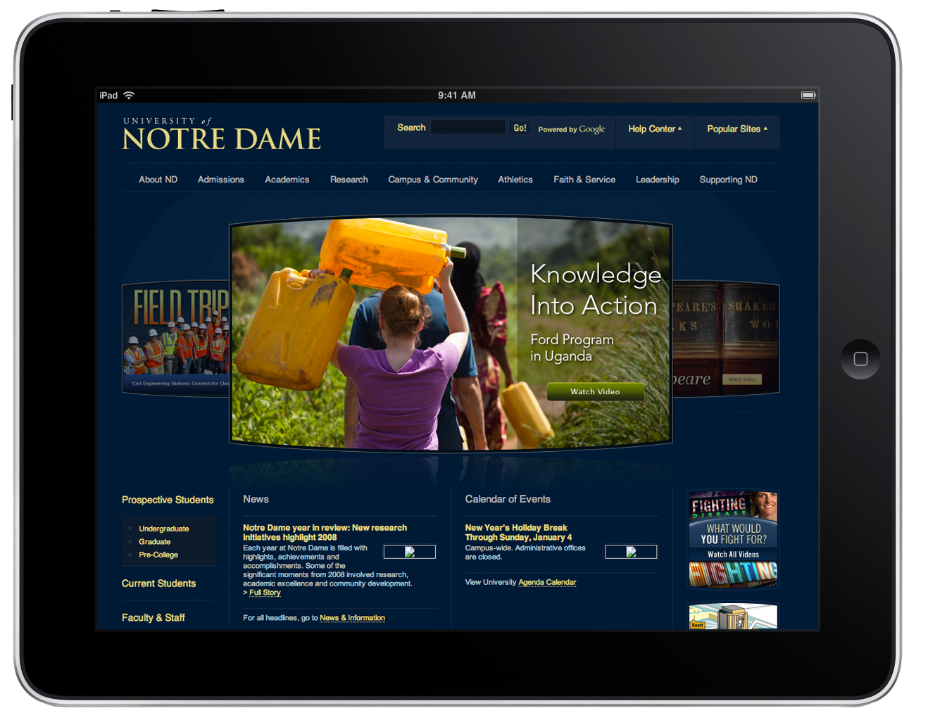
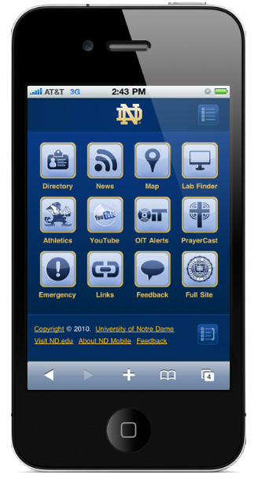
2010

Slide 33
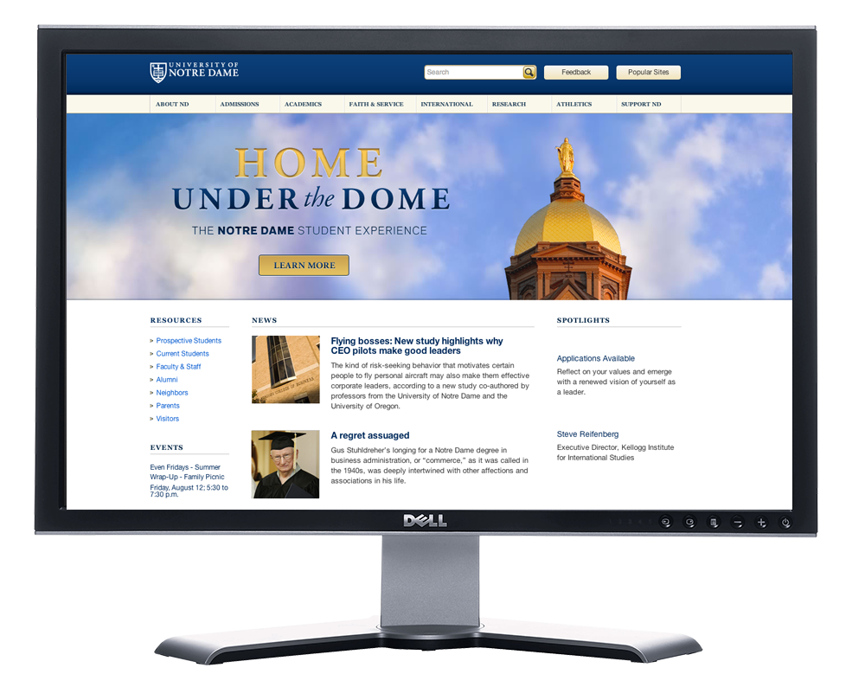
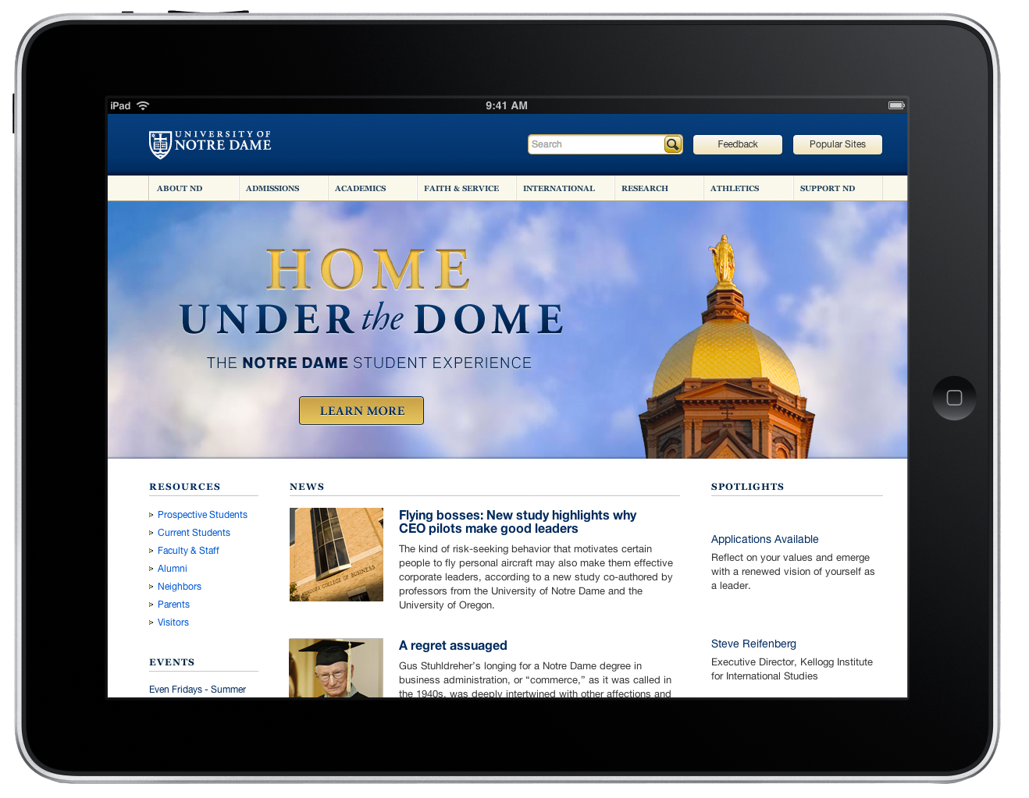
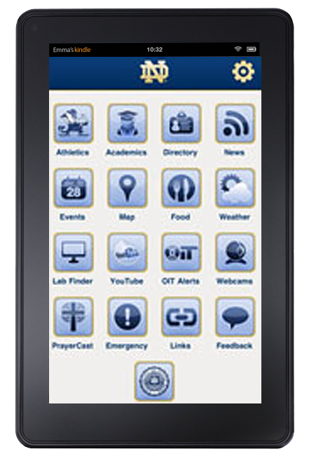
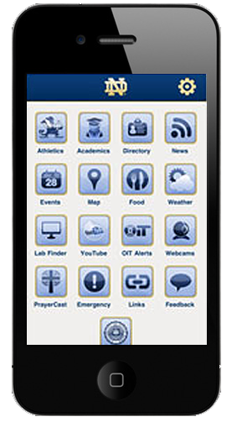
2011

Slide 34
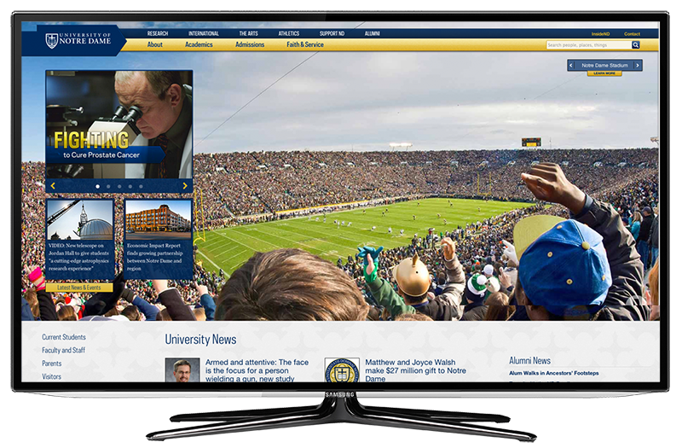
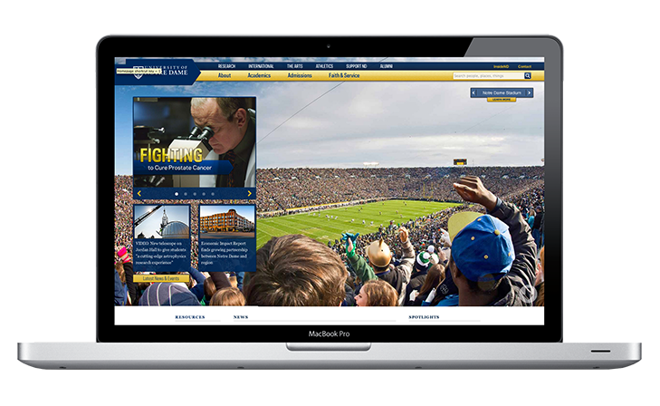
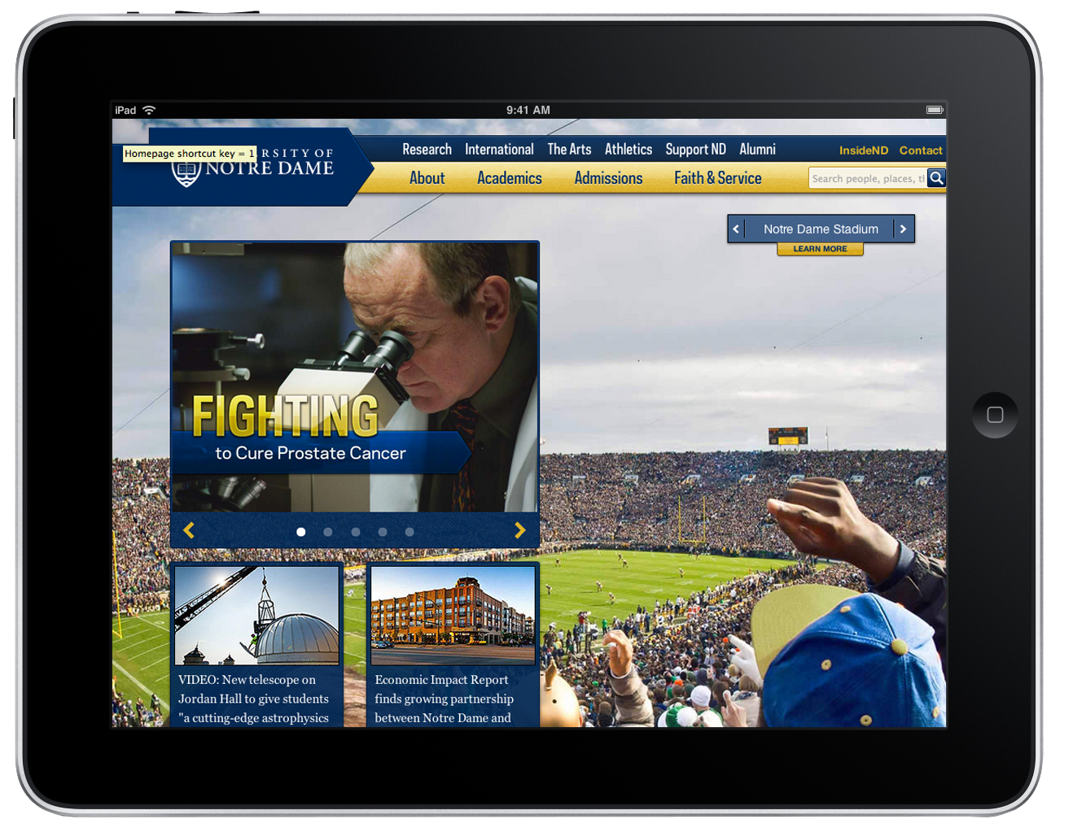
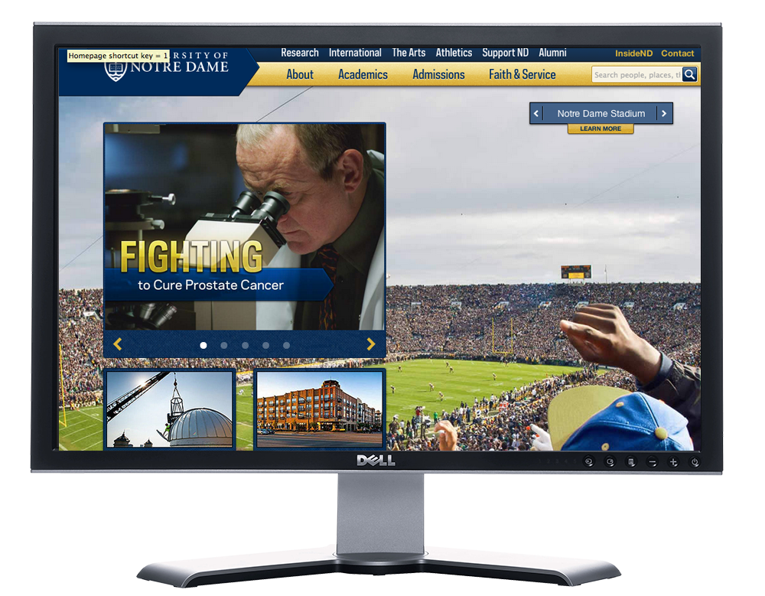
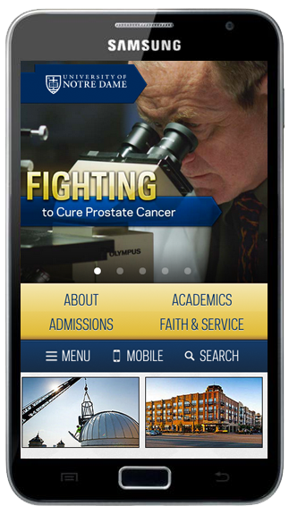
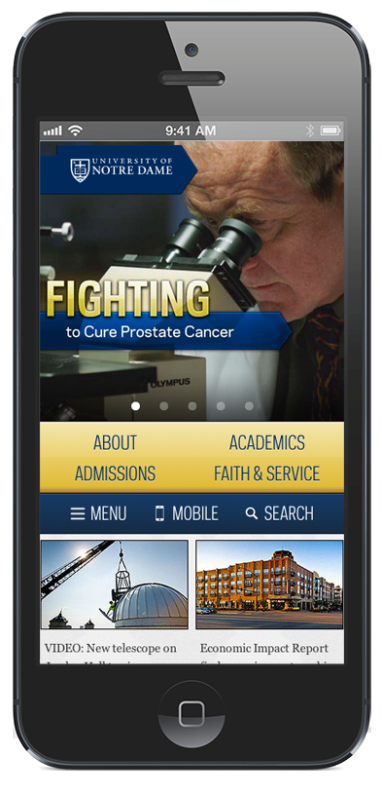
2012

Slide 35
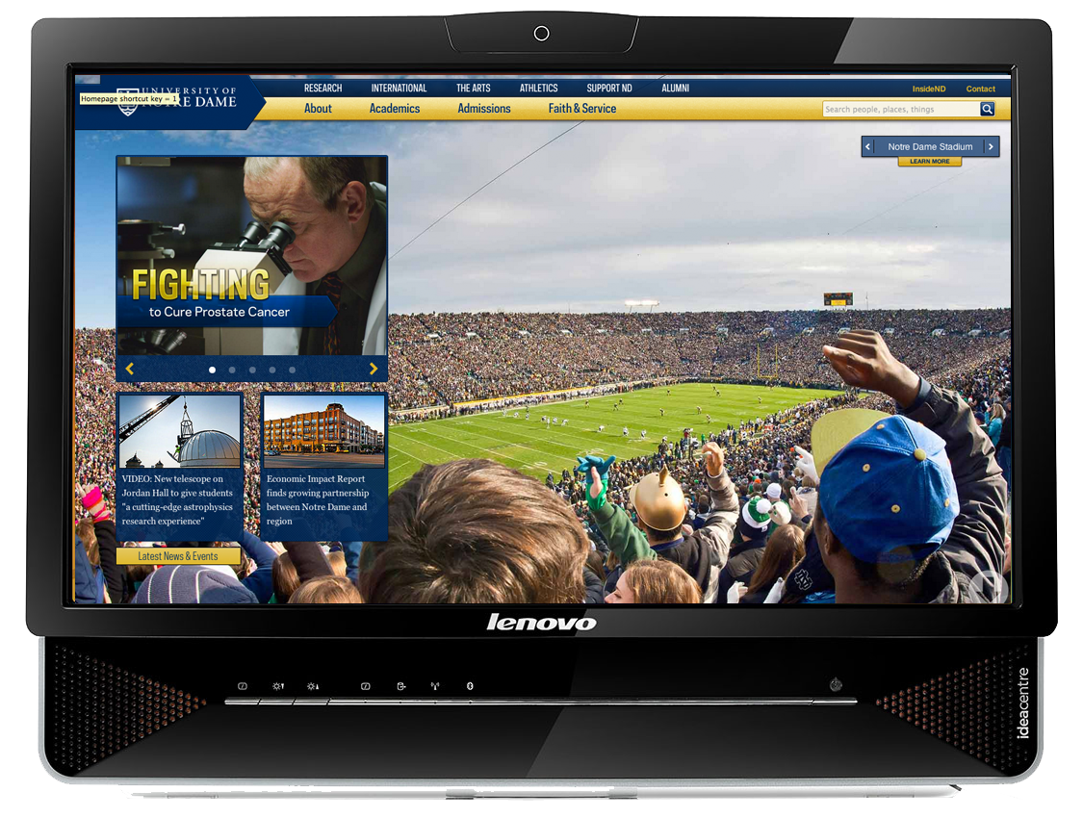
2013

Slide 36
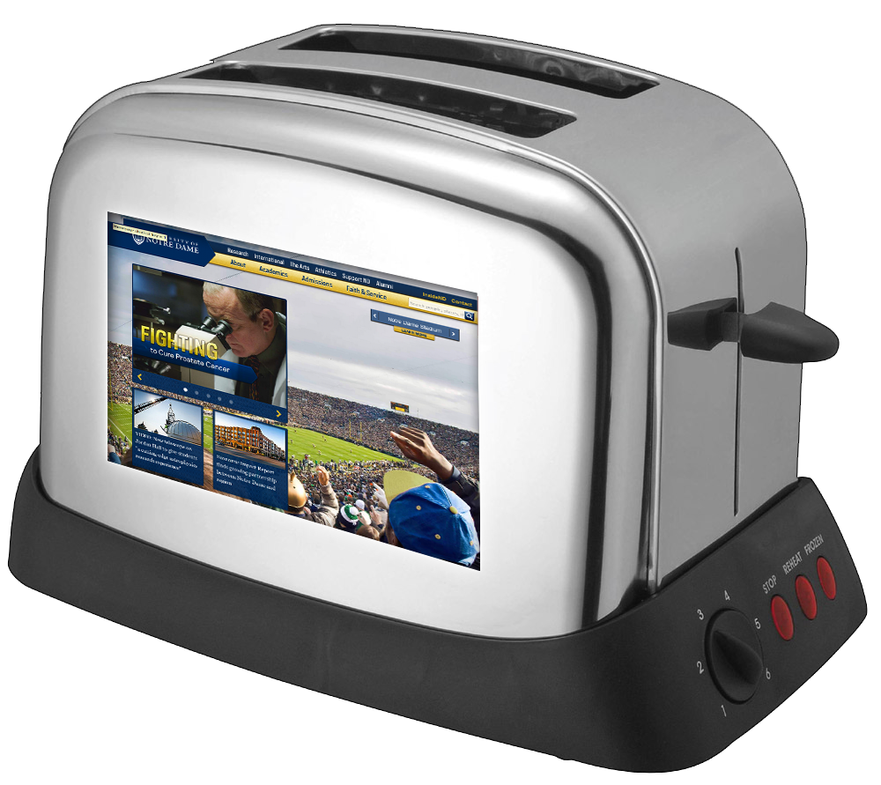
2014

Slide 37
“What’s under the Christmas tree in two years? That’s what we’re designing for today.” - Brad Frost
Notes:
By stakeholder we mean the campus unit that that owns, manages or curates the data
Once you have priorities to focus on you can begin to advocate for a strategic approach to mobility
Focus on the stakeholders that can supply the data that your prioritized audiences most want

Slide 38
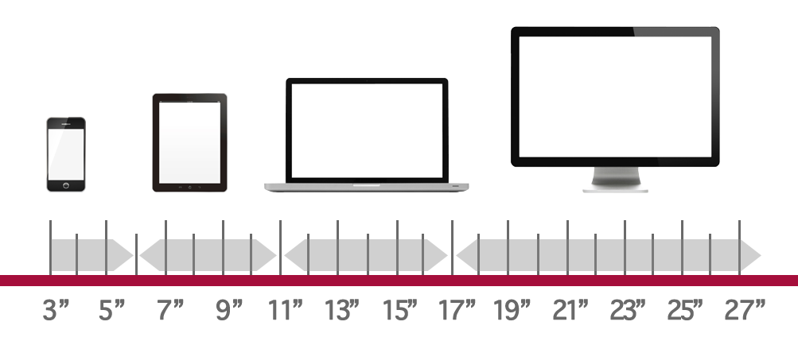
A wide spectrum of devices

Slide 39
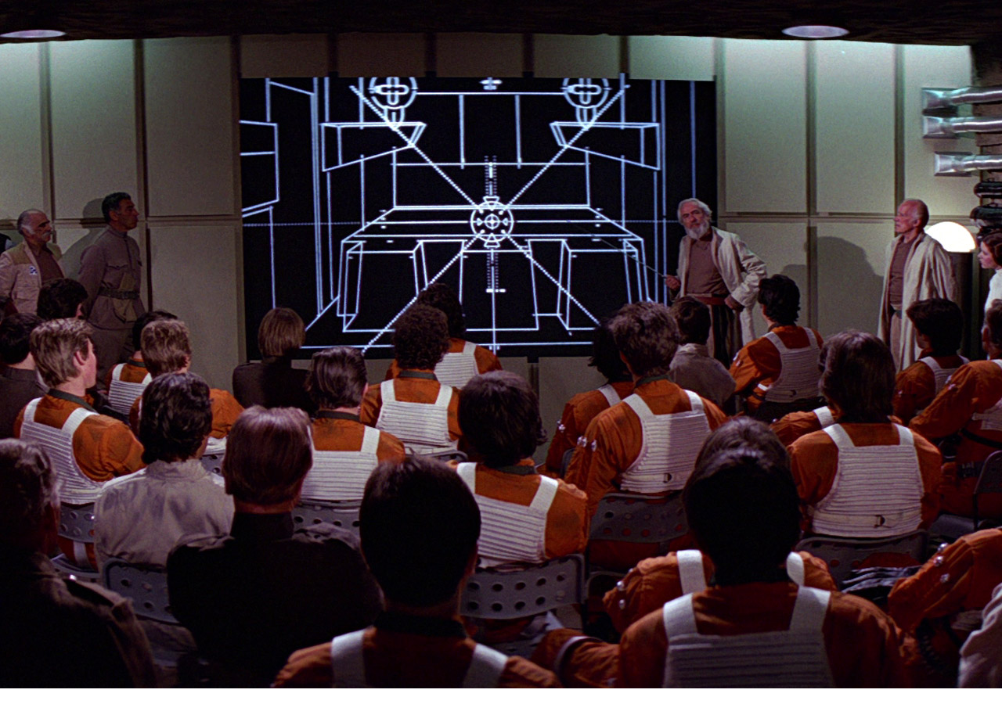
Start smart…know what you are doing and why.
Notes:
By stakeholder we mean the campus unit that that owns, manages or curates the data
Once you have priorities to focus on you can begin to advocate for a strategic approach to mobility
Focus on the stakeholders that can supply the data that your prioritized audiences most want

Slide 40
Now that we have the why…let’s get to the how.
Notes:
By stakeholder we mean the campus unit that that owns, manages or curates the data
Once you have priorities to focus on you can begin to advocate for a strategic approach to mobility
Focus on the stakeholders that can supply the data that your prioritized audiences most want

Slide 41
Planning for Responsive Web Design

Slide 42
Have a game plan
Notes:
By stakeholder we mean the campus unit that that owns, manages or curates the data
Once you have priorities to focus on you can begin to advocate for a strategic approach to mobility
Focus on the stakeholders that can supply the data that your prioritized audiences most want

Slide 43
Have a game plan
Understand the client’s Brand/Audience/Services
Design takes Time
Content & Functionality Requirements
Development
Testing an Training (if CMS)

Slide 44
Set and manage expectations
Notes:
By stakeholder we mean the campus unit that that owns, manages or curates the data
Once you have priorities to focus on you can begin to advocate for a strategic approach to mobility
Focus on the stakeholders that can supply the data that your prioritized audiences most want

Slide 45
Set and manage expectations
Design takes effort, plan for iteration and time
Critical to get feedback
Communicate a realistic timeline
Plan to spend some time

Slide 46
Content. Content. Content.
Notes:
By stakeholder we mean the campus unit that that owns, manages or curates the data
Once you have priorities to focus on you can begin to advocate for a strategic approach to mobility
Focus on the stakeholders that can supply the data that your prioritized audiences most want

Slide 47
Content. Content. Content.
What types do you have
How frequent will it change
What is the message of your site
What is the Value proposition you are trying to convey
What are the three most critical components?

Slide 48
Getting to priorities
Notes:
By stakeholder we mean the campus unit that that owns, manages or curates the data
Once you have priorities to focus on you can begin to advocate for a strategic approach to mobility
Focus on the stakeholders that can supply the data that your prioritized audiences most want

Slide 49
Getting to priorities
For Tablets - What will tablet users care most about
How does this differ from widescreen users
What can you “let go of” to simplify the view
For phone – what will phone users care most about?
For watches?

Slide 50
User experience
Notes:
By stakeholder we mean the campus unit that that owns, manages or curates the data
Once you have priorities to focus on you can begin to advocate for a strategic approach to mobility
Focus on the stakeholders that can supply the data that your prioritized audiences most want

Slide 51
User experience
User Centric
Best possible navigation
Navigation Simplification
Quick answers
Anticipate needs

Slide 52
Questions
Notes:
By stakeholder we mean the campus unit that that owns, manages or curates the data
Once you have priorities to focus on you can begin to advocate for a strategic approach to mobility
Focus on the stakeholders that can supply the data that your prioritized audiences most want

