Slide 1
Rose Rocchio, UCLA
Mojgan Amini, UCSD
Chris Ward, Kennesaw State University
Lori Tirpak , Oakland University, Rochester

Slide 2
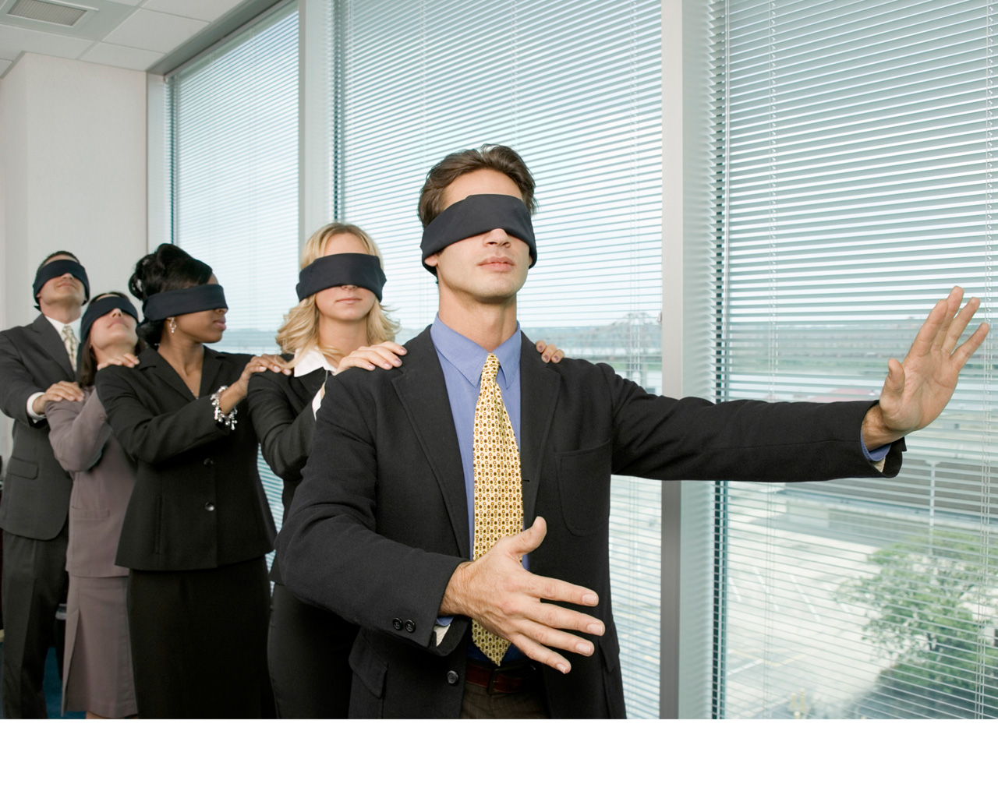
Why are we here today?

Slide 3
Mobile broadband subscriptions are expected
to grow from nearly 1 billion in 2011 to over 5
billion globally in 2016
By 2015, more Americans will access the
Internet via mobile devices than desktop PCs
As of March 2012, 46% of American adults
were smartphone owners – up from 35% in
May 2011
In 2011, global smartphone shipments
exceeded personal computer shipments for
the first time in history
WhiteHouse.gov, Digital Government: Building A 21st Century Platform to Better Serve The People, May 23, 2012

Slide 4
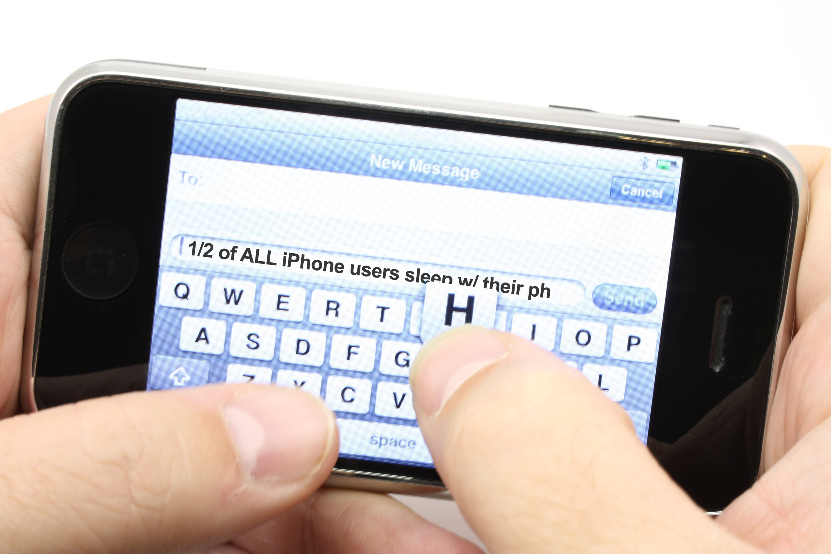
We understand the need.

Slide 5
Take the time to know where you want to go.

Slide 6
One size does not fit all.

Slide 7
No matter who you are, you have to first define your goals and needs

Slide 8
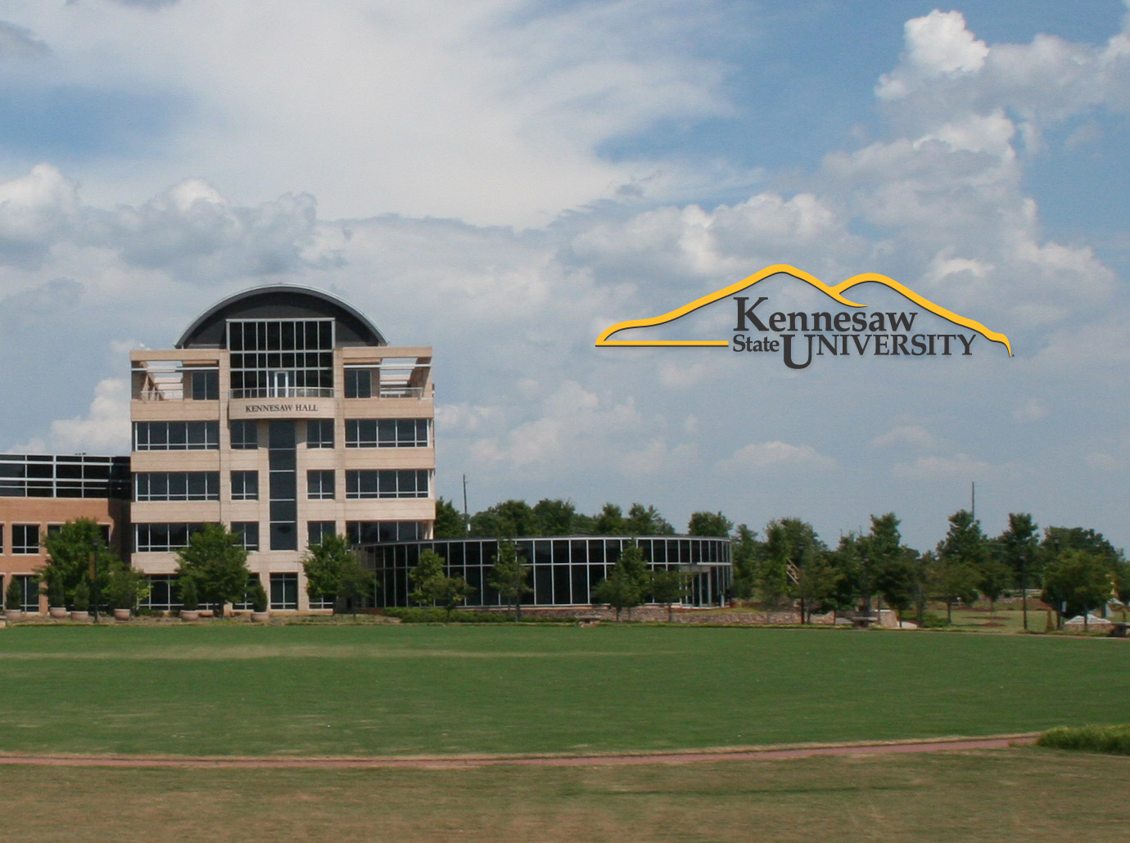
No matter who you are, you have to first define your institution’s goals and needs
Let’s try an example: KSU Admissions wants to use mobile technologies to improve information flow with prospective high school parents.

Slide 9
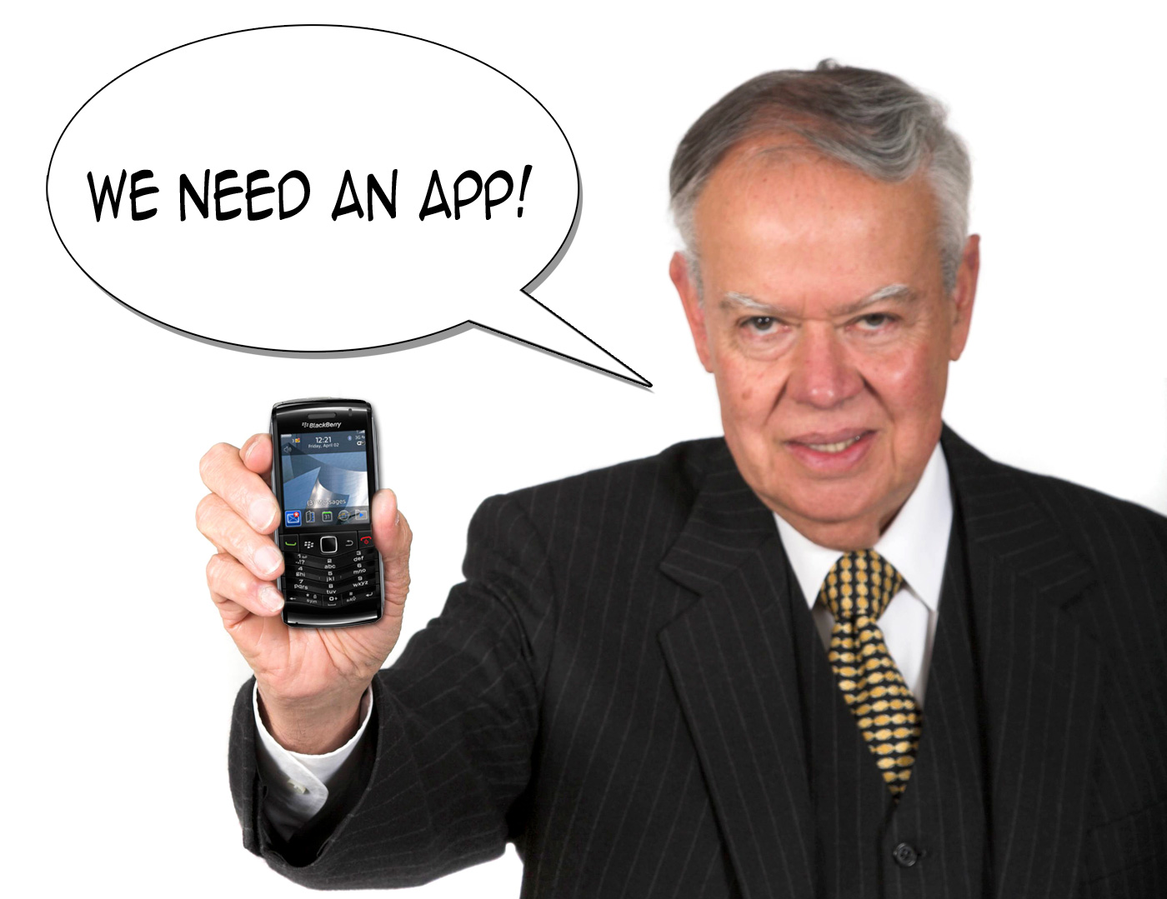

Slide 10
Platform
Resources
Content
Audience
Desktop Web Site
Mobile Web Site
Native App
In-House IT
Learning Curve
Small Budget
Outsourced IT
About KSU
Academic Programs
Tuition & Fees
Stories & Testimony
Application
HS Students
HS Parents
HS Counselors

Slide 11
Dollars + Hope ≠ A Strong Mobile Strategy

Slide 12
Platform
Resources
Content
Audience
Desktop Web Site
Mobile Web Site
Native App
In-House IT
Learning Curve
Small Budget
Outsourced IT
About KSU
Academic Programs
Tuition & Fees
Stories & Testimony
Application
HS Students
HS Parents
HS Counselors

Slide 13
Audience
Content
Resources
Platform
HS Students
HS Parents
HS Counselors
About KSU
Academic Programs
Tuition & Fees
Stories & Testimony
Application
In-House IT
Small Budget
Outsourced IT
Large Budget
Desktop Web Site
Mobile Web Site
Native App

Slide 14
One in 8 visitors to Kennesaw.edu is from a mobile device
Undergraduate Admissions site averages 50,000 visits per month
In-house Web team that specializes in HTML & CSS development
KSU has a business school with a large number of BlackBerry users
Any authentication would require visitors to have a KSU-specific ID
Whatever Admissions gets, Financial Aid & Registrar also get
One size does not fit all.
The guy who can build/support apps left for Google last spring
Enrollment Services needs solution in place for Fall 2012
2013 University spending reduced 3% due to state budget cuts
Two-thirds of Kennesaw mobile traffic is from iOS devices

Slide 15
