Slide 1
The Future is Coming: A Discussion on the Inevitable Collision of AI and Your University's Website
Christopher Ward, Kevin Ball, Michael Cahal Jonathan Maxfield, Michael Haynes Kennesaw State University

Slide 2
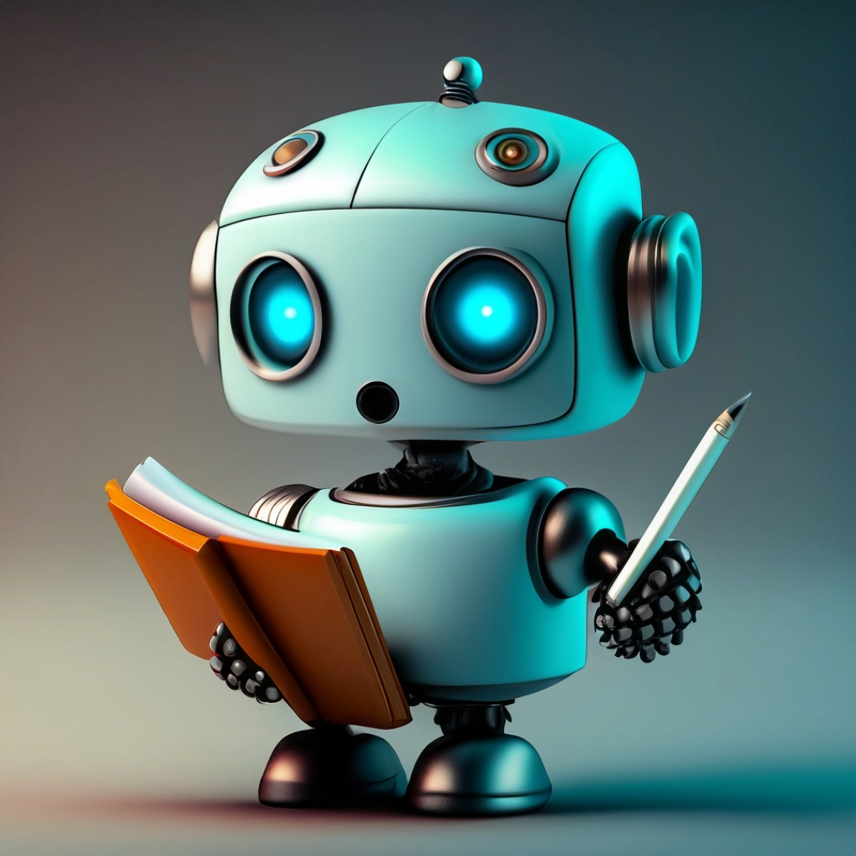
The Last Thing We Want To Do...
Talk at you about AI and Websites for 50 straight minutes. What do you want to learn from this session today?

Slide 3
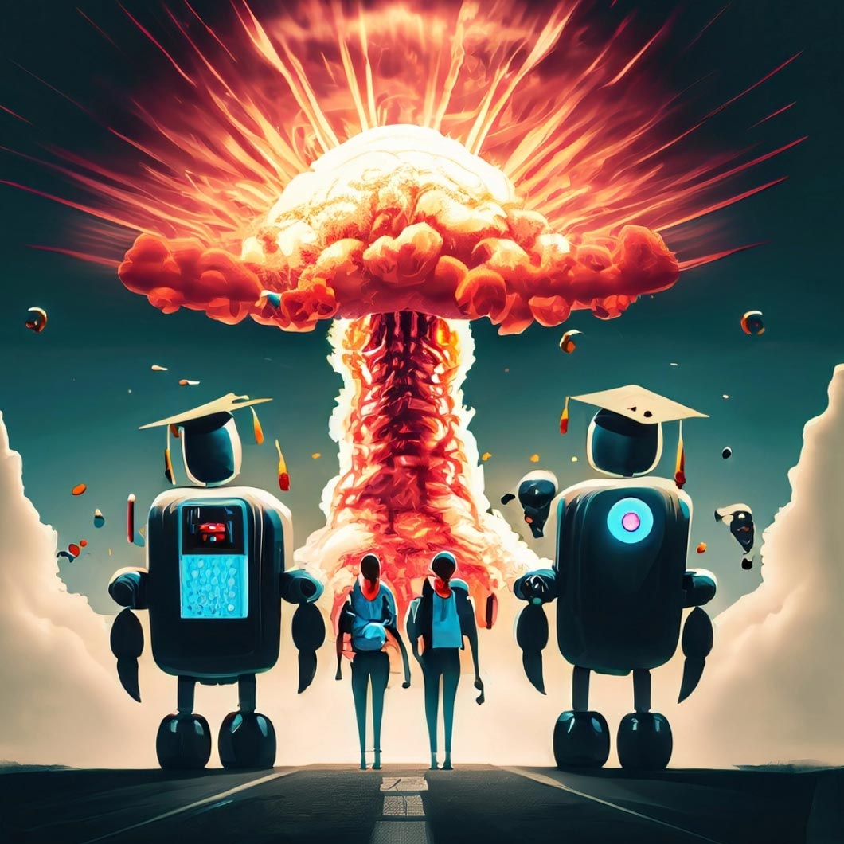
A couple of quick notes before we start:
We are going to try and do this presentation without going to the dystopian future where robots have taken all our jobs and humanity has devolved into Wall-E.

Slide 4
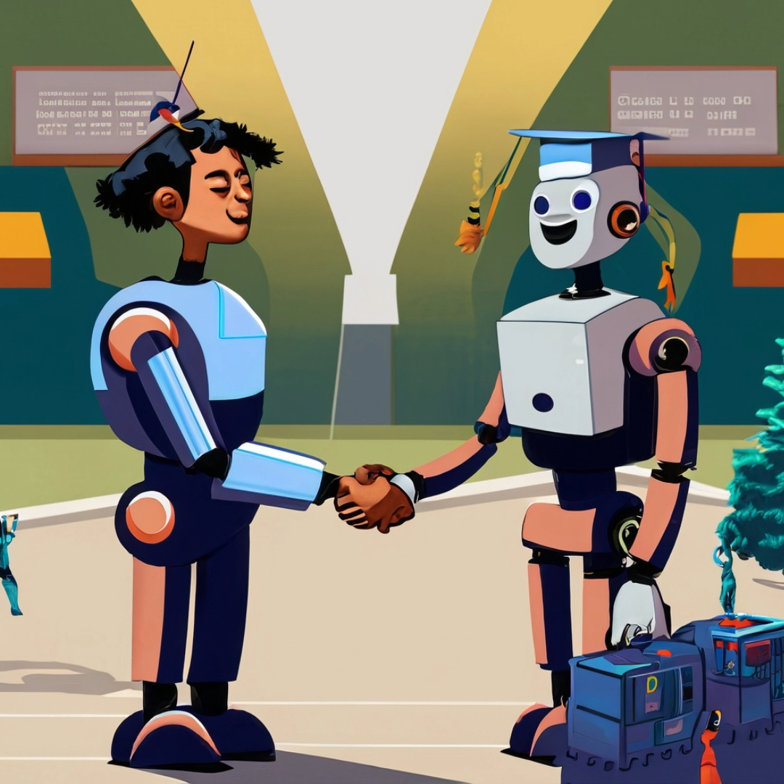
A couple of quick notes before we start:
We are going to try and stay "grounded” and work in the realm of "realistic ideas." We will try to avoid "AI insanity,” general handwringing, and anxiety-inducing trauma.

Slide 5
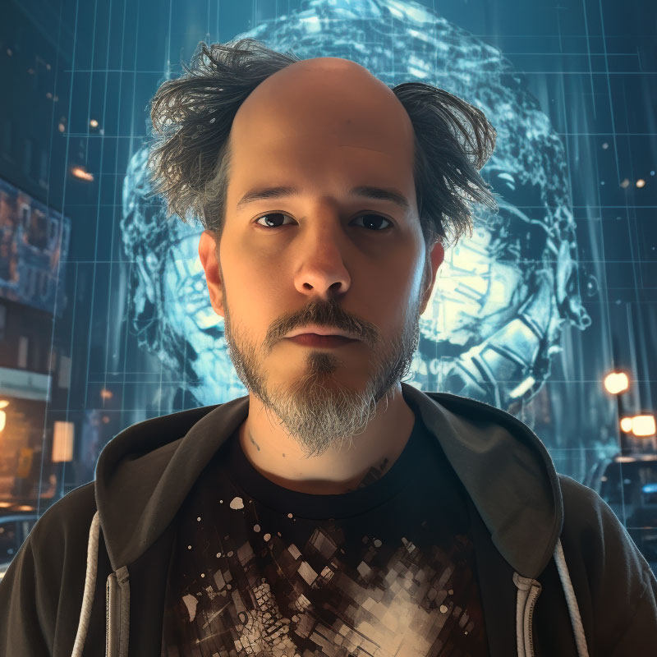
Who We Are And What We Do
Manage University CMS
Web Development
Search Engine / Forms
Web Accessibility
Kennesaw State UITS WebGroup

Slide 6
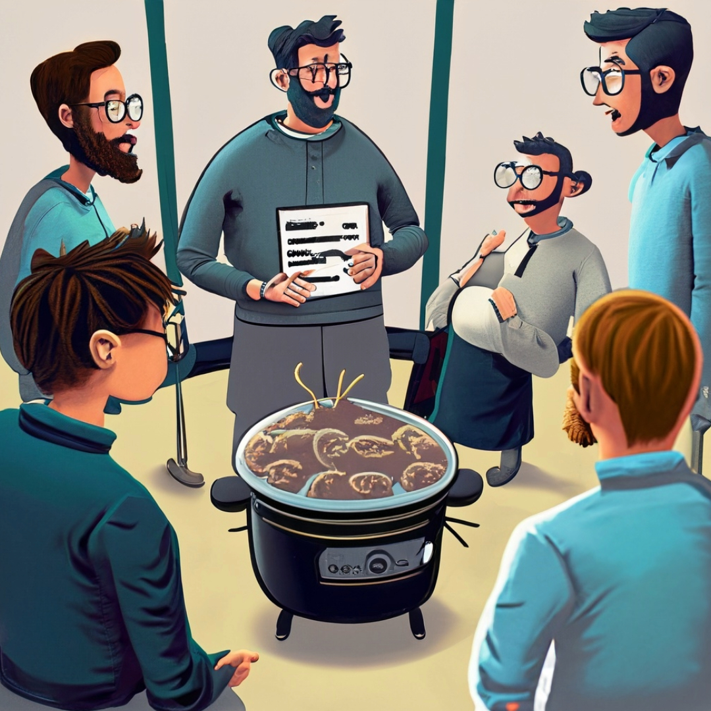
Who We Are And What We Do
We are creatively collaborative and enjoy the value of engaging in a good discussion about technology and the future of the web

Slide 7
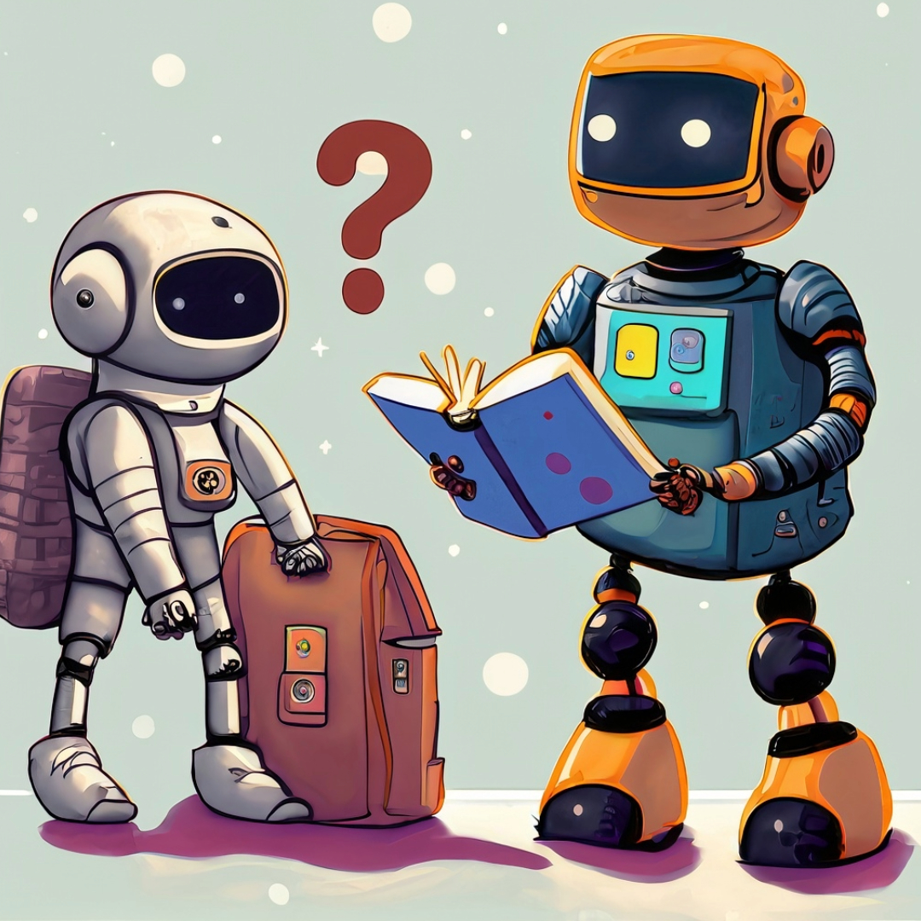
Let’s establish a Baseline - What is AI and what do we need to know for today's discussion?

Slide 8
What is AI? (Artificial Intelligence)
Artificial intelligence (AI) is the simulation of human intelligence by machines, such as computers or robots. AI uses real-time data to replicate human discernment and make decisions.
AI can be used for expert systems, natural language processing, speech recognition, and machine vision.

Slide 9
What is Generative AI?
Generative AI is a subset of AI that focuses on creating new content, such as text, images, and videos.
Generative AI works by learning from a large dataset of existing content. Once the model is trained, it will use the patterns and relationships to create new content similar to the dataset’s content.

Slide 10
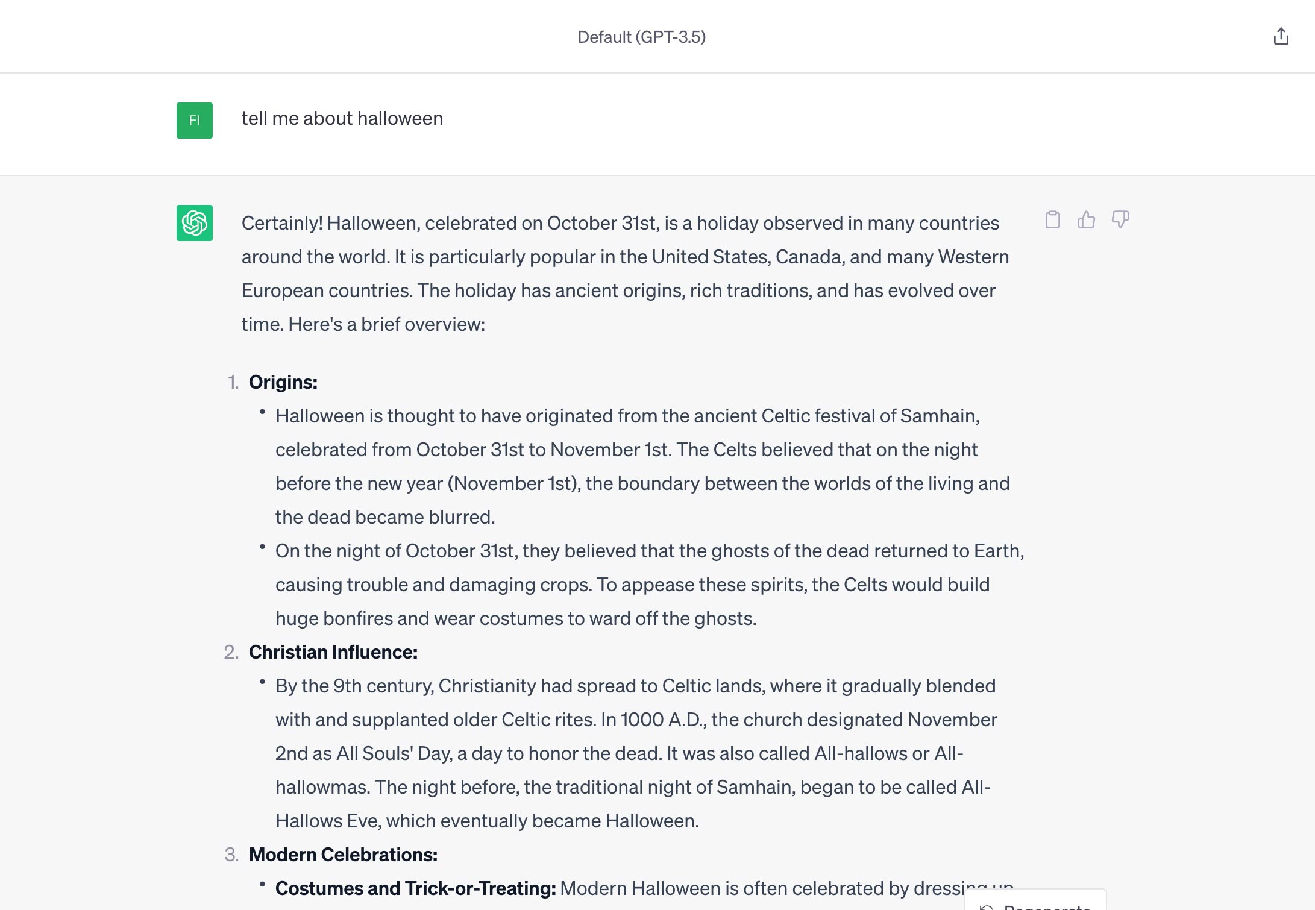
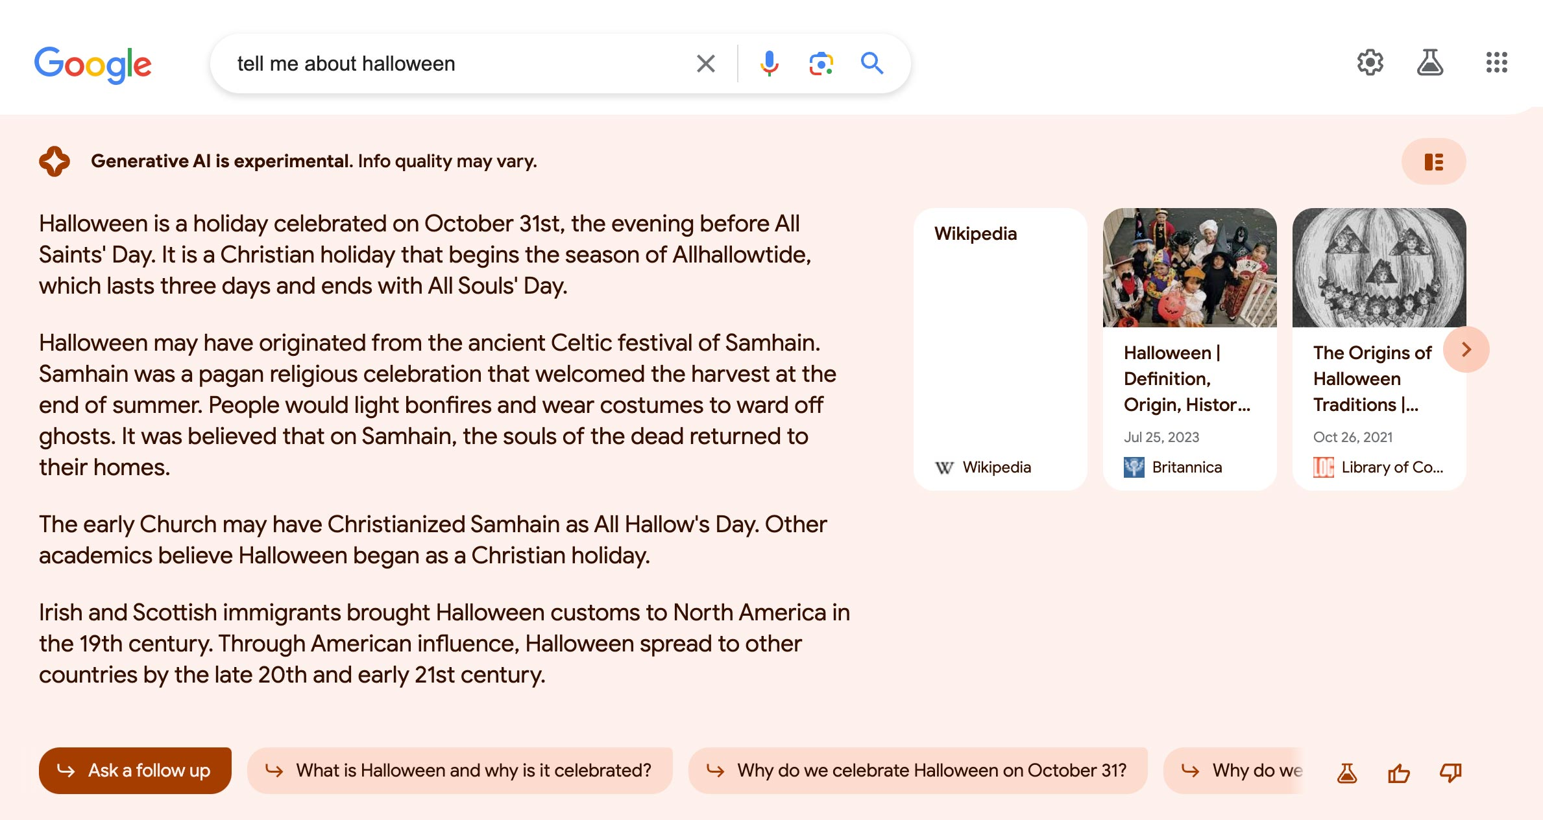
AI Text Generation
ChatGPT
Google

Slide 11
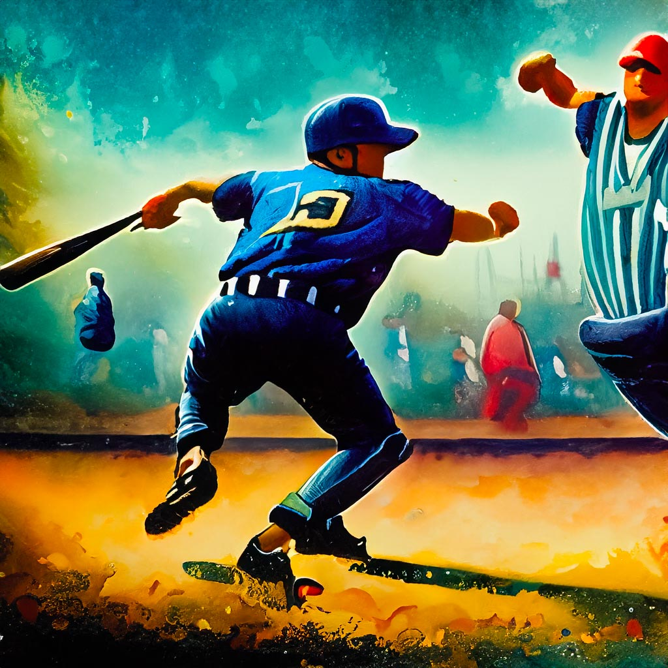
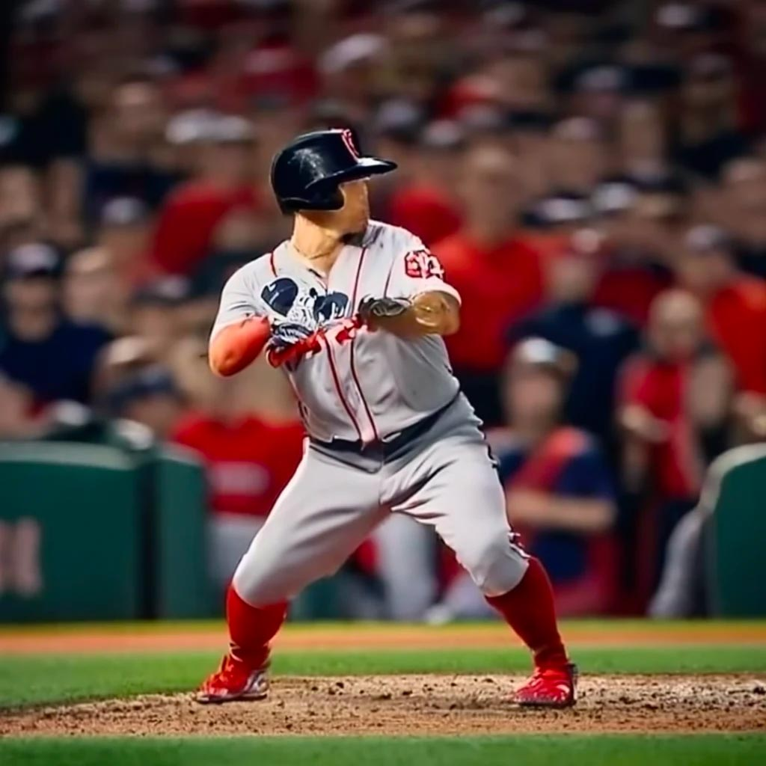
AI Image Generation
A painting of a baseball player hitting during a game
Midjourney
Adobe Photoshop
(Beta)
Adobe Firefly
OpenAI Dall-E
Craiyon

Slide 12
What We Need to Know for Today Regarding AI:
Basically…enter a prompt, wait anywhere from seconds to a minute and content will be returned.

Slide 13
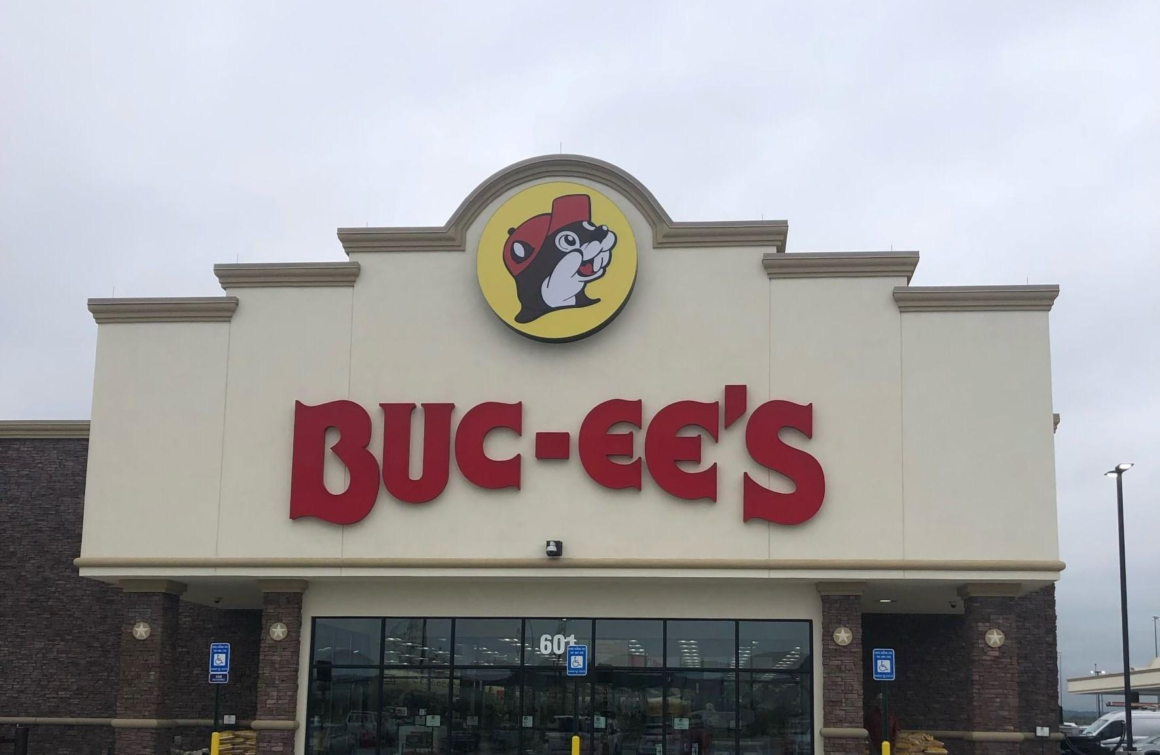
Our Day Which Shall Live In Infamy December 16, 2022
This was the day we had our first “A-HA!” moment with AI and proceeded to talk about it and its implications for websites for years to come.

Slide 14
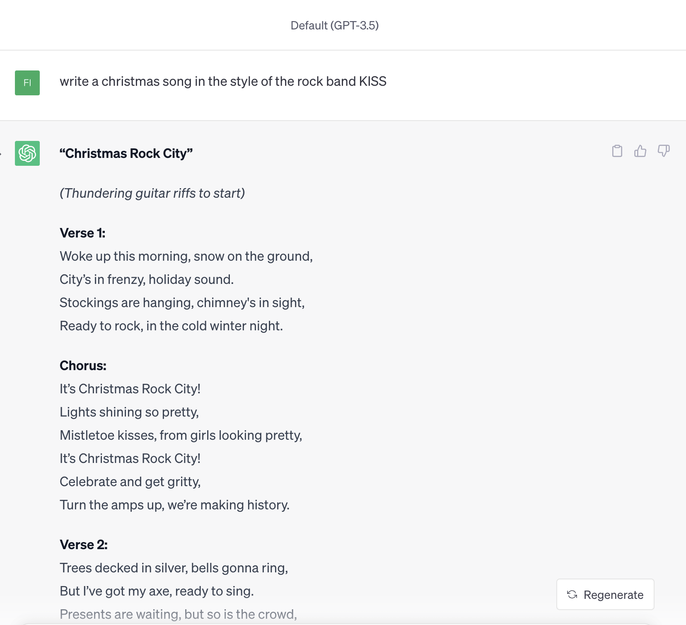
Our Day Which Shall Live In Infamy December 16, 2022
“Write a Christmas song in the style of the rock group KISS.”

Slide 15
Our Day Which Shall Live In Infamy December 16, 2022
What will it mean for the future of the web if content can be generated – about ANYTHING – instantly?
How will this affect web pages, websites, and entire domains?
Will websites stop being “websites” and become search boxes?
When are we going to feel the AI shift in higher education?

Slide 16
So…a little background is in order

Slide 17
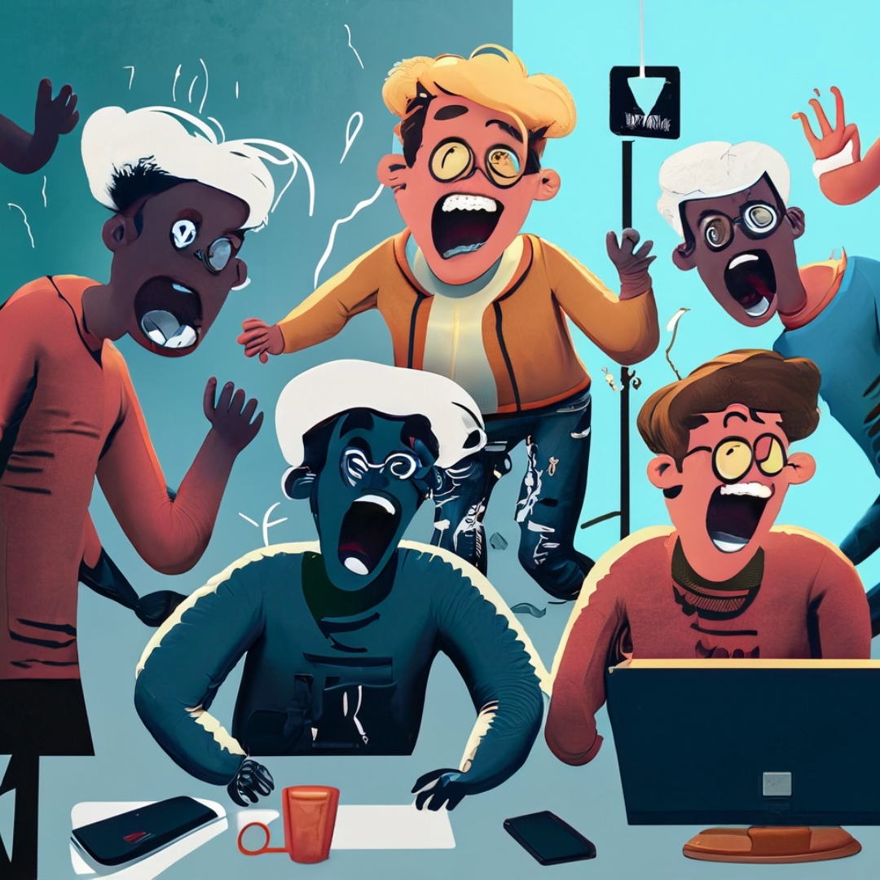
Amongst the five of us presenting, we have over 45 years of web development experience.
Unequivocally, the hardest (and longest) part of getting a website built is getting the content.

Slide 18
Hmmm….
What would it be like if INSTEAD of building and managing thousands of webpages, the website literally generated content and “built” itself based on the user’s wants and needs?

Slide 19
First, we’d have to determine AI’s text capabilities and what it can do well.
(As well as where we might run into some struggles.)

Slide 20
After playing science experiments with ChatGPT for dozens of hours and feeding it hundreds of prompts this is our takeaway about the content it can generate.

Slide 21
VERY difficult to differentiate from actual human writing
Almost limitless options to generate a variety of text-based content
Chat GPT always takes "the high road"
Weirdly "creative"

Slide 22
It was very early on that we made the connection it could seamlessly “combine” ideas into coherent output.

Slide 23
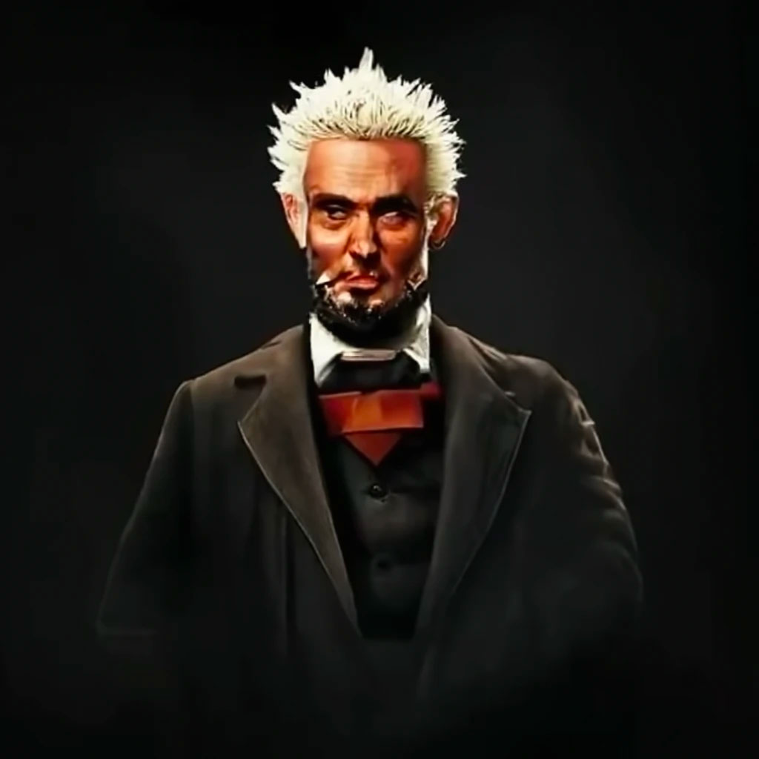
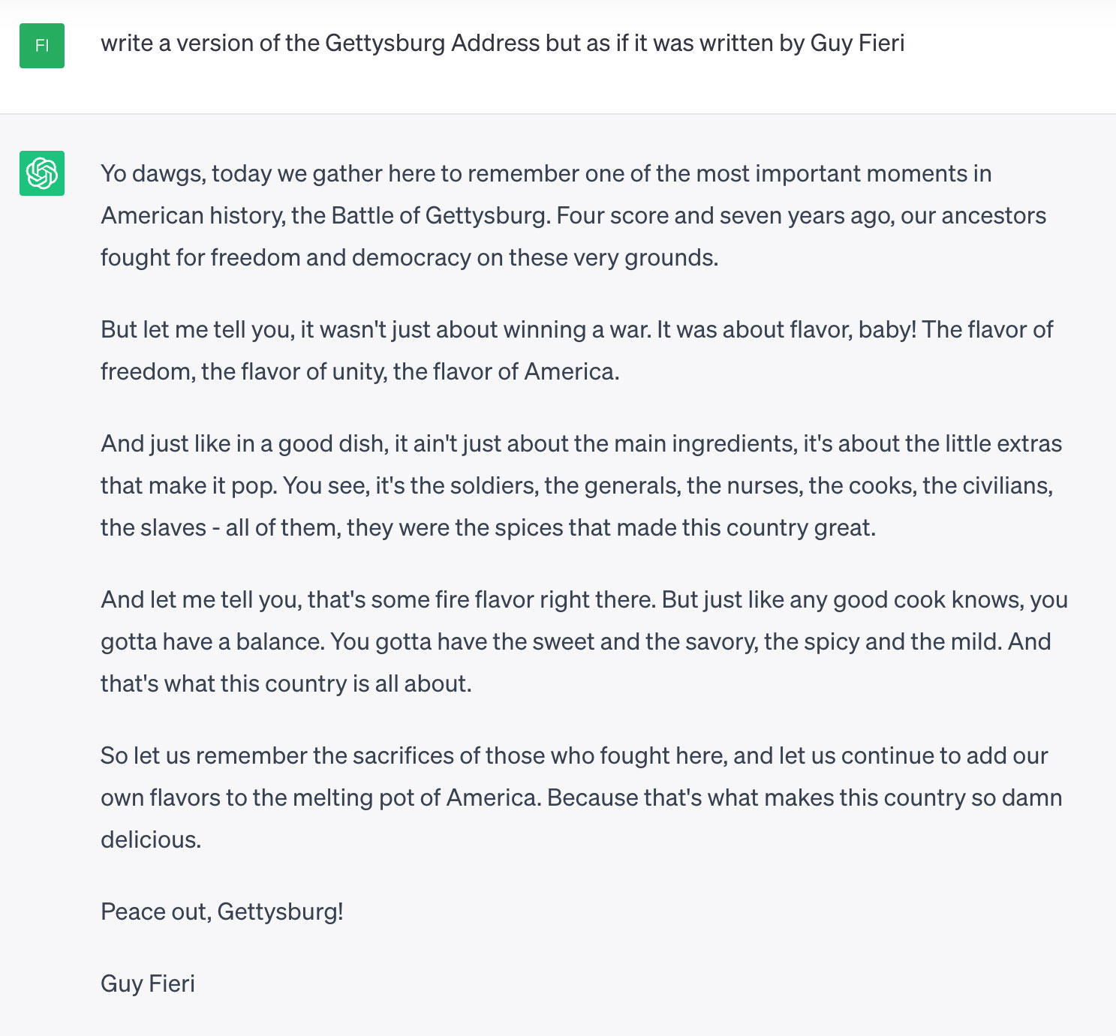

Slide 24
Well…that’s good.
But how does all of this actually apply to higher ed and OUR websites?

Slide 25
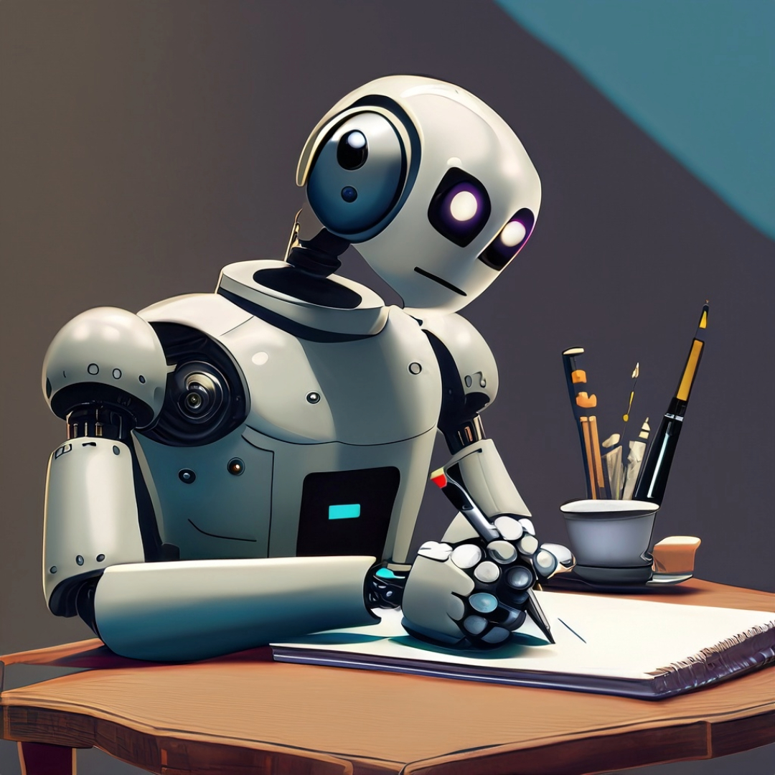
ChatGPT Takeaway #1:
While not 100% perfect, the output from ChatGPT is both grammatically correct and free of spelling errors. (More like 99.9% right.)

Slide 26
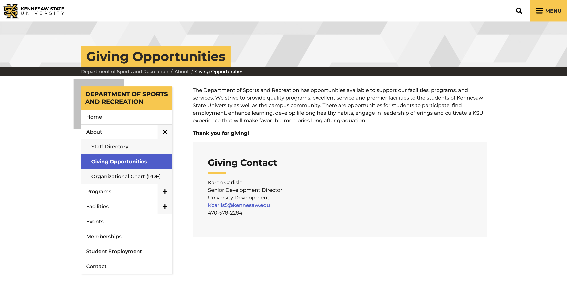

Slide 28
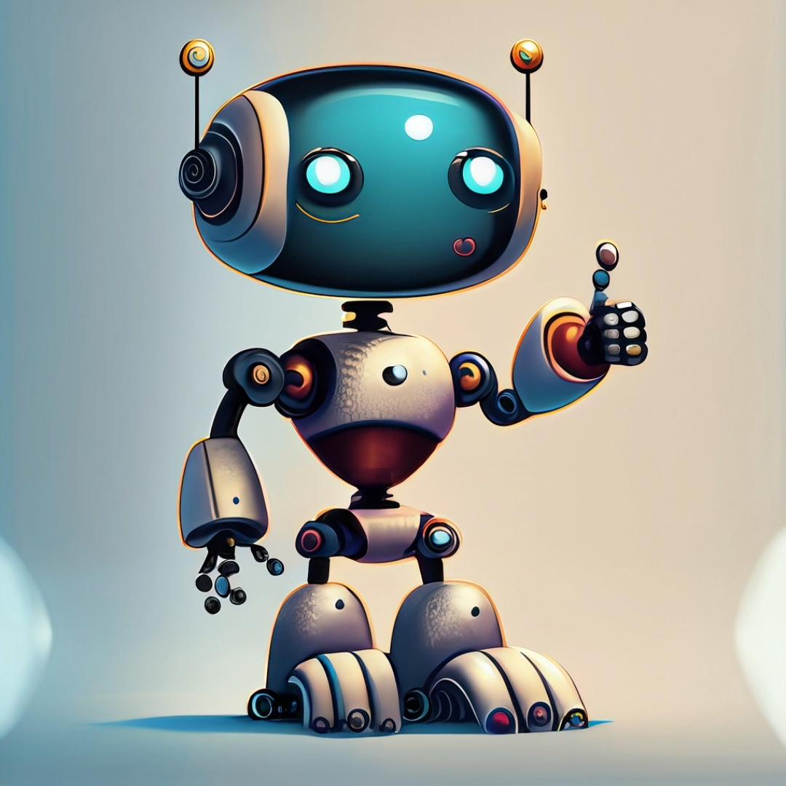
ChatGPT Takeaway #2:
ChatGPT is incredibly adept at taking incredible amounts of information from multiple sources and condensing it in a way that makes it concise and “more to the point.”

Slide 30
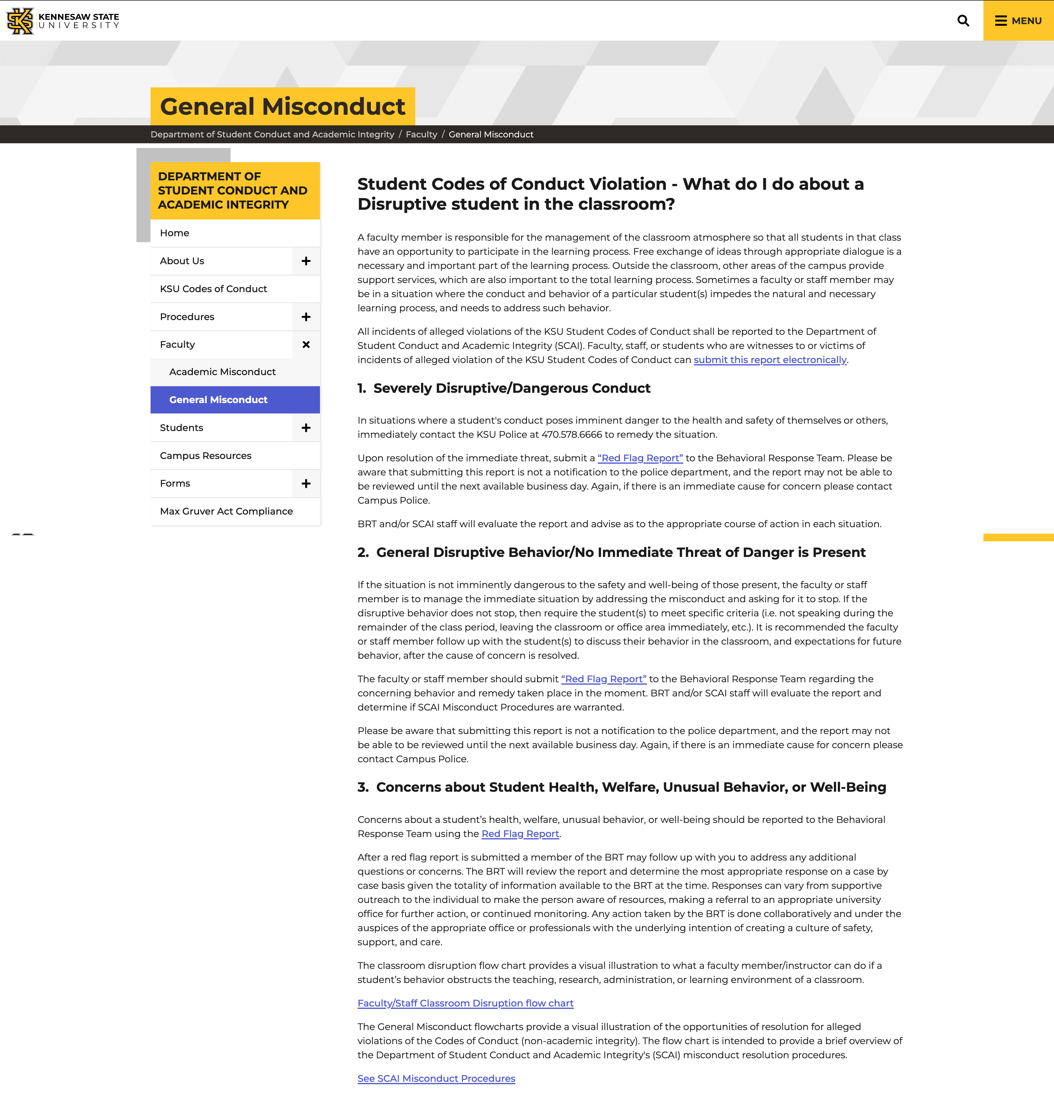

Slide 32
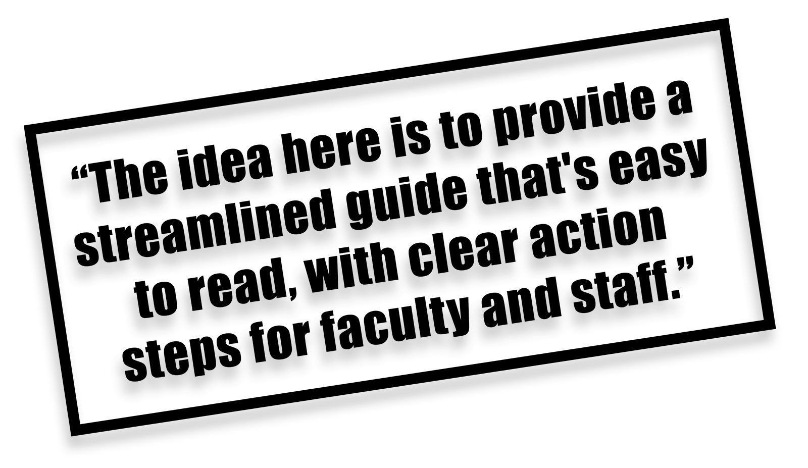

Slide 33
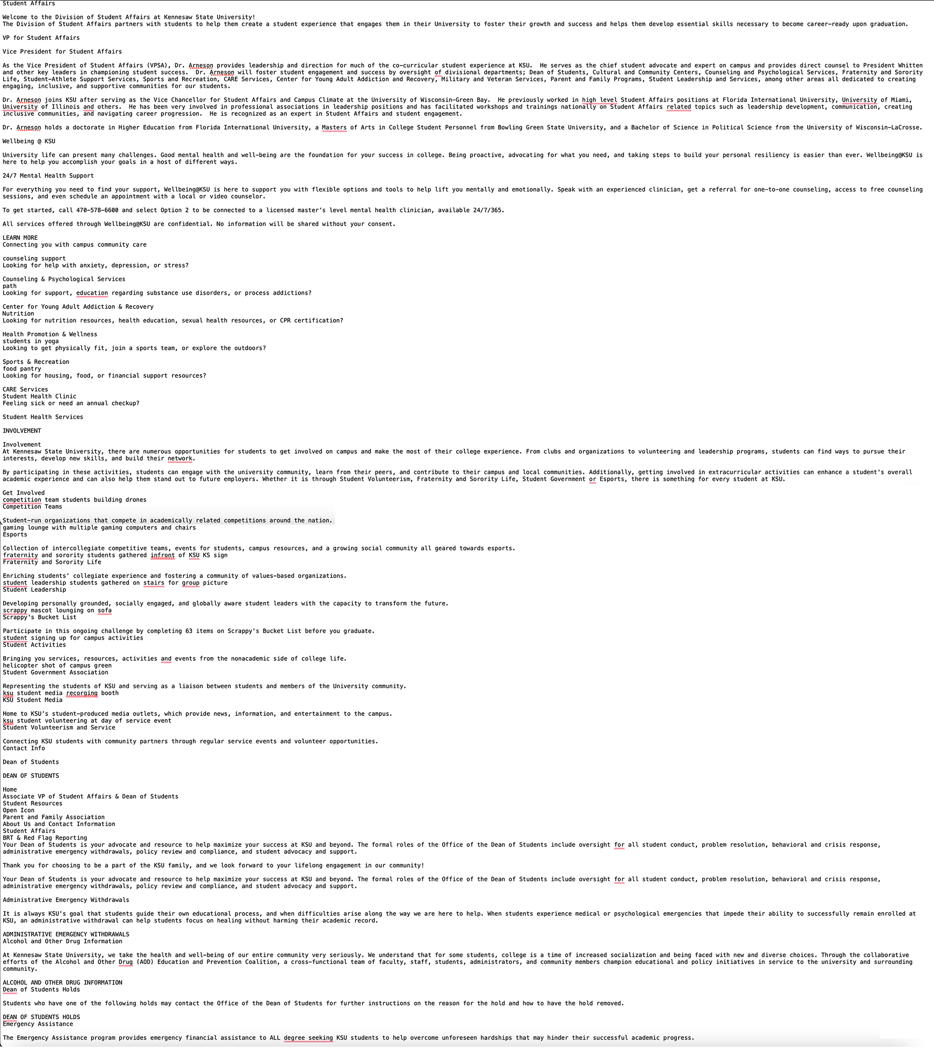
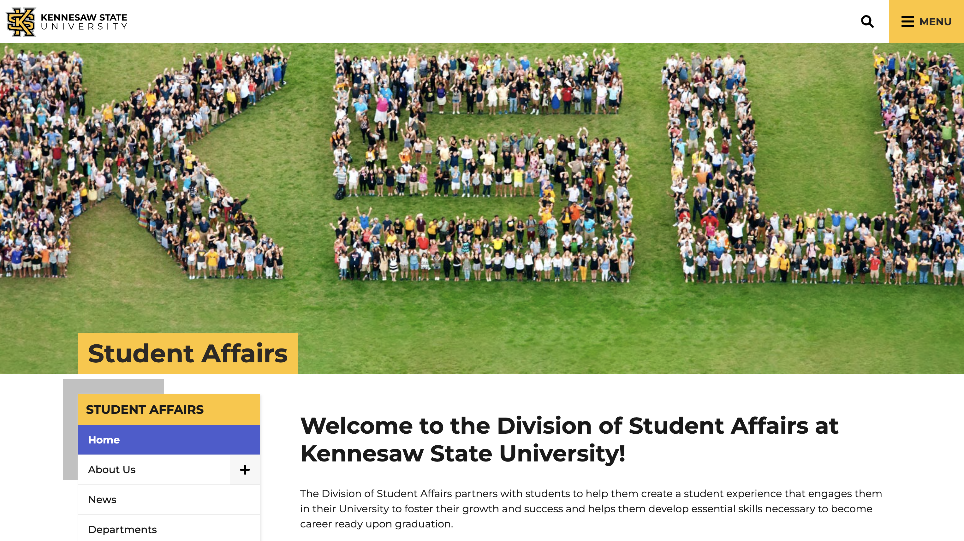
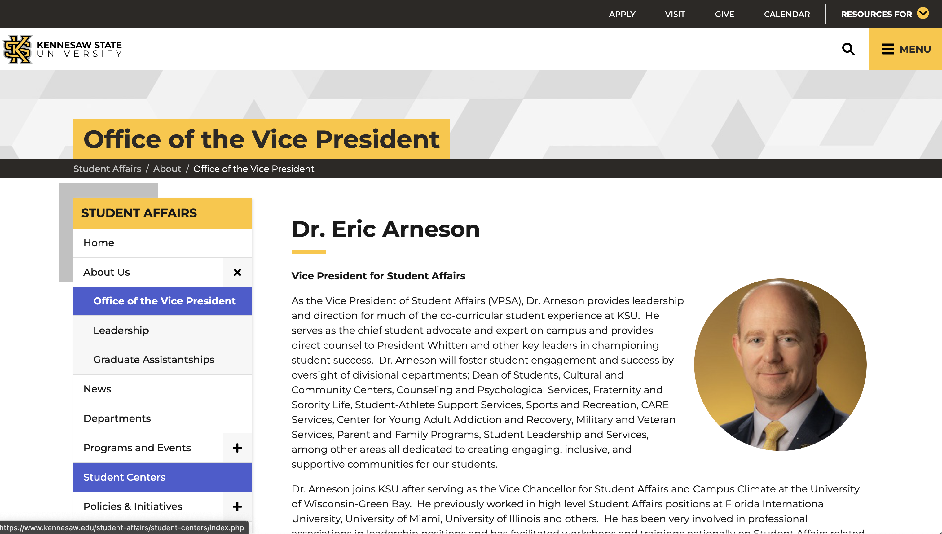
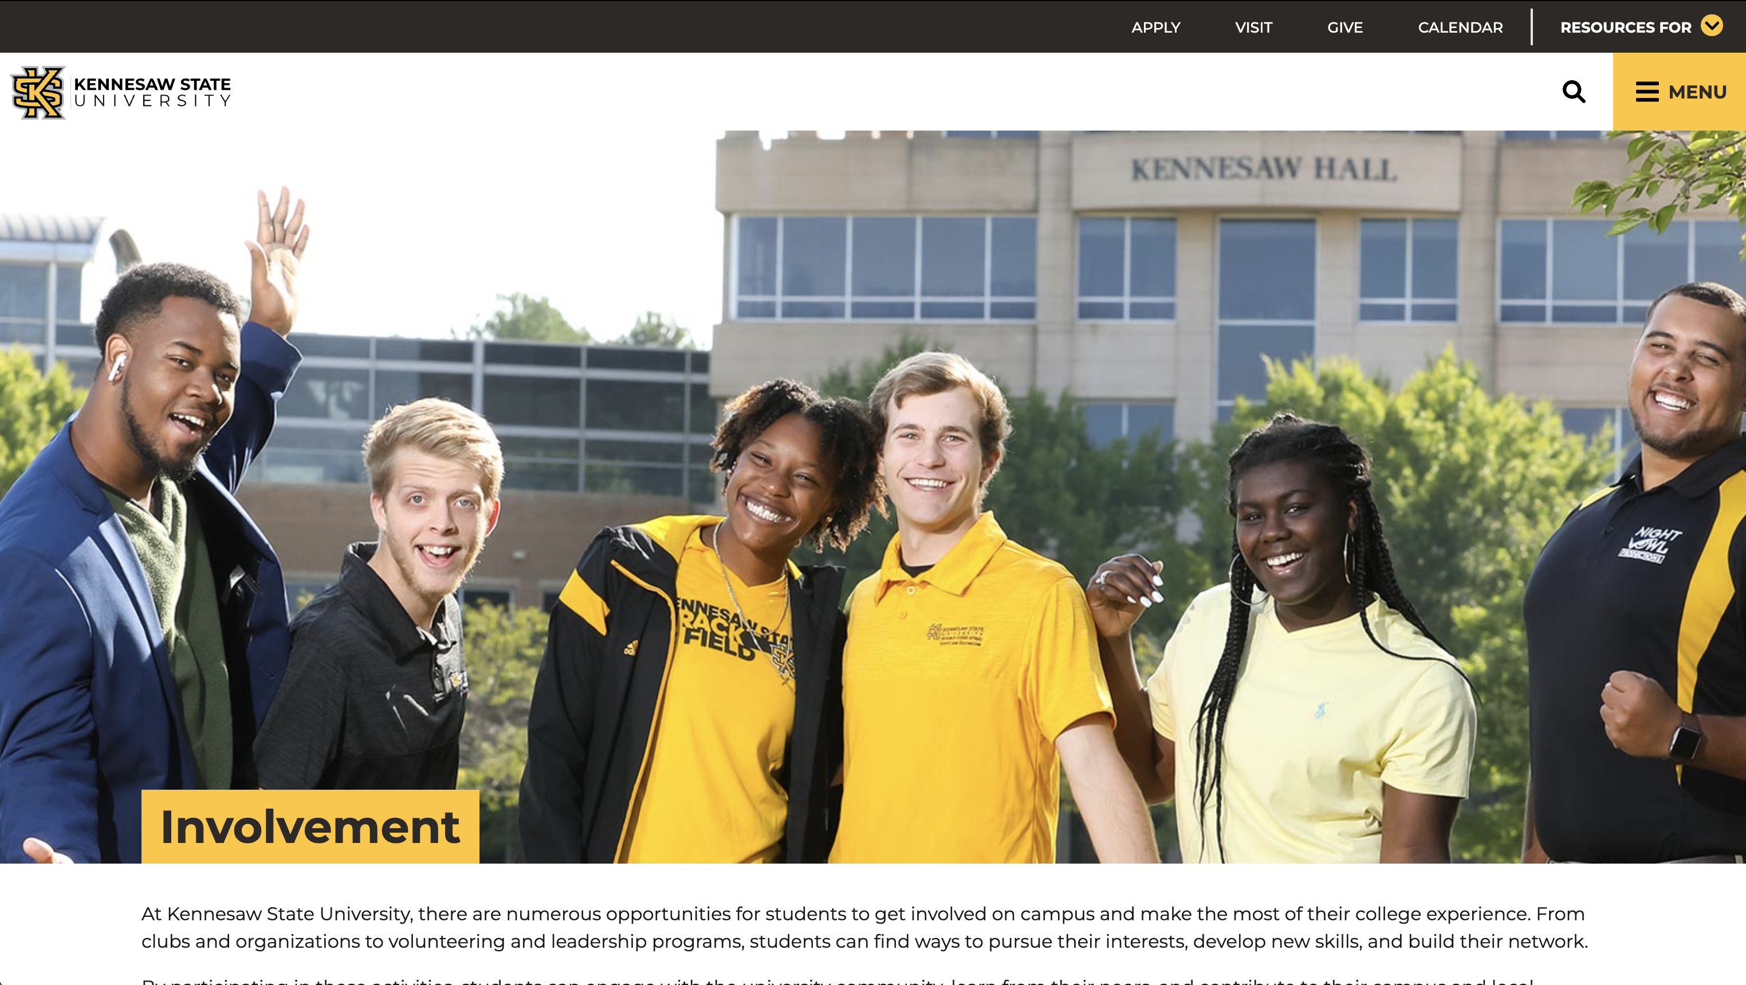

Slide 34
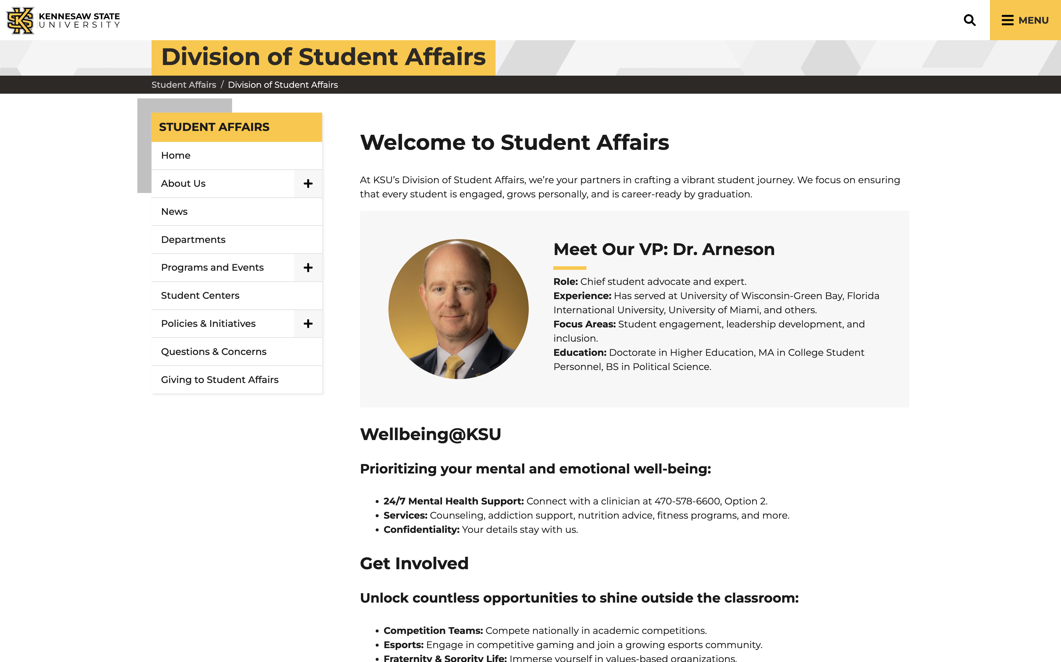

Slide 35
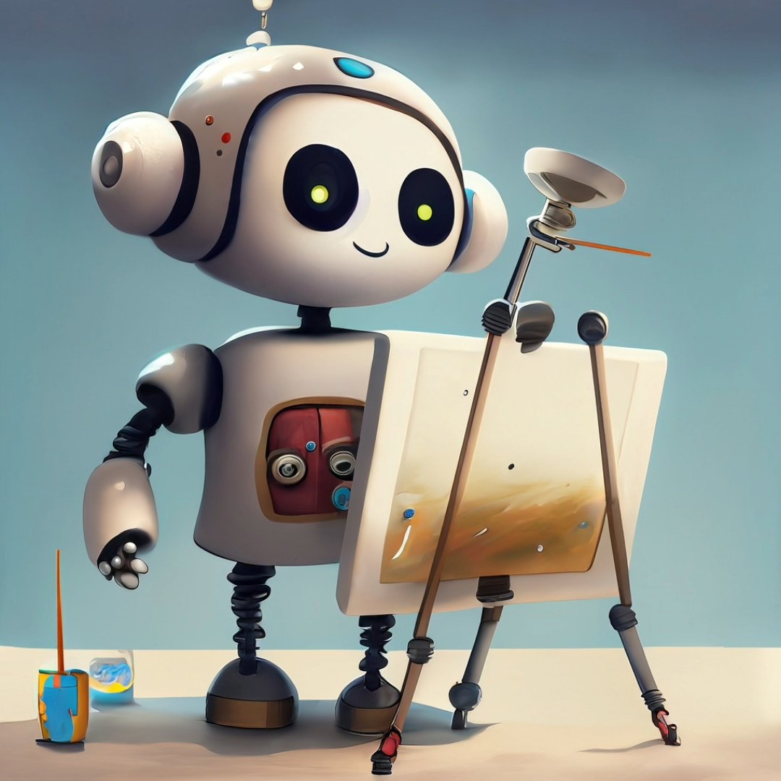
ChatGPT Takeaway #3:
It is easy to get lost in the discussion of AI mimic vs. invention.
The better (more creative) the prompt, the better the output!

Slide 36
“I need fantastical content for a website at Kennesaw State University. We are going to have a new academic program for our new campus on the moon. Tell me all about it - student life, academics, athletics. And remember it is for a webpage. The content needs to be structured for the web and speak to 18-22 year olds.”

Slide 37
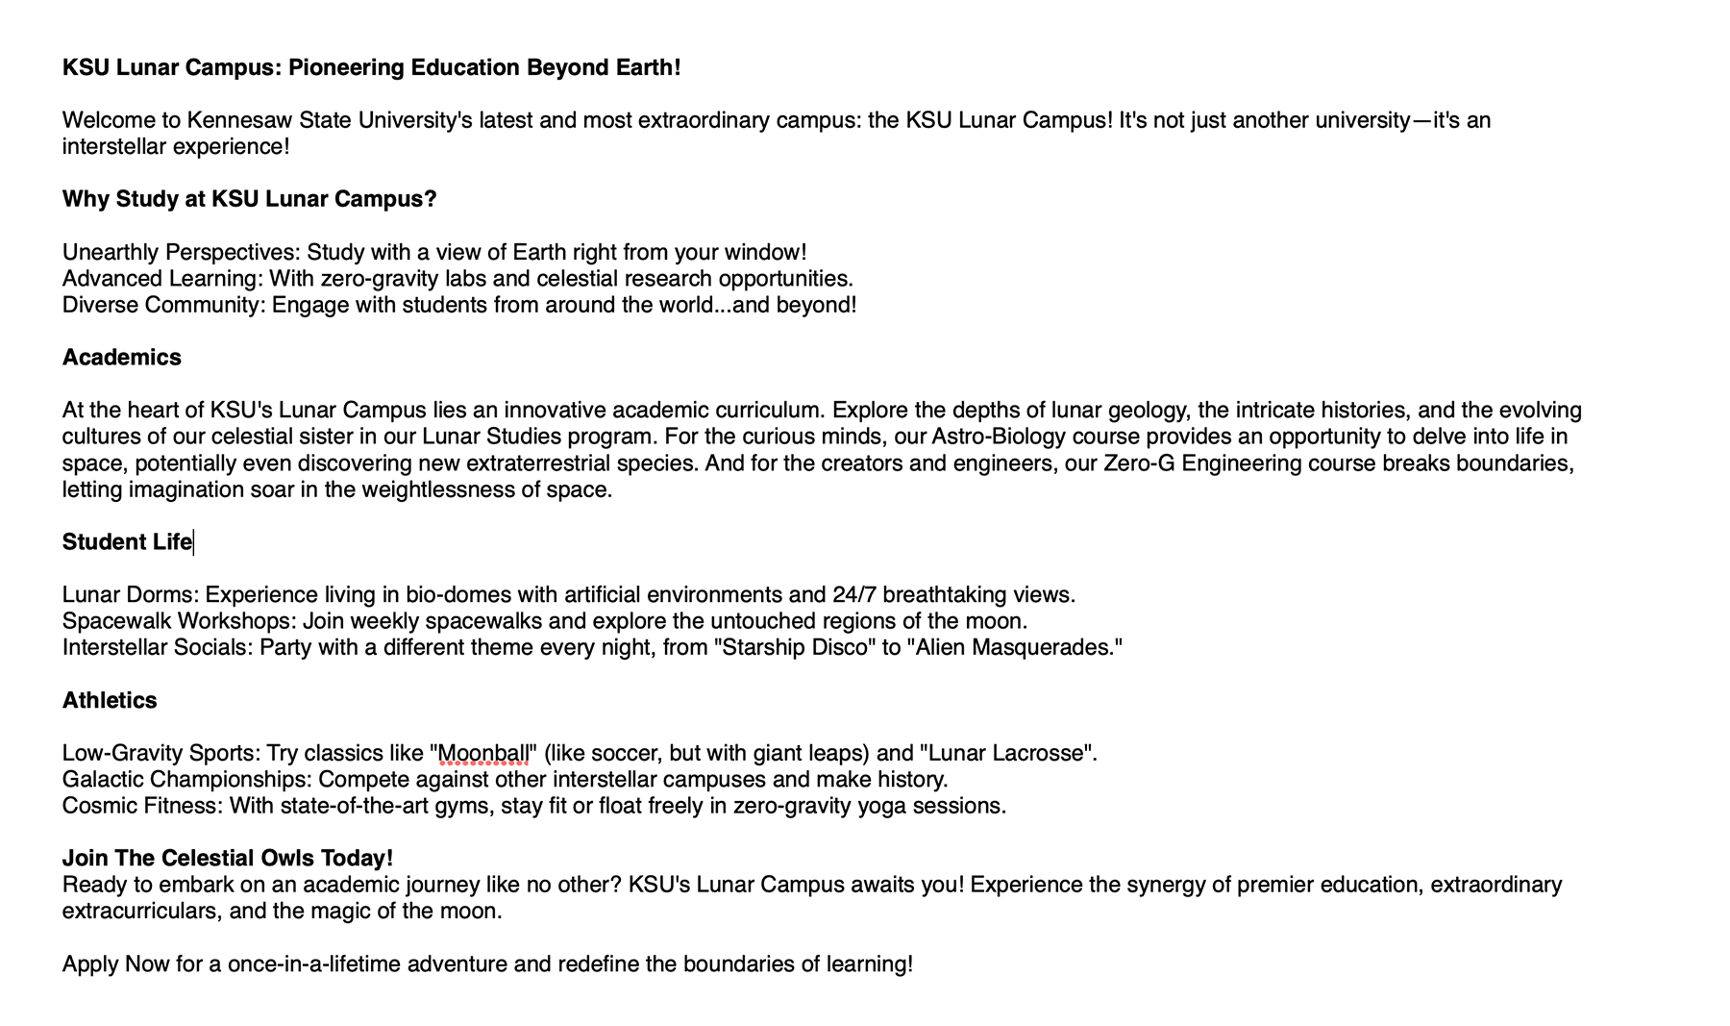

Slide 38
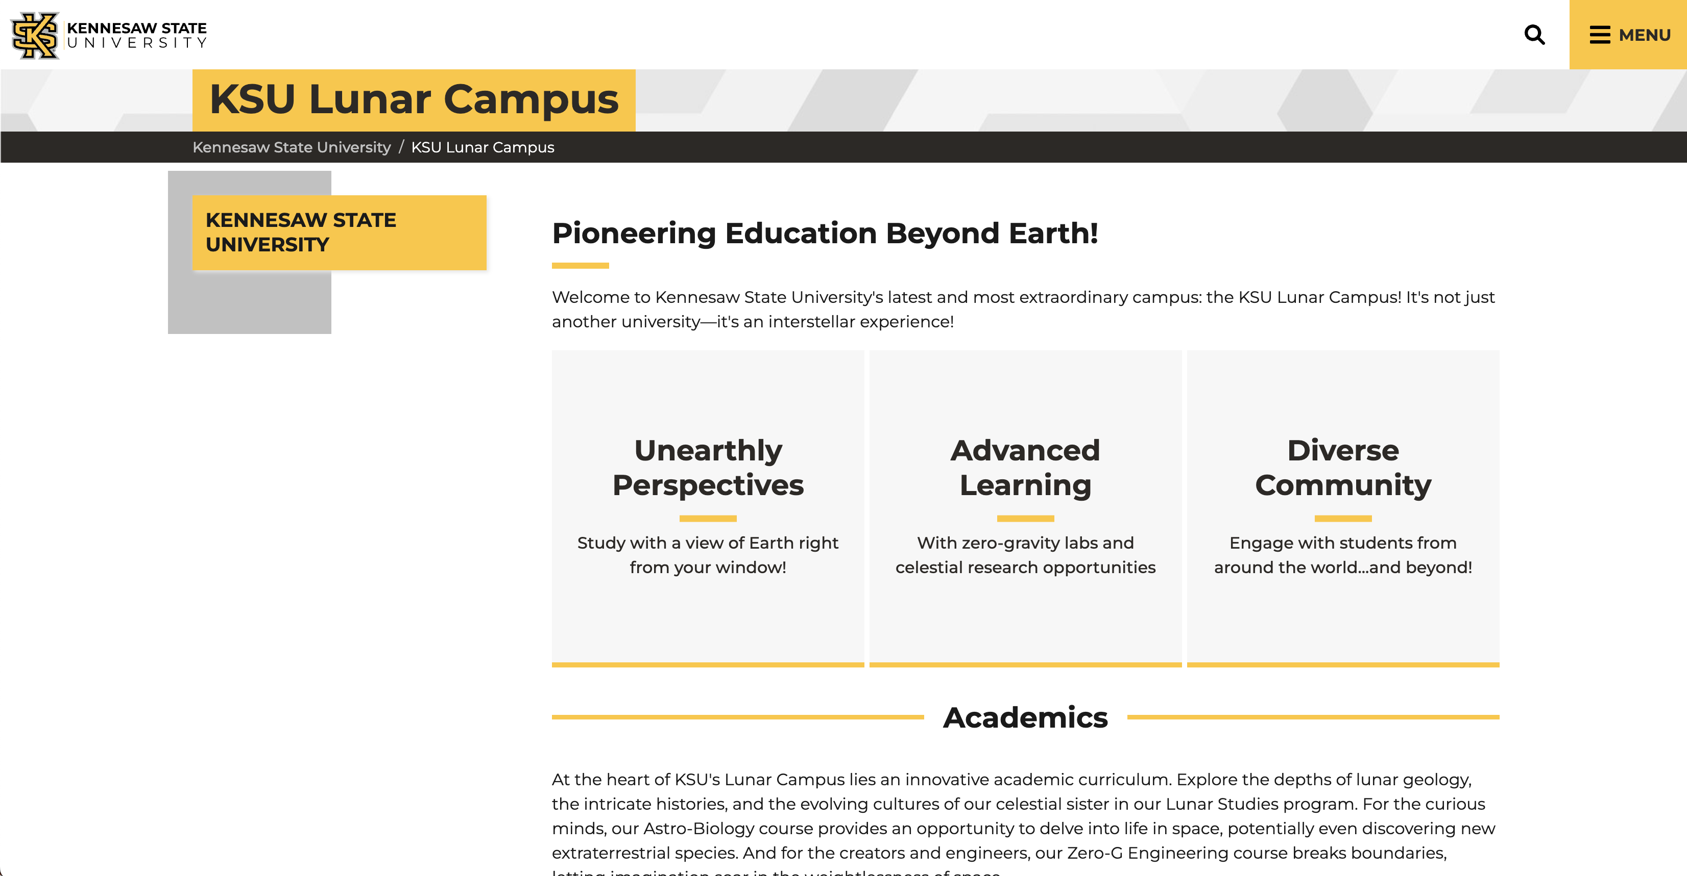

Slide 39
Now…let’s try something fantastical but something we can actually use on our website.

Slide 40
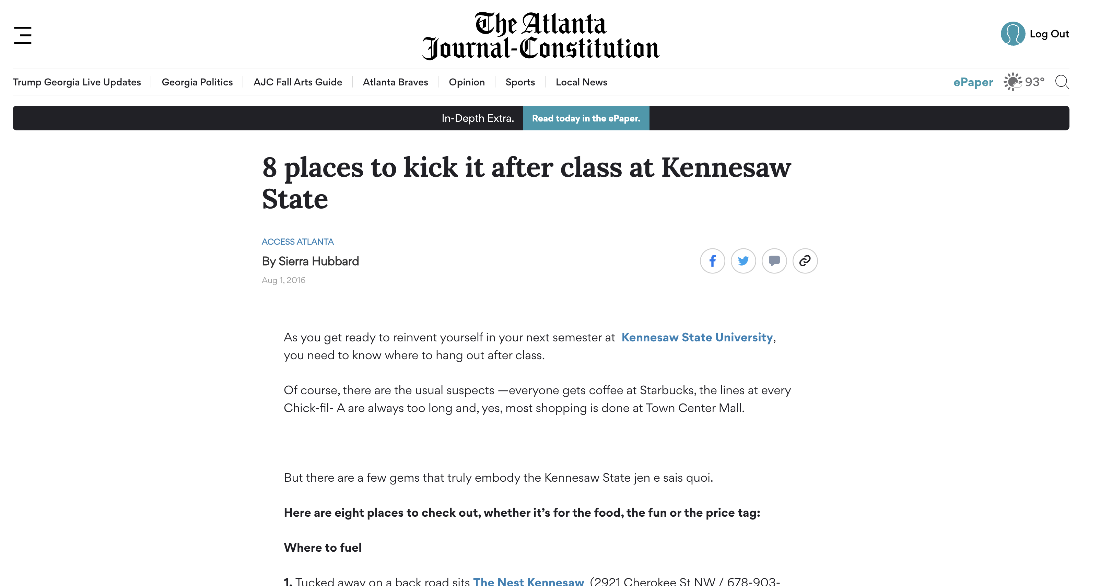
AI Text Generation
“We are going to generate a fun 3-4 paragraphs about a day in the life of Scrappy the Owl at Kennesaw State University.”

Slide 41
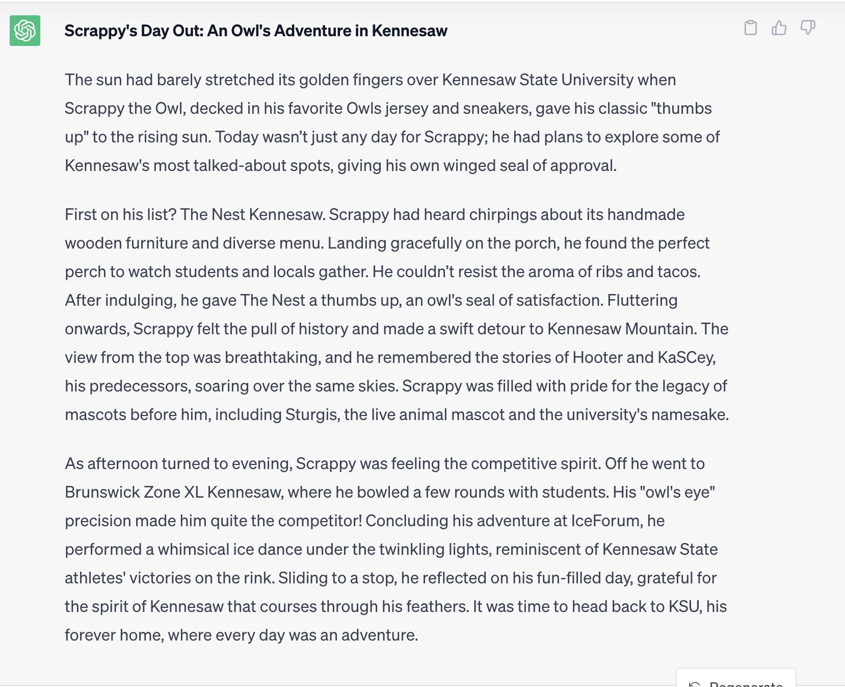
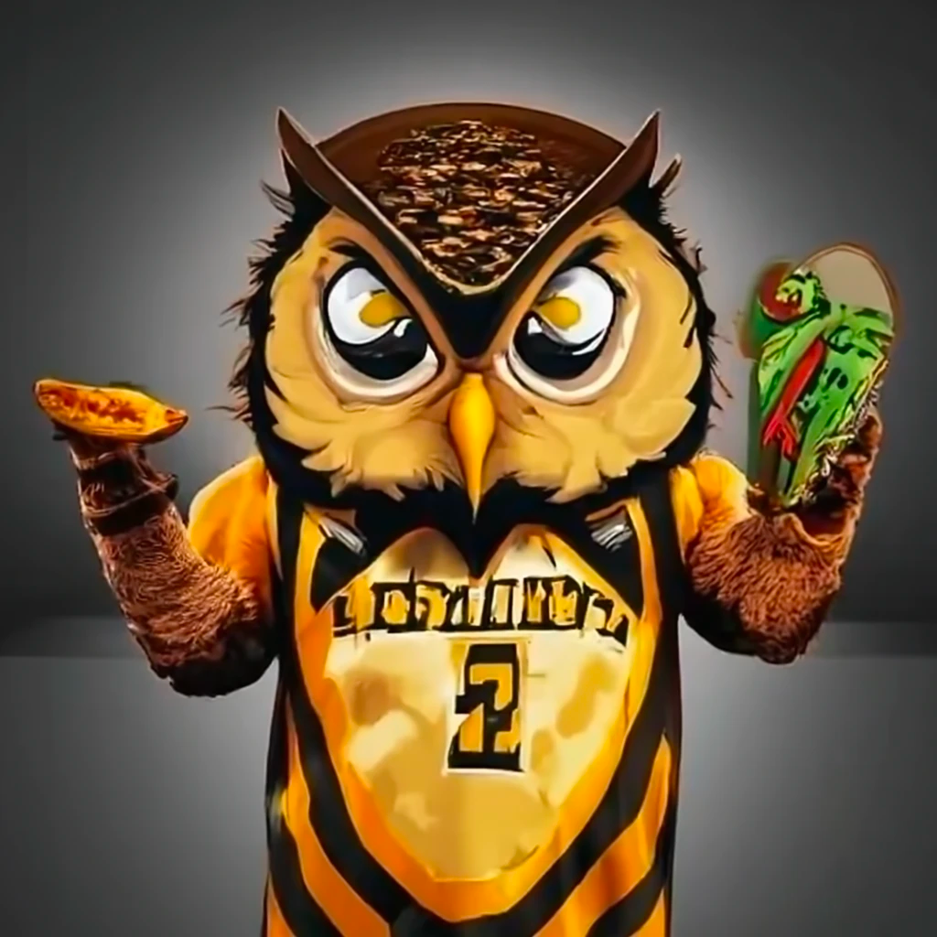

Slide 42
But...hold on a sec.

Slide 43
In this era of information insanity, how can we be sure that the AI content is factual and accurate?!?!

Slide 44
Definition & Role of AI: Artificial Intelligence enables machines to learn and decide through data, algorithms, and feedback, enhancing content accuracy.
Fact-checking & Misinformation Detection: AI verifies online information by analyzing data from multiple sources and can identify patterns of misinformation or bias in content.
Limitations & Responsibility: While AI offers transformative capabilities, human oversight is crucial to address potential inaccuracies and ensure responsible usage.

Slide 45
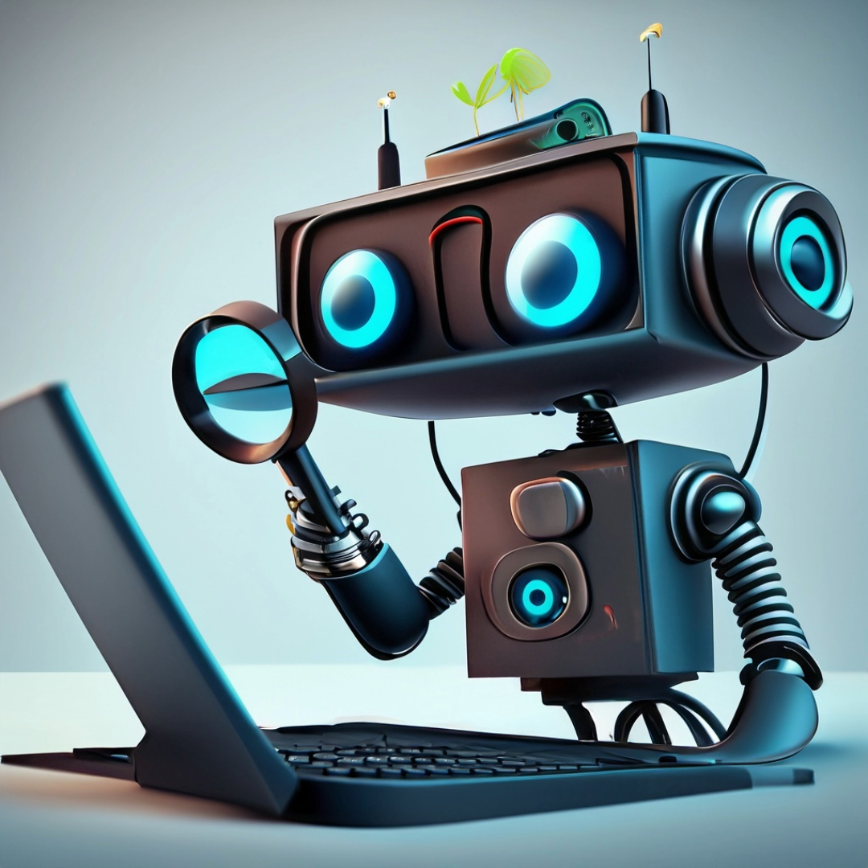
Let's take a look at Google's Generative AI and how it is generating content.
(And determine what it perceives as factual.)

Slide 46
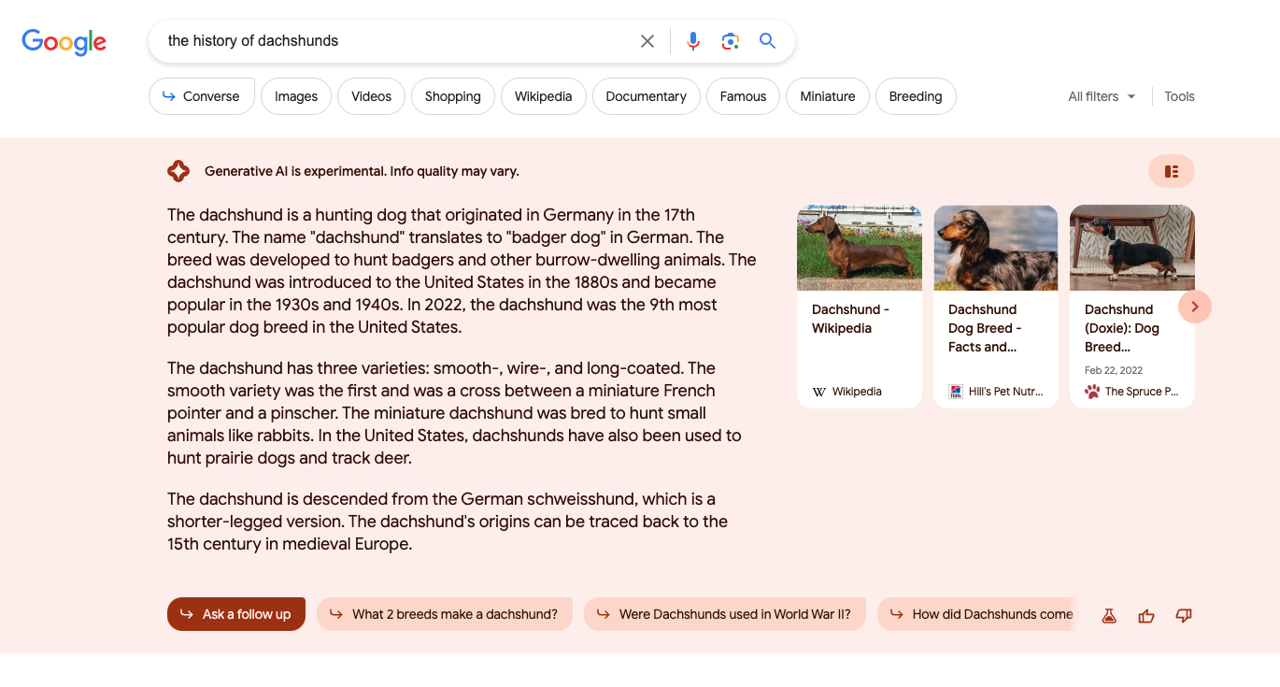

Slide 48
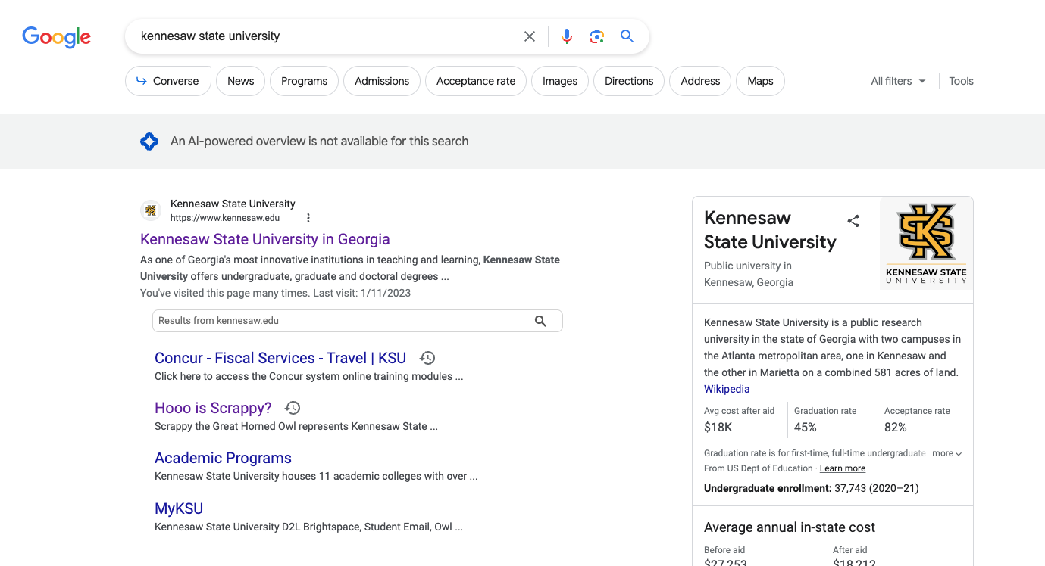

Slide 49
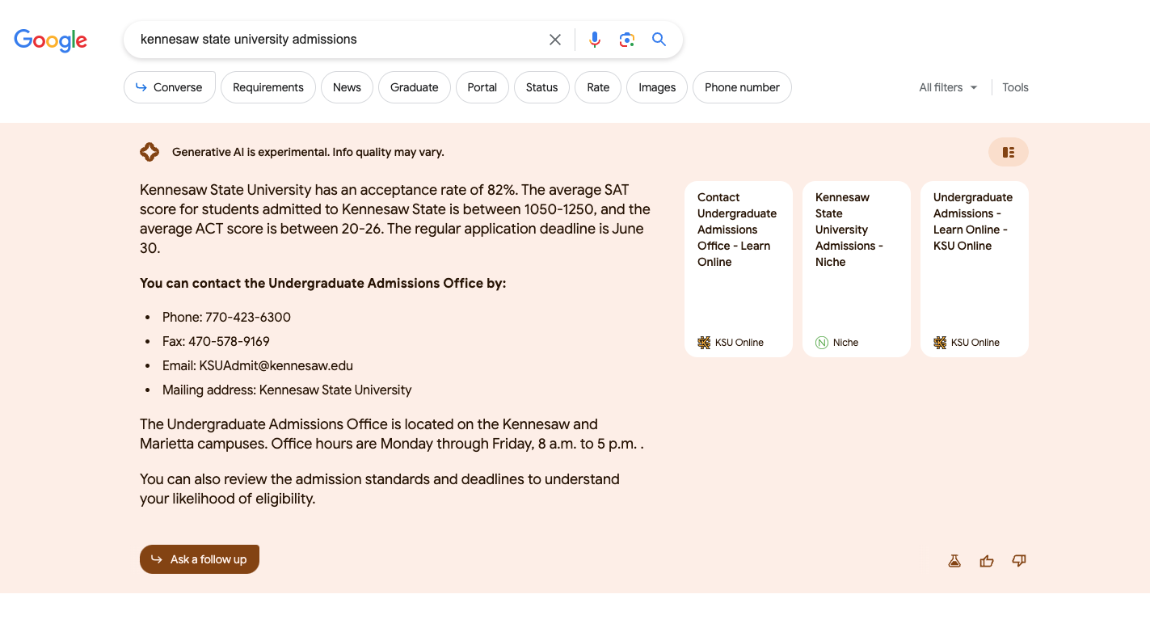

Slide 51
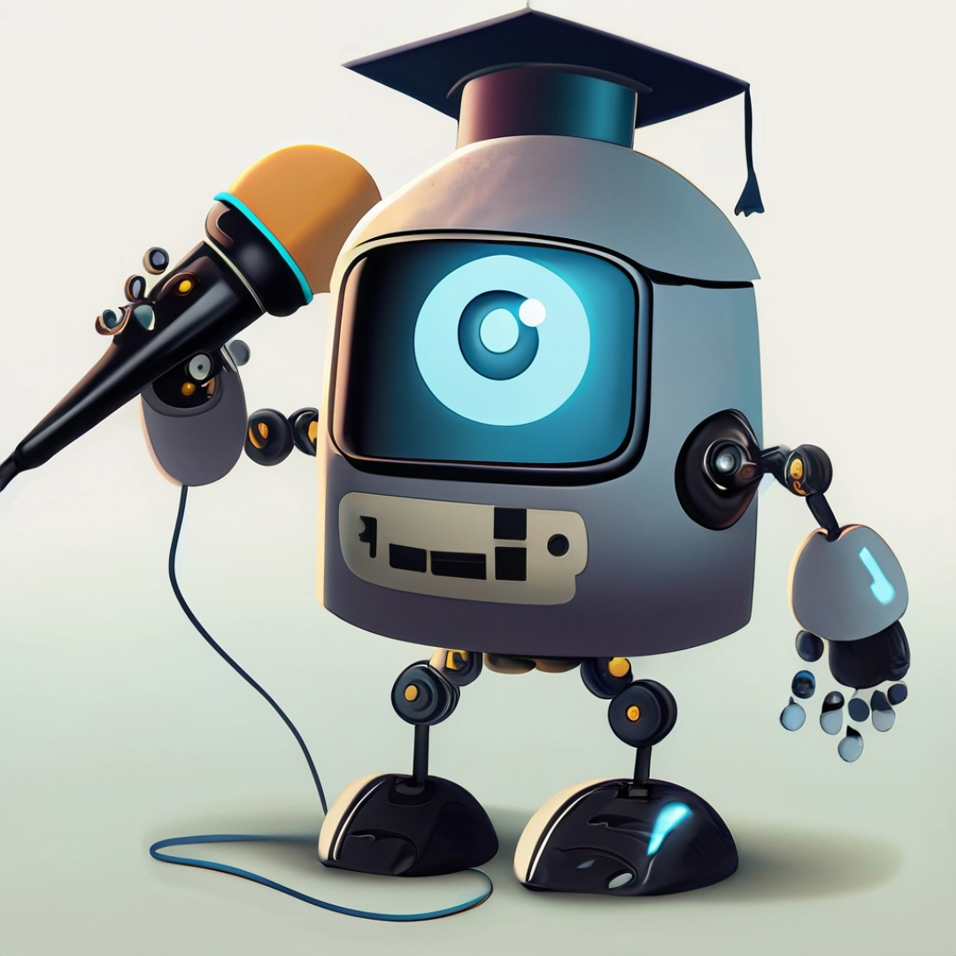
How can we take what is happening with Google's Generative AI (the future) and translate it to higher ed?

Slide 52
Google basically uses the Internet for its source of verifiable facts.
Where is a higher ed's source of verifiable facts if the future web is generated dynamically?

Slide 53
Generating AI webpages (content) for our institutions would require managing a centralized source of truth.

Slide 54
Have seen this methodology before when we implemented AI chat.
It was overwhelming because we were managing paragraphs not data and facts.

Slide 55
How we integrate AI is still a theoretical challenge.
But how will it also affect our CMSs and user experience?
(i.e. how we build and manage websites?)

Slide 56
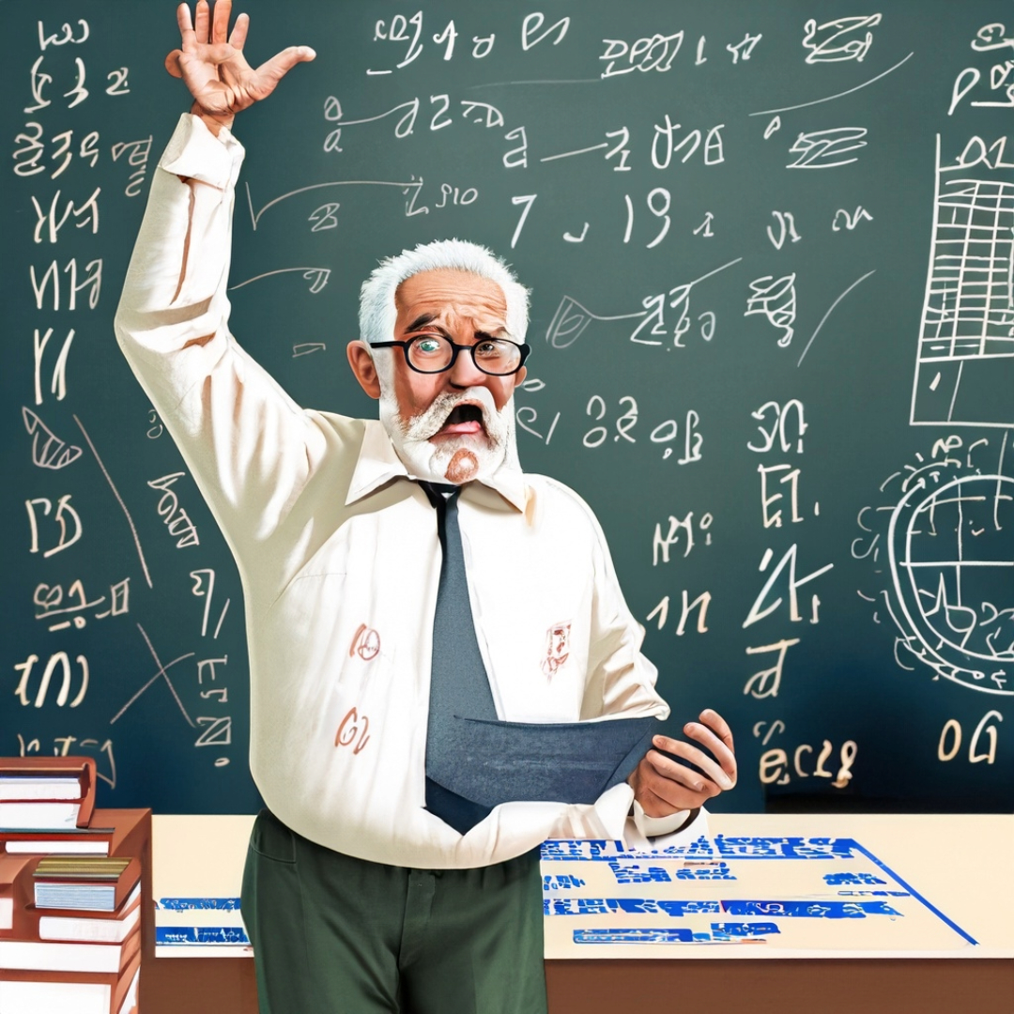
Buckle Up.
It is time for a Website Development History Lesson.

Slide 57
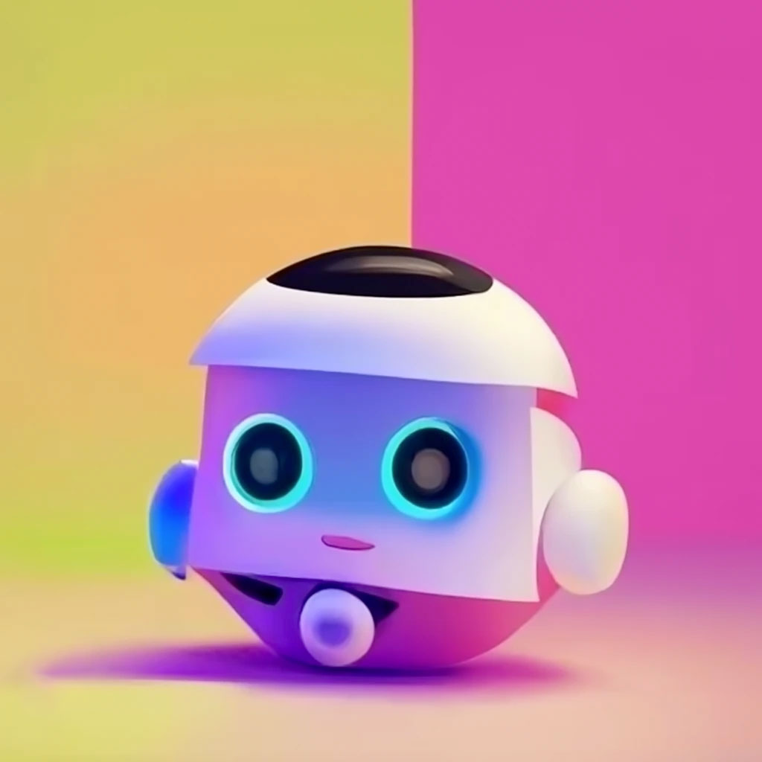
Website Development History – The 90s
Basic Design & Limited Interactivity
HTML-centric Development
Manual Site Management

Slide 58
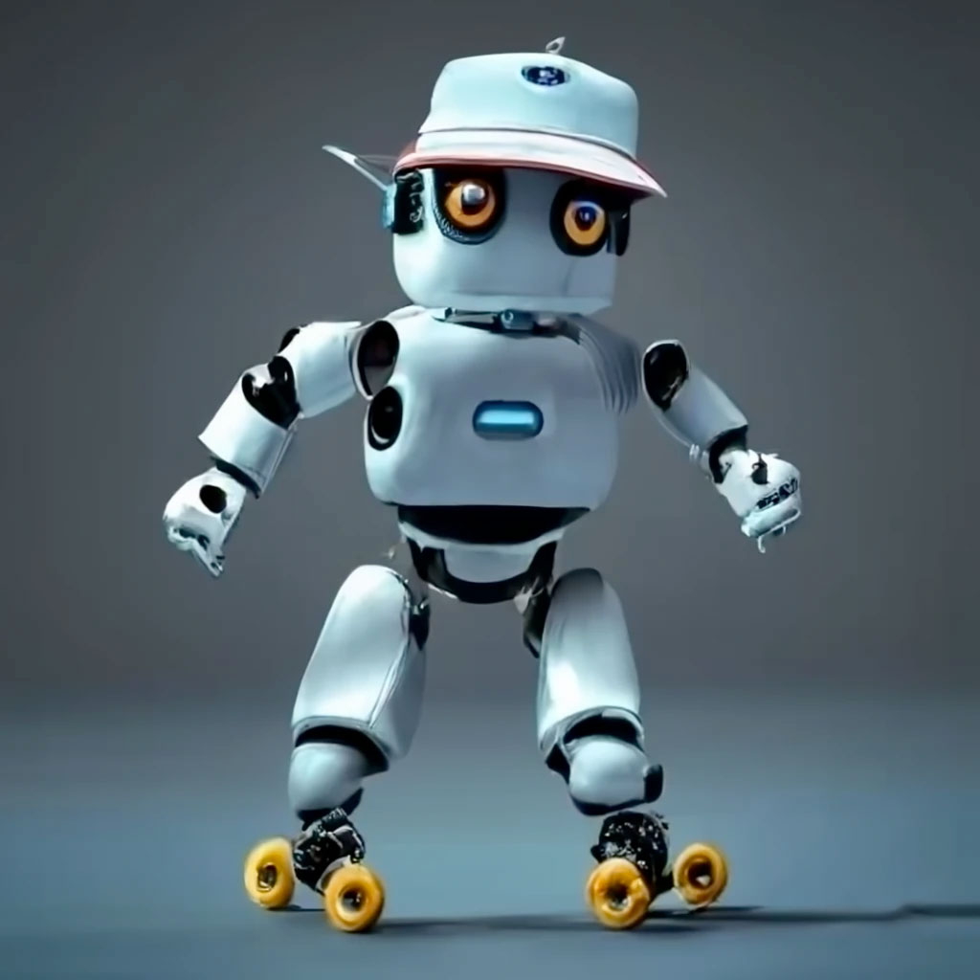
Website Development History – The 00s
Rise of Dynamic & Interactive Content
Emergence of CMS & Web Platforms
Focus on Design & User Experience (CSS)

Slide 59
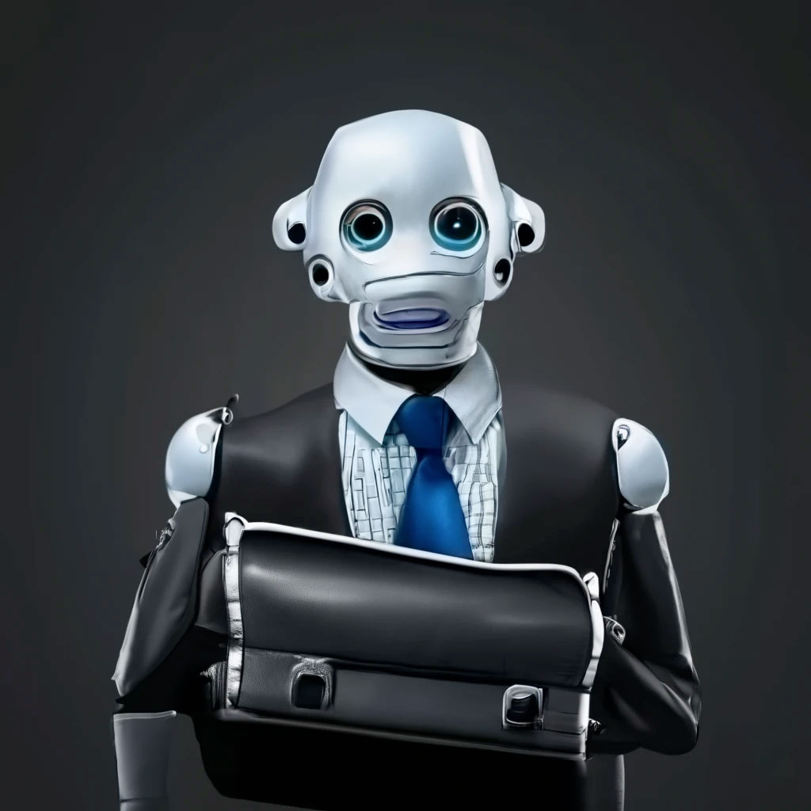
Website Development History – The 10s
Mobile-First & Responsive Design
Single Page Applications & Modern Frameworks
API-Driven & Modular Development

Slide 60
These changes over the last twenty-five years have dramatically affected how we build and maintain our university sites and domains

Slide 61
How This Usually Shakes Out
(Based on the collective 45 years of experience)
Great Idea
The Rest of Higher Ed
Notre Dame
The Real World
Web Hosting

Slide 63
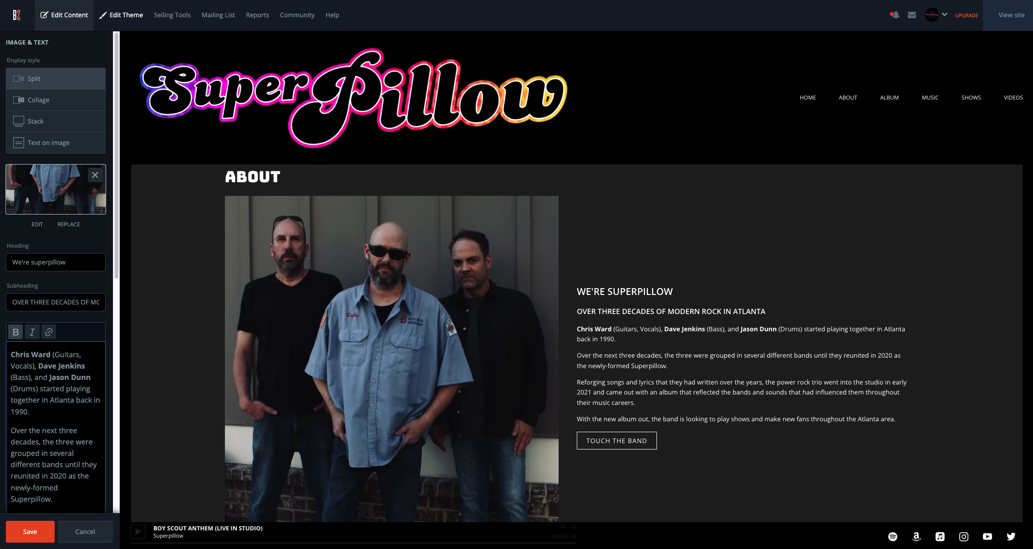

Slide 64
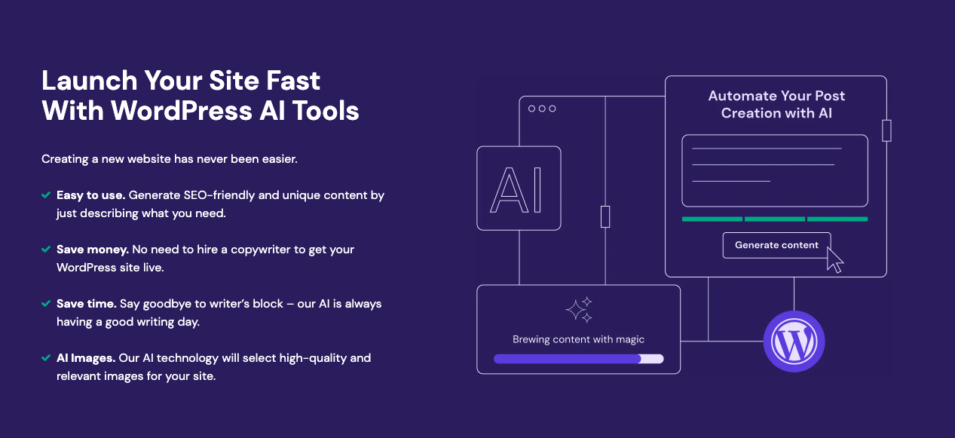
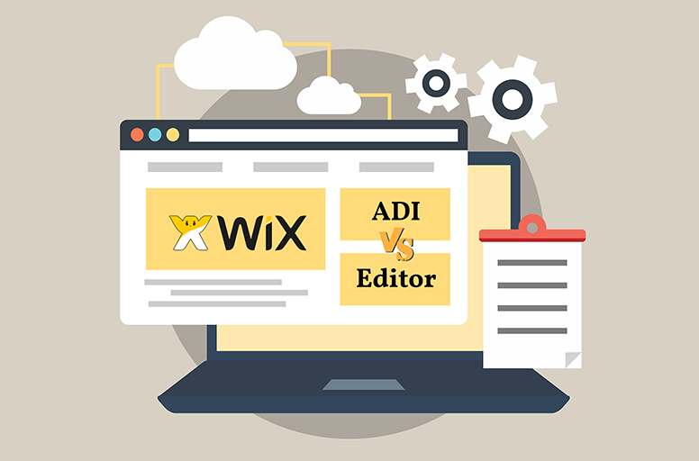
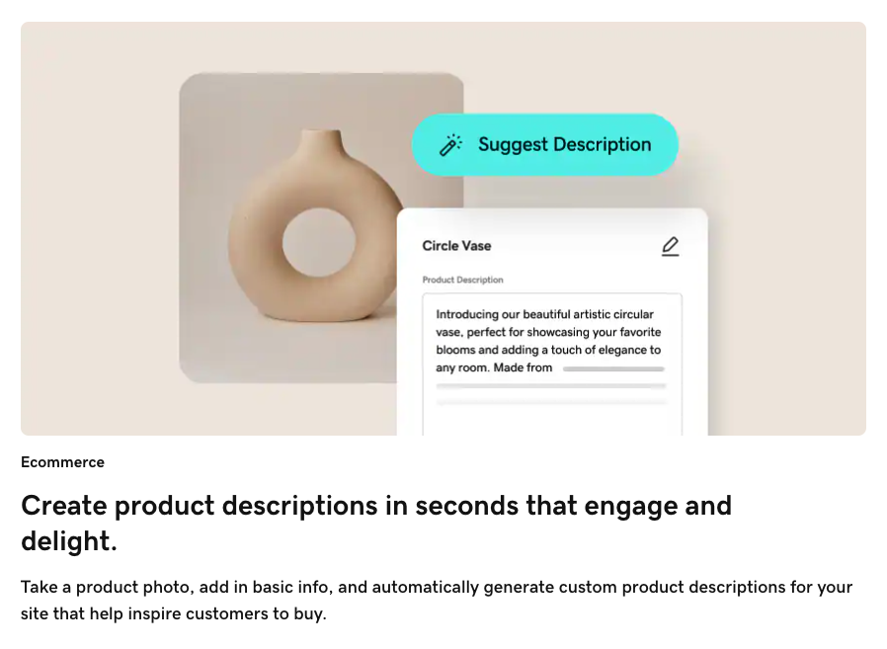
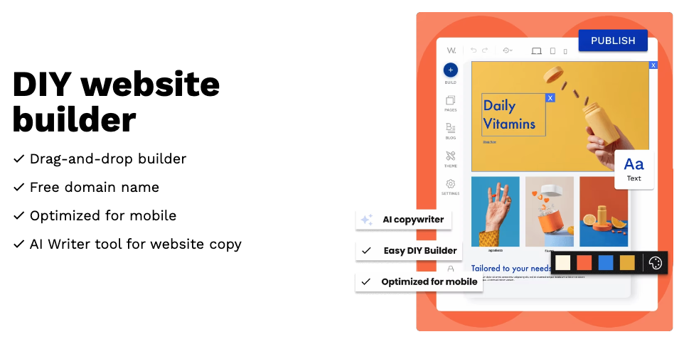

Slide 65
What happens when GoDaddy (or Squarespace, or Web.com) adds the prompt and submit button to generate an entire website in a matter of seconds?

Slide 66
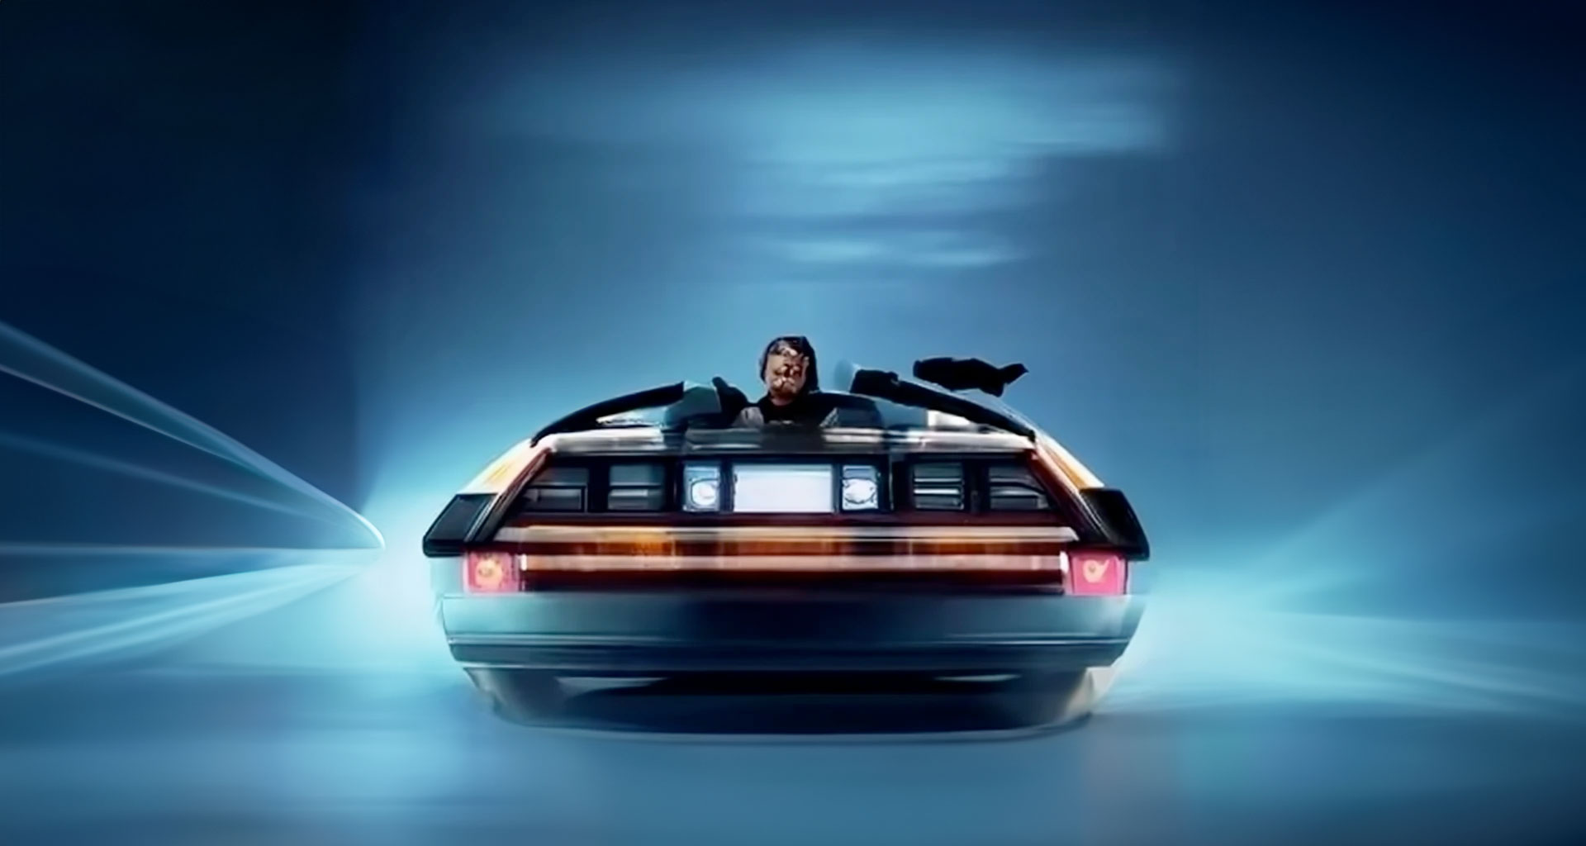
Marty...
it's time to head to the future.

Slide 67
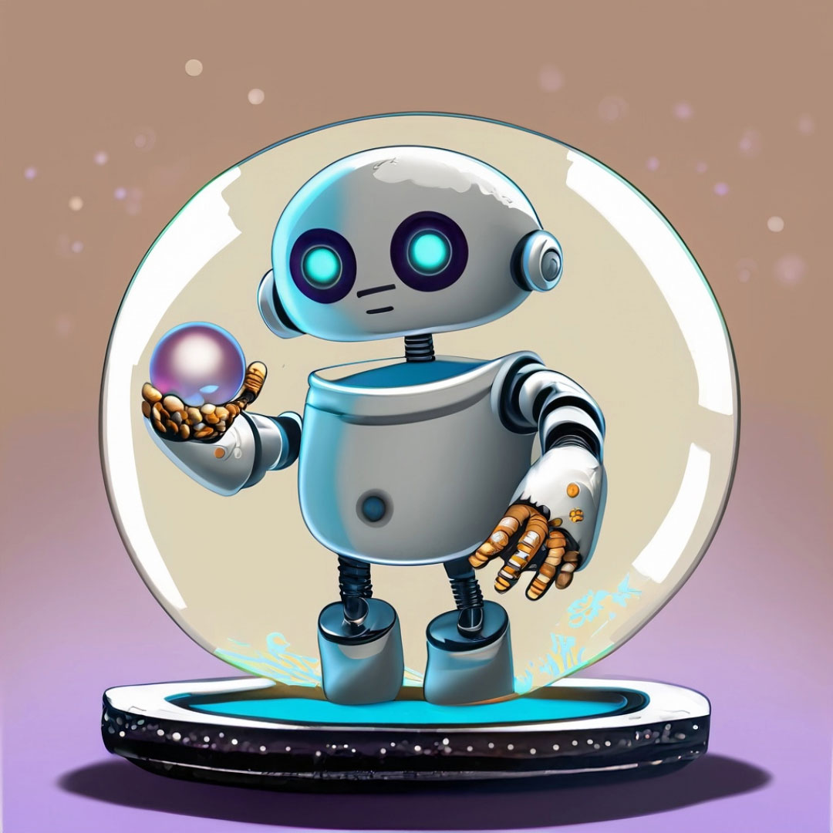
Future Implications and Questions
Shift in skill requirements in content creation positions
Quality assurance adheres to standards, accuracy, and removing biases
Evolving roles of web designers and SEO
How ALL of this interacts with Google (and if they still want to drive traffic to sites)

Slide 68
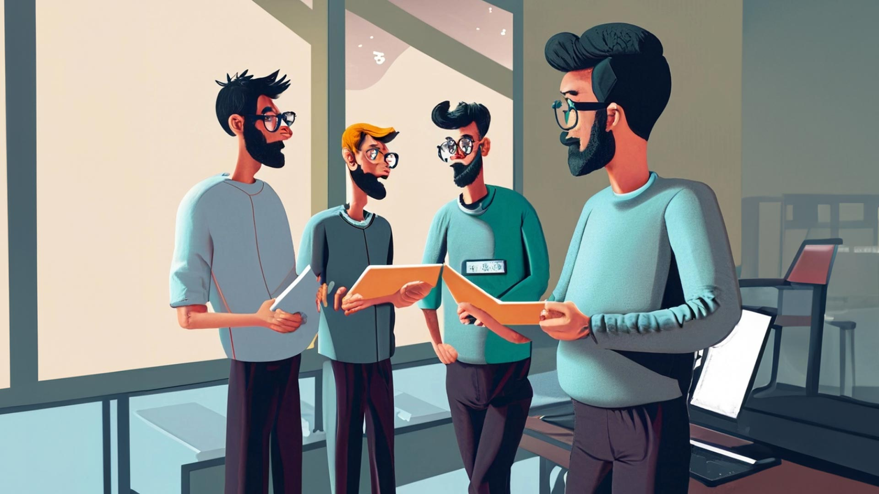
Further Discussion and Questions

