Slide 1
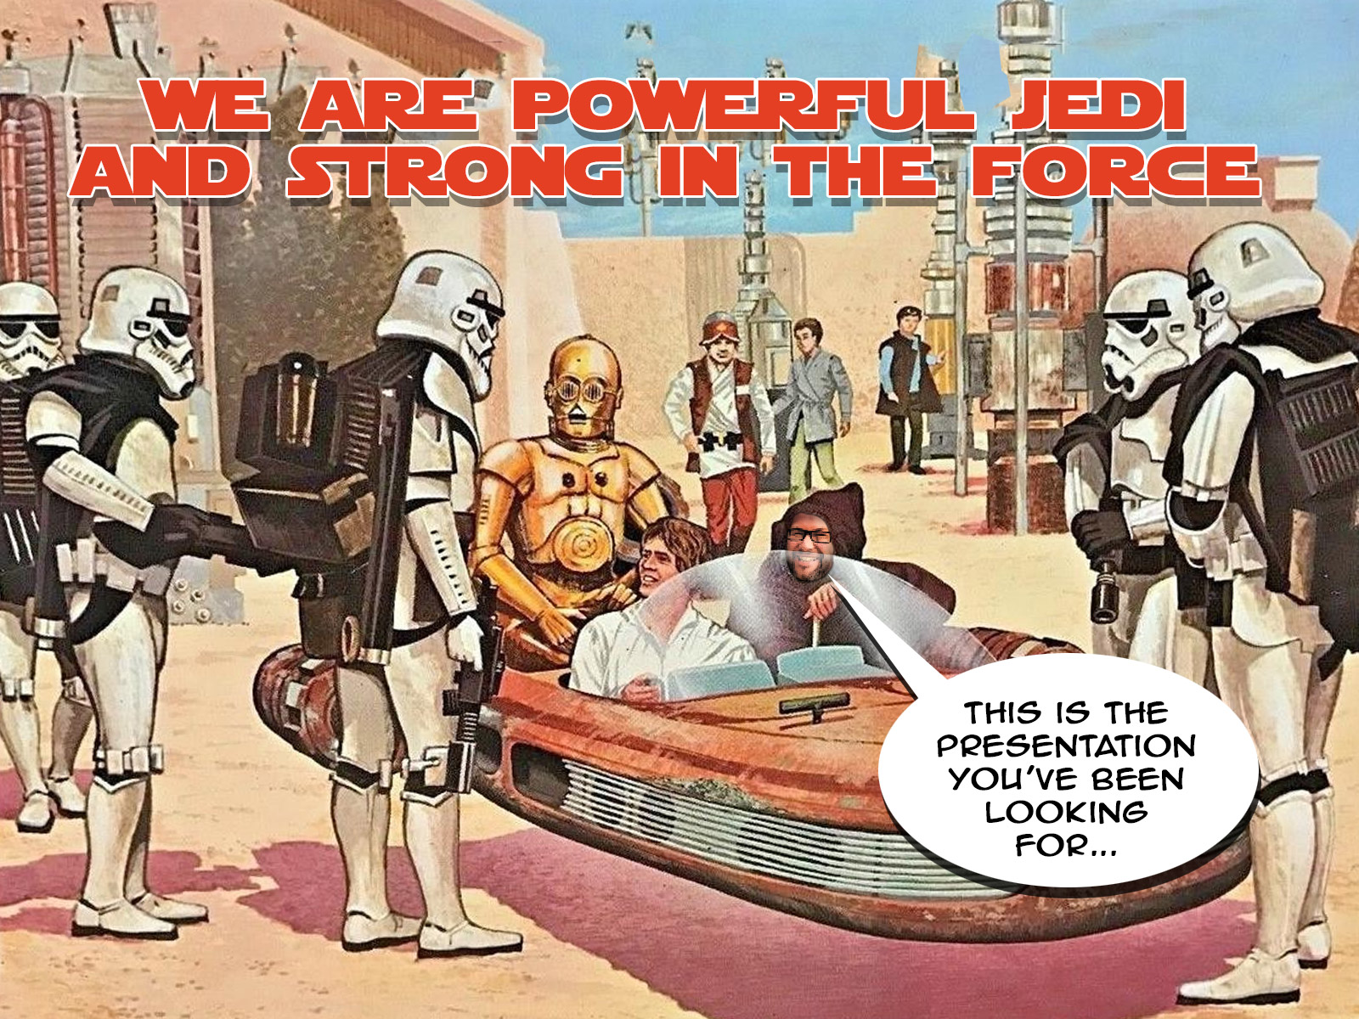
Christopher Ward Kennesaw State University Director of Web Services and Mobile Development

Slide 2
A Little Bit About Us…

Slide 3
A Little Bit About Me…

Slide 5
As Web/IT Professionals, We Are Unique and Unlike Others In Our Galaxy

Slide 6
Like the Jedi are the guardians of peace and justice in the galaxy…we are the guardians of sanity security, and stability in our systems.

Slide 7
It’s Time to Expand Our Minds…
And Start Our Jedi Training

Slide 8
The THREE TENETS of the Jedi
Wisdom
Focus
Knowledge
https://www.templeofthejediorder.org/doctrine-of-the-order

Slide 9
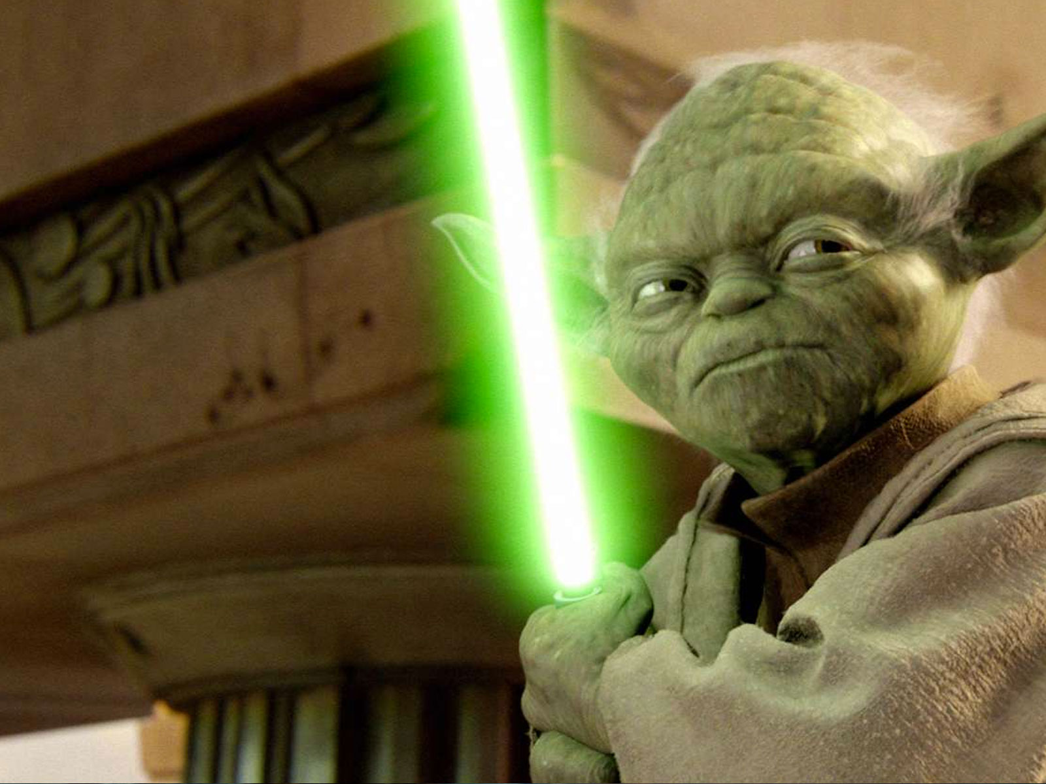
WISDOM
The sound application of accrued knowledge and experience through patient, good judgement

Slide 10
THE POWER TO SAY “NO”
WISDOM - The sound application of accrued knowledge and experience through patient, good judgement

Slide 11
FOCUS
The art of pruning the irrelevant and pouring your best into what you are doing

Slide 12
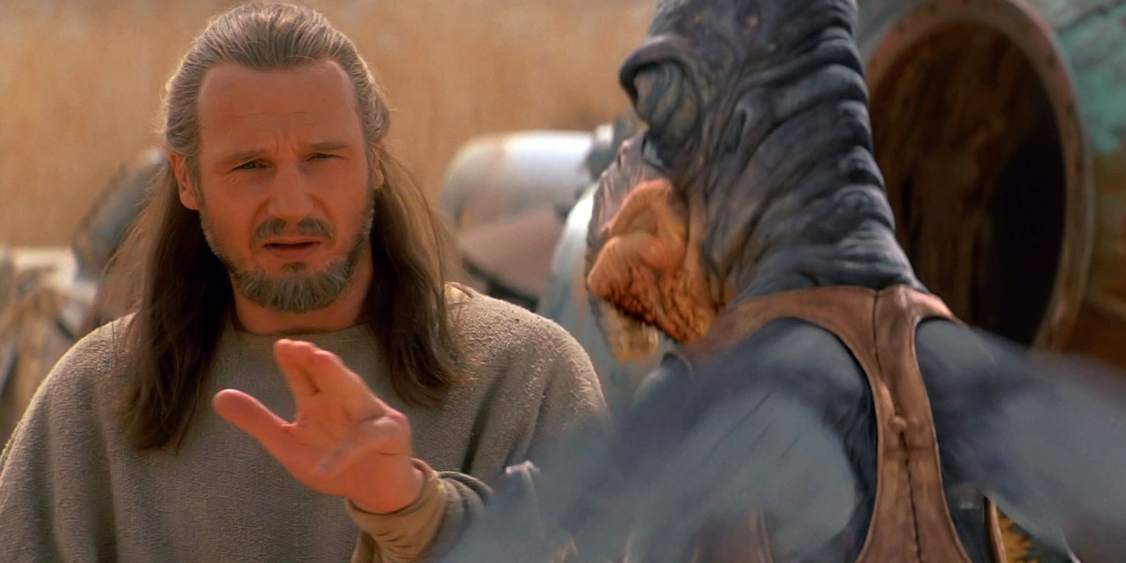
THE JEDI MIND TRICK
FOCUS - The art of pruning the irrelevant and pouring your best into what you are doing

Slide 13
KNOWLEDGE
The act of acquiring skills and information by focusing on the task at hand

Slide 14
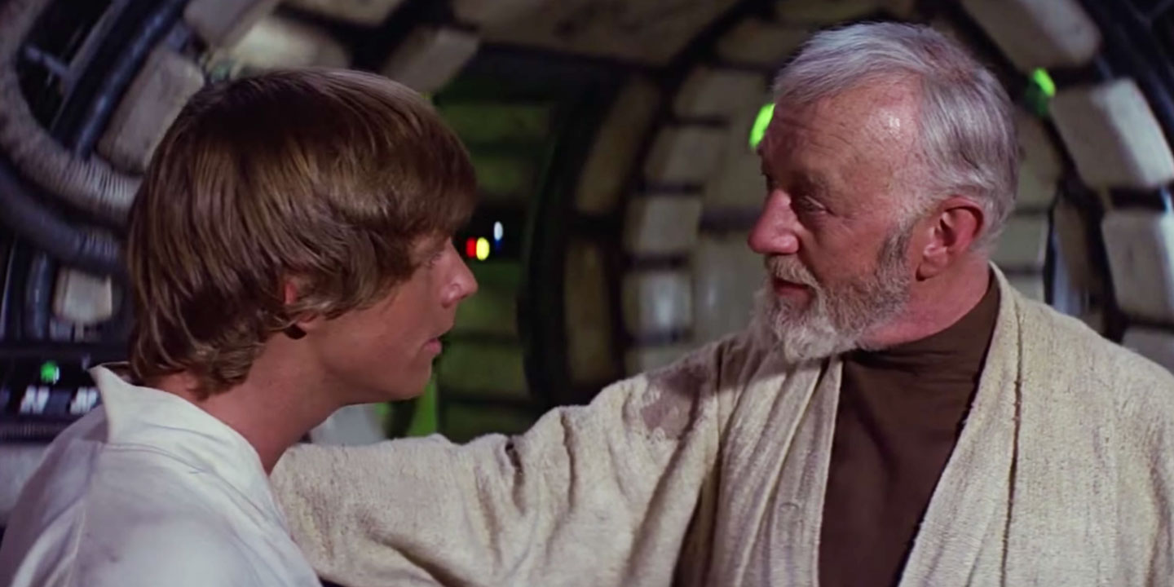
WE ARE TEACHERS
KNOWLEDGE - The act of acquiring skills and information
by focusing on the task at hand
Notes:
FOC

Slide 15
Let’s do a couple of examples.

Slide 16
EXAMPLE #1
This is Cindy. She works in the Office of Student Success. Her director has tasked her with building an online registration form. One of the items she wants is to ask for is the student’s SSN. And she wants to highlight the importance of this field with red text.

Slide 17
The THREE TENETS of the Jedi
Wisdom – The Power to say “No”
Focus – The Jedi Mind Trick
Knowledge – We Are Teachers

Slide 18
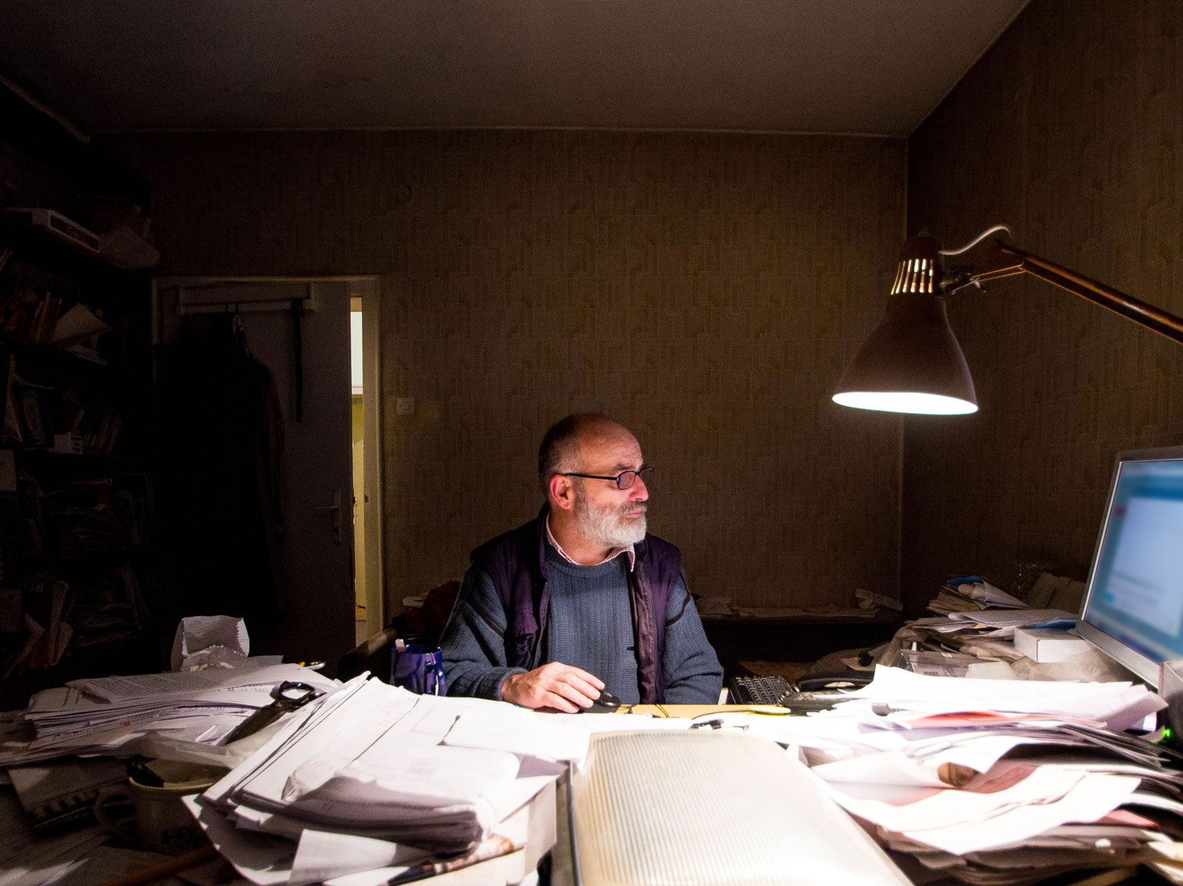
EXAMPLE #2
This is Professor White. He is a faculty member who has been “building my own webpages in notepad for almost 20 years.” He is requesting source code access to the CMS so that he can have better control over his webpages. He also LOVES tables!

Slide 19
The THREE TENETS of the Jedi
Wisdom – The Power to say “No”
Focus – The Jedi Mind Trick
Knowledge – We Are Teachers

Slide 20
We ONLY way to be an effective Jedi…is to relentlessly build TRUST

Slide 21
The TEACHINGS of the Jedi
https://www.templeofthejediorder.org/doctrine-of-the-order

Slide 22
The Jedi serve others through the ways they perform
(Excellence)
https://www.templeofthejediorder.org/doctrine-of-the-order

Slide 23
The Jedi use their skills to the best of their abilities
https://www.templeofthejediorder.org/doctrine-of-the-order
(Play To Our Strengths)

Slide 24
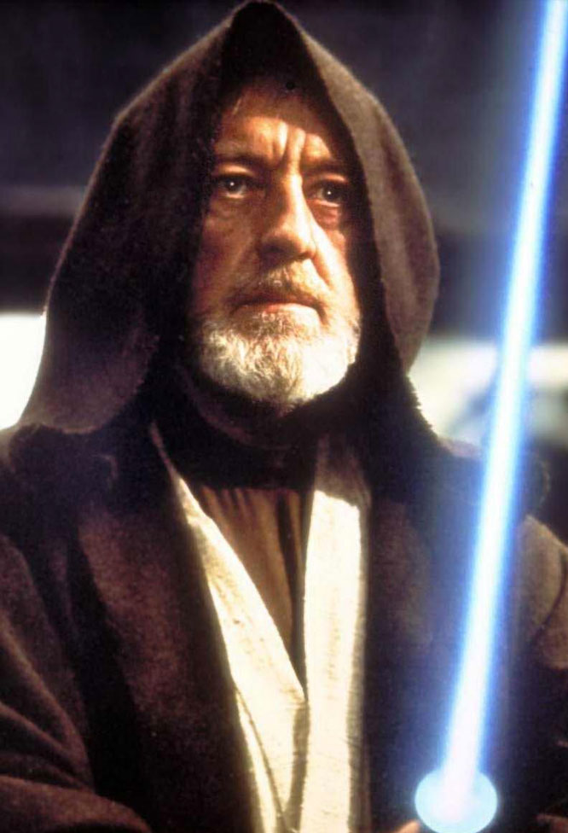
The Jedi have integrity
(Principled)
https://www.templeofthejediorder.org/doctrine-of-the-order

Slide 25
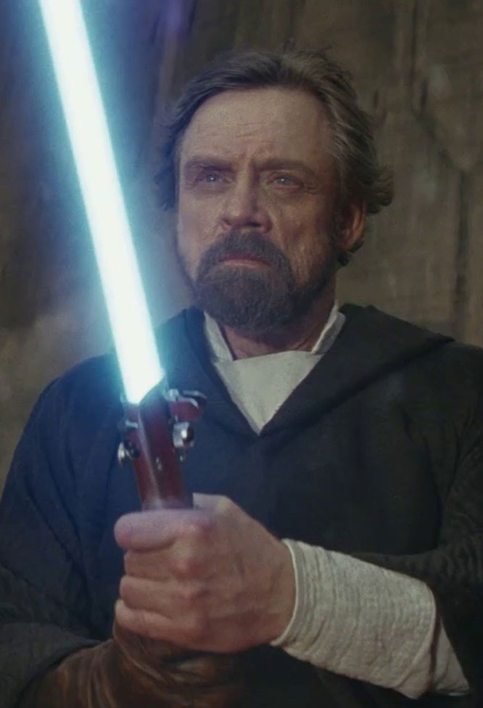
The Jedi maintain a clear mind
(Undistracted)
https://www.templeofthejediorder.org/doctrine-of-the-order

Slide 26
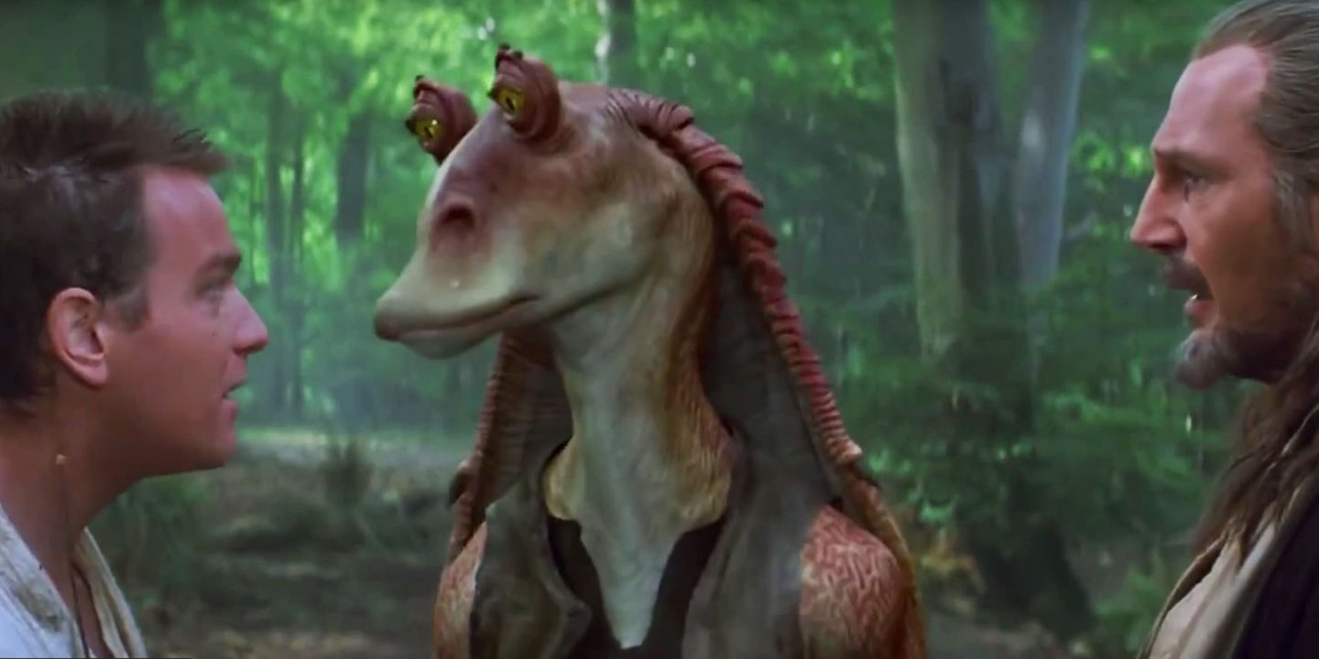
The Jedi are patient
https://www.templeofthejediorder.org/doctrine-of-the-order
Committed to Others; Not to Ourselves

Slide 27
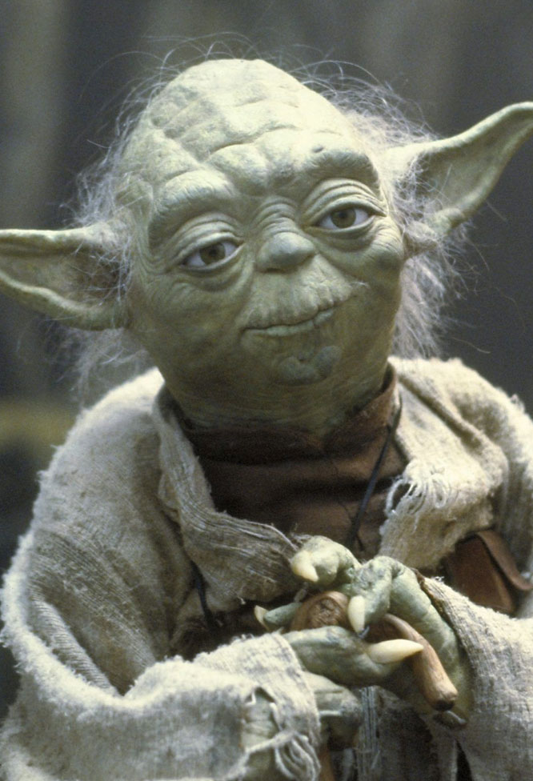
The Jedi cultivate empathy
(Caring)
https://www.templeofthejediorder.org/doctrine-of-the-order

Slide 28
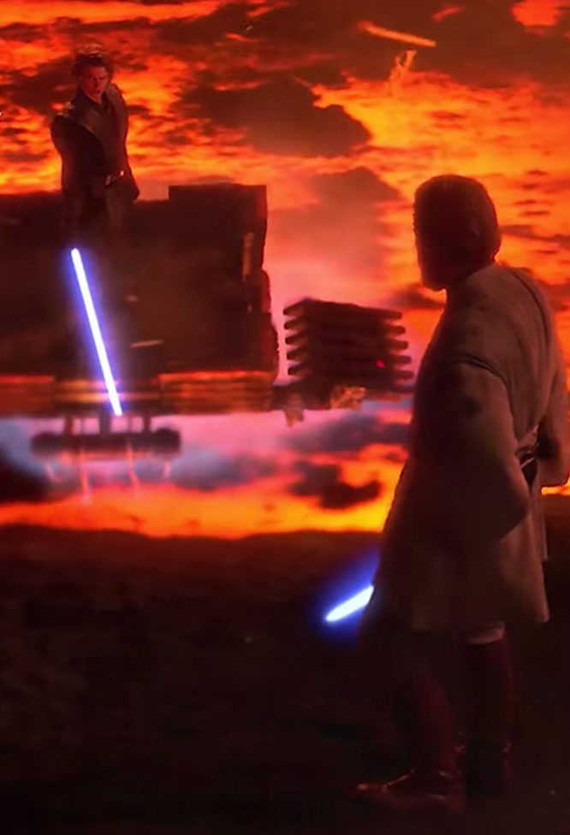
The Jedi understand their limitations
(Humility)
https://www.templeofthejediorder.org/doctrine-of-the-order

Slide 29
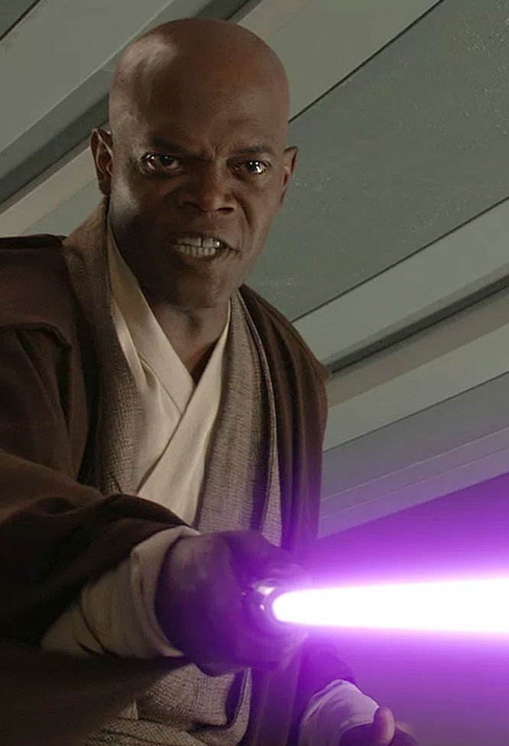
The Jedi are aware of the impacts of action and inaction
(Innovation)
https://www.templeofthejediorder.org/doctrine-of-the-order

Slide 30
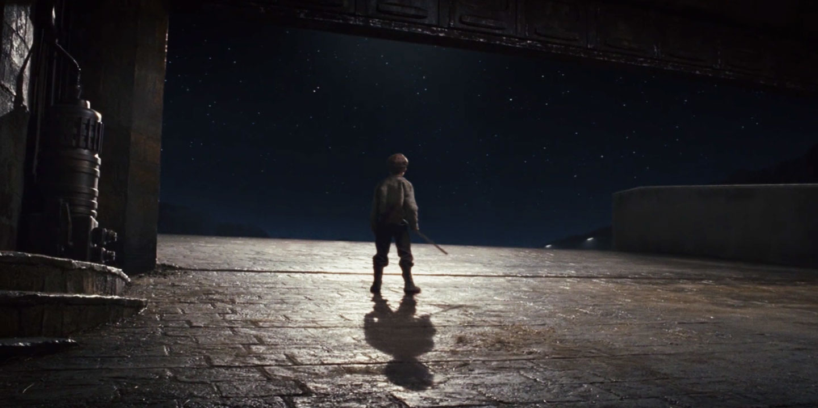
The Jedi are providers and beacons of hope
https://www.templeofthejediorder.org/doctrine-of-the-order

Slide 31
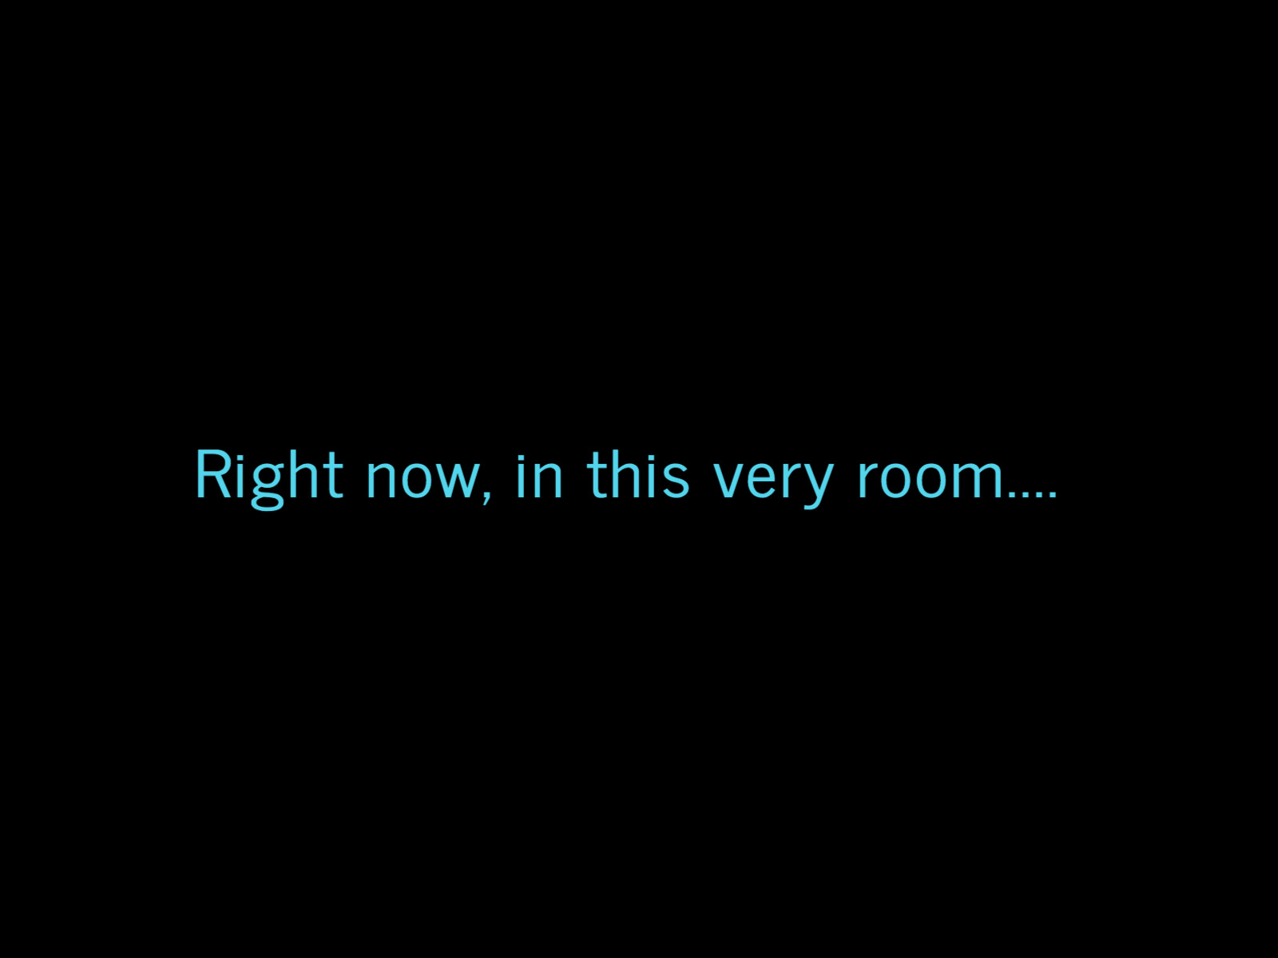

Slide 34
The CODE of the Jedi
Emotion, yet Peace
Ignorance, yet Knowledge
Passion, yet Serenity
Chaos, yet Harmony
Death, yet the Force
https://www.templeofthejediorder.org/doctrine-of-the-order

Slide 35
What happened to the Jedi…

Slide 36
In order to be a powerful Jedi, you must find your passion, direct your emotions and interweave them into all you do.

Slide 37
Find Your Passion…
And Use It to Do Great Things!

Slide 38
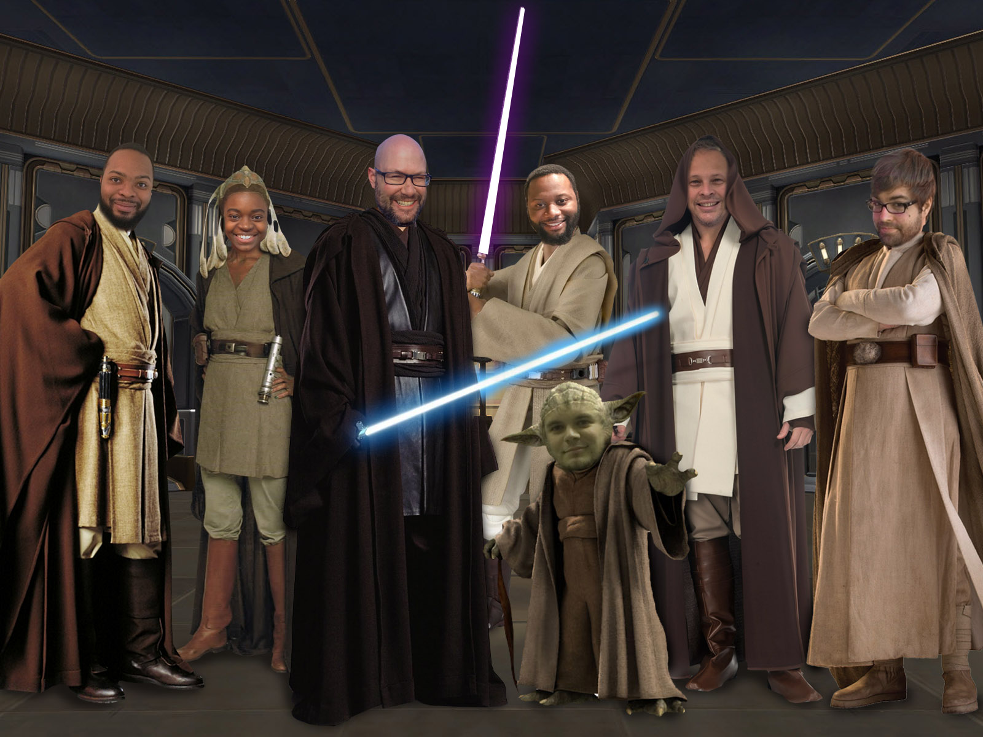
Our Jedi Order
We Are Powerful and Strong in the Force

