Slide 1
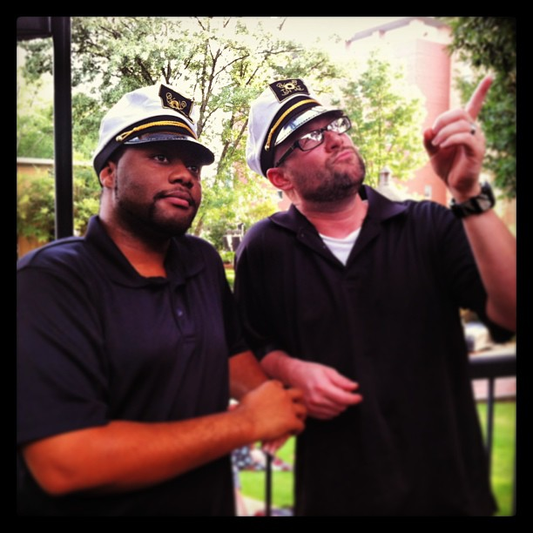
Improving the Higher Education Web Experience Through Responsive Web Design
Christopher Ward Kennesaw State University Assistant Director of Web Services
@beerpievader
Amos Williams Kennesaw State University
Lead Web and Mobile Developer
@trezzay

Slide 2
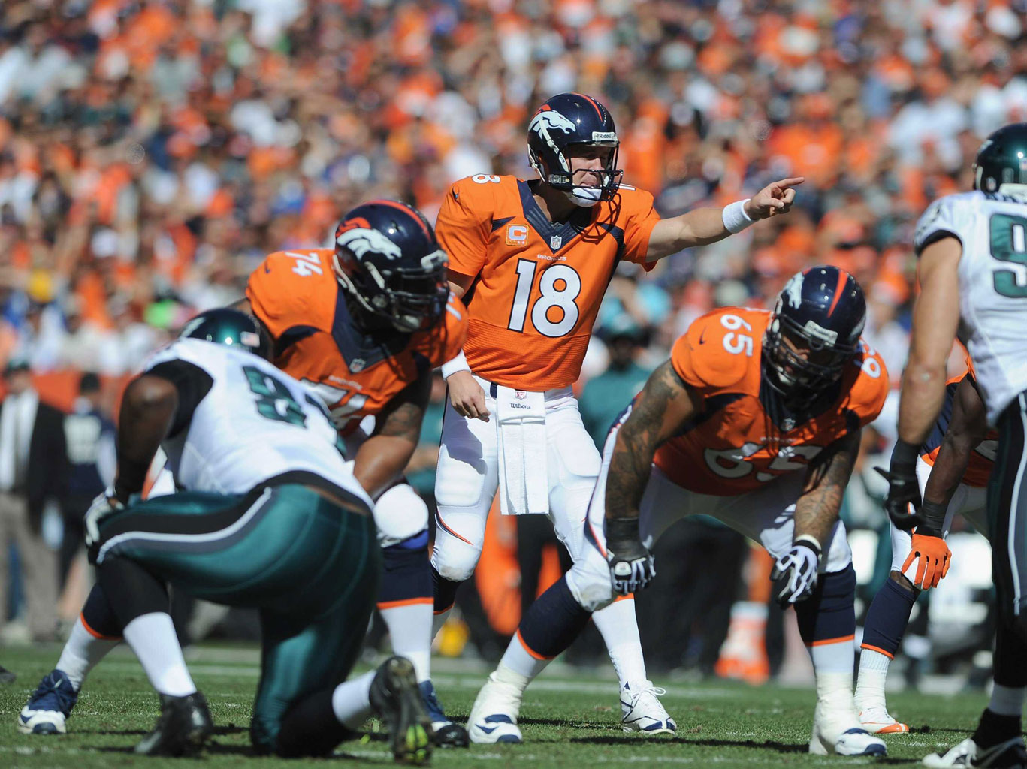
Hey,…let’s call an audible.

Slide 3
Looking Past Native Apps: Responsive Campus Map
Responsive/Mobile Websites - HTML5 Frameworks, CSS Preprocessors, and Touch Interfaces
Moving the USG Website into a Responsive Design Template
Improving the Higher Education Web Experience Through Responsive Web Design

Slide 4
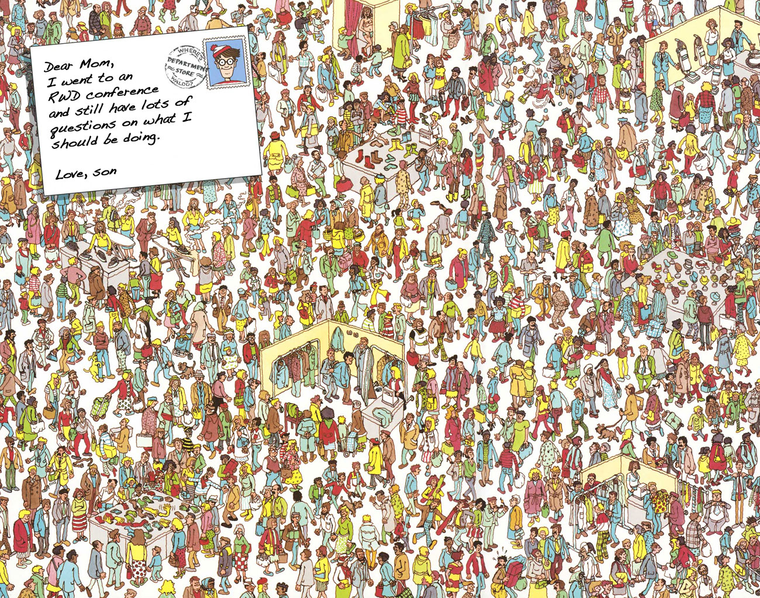

Slide 5
Improving the Higher Education Web Experience Through Responsive Web Design
Christopher Ward Kennesaw State University Assistant Director of Web Services
@beerpievader
Amos Williams Kennesaw State University
Lead Web and Mobile Developer
@trezzay

Slide 6
Improving the Higher Education Web Experience Through Responsive Web Design
Christopher Ward Kennesaw State University Assistant Director of Web Services
@beerpievader
Amos Williams Kennesaw State University
Lead Web and Mobile Developer
@trezzay

Slide 7
Questions
1.
2.
3.
4.
5.
6.
7.
8.
9.
10.

Slide 8
What we’re gonna talk about…
RWD Implementation Process at KSU
Office of Undergraduate Admissions
Office of Student Financial Aid
Office of the Registrar
Analytics
Challenges

Slide 9
So, <ALL> of this started in September 2011

Slide 10
Kennesaw State Enrollment Services
Admissions
Financial
Aid
Registrar

Slide 11
Kennesaw State Enrollment Services
Admissions
Financial
Aid
Registrar

Slide 12
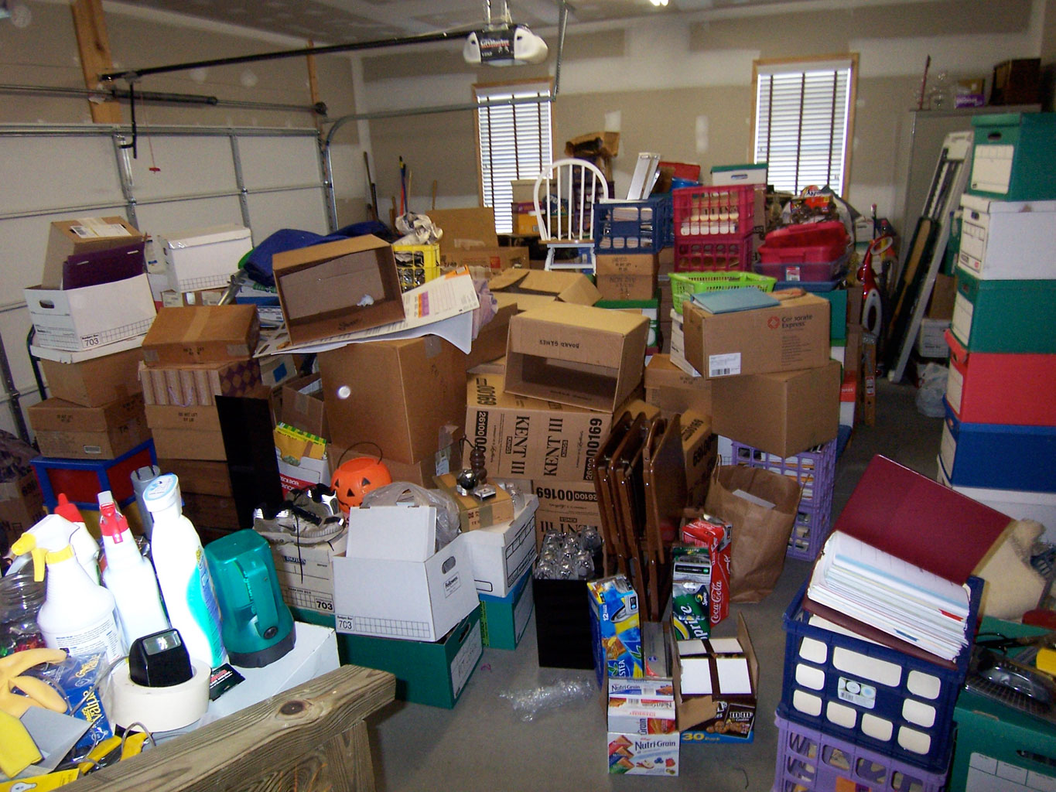
Kennesaw State Enrollment Services

Slide 13
Goals
Consistent look-and-feel
Uniform user experience
Simplify navigation
Simplify content
Oh, and make sure it works on phones

Slide 14
Office of Undergraduate Admissions

Slide 15
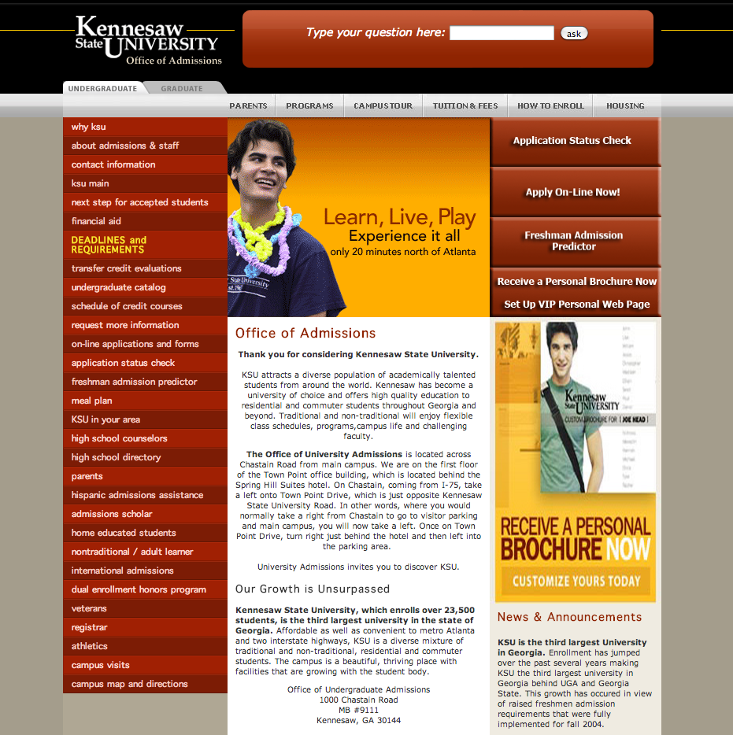

Slide 17
Admissions Action Steps
Content Inventory and Gardening
Condense Navigation
Research and Test Workable RWD Navigation Patterns
Supplement with Alternate Forms of Content

Slide 18
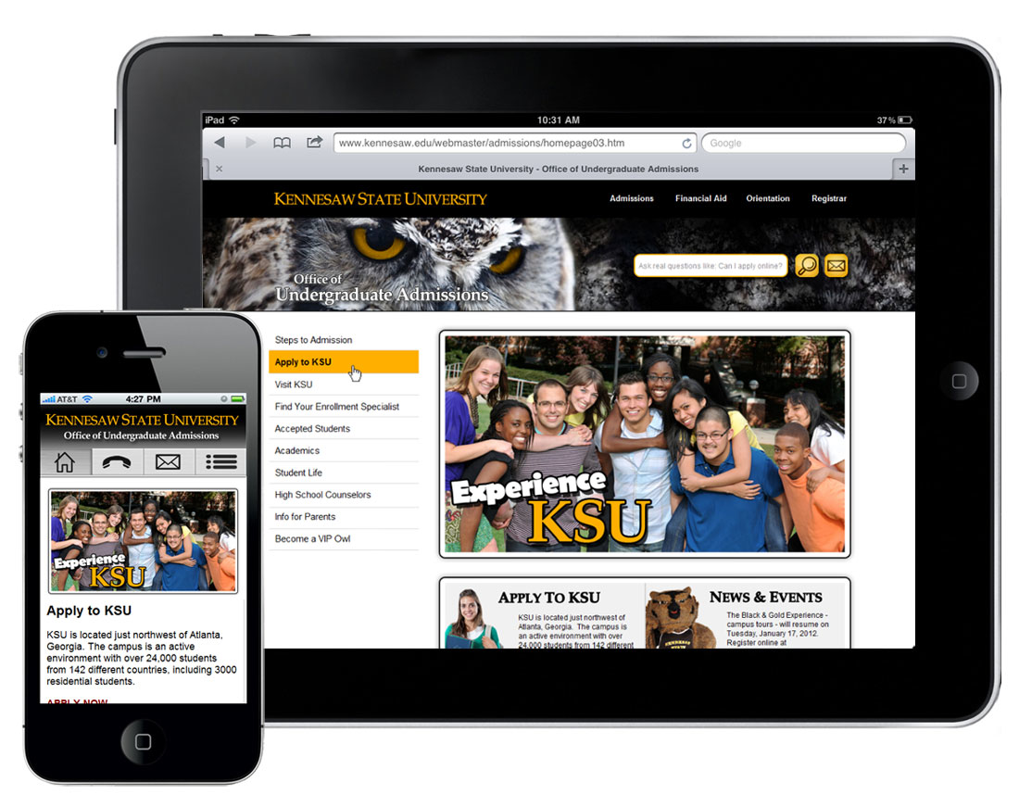
Launched July 2012

Slide 19
Office of Student Financial Aid

Slide 21
PDF Mountain

Slide 22
Financial Aid Action Steps
Mobilize Content
Integrate Video Throughout Site
Integrate Social Media Into Site
Adopt Enrollment Services Look-and-Feel

Slide 23
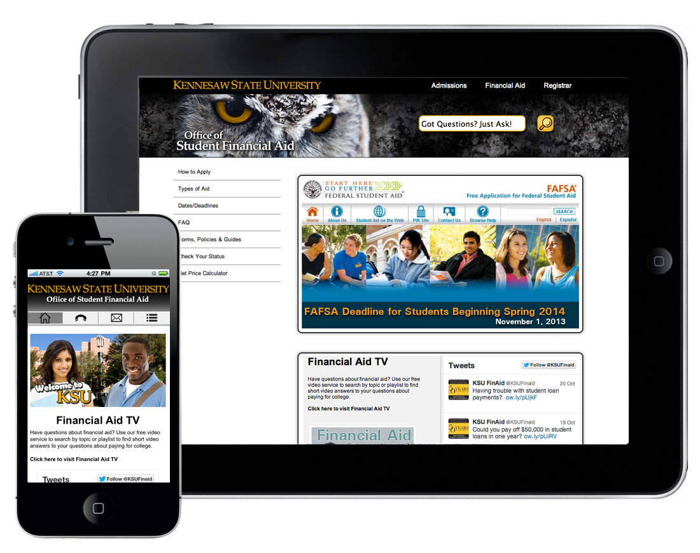
Launched January 2013

Slide 24
Office of the Registrar

Slide 25
PDF Mountain

Slide 26
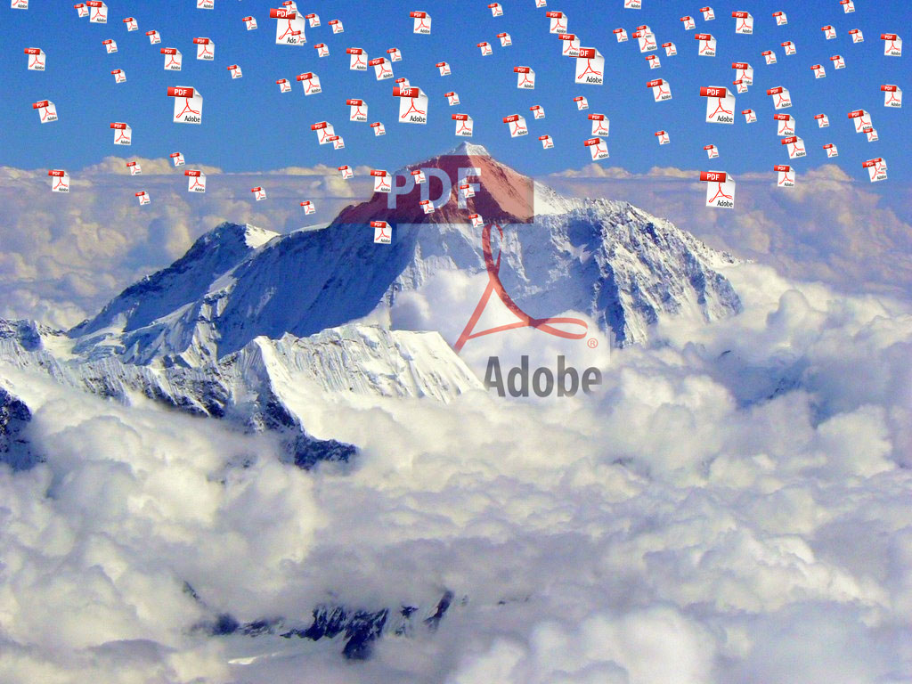
PDF Mountain

Slide 27
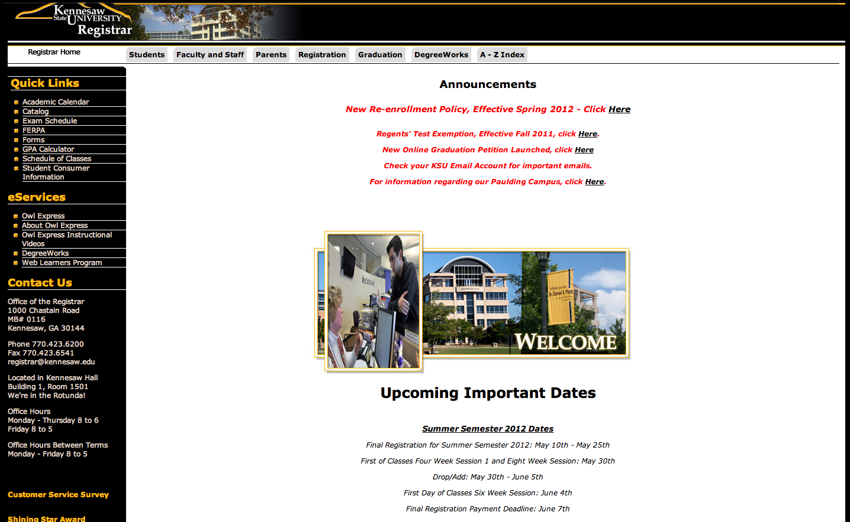

Slide 28
Registrar Action Steps
Mobilize Content
Logically Organize Content Into Simple Categories
Push Content Closer to the Home Page
Adopt Enrollment Services Look-and-Feel

Slide 29
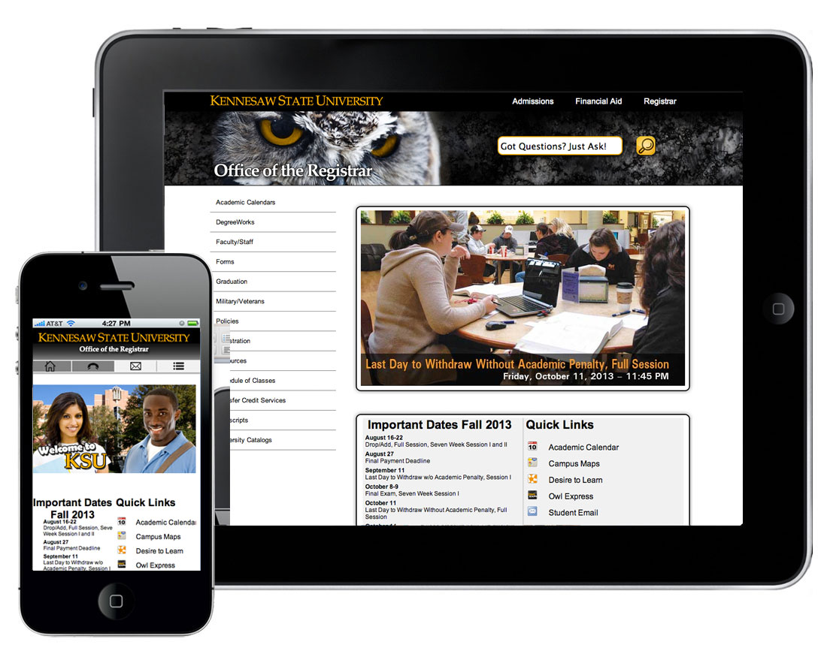
Launched July 2013

Slide 30
What Did We Learn
Responsive Web Design Is Hard
A Great Responsive Site Starts With Great Content
Responsive Web Design Requires Communication

Slide 31
The phrase responsive web design doesn’t have any meaning whatsoever to anyone outside of our field.
http://speckyboy.com/2013/08/07/why-clients-dont-care-about-responsive-web-design/

Slide 33
Higher Ed Responsive Web Design is more than putting a Web site on a phone. It is a complicated process that requires complex practices and solutions.

Slide 34
But We Also Learned <One More Thing>…

Slide 35
People Visit These Sites On Phones!
One in six visits to an Enrollment Services site is on a mobile device
One in four visits to Undergraduate Admissions is from a mobile device (135K)
Operating Systems Visiting Enrollment Services sites break roughly 2/3 iOS, 1/3 Android

Slide 36
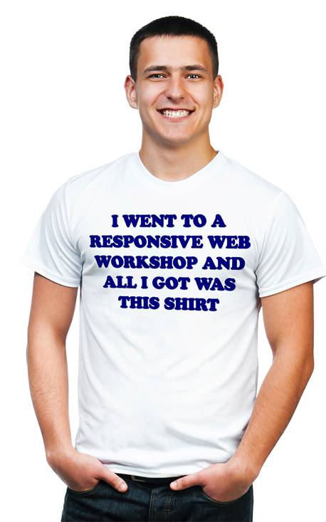
So,…Let’s Talk About You.
Where are you with Responsive Web Design?; where do you want to go?; what do you want to learn?

