Slide 1
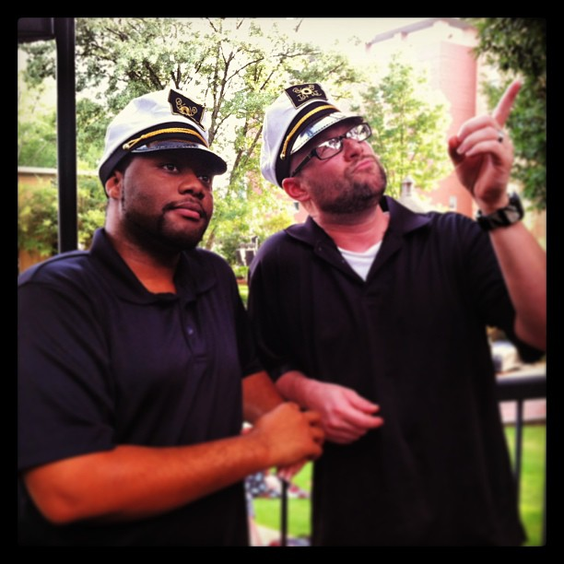
Building an Amazing Collaborative Web Team and Environment
Christopher Ward Kennesaw State University Director of Web Services and Mobile Development
@beerpievader
Amos Williams Kennesaw State University
Assistant Director of Web Services and Mobile Development @trezzay

Slide 2
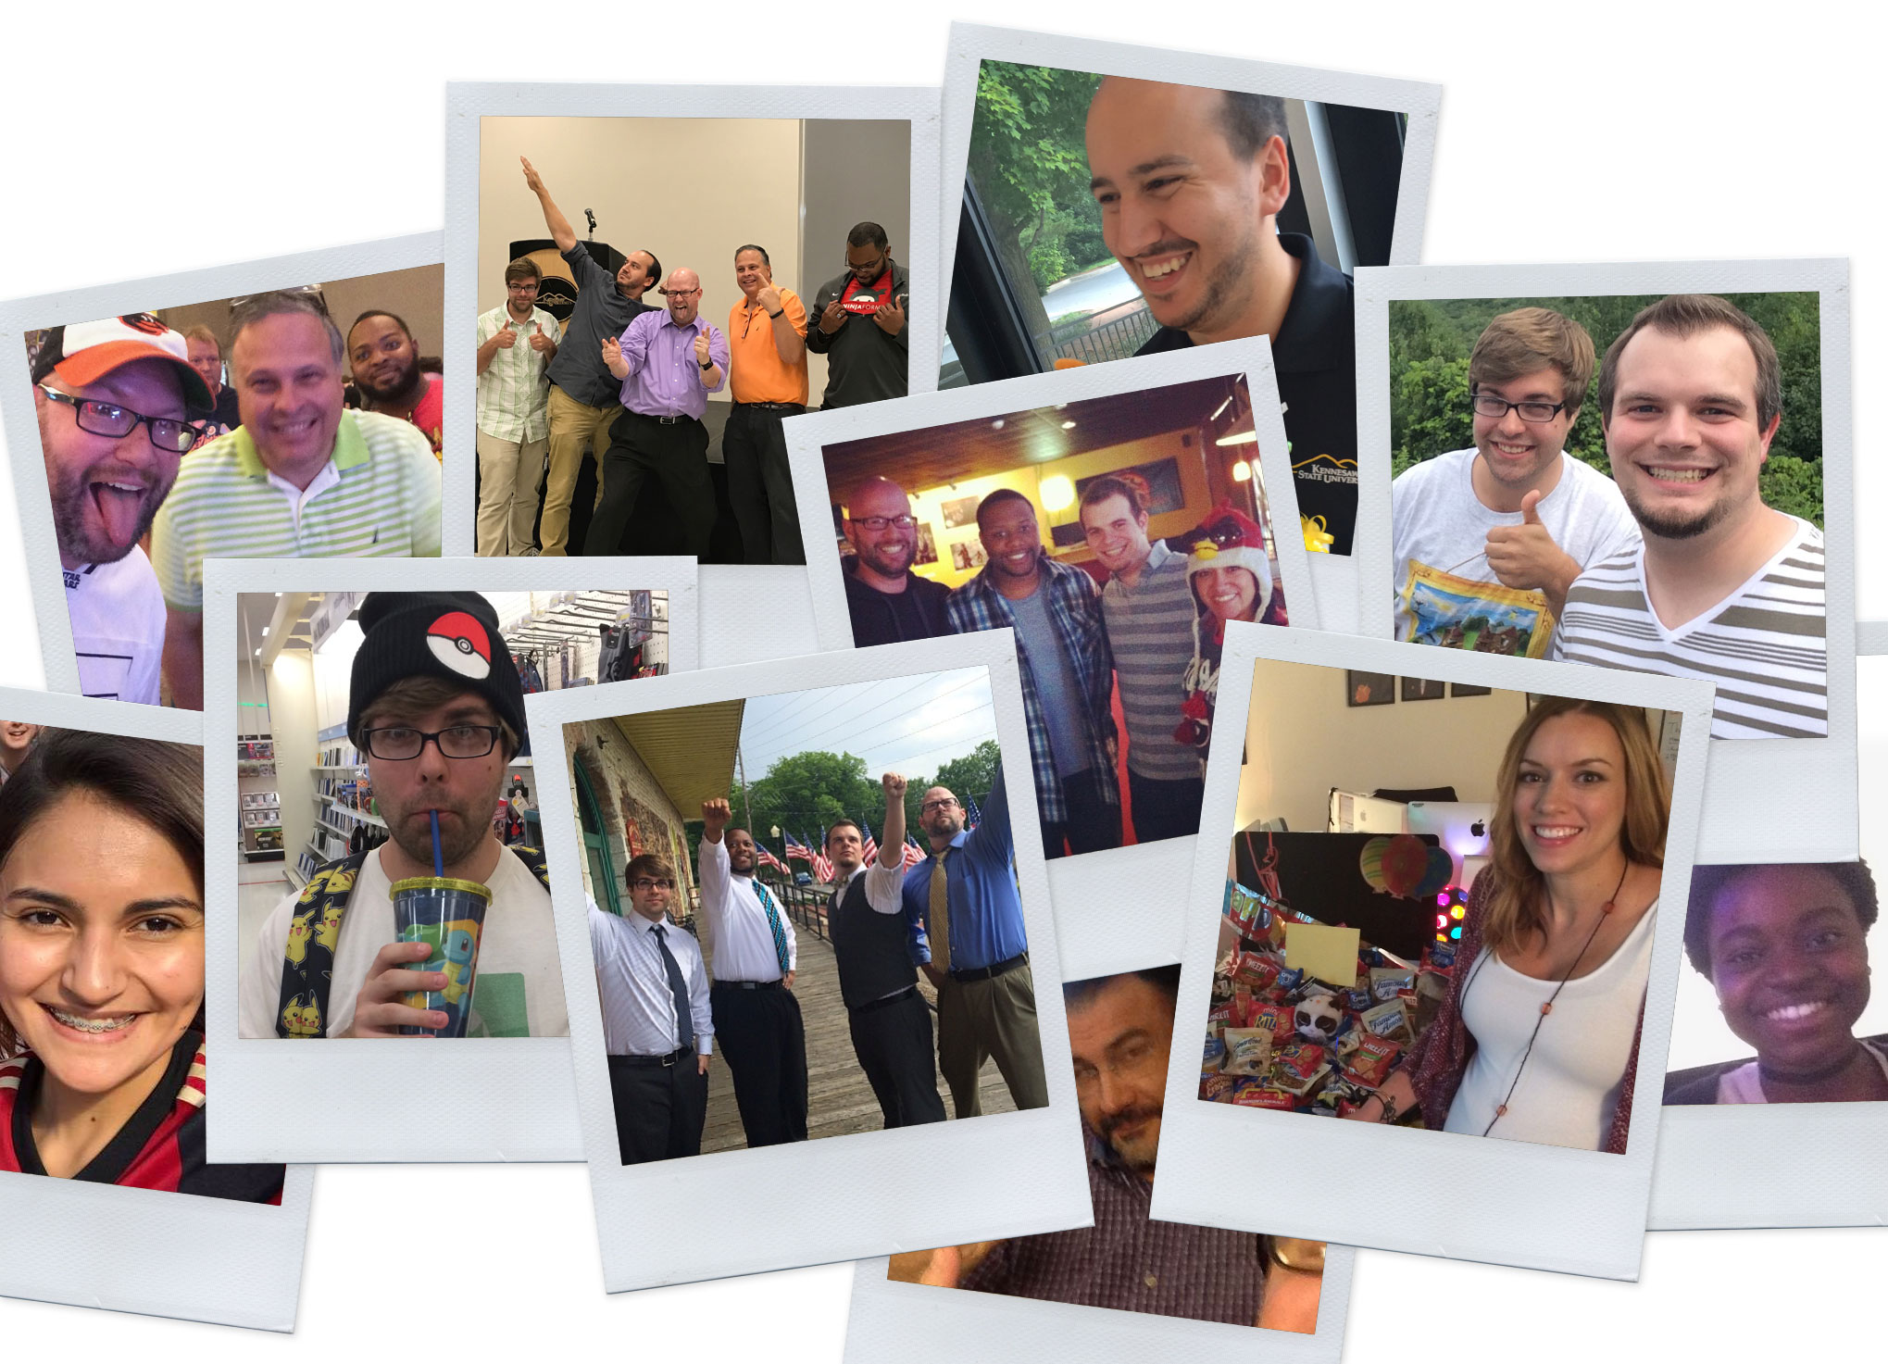
A Little Bit About Us…

Slide 3
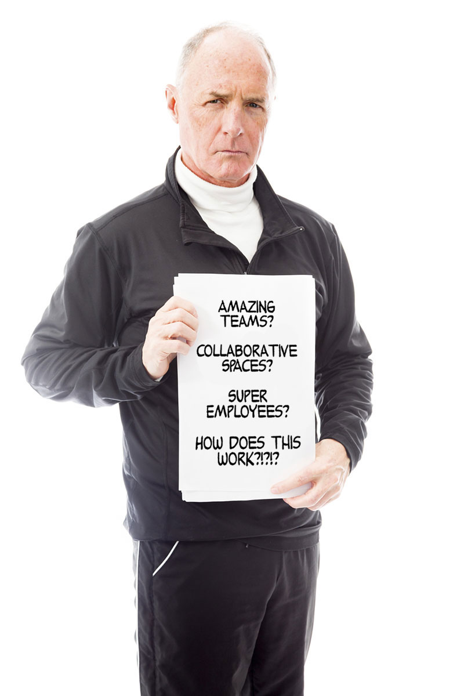
Higher Ed Responsive Web Design is more than putting a Web site on a phone. It is a complicated process that requires complex practices and solutions.
So,…what exactly are we going to be talking about today?

Slide 4
Let’s start with a story.

Slide 5
Once upon a time,
Kennesaw State University hired this guy…

Slide 6
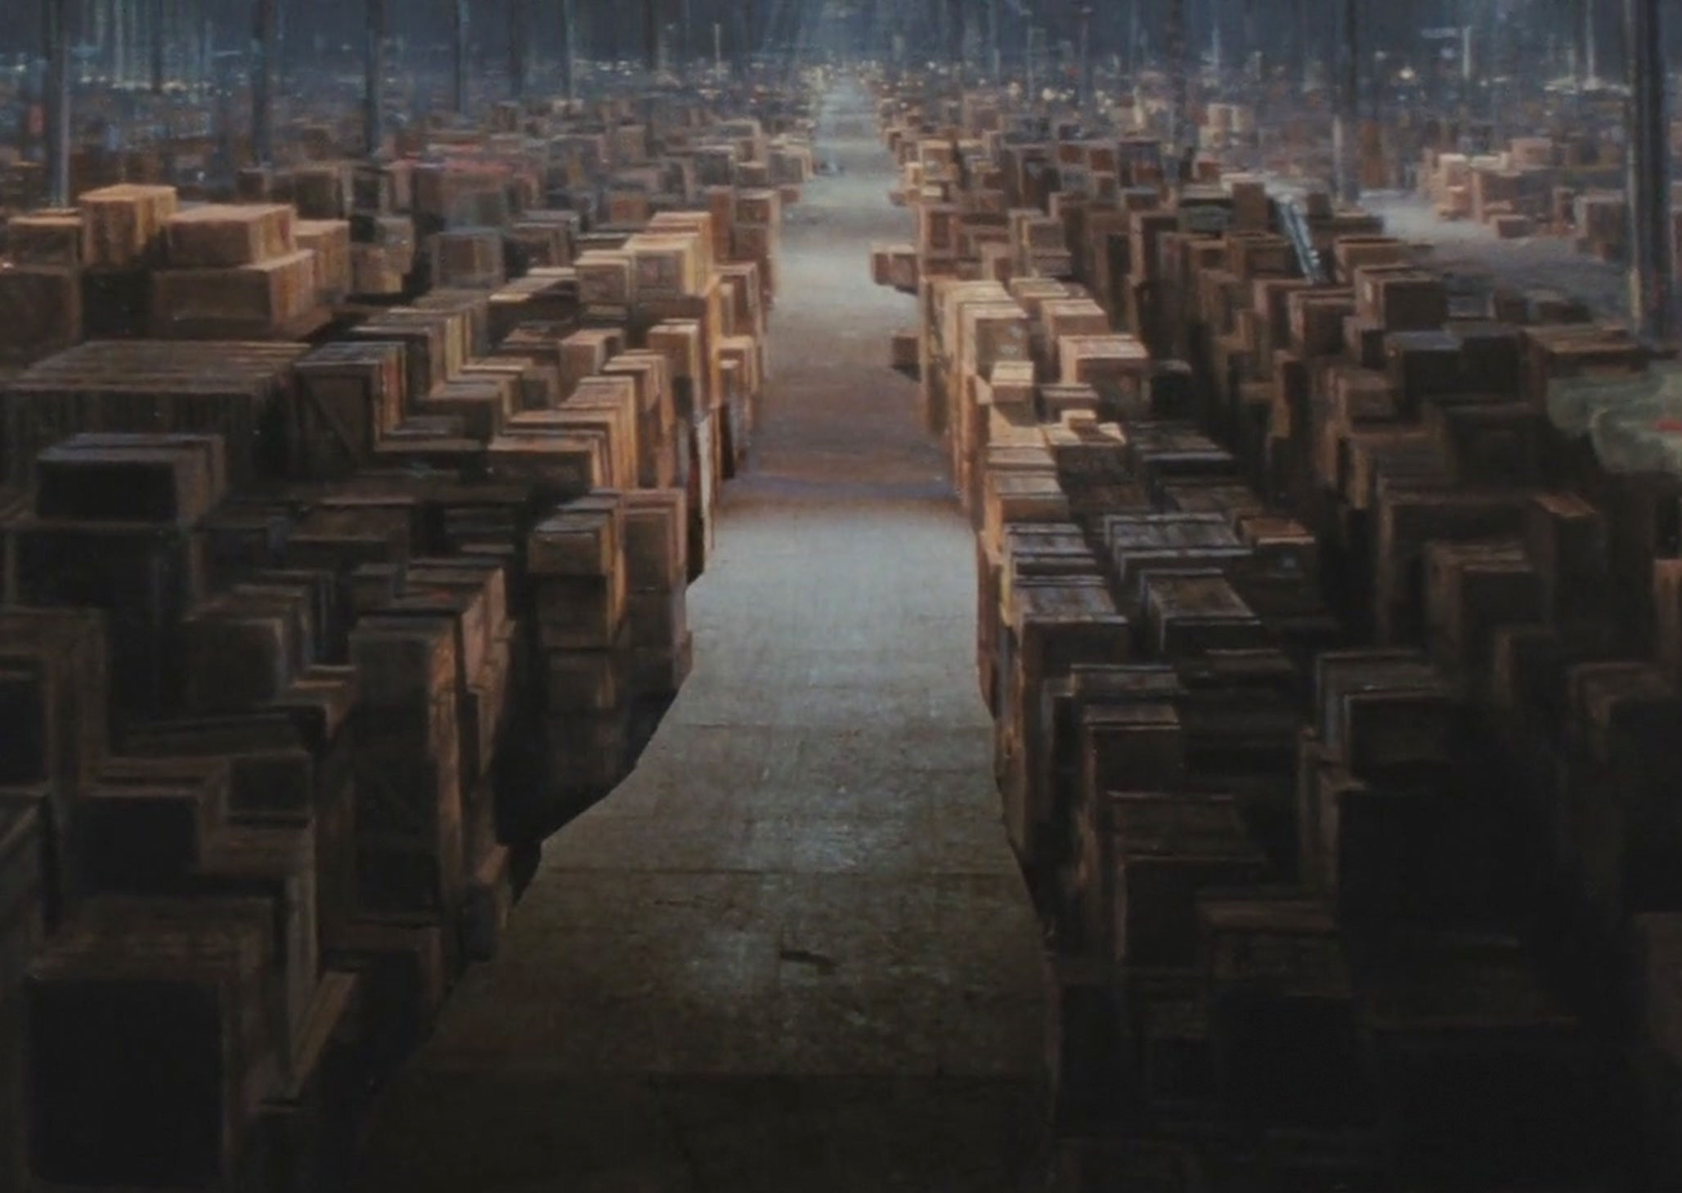
…to manage Kennesaw.edu

Slide 7
After a few years, the Web started to get REALLY hard. It required a whole new set of coding skills.

Slide 8
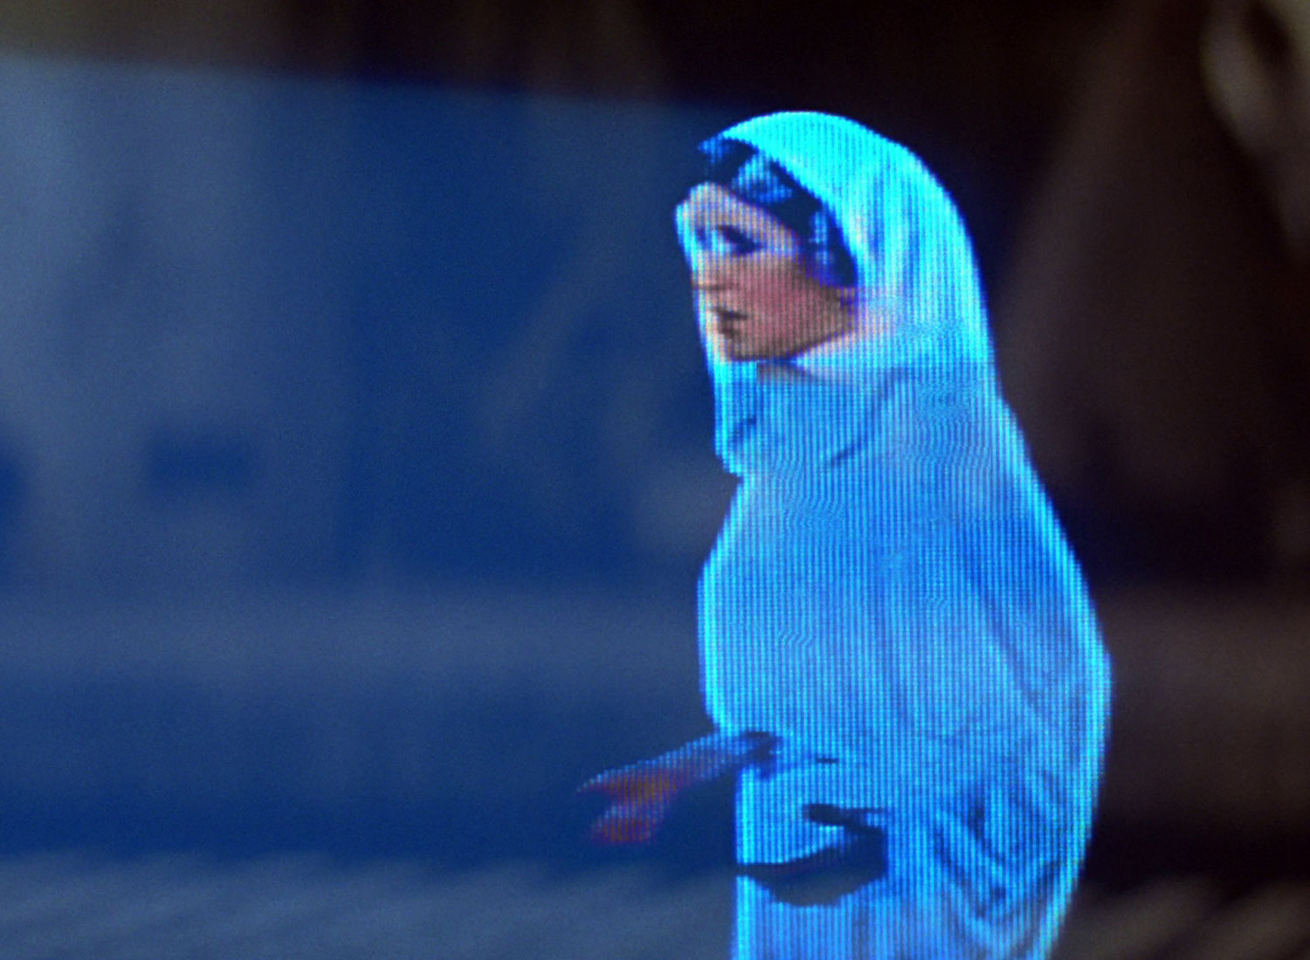
Help me, direct
supervisor…I need a real web developer.

Slide 9
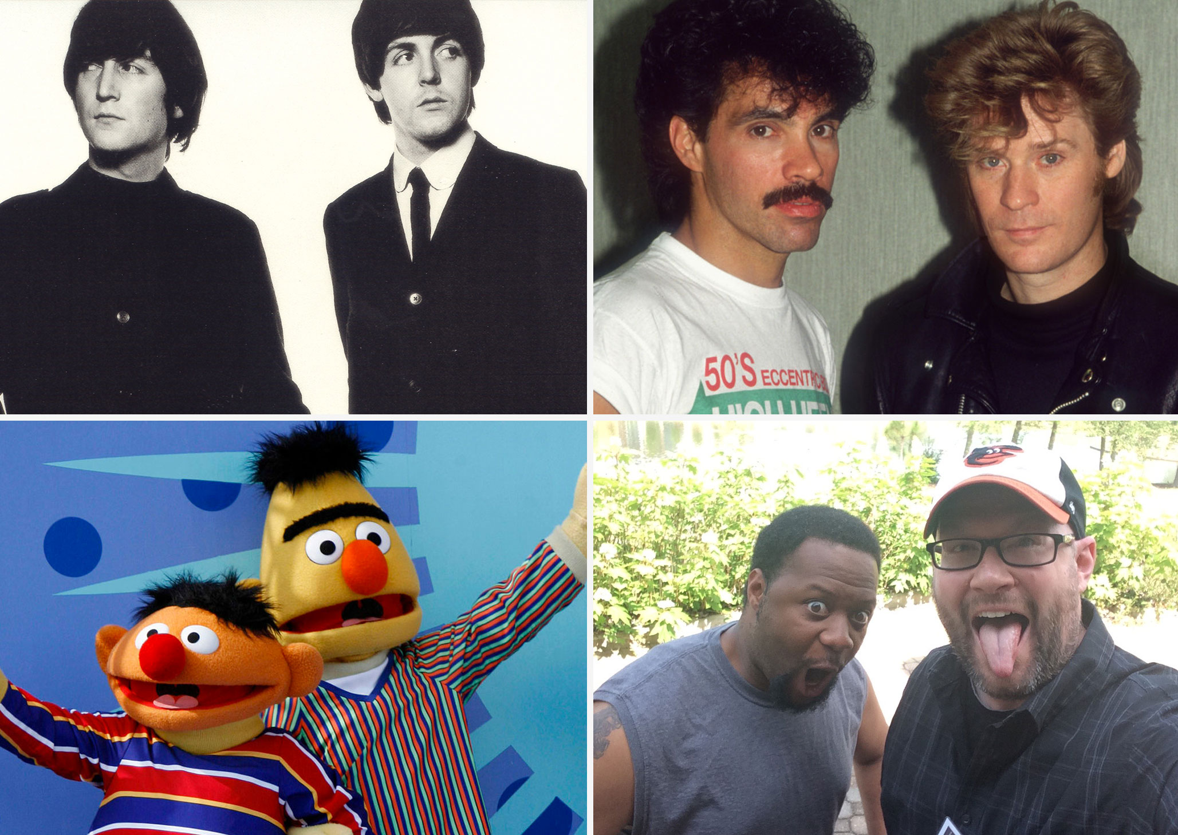

Slide 10
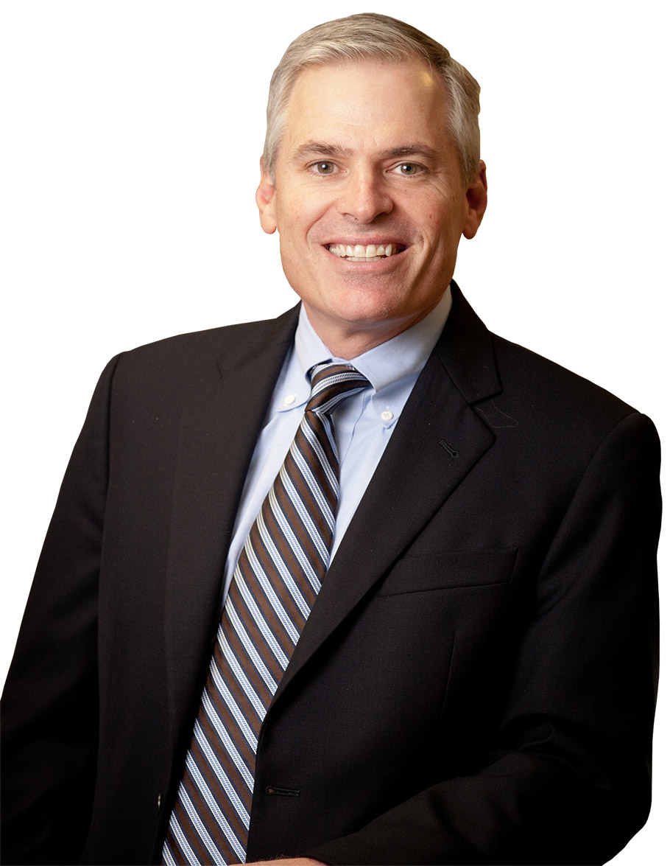
Build Amazing Culture
Patrick
Lencioni

Slide 11
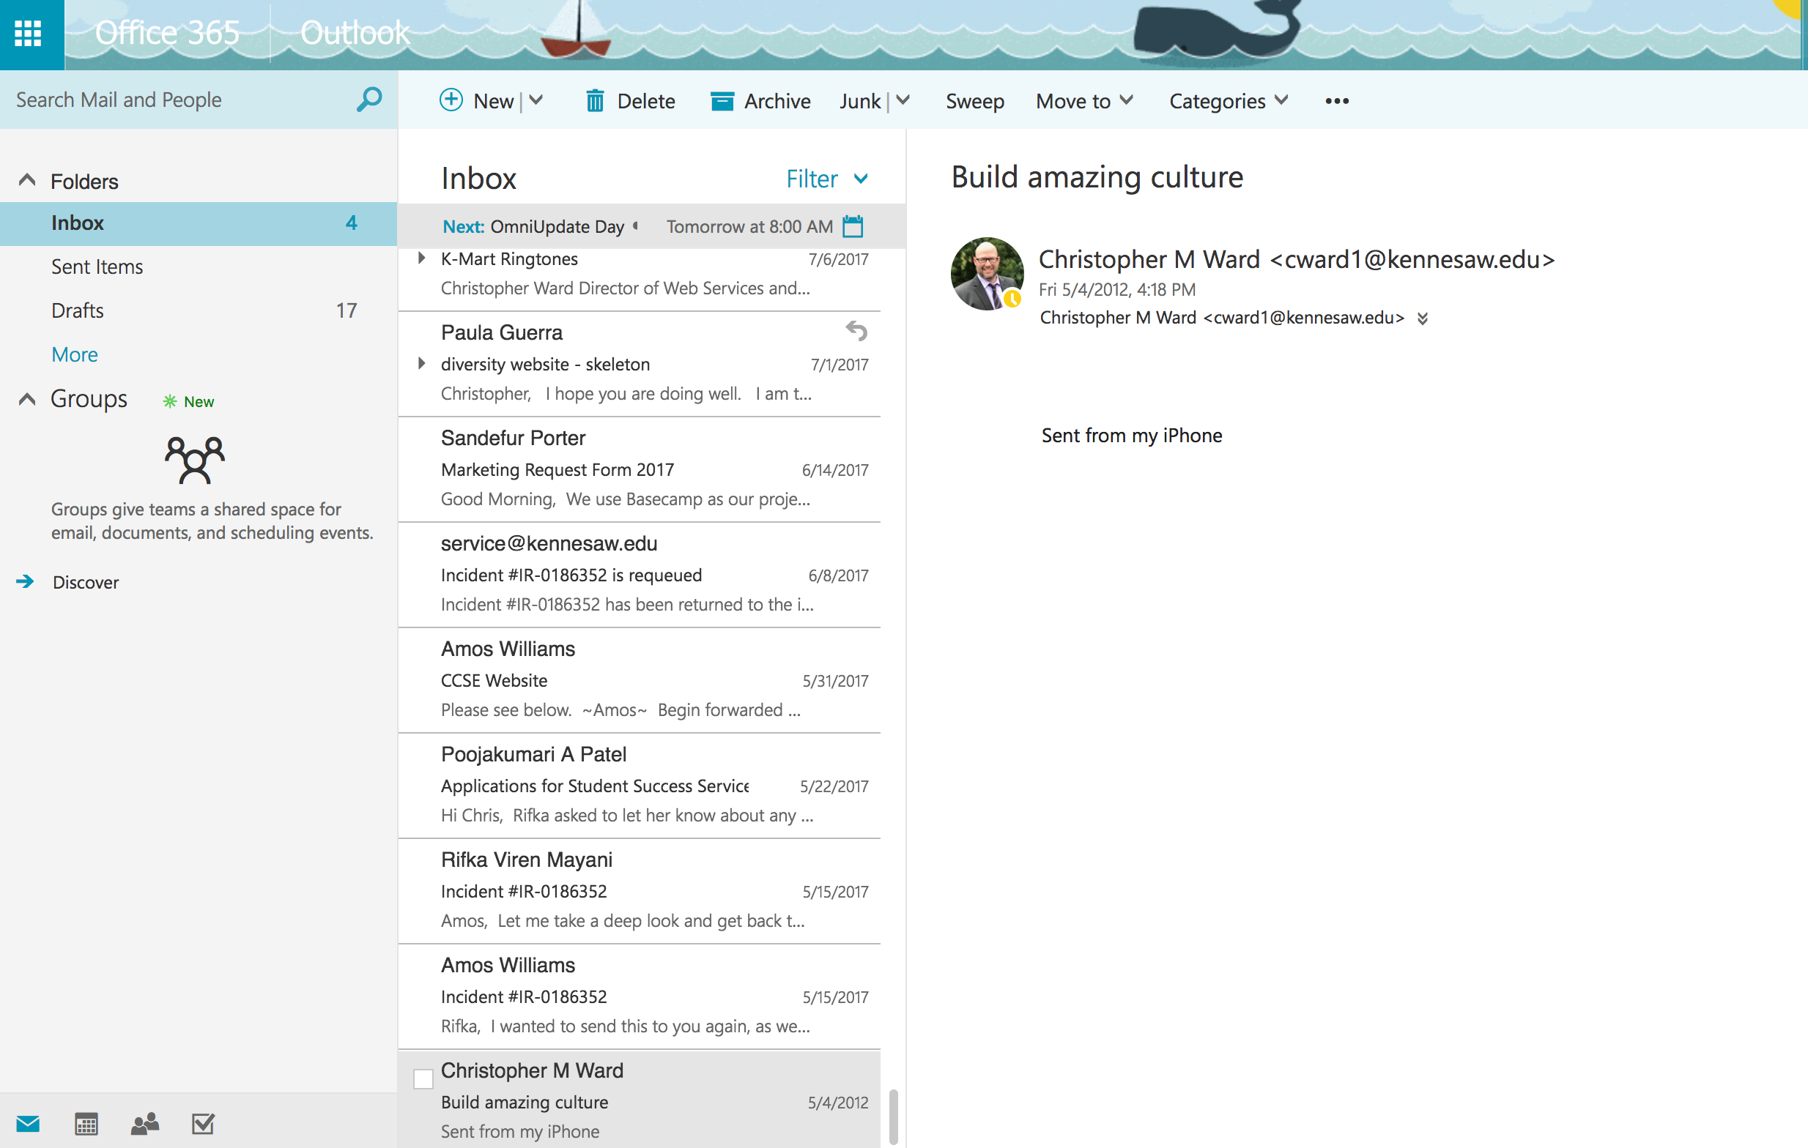

Slide 13
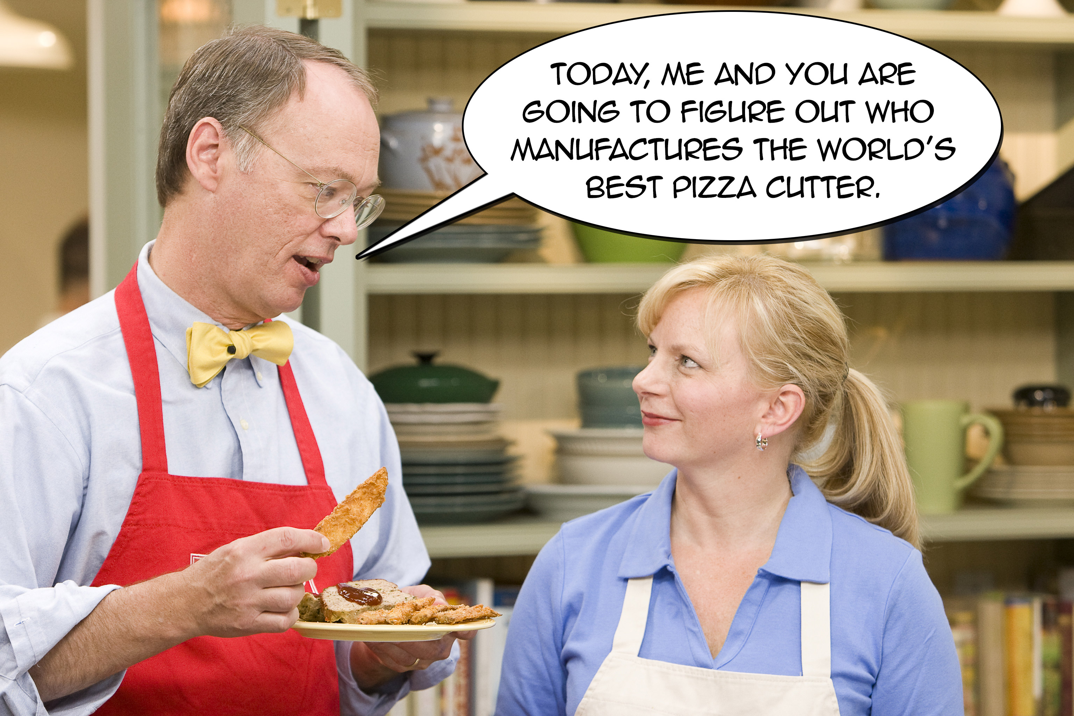

Slide 14
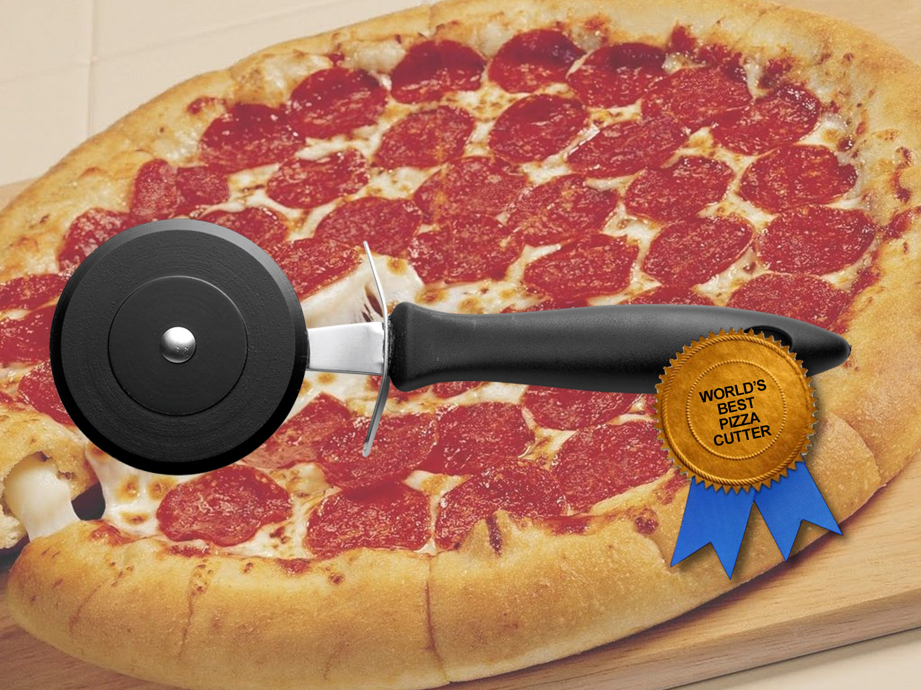
World’s Best Pizza Cutter

Slide 15
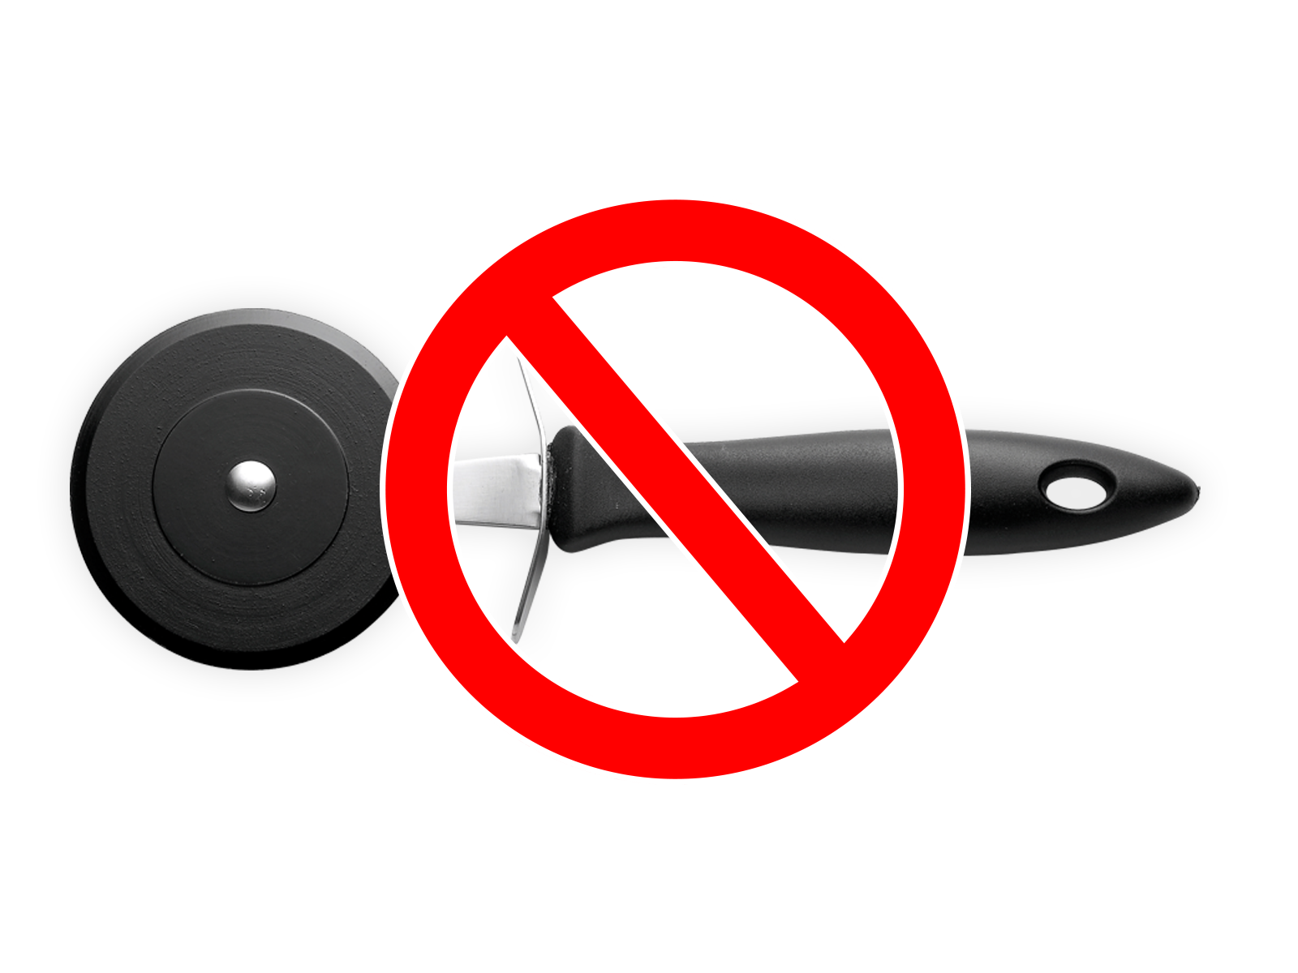
Leadership solutions…
Are NOT LIKE pizza cutters.

Slide 16
Stay honest.
Be authentic.
There is no perfect leadership profile…only perfect practices that fit your profile.

Slide 17
Our WebGroup Culture
Our relationships are built on trust
We foster a learning environment where our expertise helps grow others and where we are always learning from the people around us
We are invested in each other personally and professionally
We have a definitive sociology and hire others who will not only compliment our team but will thrive in a collaborative group setting
We have an incredible amount of fun

Slide 18
Our relationships are built on trust.

Slide 19
You Decide.
Andy Stanley

Slide 20
We foster a learning environment where our expertise helps grow others and where we are always learning from the people around us.

Slide 21
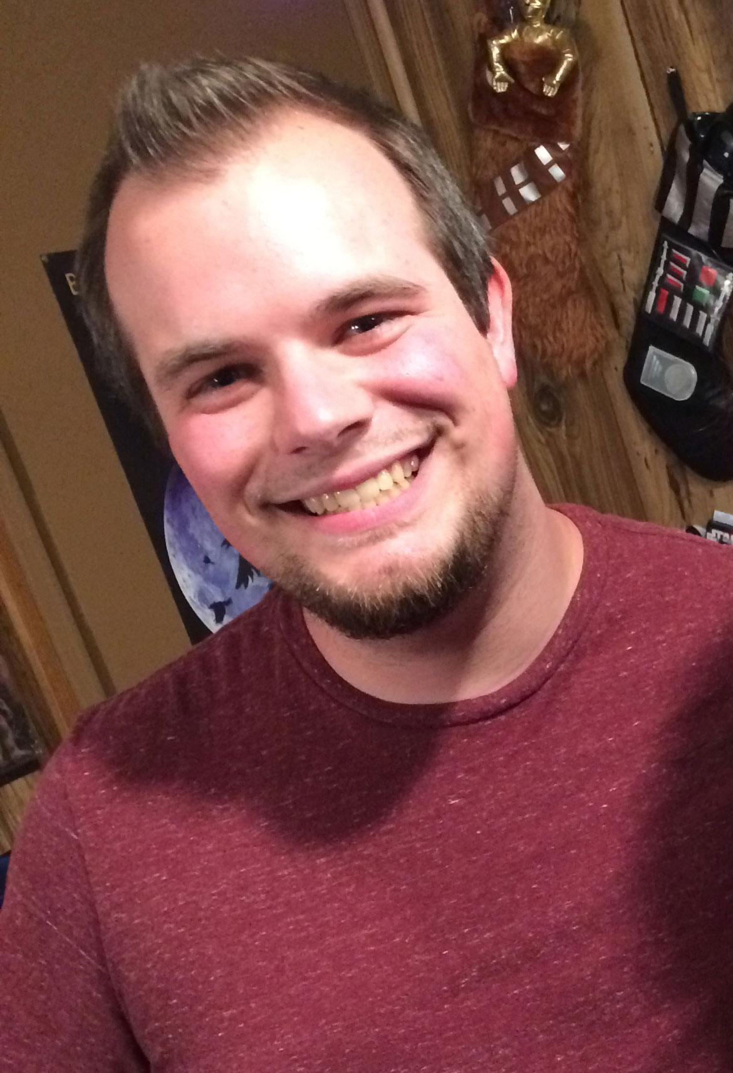
This
Is
Caleb

Slide 22
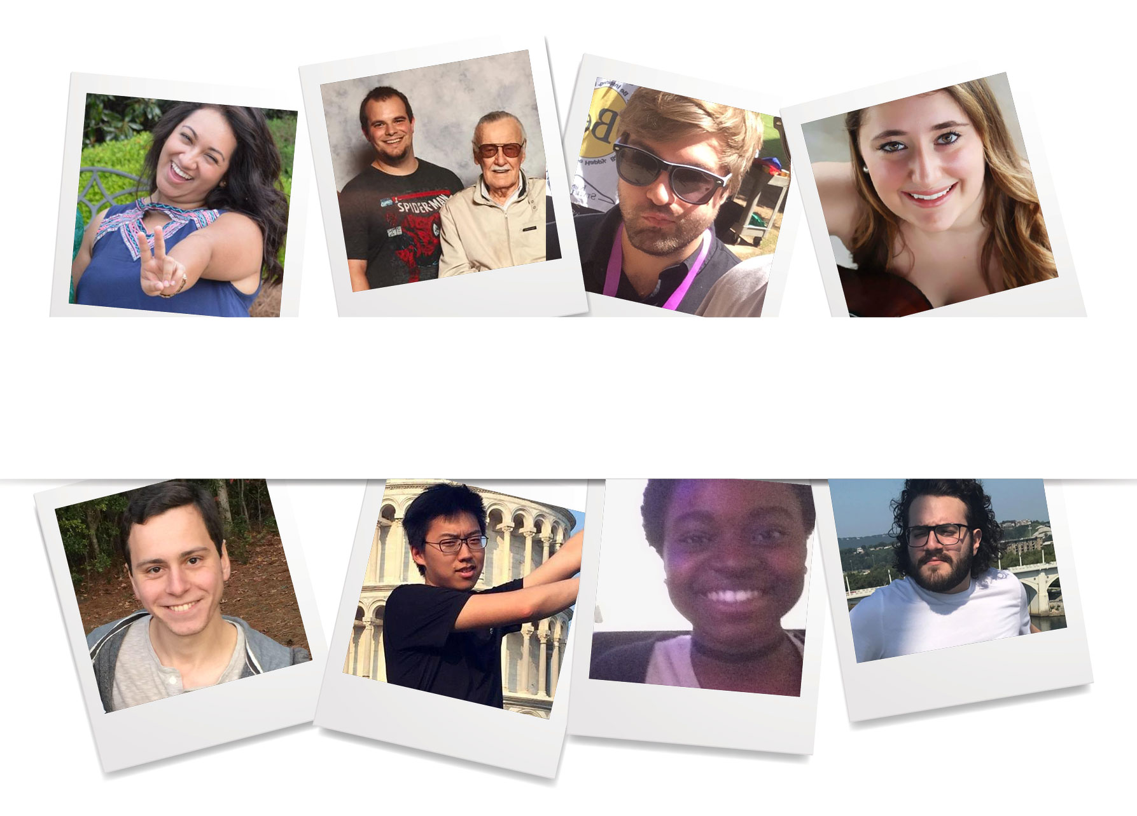
A Learning Environment Thrives When It’s Filled With People Who Want To Learn

Slide 23
We are invested in each other personally and professionally.

Slide 25
The people you lead need to feel like you are connected to them. That is how you build trust.
Dr. Henry Cloud

Slide 26
We have a definitive sociology and hire others who will not only compliment our team but will thrive in a collaborative group setting.

Slide 27
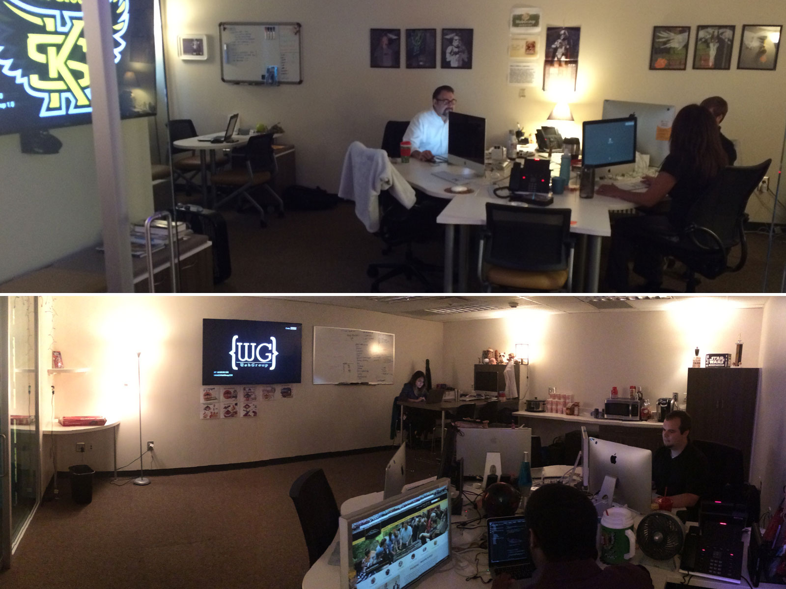

Slide 28
We have an incredible amount of fun.

Slide 29
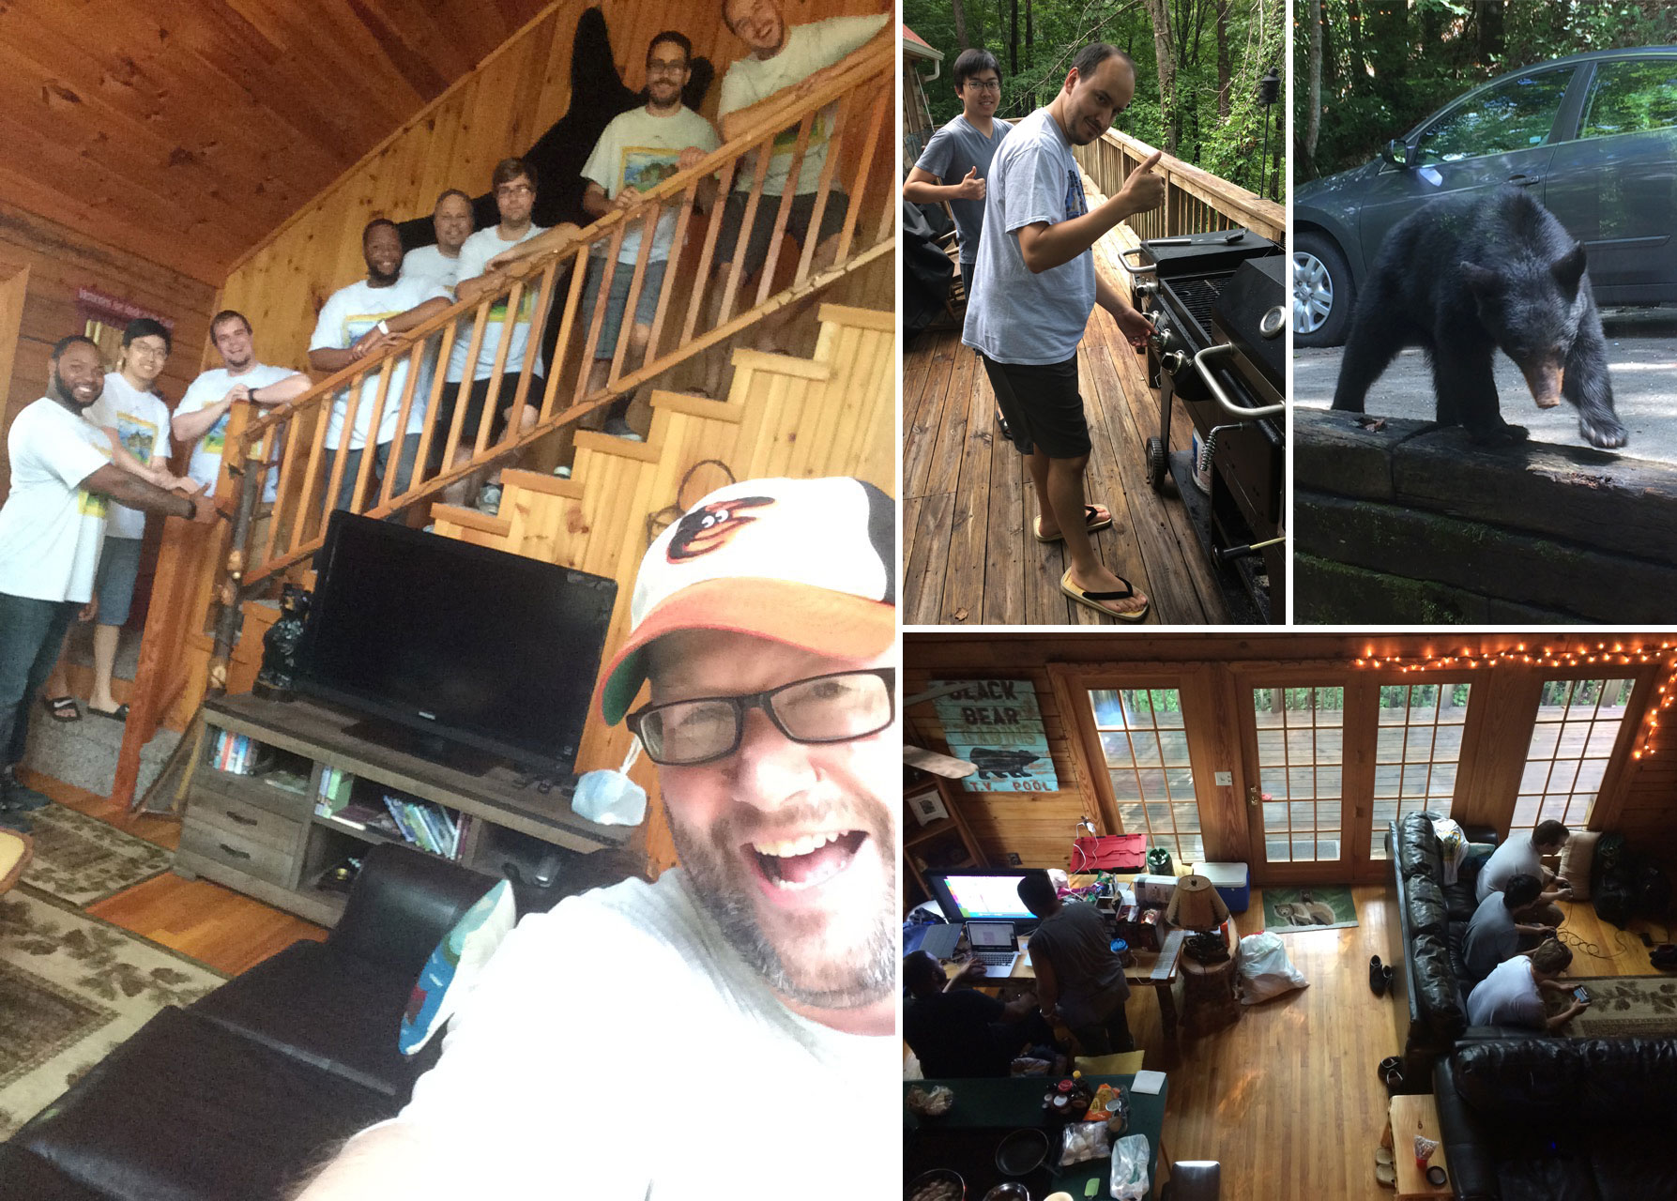
Nerd Retreat

Slide 30
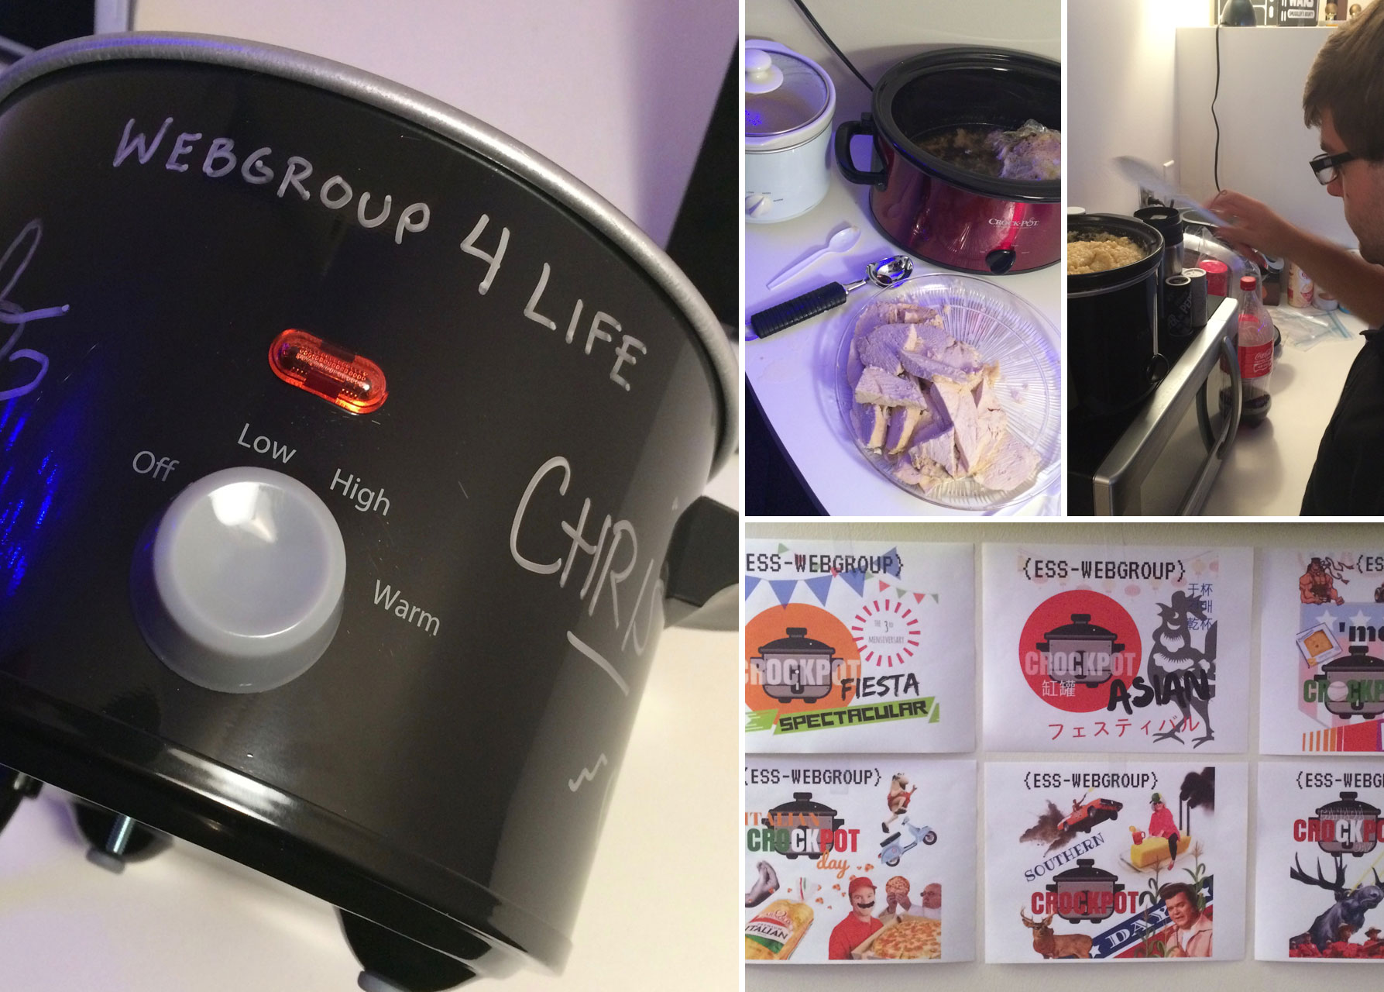
Crockpot Day

Slide 31
HealthTrails

Slide 32
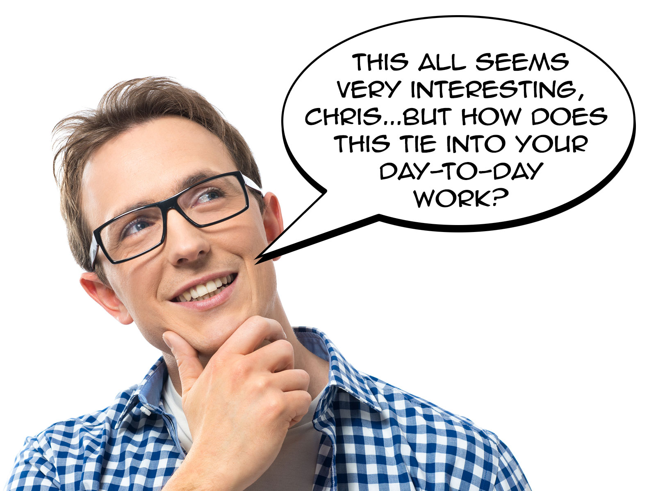

Slide 33
What We Do
(rocket science)

Slide 34
Our WebGroup Culture
Our relationships are built on trust
We foster a learning environment where our expertise helps grow others and where we are always learning from the people around us
We are invested in each other personally and professionally
We have a definitive sociology and hire others who will not only compliment our team but will thrive in a collaborative group setting
We have an incredible amount of fun

Slide 35
Our WebGroup Culture
Our relationships are built on trust
We foster a learning environment where our expertise helps grow others and where we are always learning from the people around us
We are invested in each other personally and professionally
We have a definitive sociology and hire others who will not only compliment our team but will thrive in a collaborative group setting
We have an incredible amount of fun

Slide 36
Web Users
University Web Editors
College Webmasters
WebGroup
Spheres of
Influence

Slide 38
Web Users
University Web Editors
College Webmasters
WebGroup
Spheres of
Influence

Slide 39
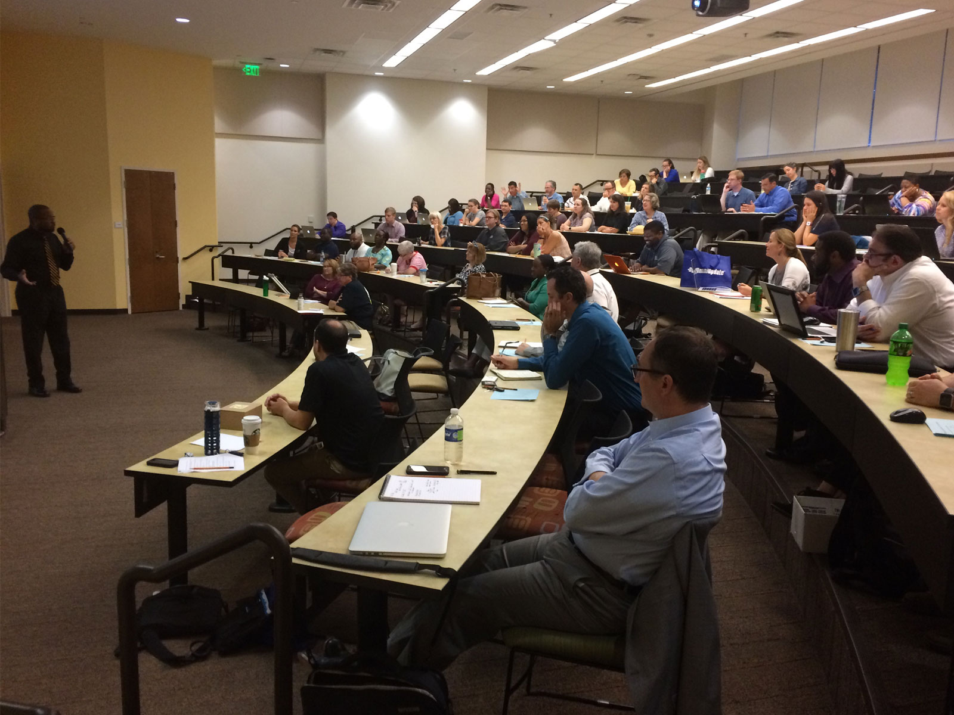
OmniUpdate Day

Slide 40
Web Users
University Web Editors
College Webmasters
WebGroup
Spheres of
Influence

Slide 41
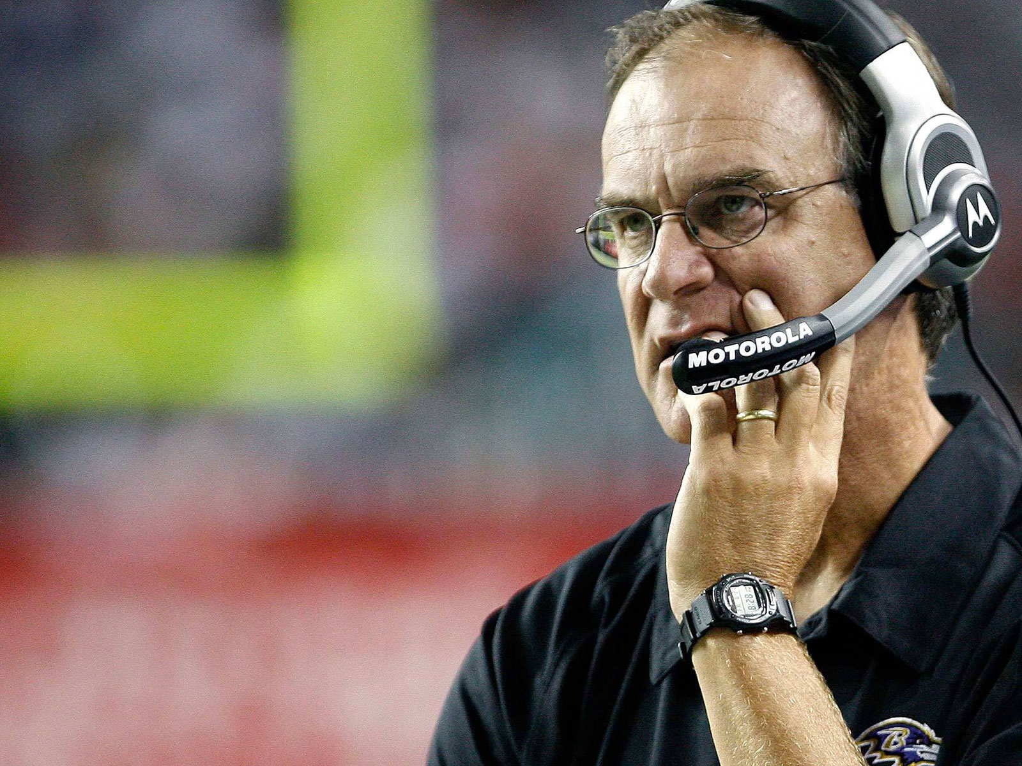
Leadership is not about authority…it’s about responsibility.
Brian Billick

Slide 42
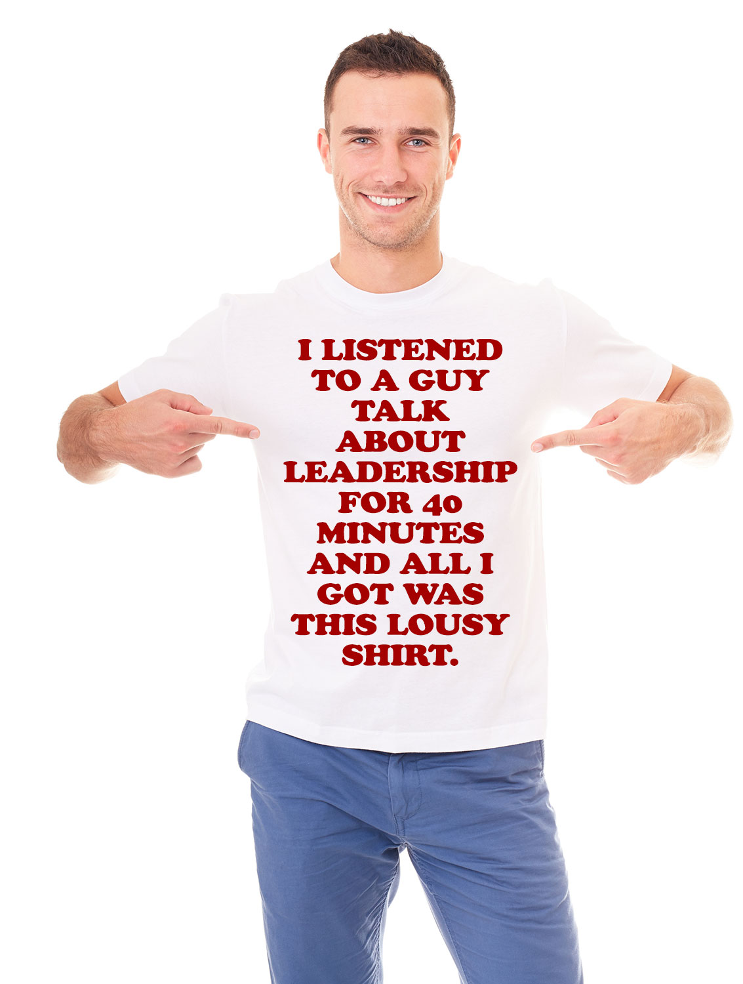
So,…Let’s Talk About You
Where are you with leading your teams?; where do you want to go?; what do you want to learn?

