Slide 1
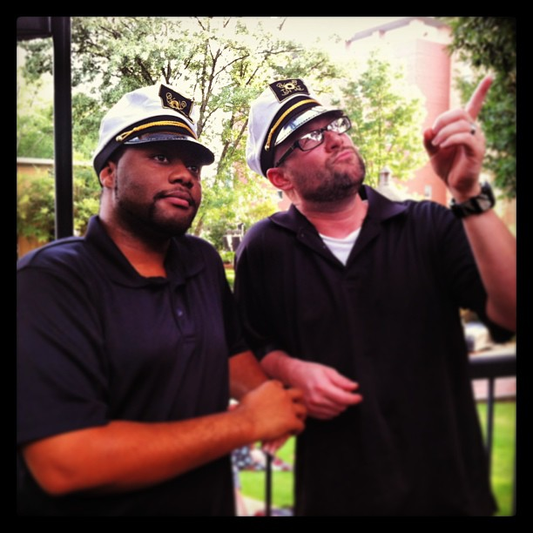
The Sustainable Mobile Web
Christopher Ward Kennesaw State University Director of Web Services and Mobile Development
@beerpievader
Amos Williams Kennesaw State University
Assistant Director of Web Services and Mobile Development @trezzay

Slide 2
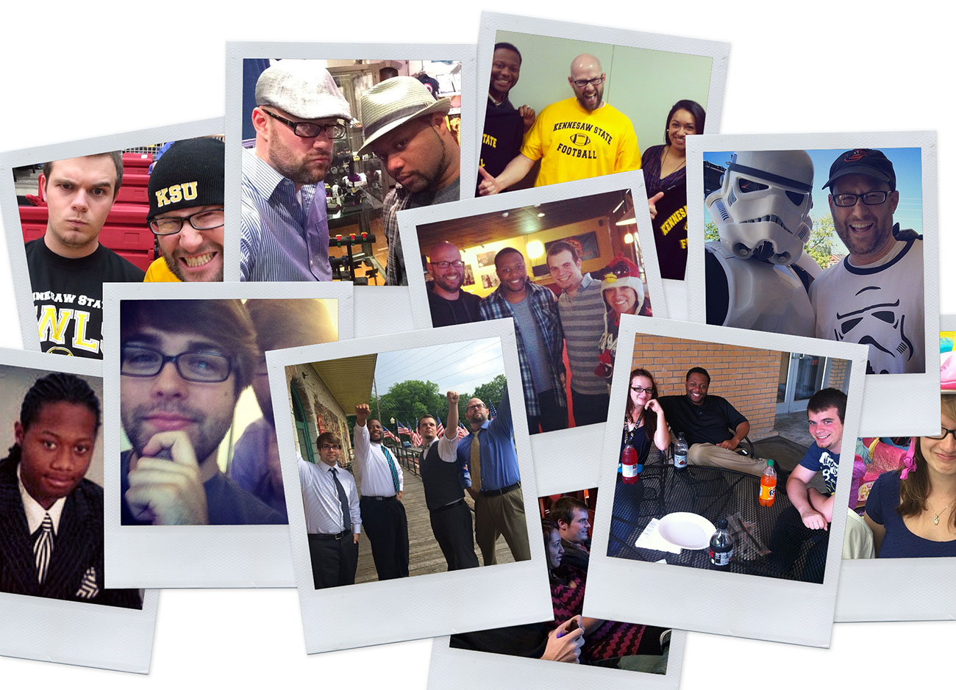
A Little Bit About Us…

Slide 3
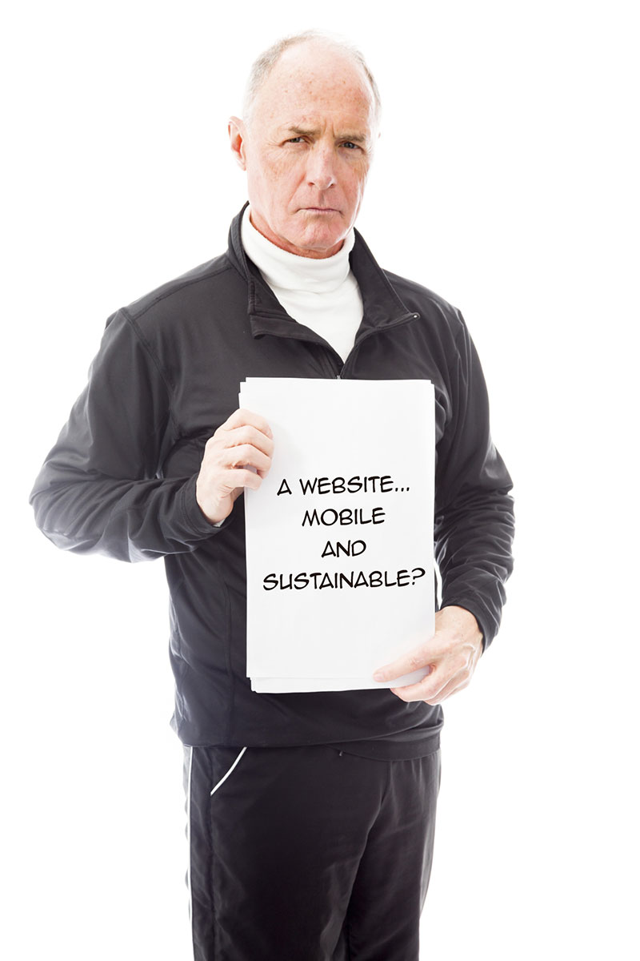
Higher Ed Responsive Web Design is more than putting a Web site on a phone. It is a complicated process that requires complex practices and solutions.
So,…what exactly are we going to be talking about today?

Slide 4
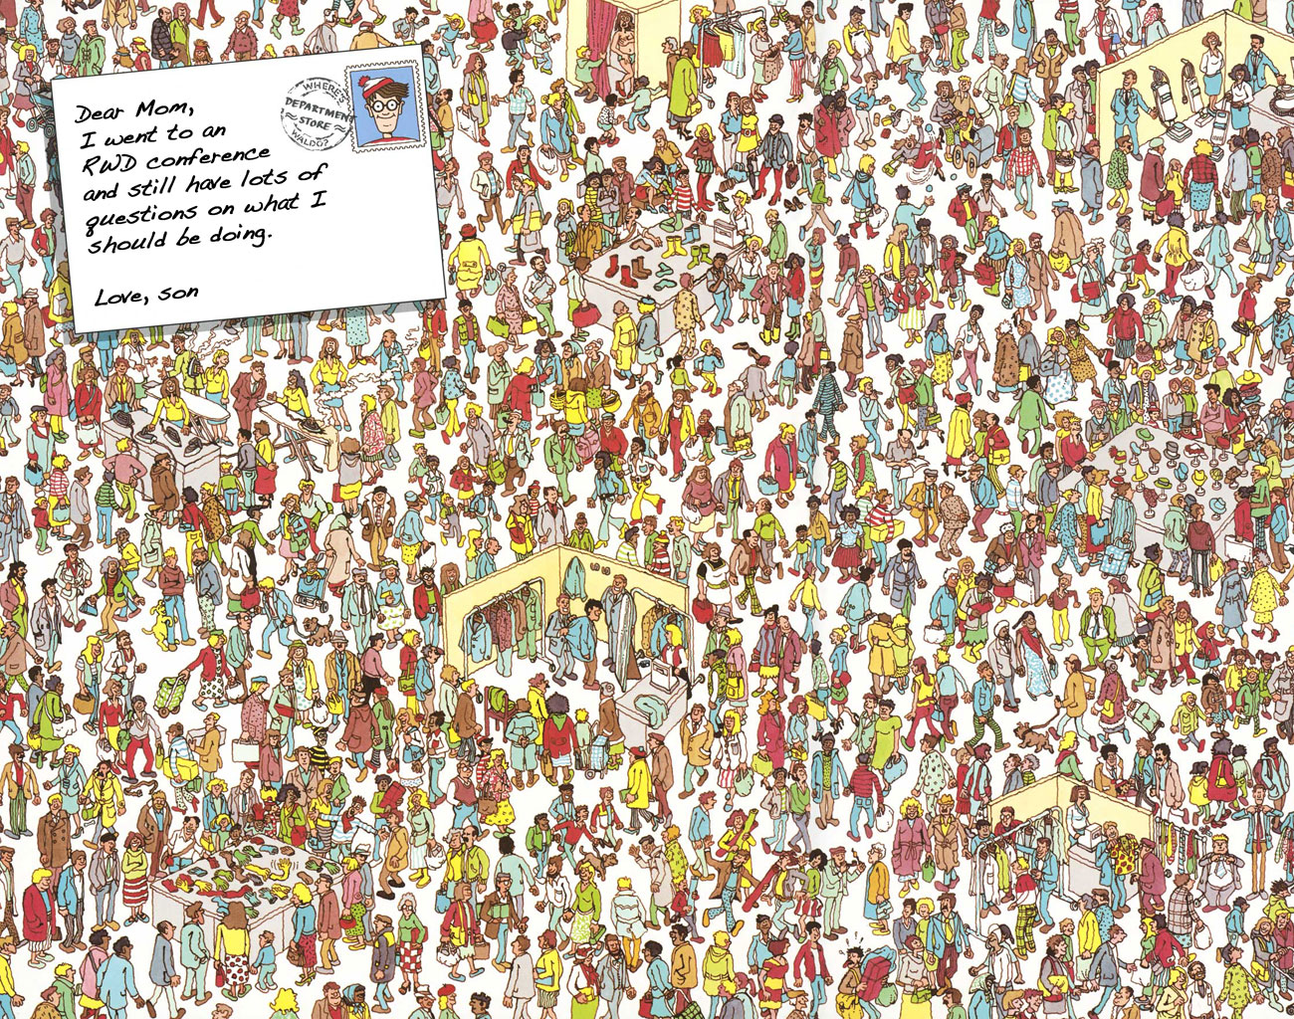

Slide 5
The Sustainable Mobile Web
Christopher Ward Kennesaw State University Director of Web Services and Mobile Development
@beerpievader
Amos Williams Kennesaw State University
Assistant Director of Web Services and Mobile Development @trezzay

Slide 6
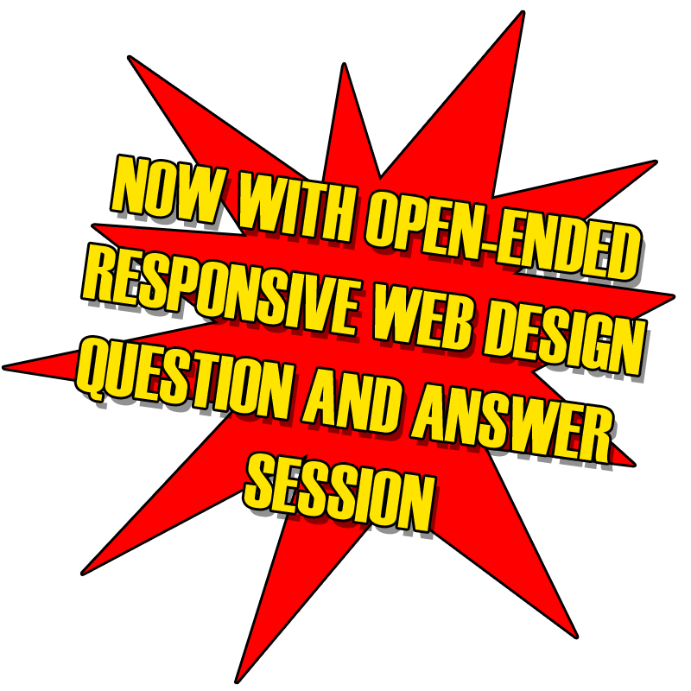
The Sustainable Mobile Web
Christopher Ward Kennesaw State University Director of Web Services and Mobile Development
@beerpievader
Amos Williams Kennesaw State University
Assistant Director of Web Services and Mobile Development @trezzay

Slide 7
Questions
1.
2.
3.
4.
5.

Slide 8
Let’s start with a story.

Slide 13
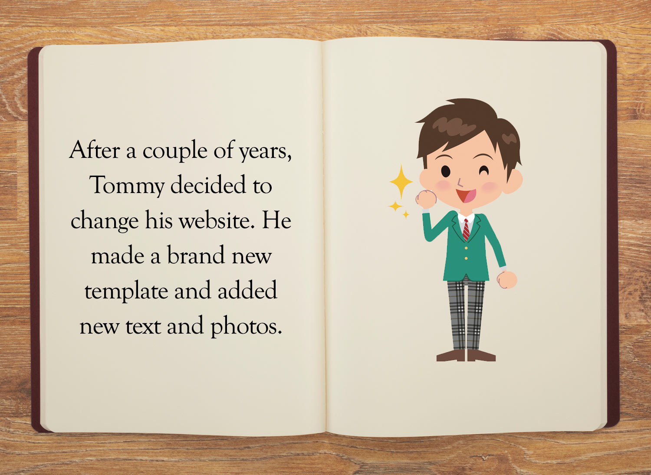

Slide 19
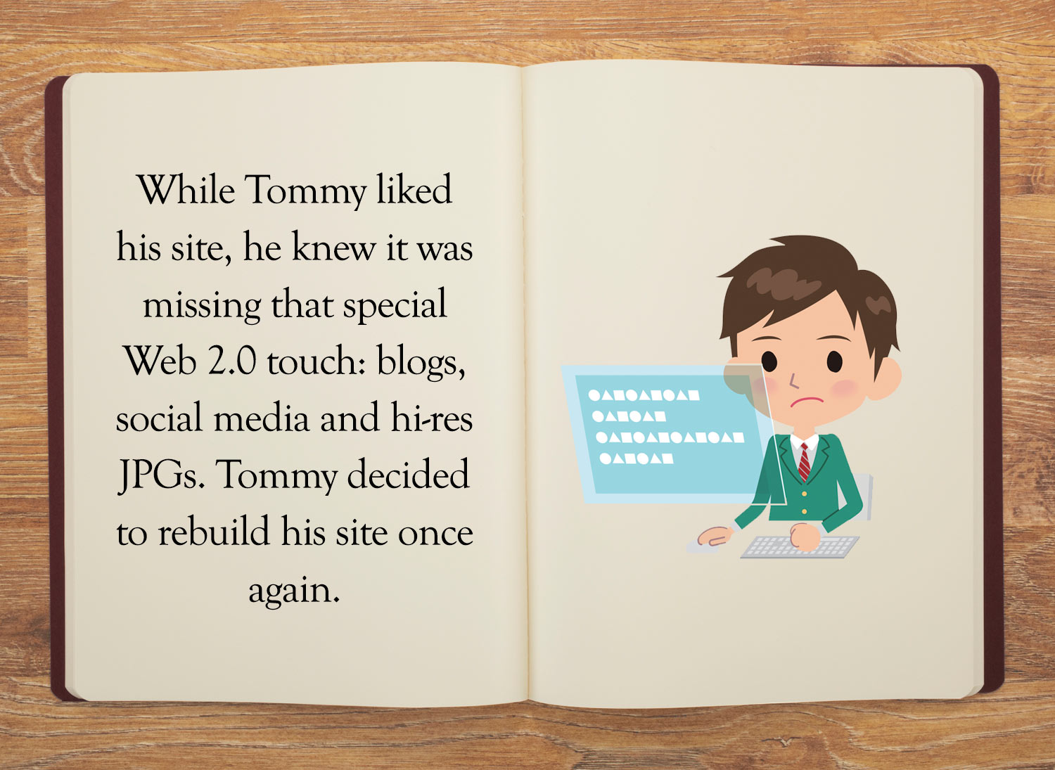

Slide 21
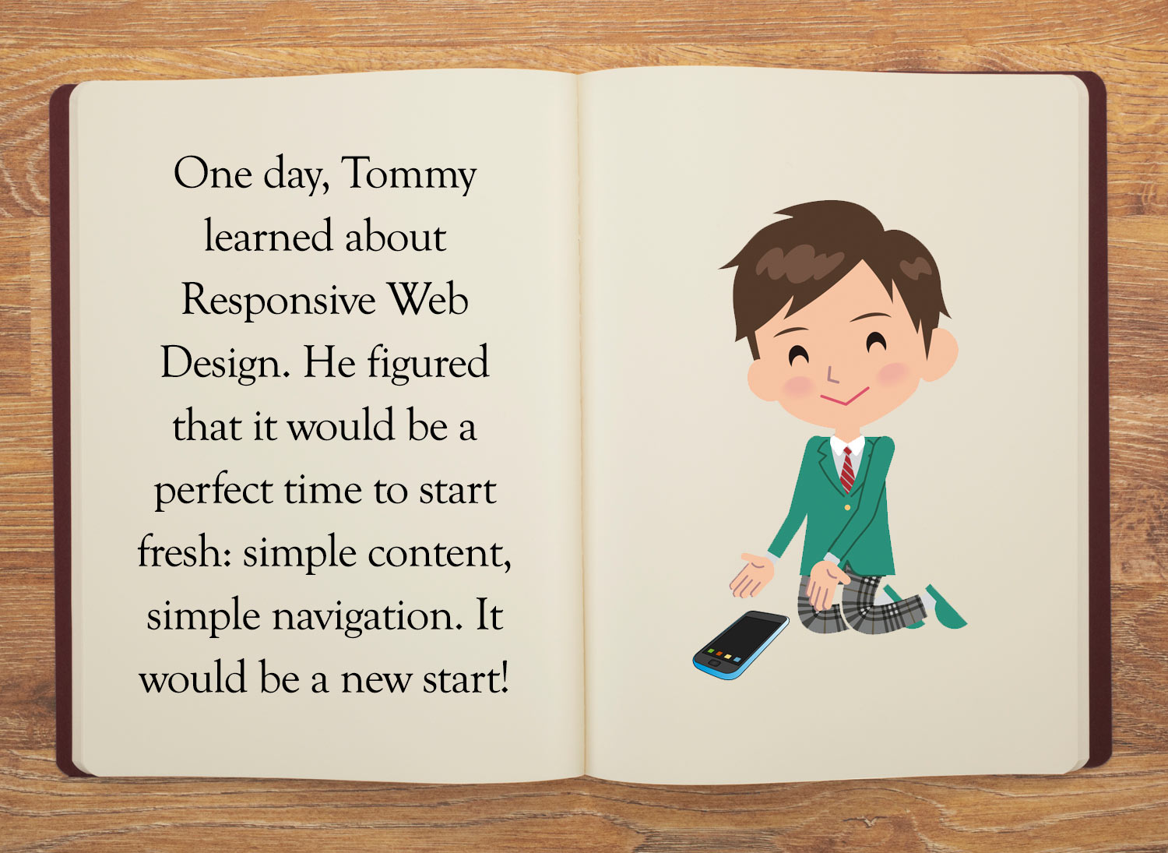

Slide 22
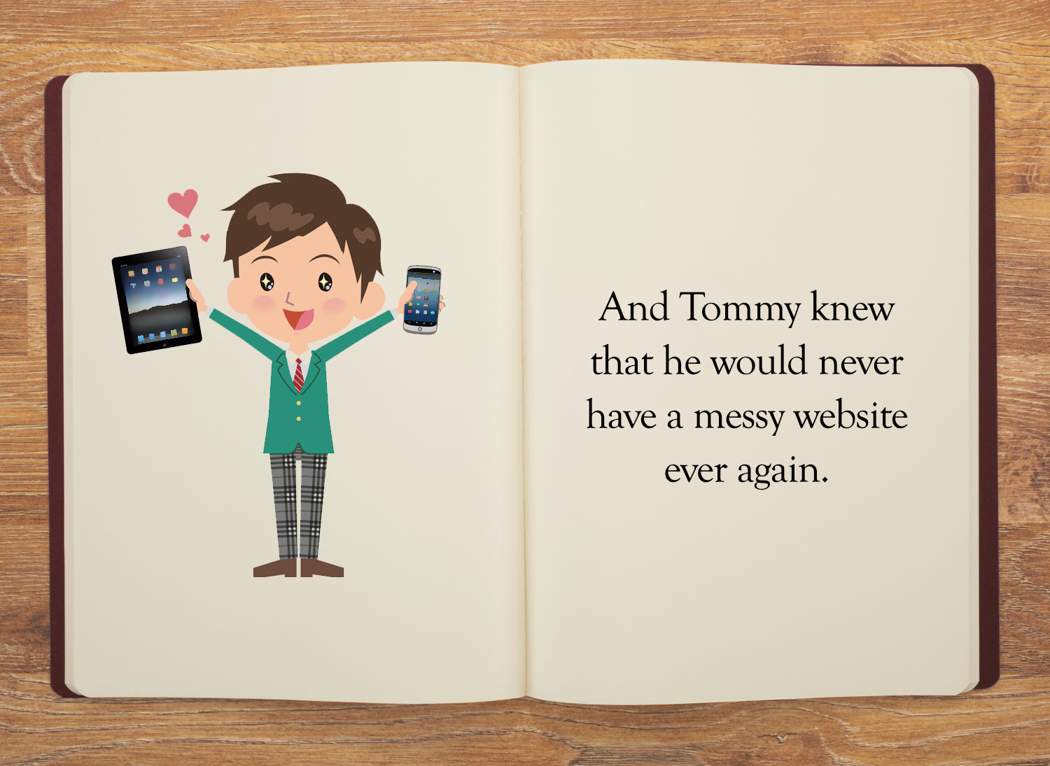

Slide 24
The “Tommy Problem” is coming...RWD is so new that most sites haven’t had a first round of redesigns yet.

Slide 25
What RWD Forces Us To Do…
Refine navigation to work on smaller screens (while not sacrificing usability)
Revise and refine content to work on a multitude of devices, operating systems and screen sizes
Be concise, to the point and get rid of all the crap
Develop responsibly (i.e. not demolish users’ data plans)

Slide 26
Let’s see a real-life example of this insanity in action.

Slide 27
So, <ALL> of this started in September 2011

Slide 28
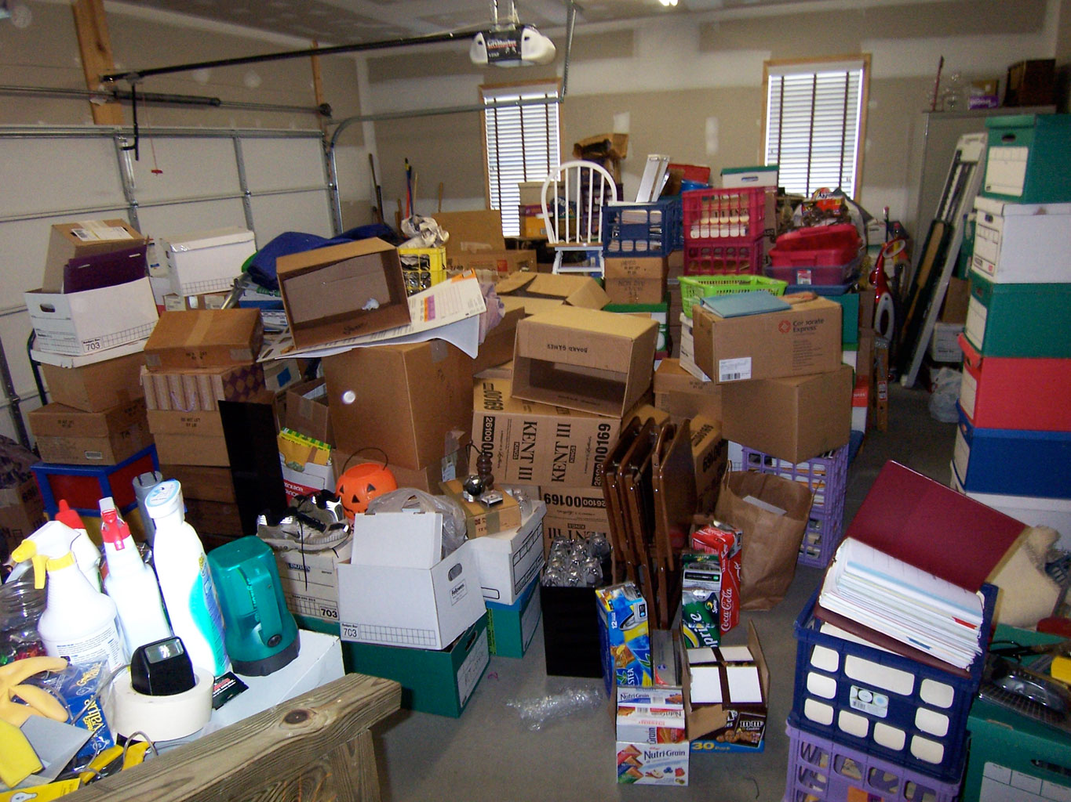
Kennesaw State University Office of Undergraduate Admissions

Slide 29
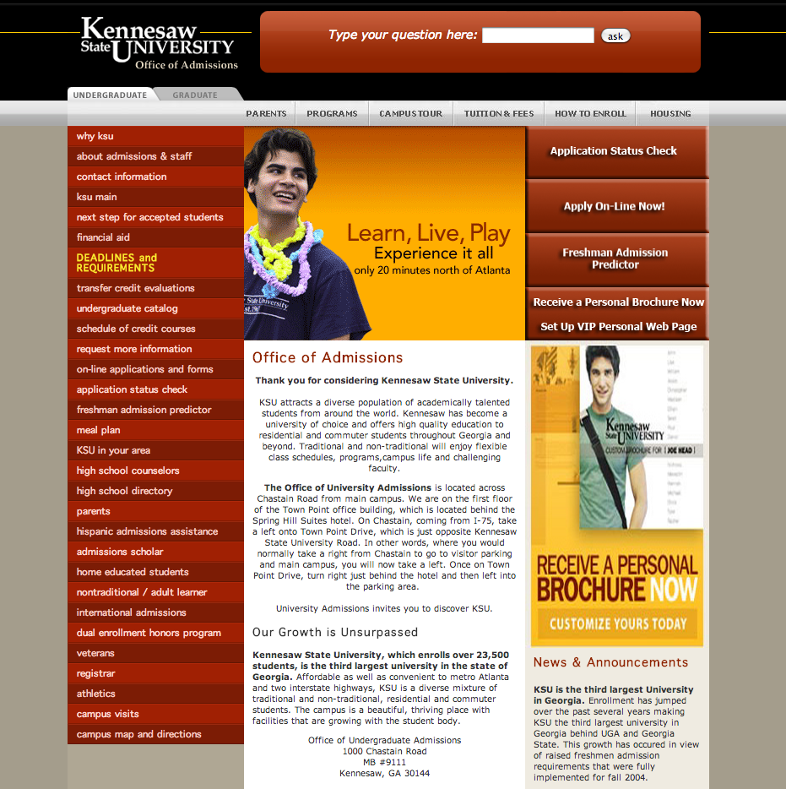

Slide 31
Admissions Action Steps
Content Inventory and Gardening
Condense Navigation
Research and Test Workable RWD Navigation Patterns
Supplement with Alternate Forms of Content

Slide 32
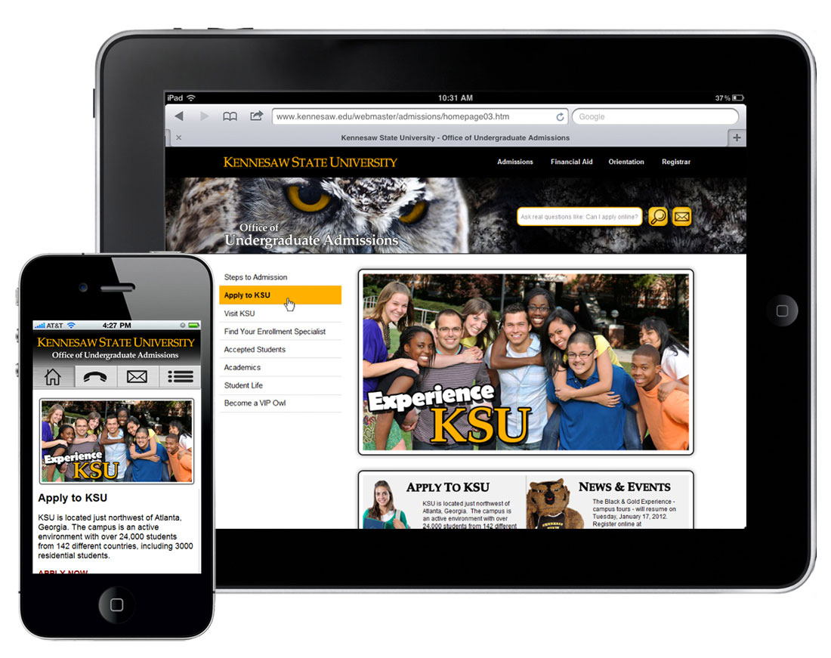
Launched July 2012

Slide 37
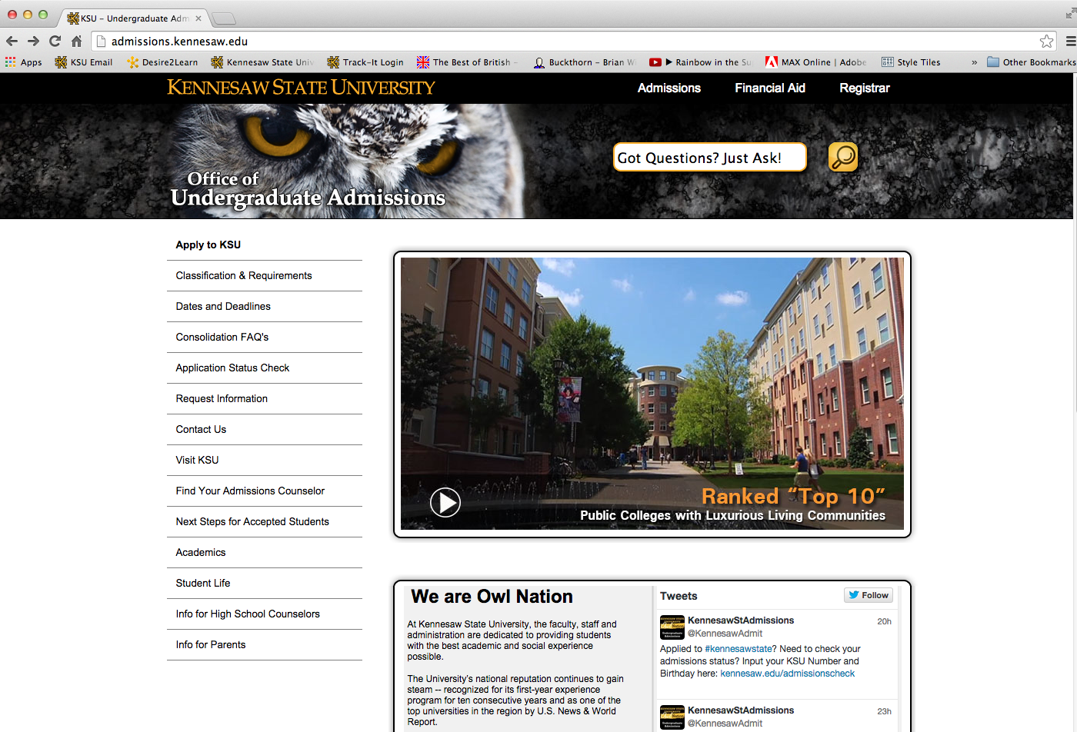

Slide 38
When the KSU Admissions responsive site launched in July 2012 there were
130 pages on the site.
Today there are over 210.

Slide 39
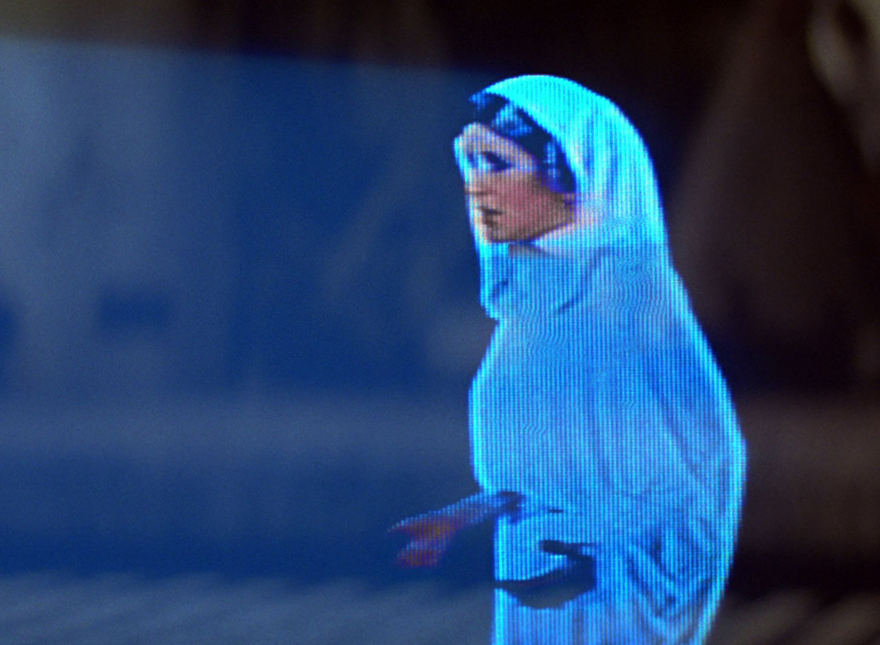
Is there anything that we could have done to prevent this from happening?

Slide 40
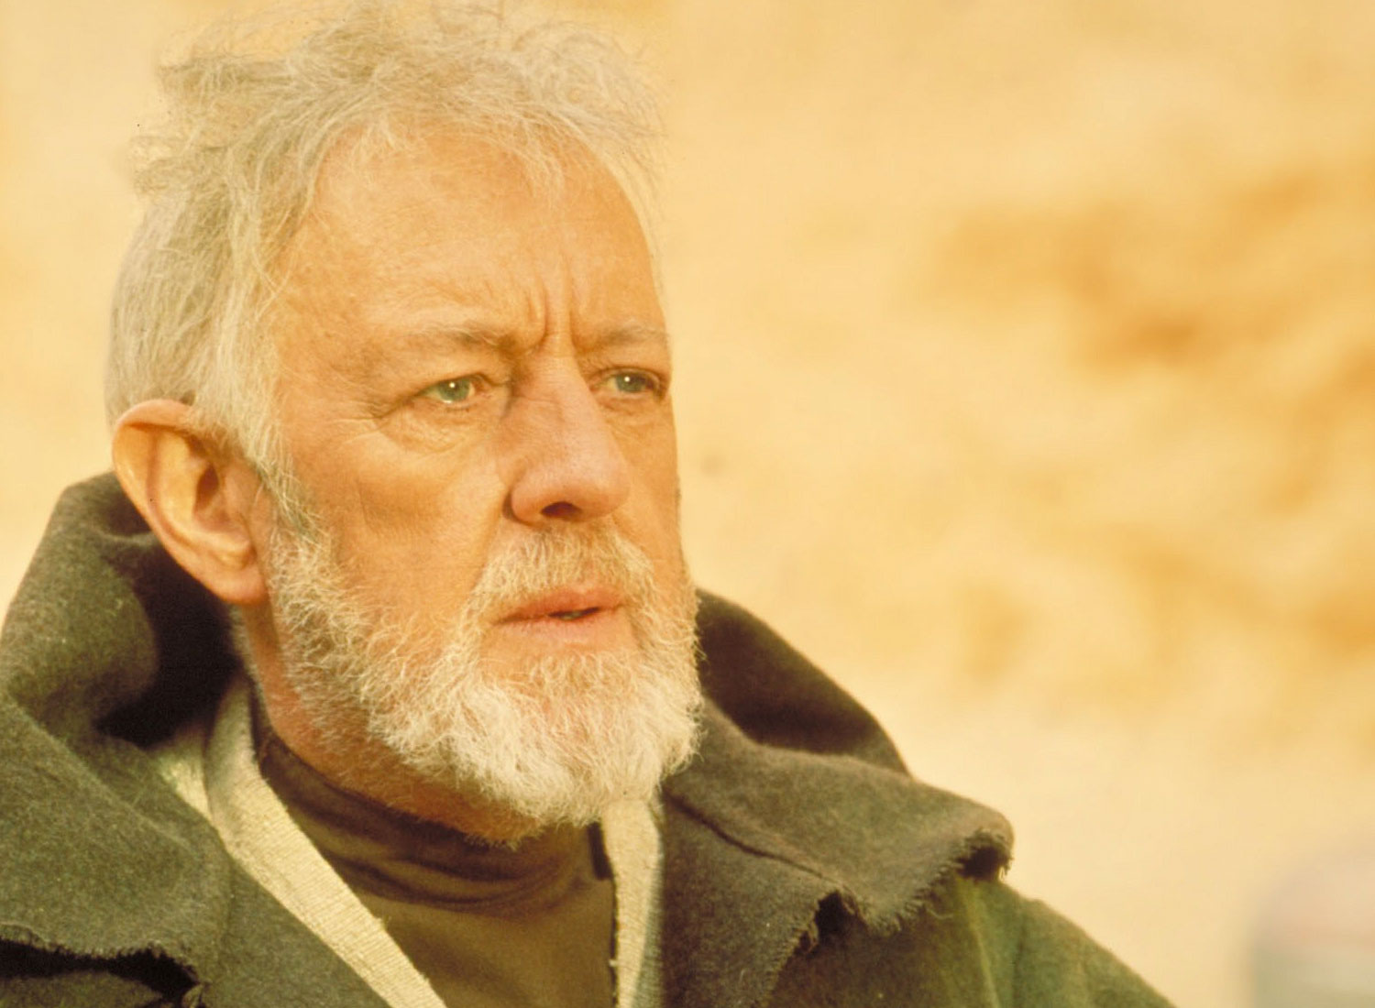
Probably Not.
We still had much to learn in 2012.

Slide 41
Well, is there anything that we can do now to prevent this from happening?

Slide 42
Yes.

Slide 43
The most important step to mobile web sustainability starts with communication and the ability of the developer and client to understand one another.

Slide 44
Things That Web Professionals Need to Be Able to Communicate (In Plain Speak) About The Mobile Web
Content Design & Strategy

Slide 45
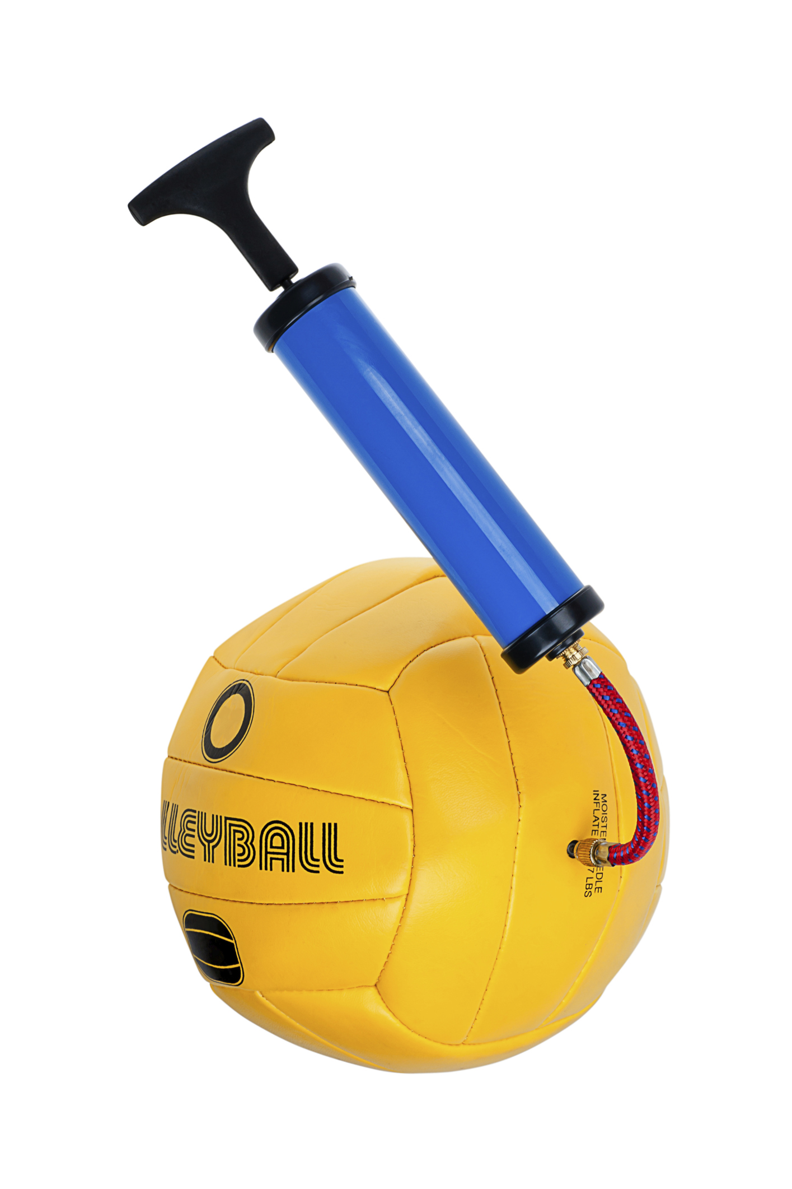
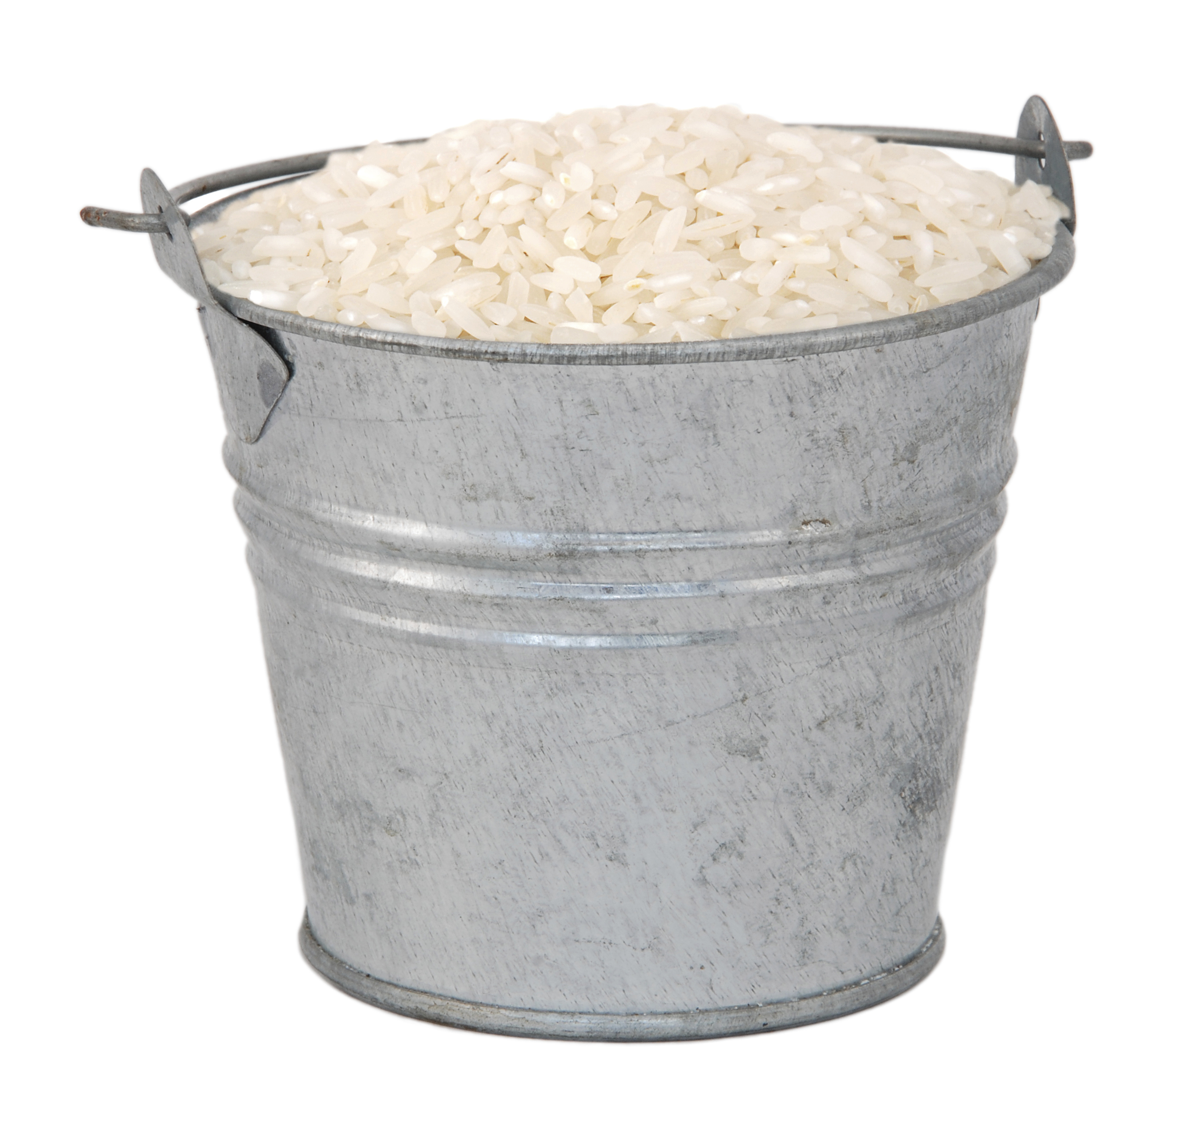
At Kennesaw State University, We Build…
Balls
Buckets

Slide 46
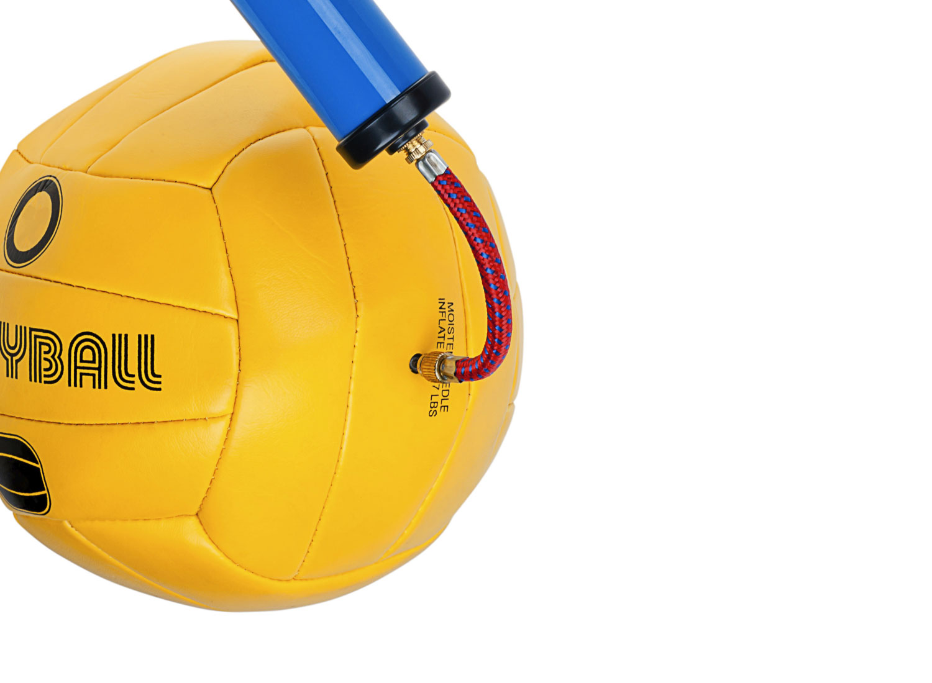
Balls
Have the ability to expand
With too much content, they are unusable
At some point the whole thing will explode and you need to start over

Slide 47
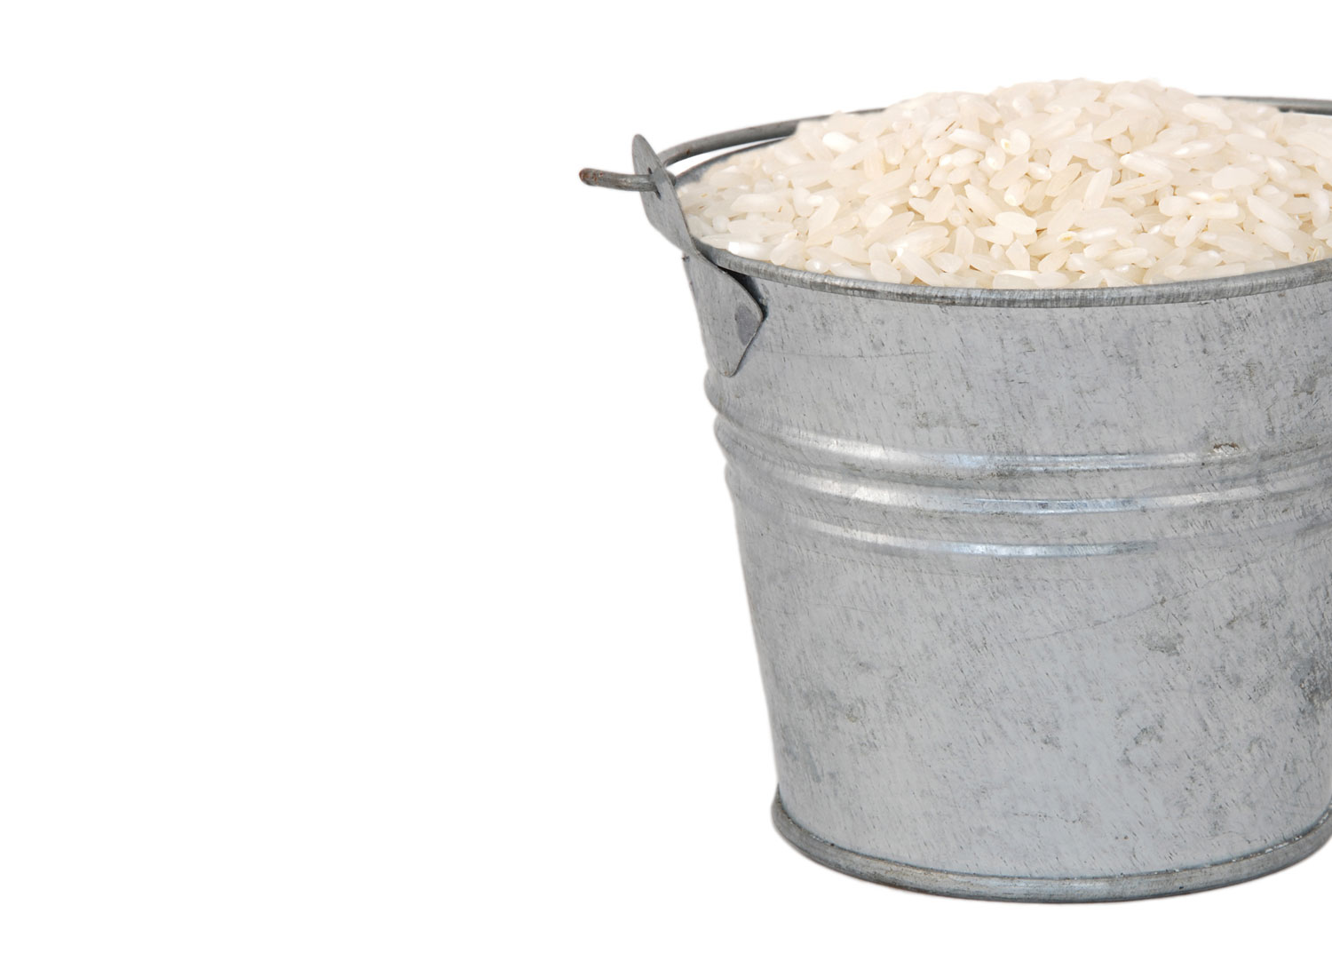
Buckets
Highly structured
Content based on fixed numbers or elements
Once it fills up, just put it in a bigger bucket

Slide 48
Let’s see a real-life example of a “balls” website.

Slide 49
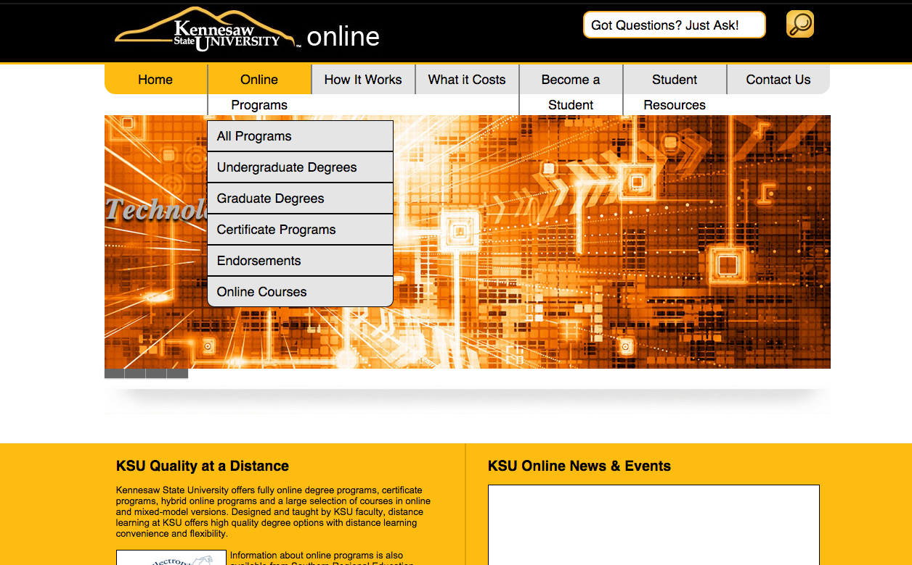
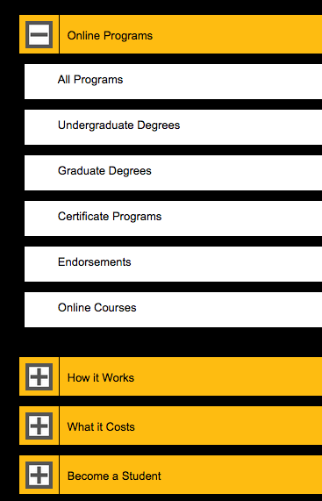

Slide 50
In 24 months, KSU Online Learning added over 130 new pages.
(Aug 2012 – July 2014)

Slide 51
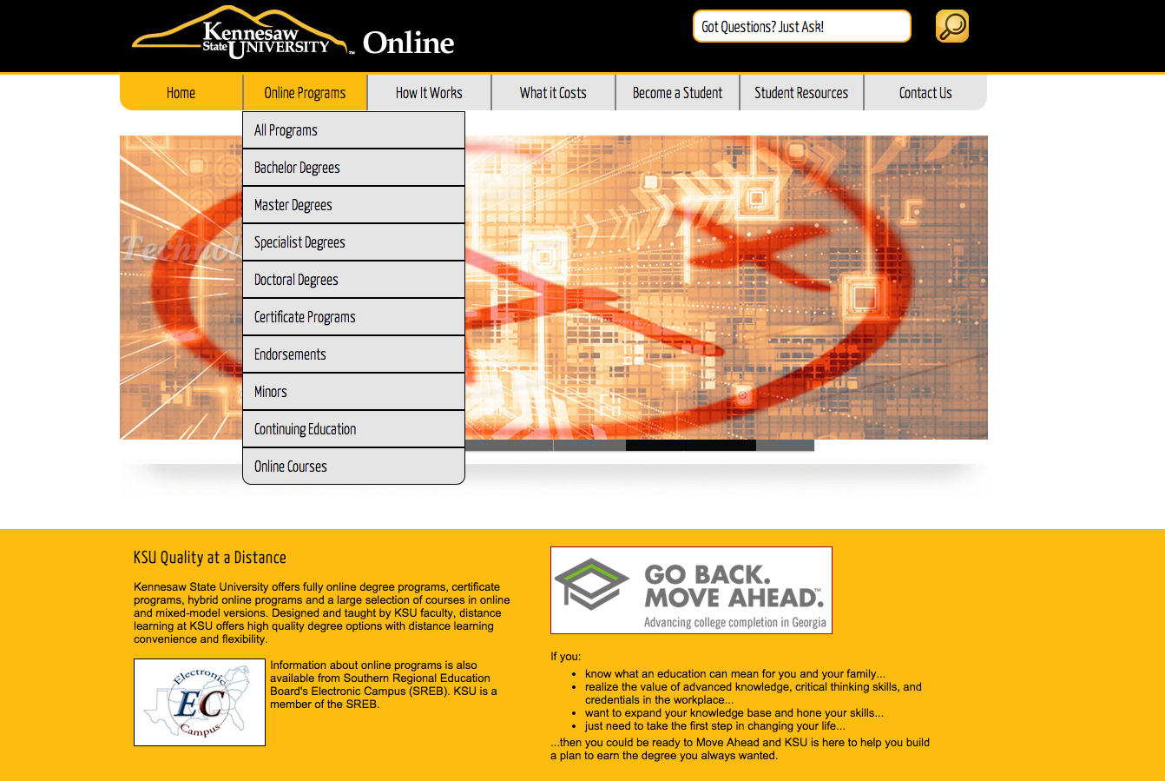
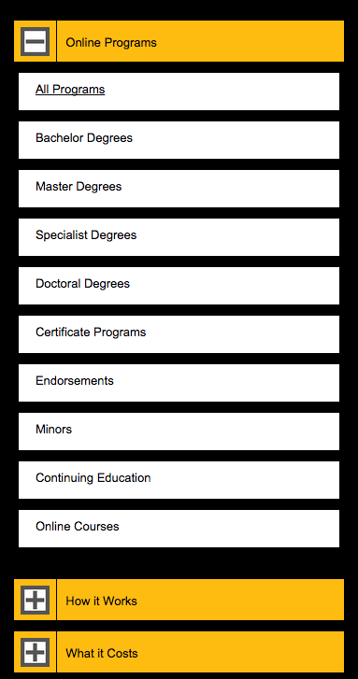

Slide 52
Let’s see a real-life example of a “buckets” website.

Slide 53
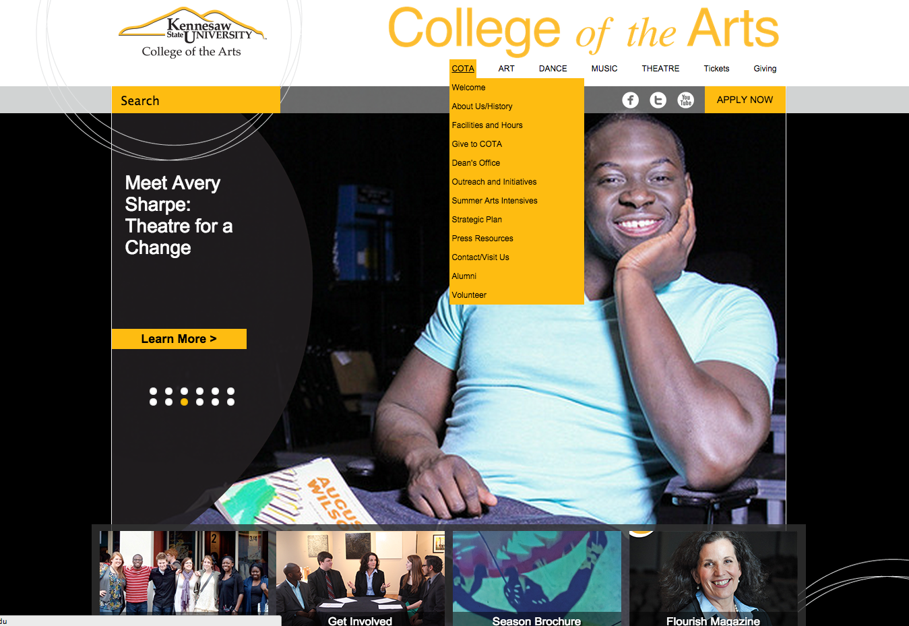
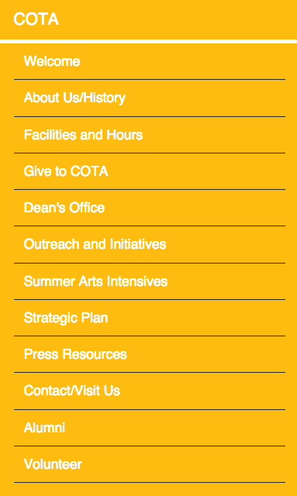

Slide 55
The broader implication with both Balls and Buckets is that pushing in new content elongates pages making sites more unusable on smaller screens.

Slide 56
Of course, there are also multiple forms of unsustainable mobile web content that must be addressed...

Slide 57
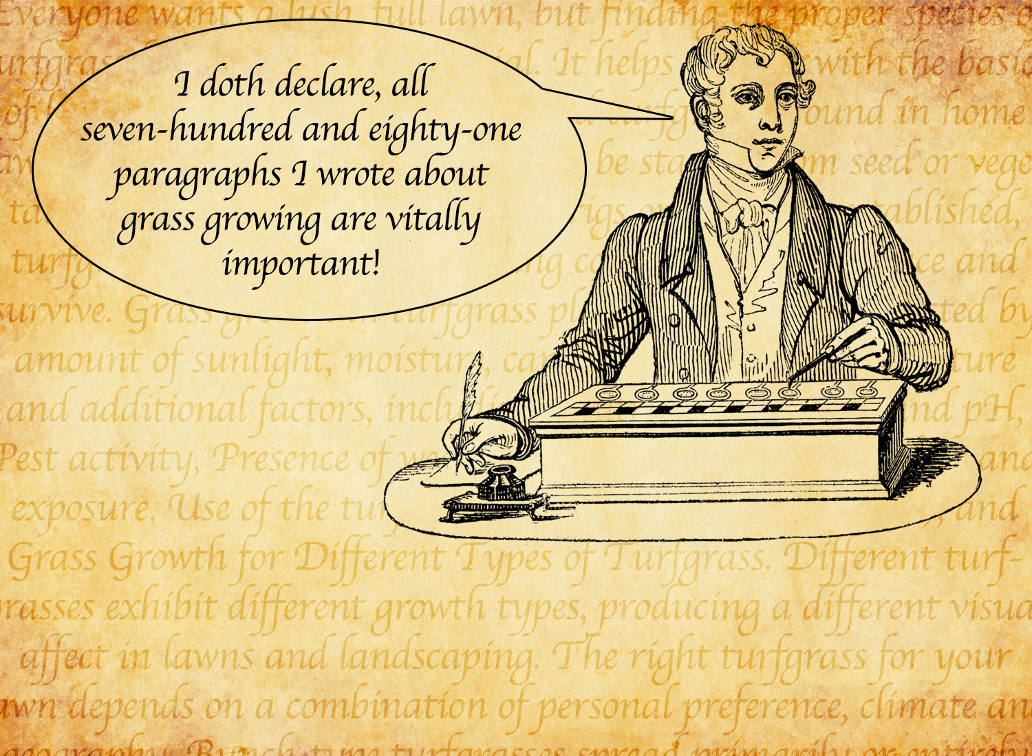
Cap’n Paragraphs

Slide 58
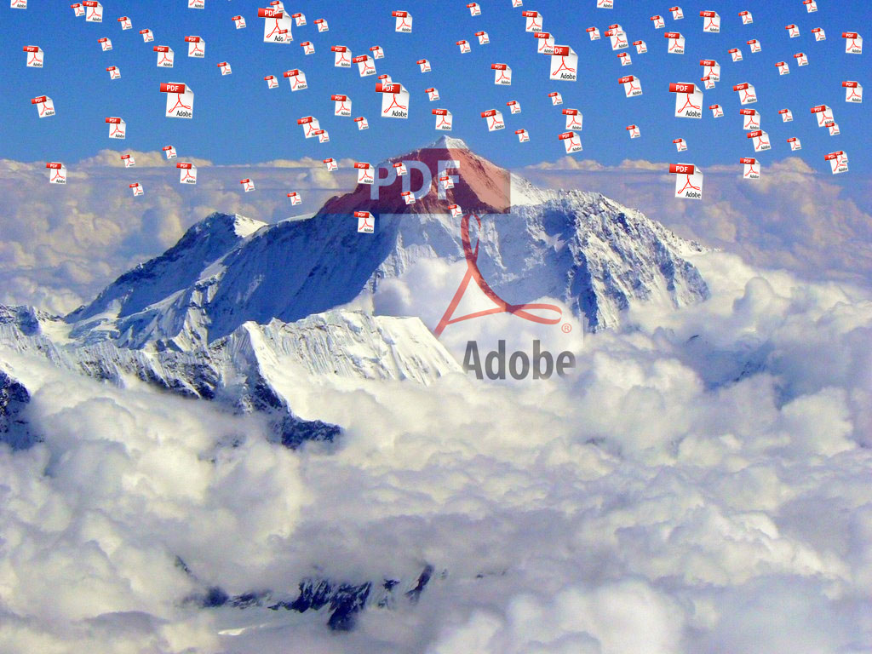
PDF Mountain

Slide 59
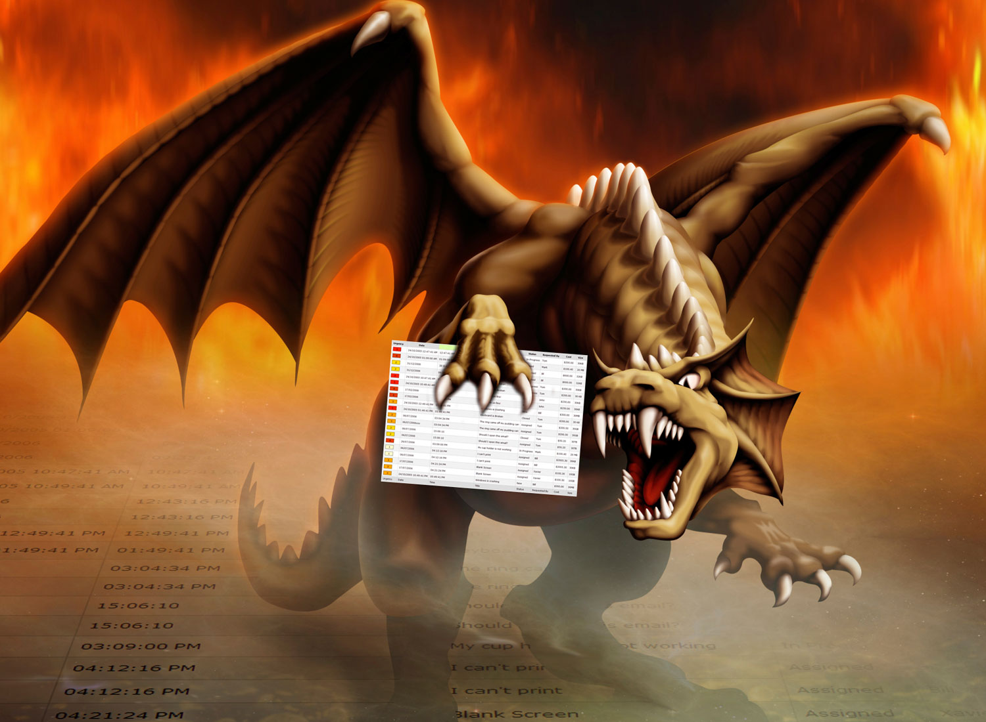
The Table Monster

Slide 60
Stack
Attack

Slide 61
Like a sustainable desktop site, a sustainable mobile website requires a content design that effectively displays information areas in a organized and usable manner.
Not just today…but also two or three years from now.

Slide 62
Things That Web Professionals Need to Be Able to Communicate (In Plain Speak) About The Mobile Web
Content Design & Strategy
Navigation Design and Development

Slide 63
“Mobile navigation should be like a good friend: there when you need them, but cool enough to give you your space. A bad friend is someone who’s not there when you need someone to talk to (when navigation is absent or hard to find), or someone who’s obnoxious because they’re always around and taking up space (dude, get off my couch). Finding the balance between accessible navigation and mobile screen real estate is an art that we’re all trying to sort out.” – Brad Frost

Slide 65
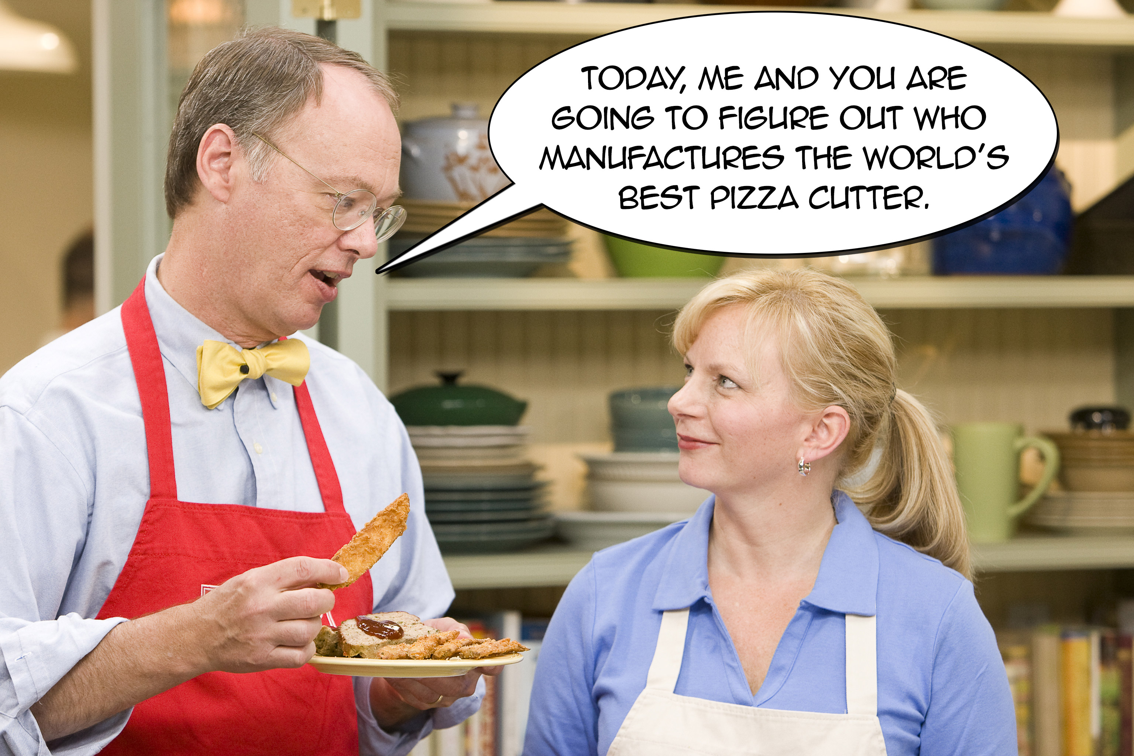

Slide 66
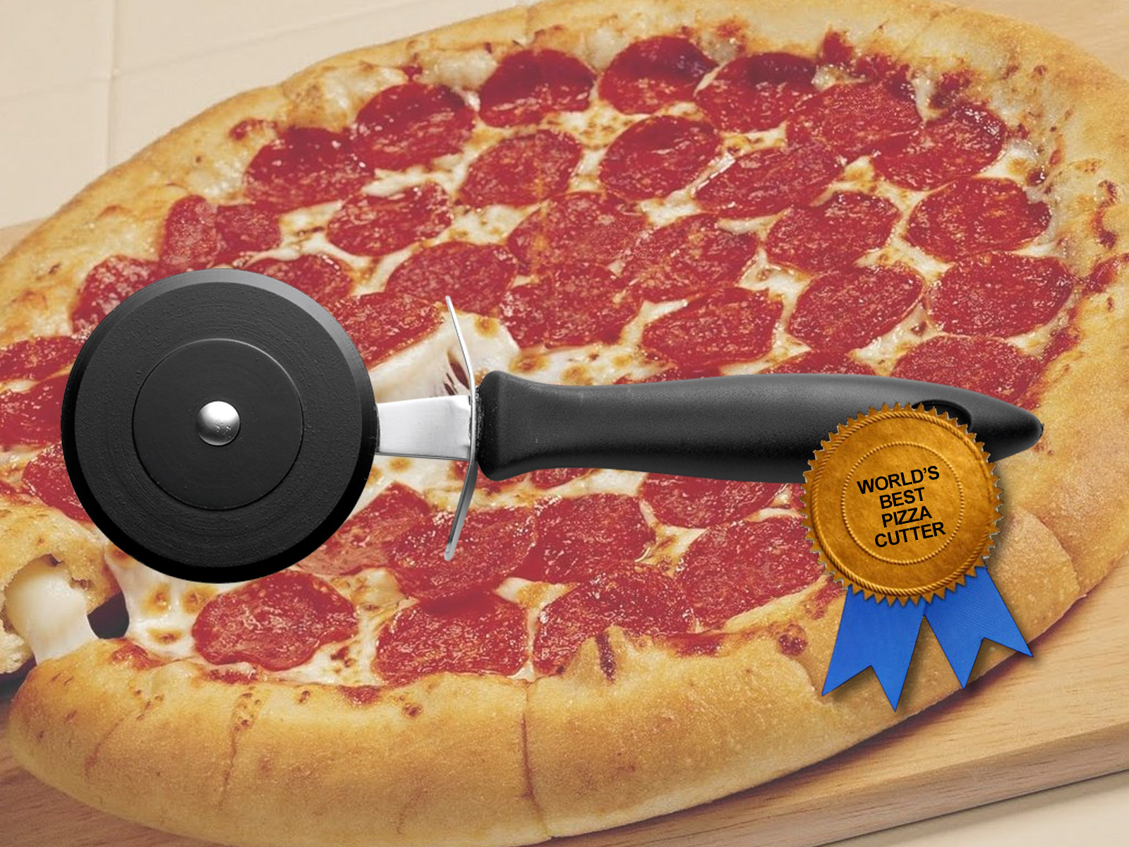
World’s Best Pizza Cutter

Slide 67
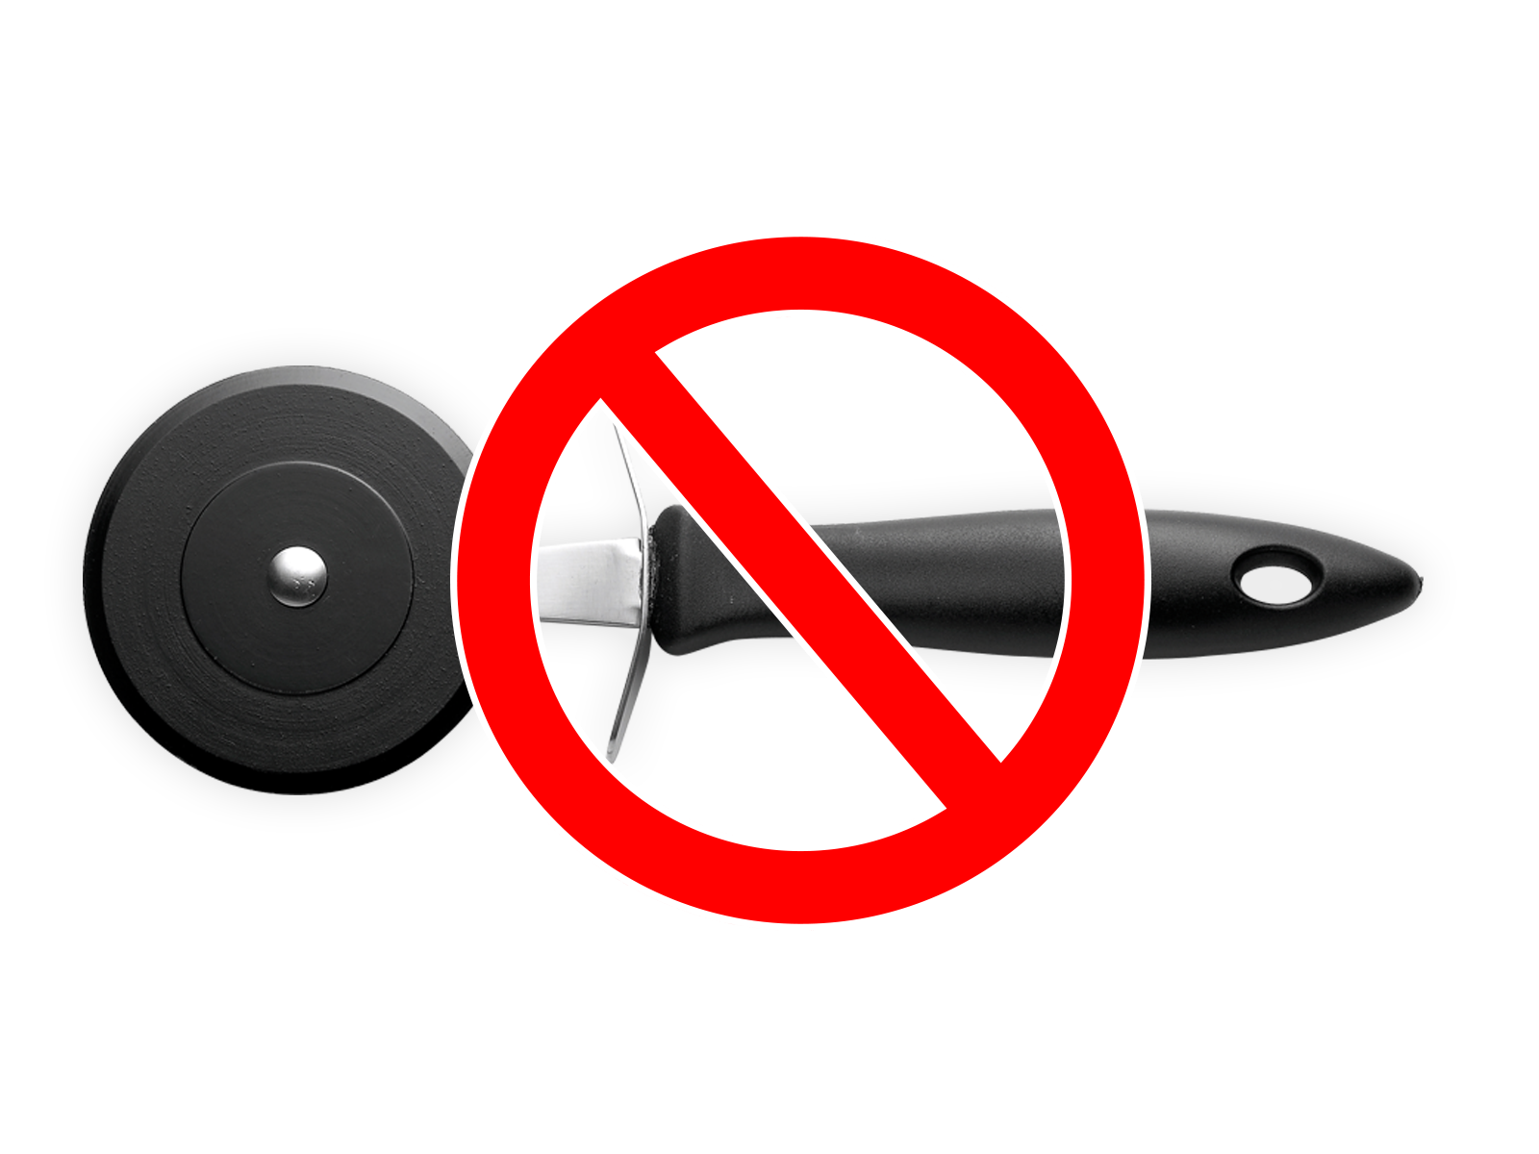
RWD navigation solutions…
Are NOT LIKE pizza cutters.

Slide 68
Well-designed RWD navigation should be flexible – the ability to accommodate expandability – without sacrificing usability.

Slide 69
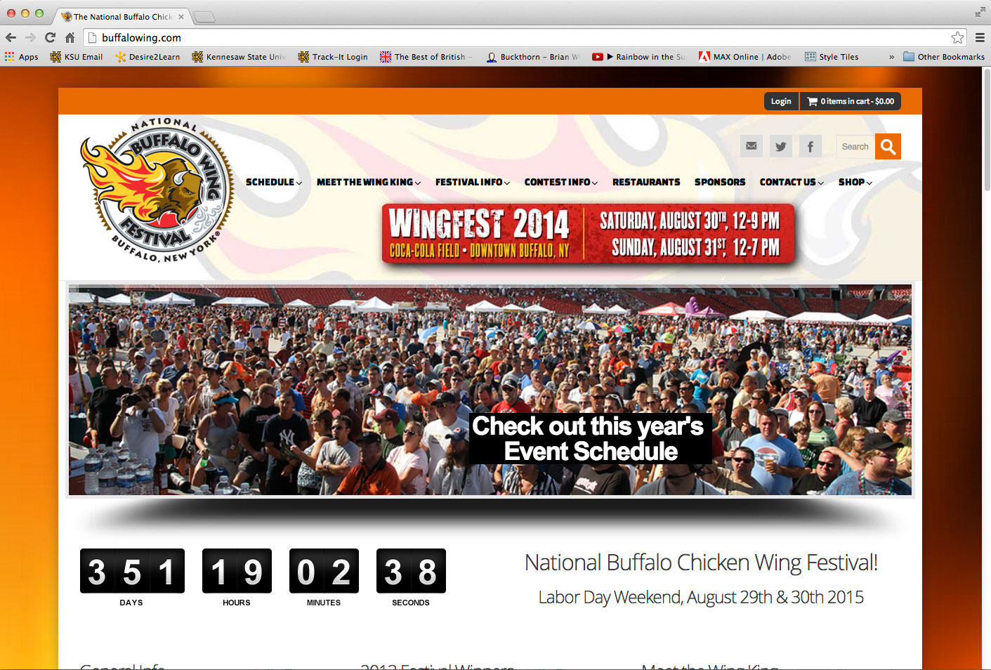

Slide 70
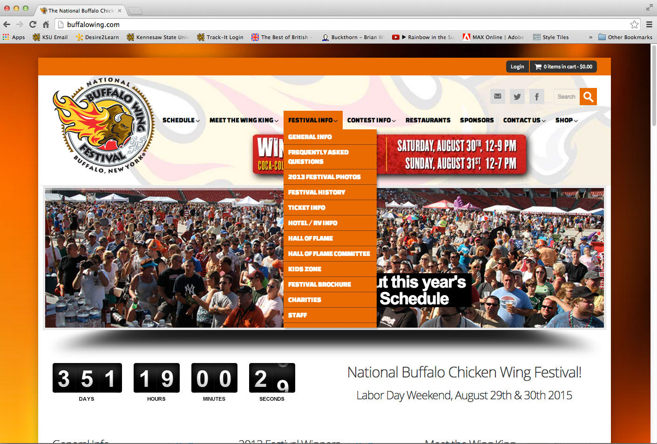

Slide 71
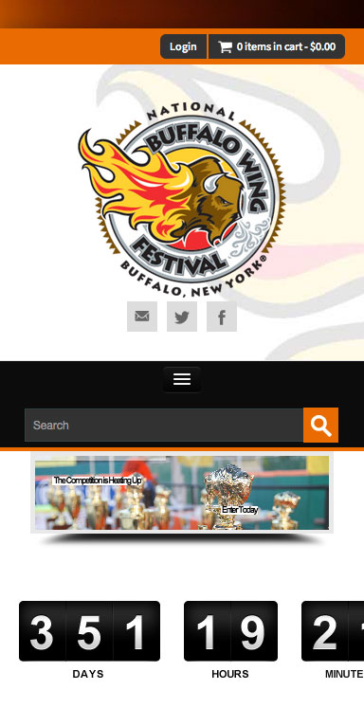

Slide 72
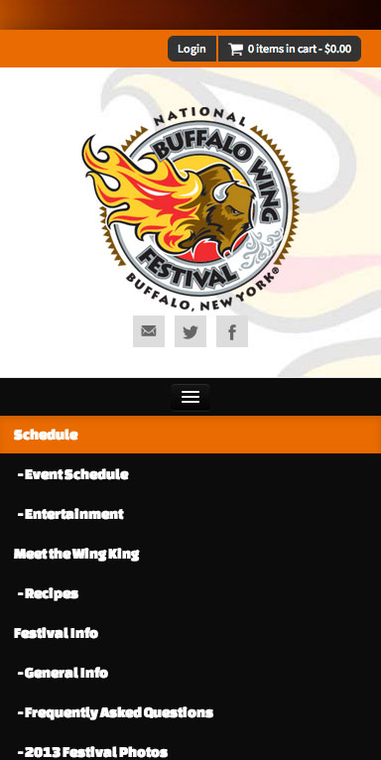

Slide 75
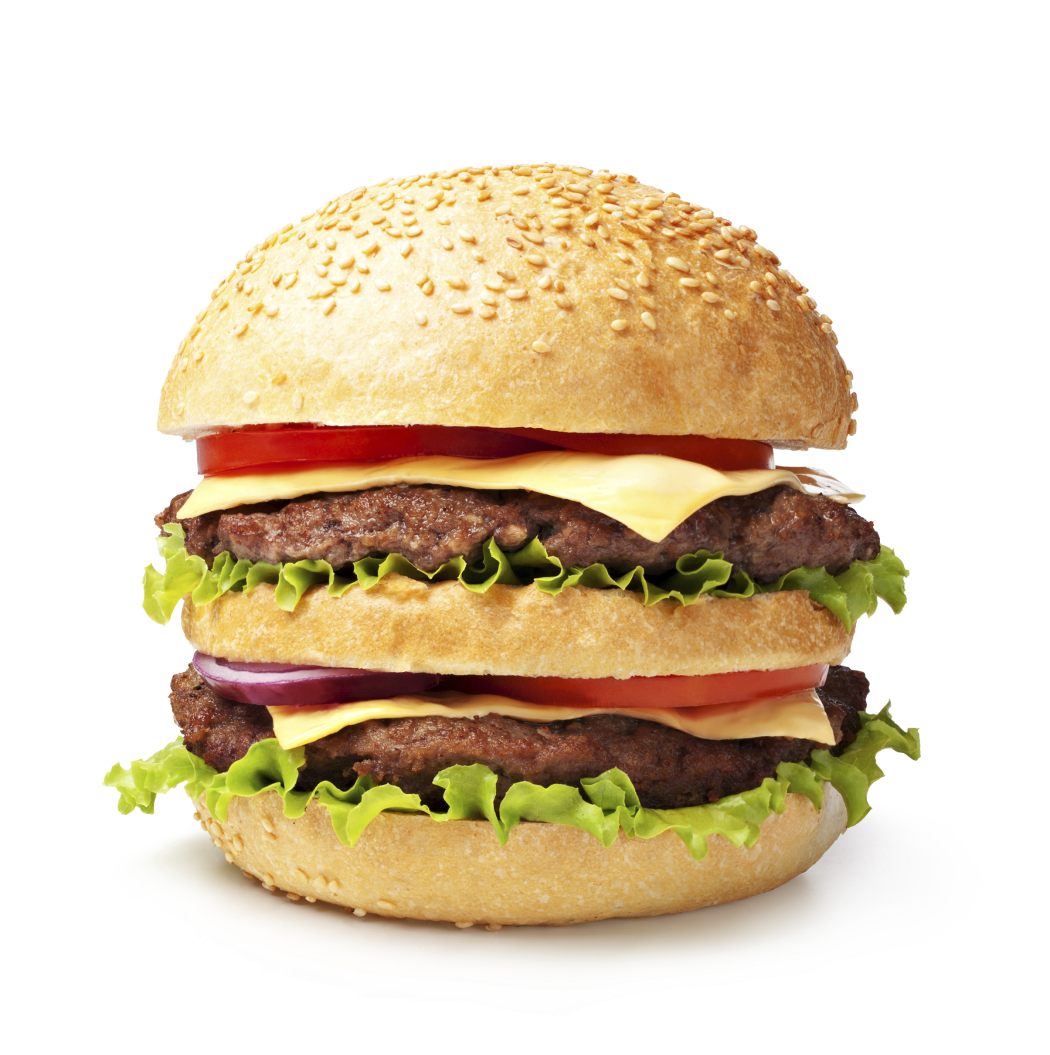
Mobile Web Navigation is not arbitrarily implementing a hamburger icon and putting a list of 42 items under it.

Slide 76
Like a sustainable desktop site, a sustainable mobile website requires a navigation pattern that effectively displays content areas in a organized and usable manner.
Not just today…but also two or three years from now.

Slide 77
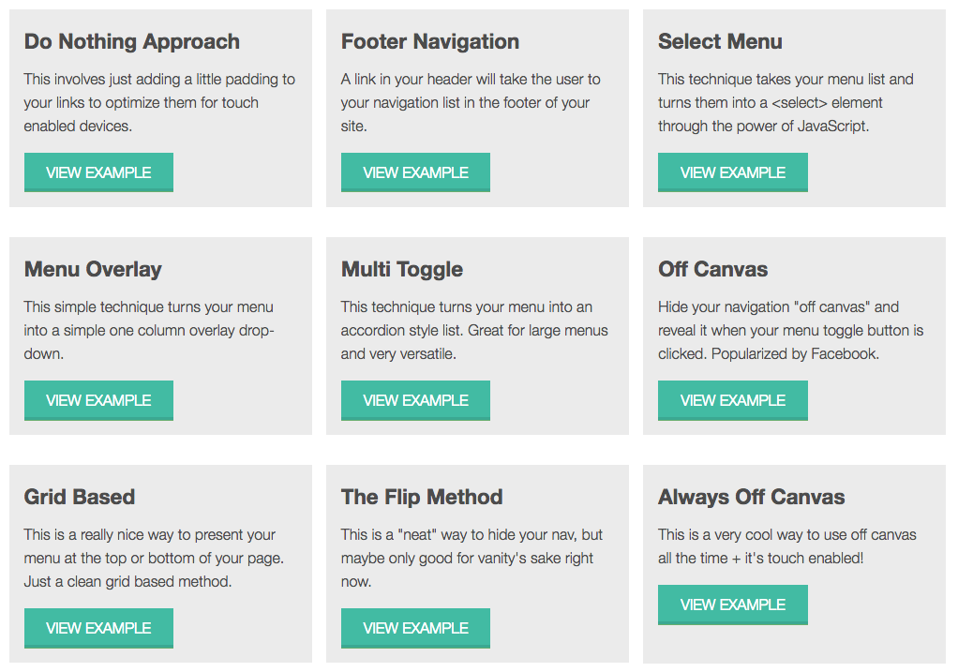
http://www.responsivenavigation.net

Slide 78
Trying to figure out mobile web strategies by guessing is like working in the dark.
(and a bit scary)

Slide 79
Things That Web Professionals Need to Be Able to Communicate (In Plain Speak) About The Mobile Web
Content Design & Strategy
Navigation Design and Development
Analytics

Slide 80
Using analytics should consistently drive decisions on content, navigation, desktop, mobile and all things in between.

Slide 81
Let’s see a real-life example of using analytics to make a sustainable site.

Slide 82
Welcome to Enterprise Systems & Services
Home of www.kennesaw.edu/ess

Slide 83
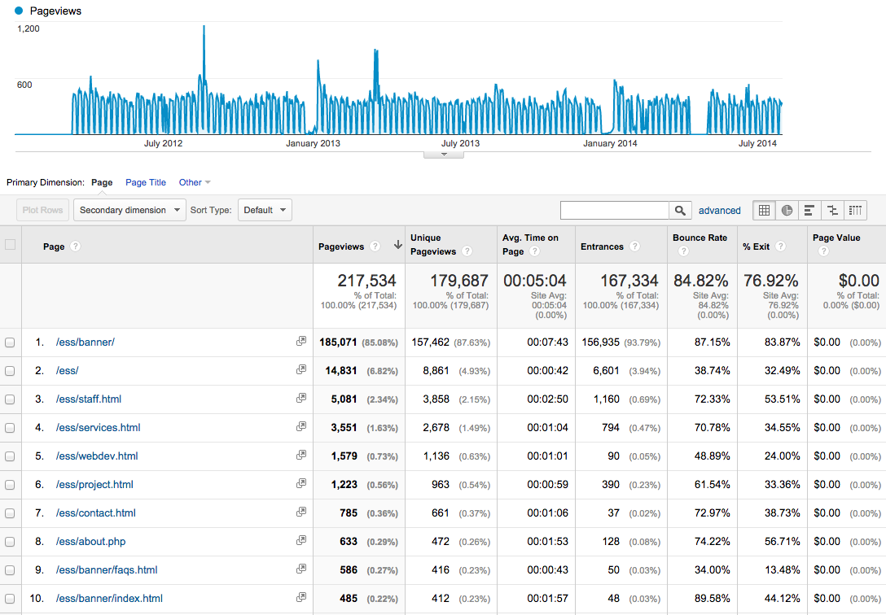

Slide 84
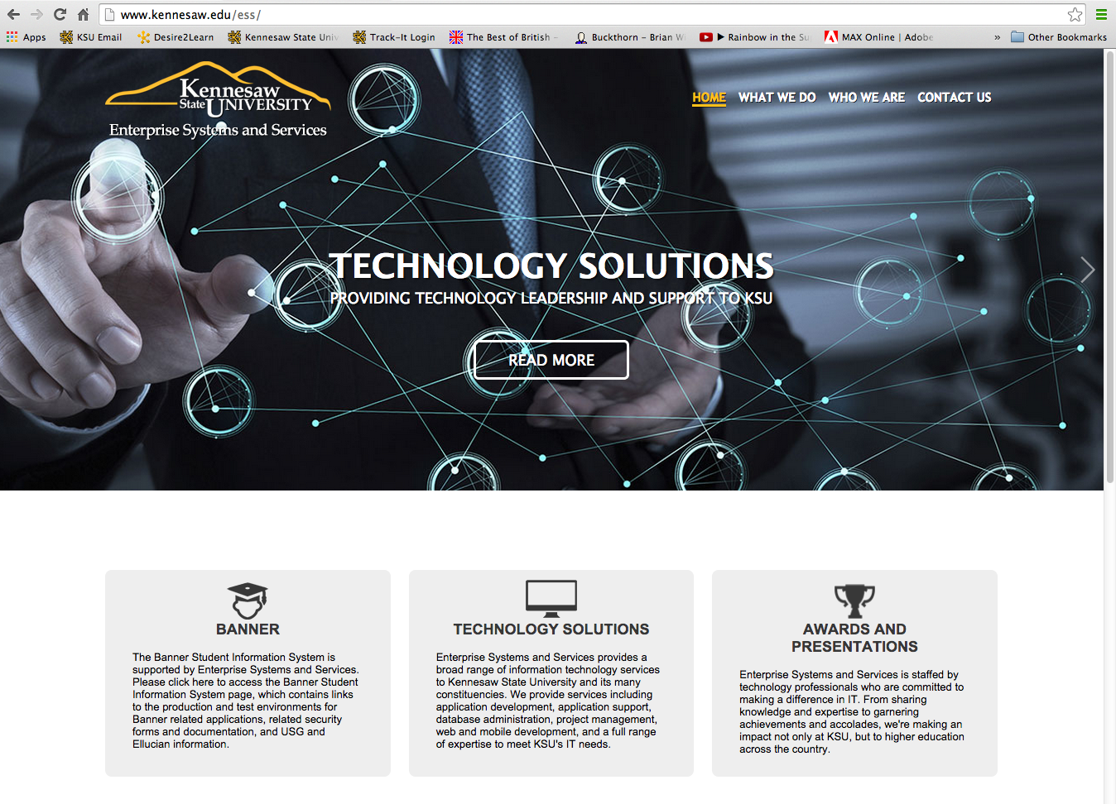

Slide 85
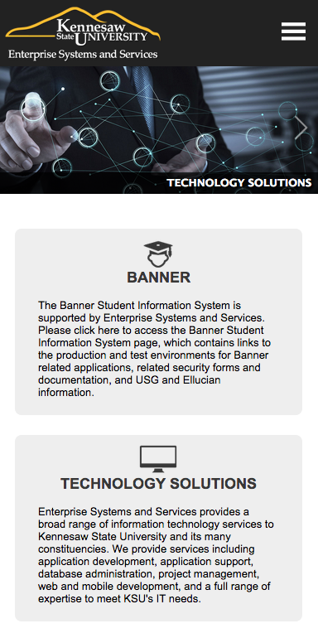

Slide 86
Things That Web Professionals Need to Be Able to Communicate (In Plain Speak) About The Mobile Web
Content Design & Strategy
Navigation Design and Development
Analytics

Slide 87
Developing for the mobile web is more than putting a site on a phone. It is a complicated process that requires complex practices and solutions.

Slide 88
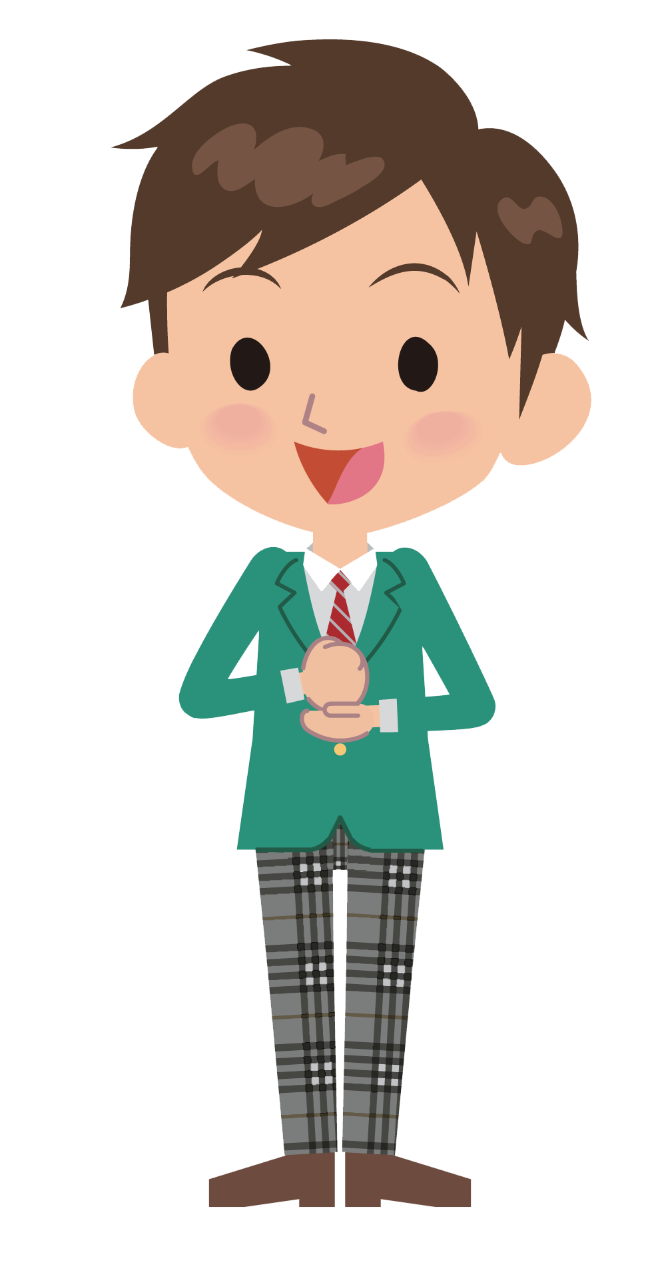
The modern web demands us to build responsibly.
That’s right…the responsible responsive
sustainable web.

