Slide 1
What a Fool Believes: Managing a Web Project Without a Project Manager
What a Fool Believes: Managing a Web Project Without a Project Manager
Paula Bechtler, Project Manager Kennesaw State University
Christopher Ward, Director of Web Services Kennesaw State University
Paula Bechtler, Project Manager Kennesaw State University
Christopher Ward, Director of Web Services Kennesaw State University

Slide 3
Why are you here today / What are you wanting to learn?

Slide 4
Why WE think this talk is important.

Slide 5
Before we start…
Let’s talk about where we were and WHY we needed a project manager for web development.

Slide 6
Kennesaw.edu
2002-2013

Slide 7
Consolidation
2014

Slide 8
Kennesaw.edu
2015-present

Slide 9
One really important note before we get started...

Slide 11
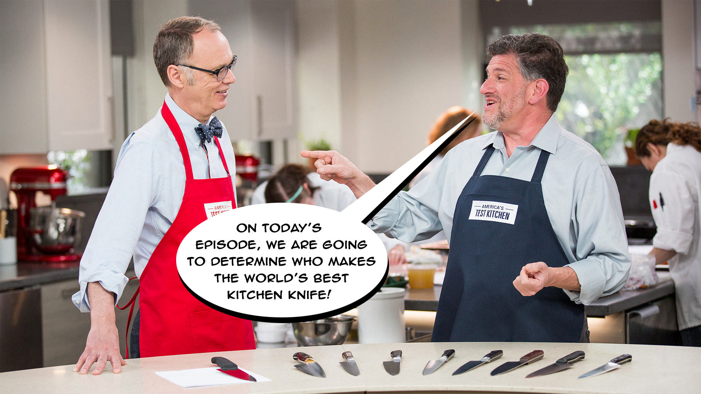

Slide 12
World’s Best Kitchen Knife

Slide 13
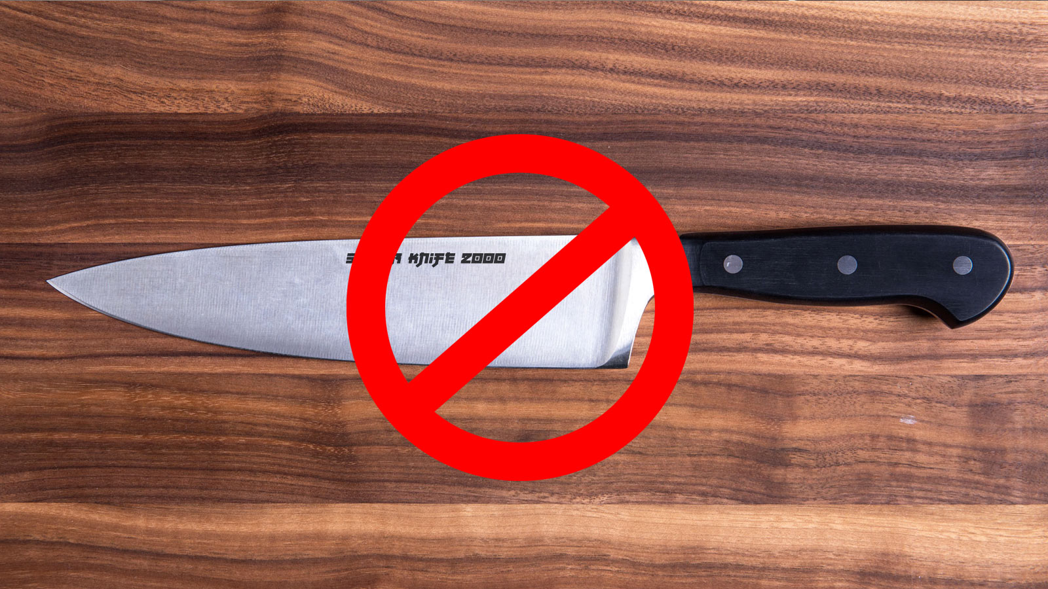
Project Management solutions…
Are NOT LIKE kitchen knives!

Slide 14
Set realistic expectations.
Be authentic.
There is no perfect project management solution…only perfect practices that fit your goals and needs.

Slide 15
Three Parts to EVERY Project
Planning
Execution
Closeout

Slide 16
Planning

Slide 17
Listen to the client/customer.

Slide 18
Define the scope of the project.

Slide 19
Know the stakeholders up front and
establish primary lines of communication.

Slide 20
Set realistic goals and
specific timeframes.

Slide 21
Determine tasks and
assign to individuals, groups, and/or teams.

Slide 22
Story Time! This is Dr. Cap N. Smooth. He has contacted the WebGroup to help him develop a new website for the university’s Yacht Club. In his initial e-mail he has indicated that he is working with another faculty member as well as a group of students who he is advising.
Dr. Smooth has let us know he has a handful of photos and some text that he has about yachting. He would like to know if he could ”just send it to us” and if we could “have something for him to look at before the start of spring semester.”

Slide 23
Execution

Slide 24
Monitor progress and stay on track.

Slide 25
Evade attempts to increase scope.

Slide 26
Inform team members of progress.

Slide 27
Story Time! After meeting with the WebGroup, Dr. Smooth returned to his office and immediately started working on exciting and fresh content for the Yacht Club’s website.
The first weekend he sent several pages of text and a few PDF files. Shortly thereafter, he neglected to send critical content necessary for the site’s completion.
Additionally, after a night of vivid brainstorming he had an idea to add a page on the site where users could upload their favorite yachting Pinterest posts. He let the WebGroup know that he wanted to add this new functionality immediately.

Slide 28
Closeout

Slide 29
Communicate to audiences upon project launch.

Slide 30
Identify lessons learned.

Slide 31
Determine future planning (especially if project was in phases).

Slide 32
Story Time! After completing the website, Dr. Smooth was ready to launch the Yacht Club’s digital presence to the world. He suggested putting flyers around campus and sending “electronic mails” to students.
After much thought, he also reconsidered the idea to have users upload photos, but rather have an Instagram feed that could display posts with the hashtag: #yachtrocking.
Lastly, he requested the ability to monitor his site’s effectiveness as well as gain access to add, edit and delete site content as needed.

Slide 33
Implementing Project Management

Slide 34
Find a method of communication
that works best for you.

Slide 35
Find an organizational methodology
that is trackable and effective.

Slide 36
Find a process
that is time efficient and improves flow of work and tasks.

Slide 37
Questions?

Slide 38
Photo Citations
Photo by Raining Huang - https://unsplash.com/photos/CUwuO2mxTds
Photo by Bogdan Glisik - https://unsplash.com/photos/o5Oz9aq_BRo
Photo by Guillaume Baudusseau - https://unsplash.com/photos/2ZMjnR2d3qk
Photo by Matt Hardy - https://unsplash.com/photos/55NI4yEAas4
Photo by Geren de Klerk - https://unsplash.com/photos/A-ozMmNf_PQ
Photo by Keyur Hardas - https://unsplash.com/photos/grIcoQE9tKg
Photo by Jessica To'oto'o - https://unsplash.com/photos/IBEDNvQbUyc
Photo by Val Vesa - https://unsplash.com/photos/TigHsiPBuo0
Photo by Lance Asper - https://unsplash.com/photos/SLf9CvojiPo
Photo by Mohamed Masaau - https://unsplash.com/photos/nfF5-G6cFwY
Photo by Maximilian Weisbecker - https://unsplash.com/photos/Esq0ovRY-Zs

