Slide 1

CH. 35 Light
Kennesaw State University
Physics 2213

Slide 2
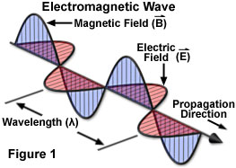
Light is a form of electromagnetic radiation
The light wave is composed of electric as well as magnetic fields perpendicular to each other and the motion of this wave is perpendicular to both of these fields.

Slide 3
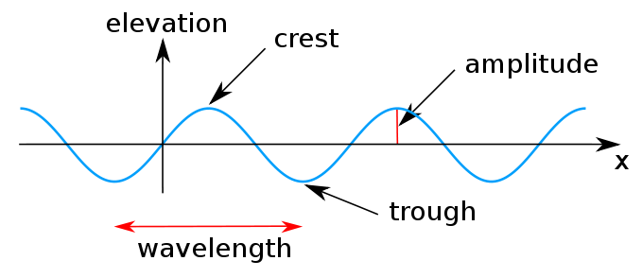
Light
Energy of a photon:
h = Planck’s constant = 6.63 x 10⁻³⁴ J.s
Light has dual nature (wave/particle)

Slide 4
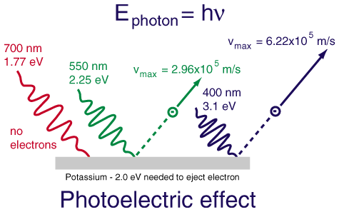
Light Particle Nature
http://www.sciencemag.org/content/338/6114/1576.full
(Example) Photoelectric Effect:

Slide 5
Other Characteristics of Light
Light is quantized
Frequency and wavelength can change and relate via equation:
Light has speed (“c”) of 3.00 x 10⁸ m/s

Slide 6
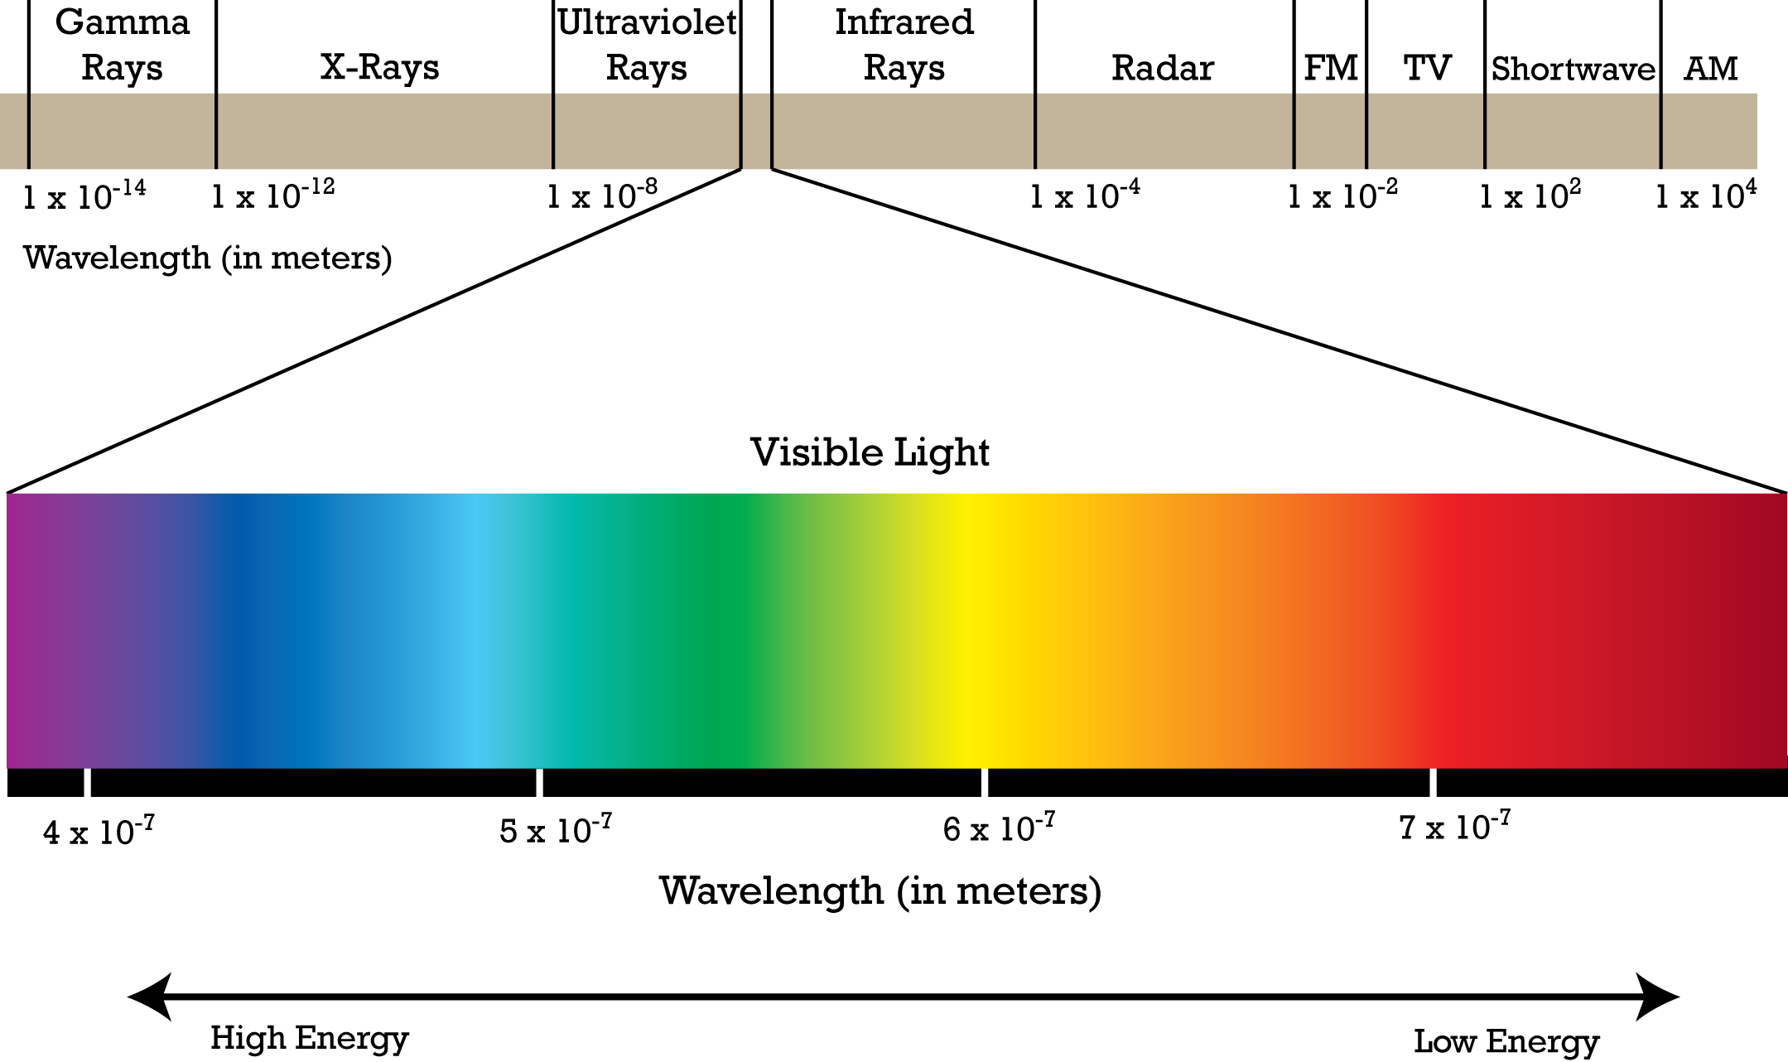
Electromagnetic Spectrum

Slide 7
Speed of Light
In a vacuum:
In a medium:
Where n = index of refraction
Examples: Vacuum n= 1.00
Air n= 1.01
Water n= 1.33
Glass n= 1.50
Diamond n= 2.10

Slide 8
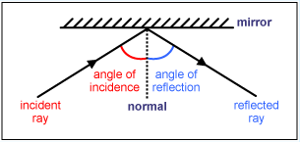
Reflection Of Light
When light hits a surface, the angle between the incident ray and the normal to the surface is called the angle of incidence
When the incident ray hits a reflecting surface, the angle between the reflected ray and the normal to the reflecting surface is called the angle of reflection
The angle of incidence is always equal to the angle of reflection

Slide 9
Refraction Of Light
When a ray of light is incident on the interphase of two different materials, the ray gets refracted when it enters a new medium.
The refracted ray makes an angle of refraction with the normal to the refracting surface.
If light travels from lighter to denser medium, the refracted ray bends towards the normal.
If light ray travels from denser to lighter medium, the refracted ray moves away from the normal.

Slide 10
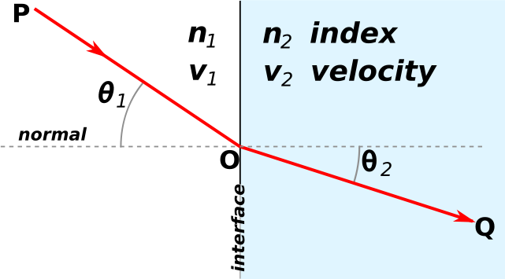
Snell’s Law
Snell’s Law of Refraction Equation:

Slide 11
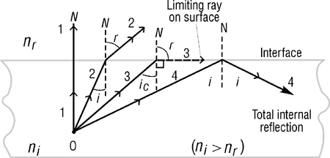
Snell’s Law Critical Angle

Slide 12
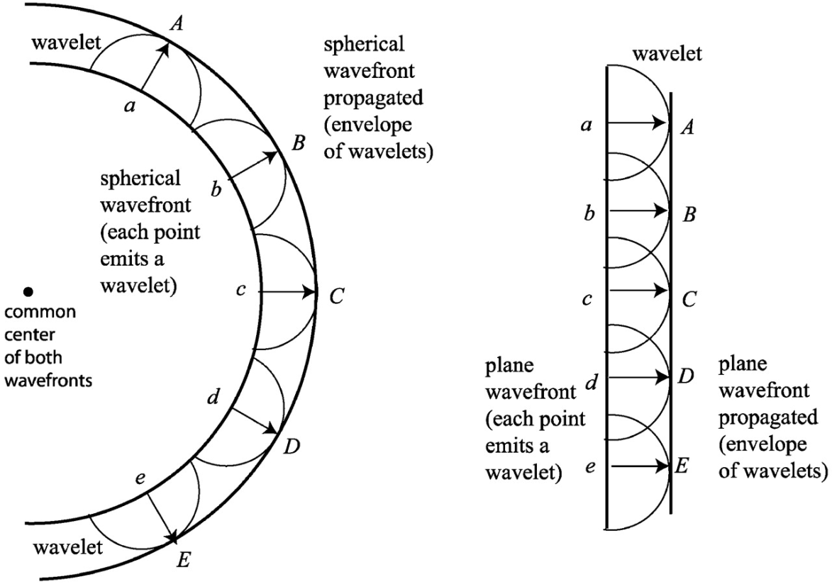
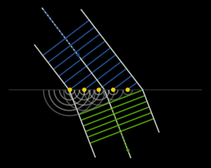
Huygens’s Principle:
Every point on a wave-front may be considered a source of secondary spherical wavelets which spread out in the forward direction at the speed of light. The new wave-front is the tangential surface to all of these secondary wavelets.
The direction of propagation of the wave is always perpendicular to the surface of the wave-front at each point.

Slide 13
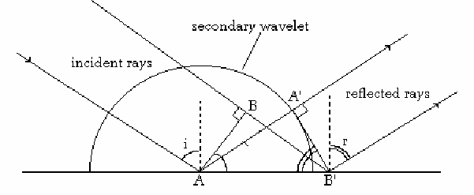
Huygens's Principle Applied to Reflection
Angle of Incidence i = Angle of Reflection r

Slide 14

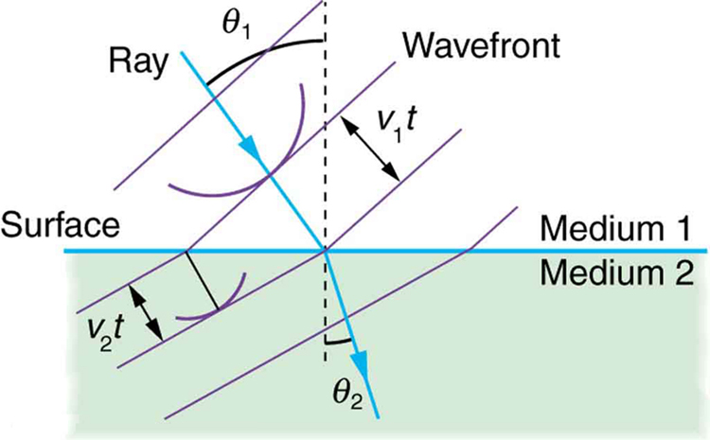

Huygens's Principle Applied to Refraction

