Slide 1
Temperature & the Laws of Thermodynamics Introduction

Slide 2
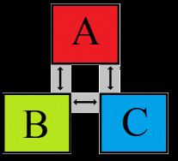
Zeroth Law of Thermodynamics
If objects A and B are separately in thermal equilibrium with a third object C, then A and B are in thermal equilibrium with each other.

Slide 3
Temperature
The property that determines whether an object is in thermal equilibrium with another.
Temperature is a measurement of the average kinetic energy of the molecules in an object or system. It is a means of determining the average internal energy within the system.

Slide 4
Temperature Cont’d
Some physical properties that change with temperature:
Volume of a liquid
The dimensions of a solid
The pressure of a gas at constant volume
The volume of a gas at constant pressure
The electric resistance of a conductor
The color of an object

Slide 5
The Celsius, Fahrenheit, and Kelvin Temperature Conversions
From | To Fahrenheit | To Celsius | To Kelvin
Fahrenheit (F) | F | (F - 32) * 5/9 | (F - 32) * 5/9 + 273.15
Celsius (C or º) | (C * 9/5) + 32 | C | C + 273.15
Kelvin (K) | (K - 273.15) * 9/5 + 32 | K - 273.15 | K
*When encountering an equation that calls for T, convert all temperatures to K. When the equation contains $∆T$, using Celsius temperatures will give you the correct answer.

Slide 6
First Law of Thermodynamics
Energy can be changed from one form to another, but it cannot be created or destroyed.
The total amount of energy and matter in the Universe remains constant, merely changing from one form to another.

Slide 7
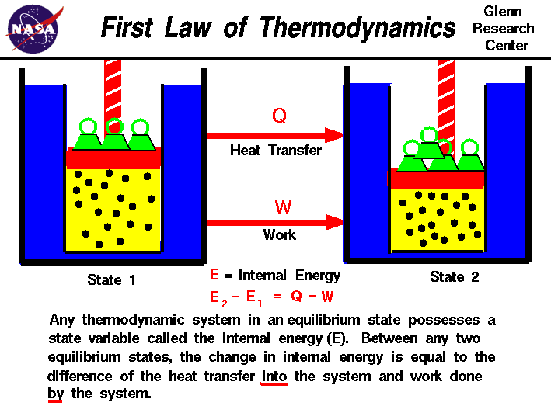

Slide 8
Second Law of Thermodynamics
The second law of thermodynamics states that for any process occurring in a closed system, the entropy increases for an irreversible system and remains constant for a reversible system, but never decreases.

Slide 10
Summary of Thermodynamic Laws

