Slide 1
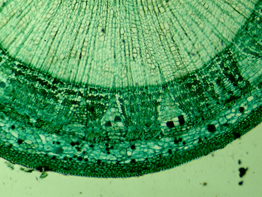
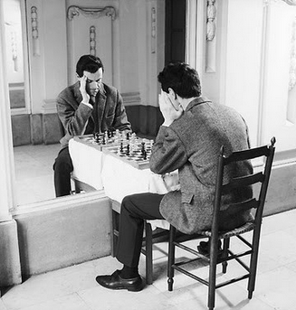
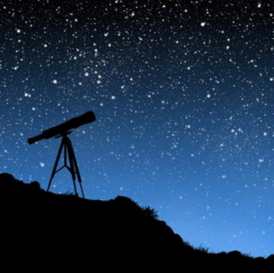
Chapter 36: Image Formation
Suggested Problems:
3,7,9,23,28,33,45,73,77

Slide 2
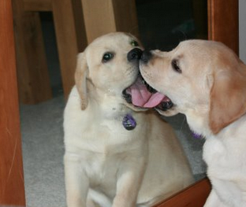
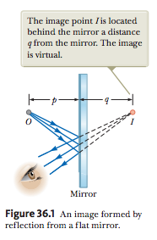
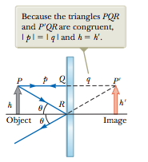
Flat Mirrors
p is called the object distance
q is called the image distance
θ₁ =θ₂
Virtual Image: formed when light rays do not pass through the image point but only appear to diverge from that point

Slide 3
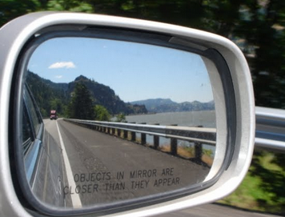
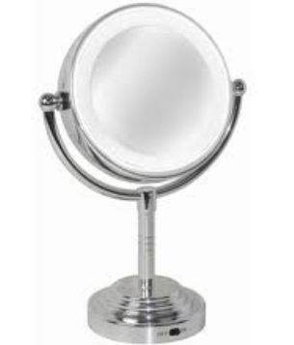
Magnification
Magnification(M)= height of image ÷ height of object
M=h’/h = -(q/p)
M=1 in flat mirror
Closer than they appear ➔ Smaller Image M<1
Make up Mirror/ Magnifying glass ➔ Larger Image M>1

Slide 4
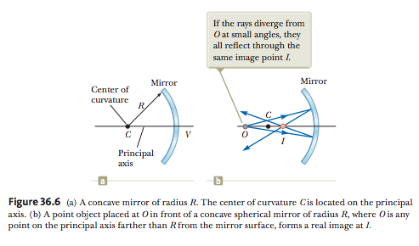
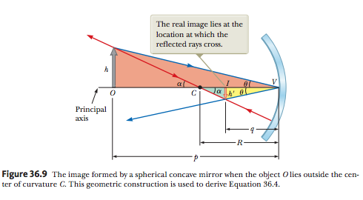
Spherical Mirrors
Curved surfaces have a focal point that is parrallel to the rays of light and they all converge at the focal point
Real Image: formed when light rays pass through and diverge from the image point
Concave mirrors have a magnification greater than one

Slide 5
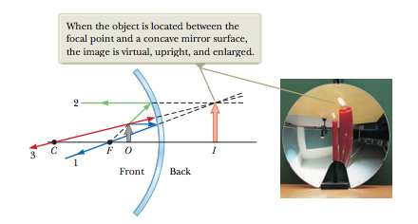

Slide 6
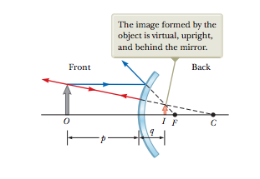
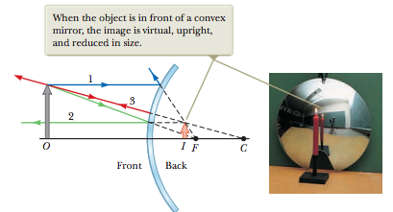
Convex mirrors have a magnification less than one

Slide 7
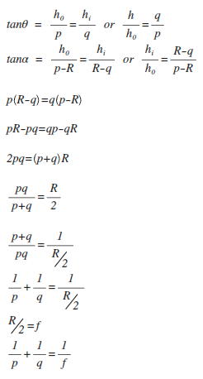
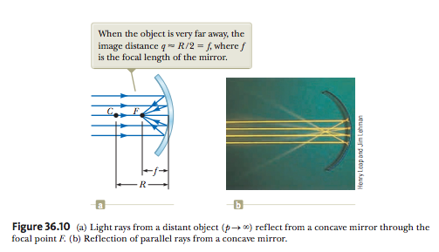
Distance of Reflected Images
f = focal length = R/2

Slide 8
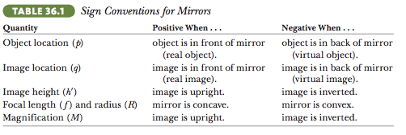
Reflections
Negitive will give an inverted image
Positive will give an upright image
For straight mirrors the focal legth goes to infinity, therefore m=1

Slide 9
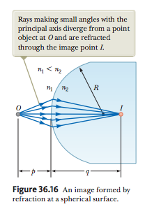
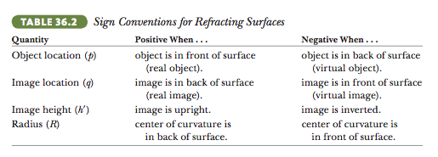
Images Formed by Refraction

Slide 10
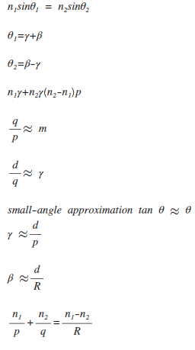
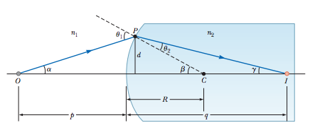
Distance of Refracted Image

Slide 11
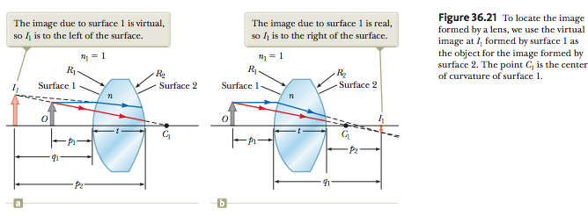
Lenses

Slide 12
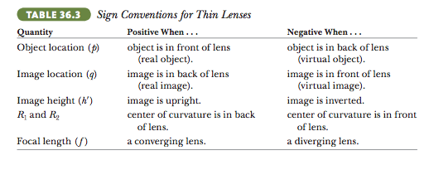
Images Formed by Lenses

Slide 13
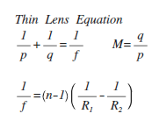
Distance of Lens Image

Slide 14
