Slide 1
See beginning of mitosis slide set for outline content for these slides

Slide 2
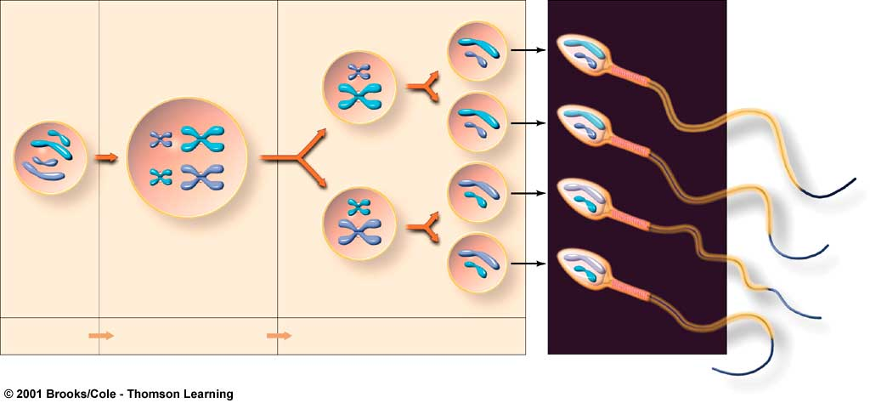
Spermatogenesis results in
4 gametes per meiotic division
cell differentation, sperm formation (mature, haploid male gametes)
secondary spermatocytes (haploid)
spermato-
gonium (diploid male reproductive cell)
primary spermatocyte (diploid)
spermatids (haploid)
GROWTH
MEIOSIS I,
CYTOPLASMIC DIVISION
MEIOSIS II,
CYTOPLASMIC DIVISION
Notes:
What is the ploidy state of each stage?
Count the number of centromeres in each cell to determine its ploidy (doesn’t correlate with the number of linear DNA molecules).

Slide 3
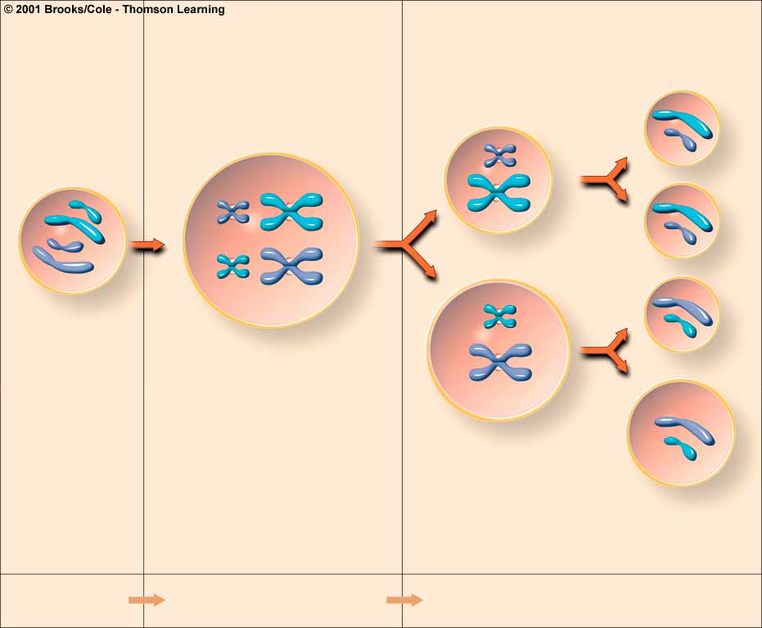
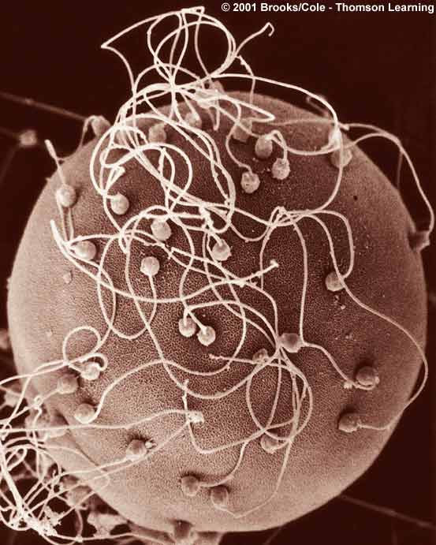
Oogenesis results in
1 gamete per meiotic division
three polar bodies (haploid)
first polar body (haploid)
oogonium (diploid reproductive cell)
primary oocyte (diploid)
secondary oocyte (haploid)
ovum (haploid)
GROWTH
MEIOSIS I,
CYTOPLASMIC DIVISION
MEIOSIS II,
CYTOPLASMIC DIVISION

Slide 4
Trisomy 21 (Down’s Syndrome) is due to incorrect segregation of chromosome 21 during meiosis
3rd Chromosome 21

Slide 5
Incidence of Down’s Syndrome According to Mother’s Age

Slide 6
Trisomy 13
Polydactyly
Ocular defects
Cleft lip and palate
Microcephaly

Slide 7
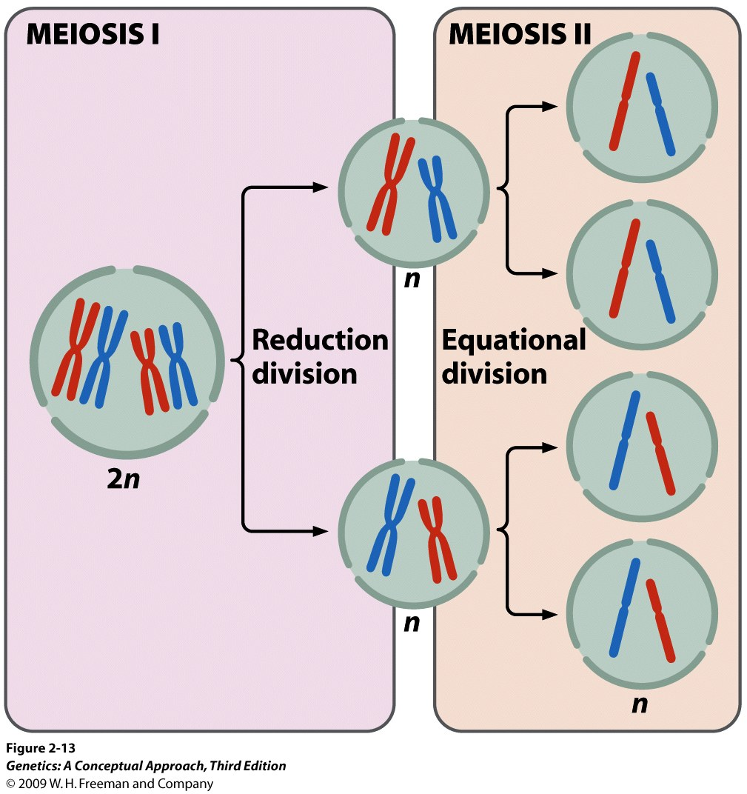
diploid,
duplicated
haploid,
duplicated
haploid,
unduplicated
Notes:
2.13 Meiosis includes two cell divisions. In this illustration, the original cell is 2n − 4.After two meiotic divisions, each resulting cell is 1n − 2.

Slide 8
Notes:
2.14 (part 1) Meiosis is divided into stages. [Photographs by C. A. Hasenkampf/Biological Photo Service.]

Slide 9
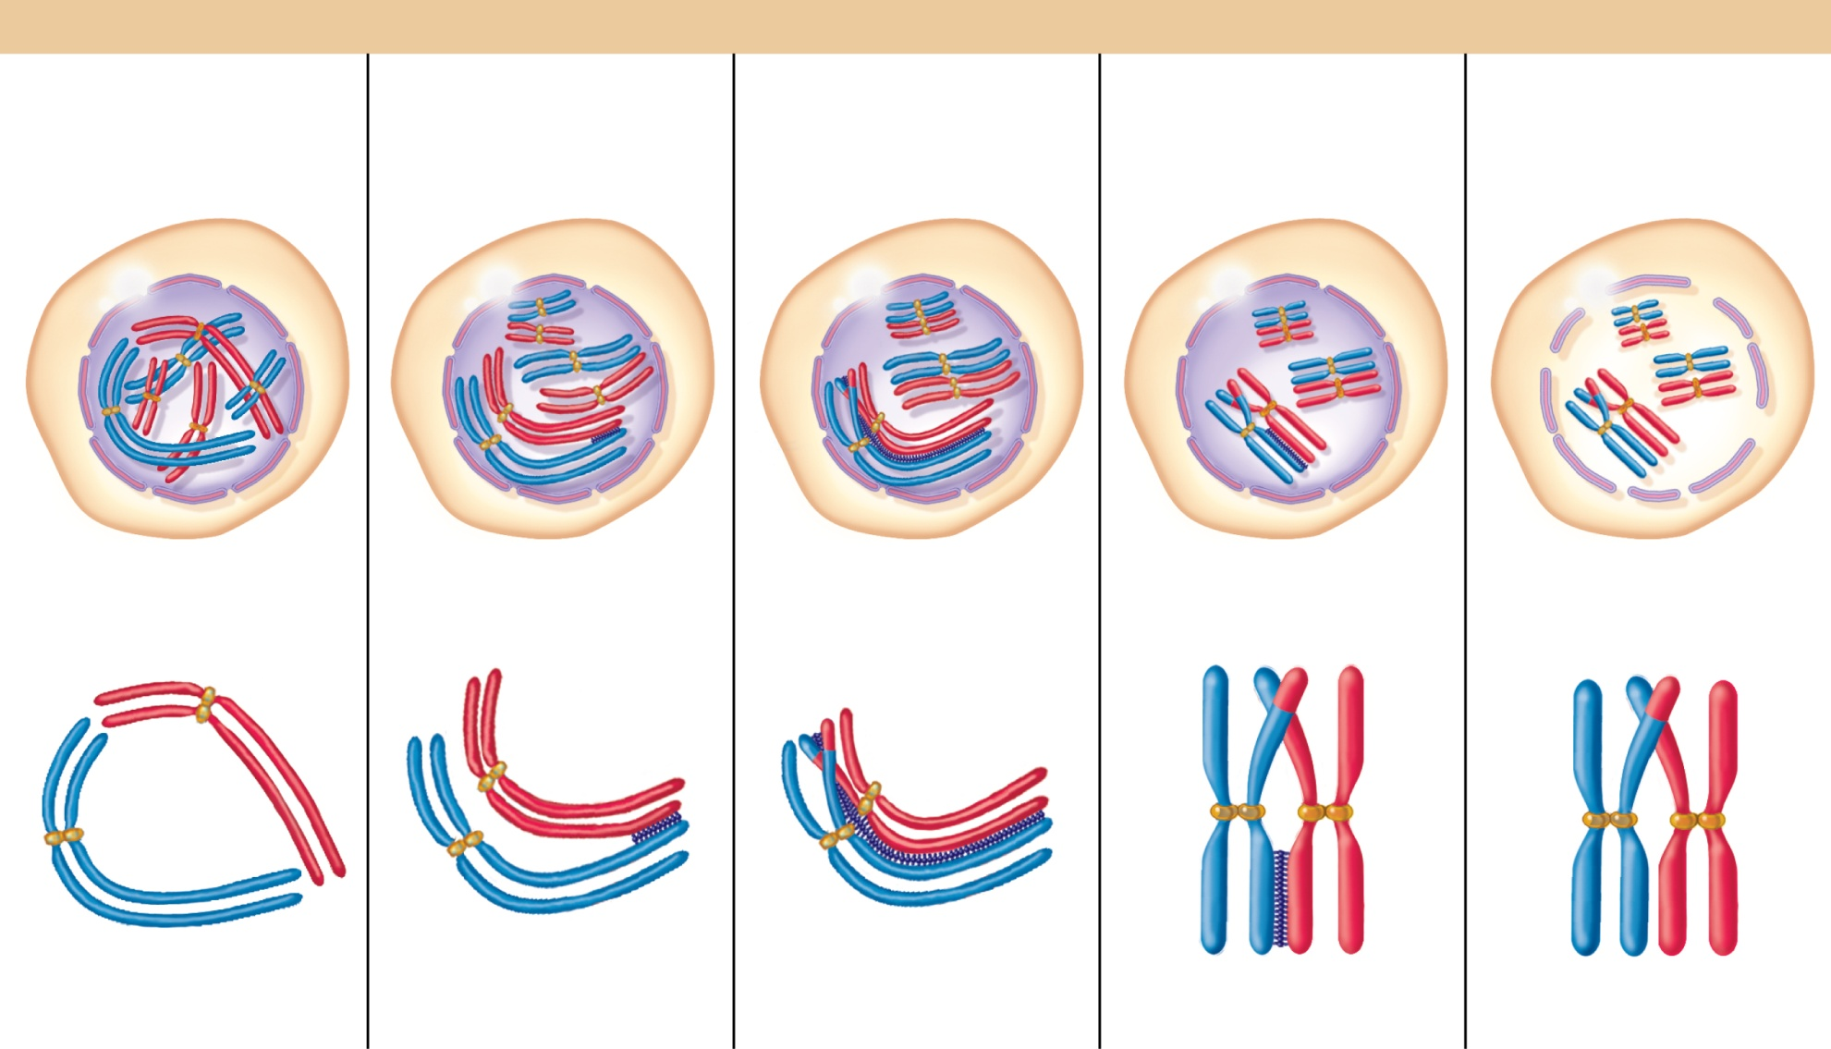
Non-sister chromatids on homologous chromosomes exchange DNA during meiotic recombination
STAGES OF PROPHASE OF MEIOSIS I
LEPTOTENE
ZYGOTENE
PACHYTENE
DIPLOTENE
DIAKINESIS
Nuclear
membrane
Bivalent
forming
Chiasma
Nuclear membrane
fragmenting
Synaptonemal
complex forming
Replicated chromosomes
condense.
Synapsis begins.
A bivalent has formed and
crossing over has occurred.
Synaptonemal complex
dissociates.
End of prophase I
Figure 2.10—Brooker Genetics

Slide 10
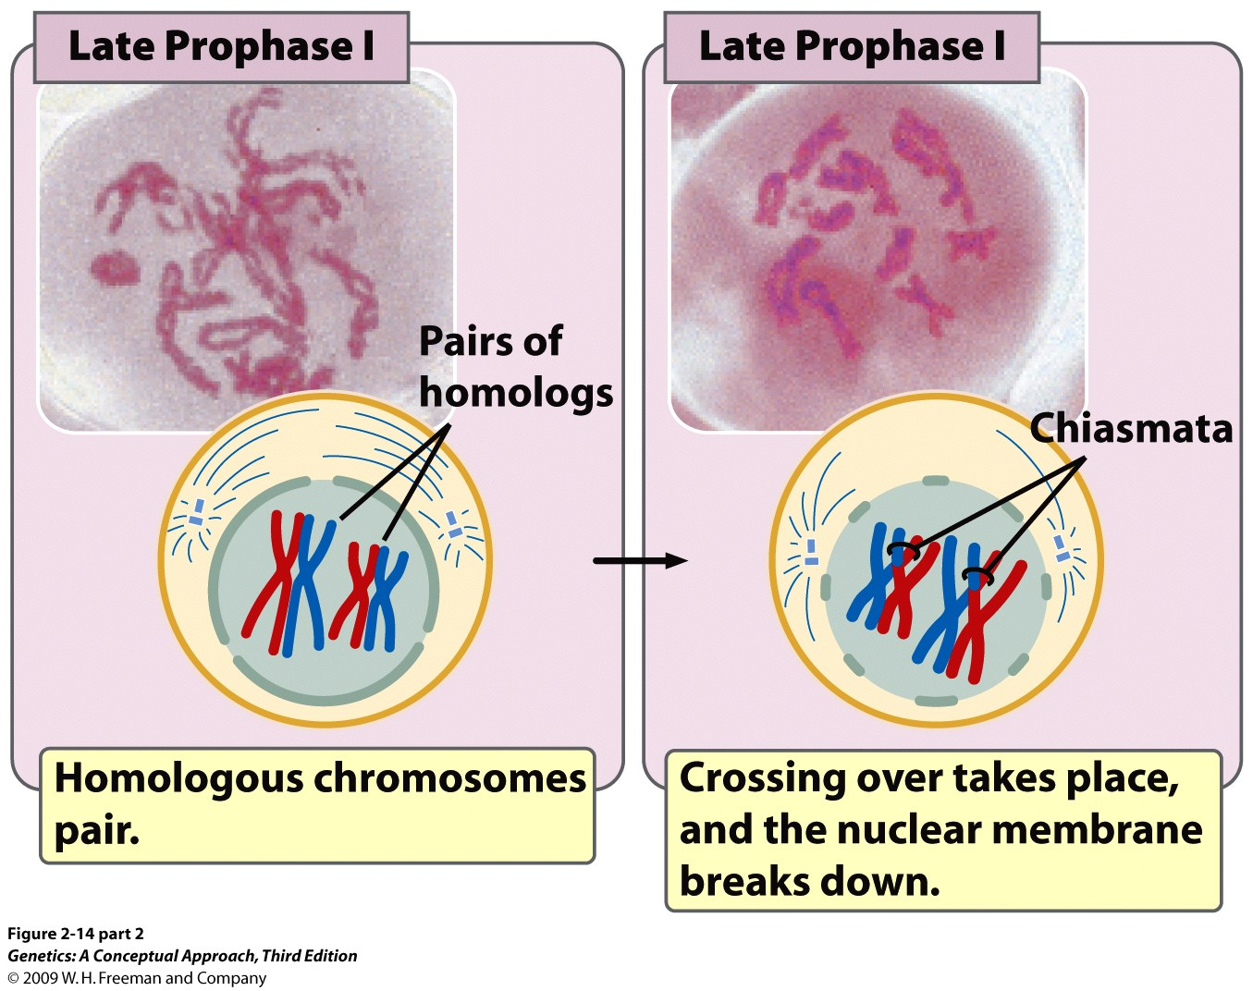
Notes:
2.14 (part 2) Meiosis is divided into stages. [Photographs by C. A. Hasenkampf/Biological Photo Service.]

Slide 11
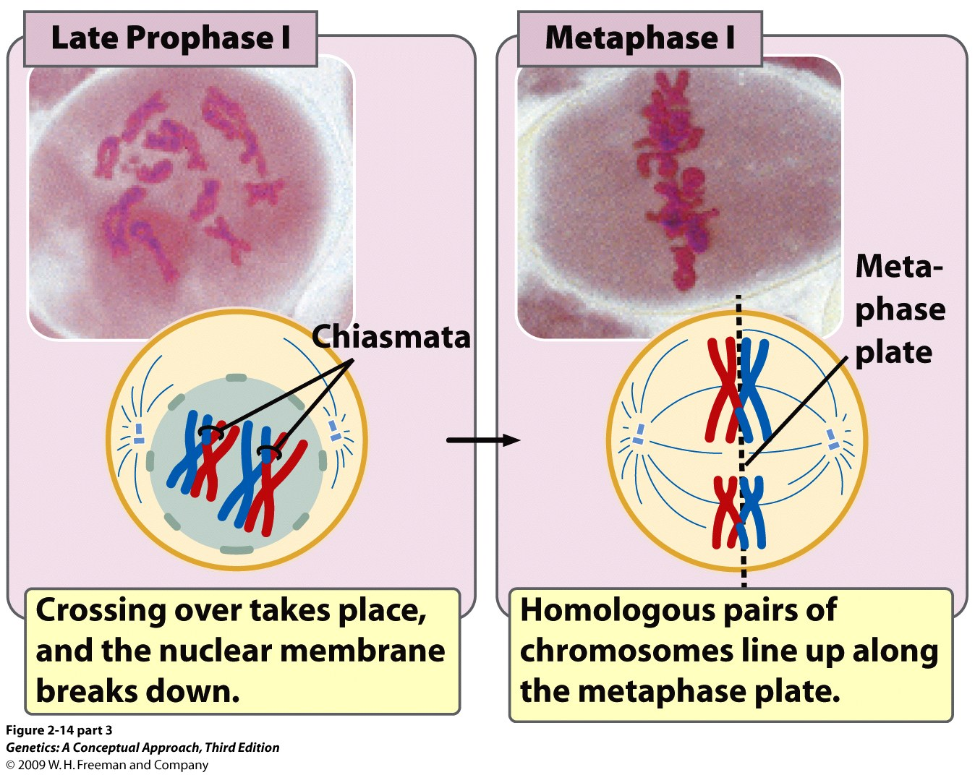
Notes:
2.14 (part 3) Meiosis is divided into stages. [Photographs by C. A. Hasenkampf/Biological Photo Service.]

Slide 12
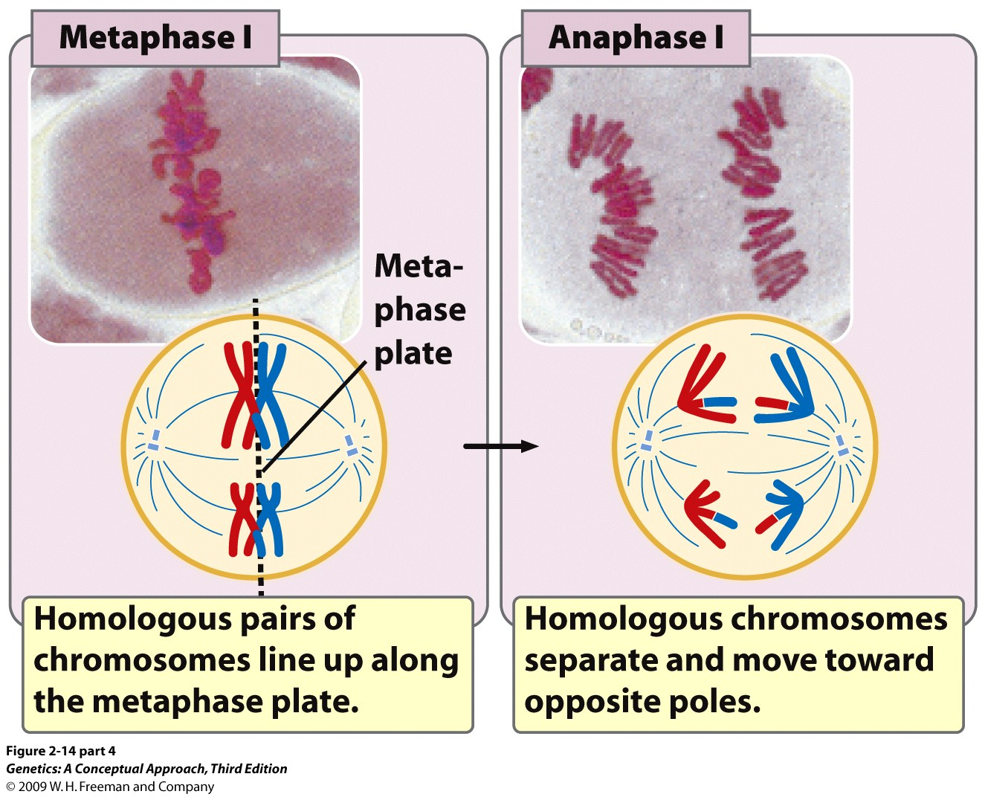
Anaphase I—splitting of homologous pairs
Notes:
2.14 (part 4) Meiosis is divided into stages. [Photographs by C. A. Hasenkampf/Biological Photo Service.]

Slide 13
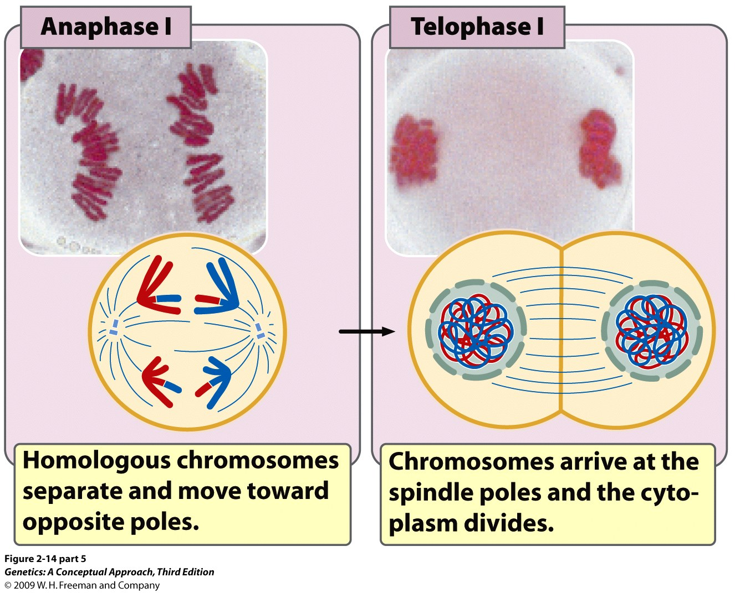
Anaphase I—splitting of homologous pairs
Notes:
2.14 (part 5) Meiosis is divided into stages. [Photographs by C. A. Hasenkampf/Biological Photo Service.]

Slide 14
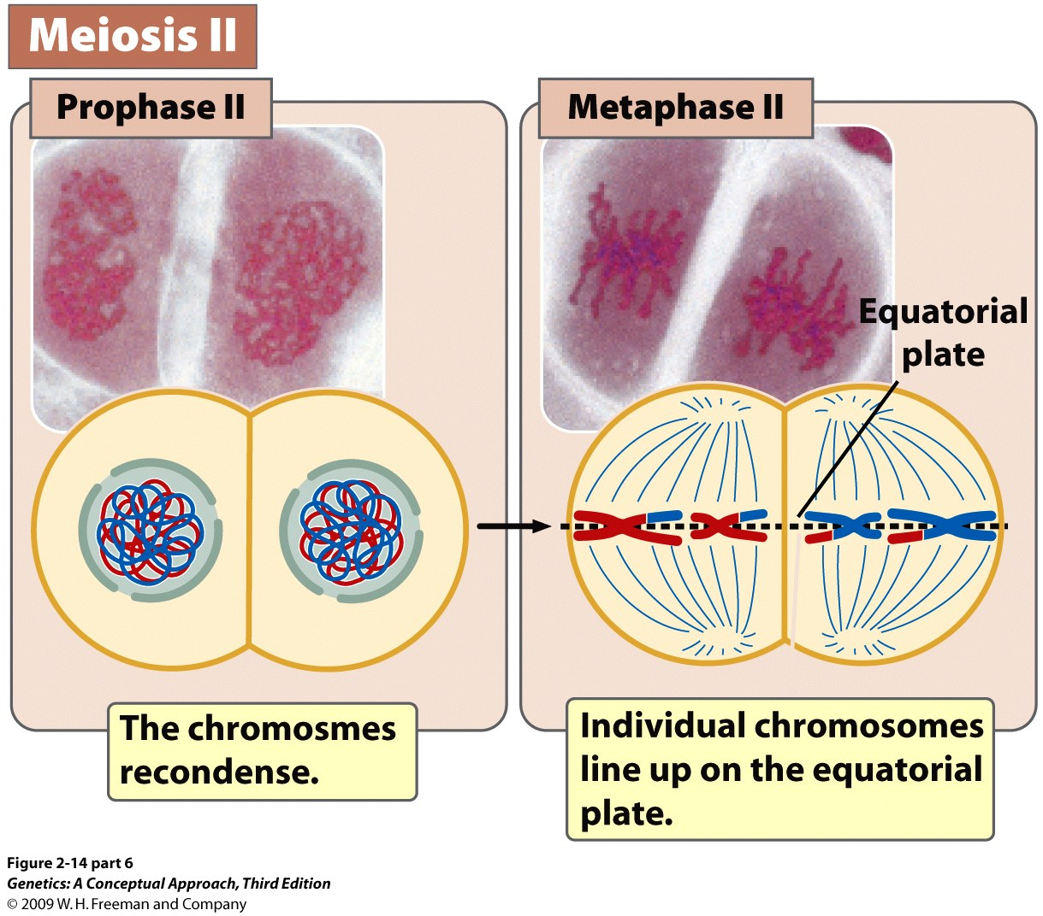
Notes:
2.14 (part 6) Meiosis is divided into stages. [Photographs by C. A. Hasenkampf/Biological Photo Service.]

Slide 15
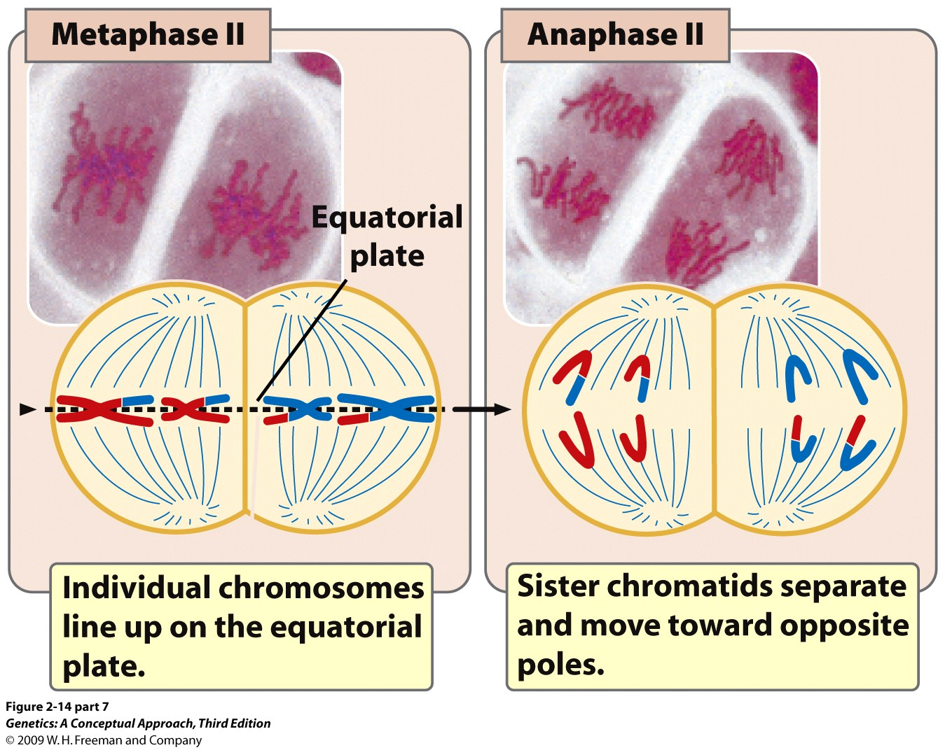
Anaphase 2—splitting of single duplicated chromosomes
Notes:
2.14 (part 7) Meiosis is divided into stages. [Photographs by C. A. Hasenkampf/Biological Photo Service.]

Slide 16
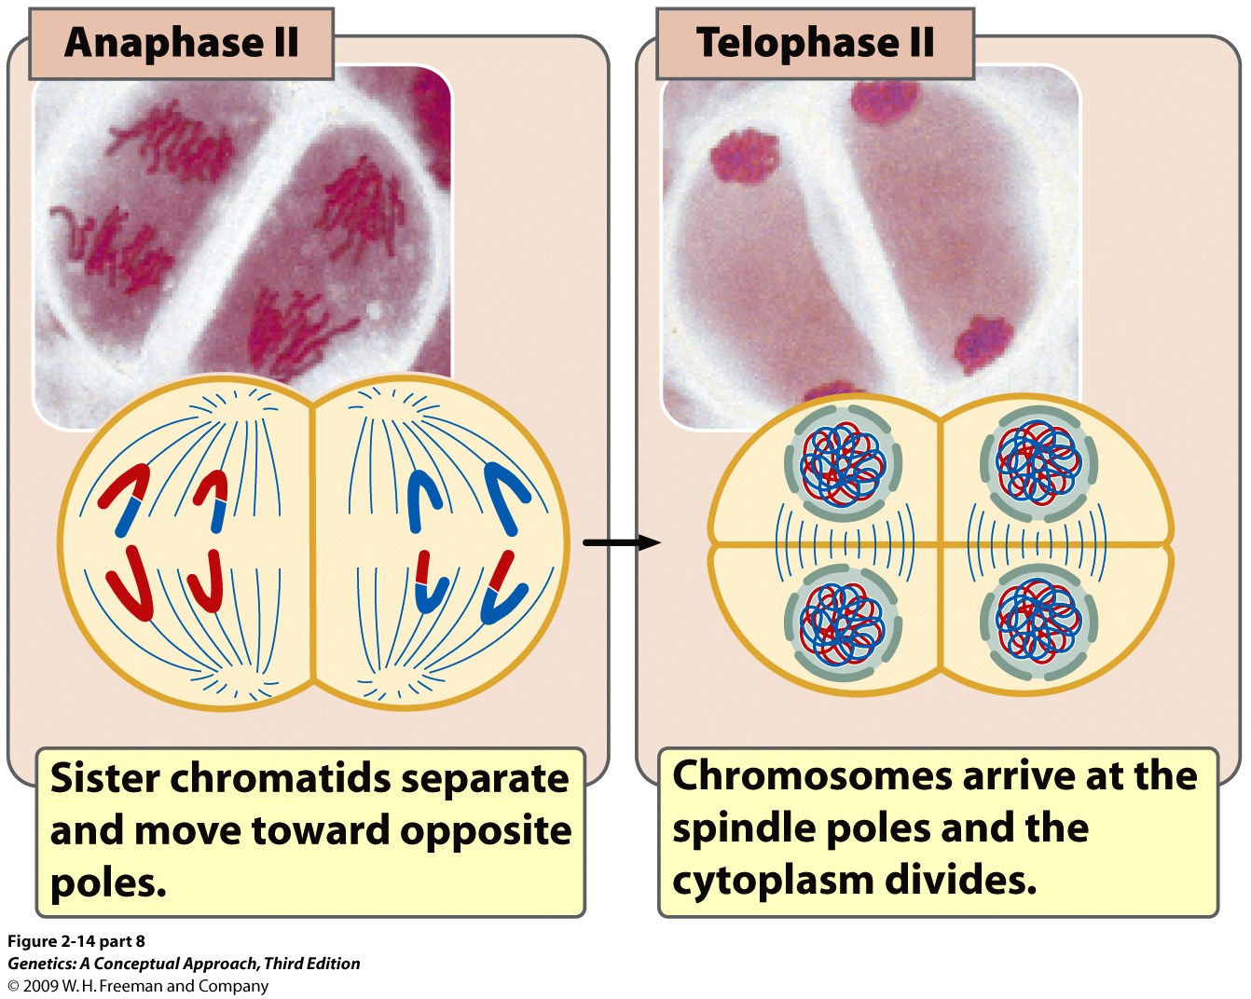
Anaphase 2—splitting of single duplicated chromosomes
Notes:
2.14 (part 8) Meiosis is divided into stages. [Photographs by C. A. Hasenkampf/Biological Photo Service.]

Slide 17
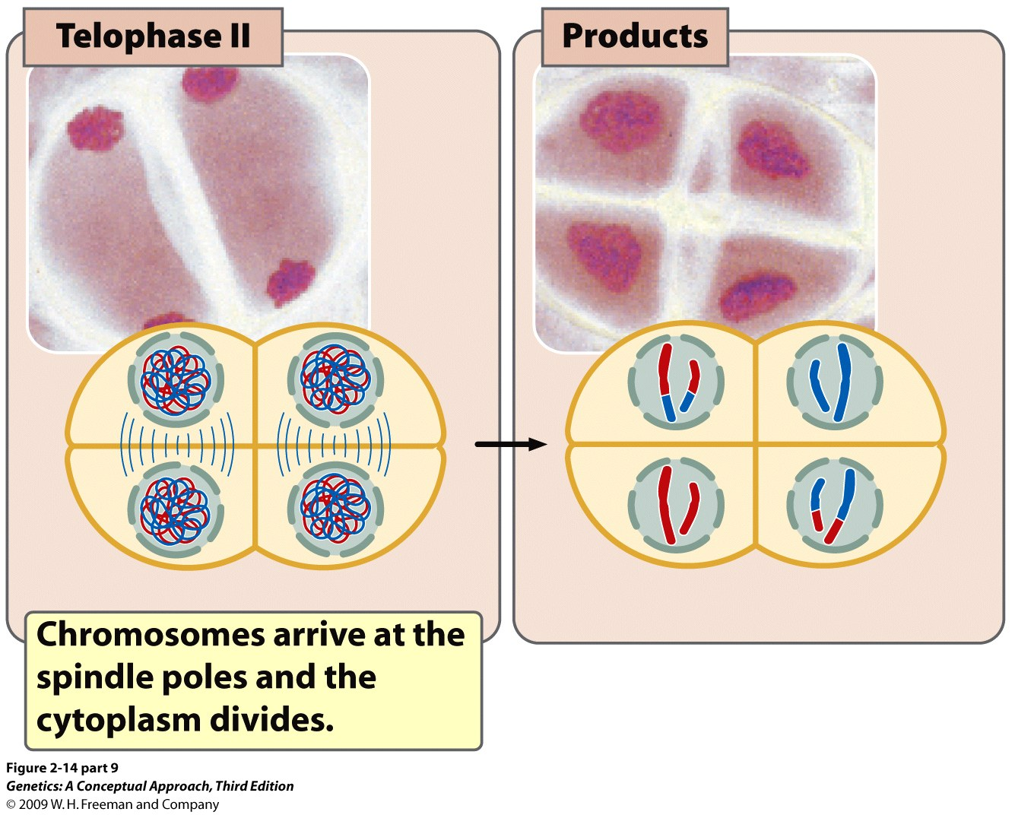
Notes:
2.14 (part 9) Meiosis is divided into stages. [Photographs by C. A. Hasenkampf/Biological Photo Service.]

Slide 18
Meiosis video
http://vcell.ndsu.nodak.edu/animations/meiosis/index.htm

Slide 19
diploid,
unduplicated
S-phase
diploid,
duplicated
haploid,
duplicated
haploid,
unduplicated
Notes:
2.13 Meiosis includes two cell divisions. In this illustration, the original cell is 2n − 4.After two meiotic divisions, each resulting cell is 1n − 2.

Slide 20
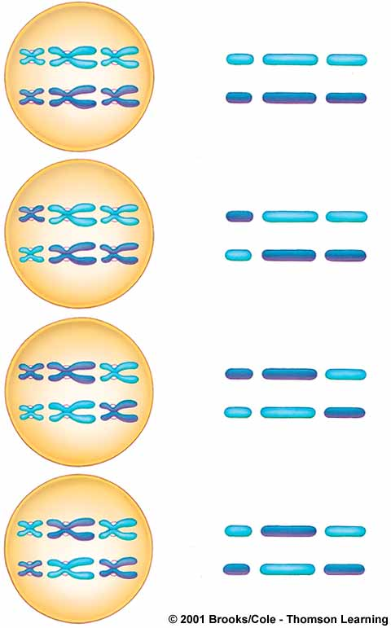
1
2
3
Random segregation of homologous chromosomes also increases genetic diversity of gametes
combinations possible
or
or
or

Slide 21
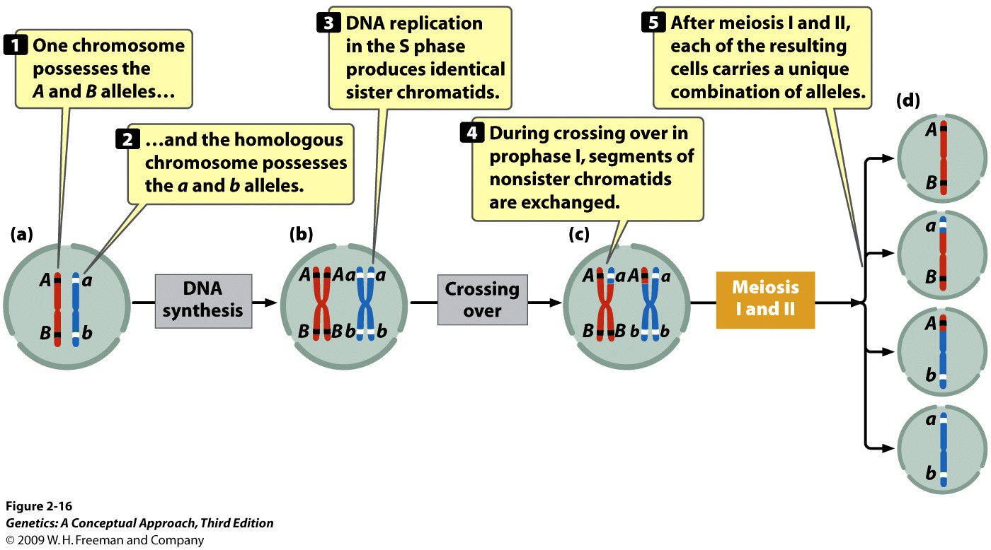
Crossing over produces new genetic variation
Dominant
recessive
Notes:
2.16 Crossing over produces genetic variation.

Slide 22
Crossing over produces new genetic variation
Dominant
recessive
Notes:
2.16 Crossing over produces genetic variation.

Slide 23
Crossing over produces new genetic variation
Dominant
recessive
Notes:
2.16 Crossing over produces genetic variation.

Slide 24
Crossing over produces new genetic variation
Dominant
recessive
Notes:
2.16 Crossing over produces genetic variation.

Slide 25
Crossing over produces new genetic variation
Dominant
recessive
Notes:
2.16 Crossing over produces genetic variation.

Slide 26
Spermatogenesis results in
4 gametes per meiotic division
cell differentation, sperm formation (mature, haploid male gametes)
secondary spermatocytes (n?)
spermato-
gonium (diploid male reproductive cell)
primary spermatocyte
(n?)
spermatids (haploid)
GROWTH
MEIOSIS I,
CYTOPLASMIC DIVISION
MEIOSIS II,
CYTOPLASMIC DIVISION
Notes:
What is the ploidy state of each stage?
Count the number of centromeres in each cell to determine its ploidy (doesn’t correlate with the number of linear DNA molecules).

Slide 27
Trisomy 21 (Down’s Syndrome) is due to incorrect segregation of chromosome 21 during meiosis
3rd Chromosome 21

Slide 28
Nondisjunction
From Campbell and Reece, Biology, 7th ed.

Slide 29
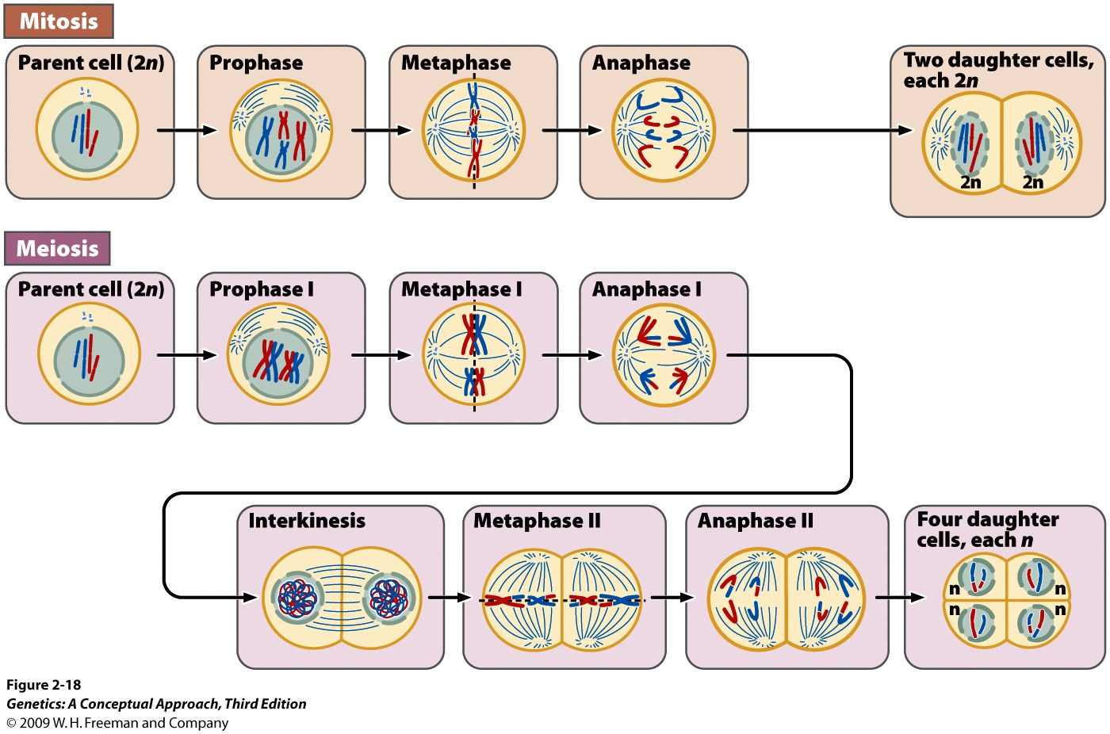
Mitosis and meiosis compared
Which phase in meiosis is most comparable to metaphase of mitosis?
Notes:
2.18 Mitosis and meiosis compared.

Slide 30
These cells were all taken from the same individual (a mammal). Identify the cell division events occurring in each cell and explain your reasoning. What is the sex of the individual? What is the diploid chromosome number?

Slide 31
These cells were all taken from the same individual (a mammal). Identify the cell division events occurring in each cell and explain your reasoning. What is the sex of the individual? Female What is the diploid chromosome number? N = 3, diploid no. = 2n or 6
Anaphase I of Meiosis
Anaphase of Mitosis
Anaphase II of Meiosis
Metaphase I of Meiosis

Slide 32
Label each chromosome “M1” or “P1”, “M2” or “P2” as appropriate (see board for the genotype of this heterozygous individual)
Continue to label the chromatids as appropriate (“M1” etc.)
Notes:
2.13 Meiosis includes two cell divisions. In this illustration, the original cell is 2n − 4.After two meiotic divisions, each resulting cell is 1n − 2.

Slide 33
A cell in G1 has 12 chromosomes. What is its diploid chromosome number?
Draw a picture of each stage.
How many chromosomes and DNA molecules will be found per cell when this original cell progresses to the following stages? (one, unduplicated chromosome = one, single DNA molecule)
Stage | picture | C’some/molecule | Stage | picture | C’some/molecule
G2 |  |  | Anaphase I
Prophase of mitosis |  |  | Prophase II
Metaphase I |  |  | Anaphase II

Slide 34
A cell in G1 has 12 chromosomes. What is its diploid chromosome number?
Draw a picture of each stage.
How many chromosomes and DNA molecules will be found per cell when this original cell progresses to the following stages? (one, unduplicated chromosome = one, single DNA molecule)
Stage | picture | C’some/molecule | Stage | picture | C’some/molecule
G2 |  | 12, 24 | Anaphase I |  | 12, 24
Prophase of mitosis |  | 12, 24 | Prophase II |  | 6, 12
Metaphase I |  | 12, 24 | Anaphase II |  | 12, 12

Slide 35
Mitosis and Meiosis: practice questions
The following comprehension questions (at end of each chapter section) in Brooker, Concepts of Genetics are recommended:
Comprehension Questions (at end of each section): sections 2.1 #1,3; 2.2; 2.3; 2.4; 2.5#1. Answers to Comprehension Questions are at the very end of every chapter.
Solved Problems at end of chapter (answers included): S1, S2, S4.
Conceptual questions and Experimental/Application Questions at end of chapter (answers found by logging into publisher’s website, or find them in the book):
Concepts—C1, C2, C3, C5, C6, C7, C8, C9, C10, C11, C12, C16, C18, C19, C20, C24, C26
A little more challenging—C13, C14

Slide 36
The fruit fly has four pairs of chromosomes, whereas the house fly has six pairs of chromosomes. Other things being equal, in which species would you expect to see more genetic variation among the progeny of a cross? Explain your choice.

Slide 37
The fruit fly has four pairs of chromosomes, whereas the house fly has six pairs of chromosomes. Other things being equal, in which species would you expect to see more genetic variation among the progeny of a cross? Explain your choice.
Expect to see more genetic variation in the house fly, because it has a greater number of independently assorting chromosomes. In addition to recombination, a species generates 2^{N} number of different gametes per individual (N = haploid chromosome number). Thus a fruit fly can generate 2⁴ different gametes, while the house fly can generate 2⁶ different gametes.

