Slide 1
Broad Course Objectives for Cell Reproduction
Students should be able to:
Describe the basic differences between prokaryotes and eukaryotes in genome organization and cell structure
Describe the cellular events that occur during the eukaryotic cell cycle and gamete formation
Describe how chromosome structure and number changes as a cell progresses through a cell cycle, meiosis I and meiosis II
Explain how meiosis and random fertilization contribute to genetic variation in sexually reproducing organisms
Necessary for understanding future material:
The cellular basis for a “diploid genotype” vs. a “haploid genotype”
The cellular basis for independent assortment of alleles
Cellular basis for Down’s Syndrome and other chromosome aneuploidy (Chromosome Variation)
DNA replication and gene expression in bacteria vs. eukaryotes

Slide 2
Outline/Study Guide for Mitosis-Meiosis
Review of cell structure necessary for understanding cell division
What structural differences exist between the genomes of viruses, bacteria, and eukaryotic cells?
What structures are responsible for the cytoplasmic division of bacterial cells?
Why does bacterial cell division not need elaborate mechanisms like lining up the chromosomes at the metaphase plate for correct chromosome segregation?
Is bacterial cell division a “cloning division” or a “reductional division”?
Eukaryotic Cell Division
In multicellular organisms which bodily processes use mitosis? Meiosis?
What is a somatic (body) cell vs. a gamete (or germ) cell?
What are the phases of the cell cycle, and what events occur in each phase?
At what points in the cell cycle is cell division regulated (“checkpoints”)?
What signaling molecules are involved in regulating the cell cycle?

Slide 3
What is the difference between being haploid vs. diploid?
What is the genetic content of the parent cell vs. the daughter cell in mitosis? In meiosis?
What are the parts of a chromosome? When is a chromosome considered a single duplicated chromosome, vs. two unduplicated chromosomes?
What are the sub-stages of mitosis and meiosis, and what cellular events occur in each phase? (example events below)
  e.g. How are the microtubules functioning in each stage?
  e.g. When does the nuclear membrane disappear and reappear?
  e.g. When does recombination occur?
  e.g. What structures are responsible for the cytoplasmic division of animal cells?
  e.g. Are the chromosomes condensed during interphase? During mitosis or meiosis?

Slide 4
Do we need to know “leptotene, zygotene, pachytene,” etc.? No
Do we need to know “G1, S, G2, M—prophase, metaphase, anaphase, telophase, cytokinesis”? Yes.
Draw chromosomes for when the cell is in G1, G2, Metaphase, and Telophase. Assume they are always condensed so that you can denote whether the chromosome is duplicated or not.
What are the resulting products of mitosis and meiosis (cellularly, and in terms of genetic variation or similarity)?

Slide 5
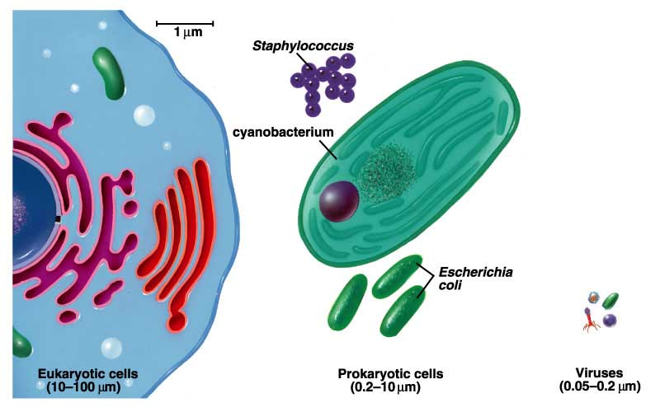
Size differences between eukaryotic cells, bacterial cells, and viruses
From Audesirk and Audesirk, Biology—Life on Earth, 6th ed

Slide 6
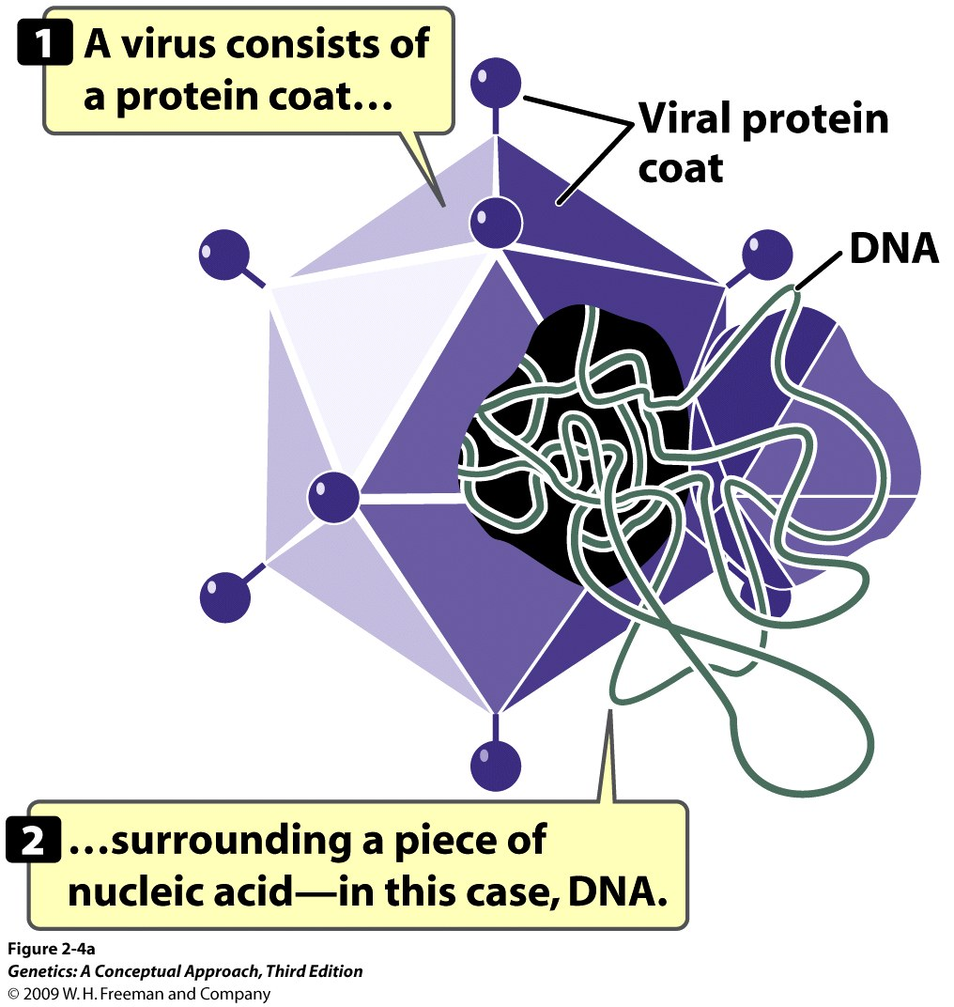
Notes:
2.4a A virus is a simple replicative structure consisting of protein and nucleic acid.

Slide 7
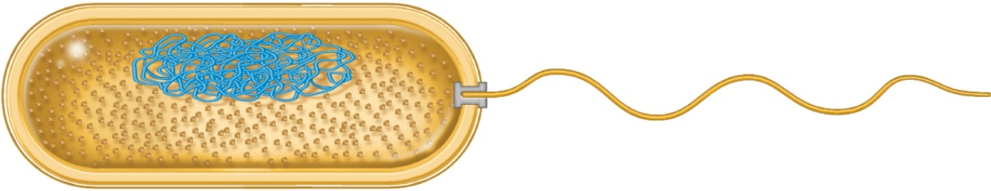
Prokaryotic Cell Structure
1 mm
Ribosomes
in cytoplasm
Flagellum
Outer
membrane
Cell wall
Plasma
membrane
(also known
as inner
membrane)
Nucleoid
(where bacterial
chromosome is
found)
(a) Bacterial cell
Brooker, Fig 2.1 a
Copyright © The McGraw-Hill Companies, Inc. Permission required for reproduction or display.

Slide 8
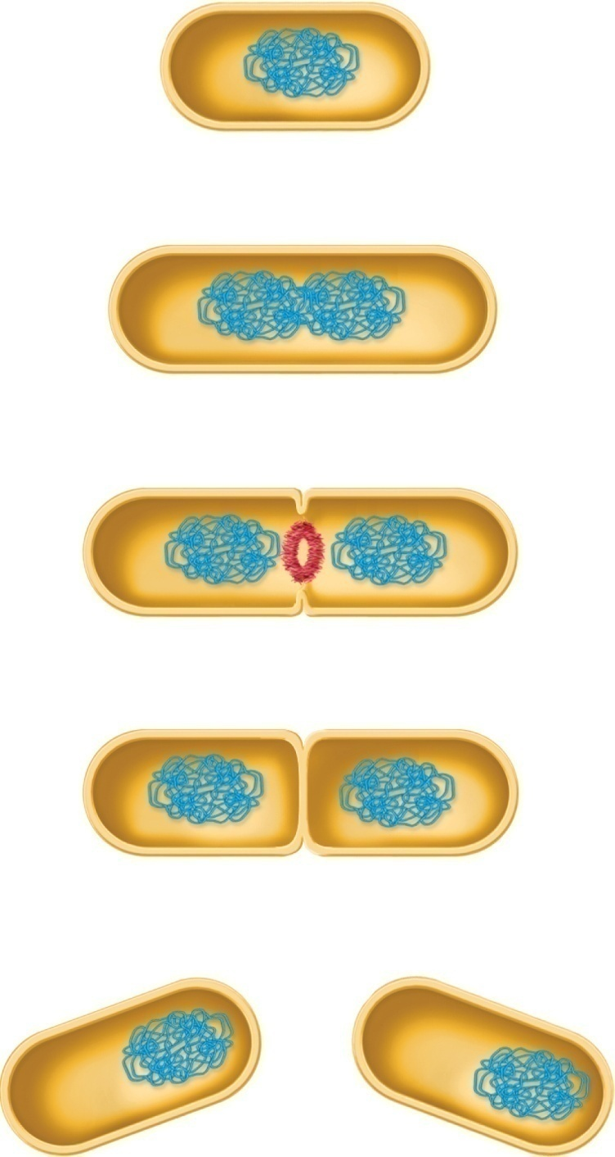
Bacterial Cell Division
Mother cell
Bacterial
chromosome
Replication of bacterial
chromosome
FtsZ protein
Septum
Two daughter
cells
Brooker, Fig 2.4
Copyright © The McGraw-Hill Companies, Inc. Permission required for reproduction or display.

Slide 9
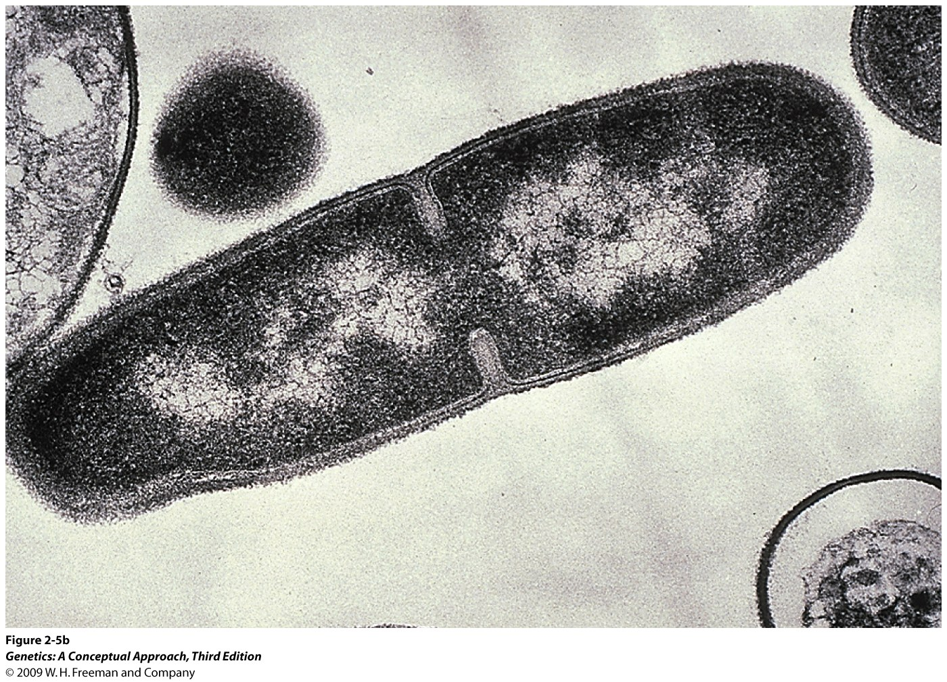
Notes:
2.5b Prokaryotic cells reproduce by simple division. [Micrograph by Lee D. Simon/Photo Researchers.]

Slide 10
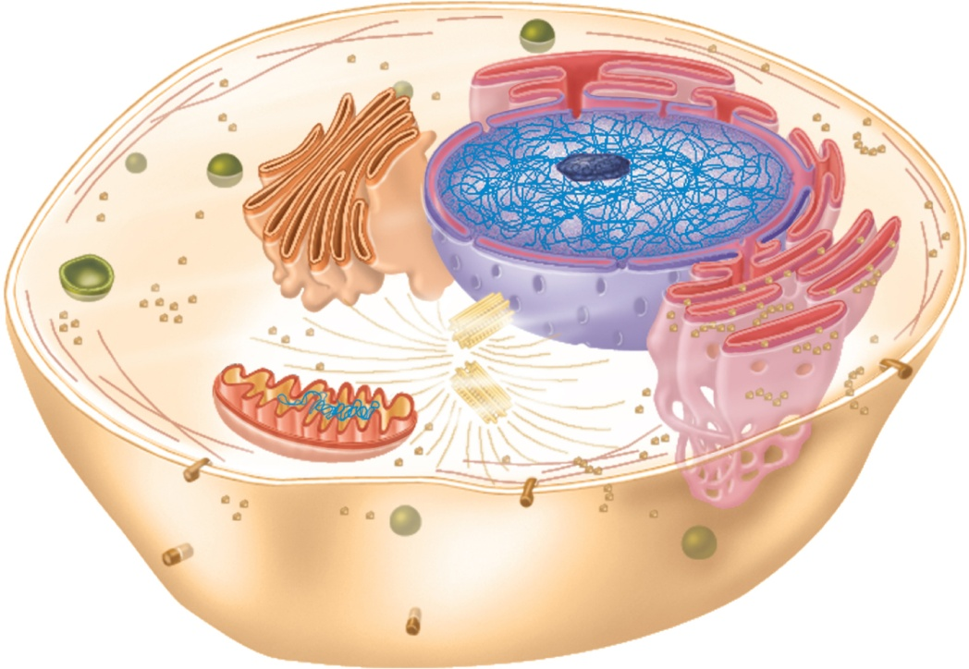
Eukaryotic Cell Structure
Microfilament
Golgi
body
Nuclear
envelope
Nucleolus
Chromosomal
DNA
Nucleus
Polyribosomes
Ribosome
Rough endoplasmic
reticulum
Cytoplasm
Membrane protein
Plasma membrane
Smooth endoplasmic
reticulum
Lysosome
Brooker Fig 2.1b
Mitochondrial DNA
Mitochondrion
Centriole
Microtubule
(b) Animal cell
Copyright © The McGraw-Hill Companies, Inc. Permission required for reproduction or display.

Slide 11
Cloning Divisions vs.
Reductional Divisions

Slide 12
Functions of mitosis and meiosis
From Audesirk and Audesirk, Biology—Life on Earth, 6th ed

Slide 13
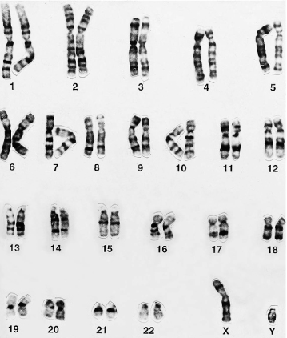
Karyotype (normal male)
Emery’s Elements of Medical Genetics, 12th ed © 2005 Elsevier

Slide 14
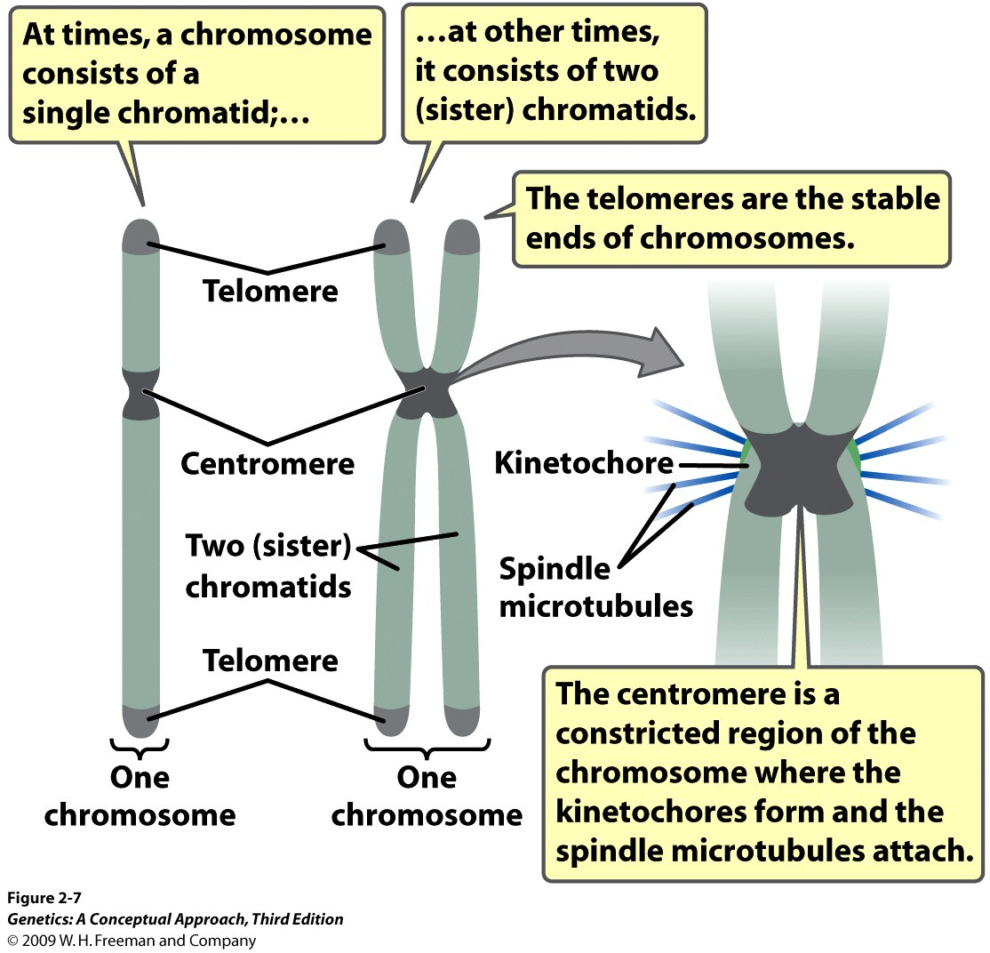
Similar to fig 2.6--Brooker
Notes:
2.7 Each eukaryotic chromosome has a centromere and telomeres.

Slide 15
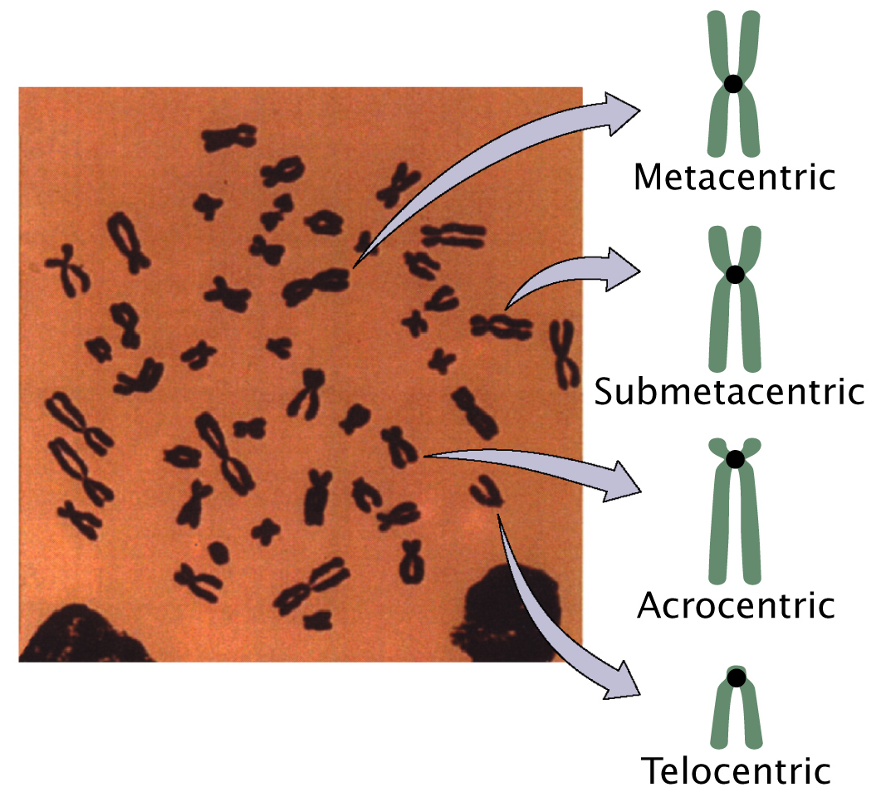
Types of Chromosomes
From Genetics, A Conceptual Approach, Pierce, 2nd ed.

Slide 16
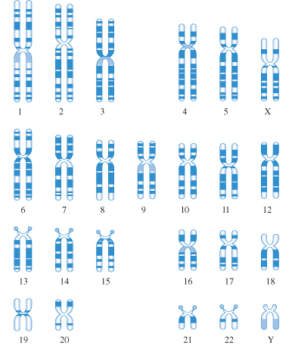
Each chromosome has a characteristic banding pattern
Emery’s Elements of Medical Genetics, 12th ed © 2005 Elsevier

Slide 17
Chromosome nomenclature

Slide 18
Examples of Public Databases for Genetic Information (human)
Online Mendelian Inheritance in Man (OMIM)
http://www.ncbi.nlm.nih.gov/entrez/query.fcgi?db=OMIM
Main database of all human genes known
HapMap Project
www.hapmap.org
Database of single nucleotide polymorphisms

Slide 19
Karyotype (normal male)
Is this a diploid or a haploid karyotype?
Emery’s Elements of Medical Genetics, 12th ed © 2005 Elsevier

Slide 20
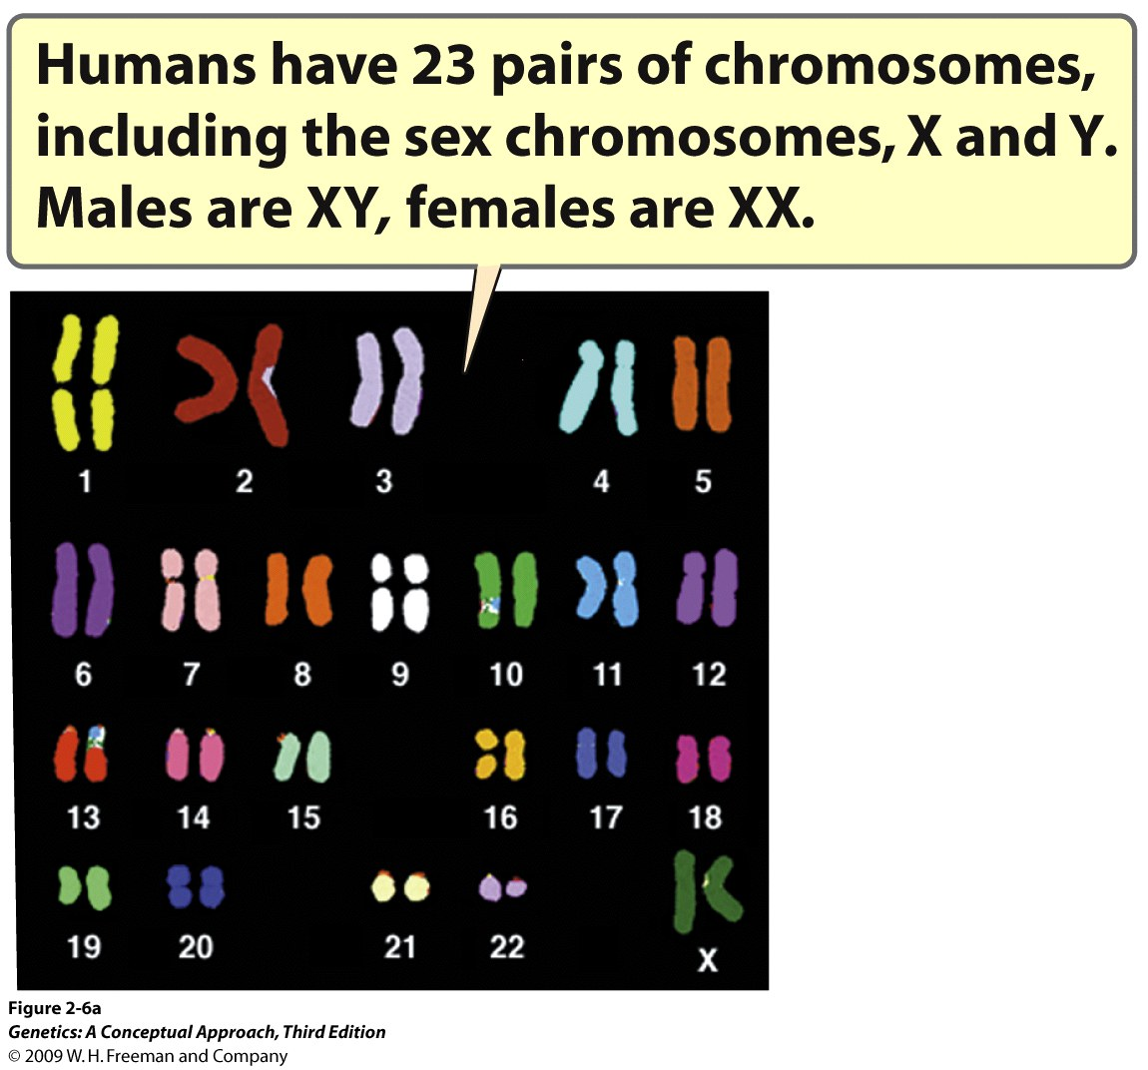
Notes:
2.6a Diploid eukaryotic cells have two sets of chromosomes. (a) A set of chromosomes from a female human cell. Each pair of chromosomes is hybridized to a uniquely colored probe, giving it a distinct color. [Part a: Courtesy of Dr. Thomas Ried and Dr. Evelin Schrock.]

Slide 21
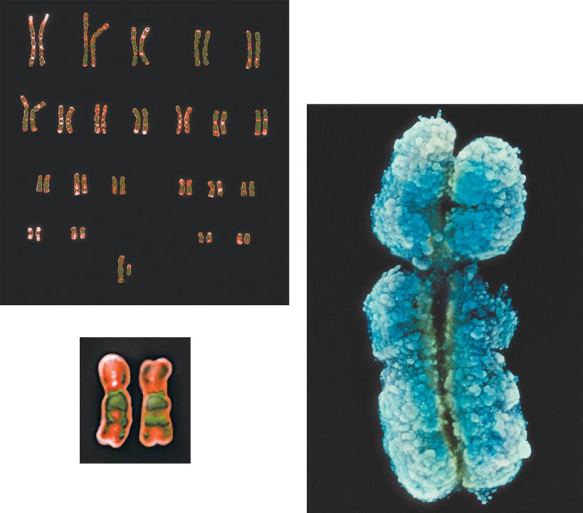
1
2
3
4
5
Homologous chromosomes
and
sister chromatids of the right homolog
6
7
8
9
10
11
12
13
14
15
16
17
18
19
20
21
22
XY
© Leonard Lessin/Peter Arnold
A pair of homologous
chromosomes
© Biophoto Associates/Photo Researchers
Brooker, Fig 2.6a
Copyright © The McGraw-Hill Companies, Inc. Permission required for reproduction or display.

Slide 22
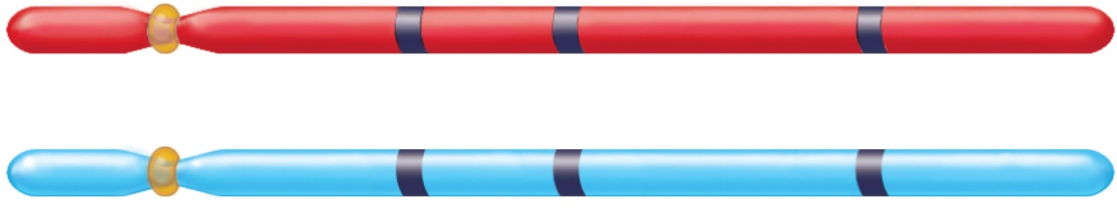
Homologous chromosomes have the same genes, but may have different alleles
Gene loci (location)
A
b
c
Homologous
pair of
chromosomes
A
B
c
Genotype:
AA
Bb
cc
Homozygous
for the
dominant
allele
Heterozygous
Homozygous
for the
recessive
allele
Brooker Fig 2.3
Copyright © The McGraw-Hill Companies, Inc. Permission required for reproduction or display.

Slide 23
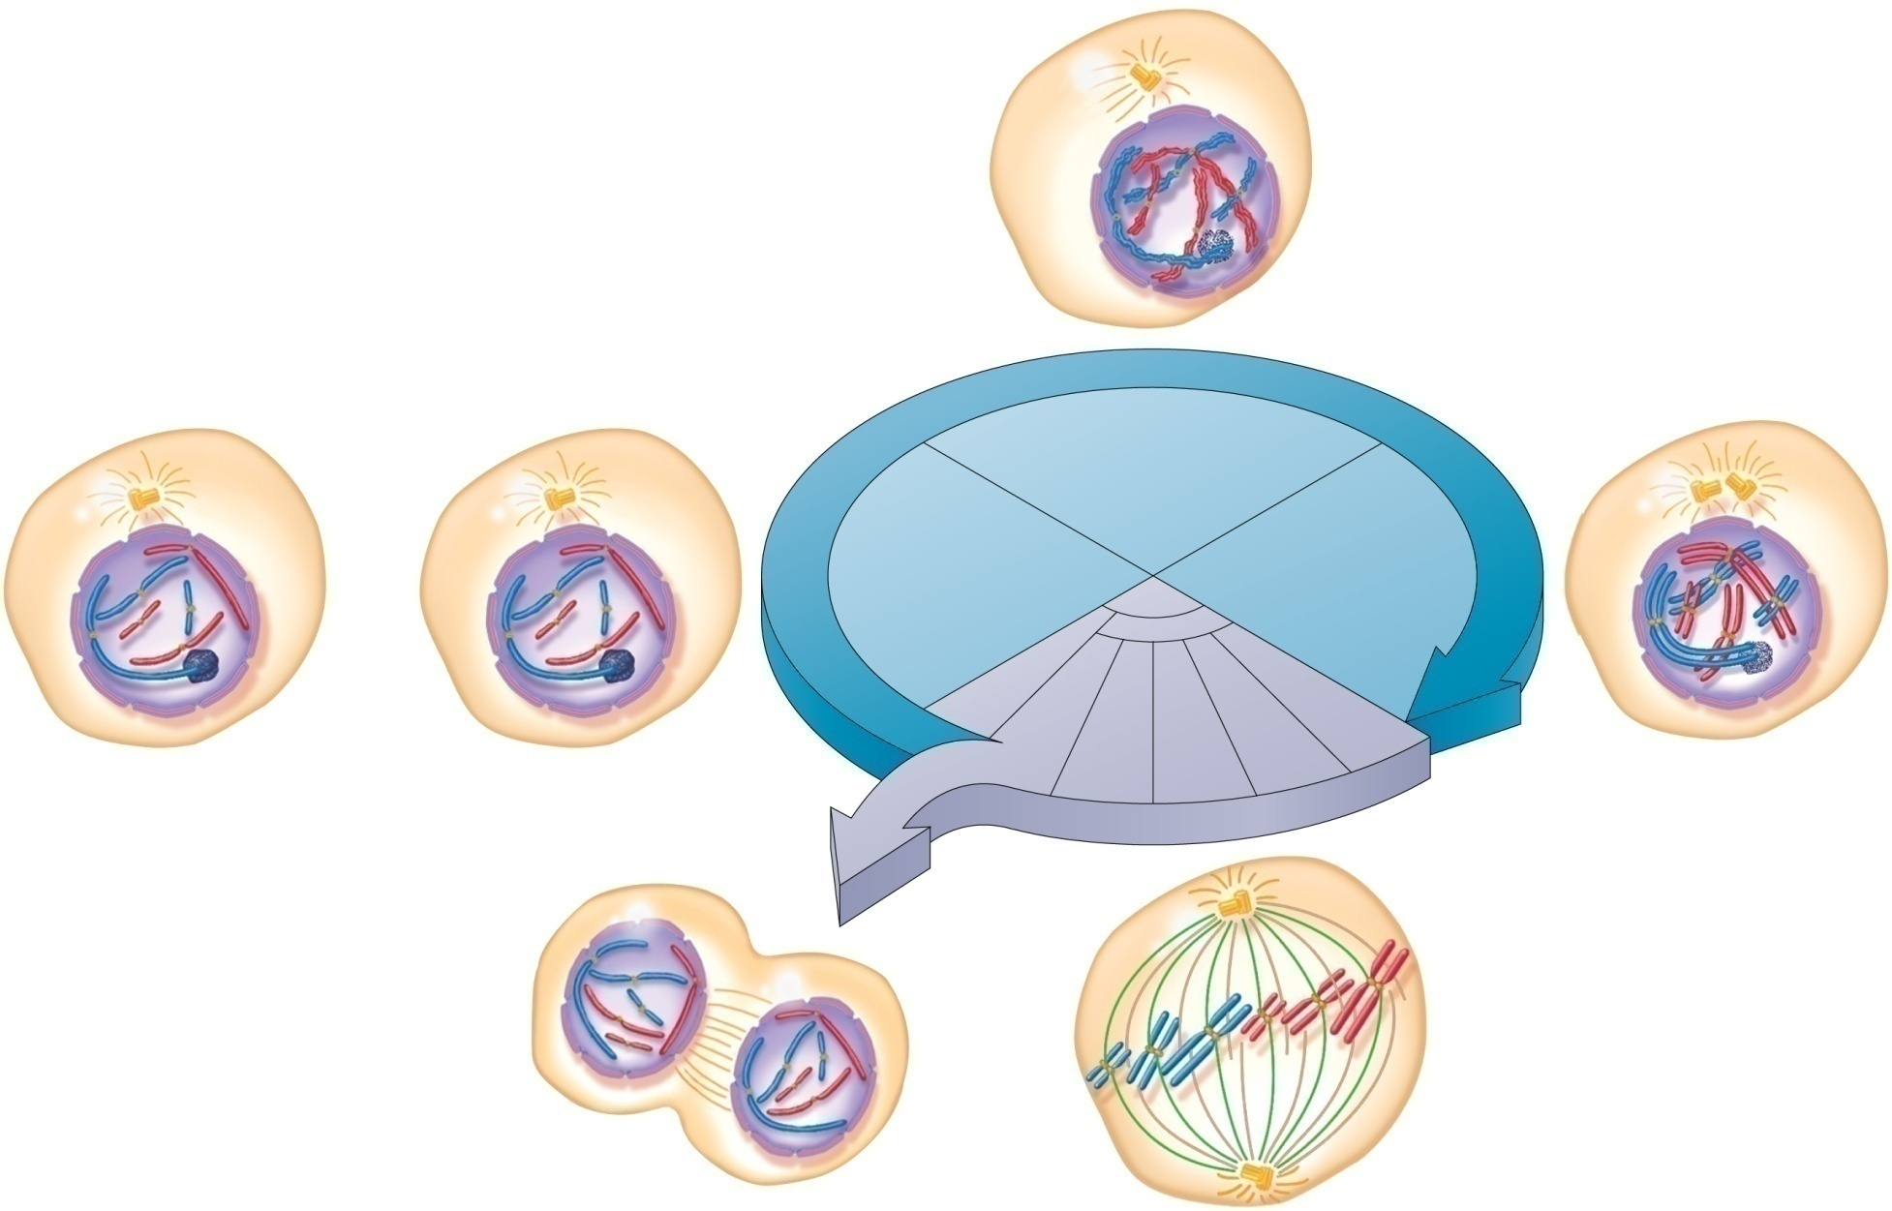
The Cell Cycle
Restriction
point
Interphase
Mother cell
S
G₁
M
G₂
Cytokinesis
Prophase
Telophase
Prometaphase
Metaphase
Anaphase
G₀
Chromosome
Nucleolus
(Nondividing cell)
Two
daughter
cells
Brooker Fig 2.5
Copyright © The McGraw-Hill Companies, Inc. Permission required for reproduction or display.

Slide 24
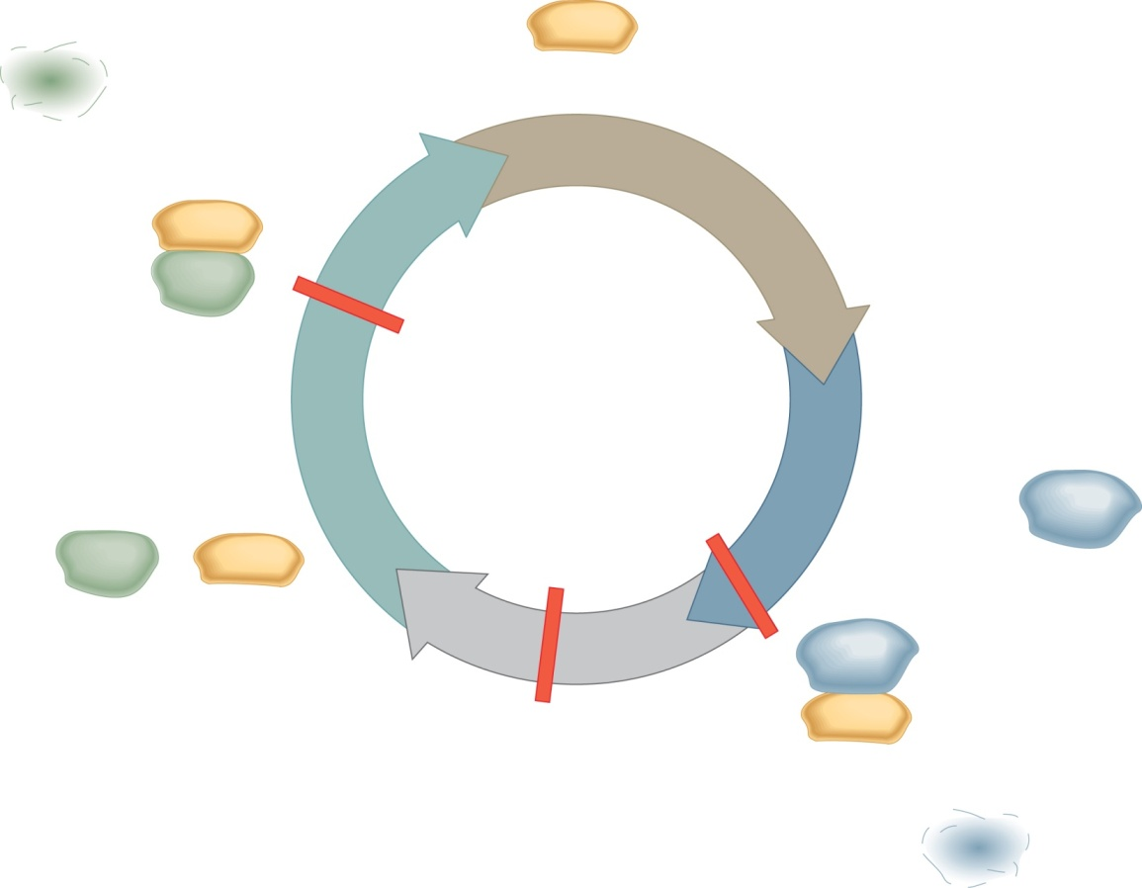
Cyclin Protein and CDK’s Regulate the Cell Cycle
G₁ cyclin is
degraded after
cell enters
S phase.
CDK
S
Activated G₁
cyclin/CDK
complex
CDK
G₁ checkpoint
G₂ checkpoint
G₂
Mitotic
cyclin
G₁
G₁ cyclin
CDK
M
Activated
mitotic
cyclin/CDK
complex
Metaphase
checkpoint
CDK
Mitotic cyclin is degraded as cell
progresses through mitosis.
Brooker, Fig 23.16
Copyright ©The McGraw-Hill Companies, Inc. Permission required for reproduction or display
Notes:
Notes for editor:
Cyclin protein should be much smaller, so that figure can denote an increase in cyclin concentration as cell cycle progresses (more cyclin protein → activation of CDK). Show phosphorylation activity of CDKs on some downstream targets.

Slide 25
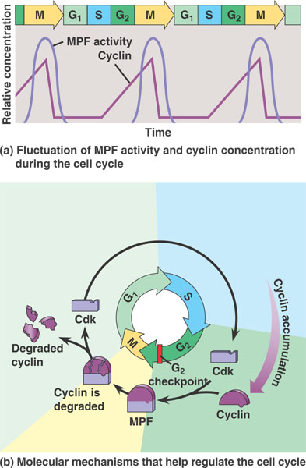
The concentration of cyclin proteins determines the Cell Cycle
(fig from Campbell’s Biology)

Slide 26
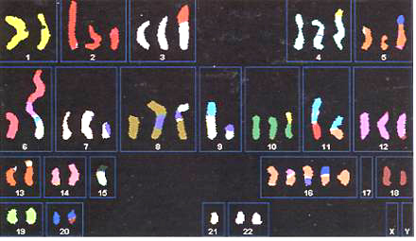
The timing of the cell cycle is important→ mistakes in mitosis result in abnormal number and type of chromosomes, and can cause cancer
Photo from Karp, Cell and Molecular Biology

Slide 27
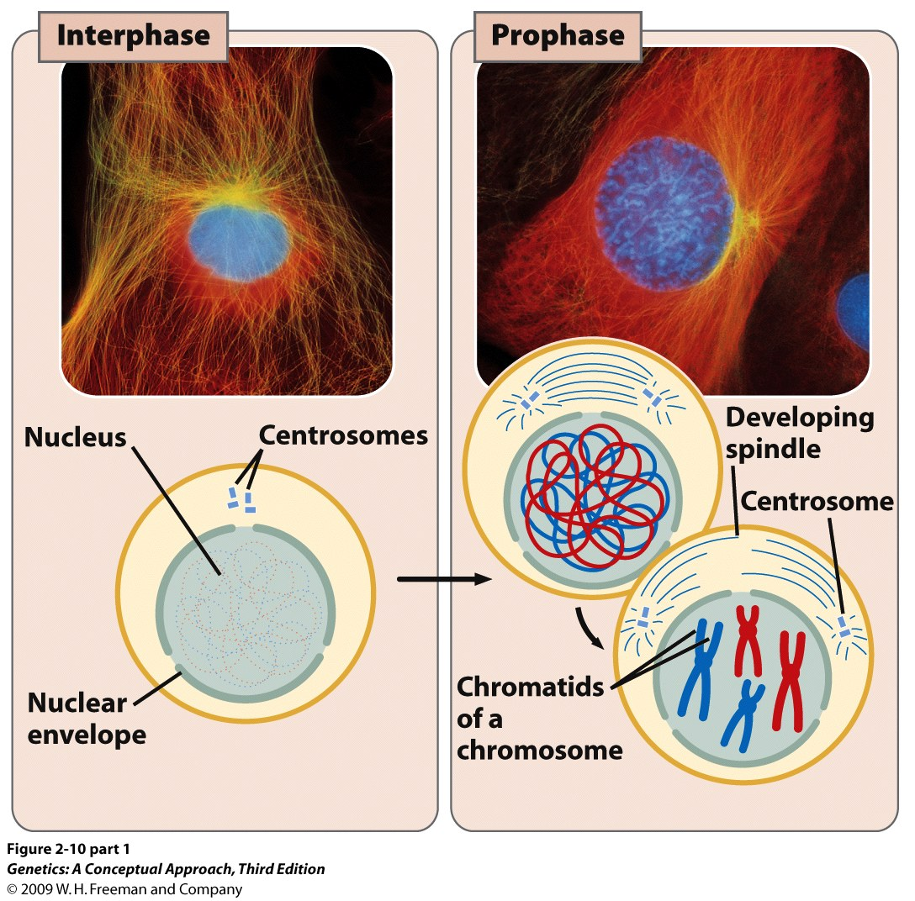
Notes:
2.10 (part 1) The cell cycle is divided into stages. [Photographs by Conly L. Rieder/Biological Photo Service.]

Slide 28
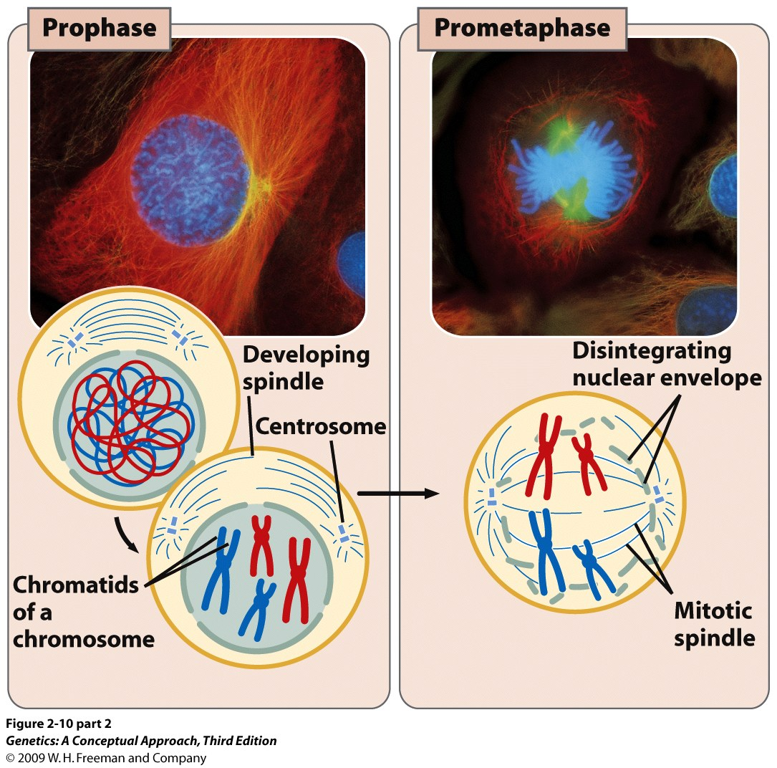
Notes:
2.10 (part 2) The cell cycle is divided into stages. [Photographs by Conly L. Rieder/Biological Photo Service.]

Slide 29
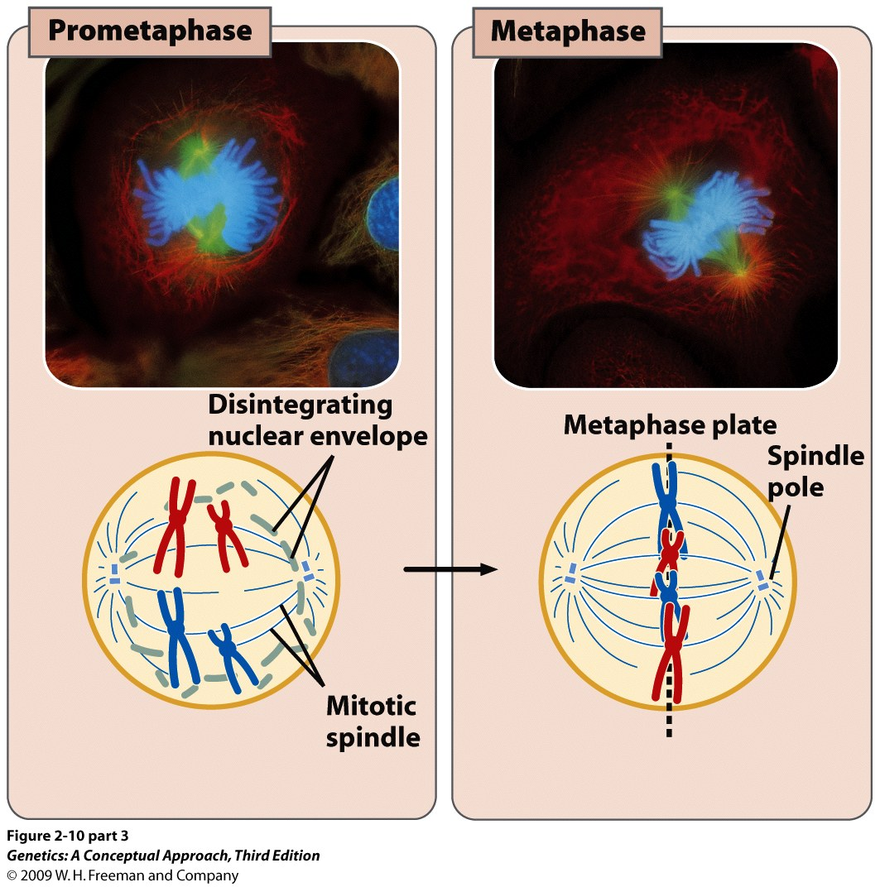
Notes:
2.10 (part 3) The cell cycle is divided into stages. [Photographs by Conly L. Rieder/Biological Photo Service.]

Slide 30
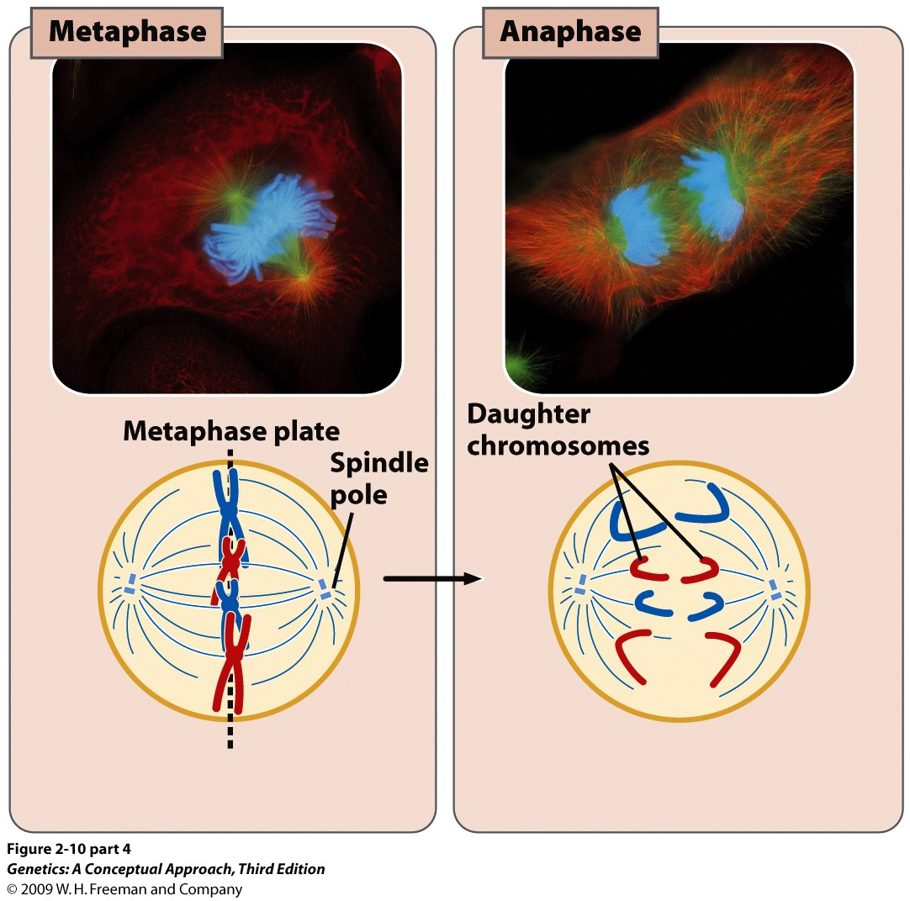
Notes:
2.10 (part 4) The cell cycle is divided into stages. [Photographs by Conly L. Rieder/Biological Photo Service.]

Slide 31
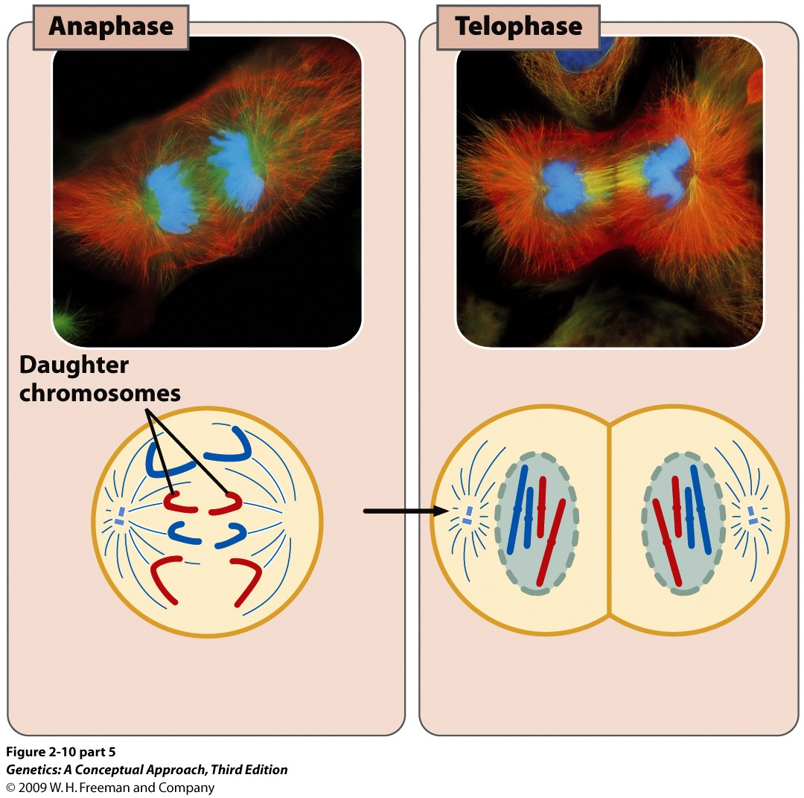
Notes:
2.10 (part 5) The cell cycle is divided into stages. [Photographs by Conly L. Rieder/Biological Photo Service.]

Slide 32
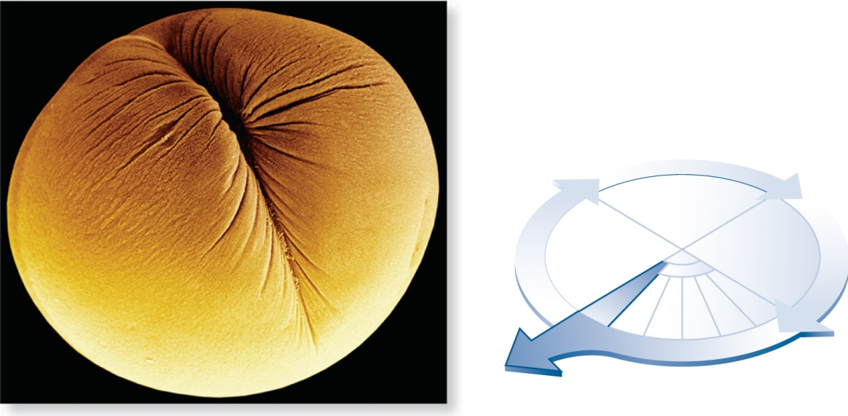
Cytokinesis = splitting of cell
“cell”
“movement”
Cleavage
furrow
S
G₁
G₂
Cytokinesis
150 mm
© Dr. David M. Phillips/Visuals Unlimited
(a) Cleavage of an animal cell
Fig 2.9, Brooker
Copyright © The McGraw-Hill Companies, Inc. Permission required for reproduction or display.

Slide 33
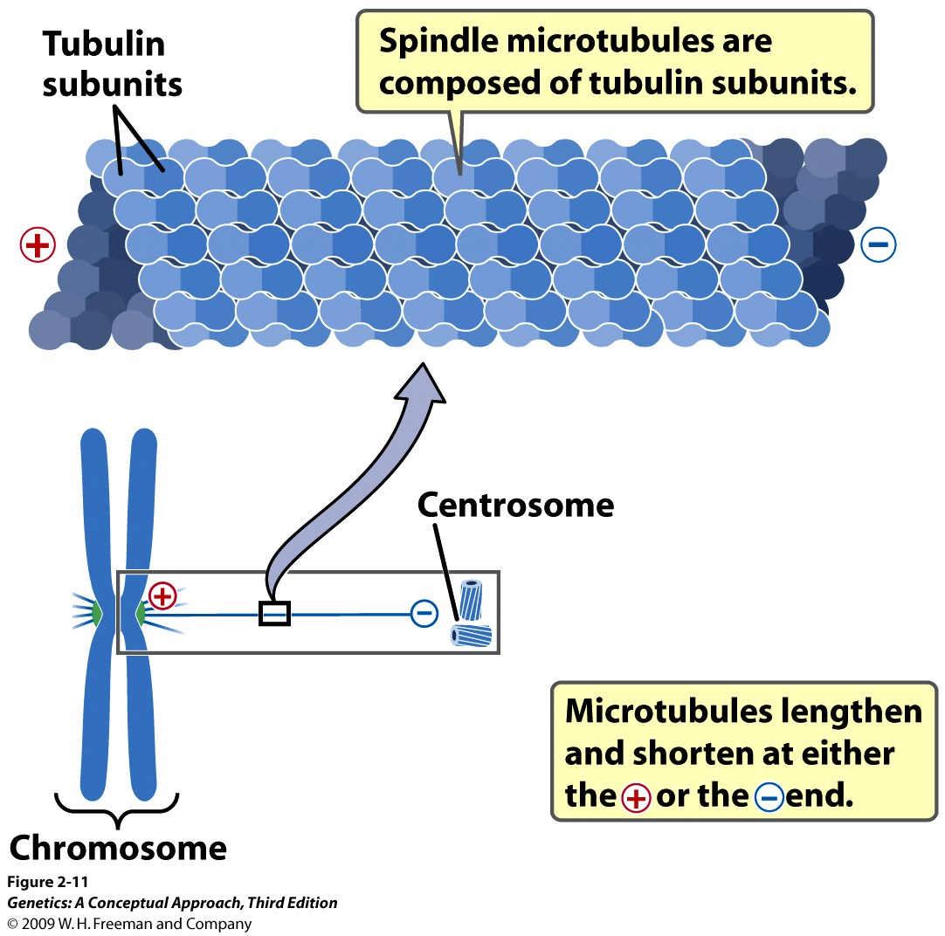
How do the microtubules appear out of “nowhere”?
Notes:
2.11 Microtubules are composed of tubulin subunits. Each microtubule has a positively charged (+) end at the kinetochore and a negatively charged (−) end at the centrosome.

Slide 34
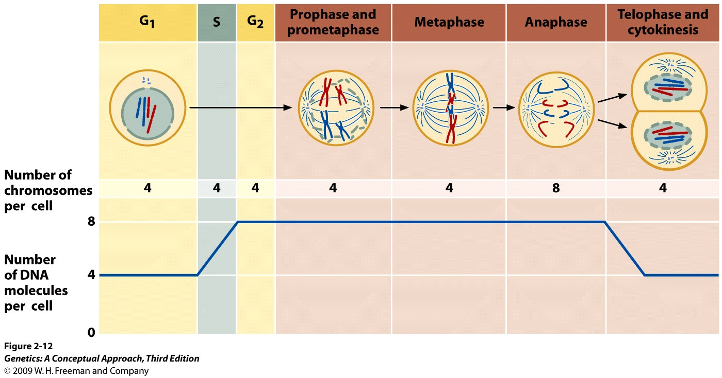
Notes:
2.12 The number of chromosomes and the number of DNA molecules change in the course of the cell cycle. The number of chromosomes per cell equals the number of functional centromeres, and the number of DNA molecules per cell equals the number of chromatids.

Slide 35
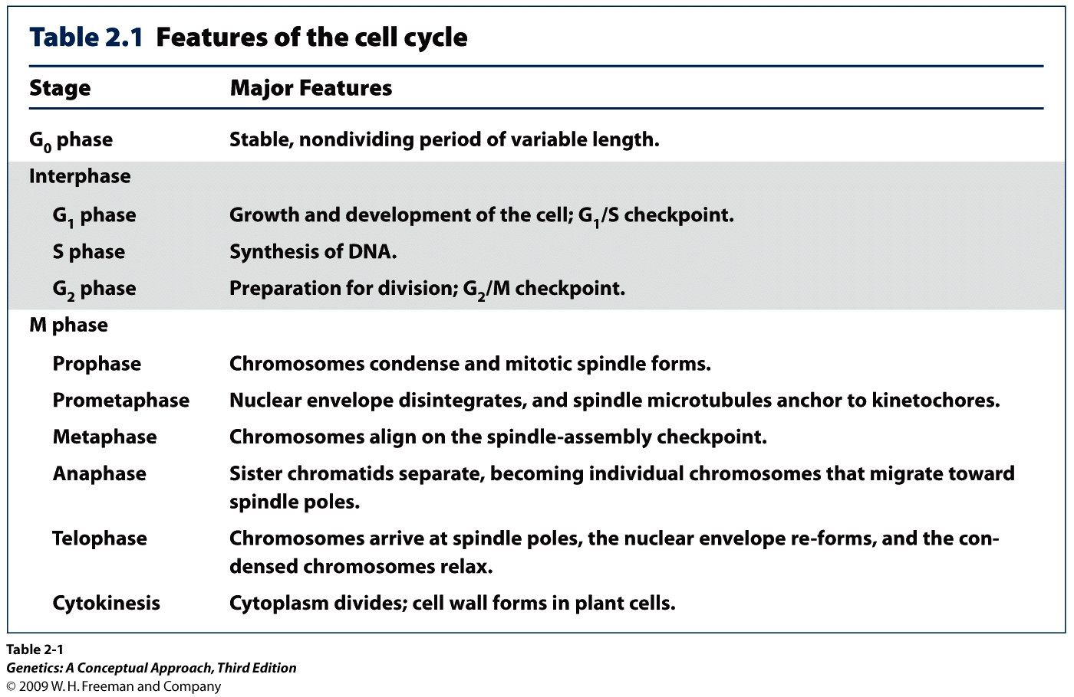
Notes:
Table 2.1 Features of the cell cycle

Slide 36
Karyotype (normal male)
Is this a diploid or a haploid karyotype?
Emery’s Elements of Medical Genetics, 12th ed © 2005 Elsevier

Slide 37
Is this a diploid or a haploid karyotype?
Emery’s Elements of Medical Genetics, 12th ed © 2005 Elsevier

Slide 38
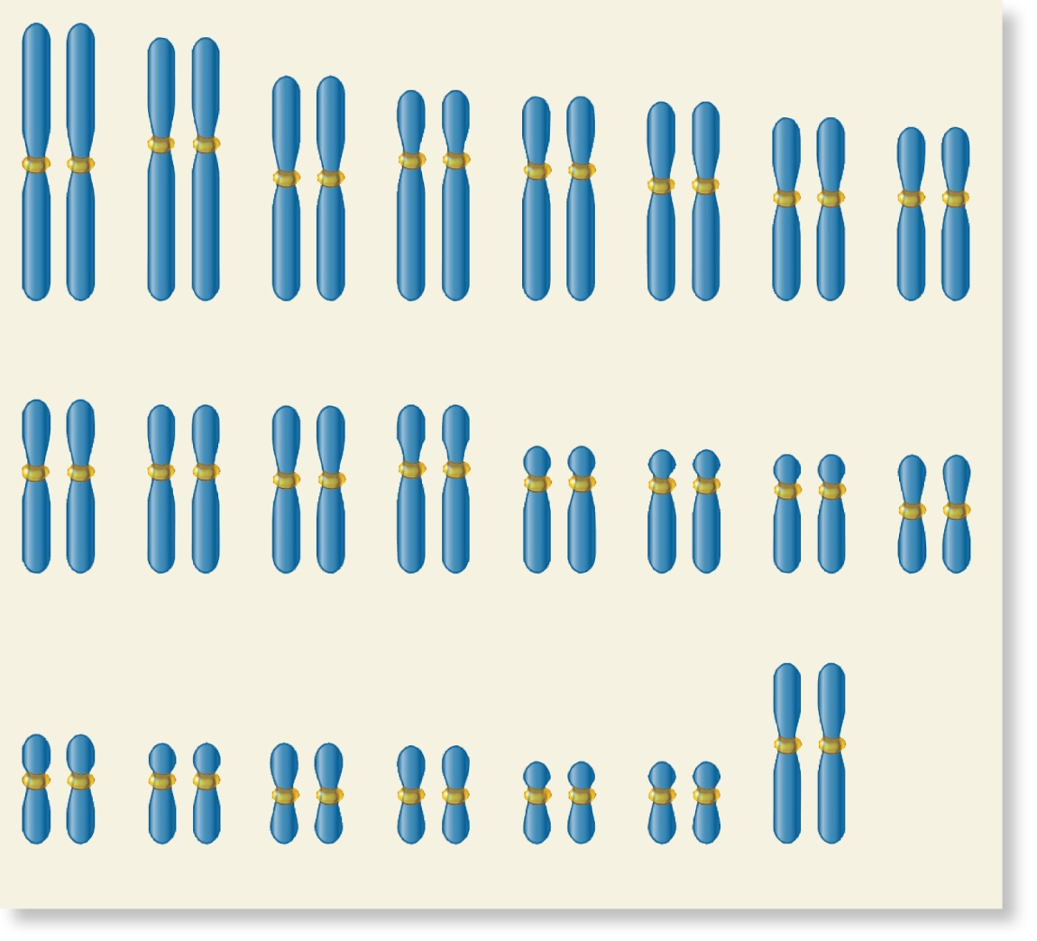
In humans, most cells are diploid and have 46 chromosomes
(23 homologous pairs)
1
2
3
4
5
6
7
8
9
10
11
12
13
14
15
16
(a) Chromosomal composition found
in most female human cells
(46 chromosomes)
17
18
19
20
21
22
XX
Figure 1.11a, Brooker
Copyright © The McGraw-Hill Companies, Inc. Permission required for reproduction or display.

Slide 39
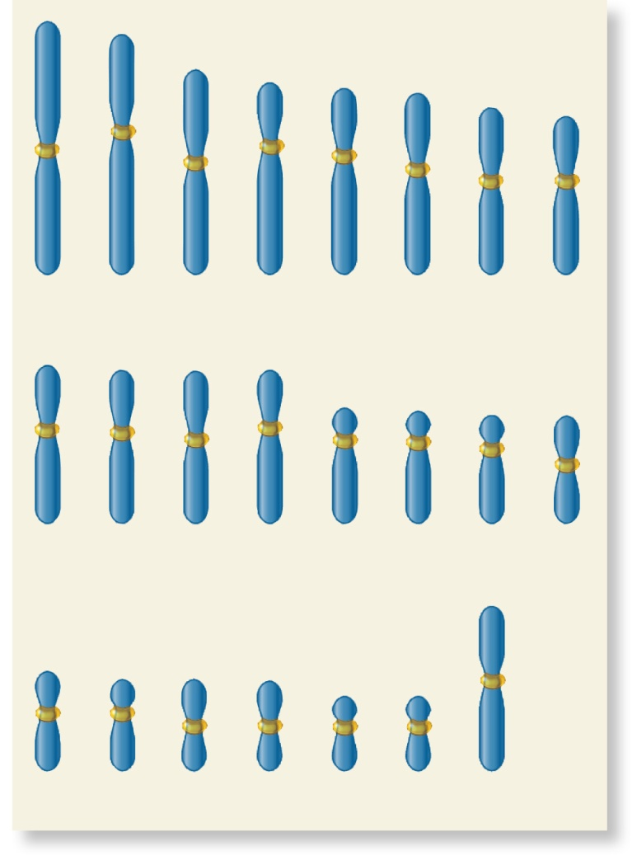
Gametes (sperm and egg)
  Are haploid
  e.g. Human gametes have 23 chromosomes
1
2
3
4
5
6
7
8
(b) Chromosomal composition found in
a human gamete (23 chromosomes)
9
10
11
12
13
14
15
16
Figure 1.11b, Brooker
17
18
19
20
21
22
X
Copyright © The McGraw-Hill Companies, Inc. Permission required for reproduction or display.

