Slide 1
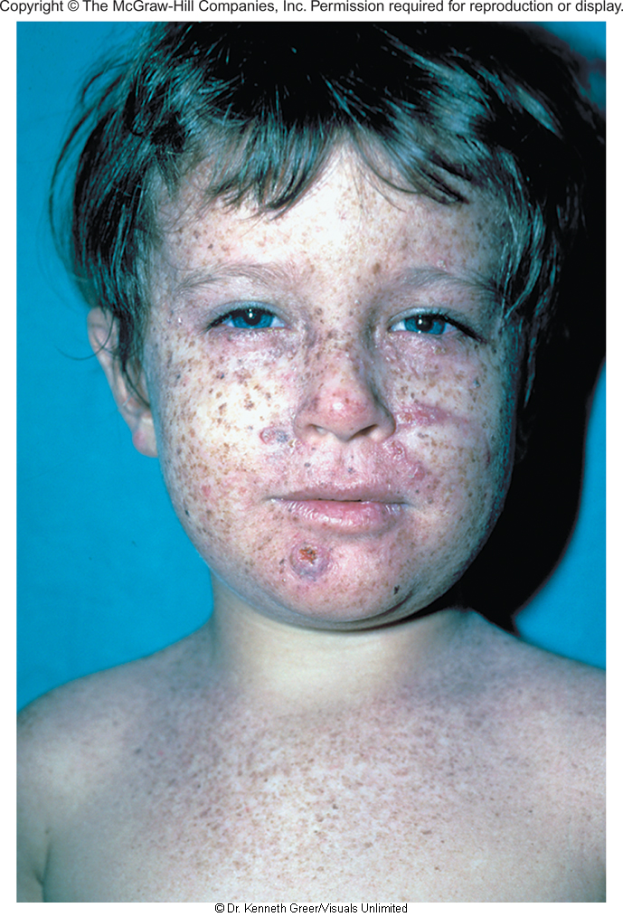
Xeroderma Pigmentosum

Slide 2
Study Guide/Outline--Mutations
Mutation Mechanisms
A gene may have a mutation rate of “1.4 x10⁻⁵” What exactly does this number mean? (from class)
What are the molecular mechanisms by which mutations arise in the DNA? What can happen during DNA replication? Recombination, chemically?
What is the difference between transitions and transversions?
Effects on Protein/Effects on the Organism
What are the differences between a missense, nonsense, and frameshift mutation? (and how do they arise)? Why does a silent mutation not result in an amino acid change?
Mutations in DNA sequence may be written as “T352C”, while mutations in amino acid sequence may be written as “Met 54 Val”. What is meant by this nomenclature?
The effect of a mutation may be reversed in an organism, either a true reversion at the same nucleotide, or through second mutations. Explain the difference between a true reversion, partial reversion, and suppressor mutations (intragenic or intergenic).
What is the difference between a somatic and germline mutation (including passing on mutation to offspring and what proportion of cells in the organism are mutant)?

Slide 3
Different mutation rates for different genes
Disease | Locus or Gene | Mutation Rate
Achondroplasia (dominant dwarfism) | FGF-R3 (fibroblast growth factor receptor 3) | 0.6 – 1.4 x 10⁻⁵
Duchenne Muscular Dystrophy | DMD | 3.5 – 4.5 x 10⁻⁵
Hemophilia A | Clotting Factor VIII | 3.2 – 5.7 x 10⁻⁵

Slide 4
Types of Mutations
Protein Changing--Deleterious or neutral (sometimes beneficial) mutations
  Missense--a.a. → different a.a.
    Sometimes neutral effect on protein if new a.a. is chemically similar to old
  Nonsense—a.a. codon → stop codon (truncation of protein)
  Insertion or deletion of nucleotide→shift in reading frame (frameshift mutation→ missense then stop codon)
Non protein-changing
Silent mutations (non-a.a. changing)--neutral Mutations
Changes in expression pattern
Mutations in the promoter or regulatory regions
position effect

Slide 5
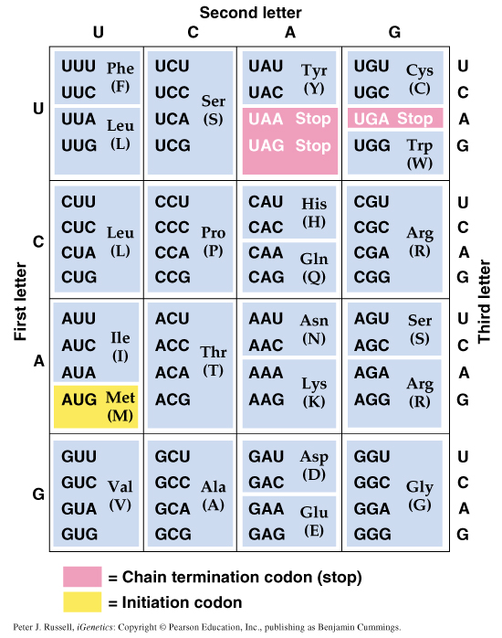
The genetic code

Slide 6
Frameshift Mutations
mRNA
Protein
Normal
A
U
G
A
A
G
U
U
U
G
G
C
G
C
A
U
U
G
C
A
A
Met
Lys
Phe
Gly
Ala
Leu
Gln
U
mRNA
Protein
Frameshift
A
U
G
A
A
G
U
U
G
G
C
G
C
A
U
U
G
C
A
A
Met
Lys
Leu
Ala
Frameshift: insertion or deletion of base pairs, producing a stop codon downstream and shortened protein

Slide 7
Frameshift Mutations
mRNA
Protein
Normal
A
U
G
A
A
G
U
U
U
G
G
C
G
C
A
U
U
G
C
A
A
Met
Lys
Phe
Gly
Ala
Leu
Gln
U
mRNA
Protein
Frameshift
A
U
G
A
A
G
U
U
G
G
C
G
C
A
U
U
G
C
A
A
Met
Lys
Leu
Ala
Frameshift: insertion or deletion of base pairs, producing a stop codon downstream and shortened protein

Slide 8
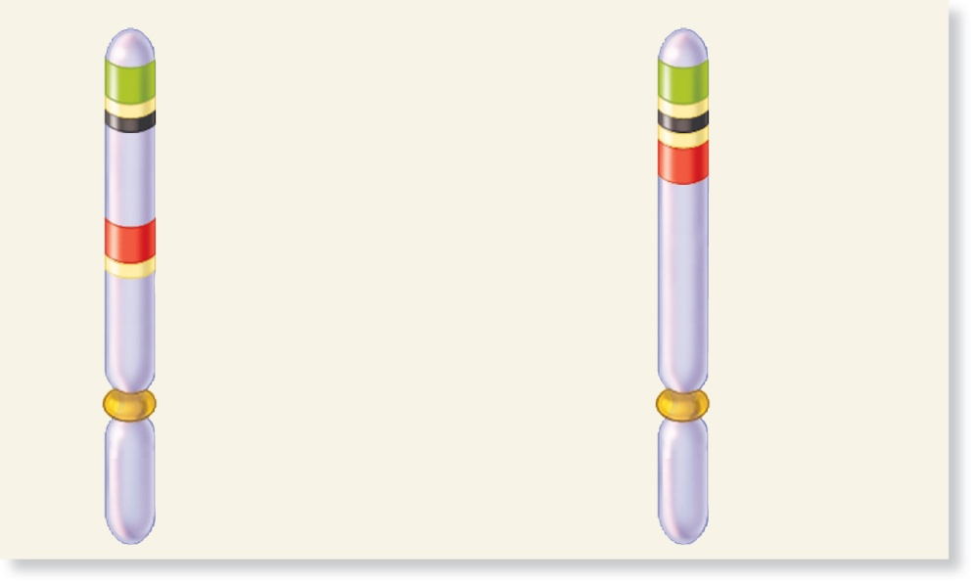
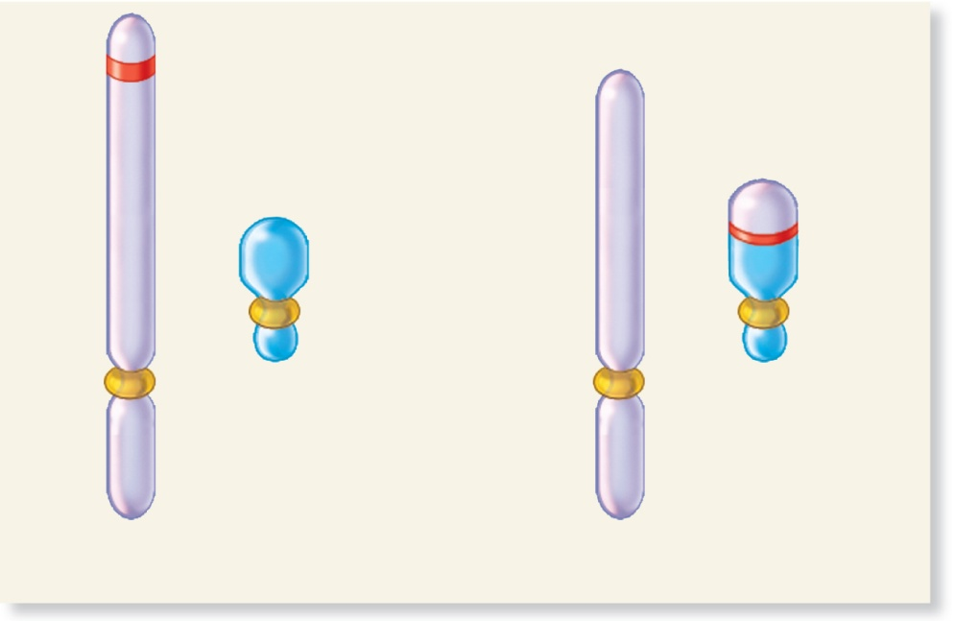
Mutations causing changes in gene expression
Coding
sequence
B
Core
promoter
B
Gene B
A
Core promoter for gene A is
moved next to regulatory
sequence of gene B.
Regulatory
sequence
Inversion
A
Coding
sequence
Core
promoter
Gene A
(a) Position effect due to regulatory sequences
Active
gene
Gene
is now
inactive.
Translocation
Heterochromatic
chromosome
(more compacted)
Translocated
heterochromatic
chromosome
Euchromatic
chromosome
Shortened euchromatic
chromosome
(b) Position effect due to translocation to a heterochromatic
chromosome
Brooker, Fig 18.2a and b
Copyright © The McGraw-Hill Companies, Inc. Permission required for reproduction or display.

Slide 9
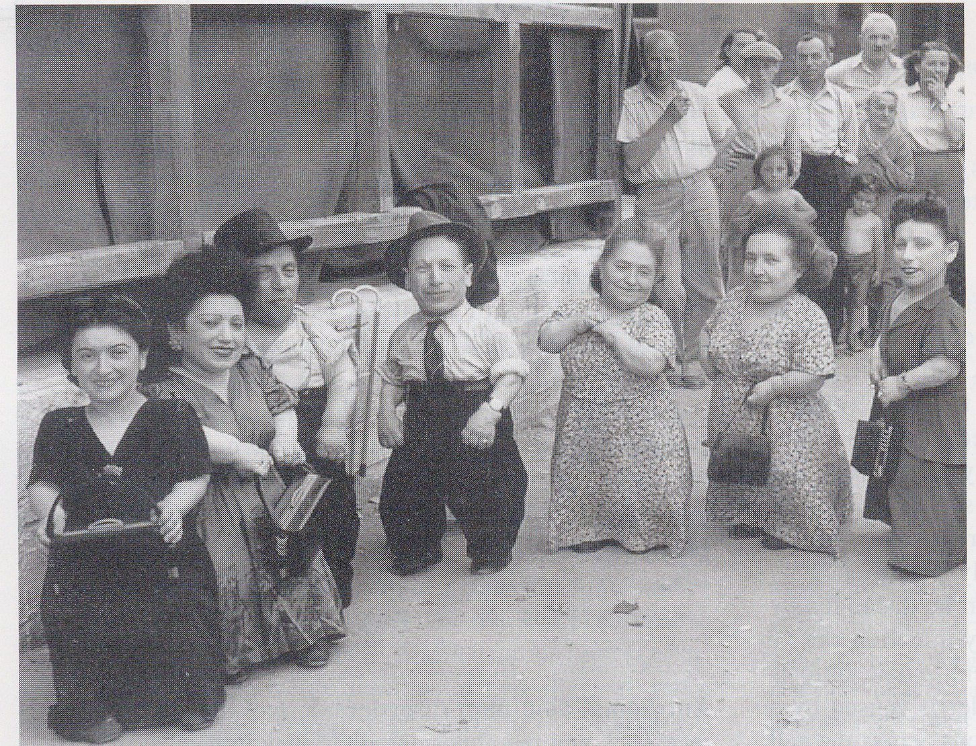
Achondroplasia
Mutation in Fibroblast Growth Factor Receptor 3 (FGFR-3)
Chromosome 4p16.3
Almost all cases→Gly 380 Arg

Slide 10
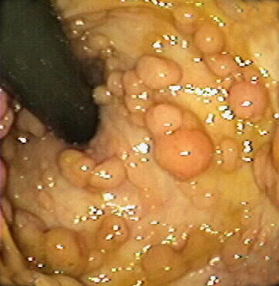
Nonsense and Frameshift Mutations in APC gene cause Familial Adenomatous Polyposis
Inner colon epithelia is covered in polyps
Risk of extracolonic tumors (upper GI, desmoid, osteoma, thyroid, brain, other)
Untreated polyposis leads to 100% risk of cancer
Prevention—prophylactic colectomy

Slide 11
Gel Electrophoresis to detect truncated APC proteins in FAP families
Normal
Mutated
DNA transcribed to mRNA
RNA translated to protein
Protein run on gel
Truncated protein has different mobility in gel
DNA
mRNA
Protein
Gel
What will the protein bands look like on the gel?

Slide 12
Gel Electrophoresis to detect truncated APC proteins in FAP families
Normal
Mutated
DNA transcribed to mRNA
RNA translated to protein
Protein run on gel
Truncated protein has different mobility in gel
DNA
mRNA
Protein
Gel
Shorter mutant protein runs faster

Slide 13
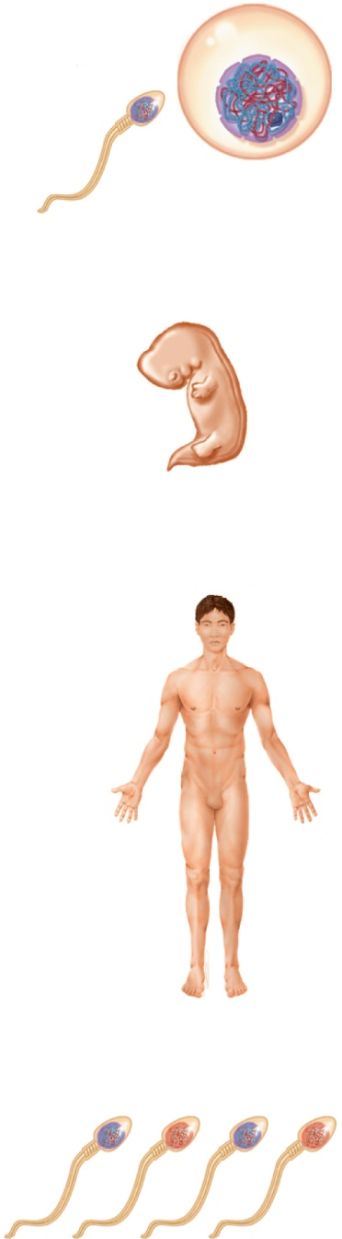
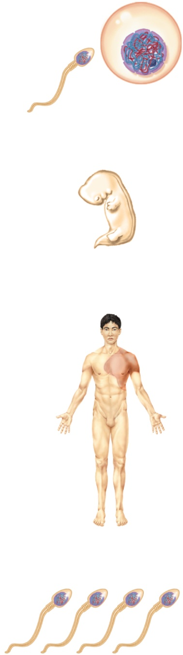
Copyright © The McGraw-Hill Companies, Inc. Permission required for reproduction or display.
Germ-line
mutation
Gametes
Somatic
mutation
Embryo
The earlier the mutation, the larger the patch
Patch of
affected
area
Mutation is
found
throughout
the entire
body.
Mature
individual
Half of
the gametes
carry the
mutation.
None of
the gametes
carry the
mutation.
Figure 18.4a and b
(a) Germ-line mutation
(b) Somatic cell mutation

Slide 14
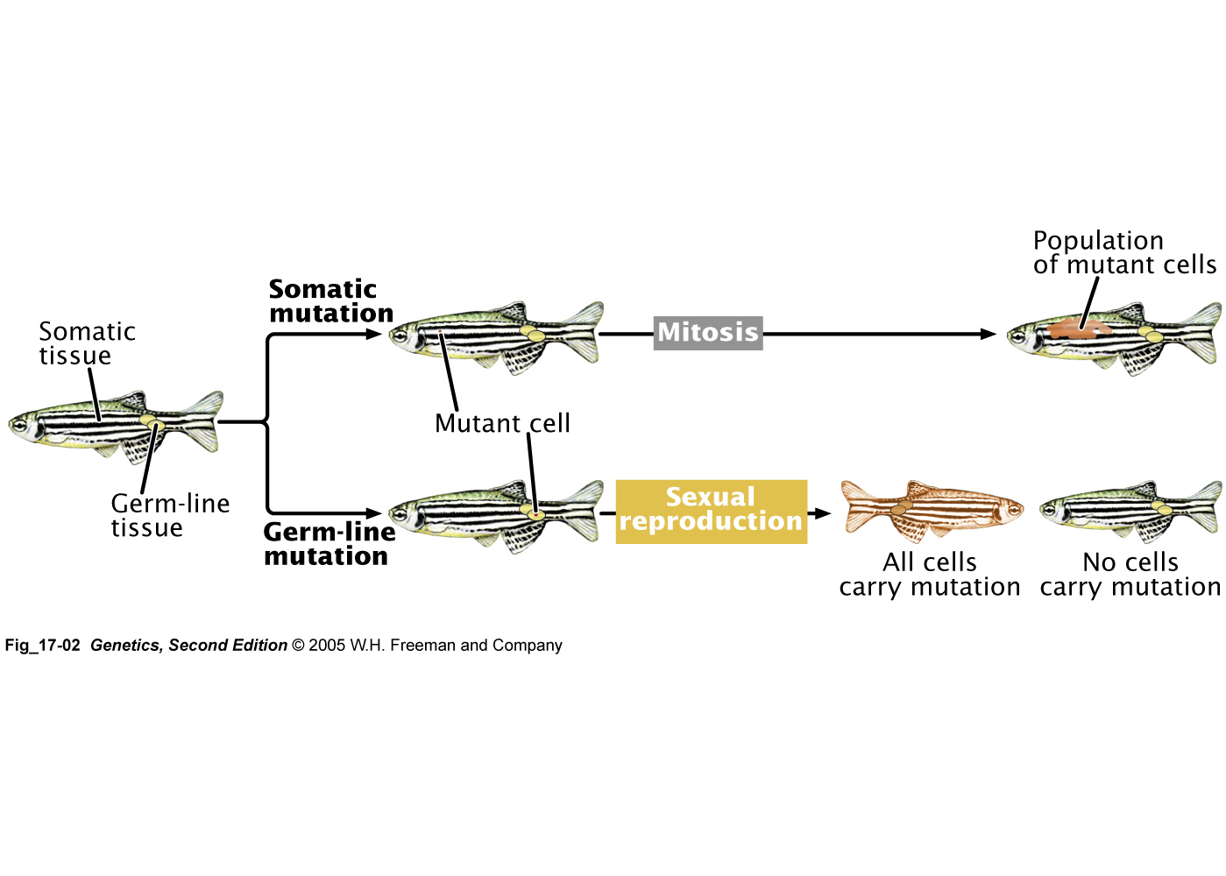
Different results of somatic vs. germline mutations

Slide 15
Sources of mutation
Mistakes in DNA replication:
  Mismatch pairing due to “wobble-like” pairing
  Slippage of DNA polymerase at repeated sequences
  Tri-nucleotide repeat expansion (e.g. Huntington's gene, FRAXA. See fig 18.12)
Spontaneous mutations:
  Depurination
  De-amination
  Tautomeric shift (see fig 18.10)
Oxidative stress and ROS
Mutagen inducers
  Chemical mutagens: ethidium bromide, 5-BrdU
  Ionizing radiation
  UV radiation

Slide 16
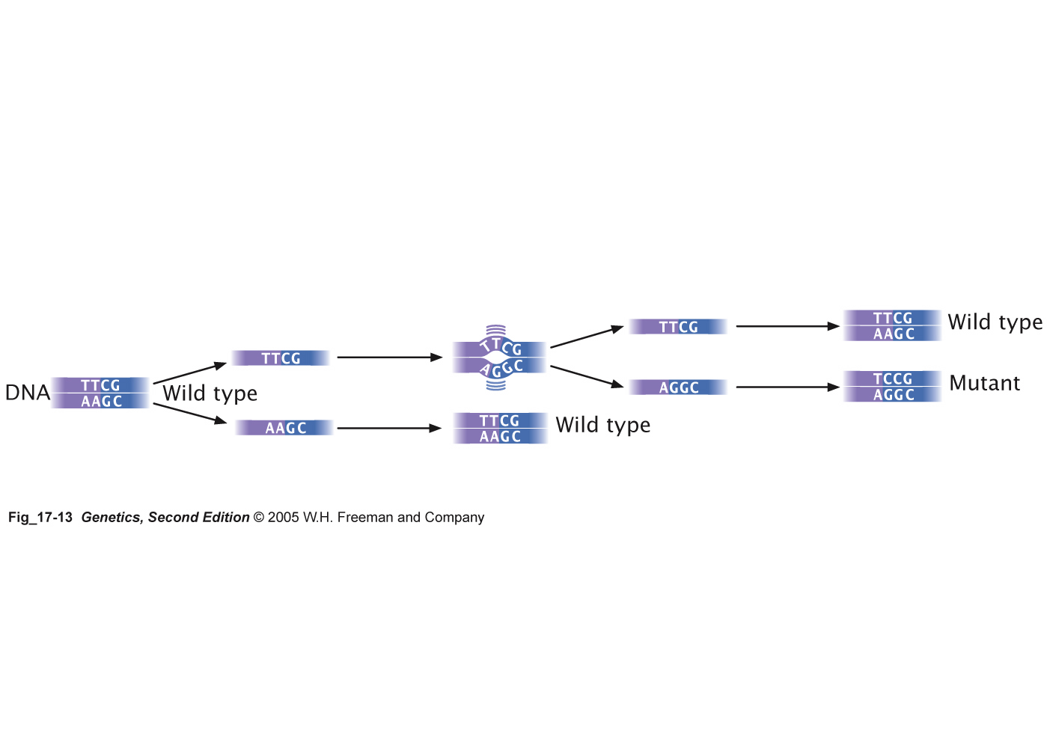
Fig 17-13 Wobble base pairing leads to a replicated error
Wobble base pairing leads to a replicated error

Slide 17
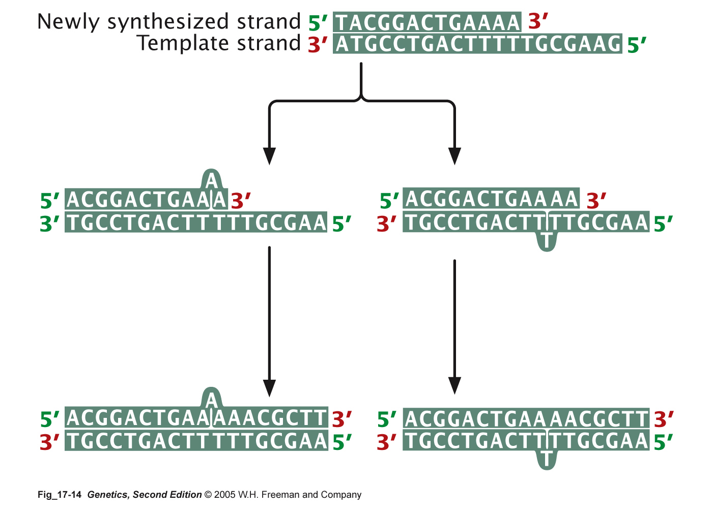
Insertions and Deletions may result from strand slippage
Deletion in newly synthesized strand
Insertion in newly synthesized strand

Slide 18
In normal individuals, trinucleotide sequences are transmitted from parent to offspring without mutation
  However, in persons with TRNE disorders, the length of a trinucleotide repeat increases above a certain critical size
    It also becomes prone to frequent expansion
    This phenomenon is shown here with the trinucleotide repeat CAG
CAGCAGCAGCAGCAGCAGCAGCAGCAGCAGCAG
n = 11
CAGCAGCAGCAGCAGCAGCAGCAGCAGCAGCAGCAGCAGCAGCAGCAGCAGCAG
n = 18
18 - 48
Copyright ©The McGraw-Hill Companies, Inc. Permission required for reproduction or display

Slide 19
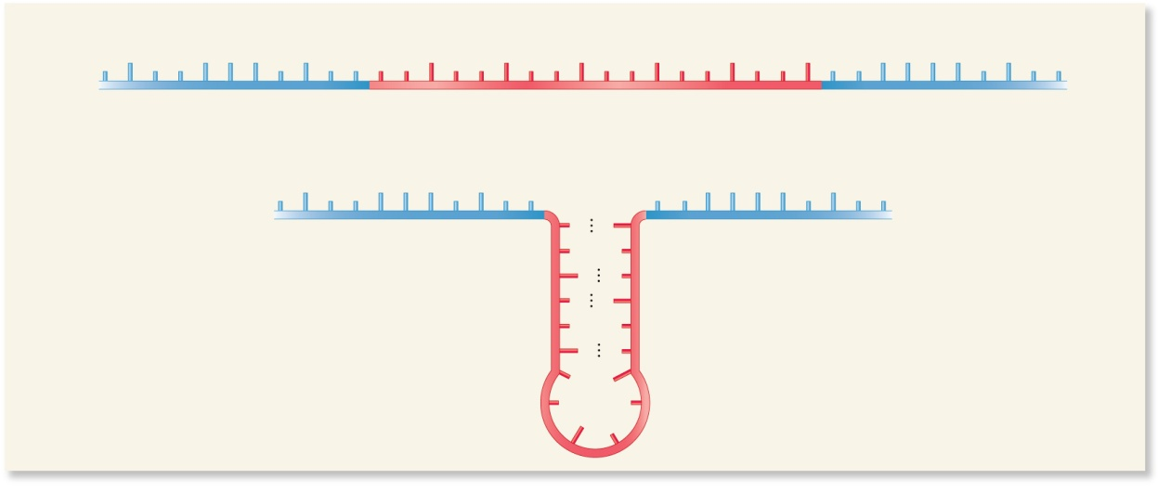
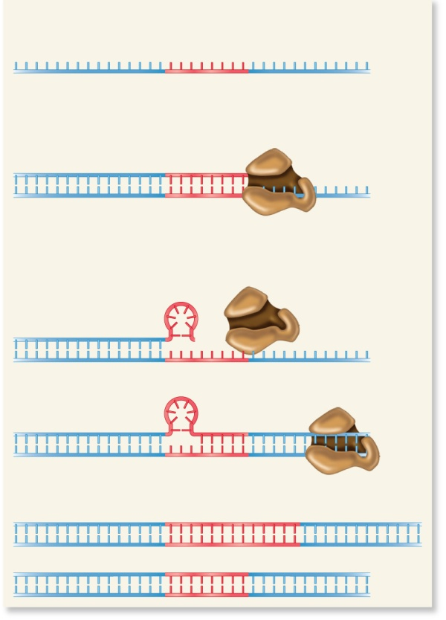
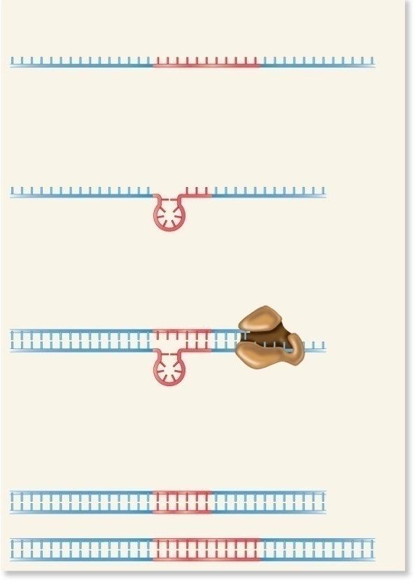
Expansion of tri-nucleotide repeats
One DNA strand with a trinucleotide repeat sequence
T
G
C
C
A
A
G
C
A
T
T
C
T
G
C
T
G
C
T
G
C
T
G
C
T
G
C
T
G
T
C
A
A
A
G
C
A
T
T
Trinucleotide (CTG) repeat
G
A
A
G
A
Hairpin formation
T
C
C
C
T
T
T
C
A
A
A
G
C
A
T
T
C
G
T
T
C
G
G
C
T
T
Hairpin with CG base pairing
G
C
T
C
G
T
C
(a) Formation of a hairpin with a trinucleotide (CTG) repeat sequence
One DNA template strand prior to DNA replication
One DNA template strand prior to DNA replication
TNRE
TNRE
DNA replication begins
and goes just past the TNRE.
Hairpin forms in template strand
prior to DNA replication.
DNA
polymerase
DNA polymerase slips off
the template strand and a
hairpin forms.
DNA replication occurs and
DNA polymerase slips over
the hairpin.
DNA polymerase resumes
DNA replication.
DNA repair occurs.
TNRE is longer.
DNA repair occurs.
TNRE is shorter.
OR
TNRE is the same length.
OR
TNRE is the same length.
  Fig-18.12
(b) Mechanism of trinucleotide repeat expansion
(c) Mechanism of trinucleotide repeat deletion

Slide 20
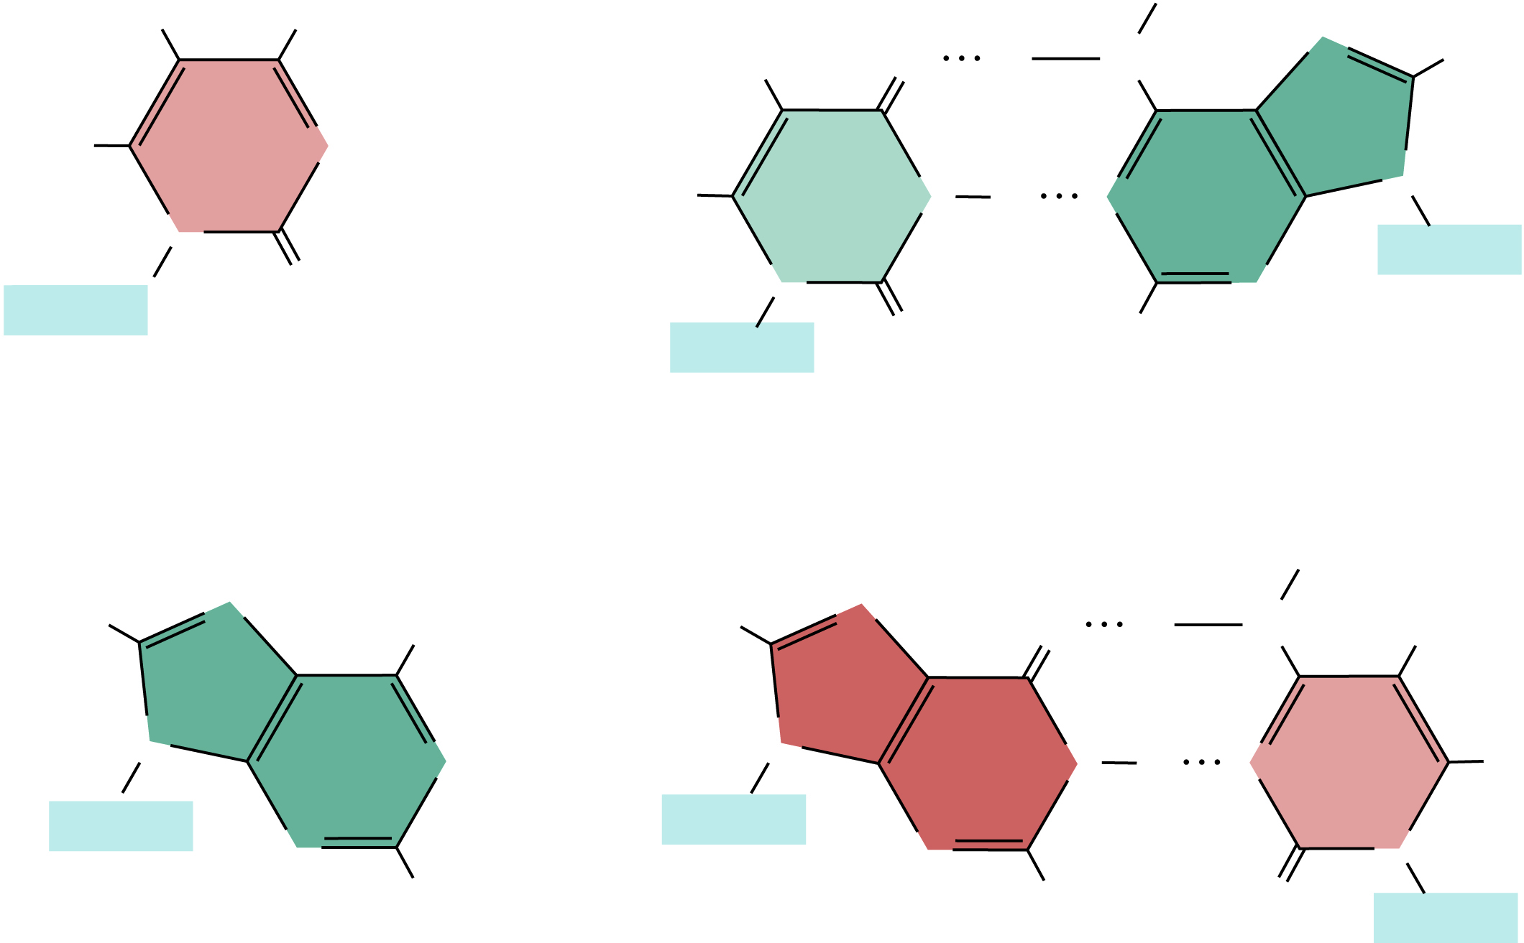
Template strand
After replication
H
NH₂
H
O
H
N
N
H
H
Cytosine
N
HNO₂
N
H
N
N
N
Uracil
Adenine
Sugar
O
N
N
Sugar
O
Sugar
H
H
H
N
NH₂
H
N
O
H
N
H
HNO₂
N
Adenine
N
Hypo
xanthine
N
N
H
N
Cytosine
H
Sugar
Sugar
N
N
N
H
H
O
Sugar
Brooks, Fig 18.13
Notes:
Base modifiers covalently modify the structure of a nucleotide
Nitrous acid, replaces amino groups with keto groups (–NH₂ to =O)
This can change cytosine to uracil (C->T transition) and adenine to hypoxanthine (A->T transversion)

Slide 21
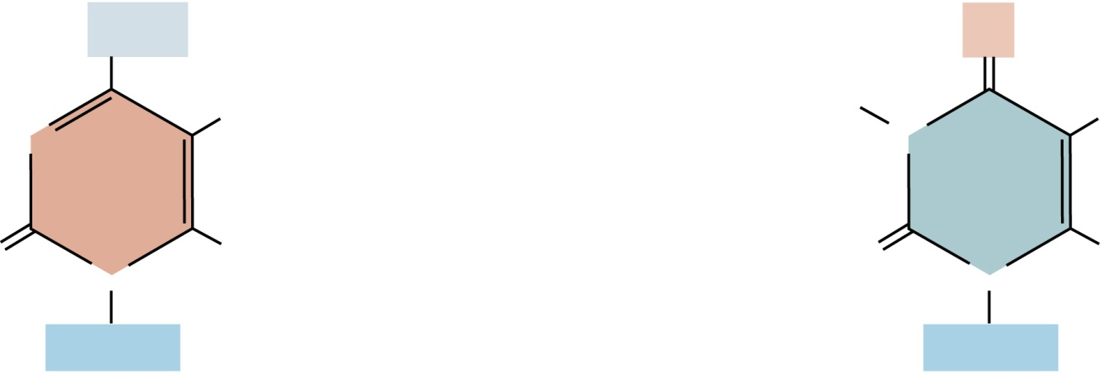
Copyright © The McGraw-Hill Companies, Inc. Permission required for reproduction or display.
NH₂
O
H
H
H
N
N
+
H₂O
+
NH₃
O
N
H
O
N
H
Sugar
Sugar
Cytosine
Uracil
(a) Deamination of cytosine
Figure 18.9a
18 - 35

Slide 22
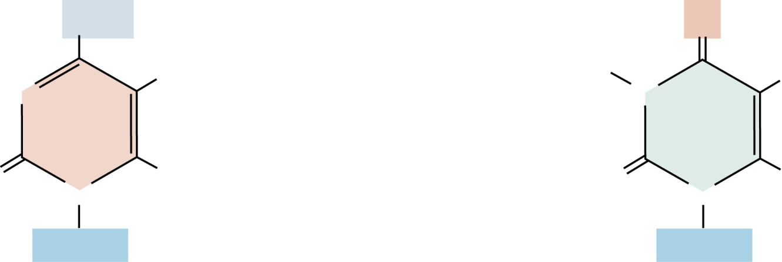
Copyright © The McGraw-Hill Companies, Inc. Permission required for reproduction or display.
NH₂
O
CH₃
H
CH₃
N
N
+
H₂O
+
NH₃
O
N
H
O
N
H
Sugar
Sugar
5-methylcytosine
Thymine
(b) Deamination of 5-methylcytosine
Figure 18.9b
18 - 38

Slide 23
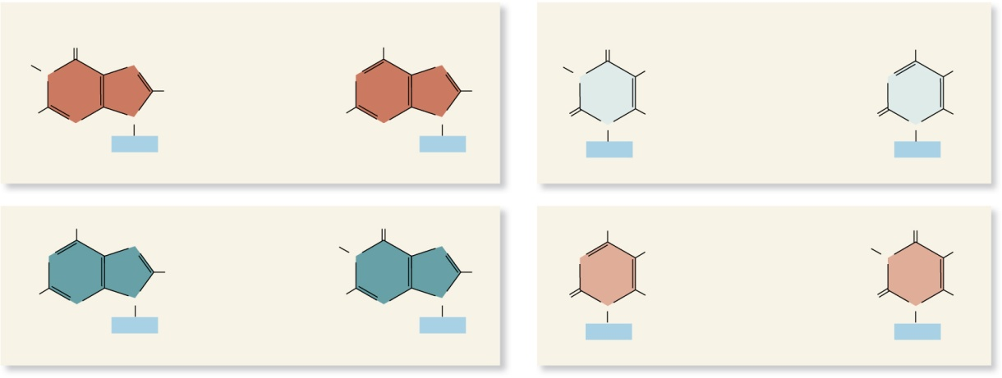
Tautomeric shifts of nucleotides change the pairing properties
Common
Rare
O
OH
H
N
N
N
N
Tautomeric shift
N
N
N
H
N
H
N
Guanine
N
H₂N
N
N
H₂N
N
N
N
N
Sugar
Sugar
Keto form
Enol form
N
NH
N
H
N
N
N
Tautomeric shift
N
N
N
H
N
H
N
Adenine
N
H
N
N
H
N
N
N
N
Sugar
Sugar
Amino form
Imino form
Common
Rare
Common
Rare
O
OH
H
N
CH₃
Tautomeric shift
N
CH₃
N
N
O
N
H
Thymine
O
N
H
N
N
Sugar
Sugar
Keto form
Enol form
NH₂
NH
N
H
Tautomeric shift
H
N
H
N
N
O
N
H
Cytosine
O
N
H
N
N
Sugar
Sugar
Amino form
Imino form
Figure 18.10a
(a) Tautomeric shifts that occur in the 4 bases found in DNA

Slide 24
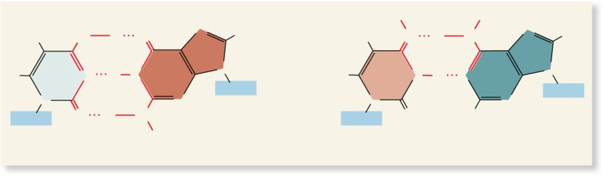
Mis–base pairing due to tautomeric shifts
H
H
N
N
H
N
H₃C
O
H
O
N
H
N
N
H
N
N
N
H
N
H
N
N
H
N
N
Sugar
Sugar
N
N
N
N
N
N
N
N
Sugar
O
H
N
Sugar
O
H
H
Thymine (enol)
Guanine (keto)
Cytosine (imino)
Adenine (amino)
Figure 18.10b

Slide 25
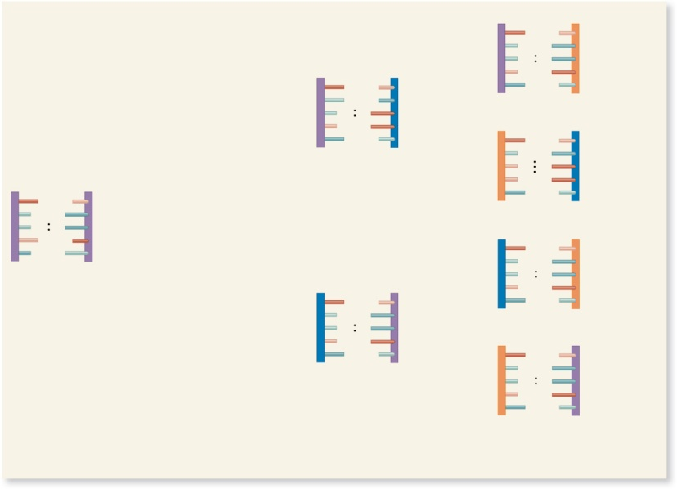
Temporary tautomeric shift
Shifted back to its normal form
5′
3′
5′
3′
T
A
Base
mismatch
T
G
3′
5′
5′
3′
A thymine base
undergoes a
tautomeric shift prior
to DNA replication.
3′
5′
C
G
Mutation
5′
3′
A second round
of DNA replication
occurs.
3′
5′
T
A
5′
3′
3′
5′
T
A
5′
3′
T
A
3′
5′
5′
3′
3′
5′
T
A
3′
5′
DNA molecules found
in 4 daughter cells
(c) Tautomeric shifts and DNA replication can cause mutation.
Figure 18.10c

Slide 26
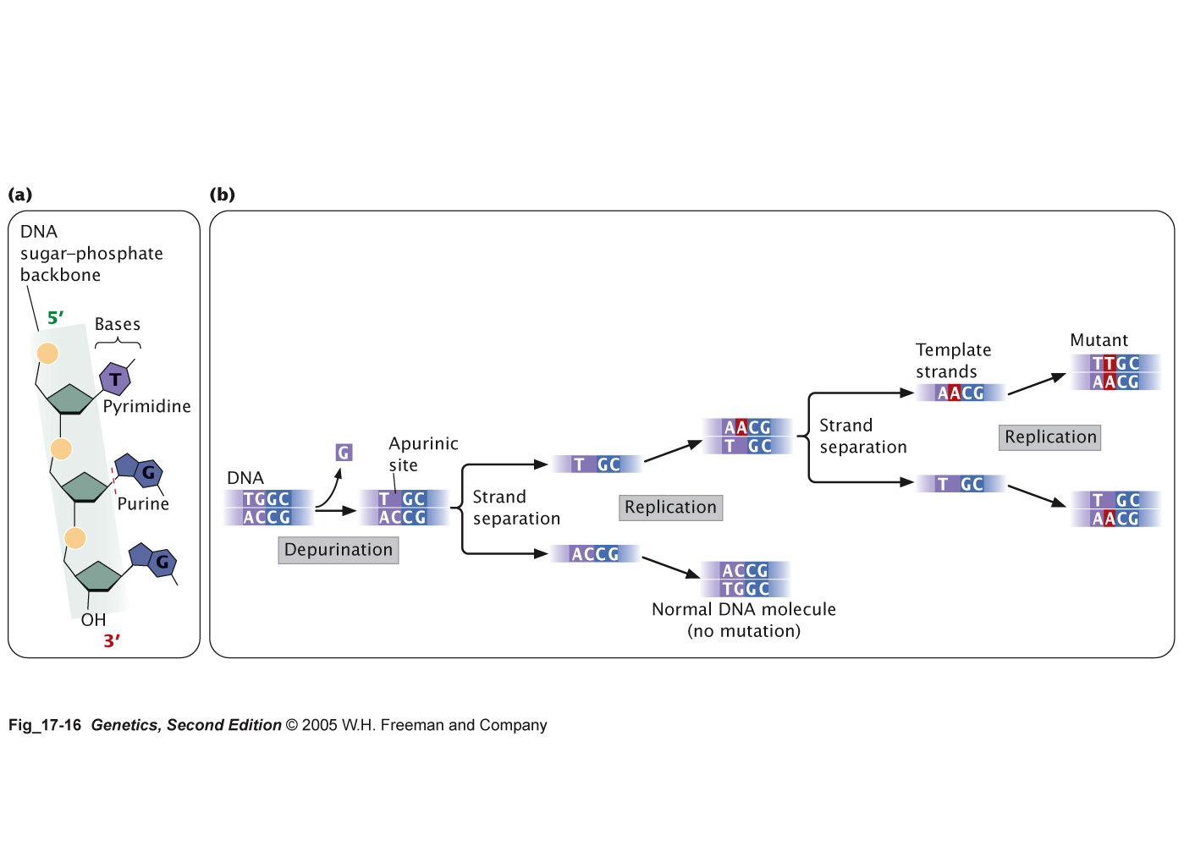
Depurination produces a “gap” in the DNA sequence

Slide 27
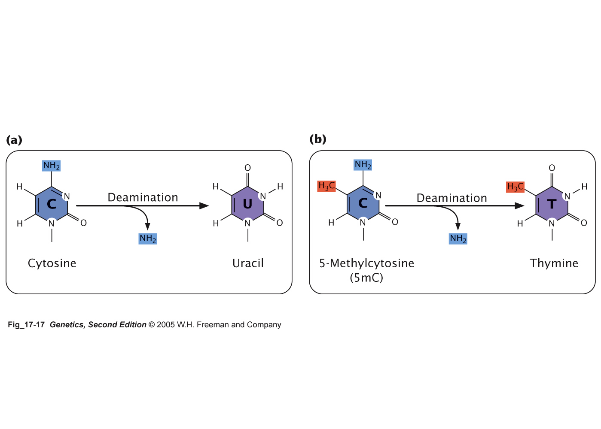
Deamination of cytosine bases results in C → T Transition

Slide 28
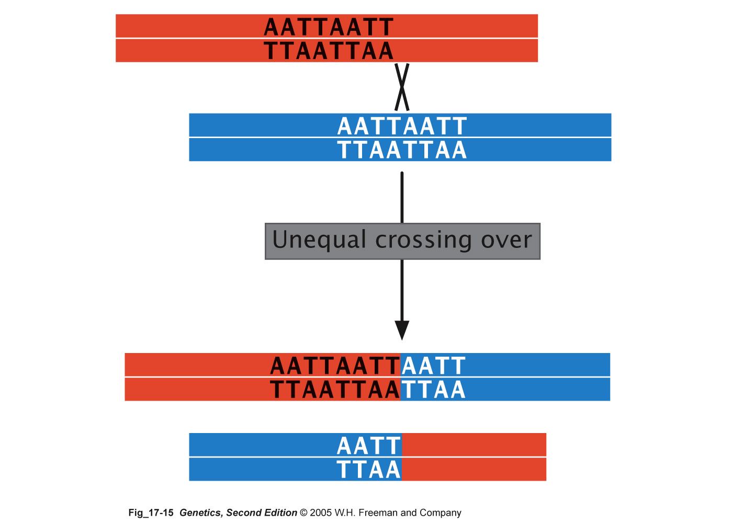
Unequal crossing over produces insertions and deletions

Slide 29
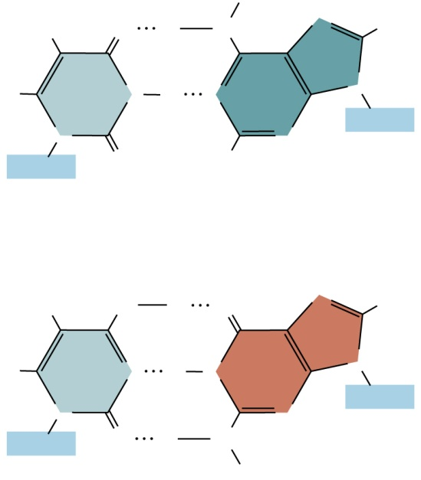
5-BrdU is an unstable chemical analog of Thymine
H
Br
O
H
N
N
H
N
H
N
N
Sugar
N
N
Sugar
O
H
5-bromouracil
(keto form)
Adenine
Br
O
H
O
N
H
N
H
N
N
Sugar
N
N
Sugar
O
H
N
H
5-bromouracil
(enol form)
Guanine
Figure 18.14a
(a) Base pairing of 5BU with adenine or guanine

Slide 30
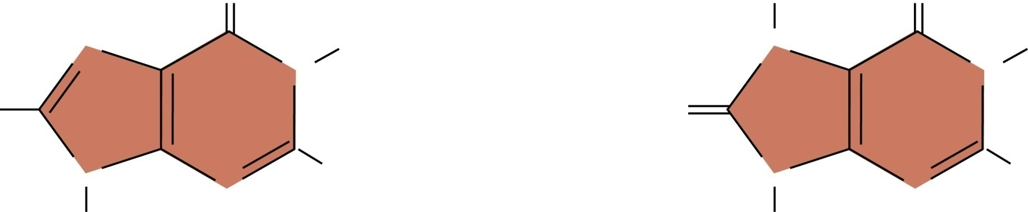
Oxidative stress and DNA damage causes G to T transversions
O
H
O
N
6
H
N
6
H
7
5
N
ROS
7
5
N
1
1
H
8
O
8
4
2
4
2
9
3
9
3
N
N
NH₂
N
N
NH₂
H
H
Guanine
Base pairs with cytosine
8-oxoguanine
(8-oxoG)
  Base pairs with adenine
Brooker, Fig 18.11
Copyright © The McGraw-Hill Companies, Inc. Permission required for reproduction or display.
Notes:
Aerobic organisms use oxygen as terminal electron acceptor
Reactive oxygen species (ROS) generated by normal metabolism
ROS used by immune system to kill invading cells
Oxidative stress is an imbalance between synthesis and destruction of ROS
ROS can damage DNA and other molecules if not removed
Refer to Figure 18.11

Slide 31
Ionizing radiation
  Includes X-rays and gamma rays
  Has short wavelength and high energy
  Can penetrate deeply into biological materials
  Creates chemically reactive molecules termed free radicals
  Can cause
    Base deletions
    Single nicks in DNA strands
    Cross-linking
    Oxidized bases
    Chromosomal breaks
18 - 62

Slide 32
Nonionizing radiation
  Includes UV light
  Has less energy
  Cannot penetrate deeply into biological molecules material
  Causes the formation of cross-linked thymine dimers
  Thymine dimers may cause mutations when that DNA strand is replicated
  Refer to Figure 18.15
18 - 63

Slide 33
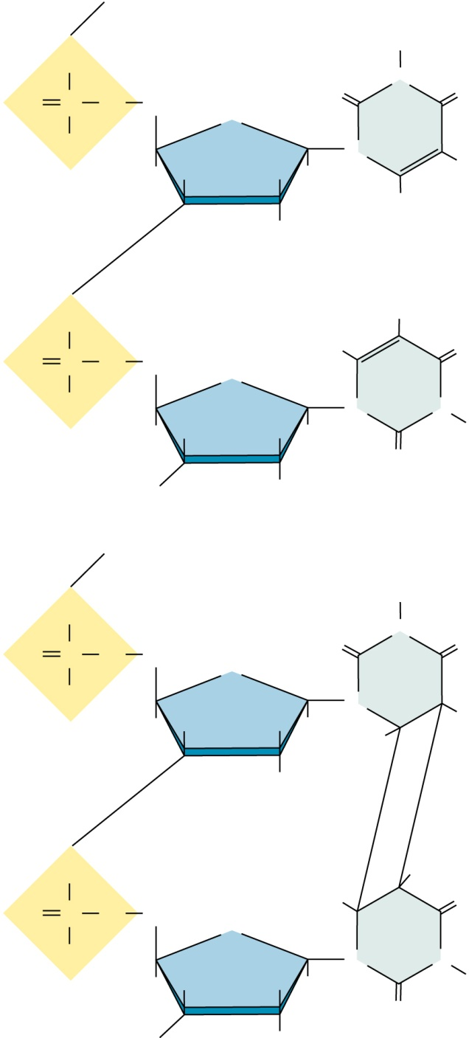
Copyright © The McGraw-Hill Companies, Inc. Permission required for reproduction or display.
O
H
O
P
O
CH₂
O
N
O
–
O
O
H
H
N
CH₃
H
H
H
H
Thymine
O
CH₃
O
P
O
CH₂
H
O
–
O
O
H
H
N
N
H
H
H
O
H
Thymine
Ultraviolet
light
O
H
O
P
O
CH₂
O
N
O
–
O
O
H
H
N
CH₃
H
H
H
H
O
CH₃
O
P
O
CH₂
H
O
–
O
O
H
H
N
N
Figure 18.15
H
H
H
O
H
Thymine dimer
18 - 64
Copyright ©The McGraw-Hill Companies, Inc. Permission required for reproduction or display

Slide 34
Go over lecture outline at end of lecture

