Slide 1
Study Guide and Outline
Broad course objective: a.) explain the molecular structure of chromosomes as it relates to DNA packaging, chromosome function and gene expression
Necessary for future material on: Chromosome Variation, Regulation of Gene Expression
DNA Packaging—Why and How
If the DNA in a typical human cell were stretched out, what length would it be? What is the diameter of the nucleus in which human DNA must be packaged?
What degree of DNA packaging corresponds with “diffuse DNA” associated with G1? What kind of DNA packaging is associated with M-phase (“condensed DNA”)?
What types of DNA sequences make up the genome? What functions do they serve?
What are the differences between euchromatin and heterochromatin?
What types of proteins are involved in chromosome packaging?
  How do nucleosomes and histone proteins function in DNA packaging?
  What is chromosome scaffolding?

Slide 2
How much DNA do different organisms have?
Organism haploid genome in bp
T4 Bacteriophage 168,900
HIV 9,750
E. coli bacteria 4,639,221
Yeast 13,105,020
Lily 36,000,000,000
Amoeba 290,000,000,000
Frog 3,100,000,000
Human 3,400,000,000
DNA content does not directly coincide with complexity of the organism. Any theories on why?

Slide 3
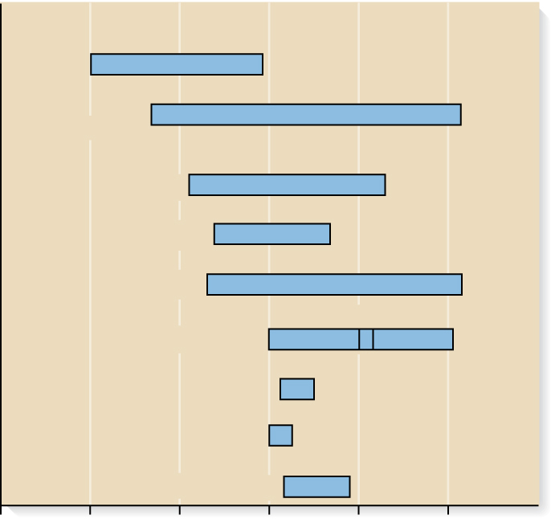
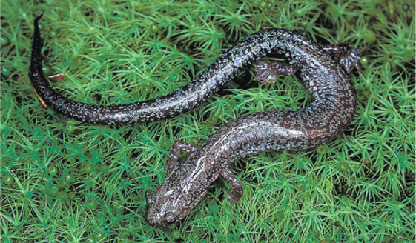
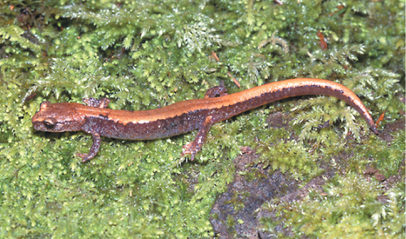
Copyright © The McGraw-Hill Companies, Inc. Permission required for reproduction or display.
Fungi
Vascular
plants
Insects
Mollusks
Fishes
© Simpson’s Nature Photography
(b) Plethodon richmondi
Salamanders
Amphibians
Reptiles
Birds
Mammals
10⁶
10⁷
10⁸
10⁹
10¹⁰
10¹¹
10¹²
(a) Genome sizes (nucleotide base pairs per
haploid genome)
© William Leonard
(c) Plethodon Iarselli
Brooker Fig 12.8
Has a genome that is more than twice as large as that of P. richmondi
Copyright ©The McGraw-Hill Companies, Inc. Permission required for reproduction or display
12-21

Slide 4
Size measurements in the molecular world
1 mm (millimeter) = 1/1,000 meter
1 μm (“micron”) = 1/1,000,000 of a meter (1 x 10⁻⁶)
1 nm (nanometer) = 1 x 10⁻⁹ meter
1 bp (base pair) = 1 nt (nucleotide pair)
1,000 bp = 1 kb (kilobase)
1 million bp = 1 Mb (megabase)
5 billion bp DNA ~ 1 meter
5 thousand bp DNA ~ 1.2 mm

Slide 5
Representative genome sizes
Phage virus: 168 kb → 65 nm phage head (~1,000 x length)
E. coli bacteria: 1,100 mm DNA → ~0.2 micron space nucleoid region (5,500 x)
Human cell: 7.5 feet of DNA → ~3 micron nucleus (2.3 million times longer than the nucleus)

Slide 6
DNA packaging: How does all that DNA fit into one nucleus?
(Equivalent to fitting 690 miles of movie film into a 30-foot room)
An organism’s task in managing its DNA:
1.) Efficient packaging and storage, to fit into very small spaces (2.3 million times smaller)
2.) Requires “de-packaging” of DNA to access correct genes at the correct time (gene expression).
3.) Accurate DNA replication during the S-phase of the cell-cycle.

Slide 7
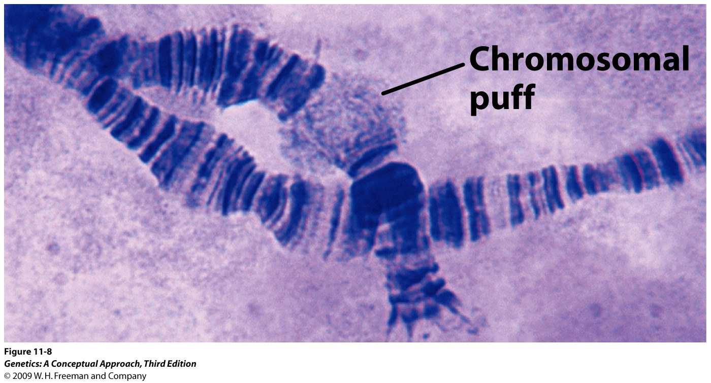
Chromosomal puffs in condensed Drosophila chromosome show states of de-condensing in expressed regions
Notes:
DNA packaging is not simple. If most of the DNA exists as “packaged”, how does the cell know to “unpackage” the right part of the genome for gene expression? (e.g. shown here is the “unpackaged” portion of the chromosome that is currently being expressed (i.e. making RNA)

Slide 8
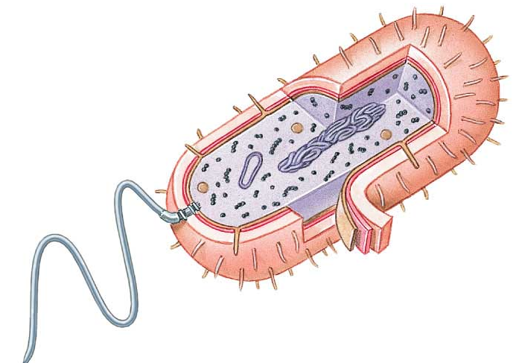
Prokaryotic genome characteristics
Circular chromosome (only one), not linear
Efficient—more gene DNA, less or no Junk DNA
One origin sequence per chromosome
How does the bacterial chromosome remain in its “tight” nucleoid without a nuclear membrane?
Notes:
How does the bacterial chromosome remain in its “tight” nucleoid without a nuclear membrane?

Slide 9
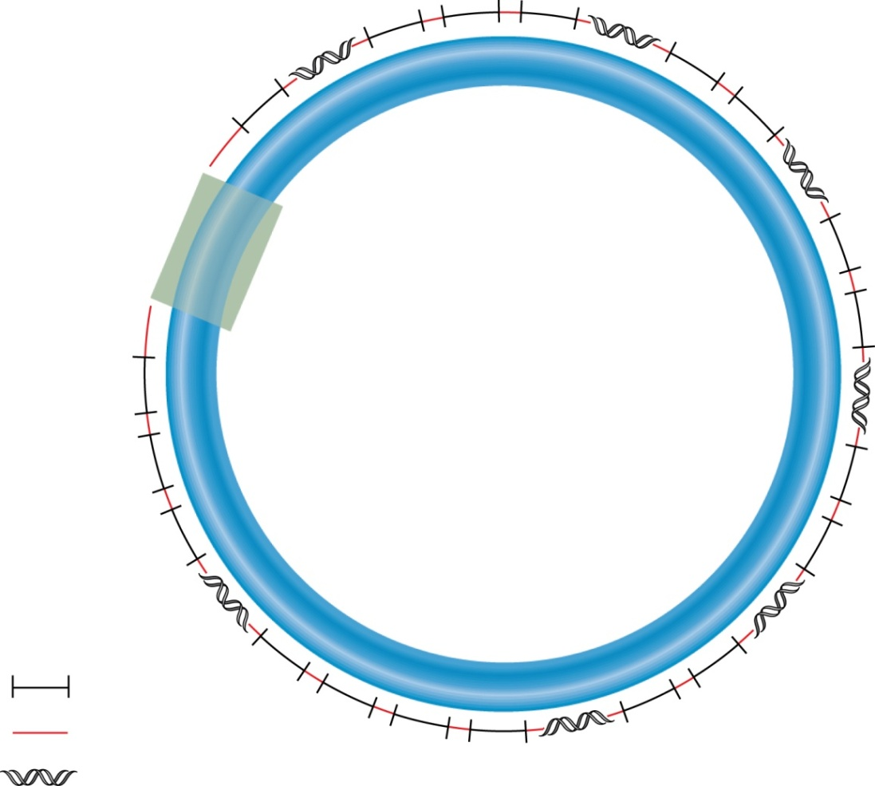
Prokaryotic genome characteristics
• Most, but not all, bacterial species
contain circular chromosomal DNA.
Origin of
replication
• A typical chromosome is a few
million base pairs in length.
• Most bacterial species contain a
single type of chromosome, but it
may be present in multiple copies.
• A few thousand different genes are
interspersed throughout the chromosome.
Genes
Intergenic regions
Repetitive sequences
Intergenic regions play roles in DNA folding, DNA replication, gene regulation, and genetic recombination
Brooker, fig 12.1
Copyright ©The McGraw-Hill Companies, Inc. Permission required for reproduction or display

Slide 10
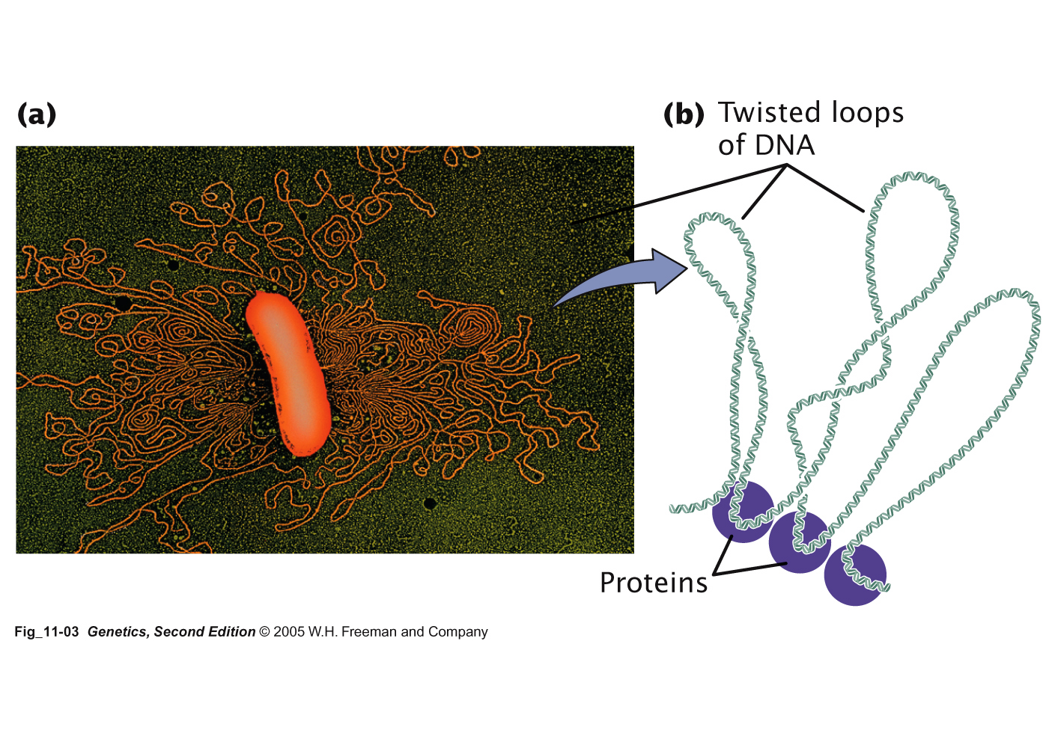
Bacterial chromosome is normally supercoiled
(~ 40 kb)
Bacterial DNA released from supercoiling

Slide 11

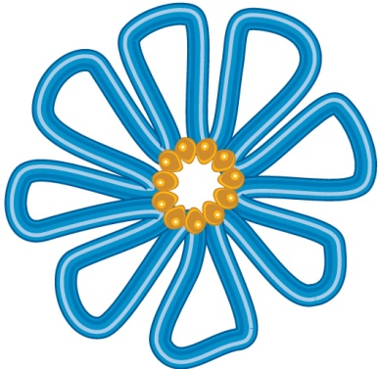
To fit within bacterial cell, the chromosome must be compacted ~1000-fold
The looped structure compacts the chromosome about 10-fold
Loop
domains
Formation of
loop domains
DNA-
binding
proteins
(a) Circular chromosomal DNA
(b) Looped chromosomal DNA with
associated proteins
Brooker, Fig 12.3
Copyright ©The McGraw-Hill Companies, Inc. Permission required for reproduction or display

Slide 12
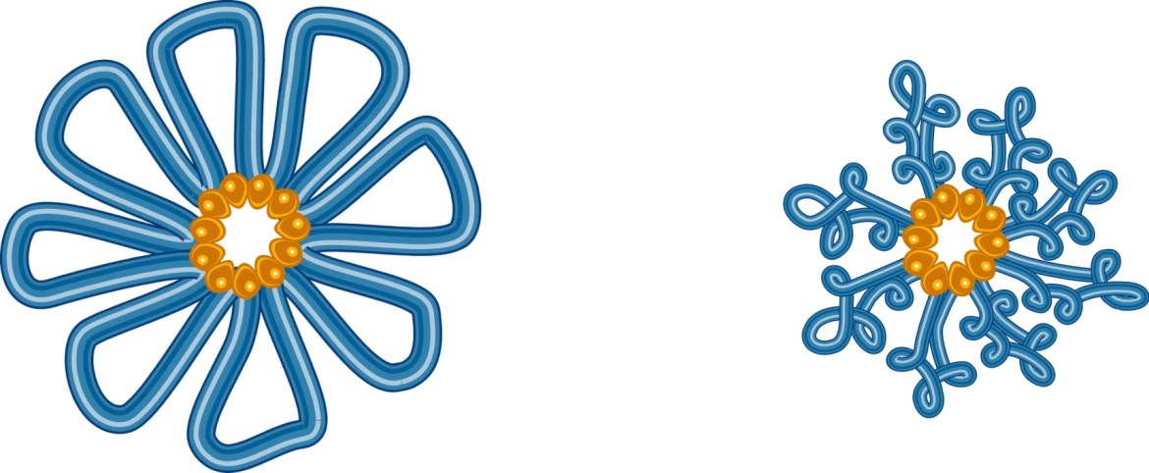
DNA supercoiling is a second important way to compact the bacterial chromosome
Supercoiling within loops creates a more compact chromosome
Supercoiling
(b) Looped chromosomal DNA
(c) Looped and supercoiled DNA
Brooker, Fig 12.3 -- illustration of DNA supercoiling
Copyright ©The McGraw-Hill Companies, Inc. Permission required for reproduction or display
12-8

Slide 13
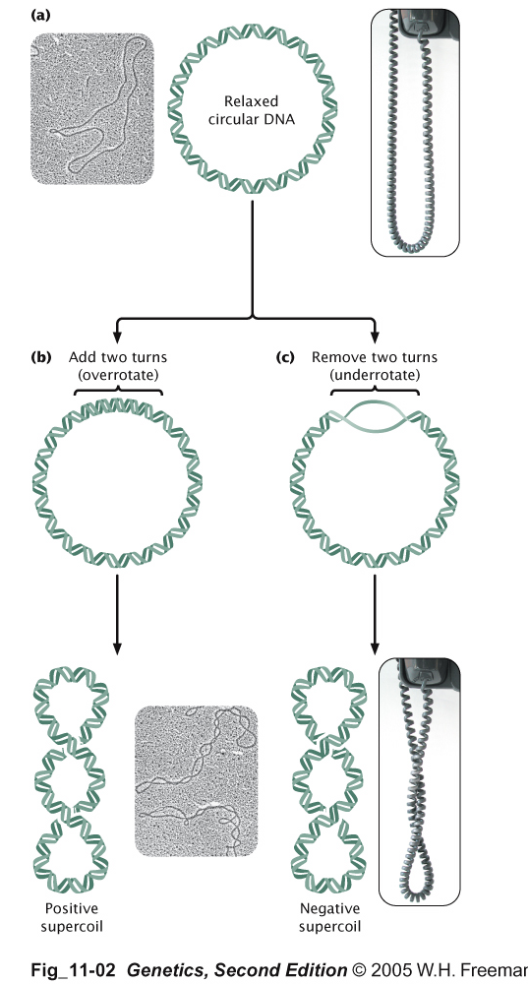
Negative and Positive Supercoiling
Like Brooker, Fig 12.4
Notes:
Topiosomerases supercoil and “uncoil” DNA.

Slide 14
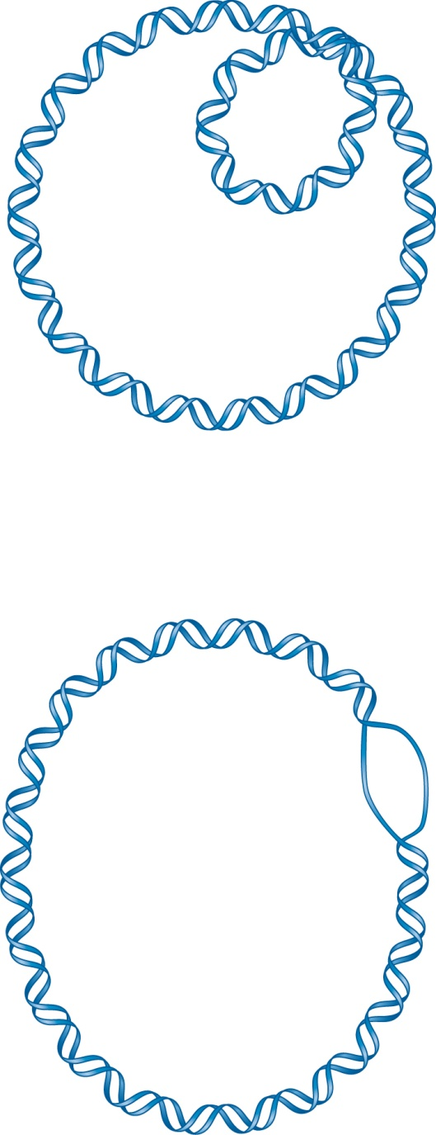
Negative supercoiling promotes DNA strand separation
Area of
negative
supercoiling
Strand
separation
This enhances DNA replication and transcription
Brooker, Fig 12.5

Slide 15
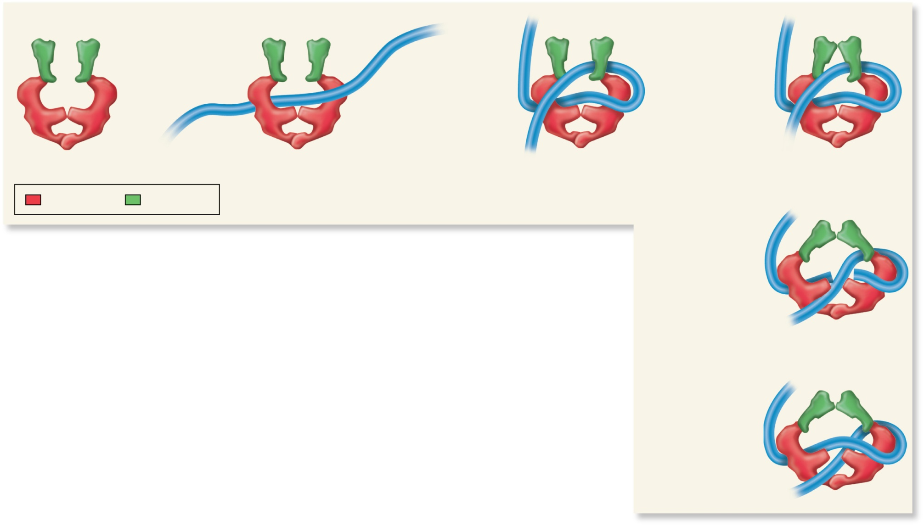
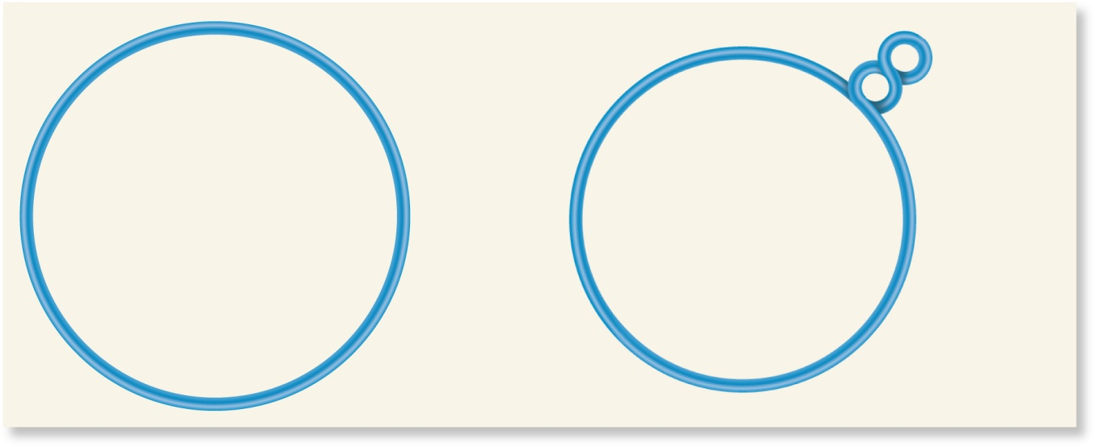
Model for coiling activity of Topoisomerase II (Gyrase)
Upper jaws
DNA wraps around
the A subunits in a
right-handed direction.
DNA binds to
the lower jaws.
DNA wraps around
the A subunits in a
right-handed direction.
Upper jaws
clamp onto DNA.
Lower jaws
DNA
DNA held in lower jaws is cut. DNA held in upper jaws is released and passes downward through the opening in the cut DNA (process
uses 2 ATP molecules).
A subunits
B subunits
(a) Molecular mechanism of DNA gyrase function
Circular
DNA
molecule
2 negative
supercoils
Cut DNA is ligated back
together, and the DNA is
released from DNA gyrase.
DNA gyrase
2 ATP
(b) Overview of DNA gyrase function
Brooker, Fig 12.6
Copyright ©The McGraw-Hill Companies, Inc. Permission required for reproduction or display

Slide 16
Eukaryotic Chromosomes

Slide 17
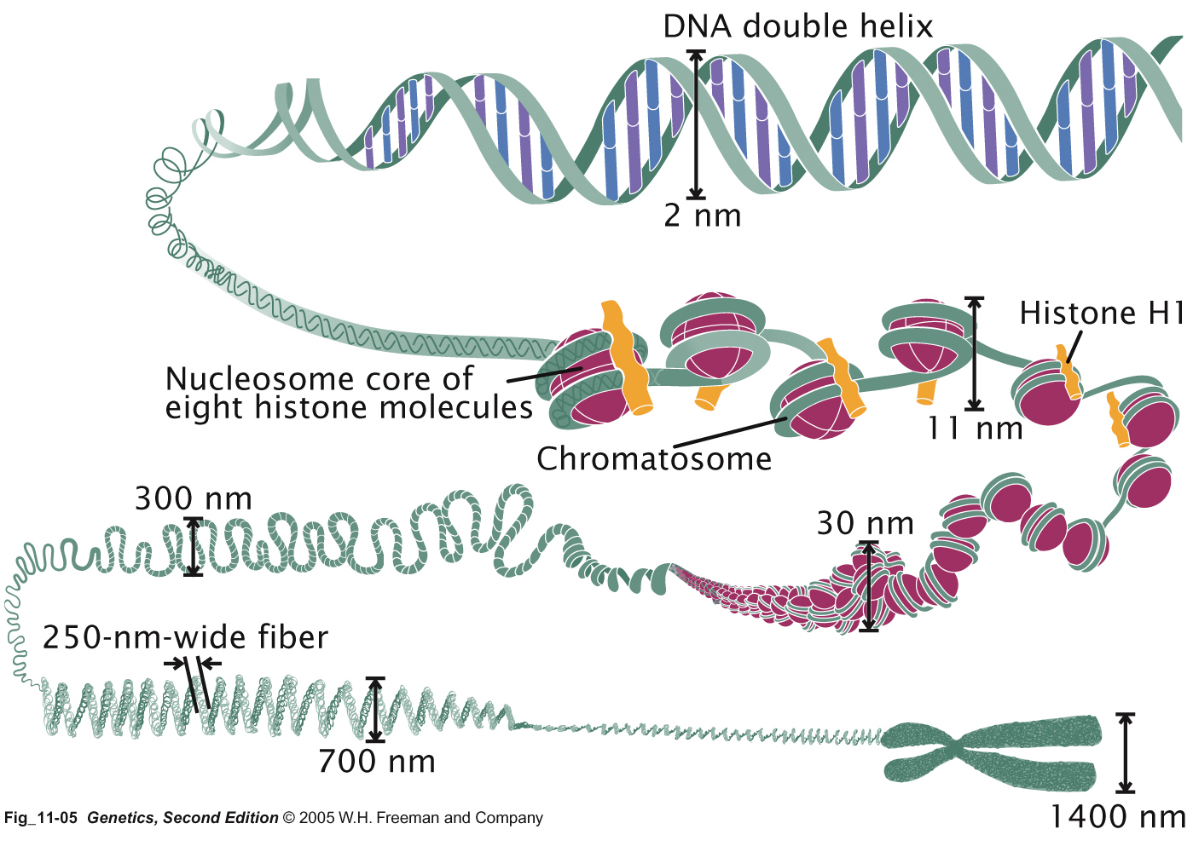
Levels of DNA Packaging in Eukaryotes

Slide 18
Types of DNA sequences making up the eukaryotic genome
DNA type Function Number/genome
Unique-sequence Protein coding and non-coding 1
Repetitive-sequence Opportunistic? few-10⁷
Centromere Cytoskeleton attachment 1 region/c’some
Telomere C’some stability Ends of c’some DNA
Notes:
“By opportunistic, or hopping in and out of the genome, I mean ~ once every 10,000 years or so. Fast on evolutionary time scale, slow from our perspective. The parasitic sequences can’t hop too much or they’d create too much damage. But occasionally an insertion will occur, and is detected. Sometimes this might be a “new mutation” in a family, the child has a mutation that the parent doesn’t (so either the mother was sleeping with the postman, OR, the mutation occurred in one of the parent’s gonads, in the egg or the sperm).

Slide 19
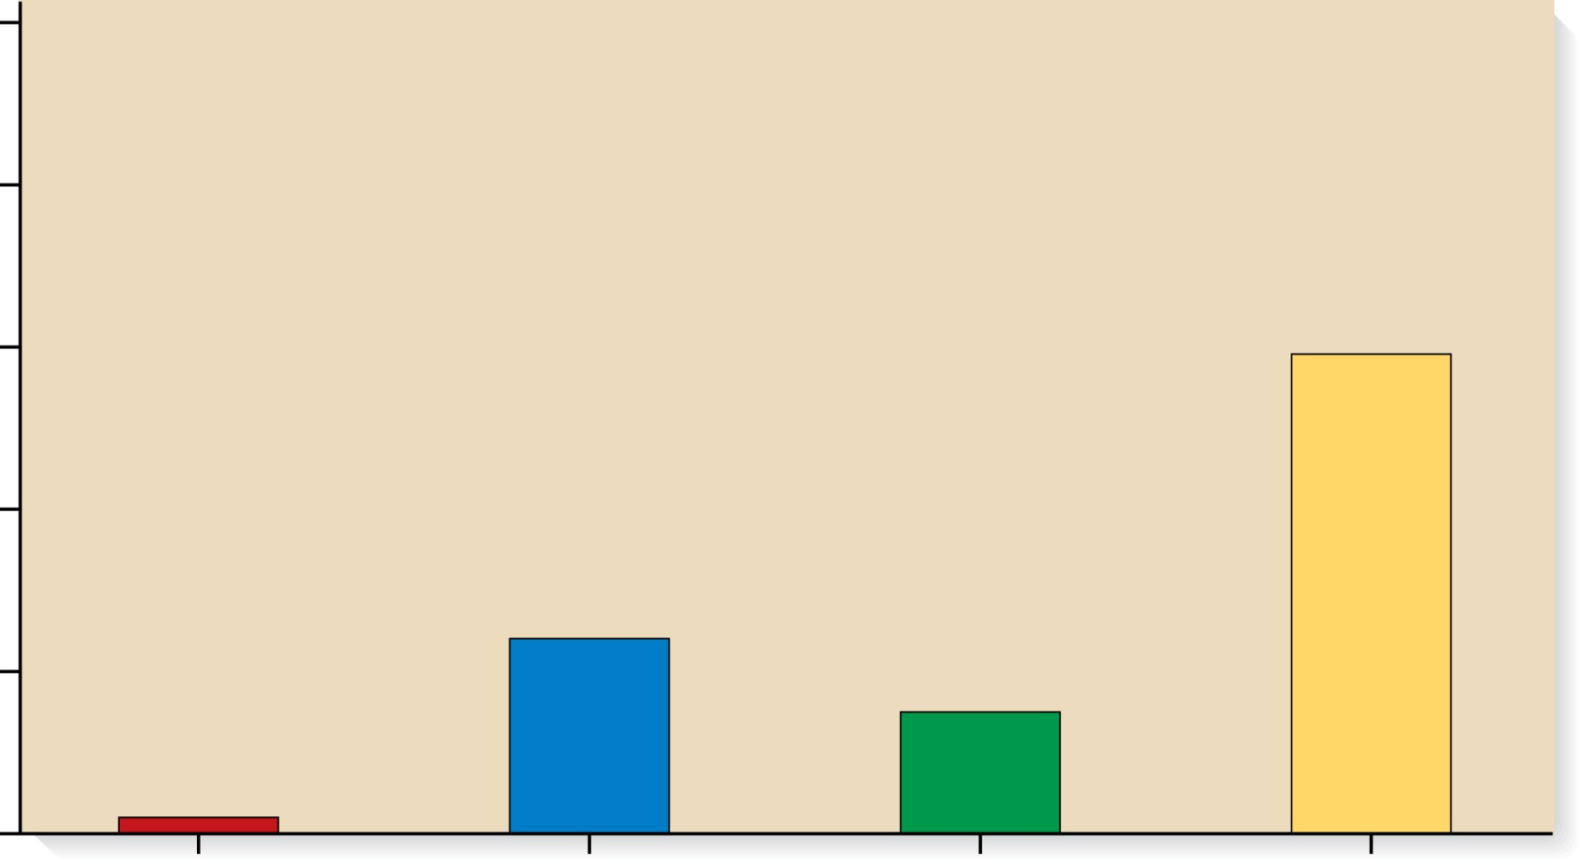
Copyright © The McGraw-Hill Companies, Inc. Permission required for reproduction or display.
100
80
59%
60
Percentage in the human genome
40
24%
20
15%
2%
0
Regions of
genes that
encode
proteins
(exons)
Introns and
other parts
of genes
Unique
noncoding
DNA
Repetitive
DNA
Brooker, Fig 12.9
Classes of DNA sequences

Slide 20
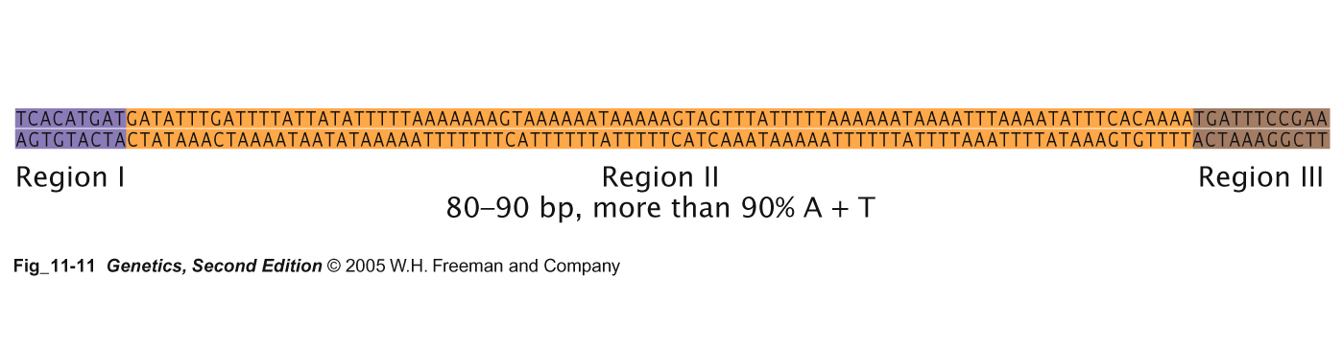
Centromere sequences
Repeating sequences
Non protein-coding
Sequences bind to centromere proteins, provide anchor sites for spindle fibers

Slide 21
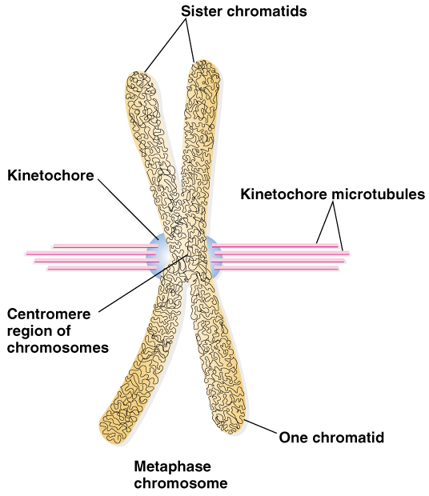
Reminder of function of kinetochores and kinetochore microtubules
Peter J. Russell, iGenetics: Copyright © Pearson Education, Inc., publishing as Benjamin Cummings.
Notes:
Experiment: placement of yeast centromere DNA onto bacterial plasmid DNA. Host yeast cell machinery could recognize the bacterial plasmid DNA by attaching to yeast centromere, treating it as a mitotic chromosome

Slide 22
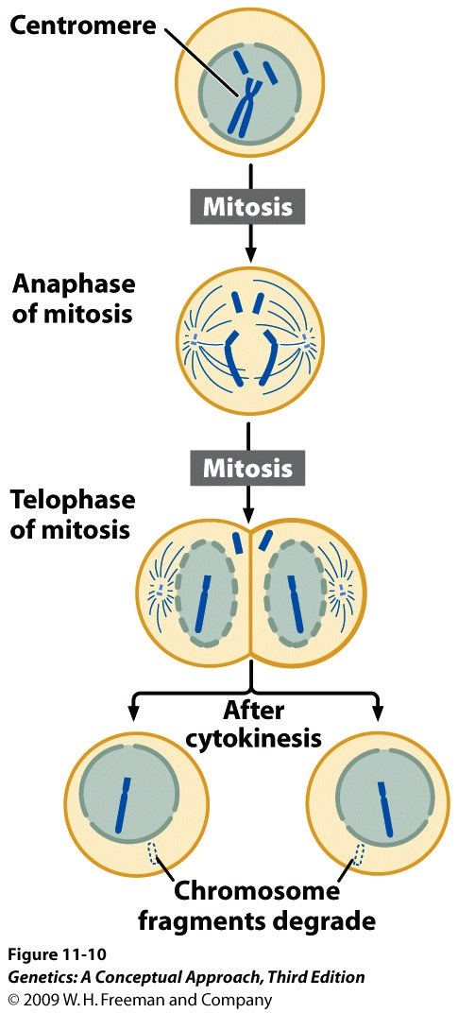
Chromosome fragments lacking centromeres are lost in mitosis
(Figure 11.10)
Notes:
Figure 11.10 Chromosome fragments that lack centromeres are lost in mitosis.

Slide 23
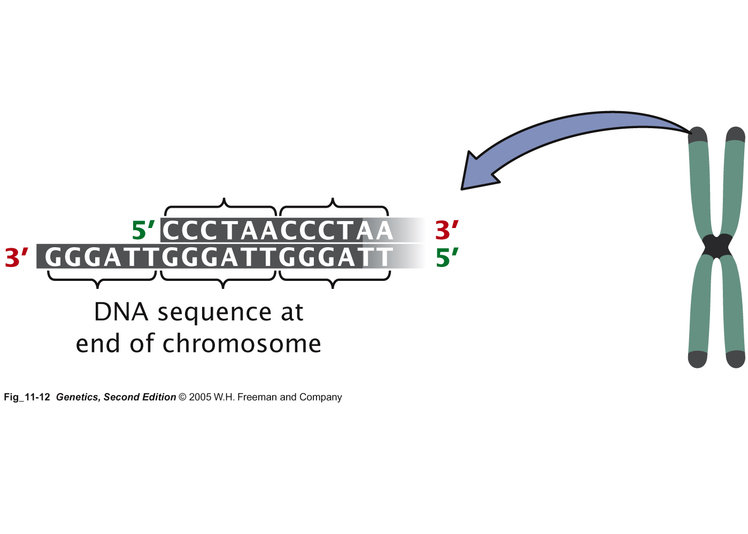
Telomere sequences function to preserve the length of the “ends”

Slide 24
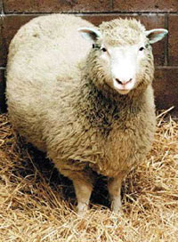
Dolly: First successful cloned adult animal
Born on July 5, 1996, Dolly died on February 14, 2003.
Dolly suffered from lung disease, heart disease and other symptoms of premature aging.

Slide 25
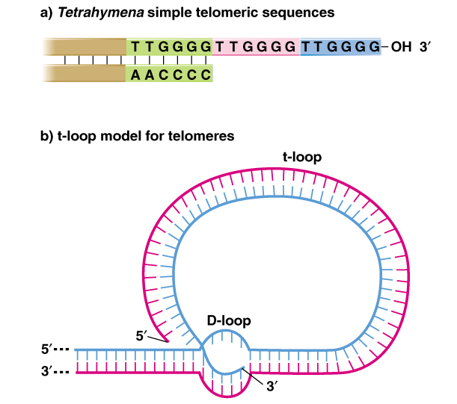
Telomeres sequences may loop back and preserve DNA-ends during replication
Peter J. Russell, iGenetics: Copyright © Pearson Education, Inc., publishing as Benjamin Cummings.

Slide 26
Major proteins necessary for chromosome structure
Protein type Function
Histone packaging at 11nm width, nucleosome formation
Linker proteins packaging at 11nm width, nucleosome formation
Scaffold “Skeleton” of the condensed mitotic c’some
Kinetochore Cytoskeleton attachment to centromere
Telomerase enzyme for preserving lengths of telomeres in stem cells (covered in DNA Replication chapter)
Telomere caps protects ends of linear chromosomes from degradation

Slide 27
Levels of DNA Packaging in Eukaryotes

Slide 28
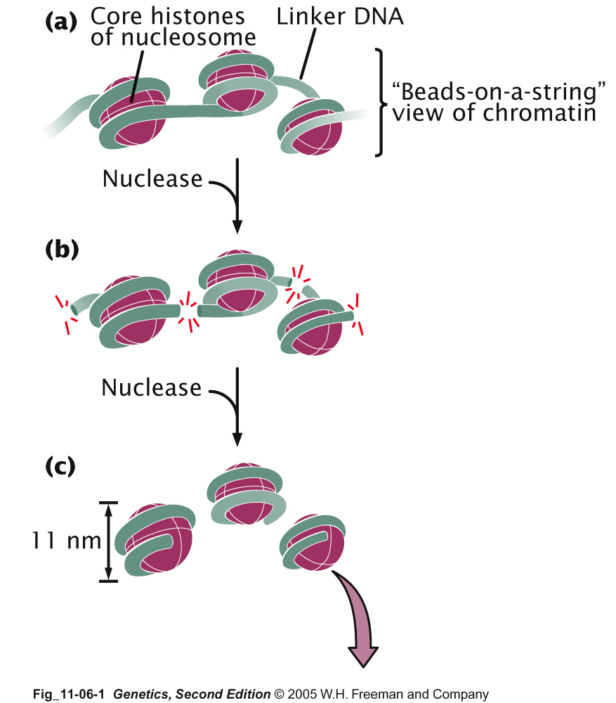
Digestion of nucleosomes reveals nucleosome structure

Slide 29
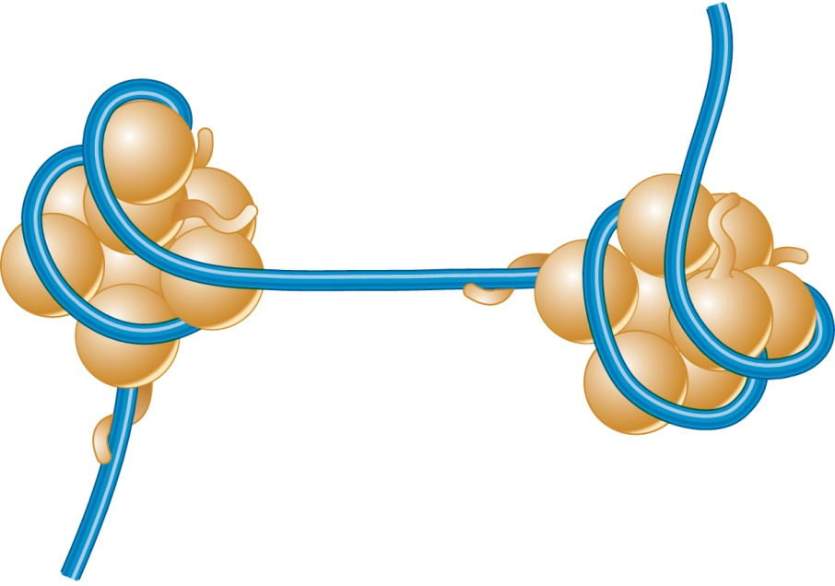
Nucleosomes shorten DNA ~seven-fold
nucleosome diameter
H2A
H2A
Linker region
H3
DNA
11 nm
H2B
H3
H4
H2B
Amino
terminal
tail
H4
Histone
protein
(globular
domain)
Nucleosome —
8 histone proteins (octamer) +
146 or 147 base
pairs of DNA
(a) Nucleosomes showing core histone proteins
Brooker, Fig 12.10a
Copyright ©The McGraw-Hill Companies, Inc. Permission required for reproduction or display

Slide 30
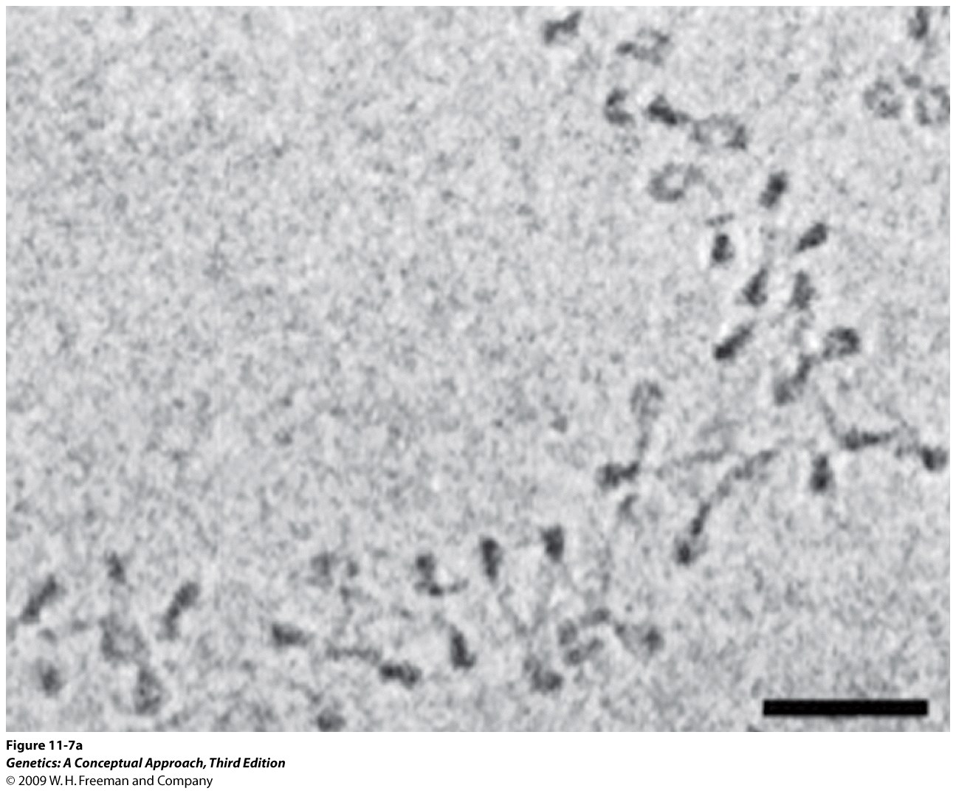
Notes:
Figure 11.7a Adjacent nucleosomes pack together to form a 30-nm fiber. (a) Electron micrograph of nucleosomes. [Part a: Jan Bednar, Rachel A. Horowitz, Sergei A. Grigoryev, Lenny M. Carruthers, Jeffrey C. Hansen, Abraham J. Koster, and Christopher L.Woodcock. Nucleosomes, linker DNA, and linker histone form a unique structural motif that directs the higher-order folding and compaction of chromatin. PNAS 1998; 95:14173–14178. Copyright 2004 National Academy of Sciences, U.S.A.]

Slide 31
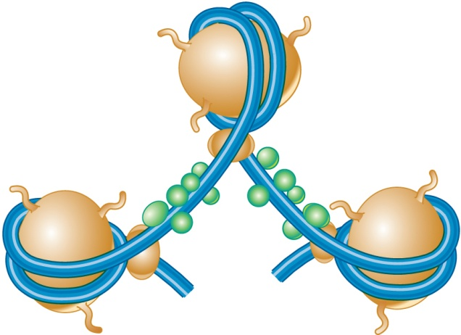
Non-histone proteins play role in chromosomes organization and compaction
Histone
octamer
Nonhistone
proteins
Histone H1
Linker
DNA
Nucleosomes showing linker histones and nonhistone proteins
Brooker, Fig 12.10c
Copyright ©The McGraw-Hill Companies, Inc. Permission required for reproduction or display

Slide 32
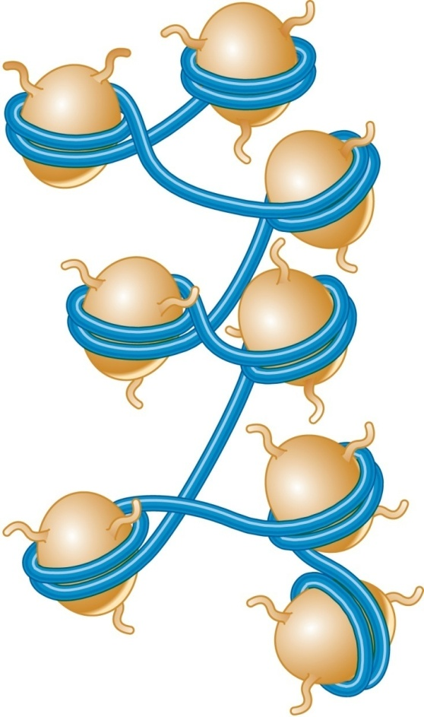
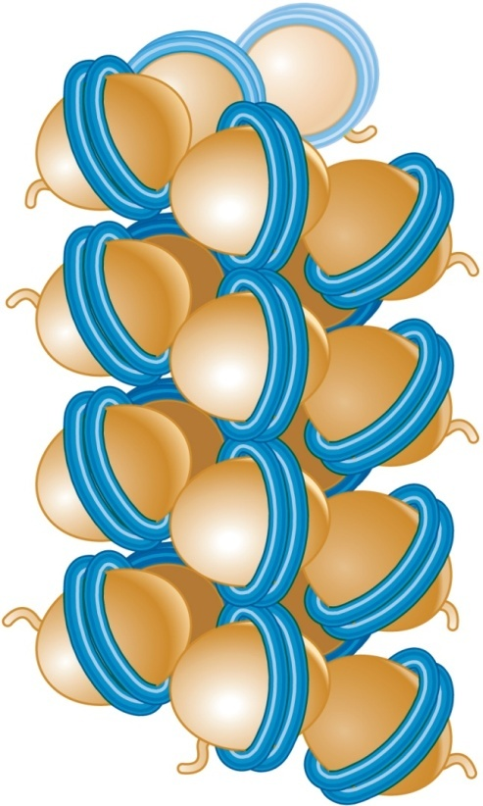
Nucleosomes closely associate to form 30 nm fiber (shortens total DNA by another 7 fold)
30 nm
30 nm
Core
histone
proteins
Irregular configuration where nucleosomes have little face-to-face contact
Regular, spiral configuration containing six nucleosomes per turn
Solenoid model
Zigzag model
Brooker, Fig 12.13
Copyright ©The McGraw-Hill Companies, Inc. Permission required for reproduction or display

Slide 33
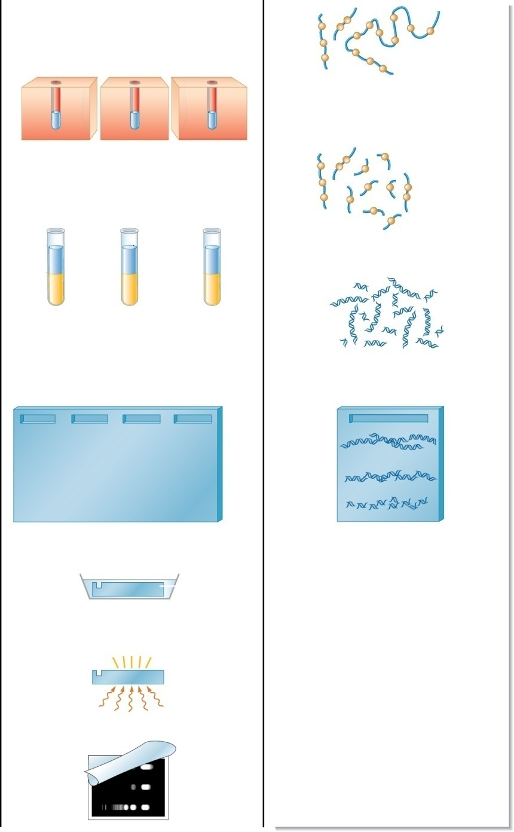
Copyright © The McGraw-Hill Companies, Inc. Permission required for reproduction or display.
Experimental level
Conceptual level
1. Incubate the nuclei with low, medium,
and high concentrations of DNase I.
The conceptual level illustrates a low
DNase I concentration.
Dnase I
Low
Medium
High
Before digestion
(beads on
a string)
37ºC
37ºC
37ºC
After digestion
(DNA is cut in
linker region)
2. Extract the DNA. This involves
dissolving the nuclear membrane with
detergent and extracting with the
organic solvent phenol.
Treat with detergent; add phenol.
Aqueous
phase
(contains
DNA)
Phenol
phase (contains
membranes and
proteins)
DNA in
aqueous
phase
Marker
Low
Medium
High
Low
3. Load the DNA into a well of an agarose
gel and run the gel to separate the DNA
pieces according to size. On this gel,
also load DNA fragments of known
molecular mass (marker lane).
–
–
Gel (top view)
+
+
Stain gel.
4. Visualize the DNA fragments by
staining the DNA with ethidium
bromide, a dye that binds to DNA and
is fluorescent when excited by UV light.
Solution
with
ethidium
bromide
Gel
View gel.
UV light
Photograph gel.
Figure 12.11
12-34

Slide 34
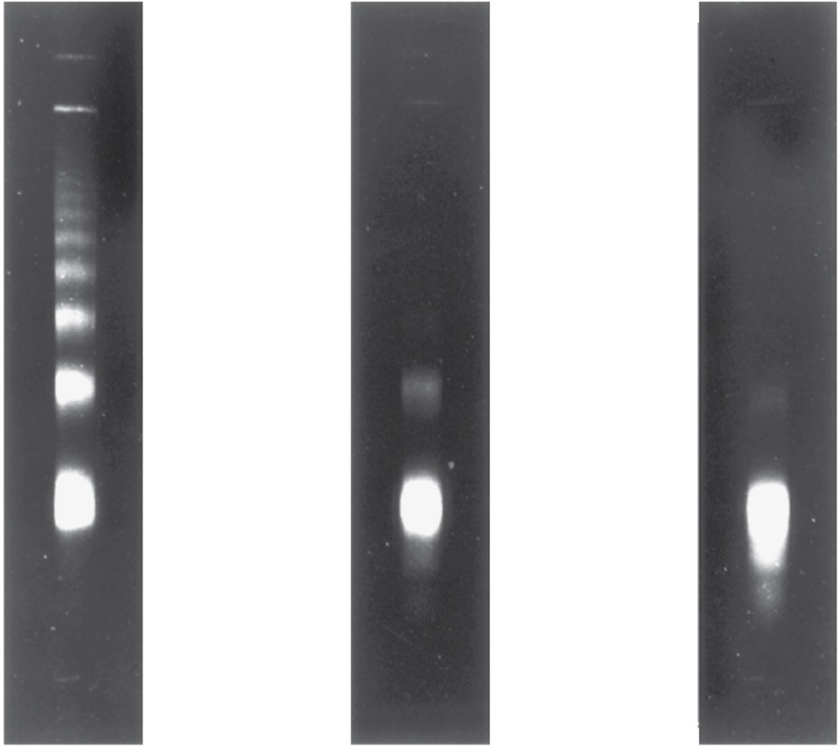
Interpreting the Data
Copyright © The McGraw-Hill Companies, Inc. Permission required for reproduction or display.
At low concentrations, DNase I did not cut all the linker DNA
Low
Medium
High
This fragment contains three nucleosomes
At high concentrations of DNase I, all chromosomal DNA digested into fragments that are ~ 200 bp in length
600bp
400bp
This fragment contains two nucleosomes
200bp
DNase concentration: 30 units ml⁻¹
150 units ml⁻¹
600 units ml⁻¹
Copyright ©The McGraw-Hill Companies, Inc. Permission required for reproduction or display
12-36

Slide 35
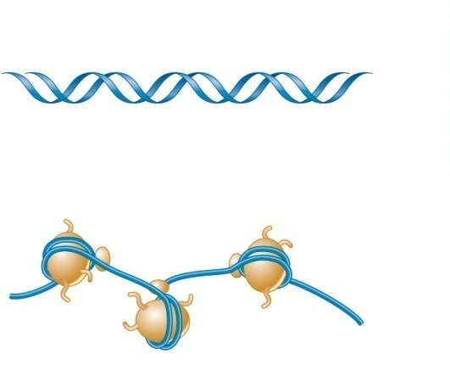
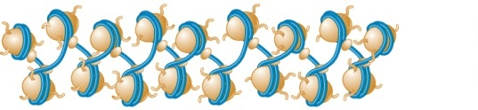
Levels of DNA Packaging
2 nm
DNA double helix
Wrapping of DNA around
a histone octamer
Histone H1
11 nm
Histone
octamer
Nucleosome
(a) Nucleosomes (“beads on a string”)
Formation of a three-dimensional zigzag structure
via histone H1 and other DNA-binding proteins
30 nm
(b) 30 nm fiber
Nucleosome
Anchoring of radial loops to the
nuclear matrix
Brooker, Fig 12.17a and b

Slide 36
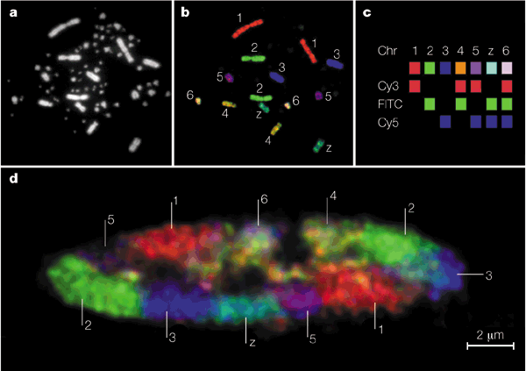
Chicken chromosomes in condensed metaphase and interphase
Does this karyotype belong to a male chicken or a female chicken?
Nature Rev Genet 2:4, 292-301

Slide 37
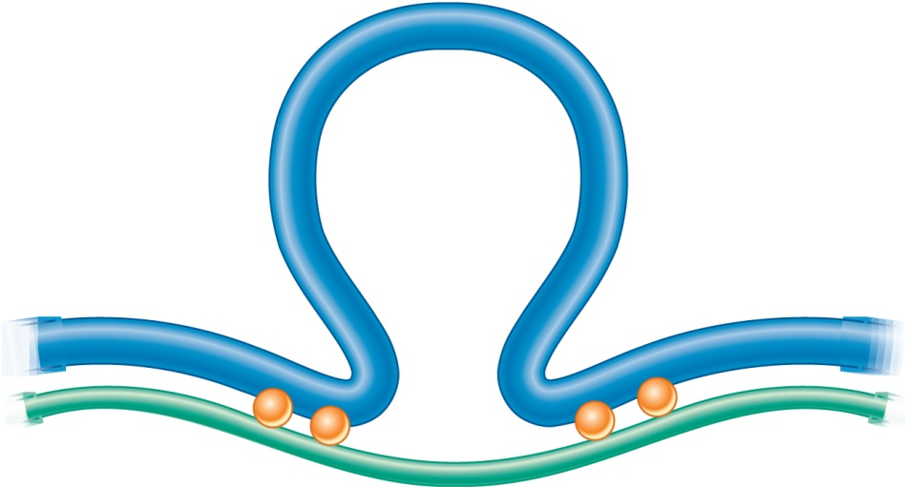
Radial loop bound to a nuclear matrix fiber
Gene
Matrix-attachment regions (MARs)
or
Scaffold-attachment regions (SARs)
Gene
Gene
Radial loop
25,000 to 200,000 bp
Protein
fiber
30-nm
fiber
MAR
MAR
MARs are anchored to the nuclear matrix, thus creating radial loops
(d) Radial loop bound to a nuclear matrix fiber
Brooker, Fig 12.14
Copyright ©The McGraw-Hill Companies, Inc. Permission required for reproduction or display

Slide 38
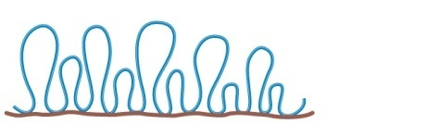
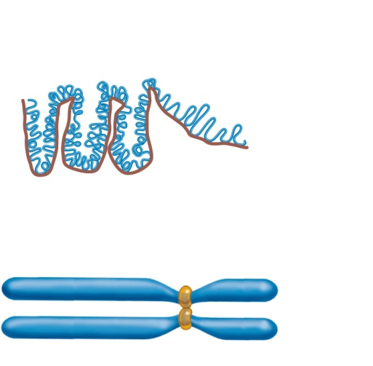
Levels of DNA Packaging, cont.
Compaction level in euchromatin (interphase)
300 nm
(c) Radial loop domains
Protein scaffold
Further compaction of
radial loops
700 nm
Compaction level in heterochromatin
Formation of a scaffold from the nuclear matrix
and further compaction of all radial loops
1400 nm
(d) Metaphase chromosome
Brooker, Fig 12.17
Notes:
Constitutive heterochromatin—always tightly compacted (e.g. highly repetitive sequences or centromere sequences)
Facultative heterochromatin—DNA that can switch back and forth (e.g. Barr bodies or inactivated X-Chromosomes)

Slide 39
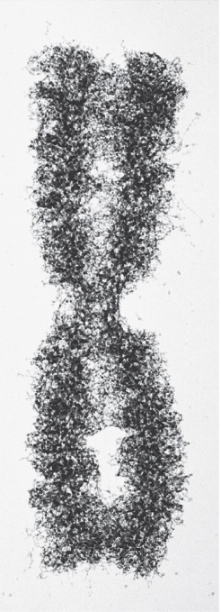
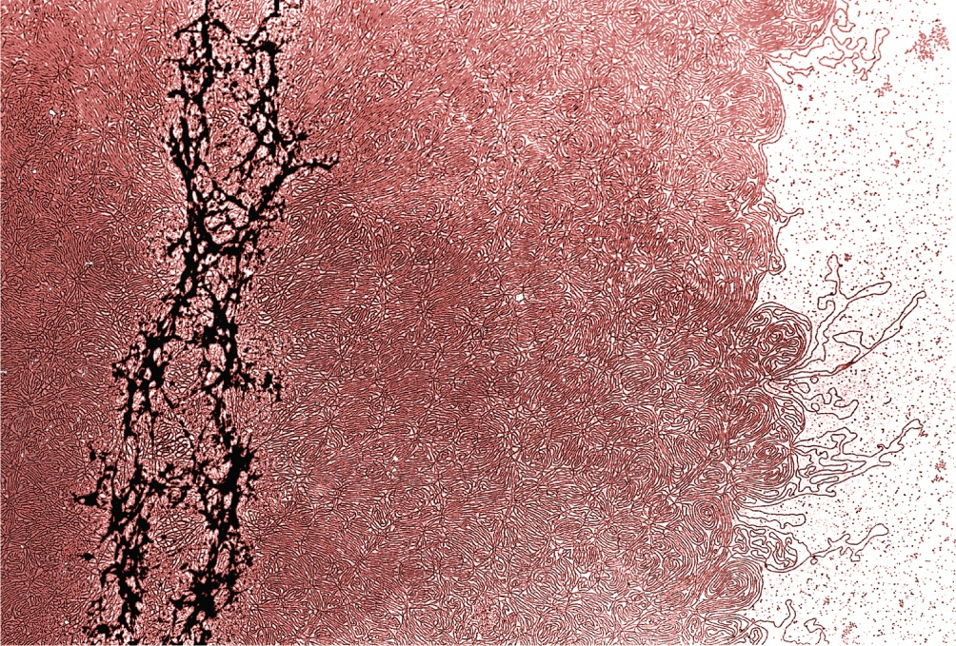
Metaphase Chromosomes
Scaffold
DNA strand
2 μm
© Peter Engelhardt/Department of Virology, Haartman Institue
© Dr. Donald Fawcett/Visuals Unlimited
Metaphase
chromosome
Metaphase chromosome treated with high salt to remove histone proteins
Brooker, Fig 12.18
Copyright ©The McGraw-Hill Companies, Inc. Permission required for reproduction or display

Slide 40
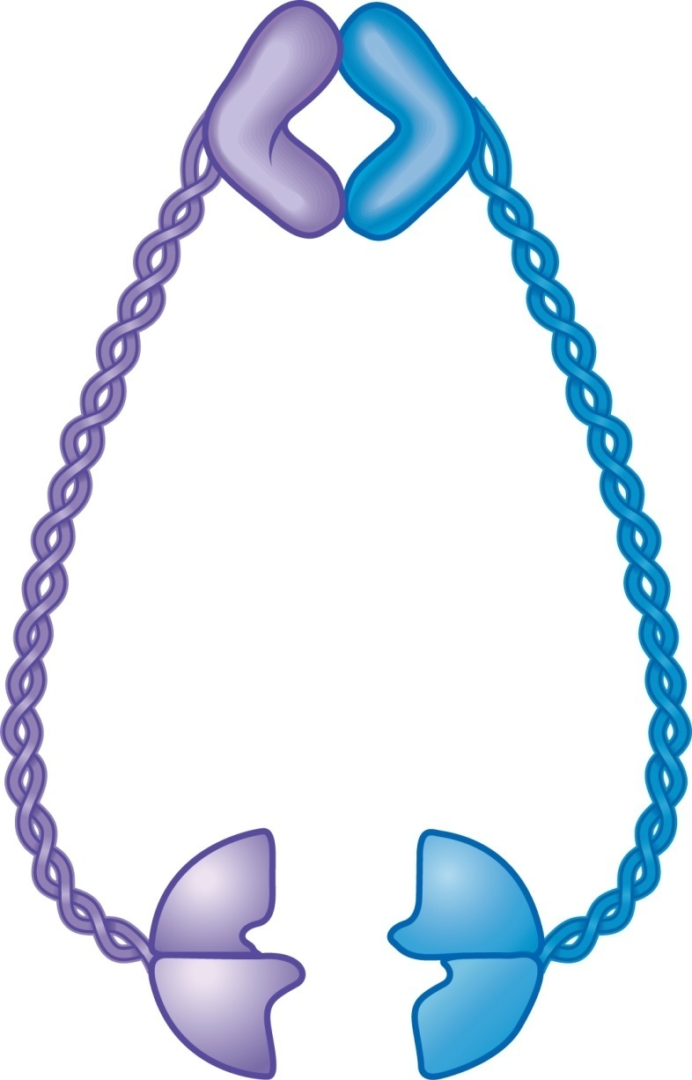
Copyright © The McGraw-Hill Companies, Inc. Permission required for reproduction or display.
Hinge
Arm
50 nm
N
C
Head
C
N
Figure 12.19
ATP-binding site
12-54

Slide 41
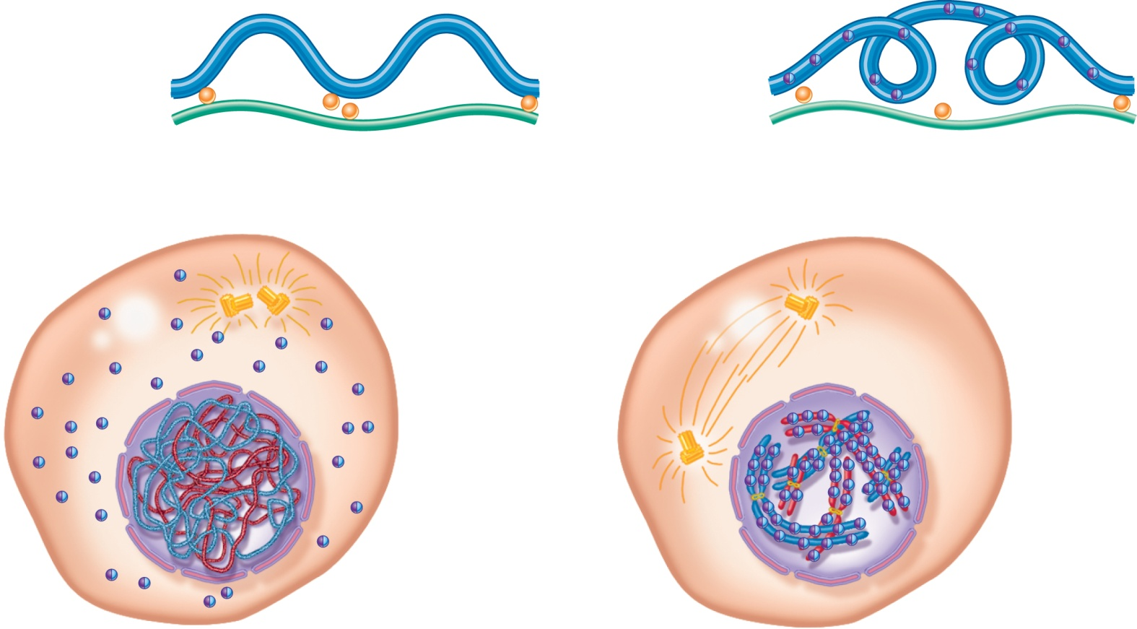
Packaging of DNA in interphase vs. M-phase
300 nm radial loops — euchromatin
700 nm — heterochromatin
Condensin
Condesin binds to chromosomes and compacts the radial loops
Condensin
(in cytoplasm)
Condesin travels into the nucleus
Difffuse
chromosome
Condensed
chromosome
G₁, S, and G₂ phases
Start of M phase
Brooker, Fig 12.20
Copyright ©The McGraw-Hill Companies, Inc. Permission required for reproduction or display

Slide 42
Chromosome Structure: practice questions
The following comprehension questions (at end of each chapter section) in Brooker, Concepts of Genetics are recommended:
Comprehension Questions (at end of each section): 12.1, 12.2, 12.3, 12.4, 12.5 #1 + 4, 12.6 #1. Answers to Comprehension Questions are at the very end of every chapter.
Solved Problems at end of chapter (answers included): [none]
Conceptual questions and Experimental/Application Questions at end of chapter (answers found by logging into publisher’s website, or find them in the book):
  Concepts—C1, C5, C8, C10, C11, C12, C13, C14, C15, C16, C17, C22, C23

