Slide 1
DNA Structure--Study Guide and Lecture Outline
Broad course objective: Students will be able to
a.) describe the molecular structure of DNA and RNA and indicate similarities and differences; b.) understand the internal structure of DNA strands and how DNA complementary pairing arises
Necessary for future material on:
DNA Replication; RNA synthesis, Biotechnology (primers, probes, PCR, Southern and Northern blotting, cloning).
Reminder of DNA’s role in Central Dogma of Biology
What are the functional requirements for a hereditary molecule?
What few organisms use RNA as its hereditary material?
Molecular Structure of DNA
What are Chargaff’s Rules and how did they help other scientists determine the helical structure of DNA?
What makes up a nucleotide?
What part of the nucleotide distinguishes an “A” nucleotide from a “G”, or a “C” or a “T”?

Slide 2
Study guide cont.
Which nucleotides are pyrimidines vs. purines?
What part of the nucleotide makes it function as an “A” nucleotide for RNA vs. an “A” nucleotide for DNA? Can you use the same nucleotides?
Within a DNA molecule (or RNA molecule), which bonds are phosphodiester bonds and which are hydrogen bonds? What is the chemical difference? (covalent vs. weak, etc.)
How many hydrogen bonds are found between G:C pairing vs. A:T pairing?
What determines whether the end of a DNA strand will be “5 prime” vs. “3 prime”?
What is a palindrome or hairpin structure?
I will not be covering the section on B-DNA, A-DNA, and Z-DNA structure.

Slide 3
What makes a good carrier of hereditary information?
Complex enough to direct the specific expression of many different phenotypes
Traits (macro level)
Proteins (molecular level)
Transferable to progeny cells or offspring (can be faithfully replicated so that offspring are like parents)
Allows mutational change proposed by Darwin
Living things do not stay exactly the same generation after generation, unlike rocks or fire
Living things can evolve and adapt to changes in the environment
Notes:
Scientists knew the conceptual definition of genes and hereditary information, thanks t[o Darwin and Gregor Mendel. But what was it physically?
➔knew something was being passed from parent to offspring, and
That substance could determine the physical appearance and physical behavior of both parent and offspring
➔But biologists also knew that the hereditary substance was not immutable, but allowed new variants to arise. (and that the new variants were also able to be passed on to offspring.

Slide 4
Cellular locations of DNA and RNA
Fig from Audesirk et al., Biology, Life on Earth, 6th ed.

Slide 5
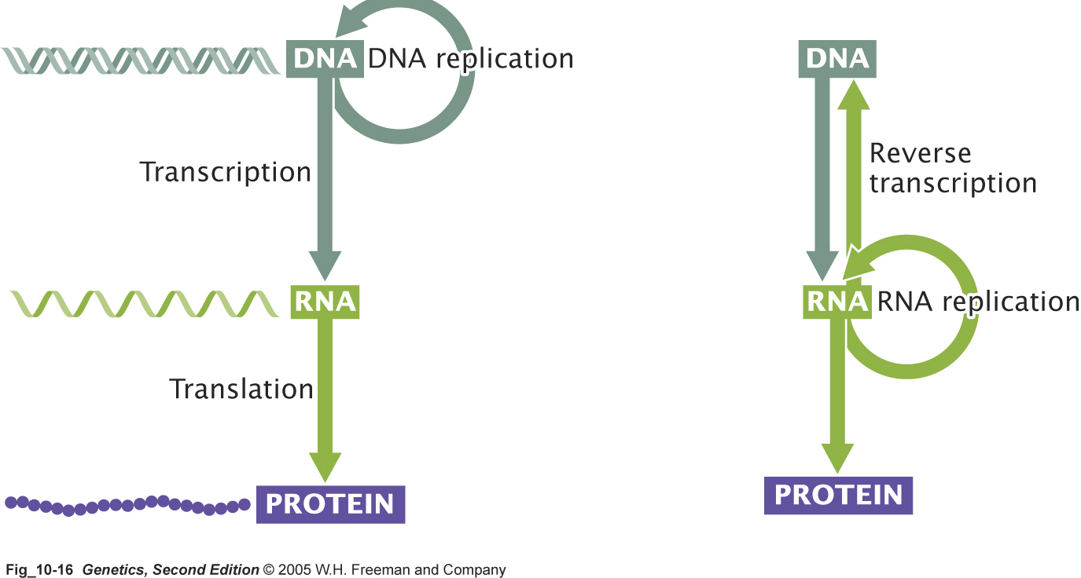
DNA as hereditary material
(traditional central dogma)
RNA as hereditary material
(retroviruses only)

Slide 6
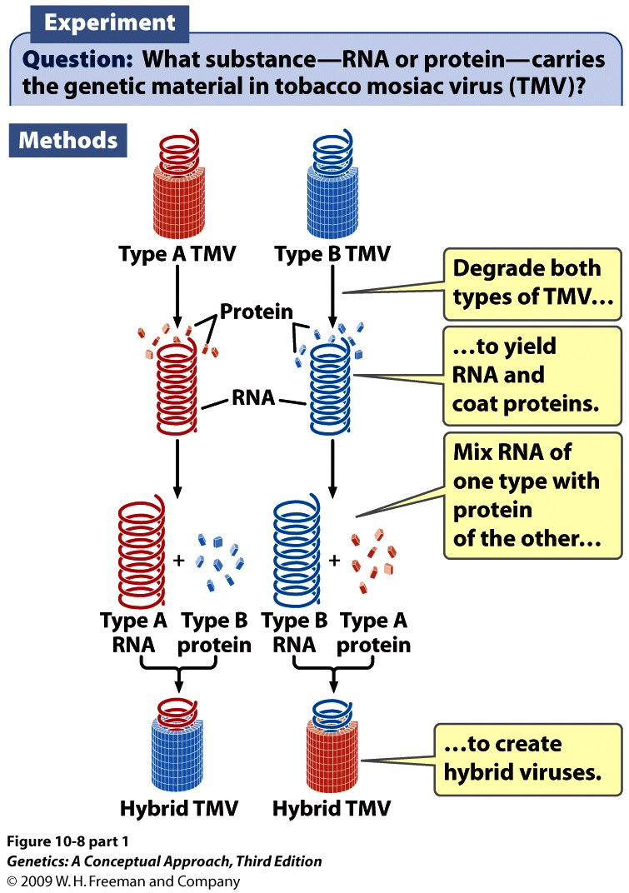
Historical proof that a nucleic acid--RNA in this case--is the carrier of hereditary information.
In 1956, A. Gierer and G. Schramm isolated RNA from the tobacco mosaic virus (TMV), a plant virus
Will the progeny viruses be determined by the protein or the nucleic acid?
Notes:
10.8 (part 1) Fraenkel-Conrat and Singer’s experiment demonstrated that RNA in the tobacco mosaic virus carries the genetic information.

Slide 7
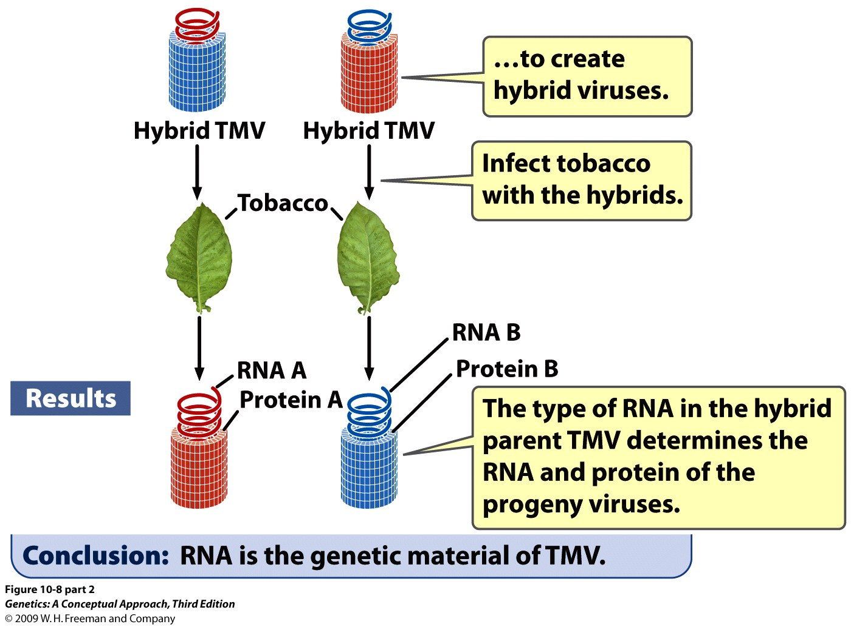
Notes:
10.8 (part 2) Fraenkel-Conrat and Singer’s experiment demonstrated that RNA in the tobacco mosaic virus carries the genetic information.

Slide 8
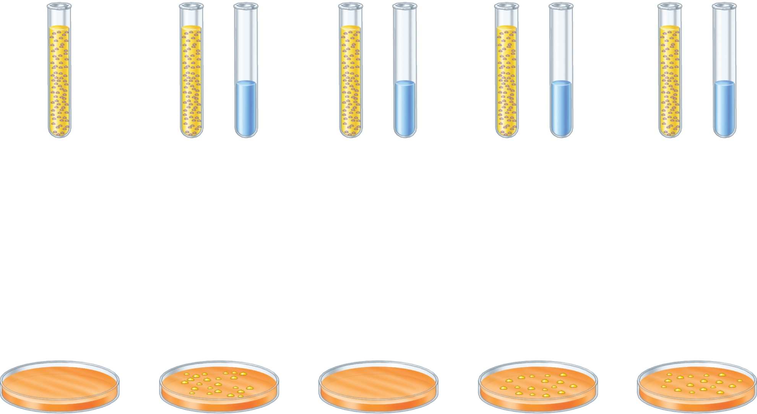
DNA is the only molecule that changes the phenotype of recipient cells (survive on limiting growth medium)
Type R
cells
Type R
cells
Type S
DNA
extract
Type R
cells
Type S
DNA
extract
Type R
cells
Type S
DNA
extract
Type R
cells
Type S
DNA
extract
+
+
+
DNase
RNase
protease
No growth
Transformed
Transformed
Transformed
Brooker Fig 11.2
Copyright ©The McGraw-Hill Companies, Inc. Permission required for reproduction or display

Slide 9
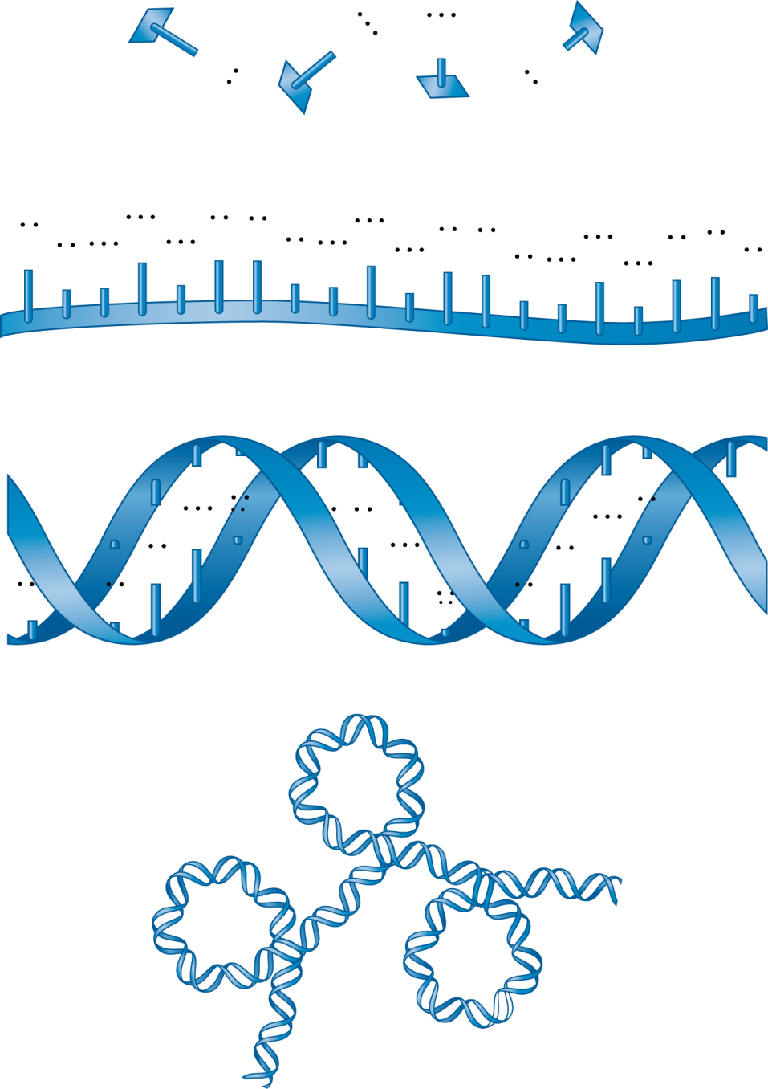
DNA structure at various scales
G
C
T
A
Nucleotides
A
G
C
A
A
T
G
A
A
G
A
A
T
C
C
C
T
C
C
T
Single strand
C
A
G
T
C
A
G
T
G
T
A
C
T
G
T
C
T
A
G
A
T
A
G
A
T
A
Double helix
Three-dimensional structure
Brooker Figure 11.6
Copyright © The McGraw-Hill Companies, Inc. Permission required for reproduction or display.

Slide 10
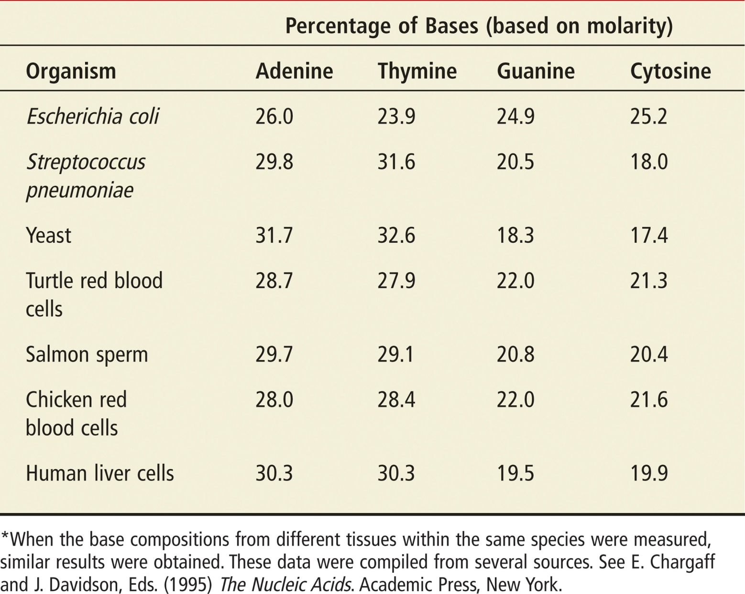
Base DNA Content of Different Species
Brooker Table 11.1

Slide 11
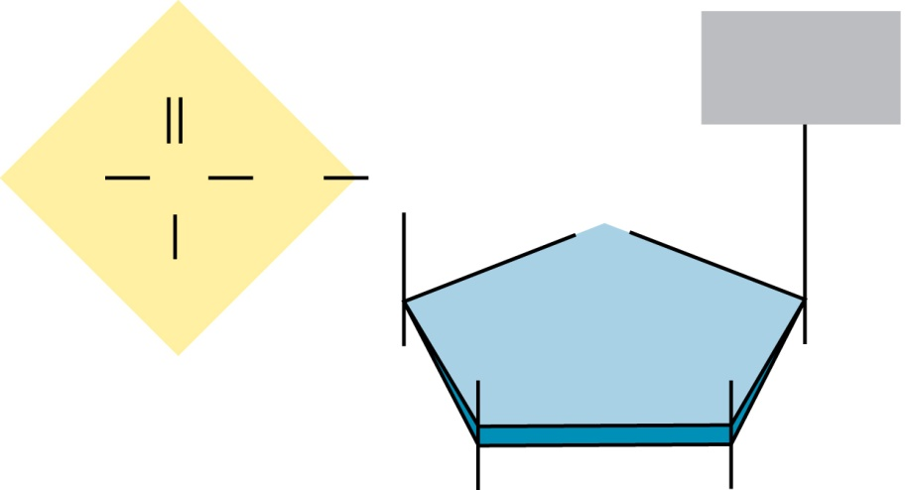
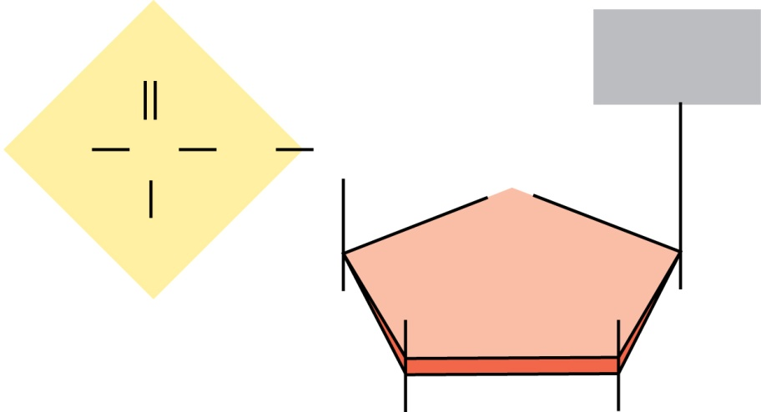
Nucleotides of DNA and RNA
O
Base
O
Base
O
P
O
CH₂
O
P
O
CH₂
5′
O
5′
O
O–
4′
1′
O–
4′
1′
H
H
H
H
H
H
H
H
Phosphate
Phosphate
3′
2′
3′
2′
OH
H
OH
OH
Deoxyribose
Ribose
DNA nucleotide
RNA nucleotide
Brooker Figure 11.8

Slide 12
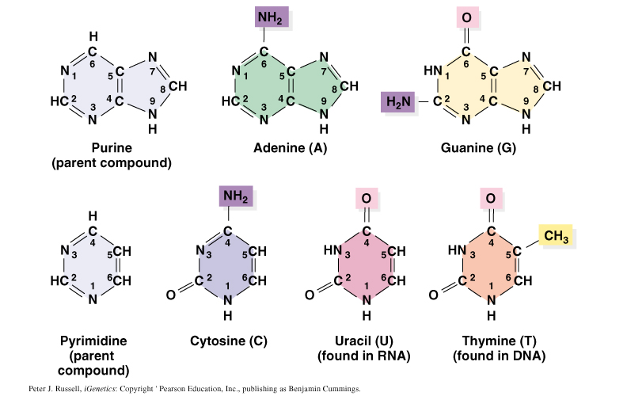
Nitrogenous bases of DNA and RNA
Similar to Brooker Figure 11.7

Slide 13
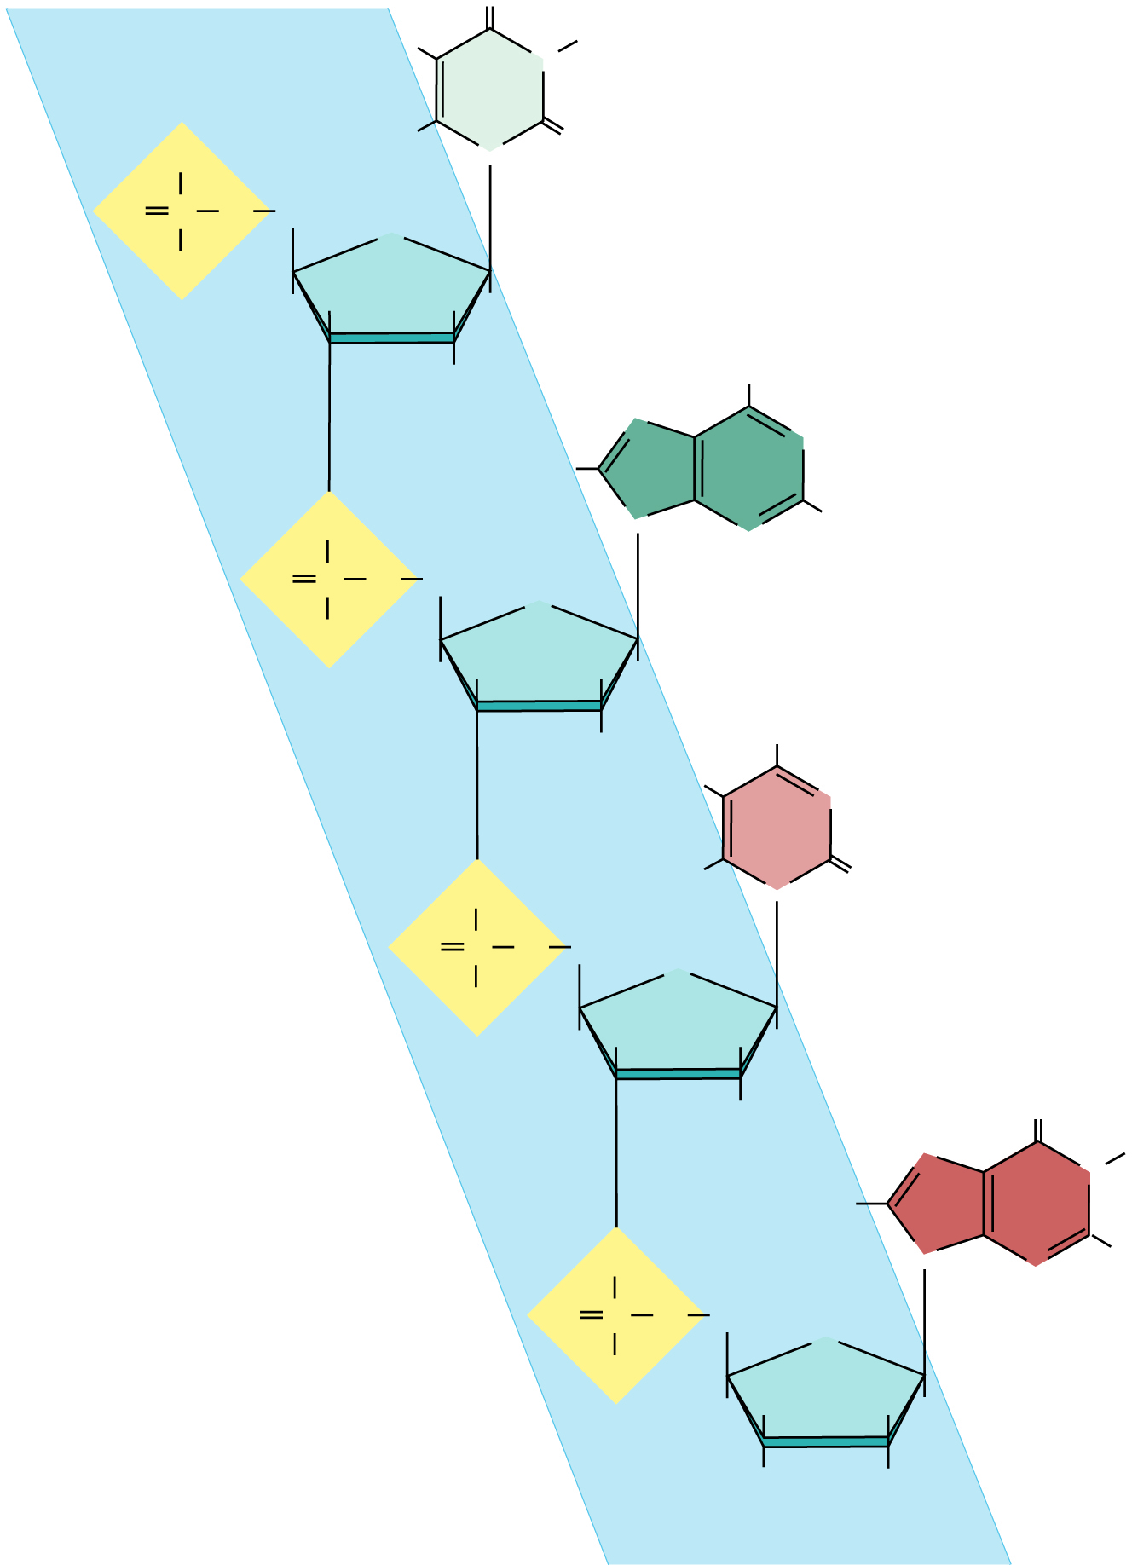
Nucleotides are joined at the 5-C and 3-C of each sugar backbone
Backbone
Bases
O
5′
CH₃
N
Thymine (T)
O
–
H
N
O
O
P
O
5′
CH₂
O
O
–
4′
H
H
1′
H
2′
H
3′
H
NH₂
Phosphodiester
linkage
N
N
H
Adenine (A)
O
N
N
O
P
O
5′
CH₂
O
O
–
4′
H
H
1′
H
2′
H
3′
H
NH₂
H
N
Cytosine (C)
O
H
N
O
O
P
O
5′
CH₂
O
O
–
4′
H
H
1′
H
2′
H
Guanine (G)
3′
H
O
N
N
H
H
O
N
N
NH₂
Single
nucleotide
O
P
O
5′
CH₂
O
O
–
4′
H
H
1′
Phosphate
H
2′
H
3′
OH
H
Brooker, Fig 11.17
3′
Sugar (deoxyribose)
Copyright © The McGraw-Hill Companies, Inc. Permission required for reproduction or display.

Slide 14
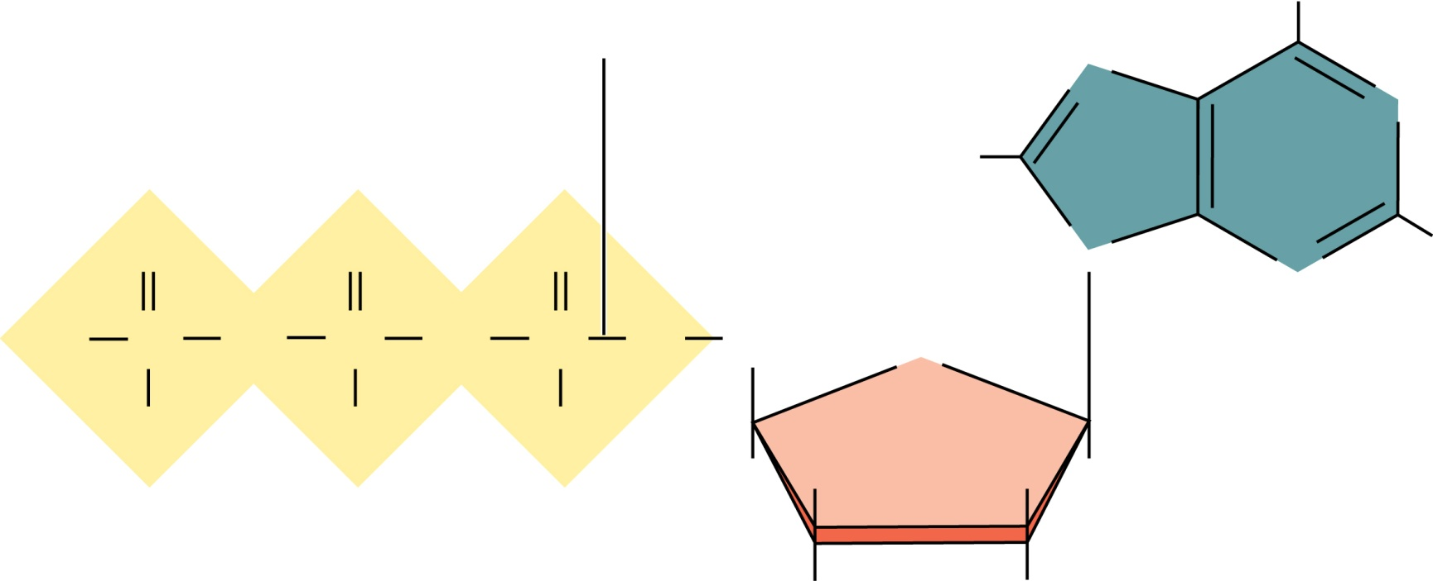
Charged nucleotides carry their own energy for the DNA synthesis reaction
Adenosine triphosphate (ATP)
Adenosine diphosphate (ADP)
Adenosine monophosphate (AMP)
Adenosine
NH₂
Phosphodiester bond
N
N
H
Adenine
O
O
O
N
N
–
O
P
O
P
O
P
O
CH₂
O
5′
O
–
O
–
O
–
4′
1′
H
Ribose
H
H
H
Phosphate groups
3
2′
HO
OH
Brooker Figure 11.9
Copyright ©The McGraw-Hill Companies, Inc. Permission required for reproduction or display

Slide 15
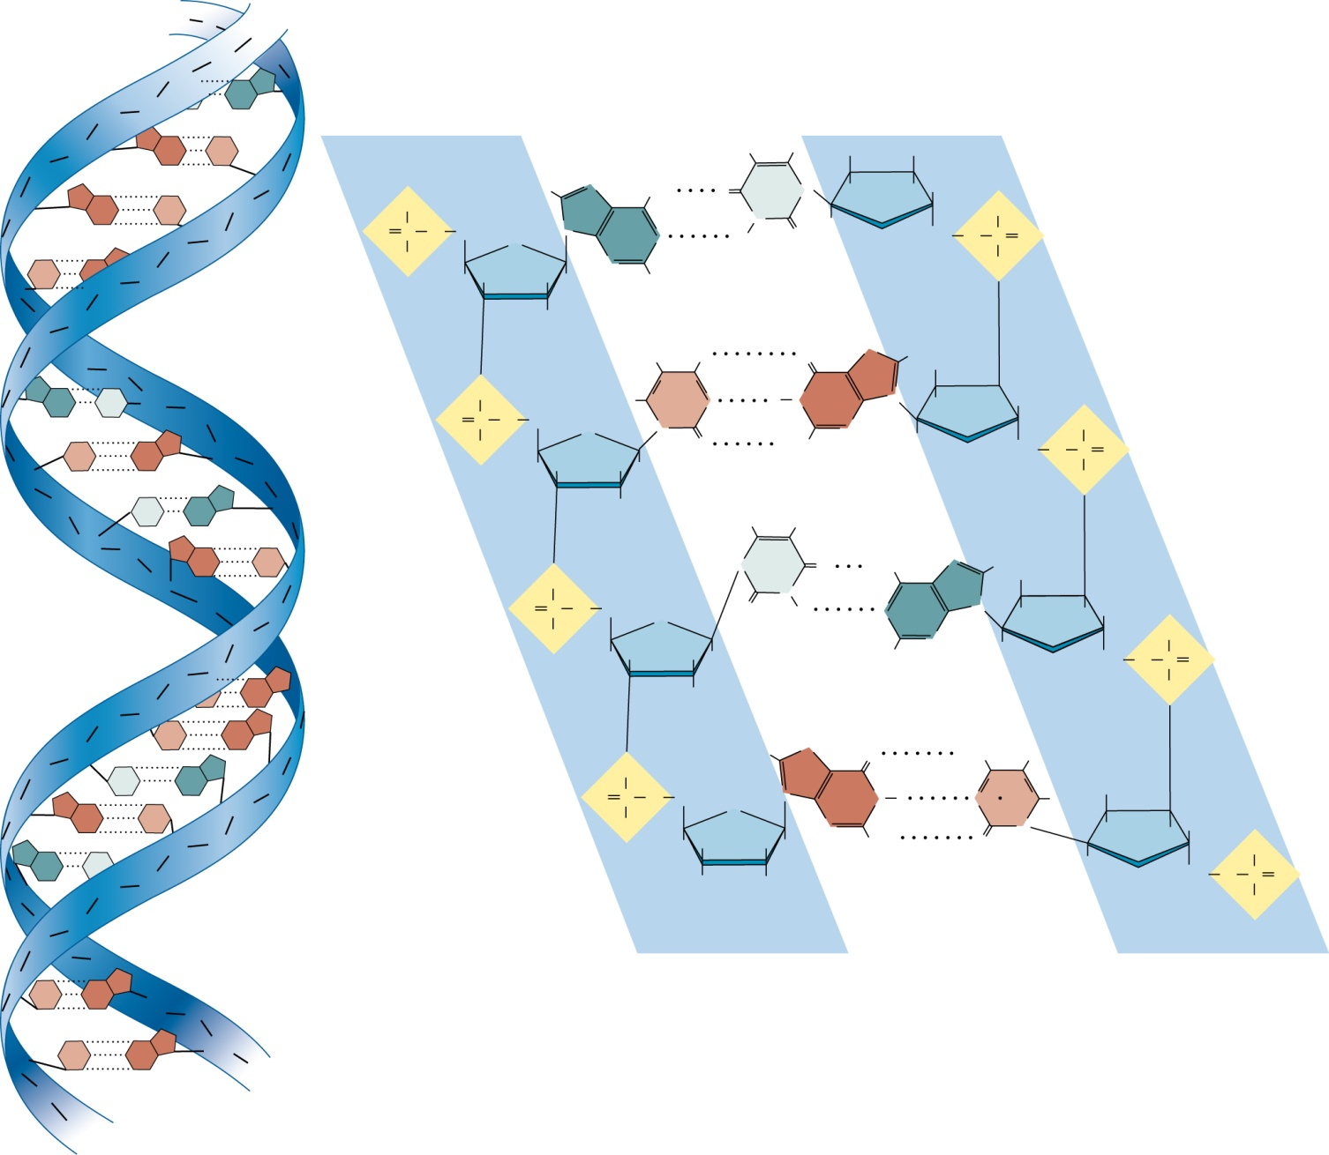
DNA exists in an anti-parallel double helix
2 nm
5′
P
3′
P
S
P
P
S
A
S
5′ end
3′ end
P
S
G
C
P
CH₃
H
H
HO
S
G
C
P
S
O
–
H
N
NH₂
T
N
H
H
H
O
–
S
O
P
O
CH₂
O
N
A
N
H
N
O
H
O
CH₂
O
P
O
C
P
O
–
N
O
S
P
S
H
H
H
H
H
P
S
H
P
S
H
NH₂
O
N
H
H
S
P
O
A
T
S
P
O
P
O
CH₂
H
C
N
H
N
G
N
H
H
H
O
–
C
G
S
O
–
O
N
O
H₂N
N
H
O
CH₂
O
P
O
S
P
H
H
H
H
O
P
T
A
S
H
H
CH₃
2 hydrogen bonds between T and A
S
P
G
C
P
N
T
H₂N
N
H
H
S
P
O
O
N
A
N
P
S
O
P
–
O
CH₂
O
H
N
H
H
H
O
–
S
P
O
H
H
H
H
H
N
H
O
CH₂
O
P
O
P
G
S
H
O
P
S
C
G
P
S
P
O
H
N
H₂N
H
T
A
P
S
O
P
O
CH₂
N
G
N
H
N
C
H
H
S
G
C
S
O
–
O
N
NH₂
N
H
H
H
A
T
P
H
H
H
H
O
H
O
O
–
S
P
S
O
H
H
CH₂
O
P
–
O
P
S
O
P
S
P
3′ end
5′ end
S
C
G
S
P
S
C
G
S
3 hydrogen bonds between T and A
P
5′
3′
Brooker Fig 11.14
Copyright ©The McGraw-Hill Companies, Inc. Permission required for reproduction or display

Slide 16
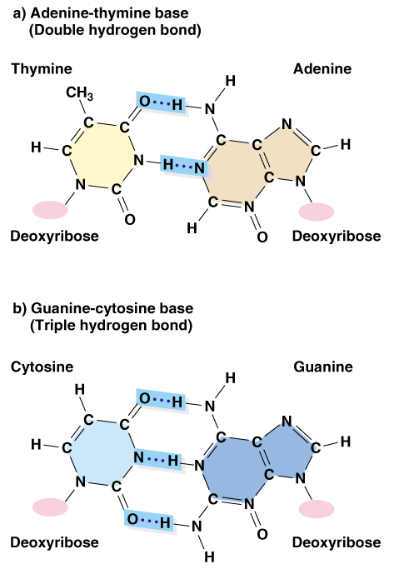
Complementary base pairs in DNA 1.) Pyrimidine always pairs with purine 2.) The higher number of hydrogen bonds in GC pairings confer sequence-specific annealing properties
Peter J. Russell, iGenetics: Copyright © Pearson Education, Inc., publishing as Benjamin Cummings.

Slide 17
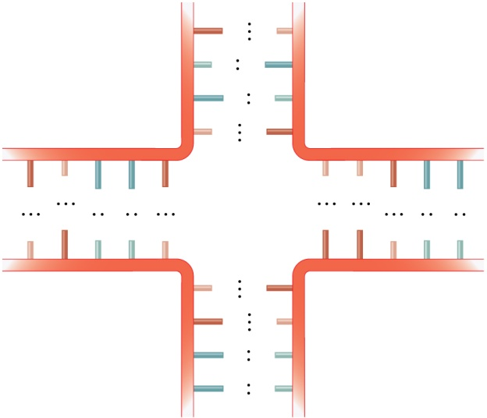
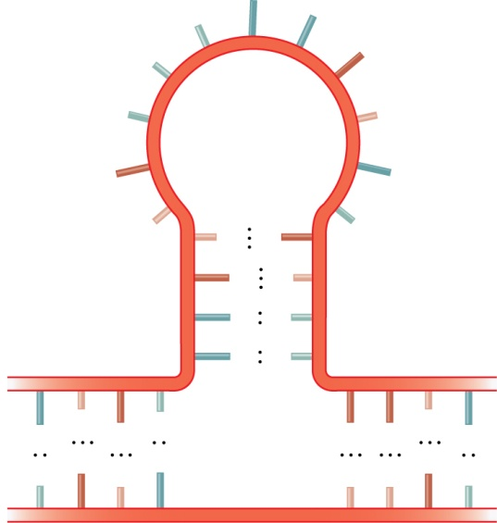
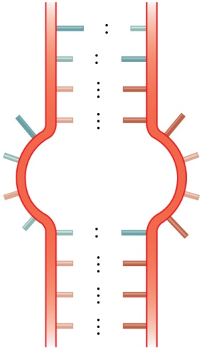
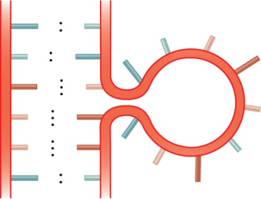
Basis of DNA or RNA 2° Structure
Complementary regions
held together by hydrogen bonds
Also called hair-pin
U
A
A
G
C
U
G
A
U
U
A
U
C
U
A
A
U
A
C
G
C
G
G
A
C
G
G
C
C
G
U
U
C
G
C
A
A
G
C
C
G
A
A
G
C
A
U
U
C
C
G
U
U
C
G
G
C
U
U
A
U
U
A
A
G
C
C
A
U
G
C
U
U
A
G
C
G
C
G
C
C
G
G
C
A
C
G
U
G
G
C
A
C
G
A
U
C
G
A
U
U
G
C
A
C
C
G
U
A
U
C
G
C
G
A
U
(a) Bulge loop
(b) Internal loop
(c) Multibranched junction
(d) Stem-loop
Noncomplementary regions
have bases projecting away from double-stranded regions
Brooker, Fig 11.18
Copyright ©The McGraw-Hill Companies, Inc. Permission required for reproduction or display

Slide 18
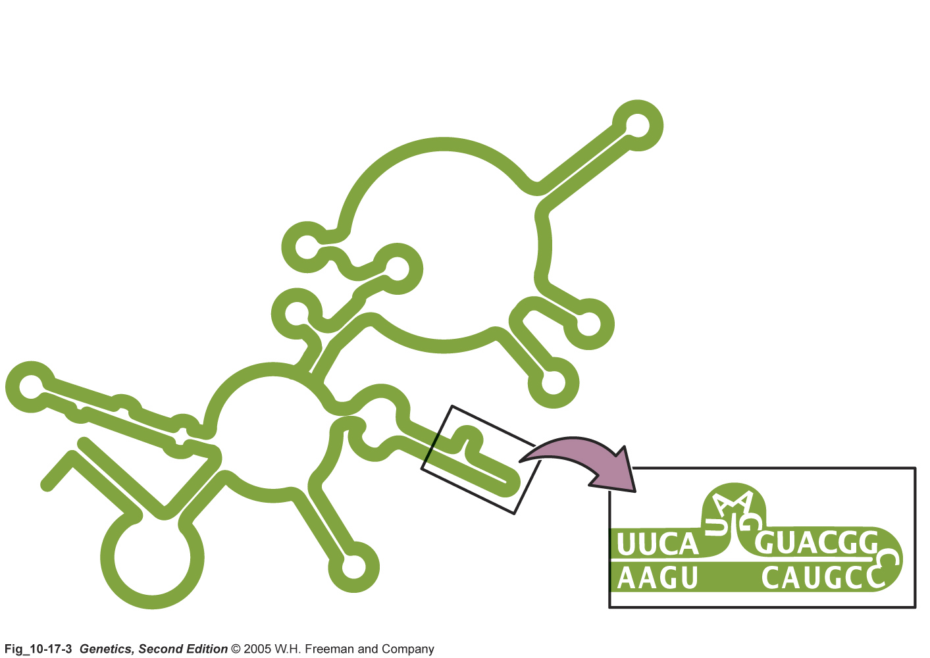
ssRNA often forms functional secondary structure
Notes:
Secondary structure is important:
--Some RNAs can have enzyme activity (e.g. ribosomal RNAs, self splicing RNAs)
--tRNAs need to correctly fold
A mutation in the sequence of the RNA can mess up its secondary structure and its function.

Slide 19
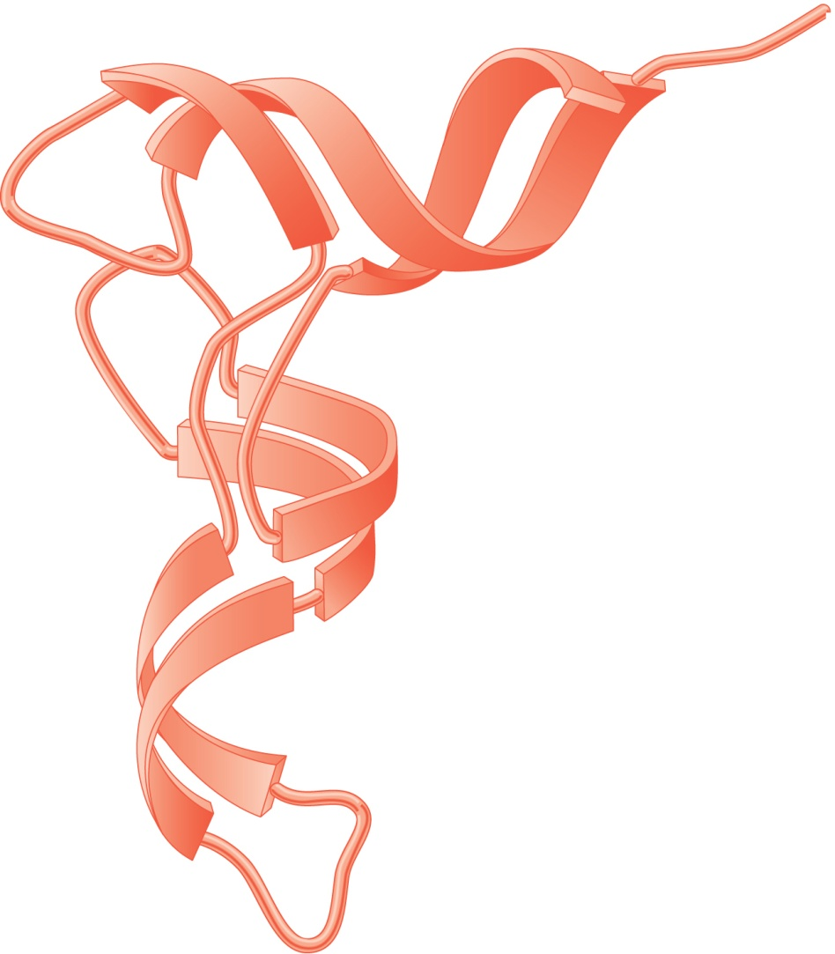
tRNA structure
Double helix
3’ end carries amino acid
3′ end
(acceptor
site)
tRNA contains single- and double-stranded regions.
These spontaneously interact to produce 3-D structure.
5′ end
Double helix
Anticodon
Brooker Fig 11.19
(a) Ribbon model
Anticodon loop
Copyright ©The McGraw-Hill Companies, Inc. Permission required for reproduction or display

Slide 20
DNA Structure: practice questions
The following comprehension questions (at end of each chapter section) in Brooker, Concepts of Genetics are recommended:
Comprehension Questions (at end of each section): 11.2, 11.3, 11.3, 11.5 #2, 11.7, Answers to Comprehension Questions are at the very end of every chapter.
Solved Problems at end of chapter (answers included): [none]
Conceptual questions and Experimental/Application Questions at end of chapter (answers found by logging into publisher’s website, or find them in the book):
Concepts—C1,C4, C5, C7, C8, C13, C14, C17, C20, C25, C26, C27, C29, E1,
A little more challenging—E3, E9

Slide 21
Go over lecture outline at end of lecture

