Slide 1
Study Guide/Outline—Eukaryotic Gene Regulation
Why is eukaryotic gene expression more complex than prokaryotic?
Name six different levels at which gene expression might be controlled.
What evidence has shown the role of chromosome packaging and histone proteins in gene regulation?
What role does DNA methylation play?
What are DNA binding motifs in transcription factor proteins?
What are enhancers and silencers?
How does RNA processing and stability contribute to gene regulation?
What is alternative splicing? How is this used in the sex-determination genes in Drosophila?
What are the Homeotic genes?
How are the Homeotic genes arranged on the chromosome and how does the chromosome location correspond to their function?
How many sets of homeotic genes do Drosophila have? Mammals?

Slide 2
Eukaryotic Gene Expression--more complex than prokaryotic expression because:
Same DNA in all cells, different gene expression pattern, depending upon cell differentiation
e.g. RBC precursor cells → hemoglobin
Pancreatic cells → insulin
Complex temporal expression (developmental stages)
E.g. (hemoglobin Hbε, HbF, HbA0)
Eukaryotes have 700x more DNA, 20x more genes
Eukaryotic DNA is packaged into chromatin.
Transcription of genes requires correct de-packaging and re-packaging.
Exons and introns allow new level of gene regulation and diversity unavailable for prokaryotes.

Slide 3
Different levels of gene regulation in eukaryotic expression

Slide 4
Levels at which eukaryotic gene expression is controlled
Initiating or inhibiting Transcription [majority]
Transcriptional activators, coactivators, repressors
Promoters
DNA response elements, enhancers, silencers
DNA packaging and chromatin structure
Histone acetylation, histone variation
DNA methylation
Initiating or inhibiting Translation
mRNA processing, alternative splicing
RNA stability
RNA silencing
Initiating or inhibiting protein activity (Post-translational modification)

Slide 5
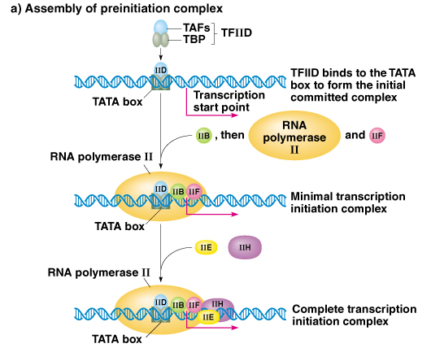
Basal (General) Transcription in Eukaryotes

Slide 6
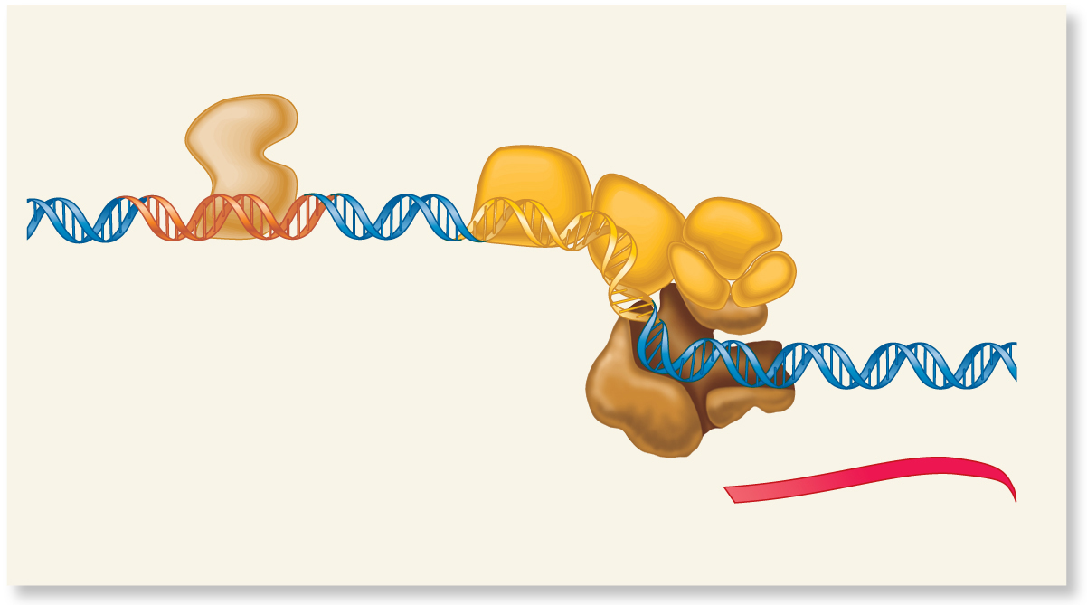
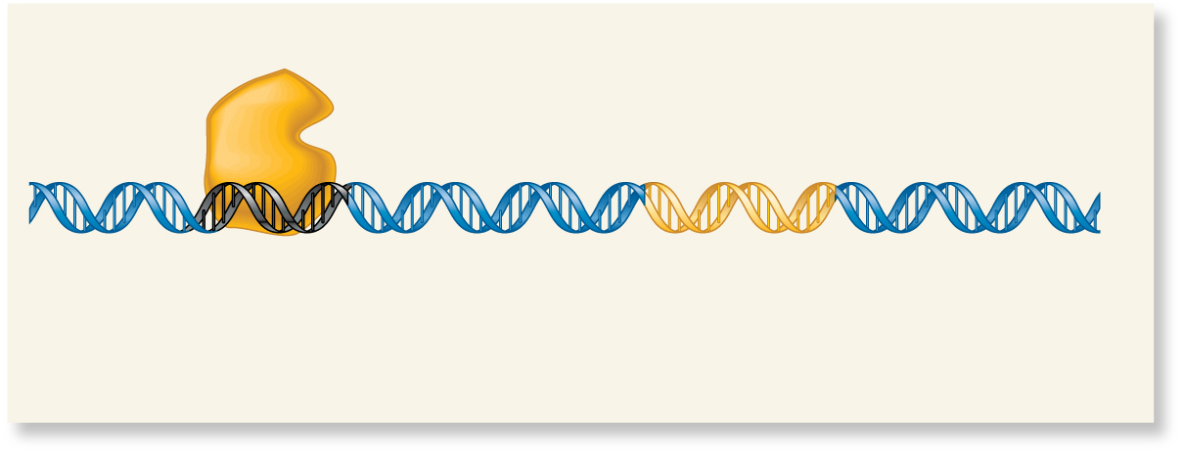
Regulatory Transcription Factors act as activators or repressors of general transcription
Activator
protein
RNA polymerase
and general
transcription
factors
Enhancer
Core
promoter
RNA transcription
is increased.
(a) Gene activation
Repressor
protein
Silencer
Core
promoter
RNA transcription
is inhibited.
(b) Gene repression
Brooker Fig 17.2

Slide 7
How do different Transcription Factor proteins recognize specific promoter sequences? (DNA-Binding Motifs in Transcription Factors)

Slide 8
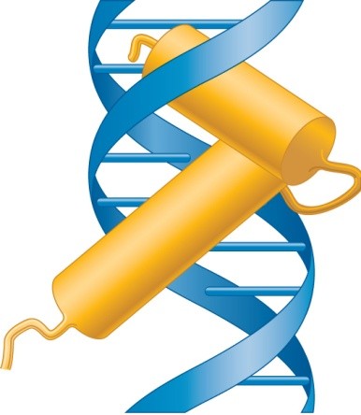
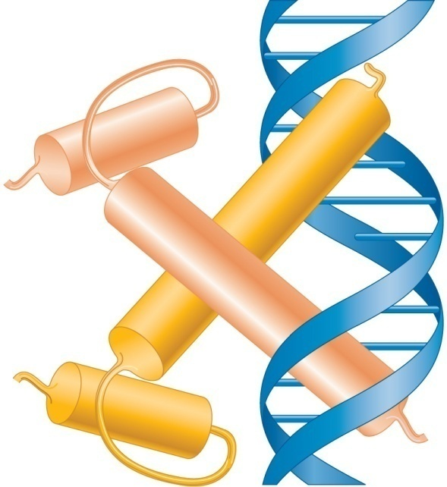
DNA-Binding Domains in Transcription Factors
Loop
Recognition
helix
Turn
Recognition
helix
(a) Helix–turn–helix motif
(b) Helix–loop–helix motif
Copyright ©The McGraw-Hill Companies, Inc. Permission required for reproduction or display
Brooker, Fig 17.3

Slide 9
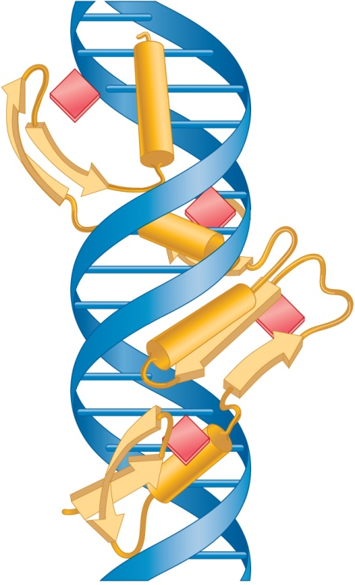
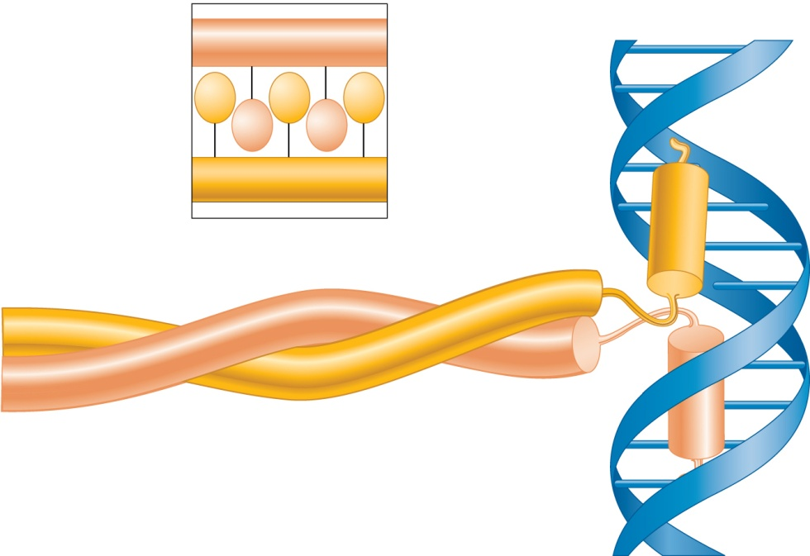
DNA-Binding Domains in Transcription Factors, cont.
Zn²⁺
1
Zinc
finger
Recognition
helix
Leu
Leu
Leu
Leucine
side chains
(zipper)
Zn²⁺
Leu
Leu
β sheet
2
Coiled
coil
3
Zn²⁺
Zn²⁺
Zinc
ion
4
Recognition
helix
(c) Zinc finger motif
(d) Leucine zipper motif
Copyright ©The McGraw-Hill Companies, Inc. Permission required for reproduction or display
Brooker, Fig 17.3

Slide 10
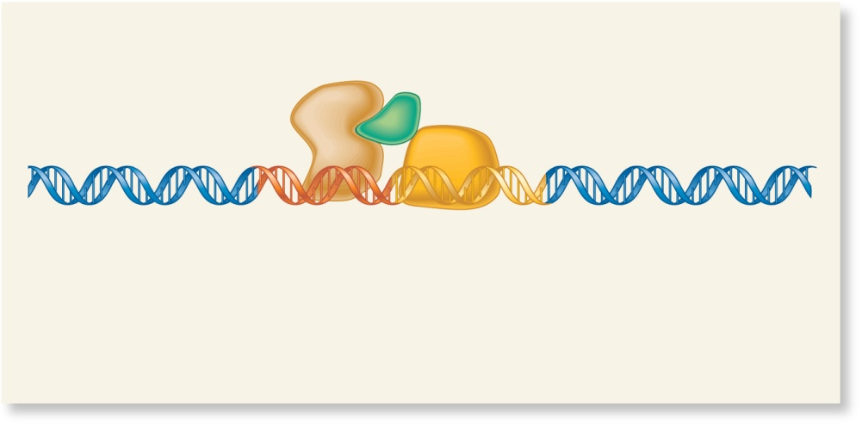
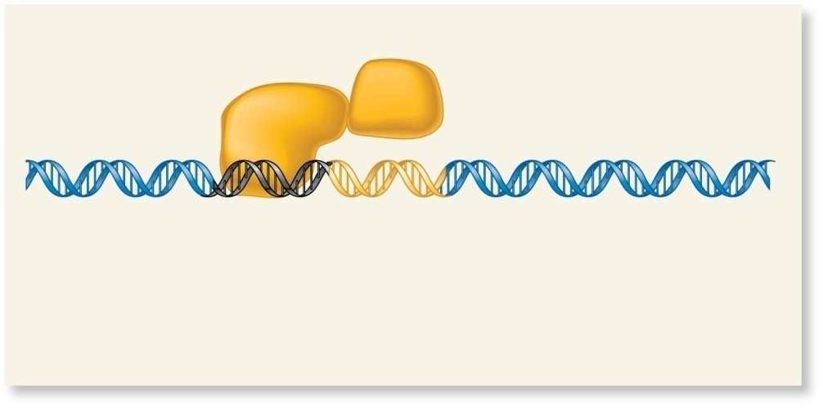
Regulatory Transcription Factors can interact directly with General Transcription Factors or with a co-factor
Activator
protein
Coactivator
ON
Repressor
protein
OFF
TFIID
TFIID
Coding sequence
Coding sequence
Enhancer
Core
promoter
Silencer
Core
promoter
The activator/coactivator complex recruits TFIID to the core promoter and/or activates its function. Transcription will be activated.
The repressor protein inhibits the binding of TFIID to the core promoter or inhibits its function. Transcription is repressed.
(a) Transcriptional activation via TFIID
(b) Transcriptional repression via TFIID
Copyright ©The McGraw-Hill Companies, Inc. Permission required for reproduction or display
Brooker, Fig 17.4

Slide 11
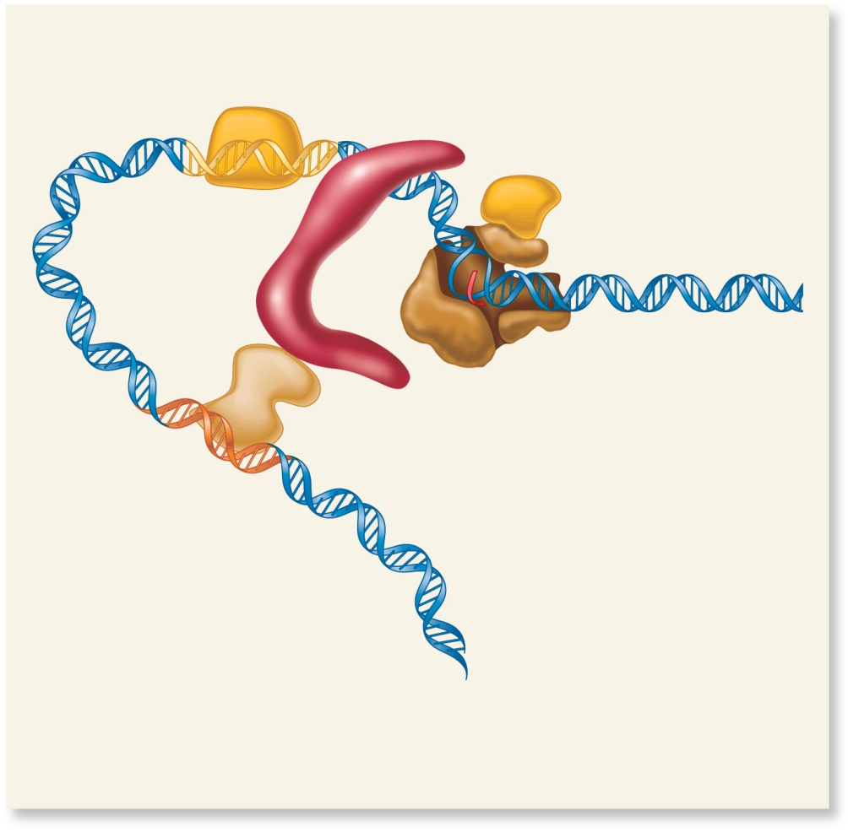
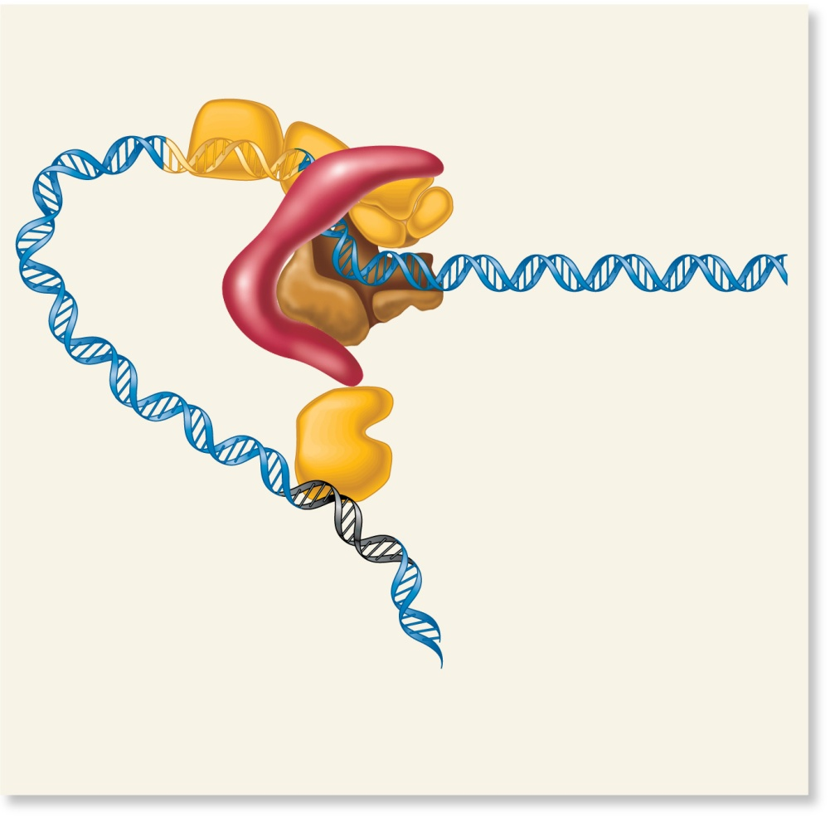
OR Mediator protein interacts between regulatory factors and general transcription factors (enhancers and silencers are distant)
Core
promoter
ON
Core
promoter
OFF
Mediator
Mediator
TFIID
RNA polymerase
and general
transcription
factors
TFIID
RNA polymerase
and general transcription
factors
STOP
Coding sequence
Coding sequence
Activator protein
Enhancer
Repressor protein
Silencer
The activator protein interacts with mediator. This enables RNA polymerase to form a preinitiation complex that can
proceed to the elongation phase of transcription.
The repressor protein interacts with mediator so that transcription is repressed.
(a) Transcriptional activation via mediator
(b) Transcriptional repression via mediator
Copyright ©The McGraw-Hill Companies, Inc. Permission required for reproduction or display
Brooker, Fig 17.5

Slide 12
Common ways to modulate regulatory transcription factors
Hormone
Transcription
factor
Response
element
(a) Binding of a small effector molecule such as a hormone
Transcription
factor
Transcription
factor
Homodimer
(b) Protein–protein interaction
Transcription
factor
PO₄^{2–}
PO₄^{2–}
PO₄^{2–}
PO₄^{2–}
Inactive
Active
(c) Covalent modification such as phosphorylation
Brooker, Fig 17.6

Slide 13
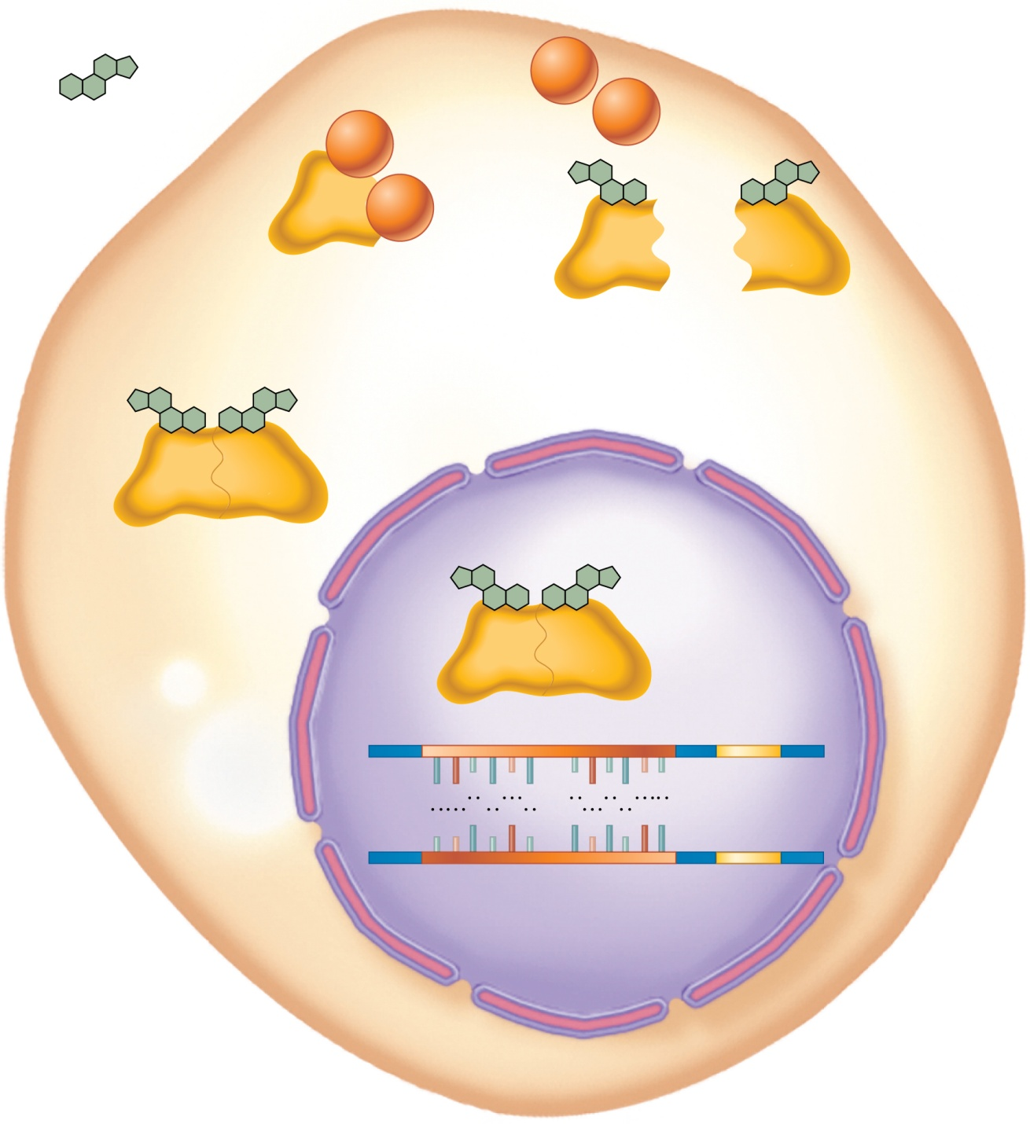
Example of hormone signal and homodimerization
Glucocorticoid
Cytoplasm
Heat shock proteins leave when hormone binds to receptor
HSP
90
HSP
90
HSP
90
HSP
90
+
Glucocorticoid
receptor
NLS
Nuclear localization signal is exposed
Nucleus
Formation of homodimer
Nuclear
pore
Core
promoter
5′
3′
A
G
R
A
C
A
T
G
T
Y
C
T
Target
gene
T
C
Y
T
G
T
A
C
A
R
G
A
3′
5′
Glucocorticoid Response Elements
GRE
Transcription activated or repressed
Brooker, Fig 17.7
Copyright ©The McGraw-Hill Companies, Inc. Permission required for reproduction or display

Slide 14
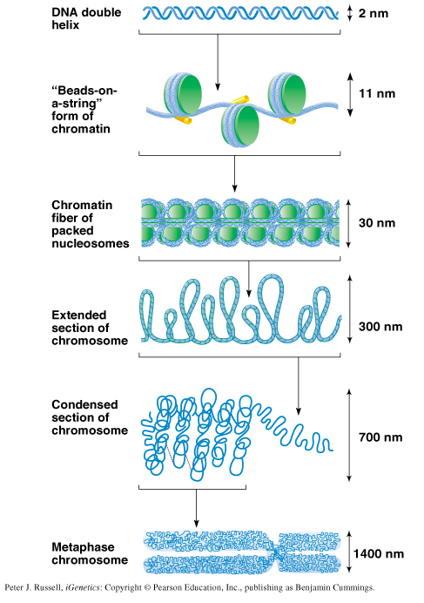
Gene expression can be repressed by chromosome packaging
Level of packaging for DNA replication or expression
Level of packaging for “Diffuse” DNA
Condensed chromosome for mitosis
Peter J. Russell, iGenetics: Copyright © Pearson Education, Inc., publishing as Benjamin Cummings.

Slide 15
Experiment showing that the areas of “unpackaging” correspond with gene expression
Condensed area does not take up radioactive RNA precursor
Chromosome “puff”—takes up radioactive uridine (mRNA nt precursor)

Slide 16
Gene-specific DNA Packaging (for tissue-specific expression)
DNA from Red Blood Cell Precursors
DNA from Red Blood Cell Precursors
Albumin
Probe
(4q11)
B-globin
Probe
(11p15.5)
Southern Blot of DNA from Red Blood cell precursors. Transcribed regions of chromosome (B-globin gene) are sensitive to DNAse enzyme digestion, while inactive regions (albumin gene) are protected.

Slide 17
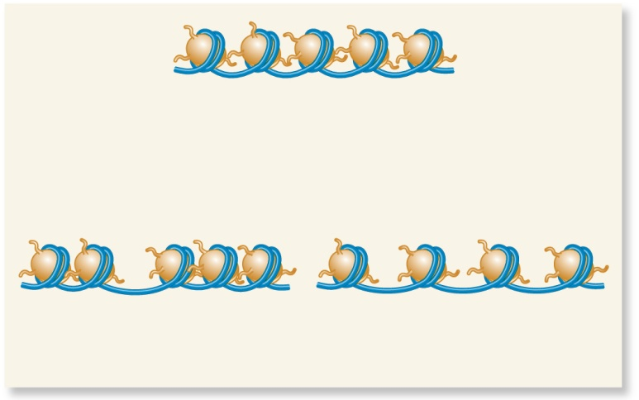
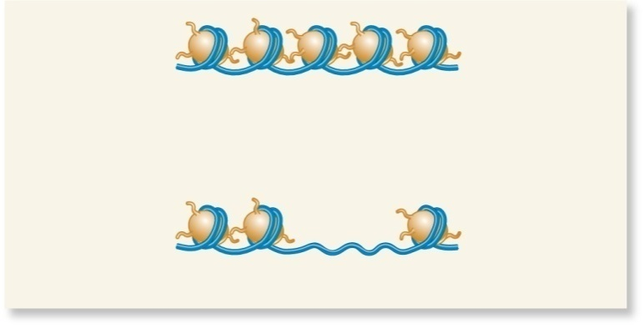
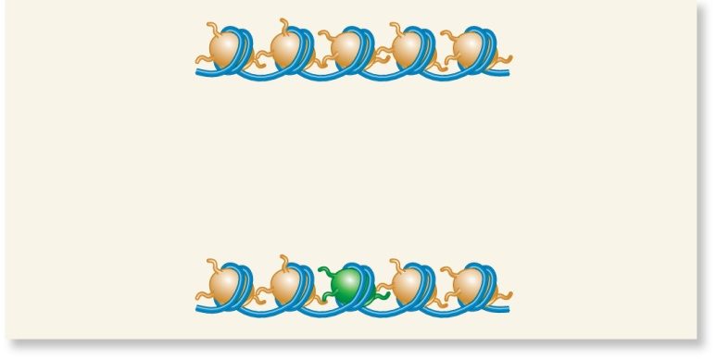
ATP-Dependent Chromatin Modeling
ATP-dependent
chromatin-remodeling
complex
or
(a) Change in nucleosome position
Change in the relative positions
of a few nucleosomes
Change in the spacing
of nucleosomes over a long distance
ATP-dependent
chromatin-remodeling
complex
(b) Histone eviction
Histone octamers are removed.
ATP-dependent
chromatin-remodeling
complex
(c) Replacement with variant histones
Variant histones
Brooker, fig 17.8

Slide 18
Histone Variants Play Roles in Chromatin Structure
DNA Repair (H2A.X)
Centromere—binding of kinetochore proteins (cenH3)
Inactivated X (macroH2A)
Telomere-(spH2B)

Slide 19
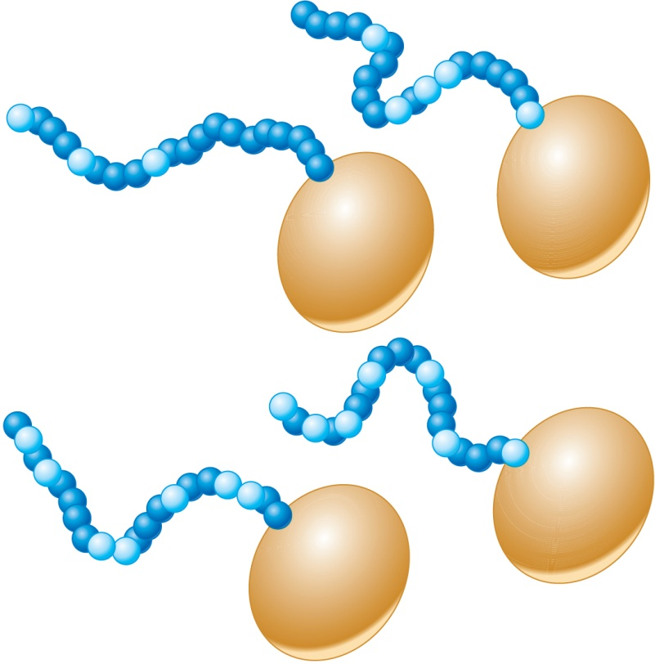
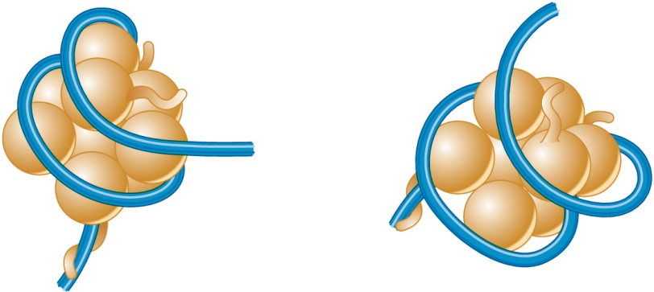
Histone Modifications and their Effect on Nucleosome Structure
ac
Amino-terminal tail
5
Lys
p
ac
p
ac
Ser
Lys
ac
Ser
Lys
15
20
Lys
ac
ac
1
0
5
Lys
Lys
10
15
20
H2B
Globular domain
H2A
p
ac
ac
Lys
Lys
Ser
m
ac
10
m
Arg
Lys
15
ac
m
Arg
m
m
ac
5
Lys
Lys
5
Lys
ac
Arg
Lys
20
H4
m
Lys
ac
p
15
20
Lys
Ser
H3
10
(a) Examples of histone modifications
Core histone
protein
Acetyl
groups
Histone
acetyltransferase
COCH₃
COCH₃
Histone
deacetylase
COCH₃
DNA is less tightly bound
to the histone proteins
Brooker, fig 17.9
(b) Effect of acetylation

Slide 20
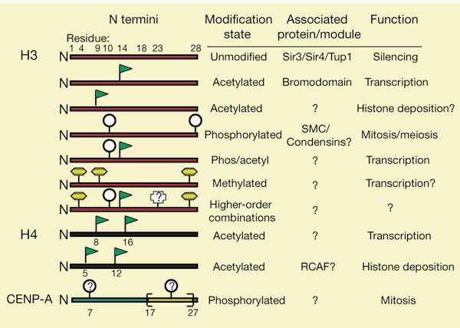
Example of Histone Code
From:
The language of covalent histone modifications
Brian D. Strahl and C. David Allis
Nature 403, 41-45(6 January 2000)
Notes:
Histone modifications occur at selected residues and some of the patterns shown have been closely linked to a biological event (for example, acetylation and transcription). Emerging evidence suggests that distinct H3 (red) and H4 (black) tail modifications act sequentially or in combination to regulate unique biological outcomes. How this hierarchy of multiple modifications extends (depicted as 'higher-order combinations') or how distinct combinatorial sets are established or maintained in localized regions of the chromatin fibre is not known. Relevant proteins or protein domains that are known to interact or associate with distinct modifications are indicated. The CENP-A tail domain (blue) might also be subjected to mitosis-related marks such as phosphorylation; the yellow bracket depicts a motif in which serines and threonines alternate with proline residues.

Slide 21
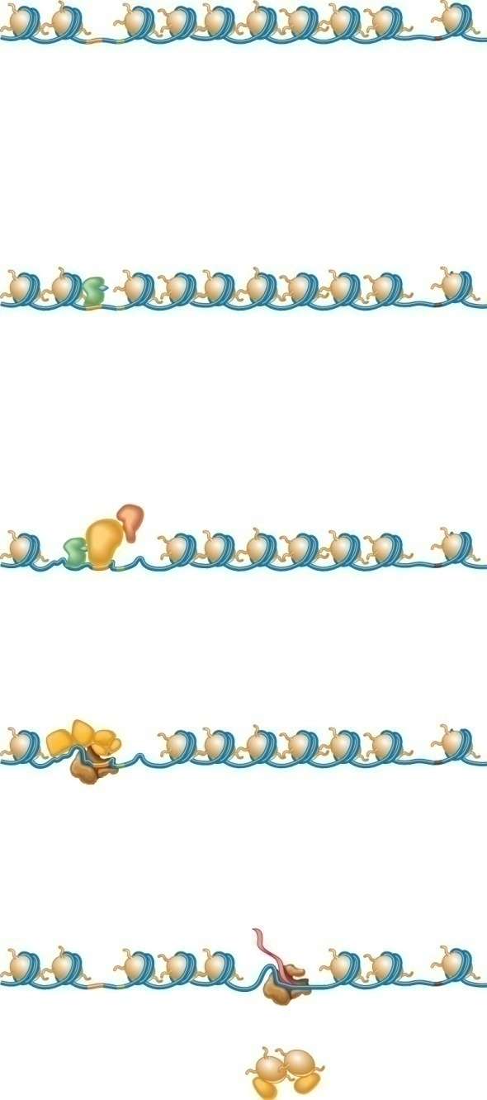
Model for histone displacement for transcription activation
Genes that can be activated are flanked by nucleosome-free regions (NFR) and well-positioned nucleosomes.
nucleosome-free regions (NFRs)
-2
-1
+1
+2
Enhancer
Transcriptional
start site
Transcriptional
termination site
Activator
-2
-1
+1
+2
BINDING OF ACTIVATORS:
Activator proteins bind to enhancer sequences.
Enhancer
Histone acetyltransferase
CHROMATIN REMODELING AND HISTONE MODIFICATION:
Activator proteins recruit chromatin remodeling complexes (e.g.SWI/SNF) and histone modifying enzymes (e.g. histone acetyltransferase). Nucleosomes may be moved or evicted. Some histones are covalently modified ( e.g. acetylation).
-2
+2
ac
ac
SWI/
SNF
ac
ac
ac
FORMATION OF PRE-INITIATION COMPLEX:
General transcription factors and RNA polymerase II are able to bind to the core promoter and form a pre-initiation complex.
-2
+2
ac
ac
ac
ac
ac
Pre-initiation complex
ELONGATION:
During elongation, histones ahead of the open complex are covalently modified by acetylation and evicted or partially displaced. Behind the open complex, histones are
deacetylated and become tightly bound to the DNA.
Deacetylated histones
-2
-1
+1
+2
Pre-mRNA
ac
ac
ac
ac
Open complex
Evicted histone
proteins
Brooker, fig 17.11
Histone Chaperone

Slide 22
Inheritance of Methylation patterns is not limited to X chromosome
Methylation of DNA used to reduce gene expression (e.g. Barr Bodies [inactivated X-chromosomes] are heavily methylated).
Methylation occurs on cytosine (changing it to 5-methylcytosine)
Methylation most commonly occurs at “CpG islands”
De-methylation associated with acetylation of histones
CH₃
……GC……..
……CG……..
CH₃

Slide 23
Prader-Willi Syndrome
Mild to moderate retardation
Hypotonia
Poor feeding in infancy
Short stature, small hands and feet
Small genitalia
Compulsive overeating and massive obesity
Caused by inheritance of 15q11-13 deletions from father (forced expression from maternal c’some).
fig from Thompson and Thompson, Genetics in Medicine, 6th ed.
Notes:
Caused by 15d11-q13 deletions on paternally inherited chromosomes (forced expression from maternal c’some)
Mild to moderate retardation
Hypotonia
Poor feeding in infancy
Short stature, small hands an feet
Small genitalia
Compulsive overeating and massive obesity

Slide 24
Angelman’s Syndrome caused by inheritance of 15q11-q13 deletions from mother (forced paternal expression)
Severe retardation
No speech
Seizures
jerky gait
inappropriate laughter,
protruding tongue
enlarged jaw
The same deletion cause different syndromes, depending on whether it is inherited from the mother or the father, due to different methylation patterns during oogenesis and spermatogenesis.
Notes:
Severe retardation—no speech
Seizures, jerky gait, inappropriate laughter, protruding tonge, enlarged jaw.

Slide 25
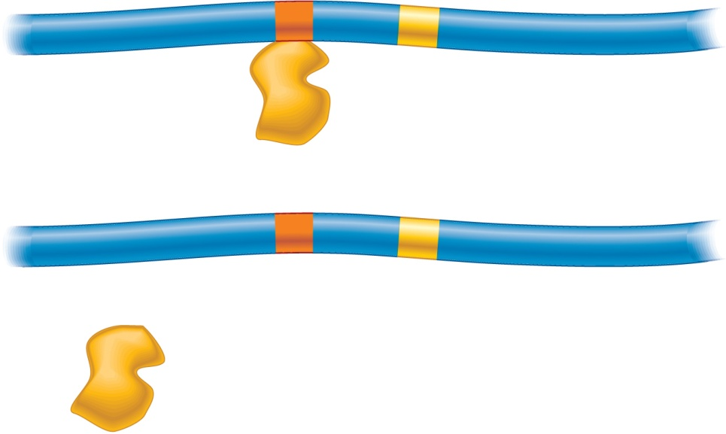
Methylation inhibits the binding of an activator protein
Enhancer
CpG island
Core promoter
Activator
protein
Coding sequence
Methylation
CH₃
CH₃
CH₃
CH₃
CH₃
CH₃
Methyl groups block the
binding of an activator protein
to an enhancer element.
Brooker, Fig 17- 13a
Copyright ©The McGraw-Hill Companies, Inc. Permission required for reproduction or display

Slide 26
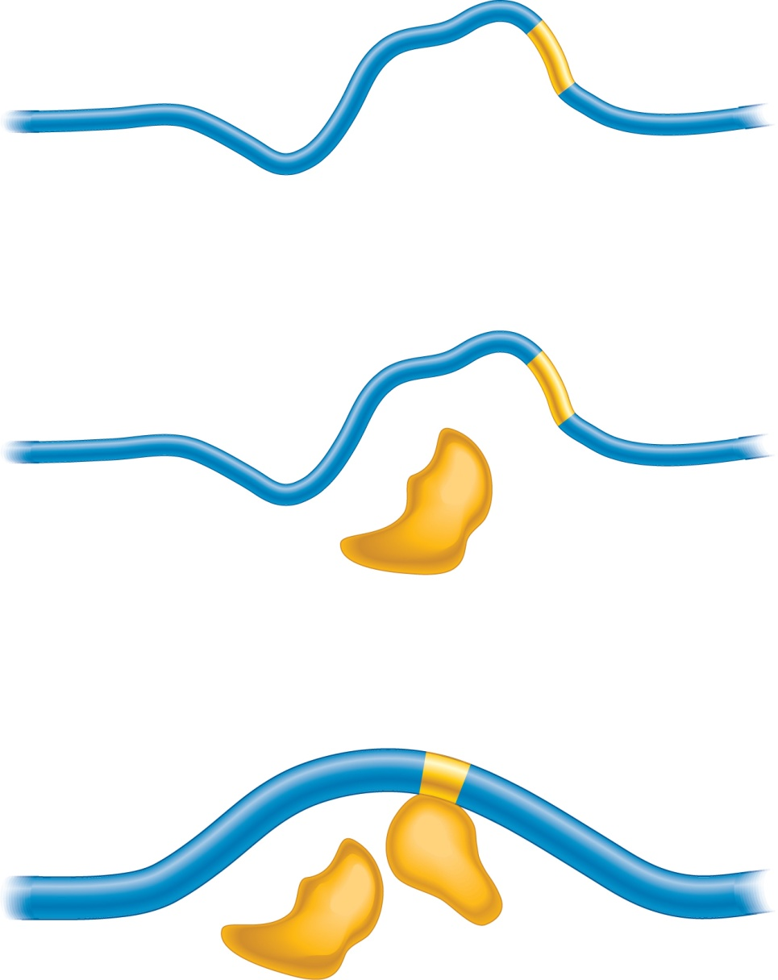
Methyl-CpG-binding protein recruits other proteins that change the
chromatin to a closed conformation
CpG island
CH₃
CH₃
Core promoter
CH₃
CH₃
CH₃
CH₃
CH₃
CH₃
CH₃
Chromatin
in an open
conformation
A methyl-CpG-binding protein
binds to the methylated
CpG island.
CH₃
CH₃
CH₃
CH₃
CH₃
CH₃
CH₃
CH₃
CH₃
Methyl-CpG
binding protein
The methyl-CpG-binding protein
recruits other proteins, such as
histone deacetylase, that convert
the chromatin to a closed
conformation.
Chromatin
in a closed
conformation
CH₃
CH₃
CH₃
CH₃
CH₃
CH₃
CH₃
CH₃
CH₃
Histone
deacetylase
Brooker, Fig 17- 13b
Copyright ©The McGraw-Hill Companies, Inc. Permission required for reproduction or display

Slide 27
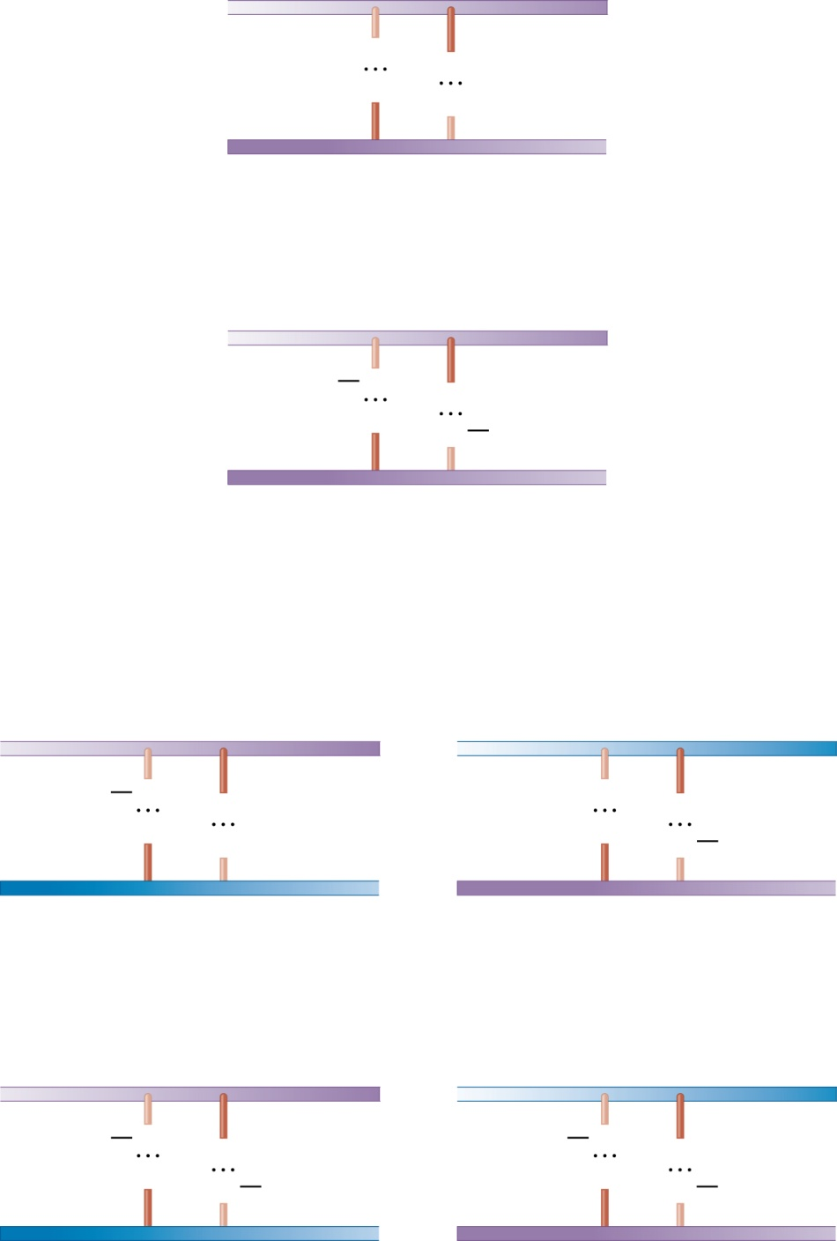
5
′
3′
C
G
G
C
3′
5′
de novo methylation
An infrequent and highly regulated event
5′
3′
CH₃
C
G
G
C
CH₃
3′
5′
DNA replication
Hemimethylated
DNA
5′
3′
5′
3′
CH₃
C
G
C
G
G
C
G
C
CH₃
3′
5′
3′
5′
DNA methylase converts hemi-methylated to fully- methylated DNA.
A frequent event.
Maintenance
methylation
Fully methylated
DNA
5′
3′
5′
3′
CH₃
C
G
CH₃
C
G
G
C
CH₃
G
C
CH₃
3′
5′
3′
5′
Brooker, Fig 17- 14

Slide 28
Levels at which eukaryotic gene expression is controlled
Initiating or inhibiting Transcription [majority]
Transcriptional activators, coactivators, repressors
Promoters
DNA response elements, enhancers, silencers
DNA packaging and chromatin structure
Histone acetylation, histone variation
DNA methylation
Initiating or inhibiting Translation
mRNA processing, alternative splicing
RNA stability
RNA silencing
Initiating or inhibiting protein activity (Post-translational modification)

