Slide 1
Biol 3300 Objectives for Genomics
Students will be able to
describe map-based and whole genome sequencing approaches
explain how genetic and physical chromosome maps are prepared
access and use genetic information from public databases, given a particular problem in biotechnology, medicine, or biology

Slide 2
Lecture Outline
Three types of maps associated with the genome
  Cytogenetic mapping
    Banding pattern
    In situ hybridization—FISH and chromosome painting
  Linkage mapping (create a genetic map)
  Physical mapping
Types of molecular markers
  RFLP
  AFLP
  Minisatellites and microsatellites
  SNPs
  STS
Molecular markers can be mapped
  Linkage mapping
  LOD mapping in human genetics
Methods of Physical mapping
  Creating a contig
  Examples of vectors that can take large chromosomal DNA fragments
  Early sequencing strategies
  An example of 2nd generation sequencing--

Slide 4
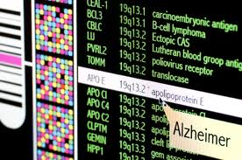
Genomics--the study of the entire genome
(not just one gene at a time)

Slide 5
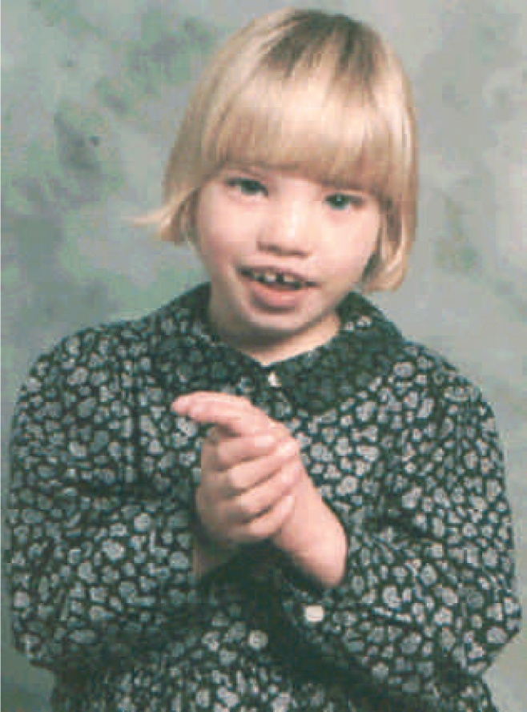
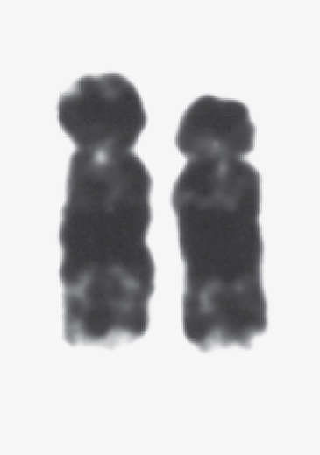
G-banding and deletions used to map some genes/phenotypes
Deleted
region
© Biophoto Assocates/Science Source/Photo Researchers
© Jeff Noneley
(a) Chromosome 5
(b) A child with cri-du-chat syndrome

Slide 6
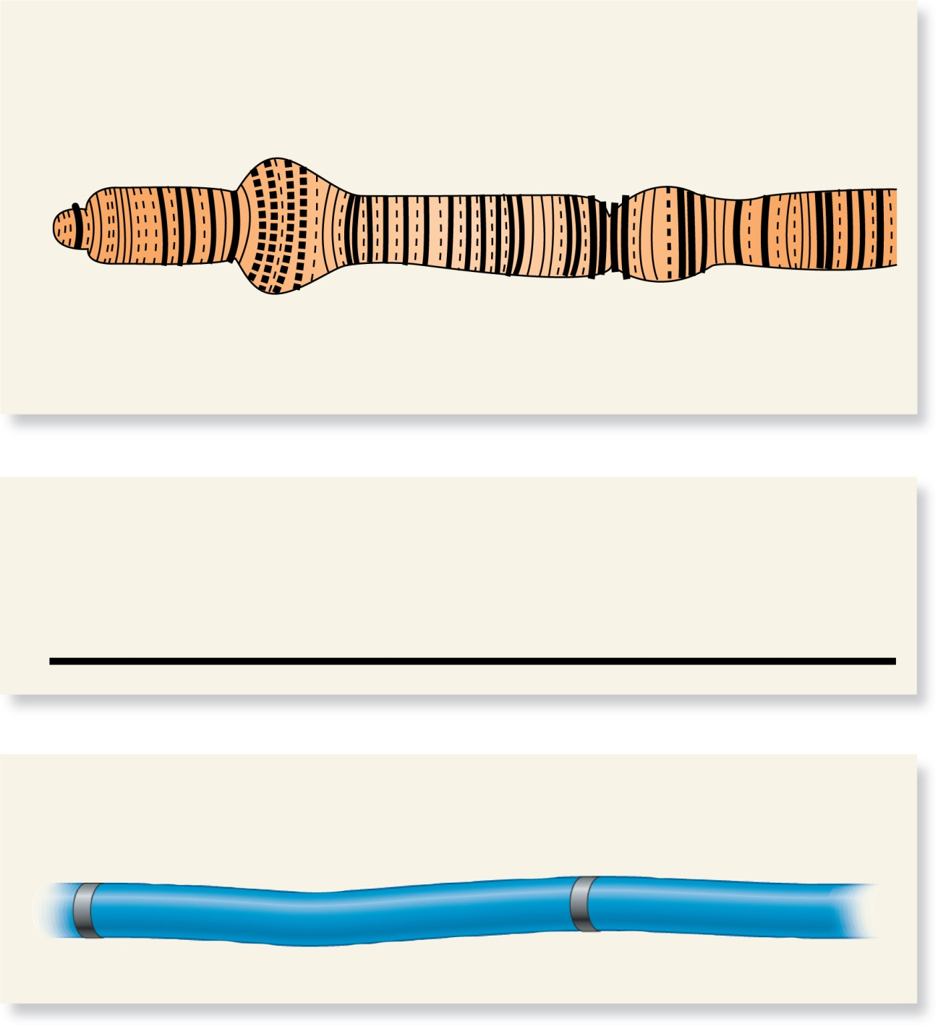
Three types of maps associated with the Genome
Cytogenetic map:
sc (1A8)
w (3B6)
A
B
C
D
E
F
A
B
C
D
E
F
A
B
C
D
E
F
A
B
C
1
1
2
2
3
3
4
Linkage map:
s
c
w
1.5 mu
Results from
each type of
mapping technique
may be slightly
different
Physical map:
sc
w
~ 2.4 x 10⁶ bp
Brooker, Figure 21.1
Copyright ©The McGraw-Hill Companies, Inc. Permission required for reproduction or display

Slide 7
For cytogenetic mapping: fluorescence in situ hybridization (FISH)

Slide 8
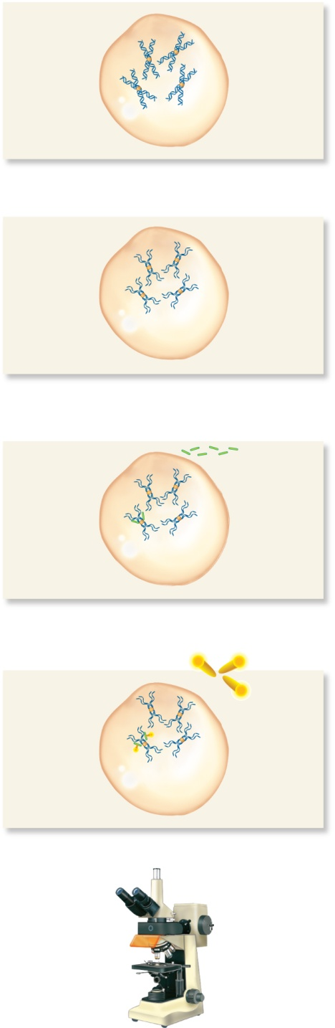
For cytogenetic mapping: fluorescence in situ hybridization (FISH)
Sister
chromatids
Treat cells
with agents
that make
them swell
and fixes
them onto
slide.
Hybridized
probe
Denature
chromosomal
DNA.
Denatured
DNA (not
in a double-
helix
form)
Add single-stranded
DNA probes that have
biotin incorporated
into them.
Add fluorescently
labeled avidin, which
binds to biotin.
Fluorescent
molecule
bound to
probe
View with a
fluorescence
microscope.
Brooker, Figure 21.2
Copyright ©The McGraw-Hill Companies, Inc. Permission required for reproduction or display

Slide 9
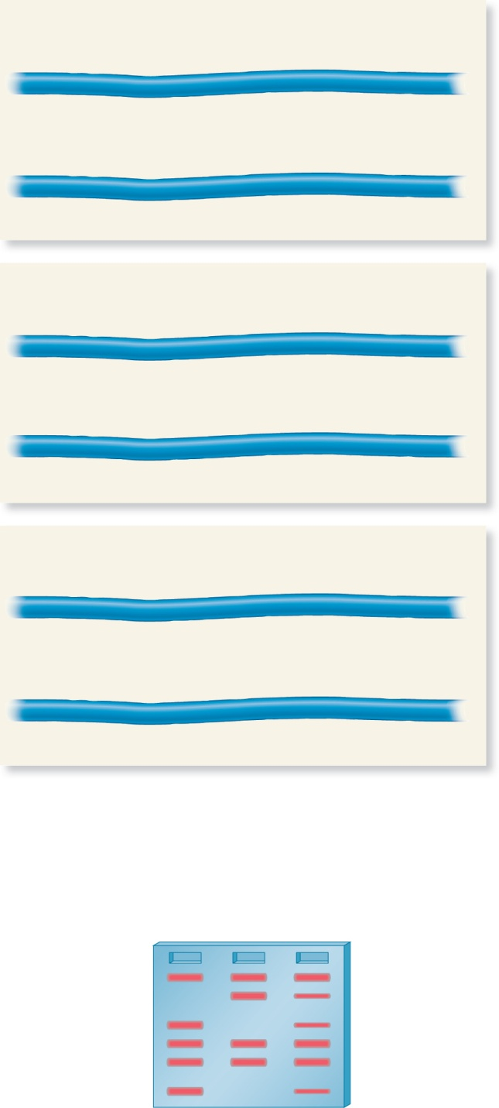
RFLP Analysis of different individuals
(molecular marker for genetic and physical mapping)
Individual 1
EcoRI
EcoRI
EcoRI
EcoRI
EcoRI
EcoRI
Homozygous for polymorphic EcoR1 site
2000 bp
5000 bp
1500 bp
3000 bp
2500 bp
EcoRI
EcoRI
EcoRI
EcoRI
EcoRI
EcoRI
2000 bp
5000 bp
1500 bp
3000 bp
2500 bp
Individual 2
EcoRI
EcoRI
EcoRI
EcoRI
EcoRI
Homozygous for loss of EcoR1 site
2000 bp
5000 bp
4500 bp
2500 bp
EcoRI
EcoRI
EcoRI
EcoRI
EcoRI
2000 bp
5000 bp
4500 bp
2500 bp
Brooker Fig 21.4
Copyright ©The McGraw-Hill Companies, Inc. Permission required for reproduction or display

Slide 10
RFLP Analysis, cont.
(molecular marker for genetic and physical mapping)
Individual 3
Heterozygous for polymorphic EcoR1 site
EcoRI
EcoRI
EcoRI
EcoRI
EcoRI
EcoRI
2000 bp
5000 bp
1500 bp
3000 bp
2500 bp
EcoRI
EcoRI
EcoRI
EcoRI
EcoRI
2000 bp
5000 bp
4500 bp
2500 bp
Cut the DNA from
all 3 individuals
with EcoRI.
(Most restriction sites are shared in the population→ if restriction segments are found in 99% of individuals then it is considered monomorphic.)
Separate the DNA
fragments by gel
electrophoresis.
1
2
3
5000 bp
4500 bp
Polymorphic
bands
indicated at
arrows.
3000 bp
2500 bp
2000 bp
1500 bp
Brooker, Fig 21.4
Copyright ©The McGraw-Hill Companies, Inc. Permission required for reproduction or display

Slide 11
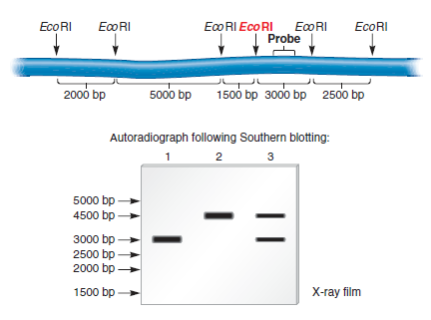
Southern Blot only shows the polymorphic band
(molecular marker for genetic and physical mapping)
Probe must bind to a polymorphic site
Figure not in Brooker

Slide 12
SNP variation—Single Nucleotide Polymorphisms
(molecular marker for genetic and physical mapping)
www.hapmap.org

Slide 13
Microsatellites
(or Short Tandem Repeats--STR)
(molecular marker for genetic and physical mapping)
CA = (CA)₁
CACACACACA = (CA)₅
CACACACACACACACACACACACACACA = (CA)₁₄
2 bp repeat
TTTTC = (TTTTC)₁
TTTTCTTTTCTTTTC = (TTTTC)₃
TTTTCTTTTCTTTTCTTTTCTTTTCTTTTC = (TTTTC)₅
5 bp repeat

Slide 14
The same forward and reverse primers PCR-amplify different allele lengths for a microsatellite
5’GGGAAA3’
(CA)₁ allele 5’-…gggaaacctgCAtcgtgccagctg…-3’
(CA)₅ allele 5’-…gggaaacctgCACACACACAtcgtgccagctg…-3”
(CA)₈ allele 5’-…cgggaaacctgCACACACACACACACAtcgtgccagctg…-3’
3’GTCGAC5’
5’GGGAAA3’
3’GTCGAC5’
5’GGGAAA3’
3’GTCGAC5’

Slide 15
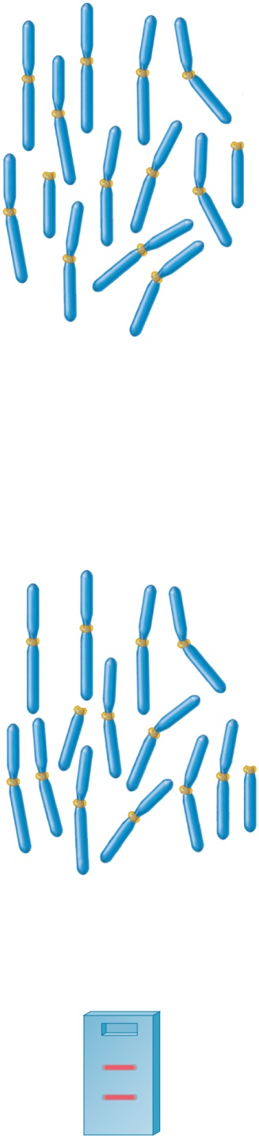
PCR of microsatellites
(molecular marker for genetic and physical mapping)
Set of
chromosomes
Add PCR primers specific to polymorphic chromosome 2 STR
2
2
Many cycles of PCR produce a large amount of DNA fragment
between the 2 primers.
(CA)₁₀ allele
Gel electrophoresis
Brooker, Fig 21.5
(CA)₅ allele

Slide 16
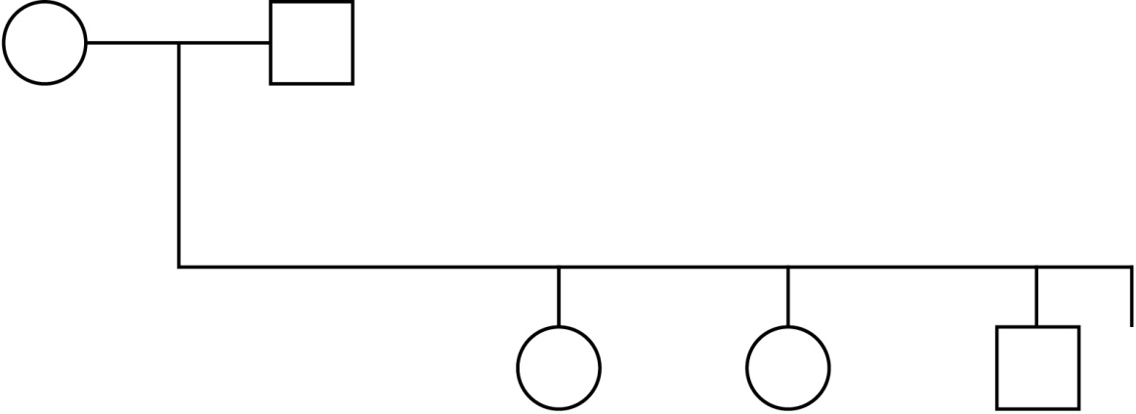
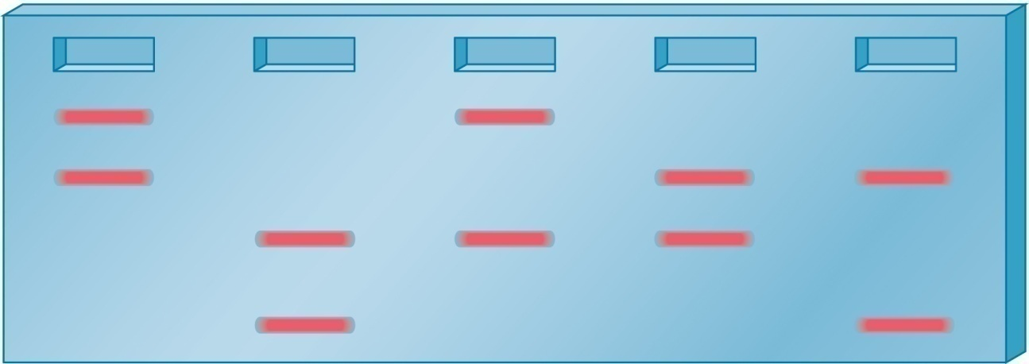
Electrophoretic gel of polymorphic microsatellite found in family (PCR amplified)
Parents
Sue
Henry
Offspring
Mary
Joelle
Hank
Sue
Henry
Mary
Joelle
Hank
154
150
Fragment length (bp)
146
140
Copyright ©The McGraw-Hill Companies, Inc. Permission required for reproduction or display
Brooker, Fig 20.12

Slide 17
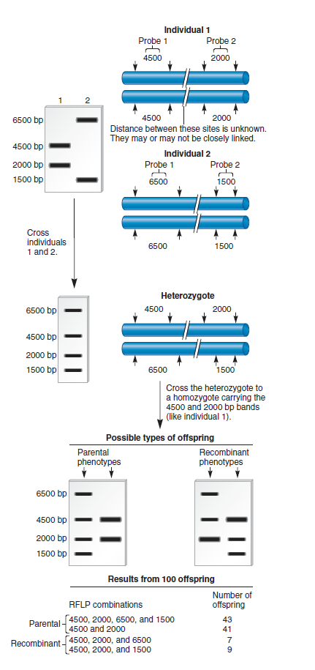
RFLPs (and other markers) can be mapped
16 recombinants/100 total offspring → 16 mu
Figure not in Brooker

Slide 18
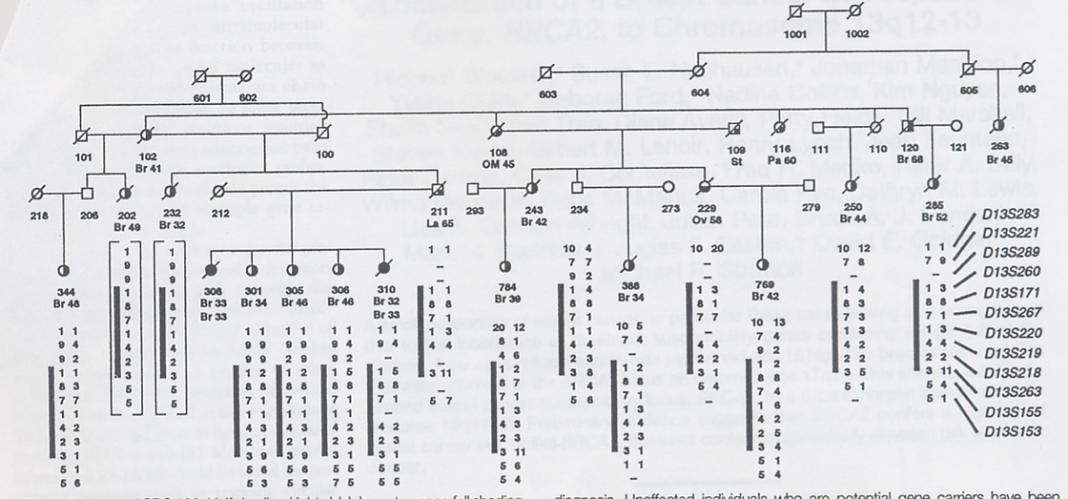
Using markers to map BRCA2 gene in humans
Fig from Wooster et al., 1995
Notes:
Sequence of BRCA2
Wooster et al., 1995

Slide 19
In human genetics, computer algorithms are used to determine linkage
The likelihood of linkage between two markers is determined by the lod (logarithm of the odds) score method
  Computer programs analyze pooled data from a large number of pedigrees or crosses involving many markers
  They determine probabilities that are used to calculate the lod score
    lod score = log₁₀
Probability of a certain degree of linkage
Probability of independent assortment
Copyright ©The McGraw-Hill Companies, Inc. Permission required for reproduction or display

Slide 20
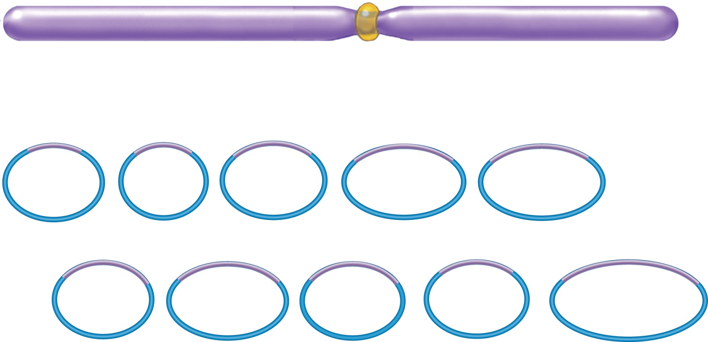
Physical Mapping
A
B
C
D
E
F
GH
I
J
K
L
M
NO
P
Q
R
Clone individual chromosome pieces
into vectors
A
B
C
D
F
GH
I
J
K
M
NO
P
1
3
5
7
9
Vector
Collection of ordered, overlapping
clones (contig)
B
C
D
E
F
GH
I
K
L
M
P
Q
R
2
4
6
8
1
0
Numbers denote chromosome order of clones
Booker, fig 21.7
Copyright ©The McGraw-Hill Companies, Inc. Permission required for reproduction or display

Slide 21
Examples of different types of vectors and host organisms
Genome of Interest | Host Organism | Vector | Size of Insert
Human genome | Yeast | YAC (Yeast Artificial Chromosome) | 100 - 2000 kb
Worm (nematode) genome | Bacteria | Cosmid | < 45 kb
Firefly genome | Virus | λ phage | < 20 kb
Drosophila genome | Bacteria | Plasmid | < 15 kb

Slide 22
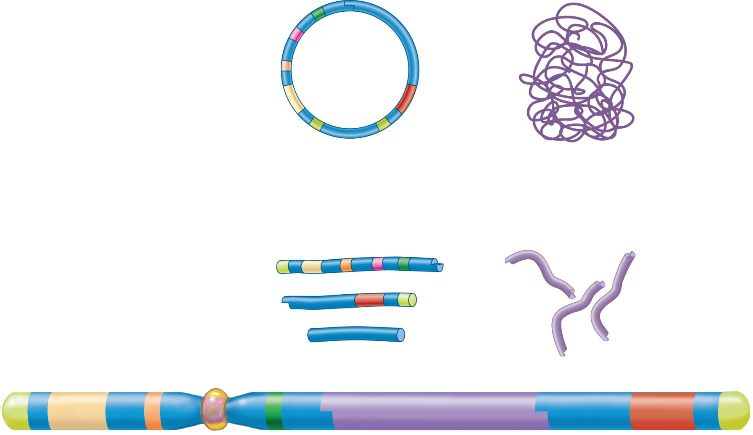
Yeast Artificial Chromosomes
ARS
(yeast origin
of replication)
CEN
(yeast
centromere)
EcoRI site
Chromosomal DNA
ORI (E.coli
origin of
replication)
Selectable
marker
gene
Selectable
Marker
gene
TEL
TEL
(yeast telomere)
BamHI
site
BamHI
site
Cut
(occasionally)
with low concentration
of EcoRI to yield very
large fragments.
Cut with
EcoRI and
BamHI.
Each arm has a different selectable marker. Therefore, it is possible to select for yeast cells with YACs that have both arms
Left
arm
Right
arm
+
Fragment not
needed in yeast
+
Mix and add DNA ligase.
Yeast
artificial
chromosome
(YAC)
TEL
Selectable
marker
gene
ORI
CEN
ARS
Large piece of chromosomal DNA
Selectable
marker
gene
TEL
Note: not drawn to scale. Chromosomal
DNA is much larger than the YAC vector.
Brooker, Fig 21.9

Slide 23
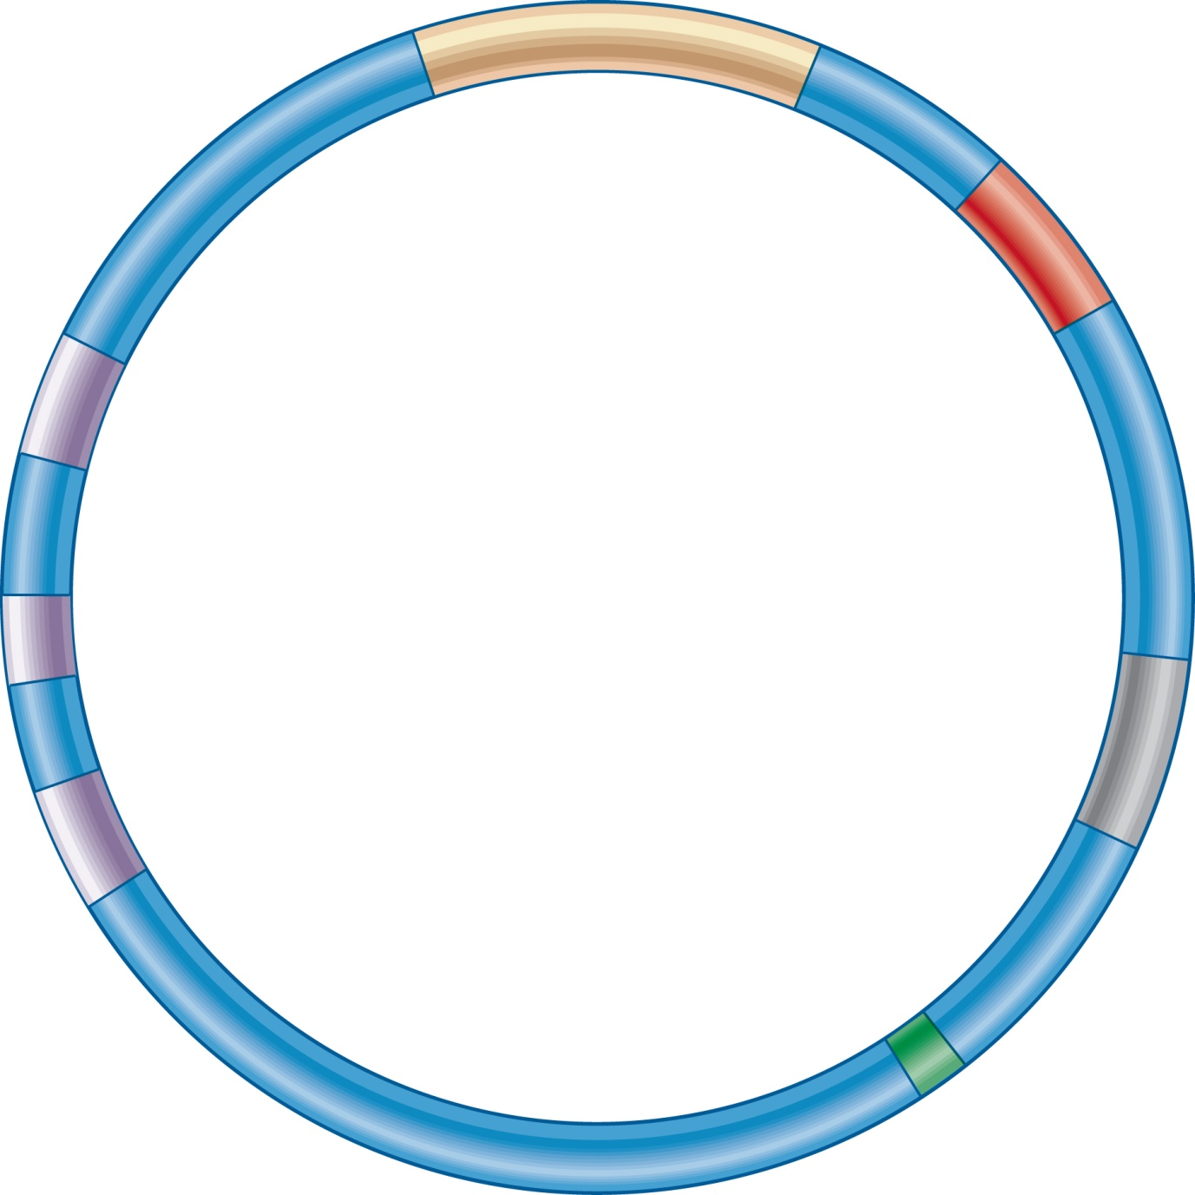
Bacterial Artificial Chromosome
Copyright © The McGraw-Hill Companies, Inc. Permission required for reproduction or display.
lacZ
cm ^{R}
HindIII BamHI SphI
parC
parB
repE
parA
oriS

Slide 24
Which clones will the green probe detect? The red probe?
C
D
E
K
L
M
A
B
C
D
F
GH
I
J
K
M
NO
P
1
3
5
7
9
Vector
B
C
D
E
F
GH
I
K
L
M
P
Q
R
2
4
6
8
1
0
Copyright ©The McGraw-Hill Companies, Inc. Permission required for reproduction or display

Slide 25
Which clones will the green probe detect? The red probe?
C
D
E
K
L
M
A
B
C
D
F
GH
I
J
K
M
NO
P
1
3
5
7
9
Vector
B
C
D
E
F
GH
I
K
L
M
P
Q
R
2
4
6
8
1
0
Copyright ©The McGraw-Hill Companies, Inc. Permission required for reproduction or display

Slide 26
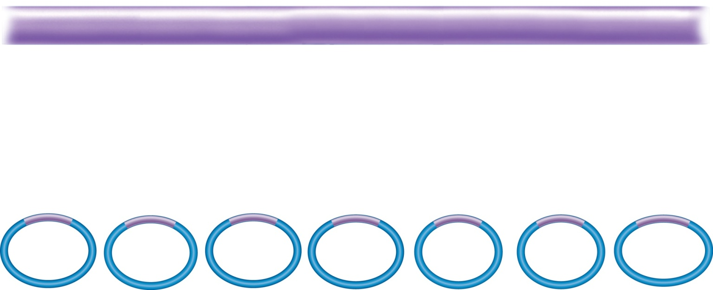
Linking the genetic map to physical map
Region of chromosome 11
Gene A
Gene B
1.5 mu
Gene A
Gene B
1
2
3
4
5
6
7
Genes A and B mapped previously to specific regions of chromosome 11
  Gene A was found in the insert of clone #2
  Gene B was found in the insert of clone #7
So Genes A and B can be used as reference points to align the members of the contig
Figure 21.8
Copyright ©The McGraw-Hill Companies, Inc. Permission required for reproduction or display

Slide 27
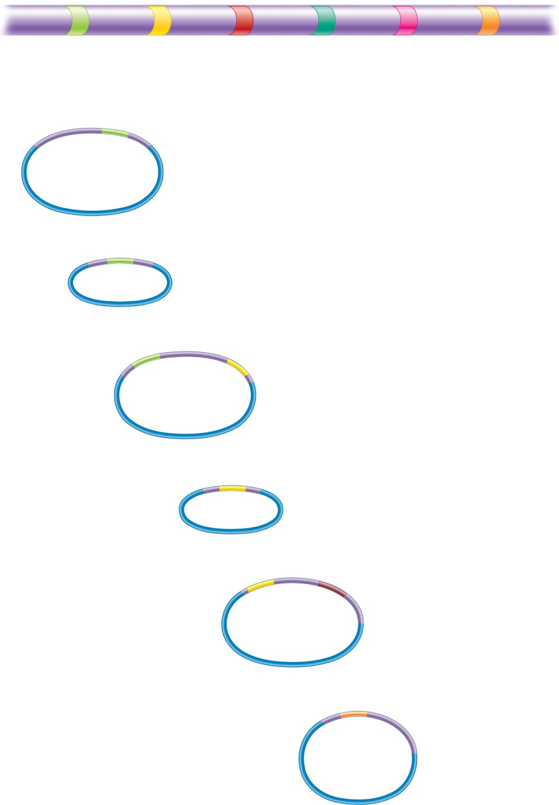
Gene B
Gene A
1
2
3
4
5
.
.
.
.
n
Numbers indicate
regions that are
subcloned.
Gene B
(Starting clone)
Cosmid
vector
The number of steps required to reach the gene of interest depends on the distance between the start and end points
Subclone*. (with radiolabeled nucleotides)
Screen a library.
1
2
(Second clone)
Subclone*.
2
Screen a library.
2
3
(Third clone)
Repeat subcloning and
screening until gene A
is reached.
n
Gene A
Figure 20.18
Copyright © The McGraw-Hill Companies, Inc. Permission required for reproduction or display.

Slide 28
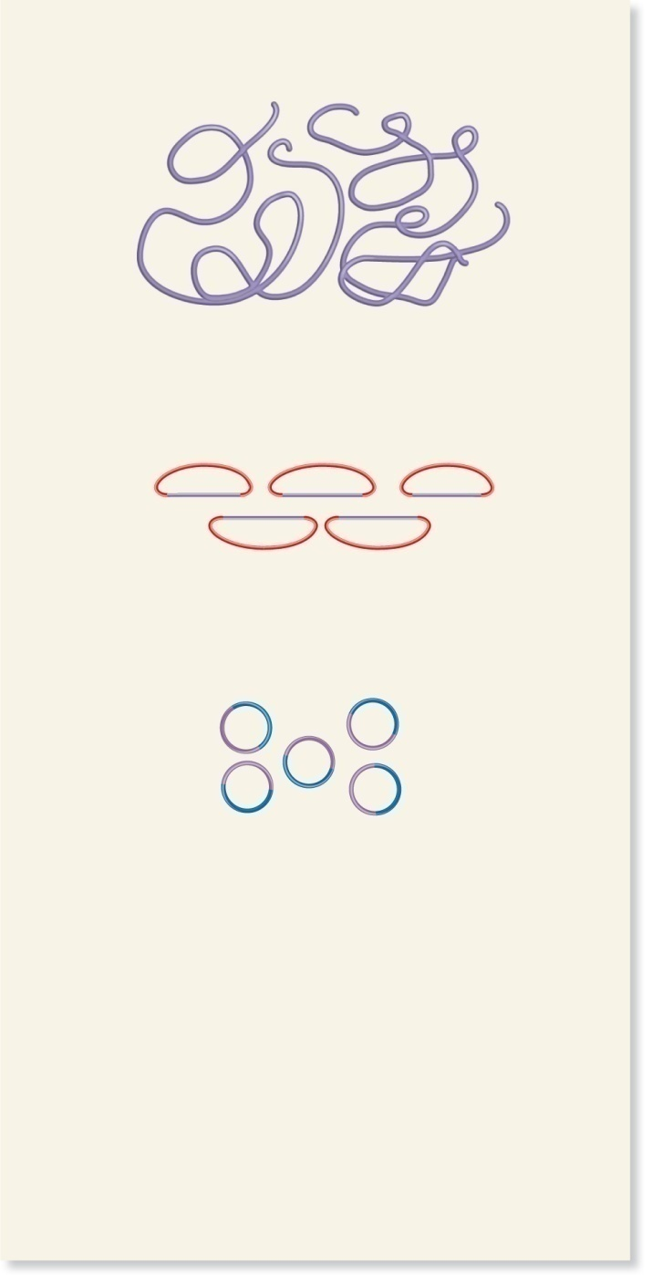
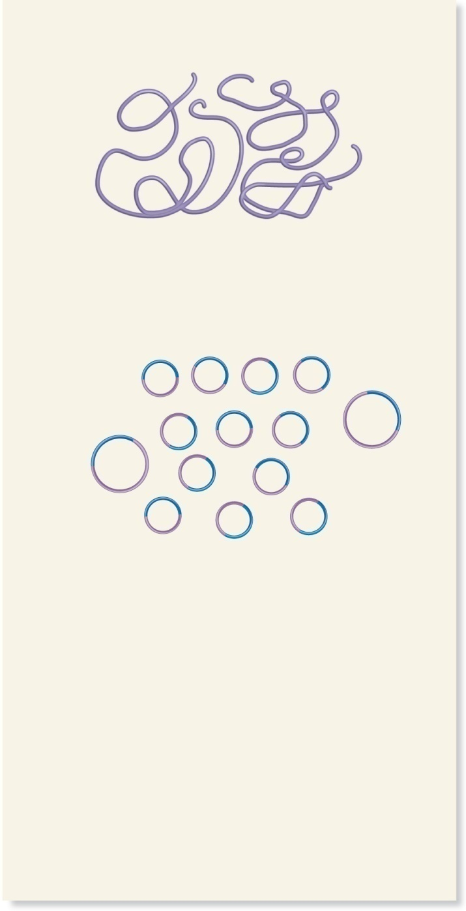
Isolate
chromosomal
DNA
Isolate
chromosomal
DNA
Clone large chromosomal
DNA fragments into BACs and
create a contig for each
chromosome.
Shear DNA into small and
large pieces. Clone
chromosomal DNA pieces
into vectors.
BAC
vector
BAC contig
Vector
Chromosomal
DNA
Chromosomal
DNA
For each BAC, shear into
smaller pieces and clone DNA
pieces into vectors.
Vector
Clones from
one BAC insert:
Chromosomal
DNA
From the clones of each BAC,
determine the chromosomal
DNA sequence, usually at
one end, by shotgun
sequencing. The results
below show the sequences
from three chromosomal DNA
clones.
Determine the chromosomal
DNA sequence, usually at
both ends, by shotgun
sequencing. The results
below show sequences of
three chromosomal DNA
clones.
C
C
G
A
C
C
T
T
A
C
C
G
A
C
C
A
T
T
A
C
C
G
G
T
A
G
G
C
A
C
C
T
G
A
C
C
A
C
C
C
G
A
T
T
A
A
T
C
A
C
C
T
G
T
T
A
C
G
G
G
T
C
T
T
A
A
T
C
G
C
G
A
A
T
T
G
G
G
G
T
C
A
A
A
C
C
T
A
G
G
Based on overlapping
regions, create one
contiguous sequence.
Based on overlapping
regions, create one
contiguous sequence.
C
C
G
A
C
C
T
T
A
C
C
G
A
C
C
A
C
C
C
G
A
T
T
A
A
T
C
G
C
G
A
A
T
T
G
T
T
A
C
C
G
G
T
A
G
G
C
A
C
C
T
G
T
T
A
C
G
G
G
T
C
A
A
A
C
C
T
A
G
G
(a) Hierarchical genome shotgun sequencing
(b) Whole-genome shotgun sequencing
Brooker, Fig 21.14

Slide 29


Slide 30
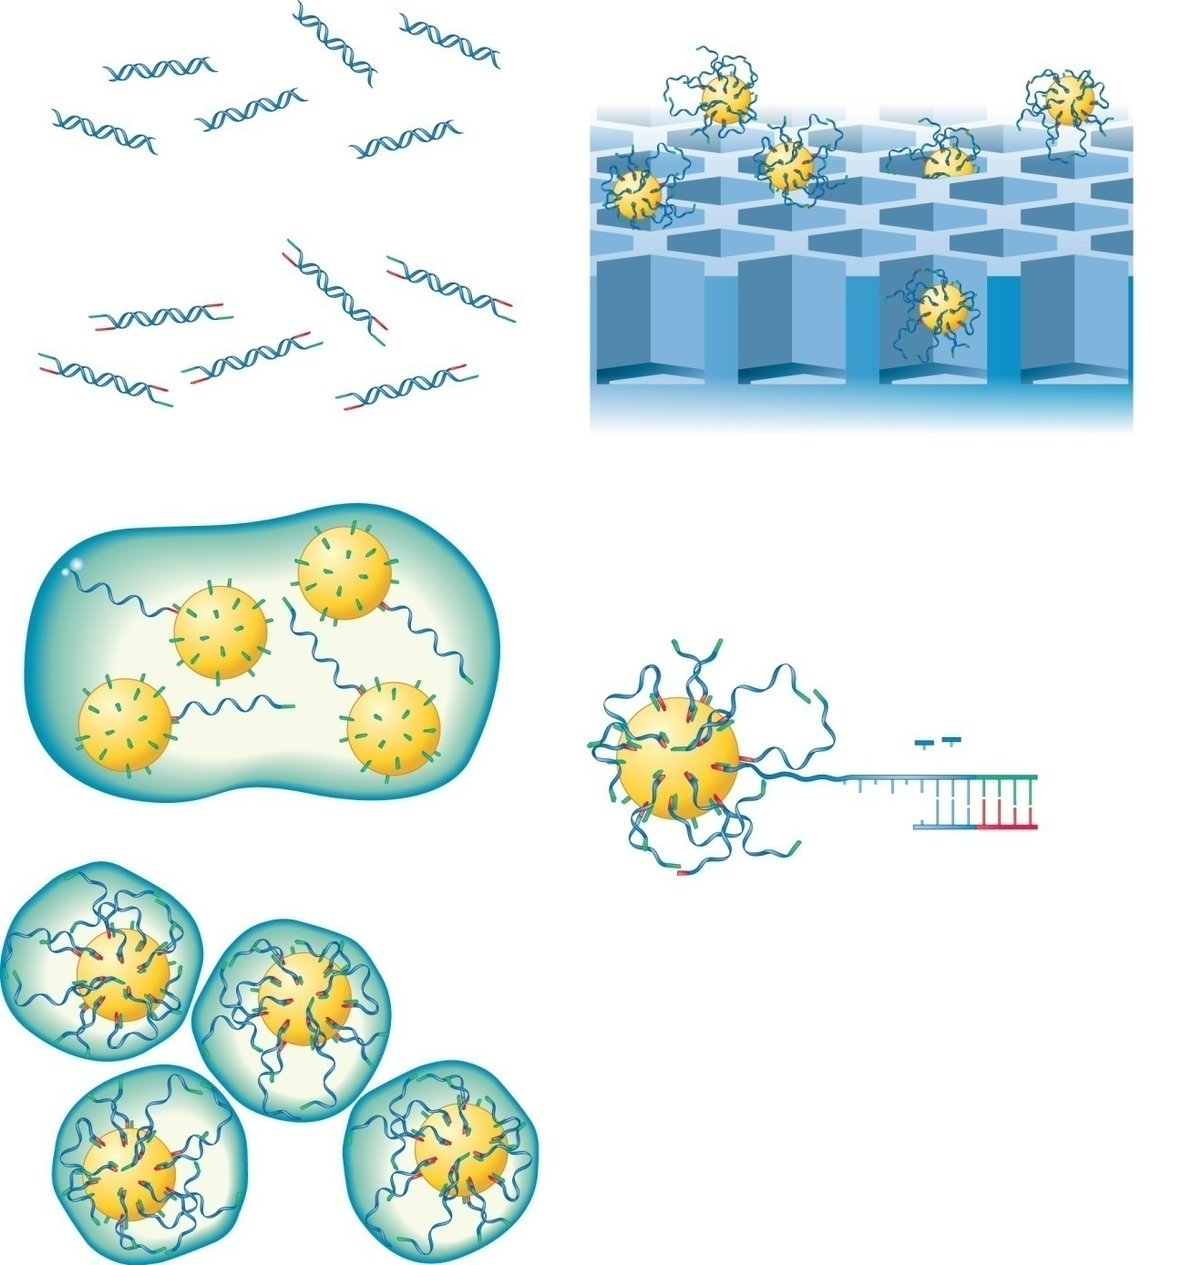
Isolate genomic DNA
and break into fragments.
Deposit the beads into a picotiter
plate. Only one bead can fit into
each well.
Fragment of
genomic DNA
Covalently attach oligonucleotide
adaptors to the 5′ and 3′ ends of
the DNA.
Adaptors
Denature the DNA into single strands and attach to beads via the adaptors. Note: Only one DNA
strand is attached to a bead.
Add sequencing reagents: DNA polymerase, primers, ATP sulfurylase, luciferase, apyrase, adenosine 5′ phosphosulfate, and luciferin.
Sequentially flow solutions containing A, T, G, or C into the wells. In the example below, T
has been added to the wells.
PPi (pyrophosphate) is released
when T is incorporated into the
growing strand.
T
T
C
A
T
G
C
A
Primer
PPi
+
Adenosine 5′
phosphosulfate
ATP sulfurylase
ATP + luciferin
Luciferase
Emulsify the beads so there is only
one bead per droplet. The droplets
also contain PCR reagents that
amplify the DNA.
Light
Light is detected by a camera
in the sequencing machine.
Brooker, Fig 21.15
Copyright © The McGraw-Hill Companies, Inc. Permission required for reproduction or display.

Slide 31
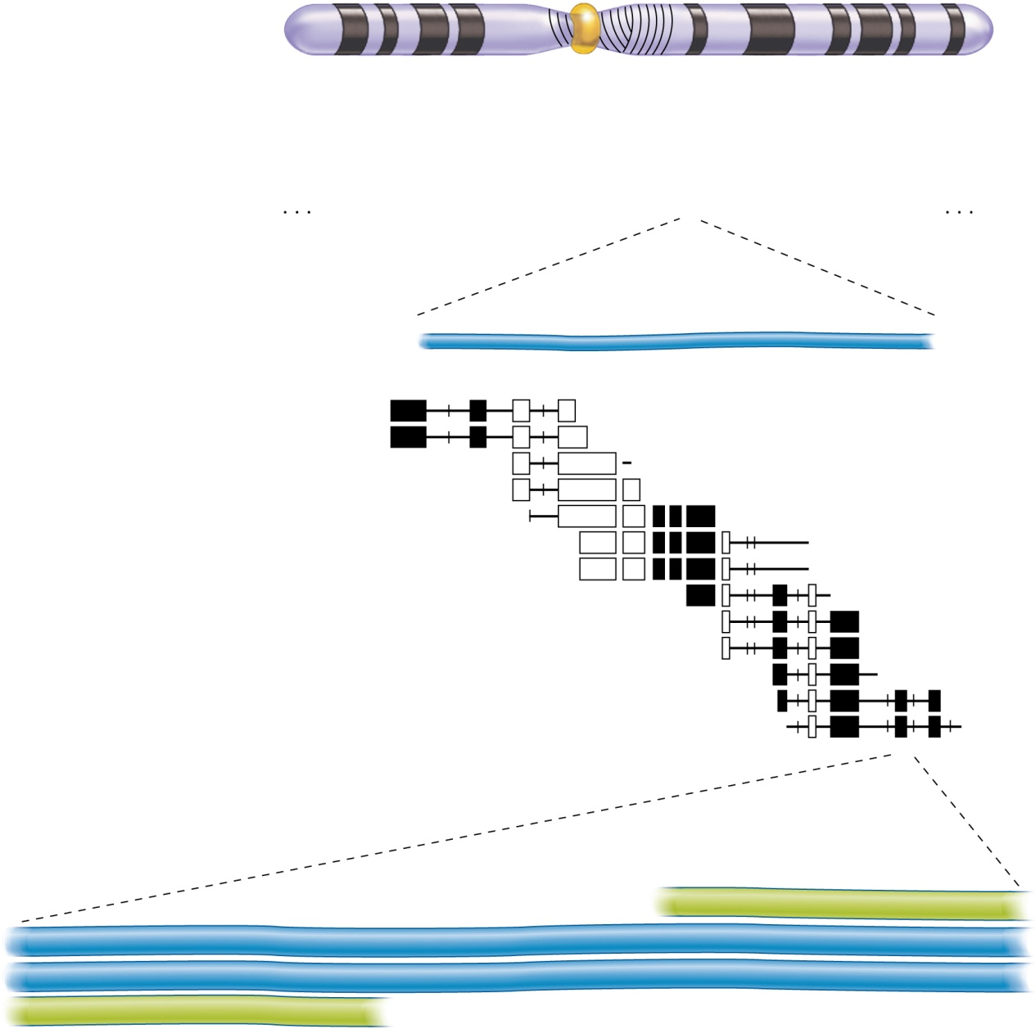
Linking all the maps
Chromosome 16
95 million bp
Cytogenetic map
(resolution of in situ
hybridization 3–5
megabases)
p
q
Low resolution
(3–5 million bp)
*
13.2
13.2
12.3
12.2
12.1
11.2
11.1
11.2
12.1
12.2
13.0
21.0
22.1
22.2
22.3
23.1
23.2
13.12
23.3
24.1
24.2
24.3
13.13
13.11
Linkage map
(resolution 3–5 cM;
not all linkage
markers are shown)
D16S159
D16AC6.5
D16S150
D16S85
D16S60
D16S48
D16S149
D16S160
D16S40
D16S144
*
500 times expansion
YAC N16Y1
150,000 bp
*
310C4
= (GT)_{n}
Physical map of
overlapping cosmid
clones (resolution
5–10 kilobases)
N16Y1-29
N16Y1-18
N16Y1-13
N16Y1-14
N16Y1-12
N16Y1-16
N16Y1-30
Cosmid
contig 211
5F3
312F1
309G11
High resolution
(1–100,000 bp)
N16Y1-19
N16Y1-10
*
STS N16Y1-10
Primer
3′
AGTCAAACGTTTCCGGCCTA
5′
5′
GATCAAGGCGTTACATGA
TCAGTTTGCAAAGGCCGGAT
3′
Sequence-tagged site
(resolution 1 base)
3′
CTAGTTCCGCAATGTACT
AGTCAAACGTTTCCGGCCTA
5′
5′
—
GATCAAGGCGTTACATGA
—
3′
Primer
219 bp
Brooker, Fig 21.11
Copyright © The McGraw-Hill Companies, Inc. Permission required for reproduction or display.

