Slide 1
Genetic Mapping--Outline/Study Guide
Broad course objectives-students should be able to:
Compare the effect of linkage and independent assortment on genetic variation and assess if genes are linked or on separate chromosomes
Explain how crossing over produces recombination and use recombination frequencies to construct a map of linked genes
Inheritance of genes that are on different chromosomes vs. close together on the same chromosome
When genes are closely linked on the same chromosome, how does this affect their segregation pattern?
How does recombination affect this segregation?
How can you tell whether the genes are segregating independently (unlinked) or with one another (linked)?
How can you use chi-square goodness of fit analysis to support a hypothesis of linkage vs. no linkage?

Slide 2
Genetic Mapping Outline/Study Guide, cont.
Gene Map Distances
How are genetic map distances between linked genes determined? (How do you determine mu?)
Given a particular map distance between two genes, what percentage of gametes are expected to be in the original configuration? In the recombinant configuration?
Given a particular map distance between genes, how would you predict the probability of getting specific progeny from parents of a specific genotype?
Determining gene order of three linked genes
How do you perform 2-point mapping and 3-point mapping?
How does one determine in cis and in trans configuration?
During 3-point mapping, why are the double-cross over events included during the calculation of each map distance?
[if covered in lecture] What is “Interference” and “coefficient of coincidence” in recombination?

Slide 3
Exceptions to Idealized Mendelian Ratios
Linkage
Lethality
Age of onset
Environment
Penetrance
Expressivity
Incomplete Dominance
Co-dominance
Epistasis and Gene Interaction

Slide 4
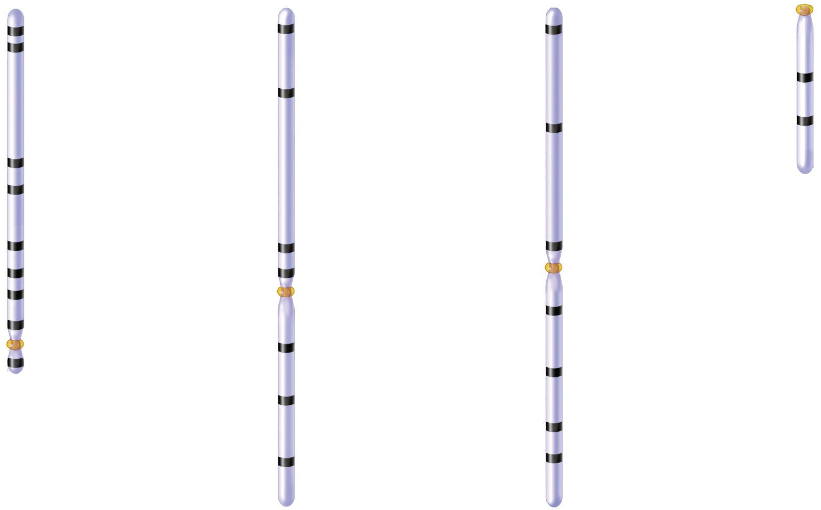
Linkage groups in Drosophila identify genes on the same chromosome
Yellow
body, y
0.0
0.0
Aristaless,
al
0.0
Roughoid
eyes, ru
1.5
White
eyes, w
13.0
Dumpy
wings, dp
1.4
Bent
wings, bt
26.0
Sepia
eyes, se
3.0
Shaven
bristles, sv
Vermilion
eyes, v
33.0
36.1
Miniature
wings, m
Rudimentary
54.5
wings, r
Bar
48.5
Black
body, b
44.0
Scarlet
eyes, st
57.0
eyes, B
Carnation
54.5
Purple
eyes, pr
Copyright © The McGraw-Hill Companies, Inc. Permission required for reproduction or display.
62.5
eyes, car
Bobbed
bristles, bb
58.5
Short
bristles, s
66.0
68.1
Little
fly, lf
67.0
Vestigial
wings, vg
Ebony
body, e
70.7
75.5
Curved
wings, c
Rough
eyes, ro
91.1
104.5
Brown
eyes, bw
100.7
Claret
eyes, ca
1 (X)
2
3
4
Brooker, Fig 7.7

Slide 5
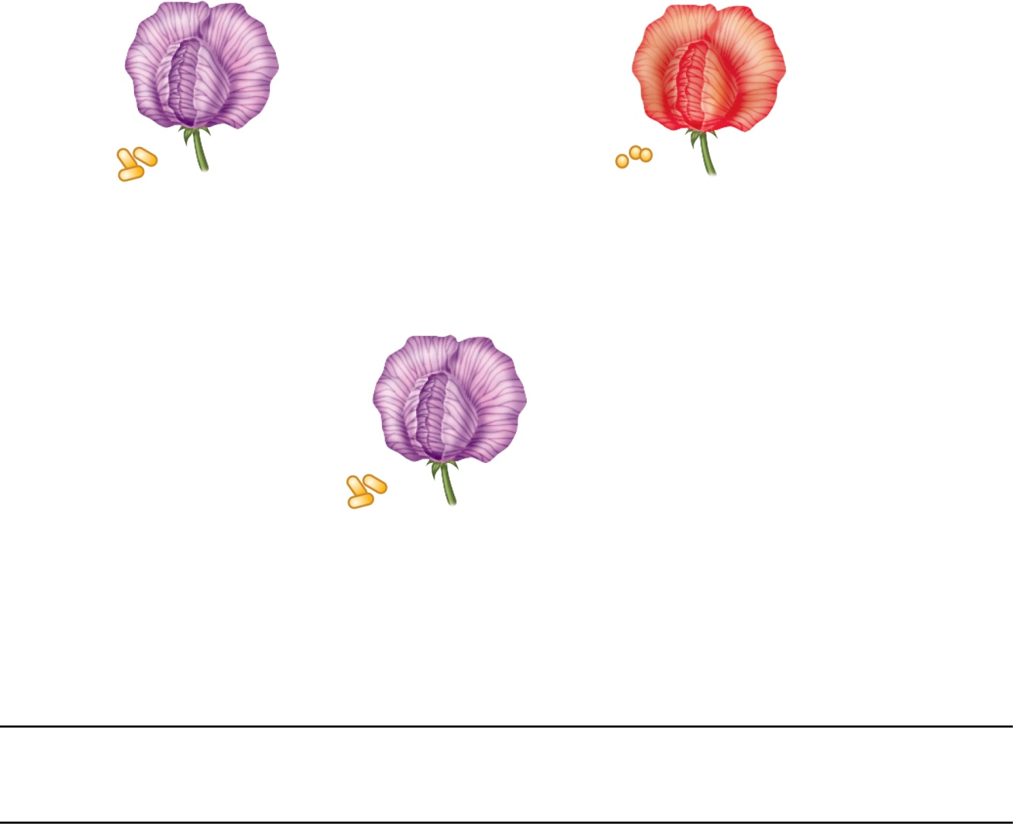
When genes are linked, the two traits do NOT segregate independently
P₀
x
Purple flowers,
long pollen (PPLL)
Red flowers,
round pollen (ppll )
F₁
Copyright © The McGraw-Hill Companies, Inc. Permission required for reproduction or display.
Much greater proportion of the parental types than recombinant types
Purple flowers,
long pollen (PpLl )
Self-fertilization
Observed
number
Expected
Under indep.
assort
F₂
Ratio
Ratio
Purple flowers, long pollen
296
15.6
240
9
Purple flowers, round pollen
19
1.0
80
3
Red flowers, long pollen
27
1.4
80
3
Brooker Figure 7.1
Red flowers, round pollen
85
4.5
27
1

Slide 6
Idealized Mendelian ratios (independent assortment):
(Dihybrid cross) RrYy x RrYy → 9:3:3:1
(Test cross) RrYy x rryy → 1:1:1:1
These idealized ratios occur when alleles of the two genes don’t “care” about one another (don’t segregate together)
“Linkage” is one of the exceptions to the idealized ratio

Slide 7
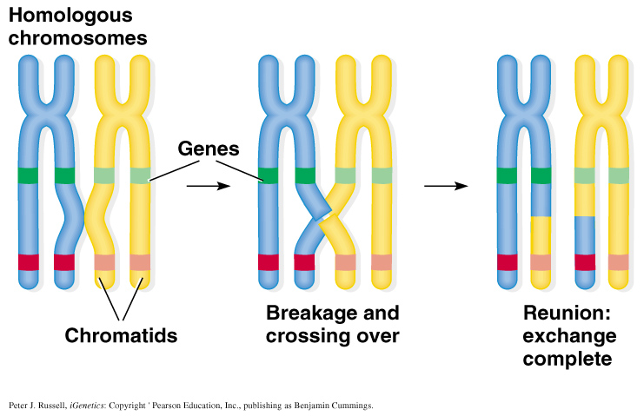
Mechanism of crossing-over
Peter J. Russell, iGenetics: Copyright © Pearson Education, Inc., publishing as Benjamin Cummings.

Slide 8
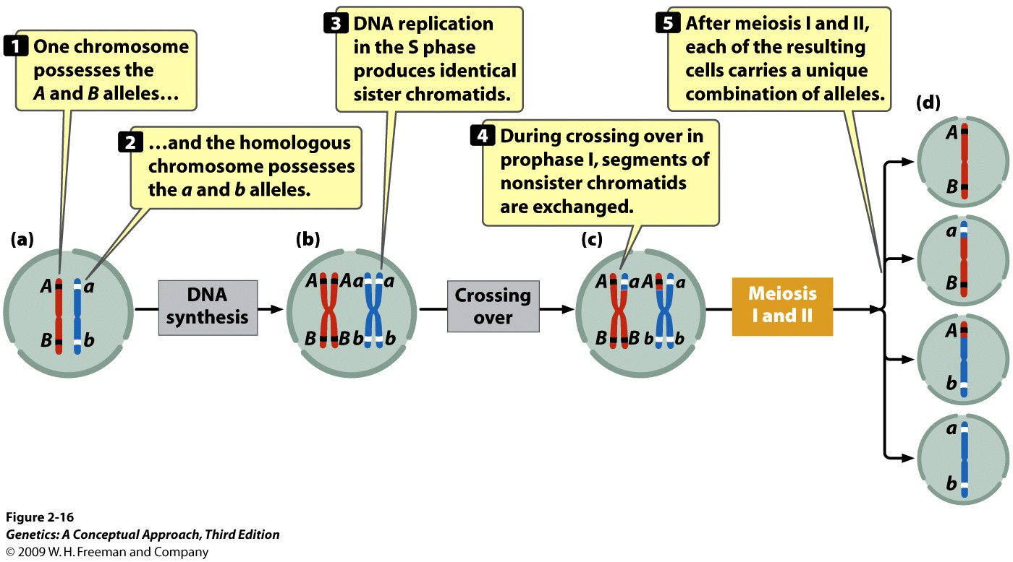
Recombination events are a rare event between linked genes
Dominant
Parental
C’some
(many)
recessive
Recombinant C’some
(few)
Recombinant
C’some
(few)
Parental
C’some
(many)
Notes:
2.16 Crossing over produces genetic variation.

Slide 9
The difference between linkage and no linkage
P₀
RRYY
ssyy
rryy
SY
sy
Test cross
F₁
RrYy
x
SsYy
rryy
R
R
R
r
R
r
y
R
r
Y
y
Y
y
Y
Y
y
F2 progeny |  | Complete linkage (0% recomb) | Incomplete linkage (X% recomb) | No linkage (Indep. Assortment)
round | yellow | 1 | many | 1
round | green | 0 | few | 1
wrinkled | yellow | 0 | few | 1
wrinkled | green | 1 | many | 1

Slide 10
The difference between linkage and no linkage
P₀
RRYY
ssyy
rryy
SY
sy
Test cross
F₁
RrYy
x
SsYy
rryy
R
R
R
r
R
r
y
R
r
Y
y
Y
y
Y
Y
y
F2 progeny |  | Complete linkage (0% recomb) | Incomplete linkage (X% recomb) | No linkage (indep. Assortment)
round | yellow | 1 | many | 1
round | green | 0 | few | 1
wrinkled | yellow | 0 | few | 1
wrinkled | green | 1 | many | 1

Slide 11
Incomplete linkage gives us useful map distance information
Test cross
RrYy
x
SsYy
rryy
R
R
R
r
R
r
y
R
r
Y
y
Y
y
Y
Y
y
F2 progeny |  | Complete linkage | Incomplete linkage | No linkage (indep. Assortment)
round | yellow | 502 | 421 | 247
round | green | 0 | 78 | 252
wrinkled | yellow | 0 | 73 | 248
wrinkled | green | 408 | 428 | 253
(0 map units)
15.1 % recombinants (15 map units)
(“50” map units)

Slide 12
# recombinant progeny__
# total progeny
Recombination frequency
=
(can be expressed as a % or a decimal)

Slide 13
Map distances
1% recombination = map unit (mu) or 1 cM (centimorgan)
e.g. 12% recombination = 12 mu or 12 cM
Recombination frequency < 50% →“linked”.
50% > Recombination frequencies → “unlinked”
(‘co-segregate’ as if they were on different chromosomes)
Recombination frequency = 0% recombination →“completely linked”
Typical chromosome: 200 mu
Typical gene = .01 mu or 60,000 nucleotides

Slide 14
2-pt cross Example 1
In snapdragons, smooth is dominant to rough, and yellow is dominant to green. A smooth, yellow individual is crossed to a rough green individual, and the following cross-progeny are obtained:
195 smooth yellow
21 smooth green
19 rough yellow
165 rough green
Are the loci linked? If linked, what are the genotypes and chromosomal configurations in the parents?
What is the map distance between the two loci?
Notes:
Two-gene problem where loci are linked. In cis configuration.

Slide 15
2-pt cross Example 2
In guinea pigs, white coat (w) is recessive to black coat (W), and wavy hair (v) is recessive to straight hair (V). A breeder crosses a guinea pig that is homozygous for white coat and wavy hair with a guinea pig that is homozygous for black straight hair. The F1 are then crossed with guinea pigs having white coats and wavy hair in a series of testcrosses. The following progeny are produced from these testcrosses:
black, straight 30
black, wavy 11
white, straight 12
white, wavy 31
total 84
a.) Are the genes that determine coat color and hair type assorting independently? Carry out chi-square tests to test this hypothesis.
b.) If the genes are not assorting independently, what is the recombination frequency between them?
Notes:
Two genes linked, in cis configuration.

Slide 16
In corn, purple kernels are dominant over yellow kernels, and full kernels are dominant over shrunken kernels. A corn plant having purple and full kernels is crossed with a plant having yellow and shrunken kernels, and the following progeny are obtained:
purple, full 112
purple, shrunken 103
yellow, full 91
yellow, shrunken 94
What are the most likely genotypes of the parents and progeny? Test your genetic hypothesis with a chi-square test (H₀ = independent assortment; H₁ = linkage)
If the genes are not assorting independently, what is the recombination frequency between them?
For chi-square tests of linkage, we can only directly test “no linkage” (indep assortment. We cannot directly test for “linkage” with chi-square analysis (too many different possible map distances to test).

Slide 17
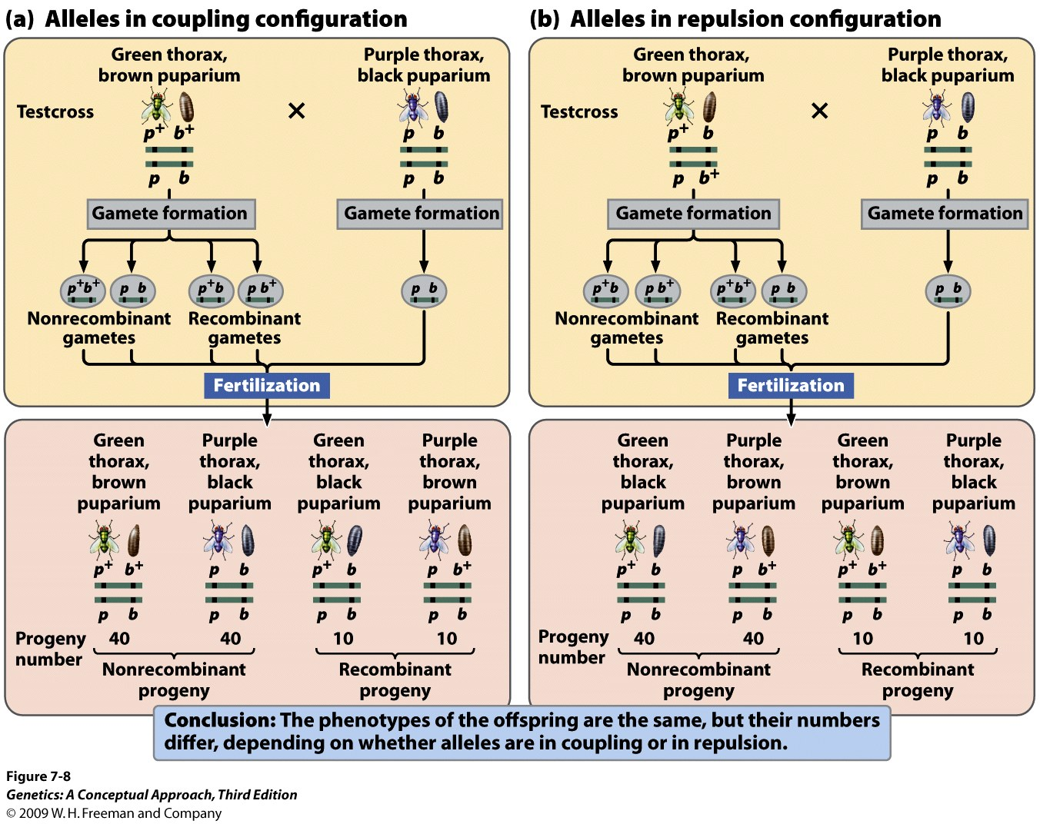
(Don’t assume that dominant A is always linked with dominant B,
and recessive a is linked with recessive b.)
What are the most frequent phenotypes you expect from each cross?
Notes:
7.8 The arrangement (coupling or repulsion) of linked genes on a chromosome affects the results of a testcross. Linked loci in the Australian blowfly, Lucilia cuprina, determine the color of the thorax and that of the puparium.

Slide 18
Notes:
7.8 The arrangement (coupling or repulsion) of linked genes on a chromosome affects the results of a testcross. Linked loci in the Australian blowfly, Lucilia cuprina, determine the color of the thorax and that of the puparium.

Slide 19
In corn, the allele for colored (C) seeds is completely dominant to the allele for colorless (c) seeds. And in another gene controlling for seed tissue, the allele for full seeds (F) is dominant to shrunken (f). A true-breeding colored shrunken-seeded plant was crossed with a true-breeding colorless, full-seeded plant. The F1 colored-full plants were test crossed to the doubly recessive type (colorless, shrunken). The F2 progeny are as follows:
Colored, full 1841
Colored, shrunken 2286
Colorless full 2436
Colorless shrunken 1805
Total 8,368
Are the genes linked?
What is the map distance?
C’some configuration of F1 heterozygote?
Notes:
Two genes linked. In trans configuration. MU = 43. Chi square value = 1444. P <<<.005. Reject hypothesis of no linkage.

Slide 20
In corn, the allele for colored (C) seeds is completely dominant to the allele for colorless (c) seeds. And in another gene controlling for seed tissue, the allele for full seeds (F) is dominant to shrunken (f). A true-breeding colored full-seeded plant was crossed with a colorless, shrunken-seeded one. The F1 colored-full plants were test crossed to the doubly recessive type (colorless, shrunken). The F2 progeny are as follows:
Colored, full 4,032
Colored, shrunken 149
Colorless full 152
Colorless shrunken 4,032
Total 8,368
Are the genes linked?
What is the map distance?
C’some configuration of F1 heterozygote?
Notes:
Two genes linked. In cis configuration

Slide 21
Which is the correct use of chi-square test in determining linkage?
a. 0.05 > p, reject hypothesis of Independent Assortment
b. 0.05 > p, support hypothesis of Independent Assortment
c. 0.05 > p, reject hypothesis of Linkage
d. p > 0.05, support hypothesis of Linkage

Slide 22
In tomatoes, tall (D) is dominant over dwarf (d), and smooth fruit (P) is dominant over pubescent fruit (p) (covered with fine hairs). A farmer has two tall and smooth plants, Plant A and Plant B. He crosses these plants with the same dwarf and pubescent plant, and obtains the following numbers of progeny:
 | Progeny of Plant A | Progeny of Plant B
Dd Pp | 122 | 2
Dd pp | 6 | 82
dd Pp | 4 | 82
dd pp | 124 | 4
What are the genotypes of plant A and plant B?
Are the loci linked? What is the mu?
Explain why different proportions of progeny are produced when plant A and plant B are crossed with the same dwarf pubescent plant.

Slide 23
What are the genotypes of plant A and plant B? Plant A: DP/dp Plant B: Dp/dP
Are the loci linked? Yes. What is the mu?
Data from Plant A: 3.9 mu
Data from Plant B: 3.5 mu
Combined data: 3.75% (16 recomb. Out of 426 total progeny)
Explain why different proportions of progeny are produced when plant A and plant B are crossed with the same dwarf pubescent plant.
Plant A is in cis for its alleles, while Plant B is in trans.

Slide 24
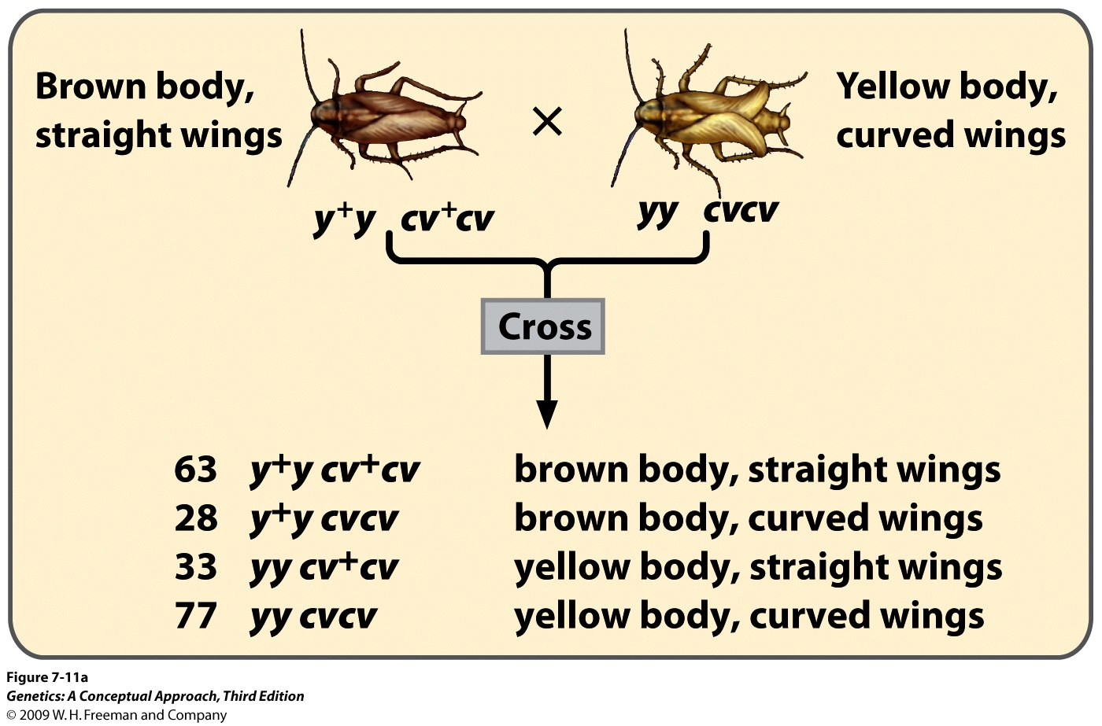
Is the heterozygous parent in cis or in trans?
Notes:
7.11a A chi-square test of independence can be used to determine if genes at two loci are assorting independently.

Slide 25
Is the heterozygous parent in cis or in trans?
Notes:
7.11a A chi-square test of independence can be used to determine if genes at two loci are assorting independently.

Slide 26
A cross between individuals with genotypes a⁺ a b⁺b X aa bb produces the following progeny:
a⁺ a b⁺b 21
a⁺ a bb 83
aa b⁺b 77
aa bb 19
a.) Does the evidence indicate that the a and b loci are linked?
b.) What is the map distance between a and b?
c.) Are the alleles in the heterozygous parent in coupling configuration or repulsion? How do you know?

Slide 27
a.) Does the evidence indicate that the a and b loci are linked? yes
b.) What is the map distance between a and b? 20 mu
c.) Are the alleles in the heterozygous parent in coupling configuration or repulsion? In repulsion (in trans)
How do you know? The class of progeny with the highest frequency represents the non-recombinant chromosome configuration of the heterozygous parent. These progeny are a⁺a bb (83) and aa b⁺b (77)

Slide 28
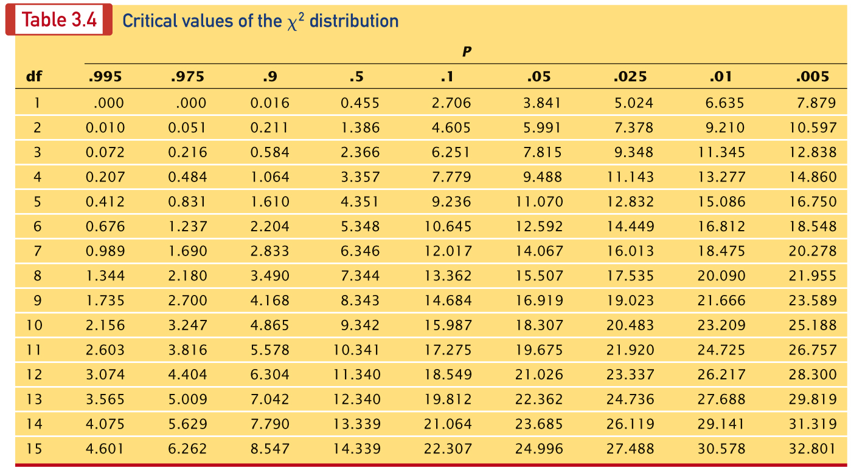

Slide 29
Genes a and b are on one chromosome, 15 mu apart. Cross a homozygous A B individual with an a b one, and cross the F1 back to an a b individual. What are the chances of getting individuals of the following phenotypes in the progeny?
A B
a b
A b
a B
Answers given in class

Slide 30
Genes a and b are on one chromosome, 15 mu apart; c and d are on another chromosome, 20 mu apart. Genes e and f are on yet another chromosome and are 10 mu apart. Cross a homozygous A B C D E F individual with an a b c d e f one, and cross the F1 back to an a b c d e f individual. What are the chances of getting individuals of the following phenotypes in the progeny?
A B; C D; E F
a b; c D; E F
A b; c D; e f
A B; C D; e f
a b; C d; e F
Answers given in class

Slide 31
Genes a and b are on one chromosome, 15 mu apart; c and d are on another chromosome, 20 mu apart. Genes e and f are on yet another chromosome and are 10 mu apart. Cross a homozygous A B C D E F individual with an a b c d e f one, and cross the F1 back to an a b c d e f individual. What are the chances of getting individuals of the following phenotypes in the progeny?
A B; C D ; E F
a b ; c D ; E F
A b ; c D ; e f
Answers given in class

Slide 32
Exercise in determining linkage groups
A series of two-point crosses entailed seven loci (a, b, c, d, e, f, and g), producing the following recombination frequencies. Using these recombination frequencies, map the seven loci, showing their linkage groups and the order and distances between the loci of each linkage group:
On lab packet

Slide 33
Loci Rec. freq (%) Loci Rec. freq
a and b 10 c and d 50%
a and c 50 c and e 8
a and d 14 c and f 50
a and e 50 c and g 12
a and f 50 d and e 50
a and g 50 d and f 50
b and c 50 d and g 50
b and d 4 e and f 50
b and e 50 e and g 18
b and f 50 f and g 50
b and g 50
On lab packet

Slide 34
Genetic Mapping: practice questions
The following comprehension questions (at end of each chapter section) in Brooker, Concepts of Genetics are recommended:
Comprehension Questions (at end of each section): 7.1, 7.2, 7.3 (I especially like #2 in section 7.3) Answers to Comprehension Questions are at the very end of every chapter.
Solved Problems at end of chapter (answers included): S1, S2, S3,
Conceptual questions and Experimental/Application Questions at end of chapter (answers found by logging into publisher’s website, or find them in the book):
Concepts—C1, C2, C4, C9, C10, E10, E11, E12, E13, E14, E15, E19, E20, E21,
A little more challenging—C8, C11, E1, E3, E4, E5, E6, E7, E16, E17, E22,

Slide 35
Go over lecture outline at end of lecture

