Slide 1
Three-point crosses (course objectives included in slide set for Two-point crosses)

Slide 2
2 pt crosses to set up three point crosses
In squash, smooth (S) is dominant to wrinkled (s), and Yellow (Y) is dominant to green (y). An individual who is heterozygous for smooth and yellow is crossed with a wrinkled green individual. The following progeny are found in the next generation:
195 smooth yellow
21 smooth green
19 wrinkled yellow
165 wrinkled green
What is the map distance between the smooth gene and the color gene?

Slide 3
2 pt crosses to set up three point crosses, cont.
In squash, smooth (S) is dominant to wrinkled (s), and bowl shaped (B) is dominant to disk shaped (b). An individual who is heterozygous for smooth and bowl is crossed with a wrinkled disk individual. The following progeny are found in the next generation:
190 smooth bowl
2 smooth disk
2 wrinkled bowl
206 wrinkled disk
What is the 2-pt map distance between the smooth gene and the shape gene?

Slide 4
3 pt crosses to determine gene order
In squash, smooth (S⁺) is dominant to wrinkled (s), Yellow (Y⁺) is dominant to green (y), and bowl shaped (B⁺) is dominant to disk shaped (b).
An individual who is heterozygous smooth, yellow, and bowl is crossed with a wrinkled, green, disk individual. The following progeny are found in the next generation:
1785 smooth yellow bowl
1750 wrinkled green disk
2 smooth yellow disk
1 wrinkled green bowl
204 smooth green bowl
221 wrinkled yellow disk
20 smooth green disk
23 wrinkled yellow bowl
What is the gene order and 3-pt map distance between the three genes?

Slide 5
Won’t another 2-pt cross between B and Y genes tell us the gene order?
Not really. Although we may get data that is consistent with a particular gene order (e.g. B is 9 mu or 11 mu away from Y), it is hard to get sufficient data to prove gene order (“statistically significant”)
The double-crossover in the 3-pt cross proves gene order beyond the shadow of a doubt.

Slide 6
Side 1
Tall Pigment Handsome
T = tall D = dark H = handsome
t = short d = pale h = homely
P0 (father) tall dark handsome x (mother) short pale homely
F1 | Observe |  | Phenotype | C'some class | Sperm c'some | Egg chromosome
 | 456 |  | tall dark handsome
 | 489 |  | short pale homely
 | 27 |  | tall pale handsome
 | 25 |  | short dark homely
 | 109 |  | tall dark homely
 | 121 |  | short pale handsome
 | 2 |  | tall pale homely
 | 3 |  | short dark handsome
 | 1232

Slide 7
Tall Pigment Handsome
T = tall D = dark H = handsome
t = short d = pale h = homely
P0 (father) tall dark handsome x (mother) short pale homely
Side 1
Rewrite chromosome in correct order once you know it (important for not making mistakes!)
F1 | Observe |  |  | C'some class | Father's c'some | Mother's chromosome
 | 456 |  | tall dark handsome | Parental | TDH→DTH | tdh→dth
 | 489 |  | short pale homely | Parental | tdh-->dth | tdh→dth
 | 27 |  | tall pale handsome | SCO short | TdH→dTH | tdh→dth
 | 25 |  | short dark homely | SCO short | tDh→Dth | tdh→dth
 | 109 |  | tall dark homely | SCO long | TDh→DTh | tdh→dth
 | 121 |  | short pale handsome | SCO long | tdH→dtH | tdh→dth
 | 2 |  | tall pale homely | DCO | Tdh→dTh | tdh→dth
 | 3 |  | short dark handsome | DCO | tDH→DtH | tdh→dth
 | 1232
D------4.6 mu--------T---------------19.1 mu------------H

Slide 8
Coefficient of Coincidence
Interference

Slide 9
Side 2
Tall Pigment Handsome
T = tall D = dark H = handsome
t = short d = pale h = homely
P0
(father) tall dark handsome x (mother) short pale homely
F1 | Observe |  | Phenotype | C'some class | Sperm c'some | Egg chromosome
 | 447 |  | tall pale handsome
 | 453 |  | short dark homely
 | 75 |  | tall dark handsome
 | 78 |  | short pale homely
 | 5 |  | tall pale homely
 | 3 |  | short dark handsome
 | 35 |  | tall dark homely
 | 37 |  | short pale handsome
 | 1133

Slide 10
Tall Pigment Handsome
T = tall D = dark H = handsome
t = short d = pale h = homely
P0
(father) tall dark handsome x (mother) short pale homely
Side 2
 | Observe |  | Phenotype | C'some class | Sperm c'some | Egg chromosome
F1 | 447 |  | tall pale handsome | parental | THd | thd
 | 453 |  | short dark homely | parental | thD | thd
 | 75 |  | tall dark handsome | SCO long | THD | thd
 | 78 |  | short pale homely | SCO long | thd | thd
 | 5 |  | tall pale homely | DCO | Thd | thd
 | 3 |  | short dark handsome | DCO | tHD | thd
 | 35 |  | tall dark homely | SCO short | ThD | thd
 | 37 |  | short pale handsome | SCO short | tHd | thd
 | 1133
Coef of Coinc: 0.704
Interference: 0.296
T------7.1 mu--------H-------------- 14.2 mu---------------D

Slide 11
Three-Point Mapping (another explanation is given in textbook)
1.) For good form, write down alleles for genes 1, 2, and 3 at top of page.
2.) Determine genotypes for heterozygous parent and cross-progeny, based on the phenotypes.
You should already know the genotype of the homozygous parent
Do the genotypes give chromosome information?
3.) Write down chromosome from homozygous test-cross parent that cross-progeny inherited. Now you are set up to determine original chromosome configuration of heterozygous parent.
4.) Determine which cross-progeny inherited parental chromosome vs. recombinant (SCO? DCO?) based on the frequency of that progeny.
5.) Determine whether heterozygous parent was in cis or in trans for all three alleles on his/her non-recombinant chromosomes (the most frequent progeny class represents the non-recombinant chromosome configuration)
6.) Determine gene order based on DCOs and non-recombinant chromosome of het parent (write out all three possible gene orders if you have to).
7.) Re-write karyotypes for the parents and progeny based on the correct gene order
8.) Identify location of recombination event in the SCO progeny (between genes 1 and 2, or genes 2 and 3?)
9.) Determine map distances between genes 1 and 2, and genes 2 and 3.

Slide 12
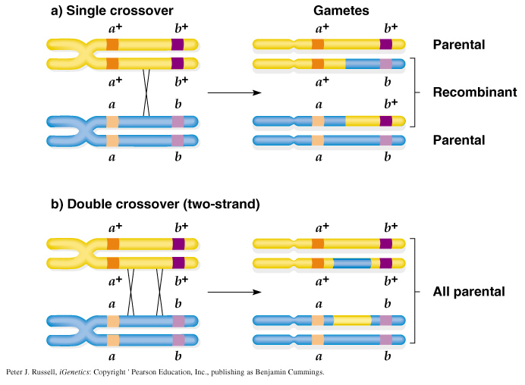
Multiple recombination events between genes may not be detected
One
Two crossovers
Peter J. Russell, iGenetics: Copyright © Pearson Education, Inc., publishing as Benjamin Cummings.

Slide 13
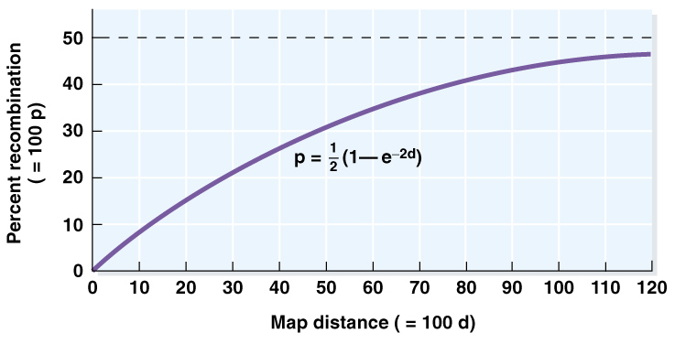
2-pt map distances decrease in accuracy as they get larger
Number of detectable recombination events does not “keep up with” the actual map distance
Mapping distances are often underestimates, esp. for larger distances

Slide 14
Phenomena that affect detectable recombination rates
Distance between two genes
The larger the distance, the more inaccurate the perceived recombination rate
We “miss” recombination events due to multiple crossovers between markers
Most accurate map distances: 0 – 7 mu
Recombination rates vary across the genome
Recombination “hotspots” and “cold spots”
Recombination events affect recombination rates in nearby areas
In 3-pt crosses, we often see fewer DCO’s than expected according to map distances calculated from 2-pt cross data→Interference and Coefficient of Coincidence

Slide 15
Go over lecture outline at end of lecture

Slide 16
In C. elegans, Rollers (Rol) are dominant to straight “skin” (r+), wildtype length (D+) is dominant to “dumpy” worms (d), and normal movement (U+) is dominant to uncoordinated (u). All three genes are on the same chromosome. The F1 of a cross between two true-breeding strains, when test-crossed, gave the following progeny:
Genes: Rol Dpy Unc
R = rol D⁺= WT U⁺= WT movement
r+ = WT d = dumpy u = uncoord
nonRol, nDpy, nUnc 27
nonRol, Dpy, nUnc 85
Rol Dpy nUnc 402
nonRol Dpy Unc 977
nonRol nDpy Unc 427
Rol nDpy Unc 95
Rol nDpy nUnc 960
Rol Dpy Unc 27
TOTAL 3,000
Parental genotypes?
Gene map?
Coefficient of coincidence and Interference?

Slide 17
In C. elegans, Rollers (Rol) are dominant to straight “skin” (r+), wildtype length (D+) is dominant to “dumpy” worms (d), and normal movement (U+) is dominant to uncoordinated (u). All three genes are on the same chromosome. The F1 of a cross between two true-breeding strains, when test-crossed, gave the following progeny:
Genes: Rol Dpy Unc
R = rol D⁺= WT U⁺= WT movement
r+ = WT d = dumpy u = uncoord
nonRol, nDpy, nUnc rr; D__;U__ 27 DCO
nonRol, Dpy, nUnc rr; dd; U__ 85 SCO sht
Rol Dpy nUnc R__; dd; U__ 402 SCO lo
nonRol Dpy Unc rr; dd; uu 977 Parent
nonRol nDpy Unc rr; D__; uu 427 SCO lo
Rol nDpy Unc R__; D__; uu 95 SCO sht
Rol nDpy nUnc R__; D__; U__ 960 Parent
Rol Dpy Unc R__; dd; uu 27 DCO
TOTAL 3,000

Slide 18
In C. elegans, Rollers (Rol) are dominant to straight “skin” (r⁺), wildtype length (D⁺) is dominant to “dumpy” worms (d), and normal movement (U⁺) is dominant to uncoordinated (u). All three genes are on the same chromosome. The F1 of a cross between two true-breeding strains, when test-crossed, gave the following progeny:
Genes: Rol Dpy Unc
R = rol D⁺= WT U⁺= WT movement
r+ = WT d = dumpy u = uncoord
Parental genotypes? F1: Rr⁺ D⁺d U⁺u x r⁺r⁺ dd uu
Gene map: D—[29.4 mu]--------R—[7.8 mu]-----U
Coefficient of coincidence: 0.785
Interference: 0.215

Slide 19
A geneticist discovers a new mutation in Drosophila that causes the flies to shake and quiver. She calls this mutation spastic (sps) and determines that spastic is due to an autosomal recessive gene. She wants to determine if the spastic gene is linked to the recessive gene for vestigial wings (vg). She crosses a fly homozygous for spastic and vestigial traits with a fly homozygous for the wild-type traits and then uses the resulting F1 females in a testcross. She obtains the following flies from this test cross:
vg+ sps+ 230
vg sps 224
vg sps+ 97
vg+ sps 99
Total 650
Are the genes linked?
What is the genetic distance?

Slide 20
A geneticist discovers a new mutation in Drosophila that causes the flies to shake and quiver. She calls this mutation spastic (sps) and determines that spastic is due to an autosomal recessive gene. She wants to determine if the spastic gene is linked to the recessive gene for vestigial wings (vg). She crosses a fly homozygous for spastic and vestigial traits with a fly homozygous for the wild-type traits and then uses the resulting F1 females in a testcross. She obtains the following flies from this test cross:
vg+ sps+ 230
vg sps 224
vg sps+ 97
vg+ sps 99
Total 650
Are the genes linked? Set up chi-square under hypothesis of non linkage: df=3, p<< 0.001 (reject hypothesis of non-linkage)
What is the genetic distance? 30 mu

Slide 21
Infomercial for Virtual Flylab 2 Handout (No more spoon-feeding. These are hard. Do them.)
In Drosophila, Dichaete (D) is a chromosome 3 mutation with a dominant effect on wing shape. It is lethal when homozygous. The genes ebony (e) and pink (p) are chromosome 3 recessive mutations affecting the body and eye color, respectively.
Flies from a Dichaete stock (assume homozygous wildtype for the other genes) were crossed to homozygous ebony, pink flies (assume homozygous wildtype for Dichaete)
The F1 progeny with a Dichaete phenotype were selected and backcrossed to the ebony, pink homozygotes. The results of this backcross were as follows (assume wildtype for the trait if the trait is not listed as a phenotype).
 |  |  |  | Karyotype
 | F2 Phenotype | Number | Genotype | Mother’s chromosome | Father’s chromosome
 | Dichaete | 401
 | Ebony, pink | 389
 | Dichaete, ebony | 84
 | Pink | 96
 | Dichaete, pink | 2
 | Ebony | 3
 | Dichaete, ebony, pink | 12
 | Wild type | 13
 | TOTAL | 1000
Notes:
Diagram this cross, showing the genotypes of the parents and offspring of both crosses.
What is the sequence and map distance between these three genes?

Slide 22
Ebony body color (e), rough eyes (e), and brevis bristles (bv) are three recessive mutations that occur in fruit flies. The loci for these mutations have been mapped and are separated by the following map distances:
e
ro
bv
20 mu
12 mu
The interference between these genes is 0.4. A fly with ebony body, rough eyes, and brevis bristles is crossed with a fly that is homozygous for the wild-type traits. The resulting F1 females are test-crossed with males that have ebony body, rough eyes, and brevis bristles; 1800 progeny are produced. Give the phenotypes and expected numbers of phenotypes in the progeny of the testcross.
On lab packet

Slide 23
