Slide 1
Microevolution

Slide 2
Mechanisms that alter existing genetic variation
    Natural Selection
    Random genetic drift
    Migration
    Nonrandom mating

Slide 3
Mechanisms that alter existing genetic variation
    Natural Selection
      Directional Selection
      Stabilizing Selection
      Disruptive Selection
      Balancing Selection
    Random genetic drift
    Migration
    Nonrandom mating

Slide 4
Natural selection works via mating efficiency, fertility, and reproductive success
Variants that are best-adapted to that environment will continue to survive and reproduce, rising in frequency
Struggle and competition for existence
Environment selects families (and the alleles they carry) that best reproduce in that environment
Allelic variation in population; some alleles enhance individual’s reproductive capacity
  Population is better adapted to its environment and/or more successful at reproduction

Slide 5
Darwinian fitness--a measure of reproductive superiority
Not to be confused with physical fitness
Fitness = relative likelihood that a phenotype will survive and contribute to the gene pool of the next generation
Consider a gene with two alleles: A and a
  The three genotypic classes can be assigned fitness values according to their reproductive potential
Copyright ©The McGraw-Hill Companies, Inc. Permission required for reproduction or display

Slide 6
Assigning relative fitness (W)
Suppose the average reproductive success is
  AA → 5 offspring
  Aa → 4 offspring
  aa → 1 offspring
The allele with the highest reproductive ability has a fitness value = 1.0
The fitness values of the other genotypes are assigned relative to 1
Fitness values (W)
  Fitness of AA: W_{AA} = 5/5 = 1.0
  Fitness of Aa: W_{Aa} = 4/5 = 0.8
  Fitness of aa: W_{aa} = 1/5 = 0.2
Copyright ©The McGraw-Hill Companies, Inc. Permission required for reproduction or display

Slide 7
How differing fitness values change HW Equilibrium
  For our hypothetical gene:
  The three fitness values are
    W_{AA} = 1.0
    W_{Aa} = 0.8
    W_{aa} = 0.2
  In the next generation, the HW equilibrium will be modified in the following way by directional selection:
    Frequency of AA: (p²) (W_{AA} )
    Frequency of Aa: (2pq) (W_{Aa} )
    Frequency of aa: (q²) (W_{aa})
    (when HW equilibrium does exists, there is “no natural selection” and the fitness values of AA, Aa, and aa are all the same or equal to one)

Slide 8
What happens when a population is changing due to natural selection?
  The three terms may not add up to 1.0, as they would in the HW equilibrium
  Instead, they sum to a value known as the mean fitness of the population:
W
    p²(W_{AA}) + 2pq(W_{Aa} ) + q²(W_{aa} ) =
W
  If both sides of the equation are divided by the mean fitness of the population,
    p²W_{AA}
    2pqW_{Aa}
    q²W_{aa}
+
+
= 1
W
W
W
  the expected genotype and allele frequencies after one generation of natural selection can be calculated
Copyright ©The McGraw-Hill Companies, Inc. Permission required for reproduction or display

Slide 9
Changing allele frequency due to lowered fitness
In Drosophila, the dominant mutation causing curly wings (Cy) is lethal when homozygous:
cy ⁺ /cy ⁺ = WT
Cy/cy ⁺ = curly
Cy/Cy = dead
The curve represents the theoretical change in frequency when the fitness value of Cy/cy⁺ is 0.5 of WT flies.
Fig from Principles of Population Genetics by DL Hartl and AG Clark. 3rd Ed. Sinauer Associates, Inc. Sunderland, MA. 1997.

Slide 10
Natural selection raises the mean fitness of the population
W =
p²W_{AA} + 2pqW_{Aa} + q²W_{aa}
= (0.64)²(1) + 2(0.64)(0.36)(0.8) + (0.36)²(0.2)
= 0.80
Using the same process, we can find all the values for the subsequent generation
  f(A) will increase to 0.85
  f(a) will decrease to 0.15
  The mean fitness of the population increases to 0.931
If an allele is introduced or arises by mutation that results in an increased fitness for those individuals that carry that allele, it can become monomorphic
Copyright ©The McGraw-Hill Companies, Inc. Permission required for reproduction or display

Slide 11
Natural selection may occur in several ways
  1. Directional selection - favors survival of one extreme phenotype that is better adapted to an environmental condition
  2. Stabilizing selection - favors the survival of individuals with intermediate phenotypes
  3. Disruptive (or diversifying) selection - favors the survival of two (or more) different phenotypes
  4. Balancing - favors the maintenance of two or more alleles
Copyright ©The McGraw-Hill Companies, Inc. Permission required for reproduction or display

Slide 12
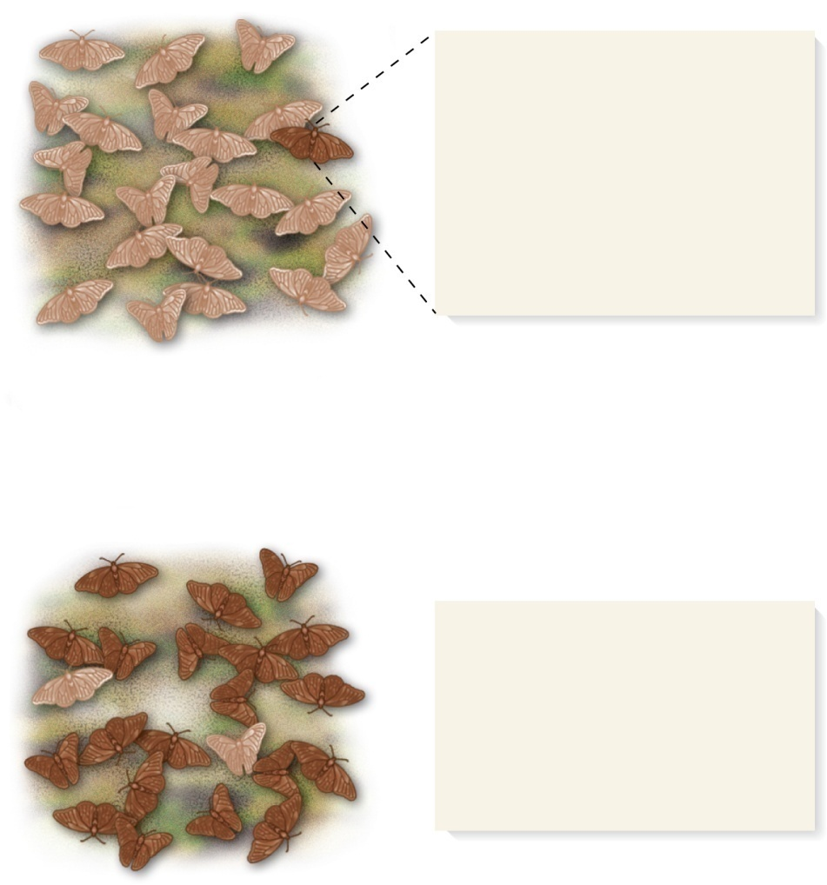
Directional Selection
Dark brown coloration arises
by a new mutation. Dark
brown wings make the
butterflies less susceptible to
predation. The dark brown
butterflies have a higher
Darwinian fitness than do the
light butterflies.
Many generations
This population has a higher
mean fitness than the starting
population because the darker
butterflies are less susceptible
to predation and therefore are
more likely to survive and
reproduce.
Affects the Hardy-Weinberg equilibrium and allele frequencies by favoring the extreme phenotype
If the homozygote carrying the favored allele has the highest fitness value then it may become monomorphic.
Brooker Fig 25.6
Copyright © The McGraw-Hill Companies, Inc. Permission required for reproduction or display.

Slide 13
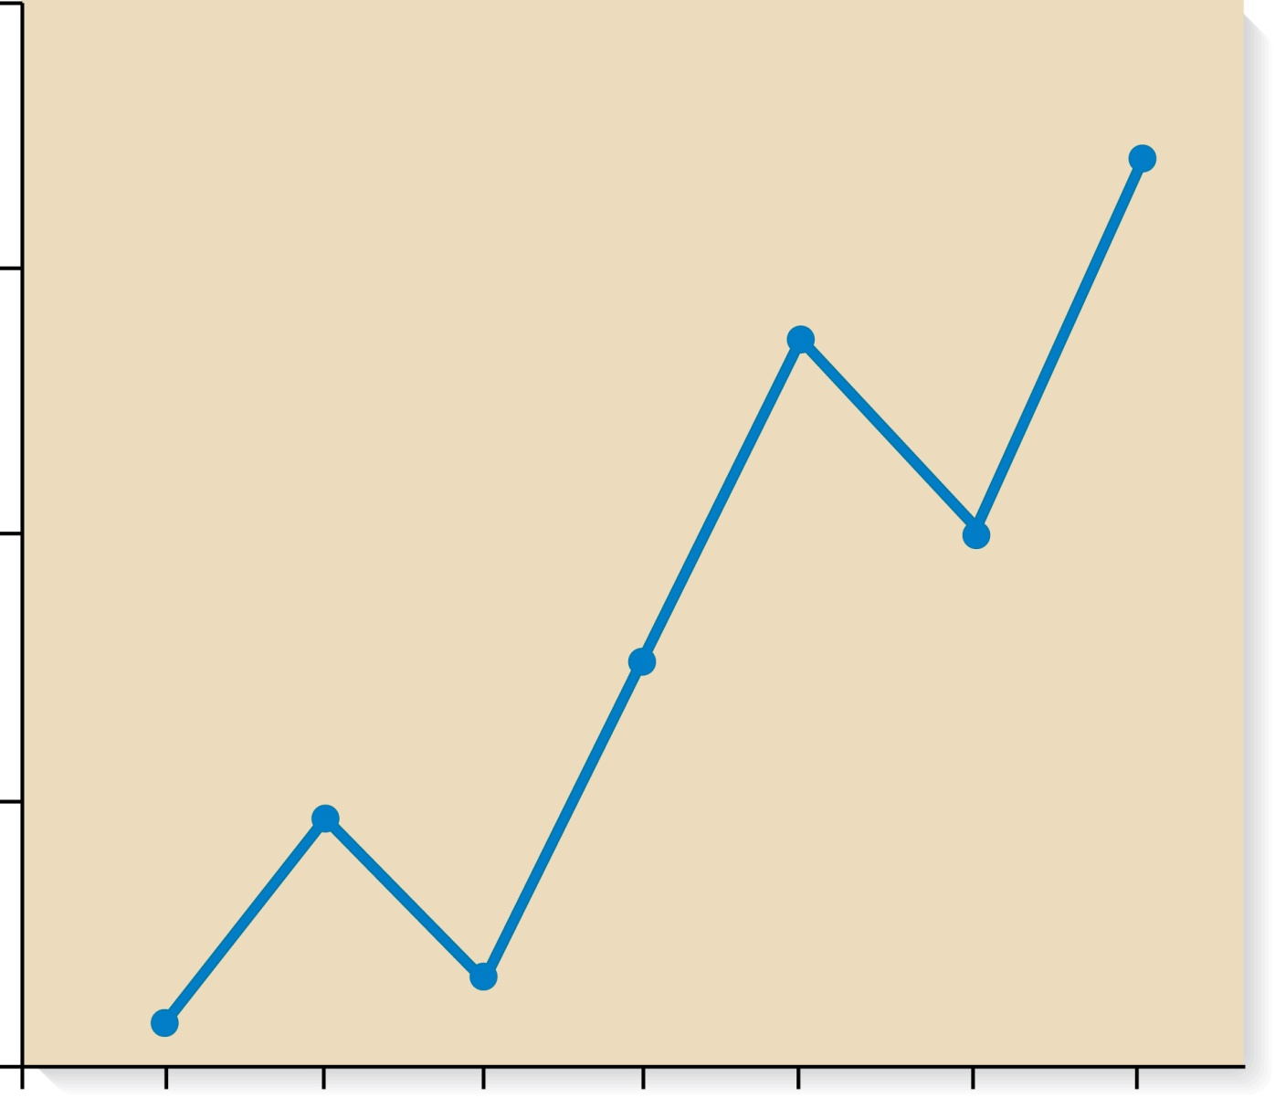
Directional selection from the introduction of DDT for mosquitos
100
75
50
% Survivors after exposure to DDT
The resistance of mosquitoes to the insecticide DDT was a relatively rare phenotype
With DDT as a selection pressure, the alleles that allowed for resistance to DDT became more frequent.
25
0
0
1
2
3
4
5
6
7
Generations

Slide 14
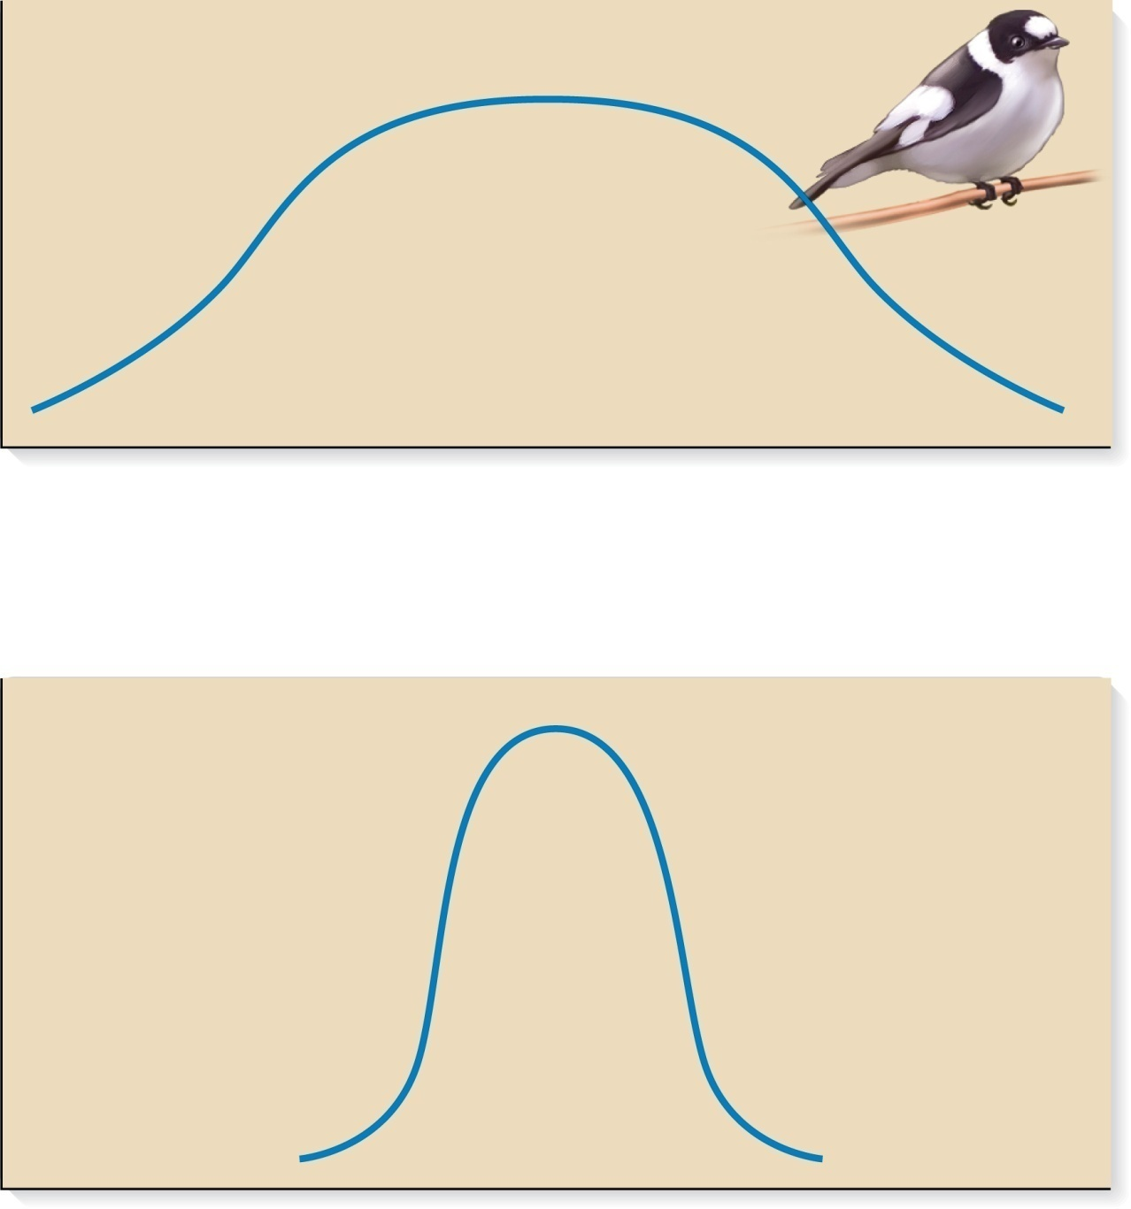
Stabilizing Selection
Copyright © The McGraw-Hill Companies, Inc. Permission required for reproduction or display.
Starting
population
Number of nests
Stabilizing selection - extreme phenotypes are selected against and the intermediate phenotypes have the highest fitness values
  Tends to decrease genetic diversity for a particular gene
    Eliminates those alleles that cause variation
  E.g. Laying eggs
    Too many eggs drains resources to care for young
    Too few eggs does not contribute to next generation
Few
Number of eggs
  Many
Population
after
stabilizing
selection
Number of nests
Few
Number of eggs
Many
Figure 25.9

Slide 15
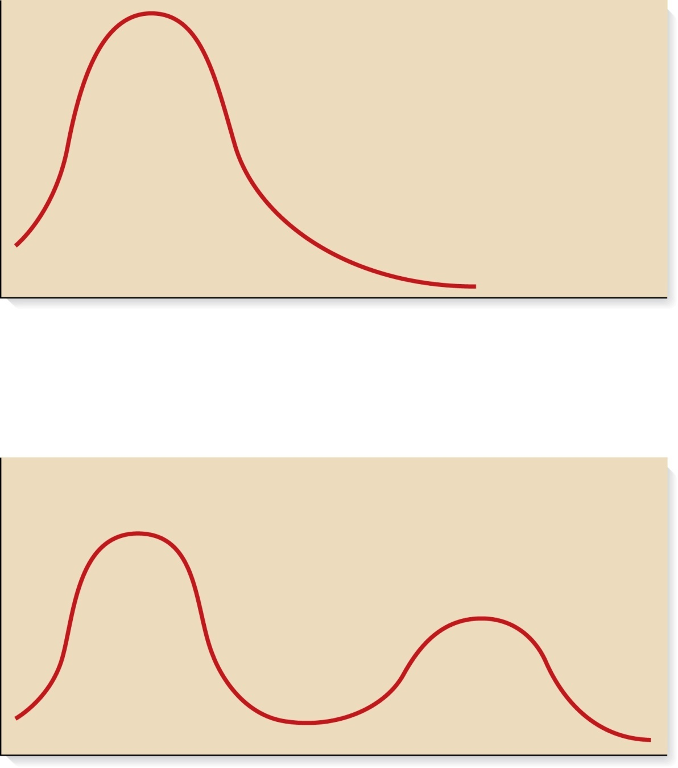
Disruptive Selection
Copyright © The McGraw-Hill Companies, Inc. Permission required for reproduction or display.
Starting population
Number of individuals
Disruptive selection favors the survival of two or more different genotypes with different phenotypes
  Also known as diversifying selection
  Caused by fitness values for a given genotype that vary in different environments
Phenotype
Population after
disruptive selection
Number of individuals
Figure 25.10
Phenotype
Copyright ©The McGraw-Hill Companies, Inc. Permission required for reproduction or display

Slide 16
  Example -- snail that lives in woods and open fields
    brown shell color favored in woods with open soil
    pink shell color favored in woods with leaf litter
    yellow shell cover favored in sunny, grassy areas
    Migration maintains balance of polymorphisms

Slide 17
Balancing Selection
A polymorphism may reach an equilibrium where opposing selective forces balance each other
  The population is not evolving toward allele fixation or elimination
  Such a situation is known as balancing selection
It can occur because of different reasons
  1. The heterozygote is at a selective advantage
  2. A species occupies a region that contains heterogeneous environments
The heterozygote is at a selective advantage
  The higher fitness of the heterozygote is balanced by the lower fitness of both corresponding homozygotes
Copyright ©The McGraw-Hill Companies, Inc. Permission required for reproduction or display

Slide 18
Balanced polymorphisms can sometimes explain the high frequency of alleles that are deleterious when homozygous
    Cystic fibrosis
      Heterozygote is resistant to diarrheal disease (such as cholera)
    Tay-Sachs disease
      Heterozygote is resistant to tuberculosis
    Sickle cell anemia
      Heterozygotes have a better chance of survival if infected by the malarial parasite Plasmodium falciparum
25 - 56
Copyright ©The McGraw-Hill Companies, Inc. Permission required for reproduction or display

Slide 19
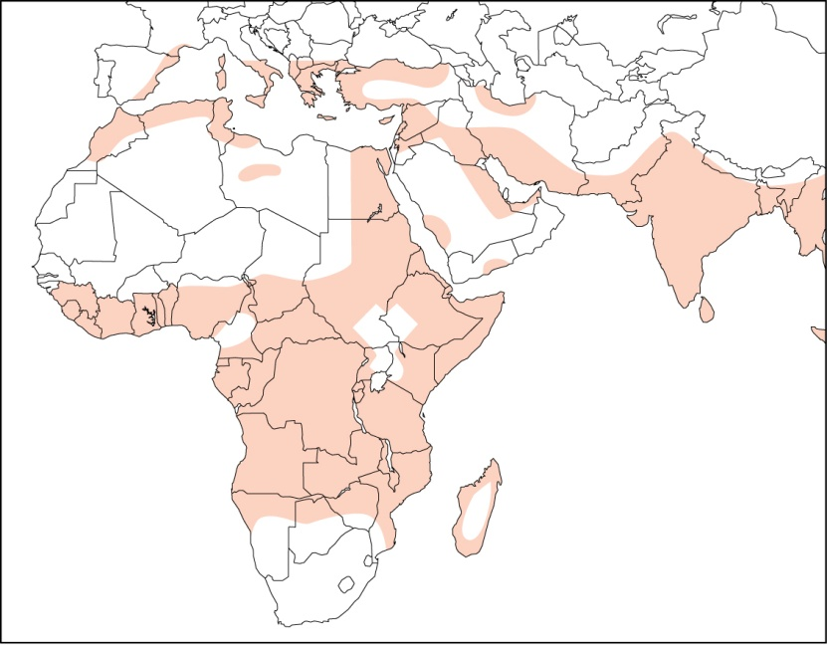
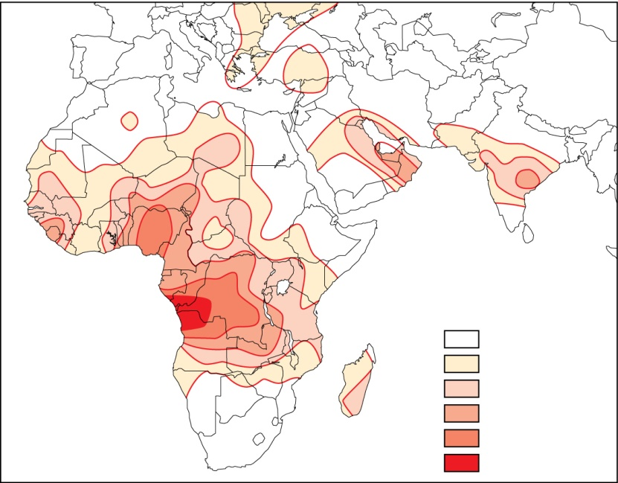
Example of Balancing Selection: the Sickle Cell allele in areas with Malaria
(a) Malaria prevalence
Sickle cell anemia
    Hb^{S} allele of the human β-globin gene
    Hb^{S}Hb^{S} -- sickle-cell anemia
    Hb^{A}Hb^{A} -- phenotypically normal
    Hb^{A}Hb^{S} has the highest fitness in areas where malaria is endemic
(b) Hb^{S} allele frequency
Hb^{S} allele frequency
(percent)
0–2.5
2.5–5.0
5.0–7.5
7.5–10.0
10.0–12.5
> 12.5
Copyright © The McGraw-Hill Companies, Inc. Permission required for reproduction or display.

Slide 20
Genetic Drift
Random genetic drift refers to random (i.e. not affected by selection) changes in allele frequencies due to chance fluctuations
  Sewall Wright played a key role in developing this concept in the 1930s
In other words, allele frequencies may drift from generation to generation as a matter of chance
Over the long run, genetic drift favors either the loss or the fixation of an allele
  The rate depends on the population size
Copyright ©The McGraw-Hill Companies, Inc. Permission required for reproduction or display

Slide 21
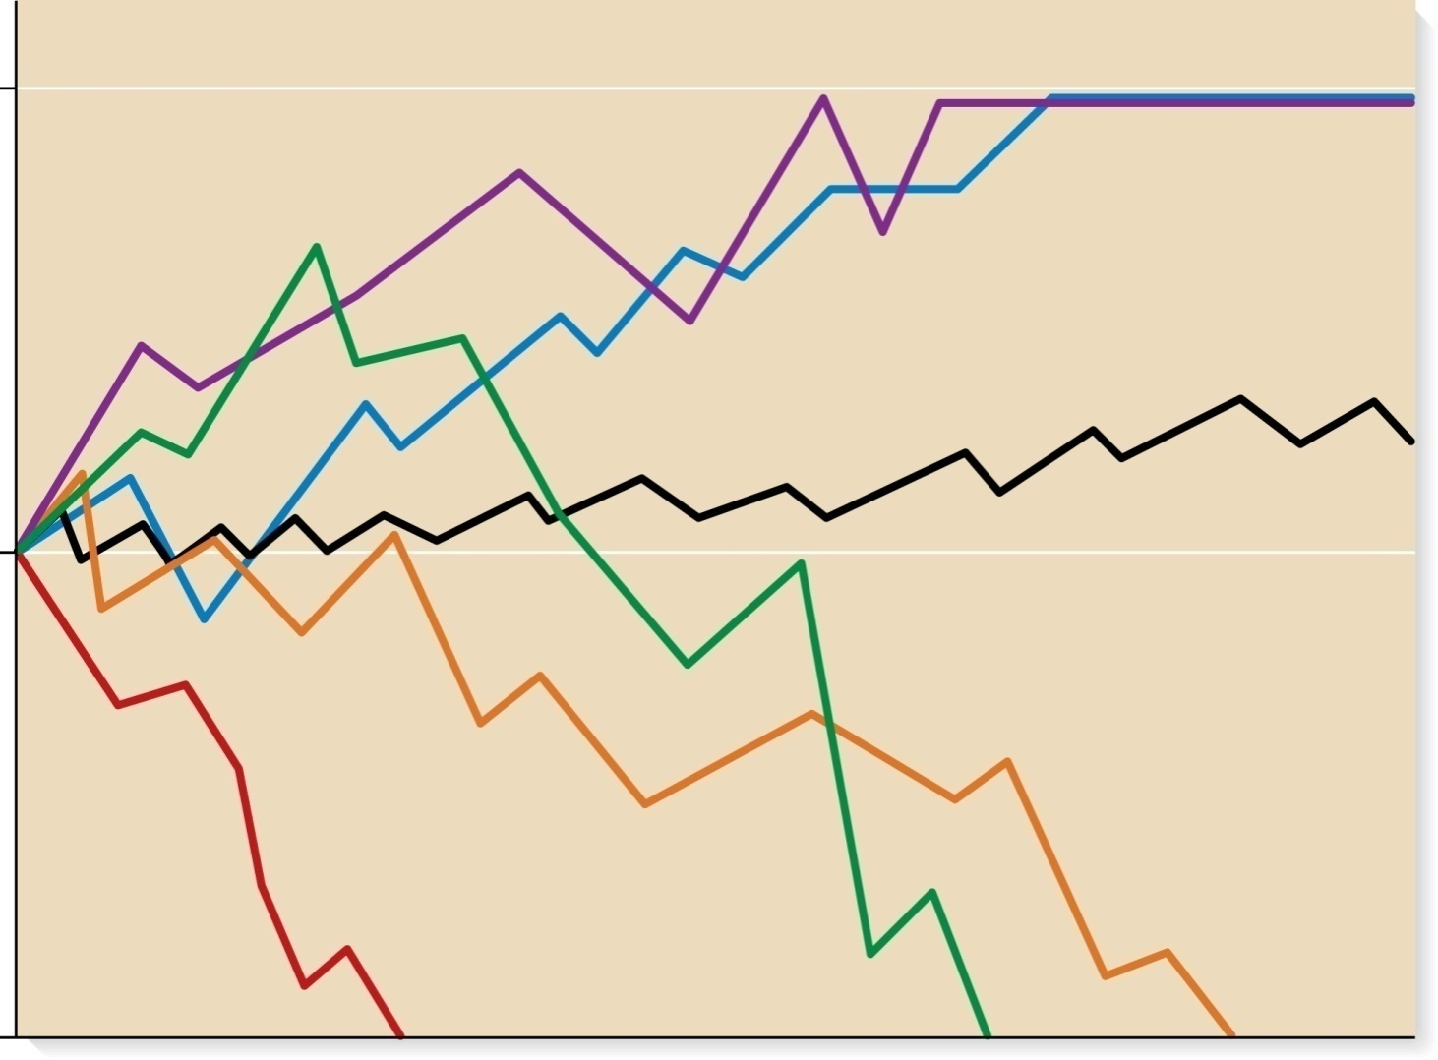
In a small population, genetic drift causes new alleles to eventually be lost, or go to fixation (100%)
Fixation of allele A
1.0
N = 20
N = 20
N = 1000
Frequency of A
0.5
N = 20
N = 20
N = 20
Loss of allele A
0
Generations
Brooker Figure 25.16
Copyright ©The McGraw-Hill Companies, Inc. Permission required for reproduction or display

Slide 22
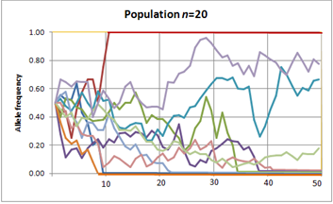
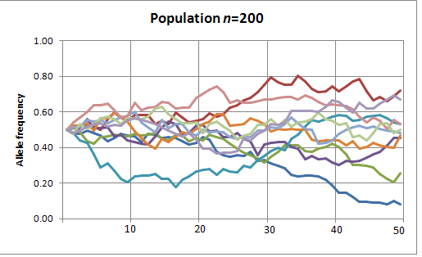
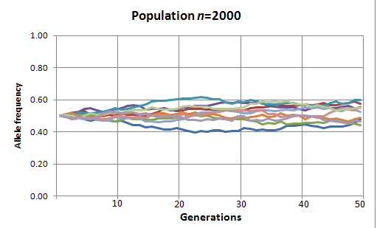
Genetic drift has less effect on larger populations

Slide 23
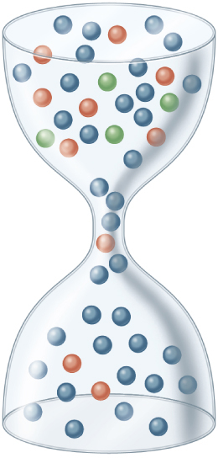
Bottleneck Effect
Large,
genetically
diverse
population
Bottleneck:
Fewer individuals,
less diversity
Large, less
genetically
diverse
population
(a) Bottleneck effect
Figure 25.17
Copyright ©The McGraw-Hill Companies, Inc. Permission required for reproduction or display

Slide 24
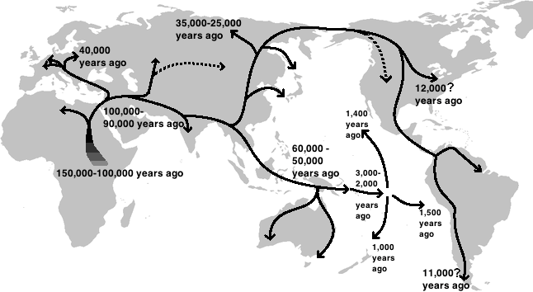
Relative Genetic Diversities in human populations implicate multiple bottlenecking events due to migration and expansion

Slide 25
Mechanisms that alter existing genetic variation
    Natural Selection
      Directional Selection
      Stabilizing Selection
      Disruptive Selection
      Balancing Selection
    Random genetic drift
    Migration
    Nonrandom mating

