Slide 1
Population Genetics
direct extension of Mendel’s laws, molecular genetics, and the ideas of Darwin
Instead of genetic transmission between individuals, population genetics considers the gene transmission at the population level
All of the alleles of every gene in a population make up the gene pool
  Only individuals that reproduce contribute to the gene pool of the next generation
Study of the genetic variation within the gene pool and how it changes from one generation to the next
25 - 3
Copyright ©The McGraw-Hill Companies, Inc. Permission required for reproduction or display

Slide 2
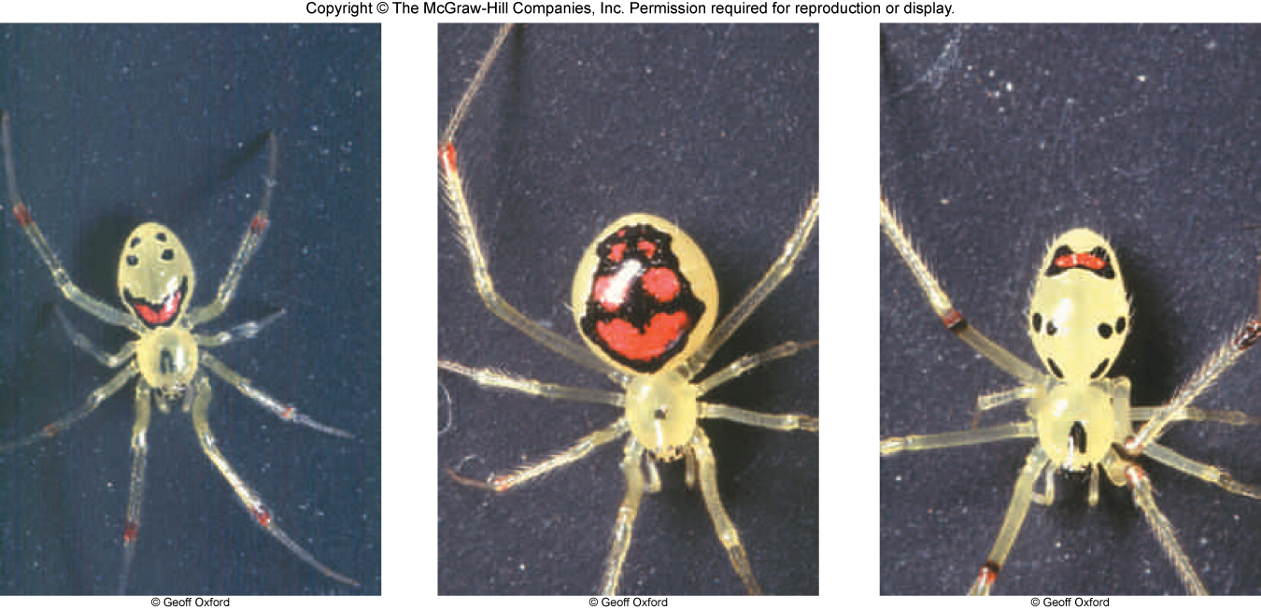
Example of polymorphism in the Happy-Face spider
Brooker fig 25 .2

Slide 3
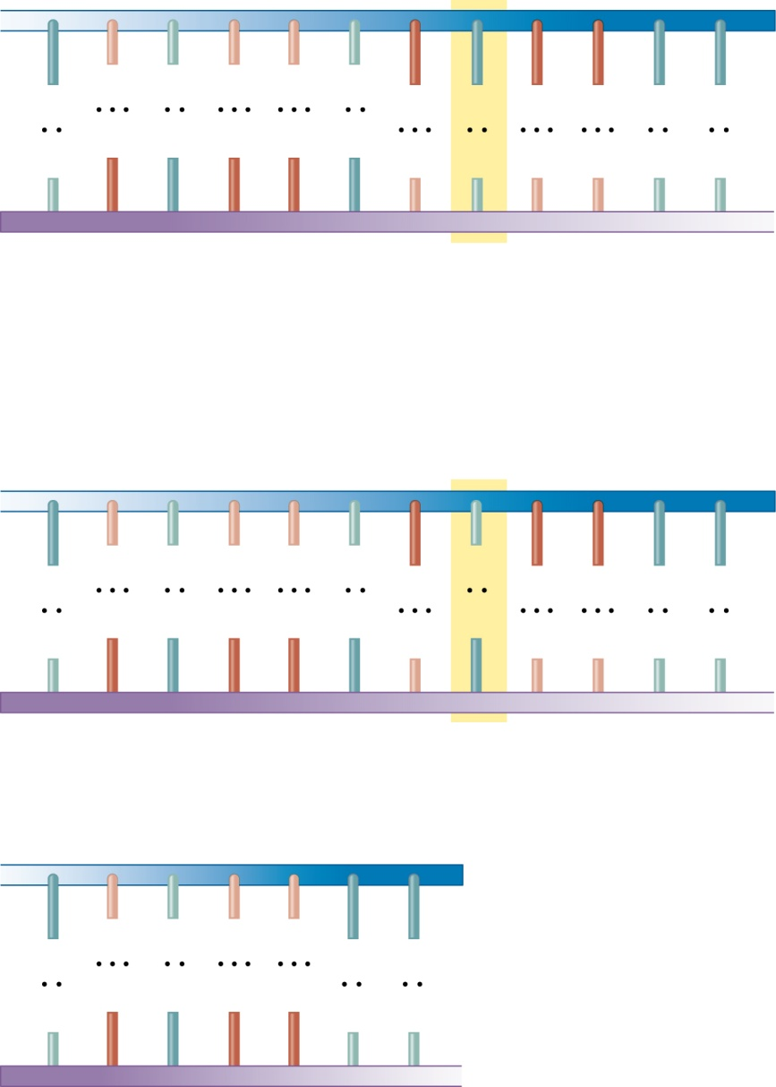
Copyright © The McGraw-Hill Companies, Inc. Permission required for reproduction or display.
Region of the human β-globin gene
A
C
T
C
C
T
G
A
G
G
A
A
G
A
G
G
A
Hb^{A} allele
T
C
T
C
C
T
T
These two alleles are an
example of a single
nucleotide polymorphism
in the human population.
These
are three
different
alleles of
the human
β-globin
gene. Many
more have
been
identified.
A
C
T
C
C
T
G
T
G
G
A
A
T
G
A
G
G
A
C
A
C
C
T
T
Hb^{S} allele
A
C
T
C
C
A
A
Loss-of-function allele
T
G
A
G
G
T
T
Site of 5-bp deletion
25 - 9

Slide 4
Allelic and Genotypic Frequencies
Number of copies of an allele in a population
  Allele frequency =
Total number of all alleles for that gene in a population
Number of individuals with a particular genotype in a population
  Genotype frequency =
Total number of all individuals in a population
Copyright ©The McGraw-Hill Companies, Inc. Permission required for reproduction or display

Slide 5
Allele Frequency
Consider a population of 100 frogs
  64 dark green (genotype GG)
  32 medium green (genotype Gg)
  4 light green (genotype gg)
  100 total frogs
Number of copies of allele g in the population
  Frequency of allele g =
Total number of alleles in the population
Homozygotes have two copies of allele g
Heterozygotes have only one
(2)(4) + 32
  Frequency of allele g =
(2)(100)
All individuals have two alleles of each gene
40
  Frequency of allele g =
= 0.2, or 20%
200
Copyright ©The McGraw-Hill Companies, Inc. Permission required for reproduction or display

Slide 6
Genotype Frequency
(frequency of individuals with particular genotype)
Consider a population of 100 frogs
  64 dark green (genotype GG)
  32 medium green (genotype Gg)
  4 light green (genotype gg)
  100 total frogs
Number of individuals with genotype gg in the population
  Frequency of genotype gg =
Total number of all individuals in the population
4
  Frequency of genotype gg =
= 0.04, or 4%
100
Copyright ©The McGraw-Hill Companies, Inc. Permission required for reproduction or display

Slide 7
More on allele and genotype frequencies
For each gene, allele and genotype frequencies are always < 1
  (less than or equal to 100%)
Monomorphic genes (only one allele)
  Allele frequency = 1.0 (or very close to 1)
Polymorphic genes
  Frequencies of all alleles → add up to 1.0
  Pea plant example
    Frequency of G + frequency of g = 1
    Frequency of G = 1 – frequency of g
    = 1 – 0.2
    = 0.8, or 80%

Slide 8
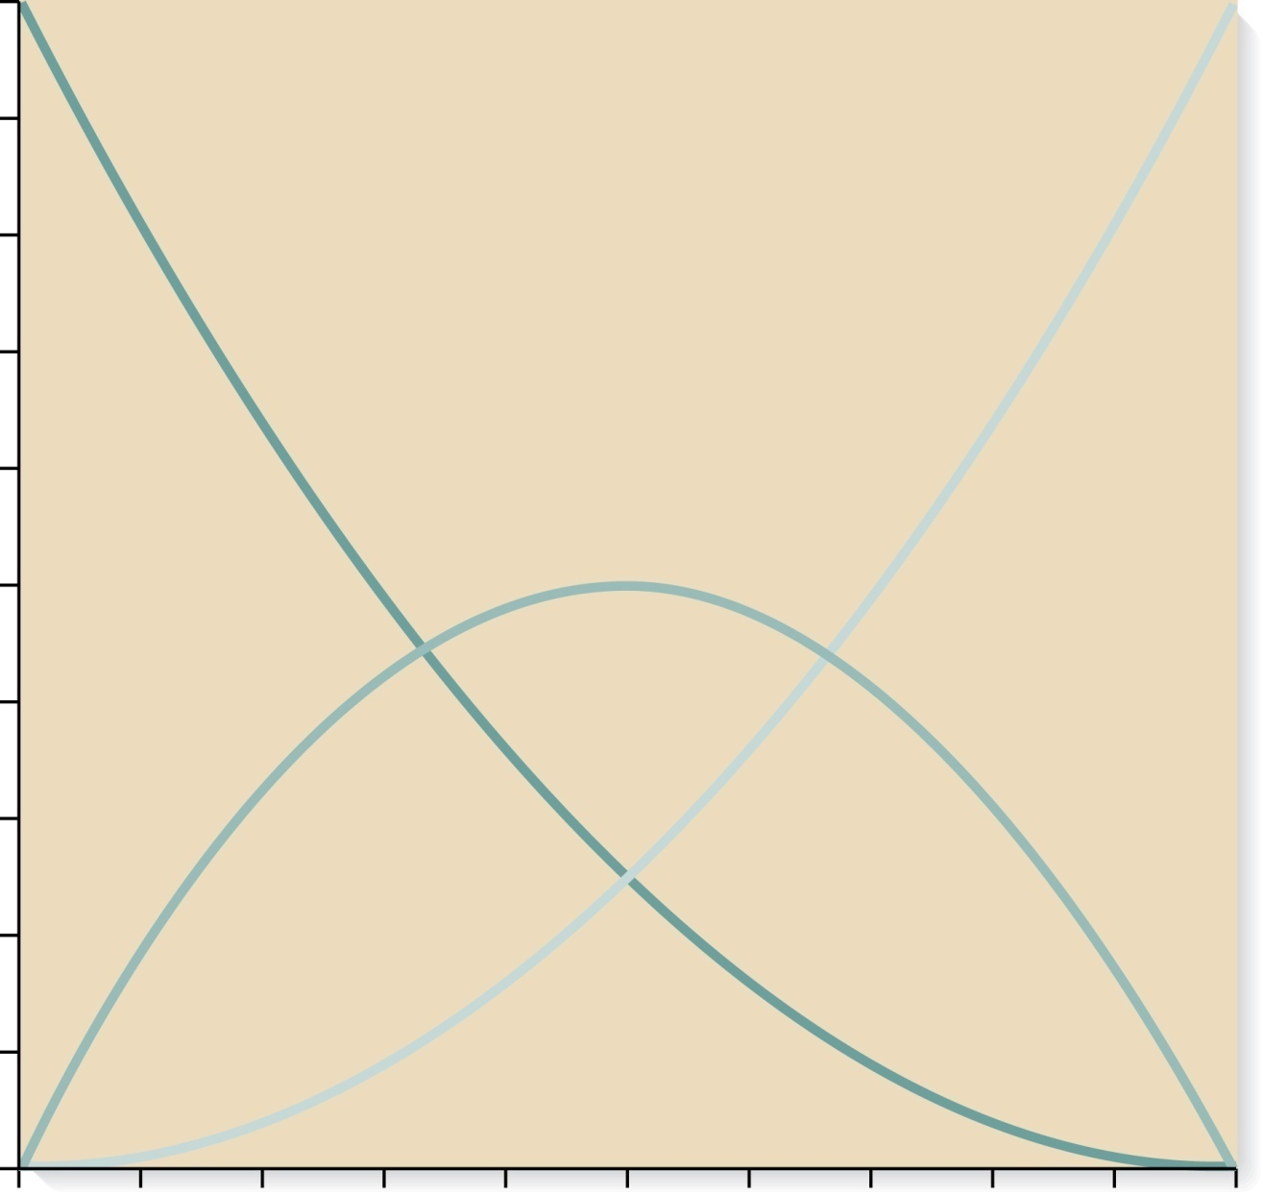
Mathematical relationship between alleles and genotypes
1.0
0.9
GG
gg
0.8
0.7
0.6
Gg
Genotype frequency
0.5
0.4
0.3
Copyright ©The McGraw-Hill Companies, Inc. Permission required for reproduction or display
0.2
0.1
0
0
0.1
0.2
0.3
0.4
0.5
0.6
0.7
0.8
0.9
1.0
Brooker Figure 25.5
Frequency of allele g

Slide 9
Mathematical relationship between alleles and genotypes is described by the Hardy-Weinberg Equation (HWE)
For any one gene, HWE predicts the expected frequencies for alleles and genotypes (population must be in equilibrium)
Example:
Polymorphic gene exists in two alleles, G and g
  Population frequency of G is denoted by variable p
  Population frequency of g is denoted by variable q
    By definition p + q = 1.0
  The Hardy-Weinberg equation states:
    (p + q)² = 1
    p² + 2pq + q² = 1
X-axis in Fig 25.5
Copyright ©The McGraw-Hill Companies, Inc. Permission required for reproduction or display

Slide 10
What is a population in equilibrium?
(the one in Fig 25.5)
When the genotype and allele frequencies remain stable, generation after generation (when the relationship between the two remains “true”)
A population can be in equilibrium only if certain conditions exist:
  1. No new mutations
  2. No genetic drift (population is so large that allele frequencies do not change due to random sampling between generations)
  3. No migration
  4. No natural selection
  5. Random mating
In reality, no population satisfies the Hardy-Weinberg equilibrium completely
However, in some large natural populations there is little migration and negligible natural selection →HW equilibrium is nearly approximated for certain genes
Copyright ©The McGraw-Hill Companies, Inc. Permission required for reproduction or display

Slide 11
Example of change of allele and genotype frequencies over time
When a population is in equilibrium, allele frequencies remain stable generation after generation.
Imagine the opposite: what would happen in a population where everyone was heterozygous? (assuming no selection, etc.) The next generation would have some homozygotes, heterozygotes, etc.
Here is one example of the change of allele and genotype frequencies over many generations (Generation 1 starting with allele g at 50%).
Genotype Frequency
Frequency of g allele
Fig adapted from Principles of Population Genetics by DL Hartl and AG Clark. 3rd Ed. Sinauer Associates, Inc. Sunderland, MA. 1997.

Slide 12
HWE cont.
To determine if the genes or genotypes of a population are not changing, the expected frequencies of the different genotypes can be calculated and compared to what is observed
If p = 0.8 and q = 0.2, then the expected frequencies of the different genotypes in a population that is not changing can be determined
  frequency of GG = p² = (0.8)² = 0.64
  frequency of Gg= 2pq = 2(0.8)(0.2) = 0.32
  frequency of gg = q² = (0.2)² = 0.04
Refer to Figure 25.4
Copyright ©The McGraw-Hill Companies, Inc. Permission required for reproduction or display

Slide 13
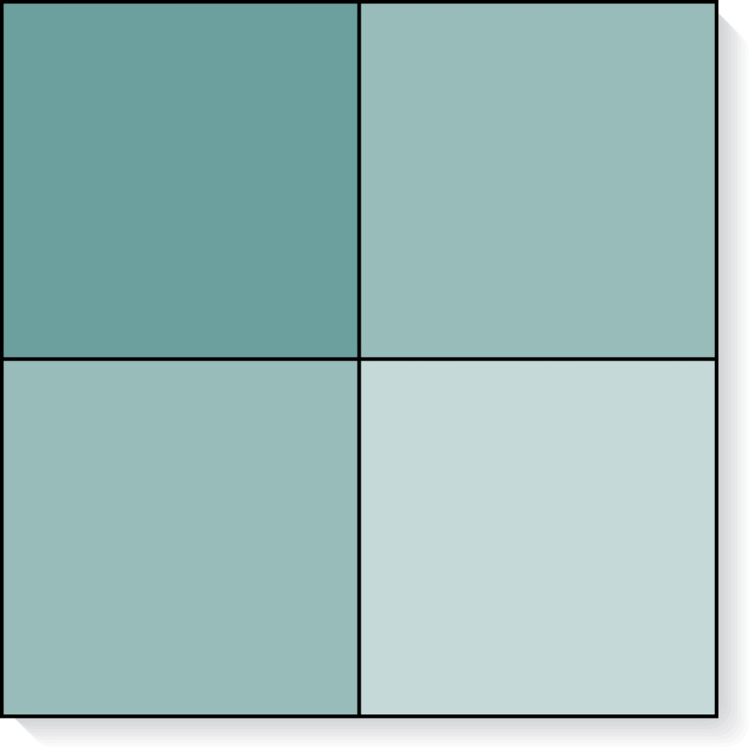
HWE is the Punnett Square for the population
Frequency 0.8
Frequency 0.2
G
g
Frequency 0.8
GG
Gg
G
(0.8)(0.8) = 0.64
(0.8)(0.2) = 0.16
Copyright ©The McGraw-Hill Companies, Inc. Permission required for reproduction or display
Frequency
0.2
Gg
gg
g
(0.8)(0.2) = 0.16
(0.2)(0.2) = 0.04
GG frequency = 0.64
Gg frequency = 0.16 + 0.16 = 0.32
gg frequency = 0.04
Brooker Figure 25.4

Slide 14
Why bother with HWE?
HWE provides a null hypothesis against which we can test many theories of evolution (provides a framework to help understand when allele and genotype frequencies do* change)
HW equation can extend to 3 or more alleles
Copyright ©The McGraw-Hill Companies, Inc. Permission required for reproduction or display

Slide 15
Example of using X² analysis to see if a gene is in HWE
  Consider a human blood type called the MN type
  (two co-dominant alleles, M and N)
  An Inuit population in East Greenland has 200 people
      168 were MM
      30 were MN
      2 were NN
      200 total
Copyright ©The McGraw-Hill Companies, Inc. Permission required for reproduction or display

Slide 16
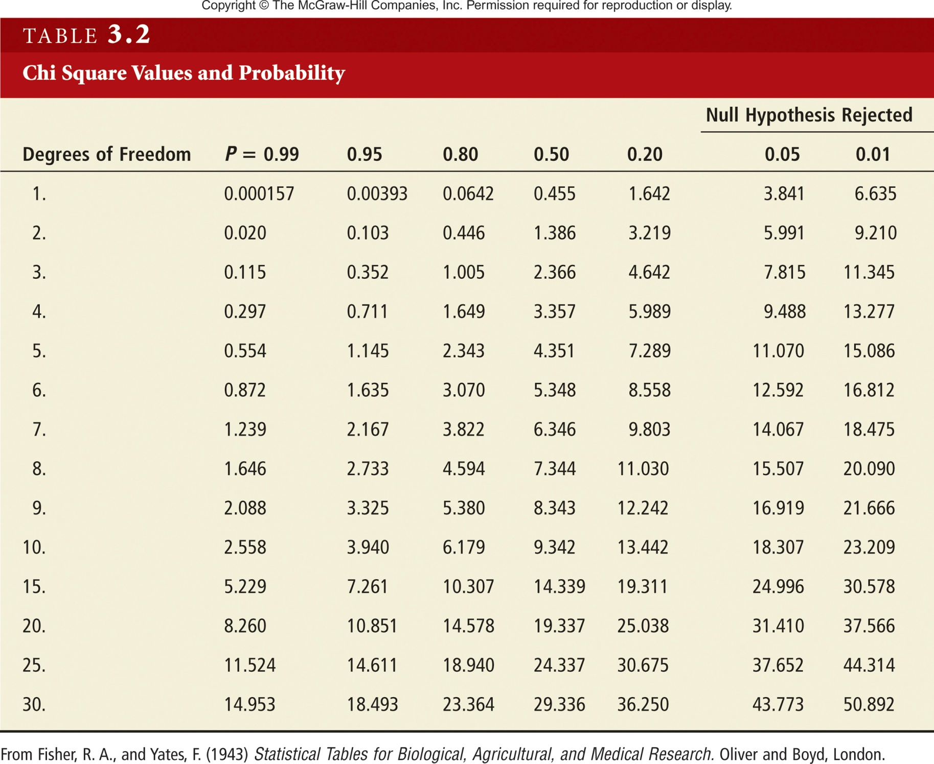

Slide 17
Explanation of degrees of freedom and HWE in X² analysis
# constraints imposed on comparison between Obs. and Exp.
Degrees of Freedom
# of groups measured
=
1st constraint: total of expected column is forced to equal the total of observed.
Additional restrictions imposed for each parameter that is estimated from the sample (p in this case). (restriction for q is not included because p and q are really two sides of the same parameter)

Slide 18
Explanation of degrees of freedom and HWE in X² analysis
# constraints imposed on comparison between Obs. and Exp.
Degrees of Freedom
# of groups measured
=
Degrees of Freedom
=
3 groups
1
1
=
1
Restriction imposed for estimating p from the sample
Constraint for forcing total of expected column to equal the total of observed.

Slide 19
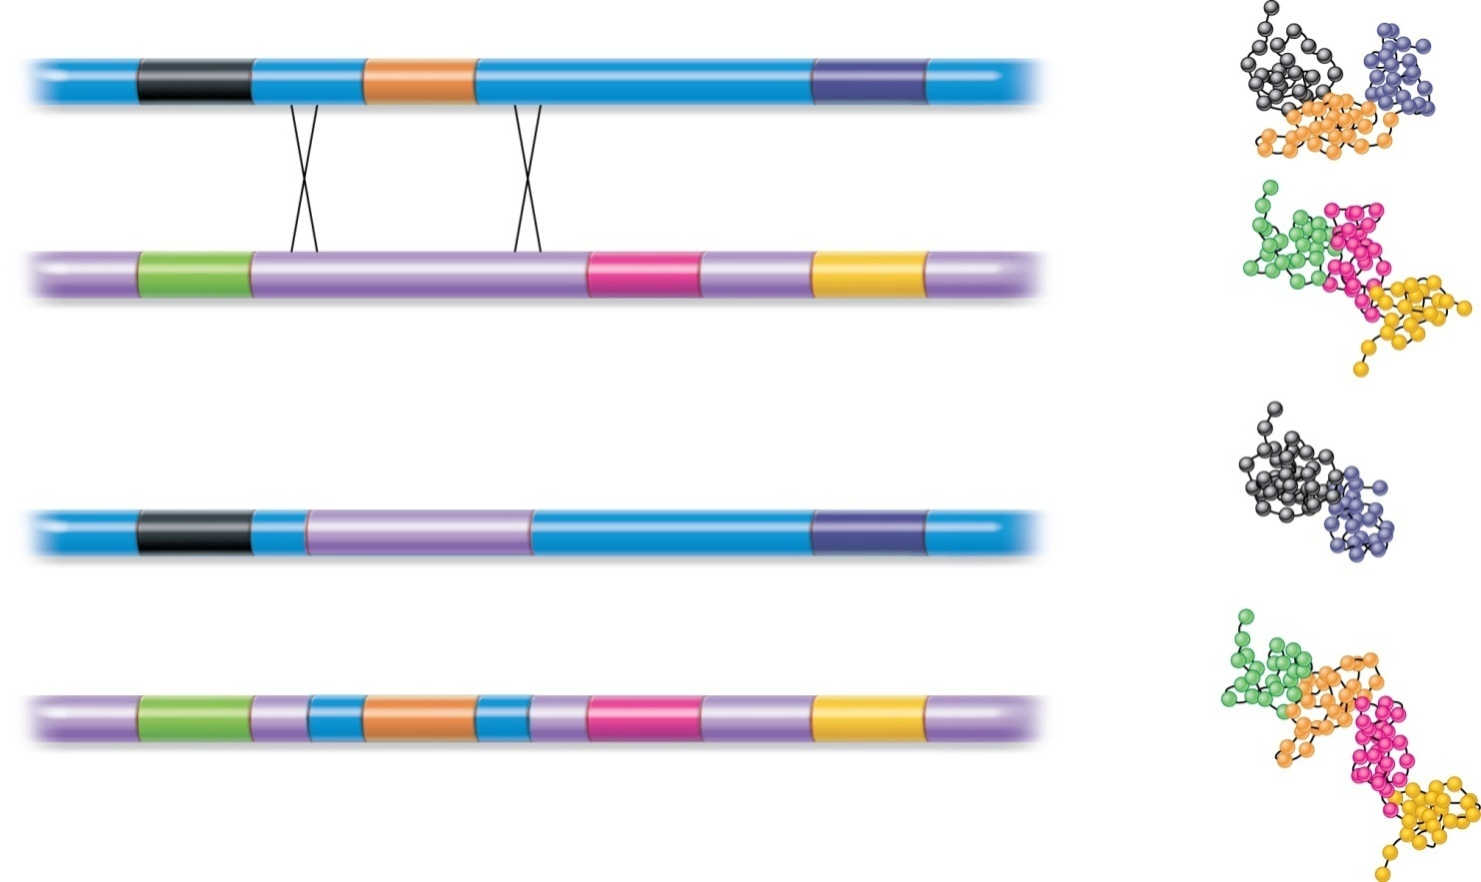
New genes may be produced by exon shuffling
Domain 1
Exon1 Intron1 Exon 2
Intron 2
Exon 3 Intron 3
3
Gene 1
Protein 1
2
Exon 1
Intron 1
Exon 2 Intron 2 Exon 3 Intron 3
1
2
Gene 2
Protein 2
3
A segment of gene 1, including
exon 2 and parts of the flanking
introns, is inserted into gene 2.
1
Domain 2 is missing. Natural
selection may eliminate this
gene from the population if it
is no longer functional.
Exon 1
Exon 3
3
Gene 1
Protein 1
Gene 1 is missing exon 2.
Domain 2 from gene 1 has
been inserted into gene 2. If
this protein provides a new,
beneficial trait, natural
selection may increase its
prevalence in a population.
1
Exon 1
Exon 2
Exon 2
Exon 3
Gene 2
Protein 2
2
Gene 2 has exon 2 from gene 1.
2
3
Brooker Figure 25.19
Copyright ©The McGraw-Hill Companies, Inc. Permission required for reproduction or display

Slide 20
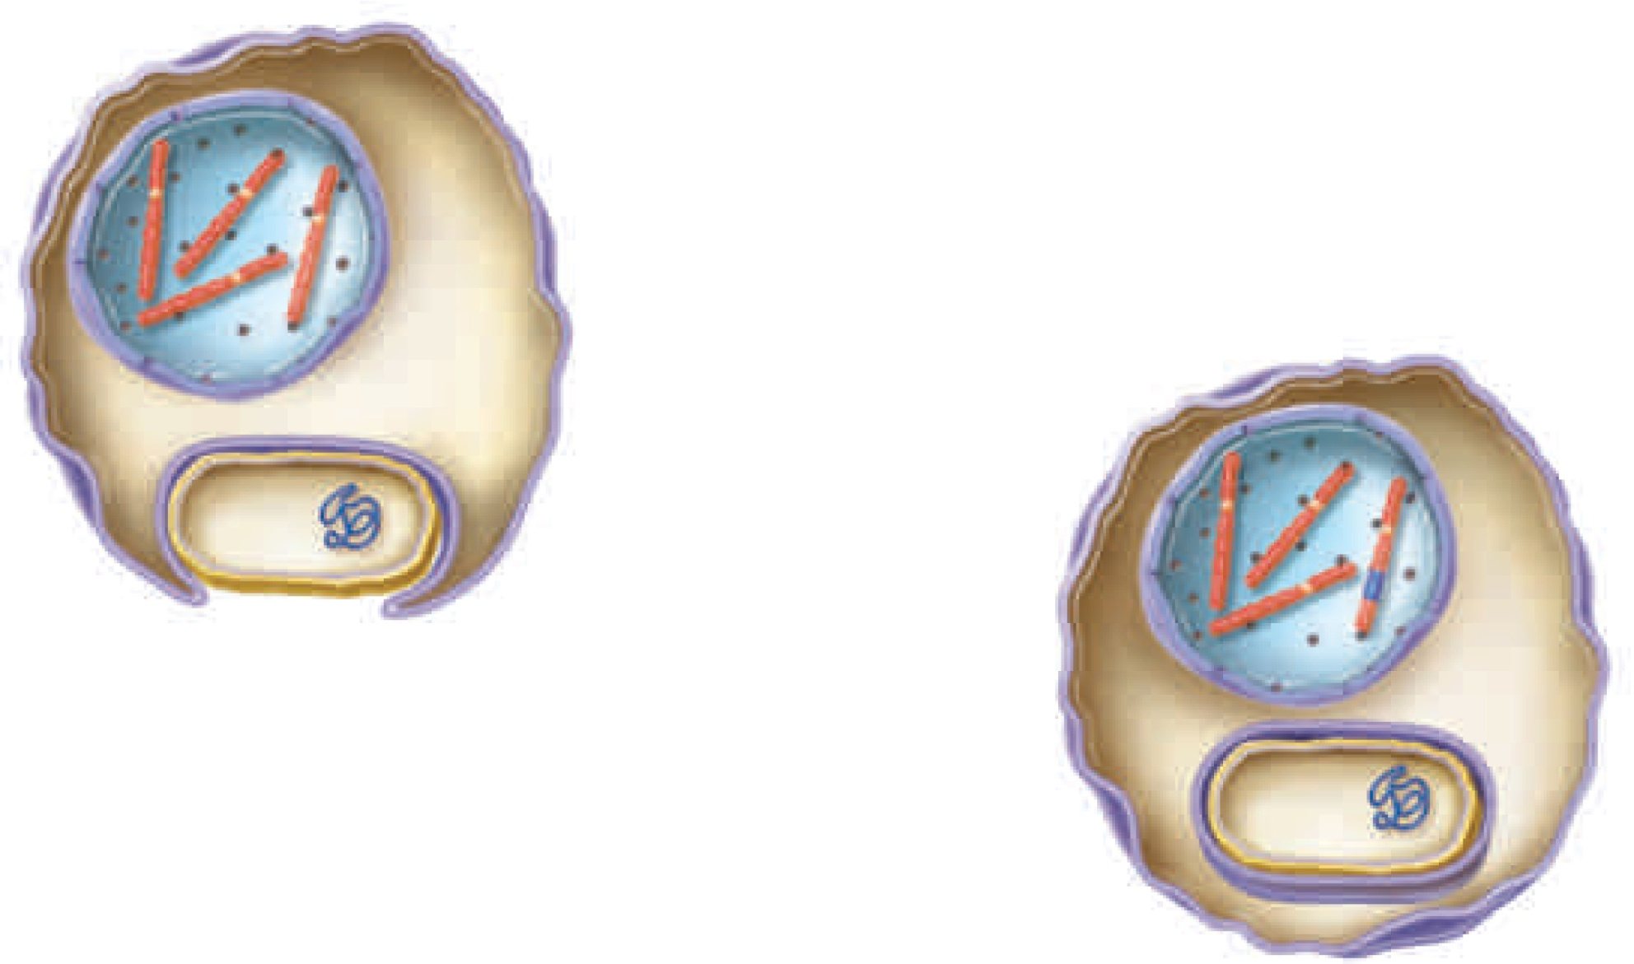
New genes can be acquired by horizontal gene transfer
Eukaryotic
cell
Bacterial gene
Gene
transfer
Bacterial
cell
Bacterial
chromosome
Endocytic
vesicle
Brooker Fig 25 .20

Slide 21
Genetic Variation Produced by Changes in Repetitive Sequences
    Transposable elements
    Microsatellites (short tandem repeats -- STR).
      Repeat of 1-6 bp sequence
      Usually repeated 5-50 times
      E.g. CA_{n} repeat is found in human genome every 10kb
      (the more closely related individuals are, the more likely they are to have the same size repeats→Very useful in population genetics and DNA fingerprinting
        Forensics
        Tracking infection sources
    Minisatellite has repeat of 6-80 bp covering 1,000-20,000 bp
Copyright ©The McGraw-Hill Companies, Inc. Permission required for reproduction or display

Slide 22
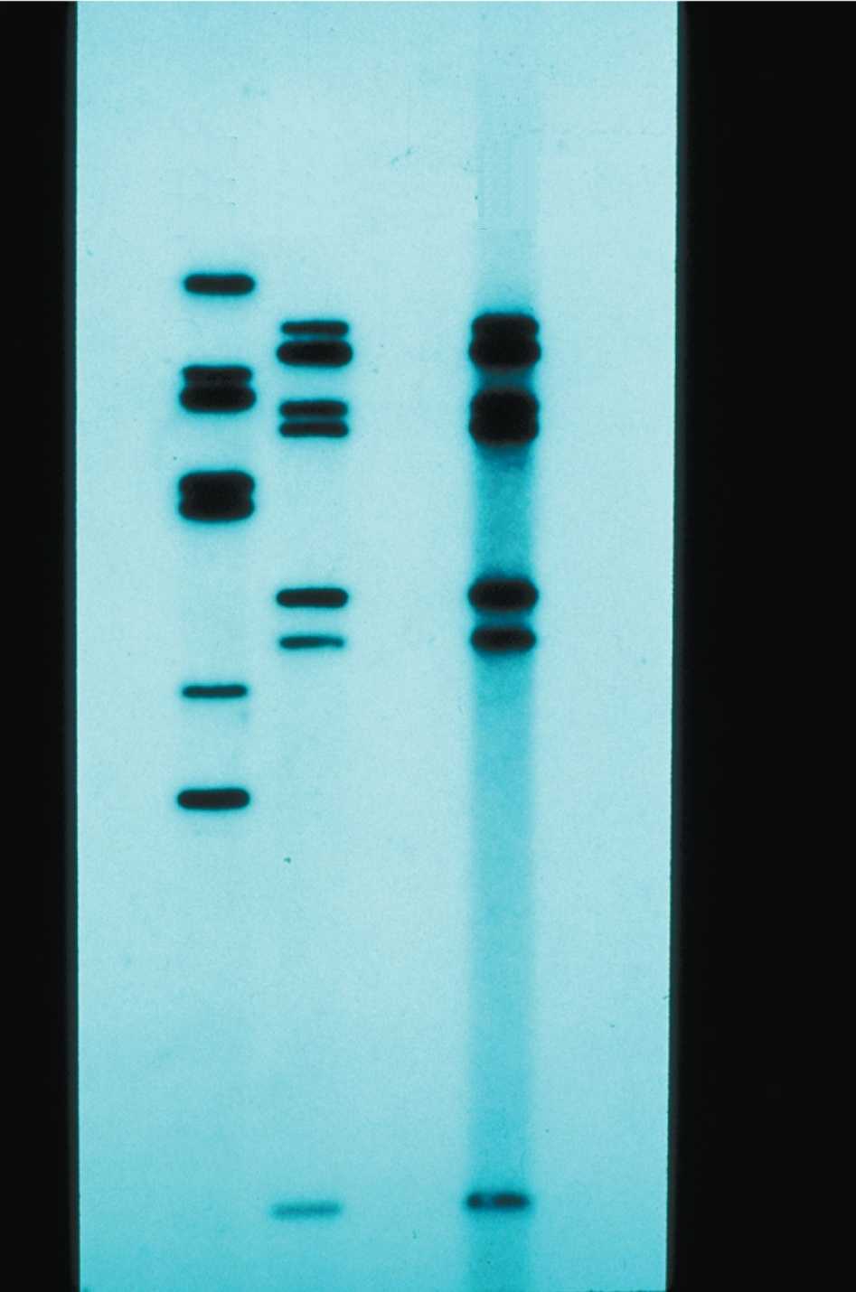
Copyright © The McGraw-Hill Companies, Inc. Permission required for reproduction or display.
S 1 S 2 E(vs)
Figure 25.21
© Leonard Lesin/Peter Arnold
25 - 109
Copyright ©The McGraw-Hill Companies, Inc. Permission required for reproduction or display

Slide 23
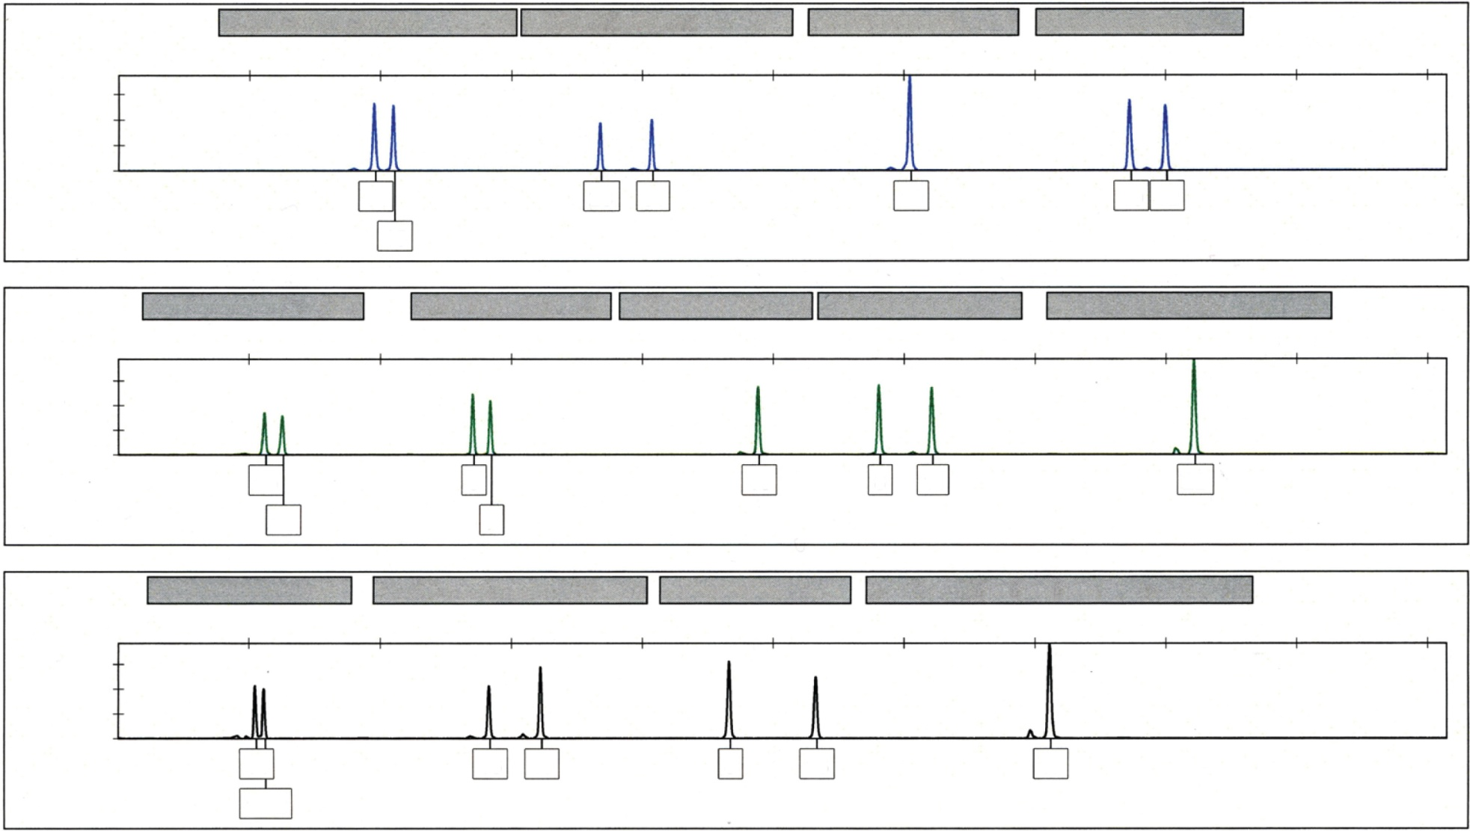
Copyright © The McGraw-Hill Companies, Inc. Permission required for reproduction or display.
D8S1179
D21S11
D7S820
CSF1PO
120
180
240
300
360
1200
0
10
14
28
31
10
12
15
D3S1358
TH01
D13S317
D16S539
D2S1338
180
240
300
360
1200
0
15
6
13
8
11
22
16
7
D19S433
vWA
TPOX
D28S51
120
180
240
300
360
1000
0
14
16
19
8
13
17
14.2
25 - 110

