Slide 1
Broad course objectives--students should be able to:
a.) describe at the biochemical level the events that occur to go from gene to phenotype;
b.) identify different types of RNA, note their properties, how they are processed to yield a functional form, and their function in gene expression;
c.) recognize the importance of regulating gene expression in prokaryotes and eukaryotes and describe the levels at which gene expression is controlled; explain the structure and function of operons
Necessary for material on:
Lab Discussion on PCR and primer design
Understanding use of siRNA in gene silencing technology
RNA Processing
Translation
Regulation of gene expression in prokaryotes and eukaryotes.

Slide 2
Outline/Study Guide
What are the cellular locations of transcription and translation in prokaryotic vs. eukaryotic cells?
How does this affect the timing and regulation of protein synthesis in a bacterial cell vs. a eukaryotic cell?
How is a gene defined? (Mendelian definition and more modern definition)
Must all genes encode a protein?
What are the different classes of RNA and their functions?
If an mRNA is translated in the 5’→ 3’ direction, which DNA strand is therefore the coding or template strand for the gene? If RNA were made off of the other DNA strand, would it code for protein?
In terms of cellular energy, why must RNA be synthesized in the 5’→ 3’ direction?

Slide 3
Study Guide/Outline—Transcription, cont.
What is a promoter?
How is RNA polymerase correctly oriented on the promoter? What does “Y” “R” and “N” mean in a consensus sequence?
Bacterial Transcription
What components make up bacterial RNA polymerase? How does the sigma factor enable the bacteria to turn on or off specific genes?
How does transcription termination occur in bacteria?
Eukaryotic Transcription
How many RNA polymerases exist in eukaryotes?
What are the TFII transcription factors (and what is meant by the Roman numeral II)?
What role do enhancers and silencers play? How are they different, in function and location, from promoter sequences?
How is newly synthesized RNA released from the transcription machinery in eukaryotes? (hint: has to do with the polyA tail)

Slide 4
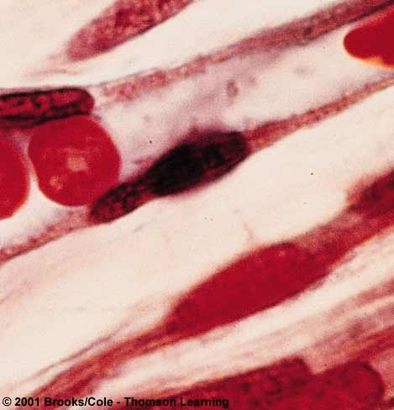
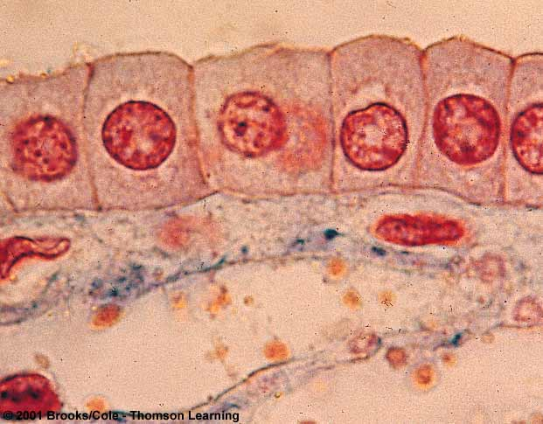
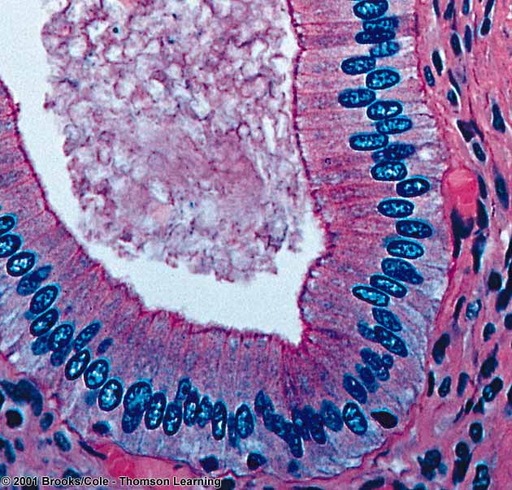
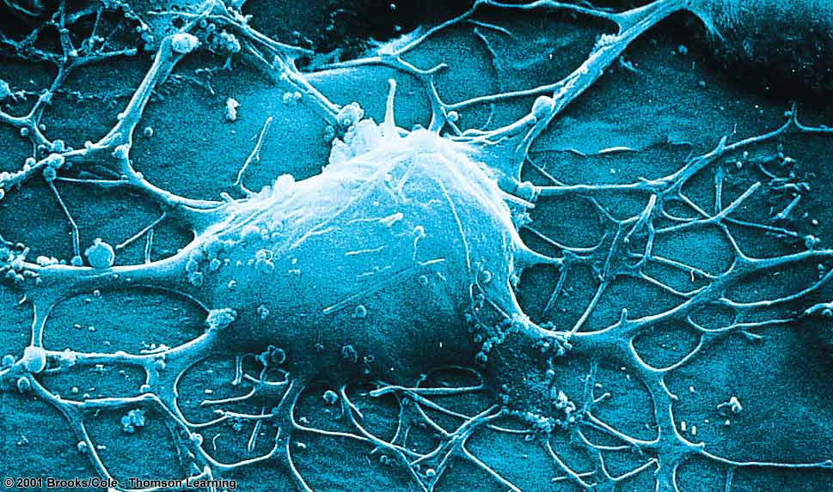
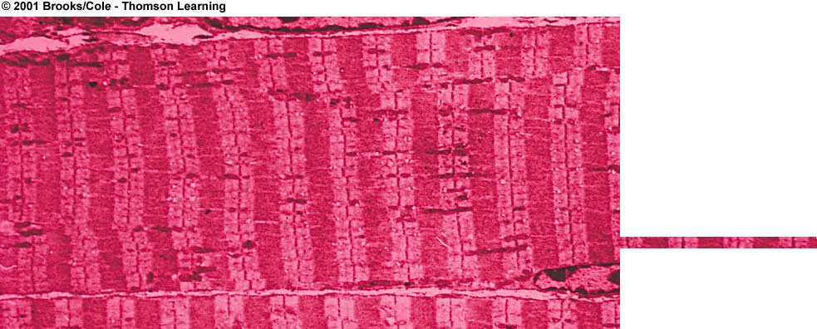
All of these cells have the same DNA. How do they develop into different tissue types?
Simple squamous
epithelium
Simple cuboidal
epithelium
Simple columnar
epithelium

Slide 5
Definitions of a Gene
Mendelian definition: heritable unit of a physical trait
Early (~1906) molecular definition: one gene → one enzyme
Modern definitions: all sequences of DNA that are transcribed into a functional, single RNA molecule
Non-coding genes: tRNAs, rRNAs, snRNAs, snoRNAs
Coding genes: exons and introns, or the entire transcriptional unit (promoter, exons, introns)

Slide 6
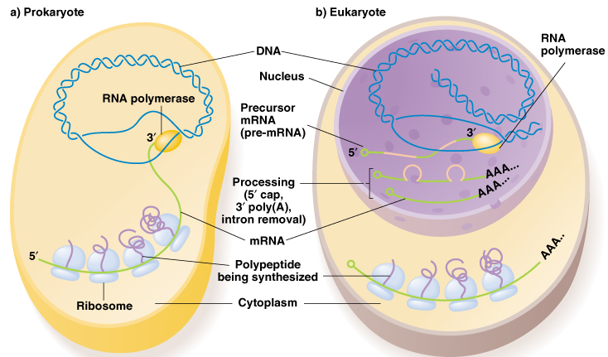
mRNA and protein synthesis are coupled in bacteria
mRNA must be processed and transported out of nucleus for translation

Slide 7
Orientation of transcribed DNA strand, non-transcribed DNA, and RNA

Slide 8
Published gene sequences are the non-template strand (matches the RNA sense strand) for direct translation of sequence into protein
http://www.ncbi.nlm.nih.gov/entrez/query.fcgi?db=OMIM
http://www.ncbi.nlm.nih.gov/entrez/query.fcgi?db=OMIM

Slide 9
Published strand of the cystic fibrosis gene (CFTR-7q31.2). Sequence corresponds to its RNA sense strand (and is the non-template strand of the gene)
1 5’AATTGGAAGC AAATGACATC ACAGCAGGTC AGAGAAAAAG GGTTGAGCGG CAGGCACCCA
61 GAGTAGTAGG TCTTTGGCAT TAGGAGCTTG AGCCCAGACG GCCCTAGCAG GGACCCCAGC
121 GCCCGAGAGA CCATGCAGAG GTCGCCTCTG GAAAAGGCCA GCGTTGTCTC CAAACTTTTT
181 TTCAGCTGGA CCAGACCAAT TTTGAGGAAA GGATACAGAC AGCGCCTGGA ATTGTCAGAC
241 ATATACCAAA TCCCTTCTGT TGATTCTGCT GACAATCTAT CTGAAAAATT GGAAAGAGAA
301 TGGGATAGAG AGCTGGCTTC AAAGAAAAAT CCTAAACTCA TTAATGCCCT TCGGCGATGT
361 TTTTTCTGGA GATTTATGTT CTATGGAATC TTTTTATATT TAGGGGAAGT CACCAAAGCA
421 GTACAGCCTC TCTTACTGGG AAGAATCATA GCTTCCTATG ACCCGGATAA CAAGGAGGAA
481 CGCTCTATCG CGATTTATCT AGGCATAGGC TTATGCCTTC TCTTTATTGT GAGGACACTG
541 CTCCTACACC CAGCCATTTT TGGCCTTCAT CACATTGGAA TGCAGATGAG AATAGCTATG
601 TTTAGTTTGA TTTATAAGAA GACTTTAAAG CTGTCAAGCC GTGTTCTAGA TAAAATAAGT
661 ATTGGACAAC TTGTTAGTCT CCTTTCCAAC AACCTGAACA AATTTGATGA AGGACTTGCA

Slide 10
Complete unit of transcription: promoter, coding region, termination sequence

Slide 11
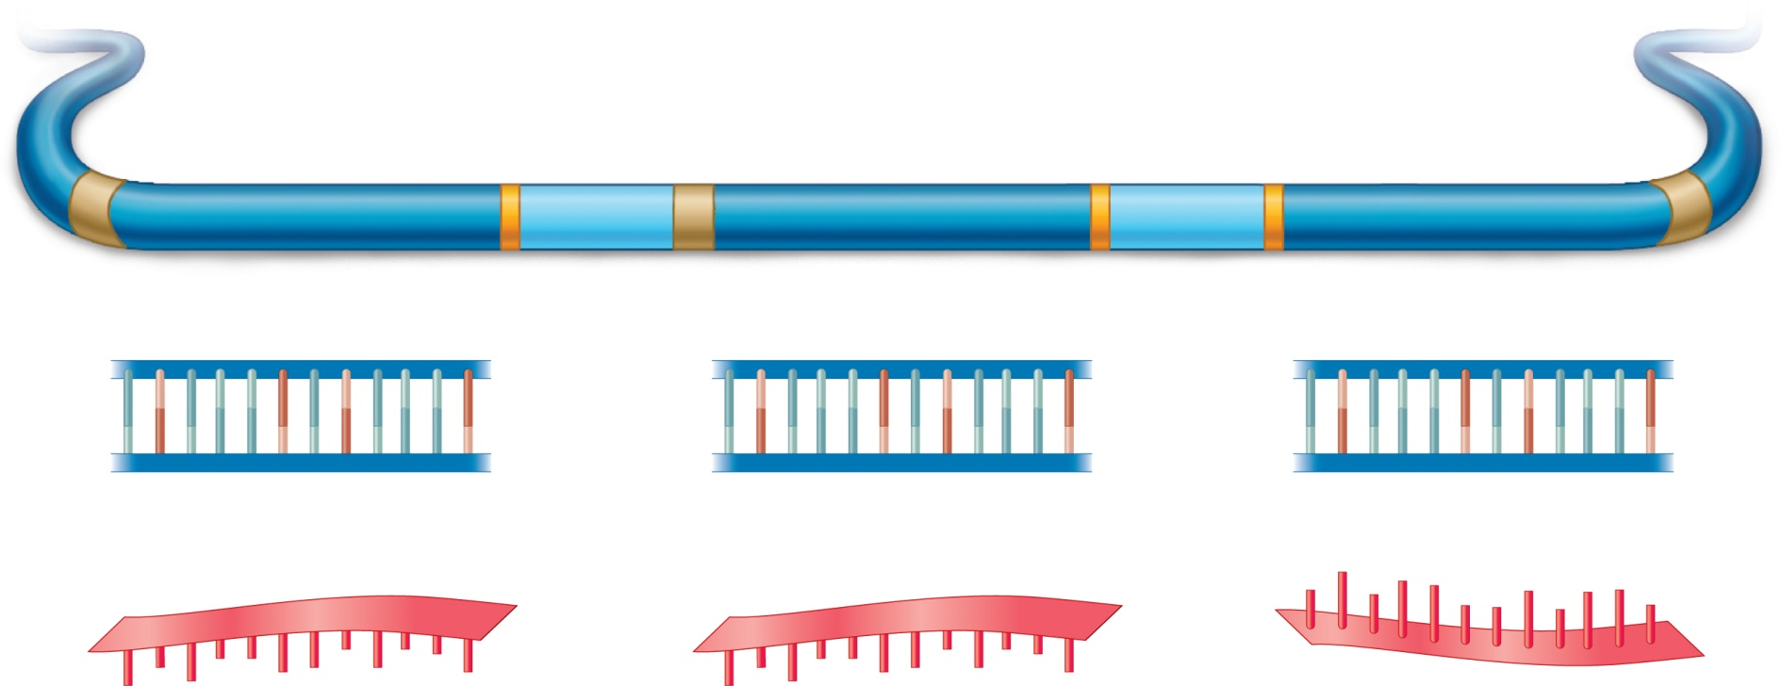
Neighboring genes may be coded on opposite DNA strands
Gene A
Promoter
Gene C
Promoter
Gene B
Promoter
Gene A
Gene B
Gene C
Direction of
transcription
5′
3′
5′
3′
5′
Template strand
3′
3′
5′
3′
5′
3′
5′
Direction of
transcription
Template strand
Template strand
5′
3′
5′
3′
3′
5′
Gene A RNA
Gene B RNA
Gene C RNA
Direction of
translation
Brooker Fig 14.9
Copyright © The McGraw-Hill Companies, Inc. Permission required for reproduction or display.

Slide 12
Bacterial RNA Polymerase is made of five proteins (subunits)
Why is RNA polymerase able to do so many things that DNA polymerase can’t do? (e.g. start without a primer, recognize beginning sequences, “unzip” DNA template, “unwind” DNA template, etc.)

Slide 13
Specific gene expression in prokaryotes is specified by promoter sequence and sigma factor recognition
Sigma factor | Condition of cell when induced | Promoter recognized | Gene activated
σ⁷⁰ | Normal conditions | [-35] -TTGACA- [-10] -TATAAT- | Genes for normal cell function
σ³² | Heat shock | [-39] –CCCC- [-15] -TATAAATA- | Heat shock proteins and chaperonins (protein “stabilizers”)
σ⁵⁴ | Low nitrogen | [-26] -GTGGC- [-14] -TTGCA-- | [Alternative a.a. synthesis]
σ²³ | T4 phage infection | [-15] -TATAATA | [Restriction enzyme for destroying phage DNA]

Slide 14
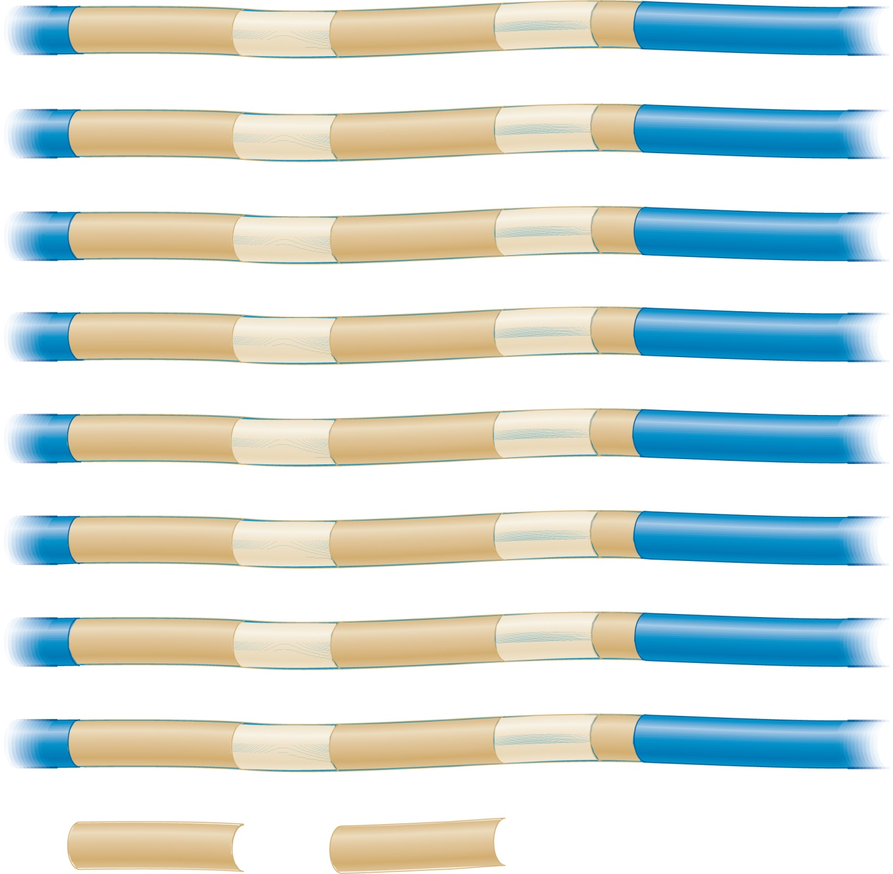
Promoter sequences of various bacterial genes
+1
Transcribed
–35 region
–10 region
Transcribed
lac operon
TTTACA
N₁₇
TATGTT
N₆
A
lacI
GCGCAA
N₁₇
CATGAT
N₇
A
trp operon
TTGACA
N₁₇
TTAACT
N₇
A
rrn X
TTGTCT
N₁₆
TAATAT
N₇
A
recA
TTGATA
N₁₆
TATAAT
N₇
A
lexA
TTCCAA
N₁₇
TATACT
N₆
A
tRNA^{tyr}
TTTACA
N₁₆
TATGAT
N₇
A
Consensus
TTGACA
TATAAT
Brooker, Fig 14.5
Copyright ©The McGraw-Hill Companies, Inc. Permission required for reproduction or display

Slide 15
Upstream consensus sequences in bacterial promoters

Slide 16
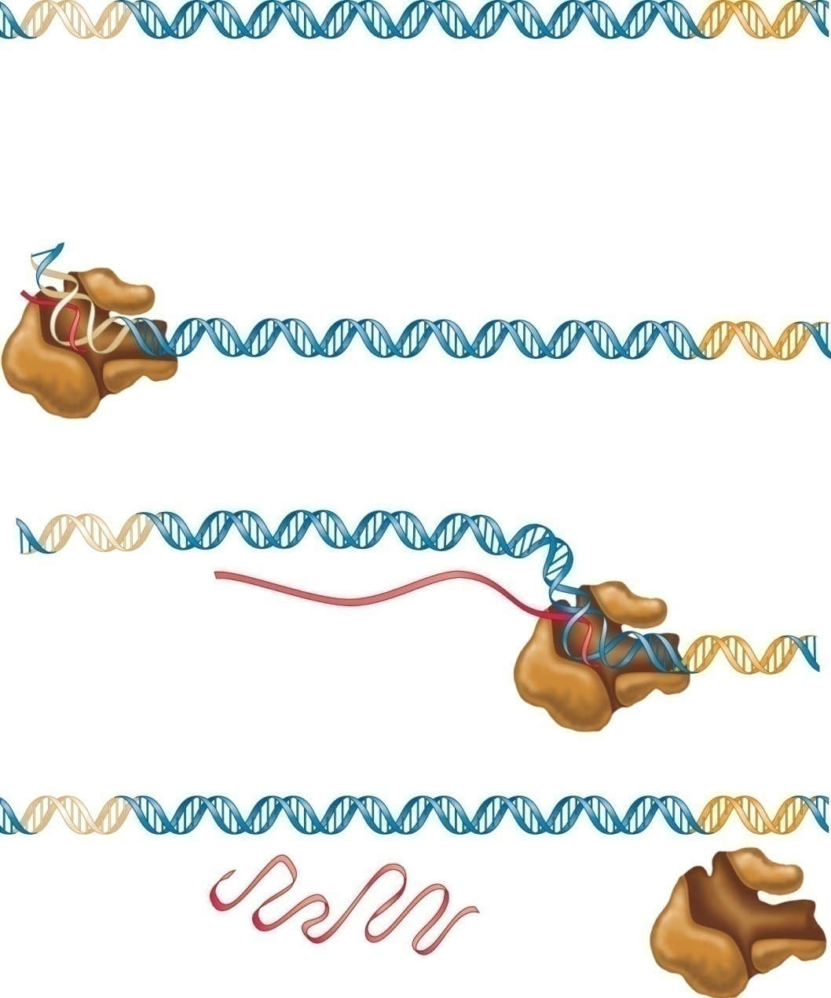
Stages of Transcription
DNA of a gene
Promoter
Terminator
5′ end of growing
RNA transcript
INITIATION:
Promoter sequence functions as recognition site for transcription factors.
Transcription factor(s) enable RNA polymerase to bind to promoter.
DNA is denatured into a bubble (open complex).
Open complex
RNA polymerase
ELONGATION/SYNTHESIS of RNA transcript:
RNA polymerase slides along DNA to synthesize RNA.
TERMINATION: Terminator sequence is reached that causes RNA polymerase and the RNA transcript to dissociate from DNA.
Completed RNA
transcript
RNA
polymerase
Brooker, Fig 14.3
Copyright © The McGraw-Hill Companies, Inc. Permission required for reproduction or display.

Slide 17
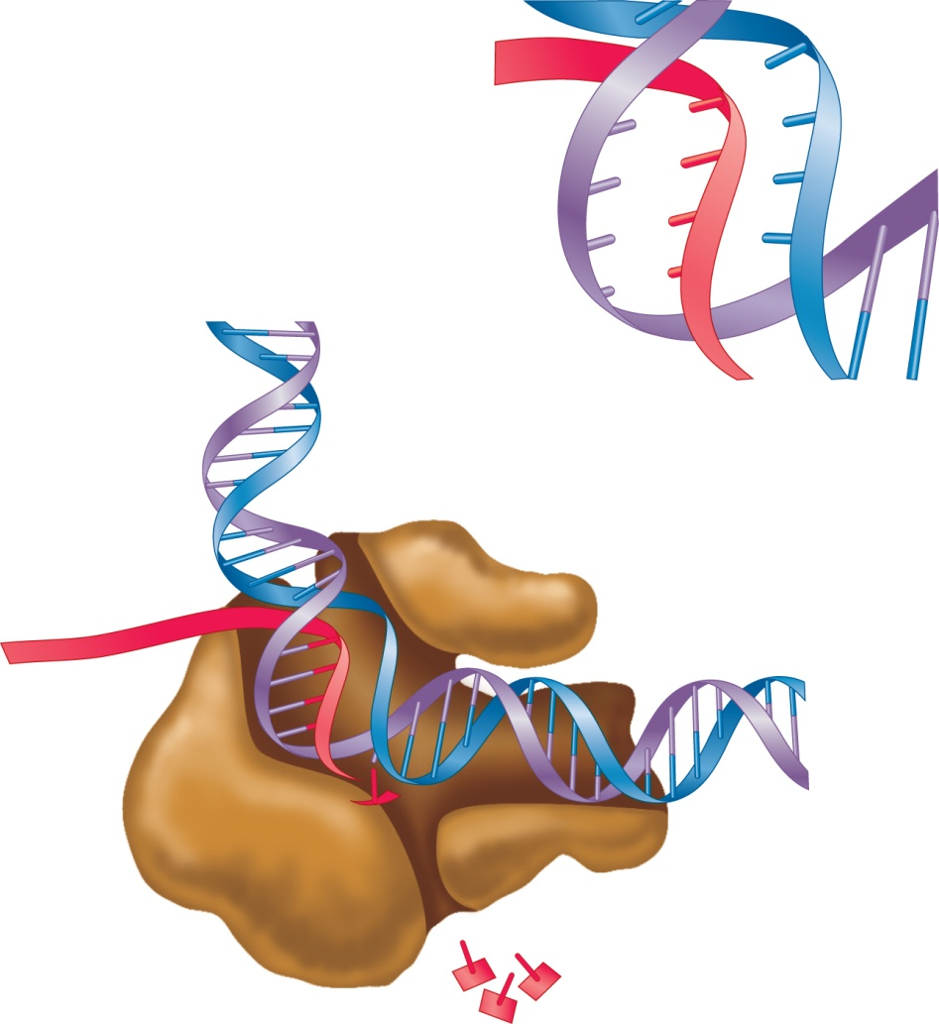
Coding
strand
T
A
U
C
G
C
A
T
A
G
5′
3′
C
G
Coding
strand
Template strand
3′
Template
strand
Rewinding of DNA
RNA polymerase
Open complex
Unwinding of DNA
RNA
Direction of
transcription
5′
3′
RNA–DNA
hybrid
region
5′
Nucleotide being
added to the 3′
end of the RNA
Nucleoside
triphosphates (NTPs)
Key points:
• RNA polymerase slides along the DNA, creating an open
complex as it moves.
• The DNA strand known as the template strand is used to make a
complementary copy of RNA as an RNA–DNA hybrid.
• RNA polymerase moves along the template strand in a 3′ to 5′ direction,
and RNA is synthesized in a 5′ to 3′ direction using nucleoside
triphosphates as precursors. Pyrophosphate is released (not shown).
Figure 14.8
• The complementarity rule is the same as the AT/GC rule except
that U is substituted for T in the RNA.

Slide 18
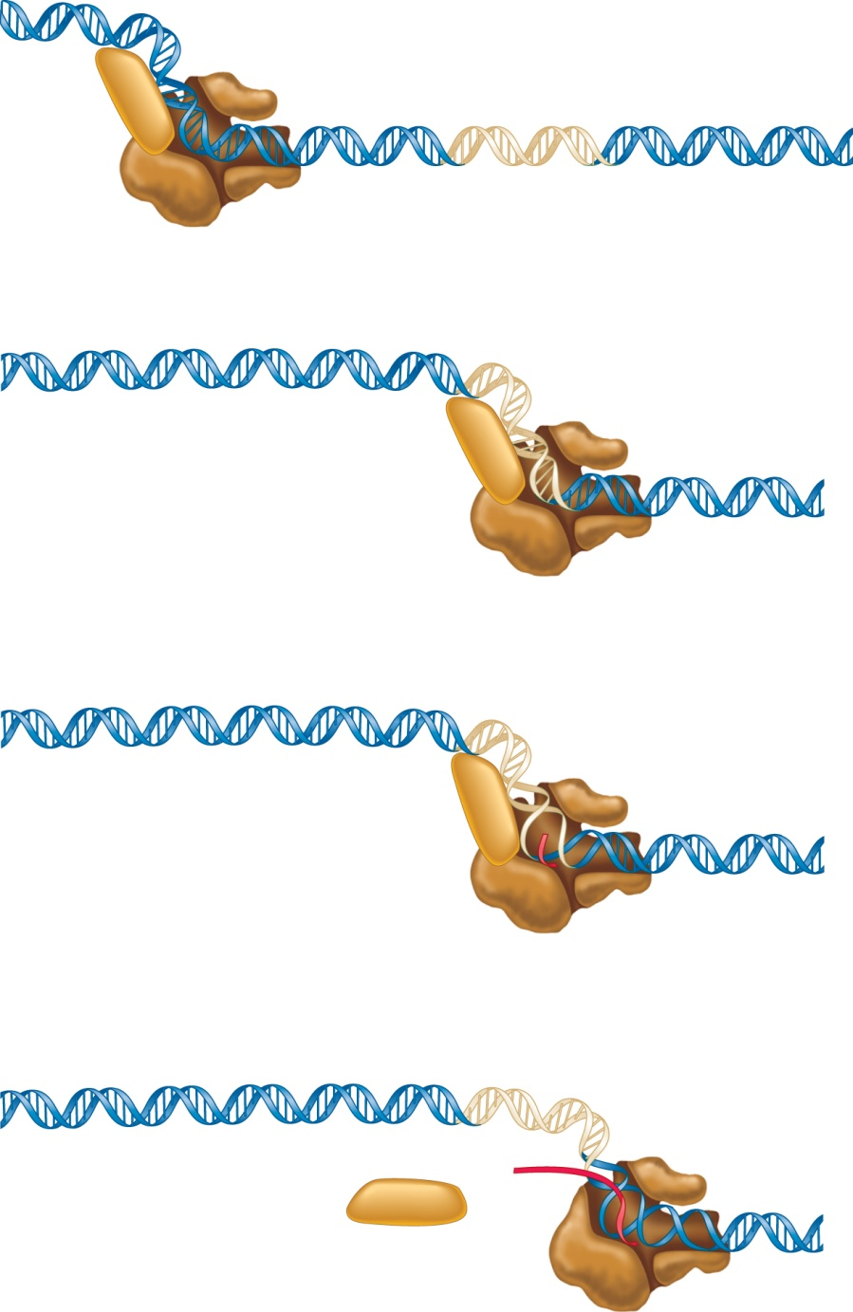
RNA transcription in bacteria
Promotor region
σ
–35
–10
After sliding along the DNA, σ factor recognizes promoter;
RNA polymerase holoenzyme forms a closed complex.
RNA polymerase
holoenzyme
–35
–10
σ
Closed complex
–35
–10
An open complex is formed,
and a short RNA is made.
σ
Open complex
–35
–10
σ factor is released, and the
core enzyme is able to move
down the DNA and make RNA.
RNA transcript
σ factor
RNA polymerase
core enzyme
Brooker, Fig 14.7
Copyright © The McGraw-Hill Companies, Inc. Permission required for reproduction or display.

Slide 19
Rho-dependent termination
DNA codes for ρ recognition site (RUT--rho utilization site)
Terminator
5′
RUT
3′
ρ recognition
site in RNA
5′
ρ protein binds to the
rut site in RNA and moves
toward the 3′ end.
3′
ρ protein
Brooker, Fig 14.10
Copyright © The McGraw-Hill Companies, Inc. Permission required for reproduction or display.

Slide 20
Rho-dependent termination, cont.
RNA polymerase reaches the
terminator. Stem-loop causes RNA polymerase to pause.
5′
Terminator
Stem-loop
3′
ρ protein catches up to the open complex and separates the RNA-DNA hybrid.
3′
5′
Figure 14.10
DNA strands close up and RNA polymerase and RNA strand fall away
Copyright © The McGraw-Hill Companies, Inc. Permission required for reproduction or display.

Slide 21
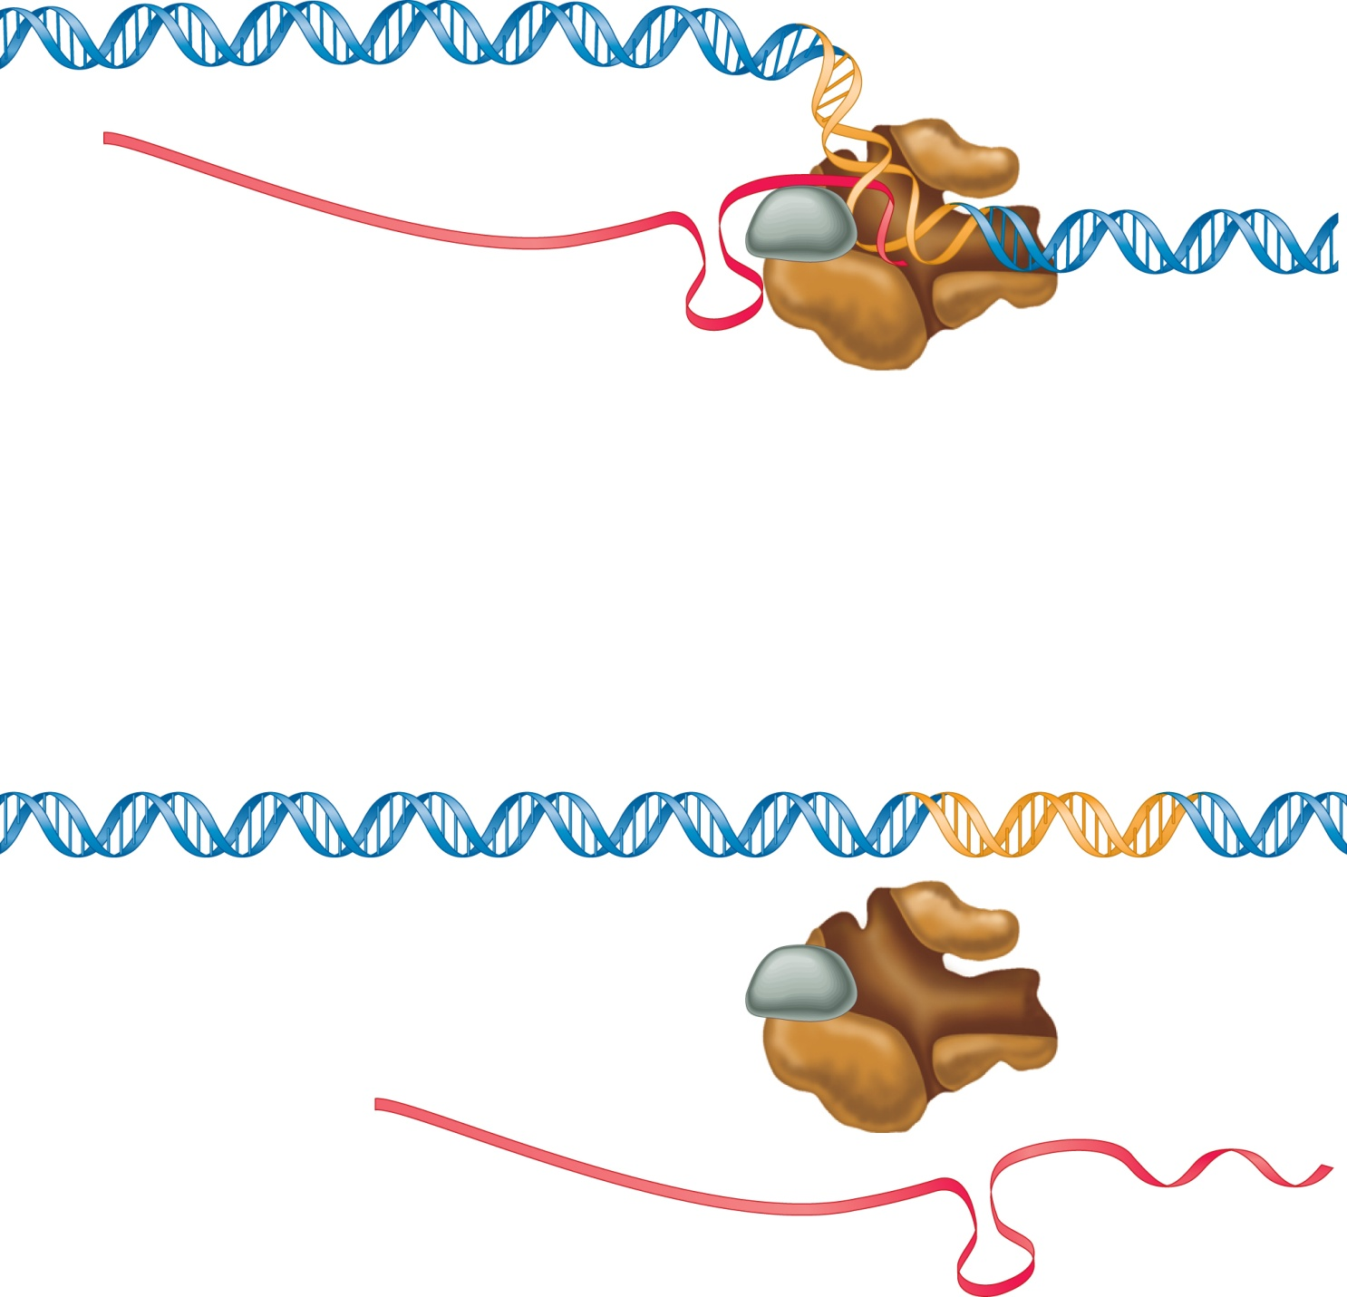
Rho-INdependent Termination
U-rich RNA in
the RNA-DNA
hybrid
5′
Stem-loop that causes
RNA polymerase to pause
NusA
While RNA polymerase pauses,
the U-rich sequence is not able to
hold the RNA-DNA hybrid together.
Terminator
5′
U
U
U
U
3′
Termination occurs.
Brooker, Fig 14.11
Copyright © The McGraw-Hill Companies, Inc. Permission required for reproduction or display.

