Slide 1
Broad Course Objectives
Review the structure of amino acids and polypeptide chains;
Understand how gene sequence determines amino acid sequence
Explain the structure and function of operons;
Explain the structure and function of ribosomes
Necessary for material on Mutations and Hemoglobin Analysis lab.

Slide 2
Study Guide/Outline--Translation
Basic structure of protein
What is the amino-end and the carboxy-end of a polypeptide chain (amino acid chain)? How do the amino acids differ from one another?
What is a peptide bond? What is the difference between 1º, 2º,3º and 4º structure in proteins?
Deciphering the mRNA Transcript
Be able to predict RNA transcript and amino-acid chains if given the sequence of DNA and the codon table.
How does the sequence of DNA nucleotides specify the sequence of amino acids in the protein for which it codes?
What is a codon? What is an anti-codon and where is it found? What are “Start” and “Stop” codons?
Does every codon correspond to different amino acids? Which nucleotide within the codon [1st, 2nd, or 3rd] varies the most and still specifies the same amino acid?
In general, what roles do tRNAs and ribosomes play in translation? How are tRNA’s “charged”?
How is mRNA Translated?
What are the events associated with Initiation, Elongation, and Termination during translation?
What does each component of the translation complex—mRNA, tRNA, small ribosomal subunit, large ribosomal subunit—do during translation?
Which subunit joins the amino acids together? Why is it called a “ribozyme”?
What is a “reading frame”?
How does translation end?
In what part of the cell does translation occur?

Slide 3
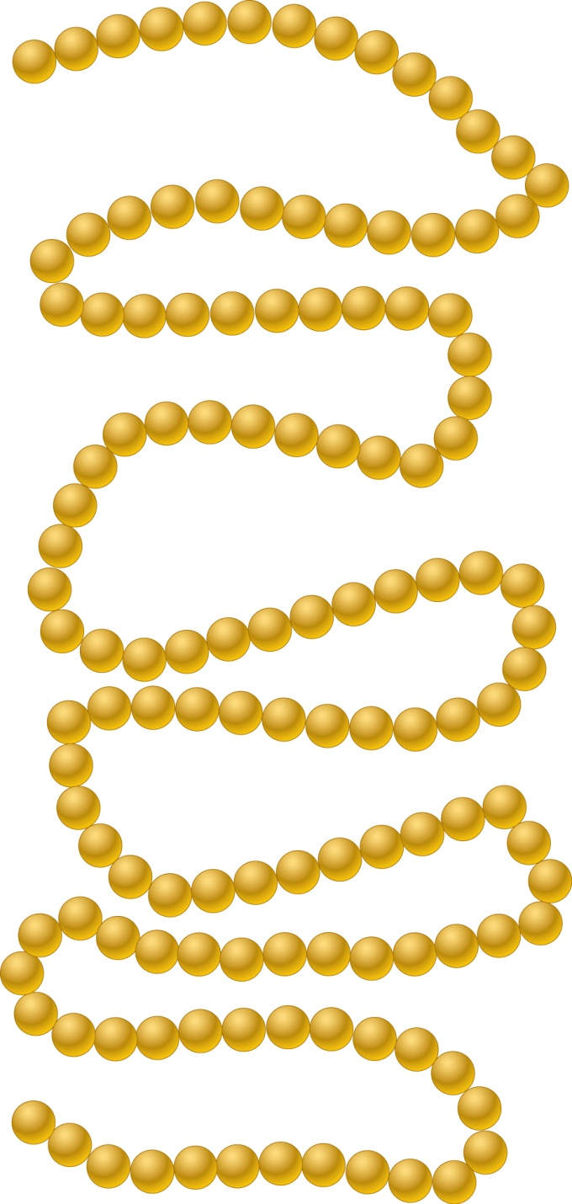
Primary (1º) Structure of Proteins—sequence of amino acids
1
Val
Phe
Gly
Arg
Cys
Glu
Leu
10
Lys
Ala
Ala
NH₃⁺
Ala
Met
Lys
Tyr
Gly
Arg
20
Arg
Leu
Ser
Tyr
Asn
Asp
Leu
Gly
His
Gly
30
Asn
Trp
Val
Cys
Ala
Ala
Lys
Phe
Glu
Ser
Asn
Asn
Arg
Phe
Thr
Asn
Thr
Ala
40
Asn
Asp
Gin
Thr
50
Gly
Ser
60
Trp
Thr
Asn
Ser
Arg
Trp
Asp
Leu
Gln
lle
Cys
Tyr
Gly
lle
Asn
Leu
Asn
Arg
Ser
Gly
70
Gly
Asp
Cys
Pro
Thr
Arg
Asn
lle
Asp
lle
Thr
90
Pro
80
Ser
Ser
Ala
Cys
Ser
Ala
Leu
Leu
Ser
Gly
Asp
Gly
Cys
Asn
Val
Met
Asp
Ser
Val
lle
Lys
Lys
Ala
129 amino acids long
100
The amino acid sequence of the enzyme lysozyme
Asn
Ala
Trp
Val
Ala
Trp
Arg
Asn
Arg
110
Cys
Lys
129
Gly
Leu
Arg
120
COO–
Cys
Gly
Arg
lle
Trp
Ala
Gln
Thr
Val
Asp
Copyright ©The McGraw-Hill Companies, Inc. Permission required for reproduction or display
Brooker, Fig 15.6

Slide 4
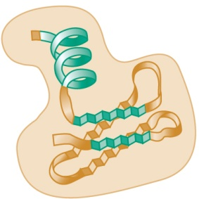
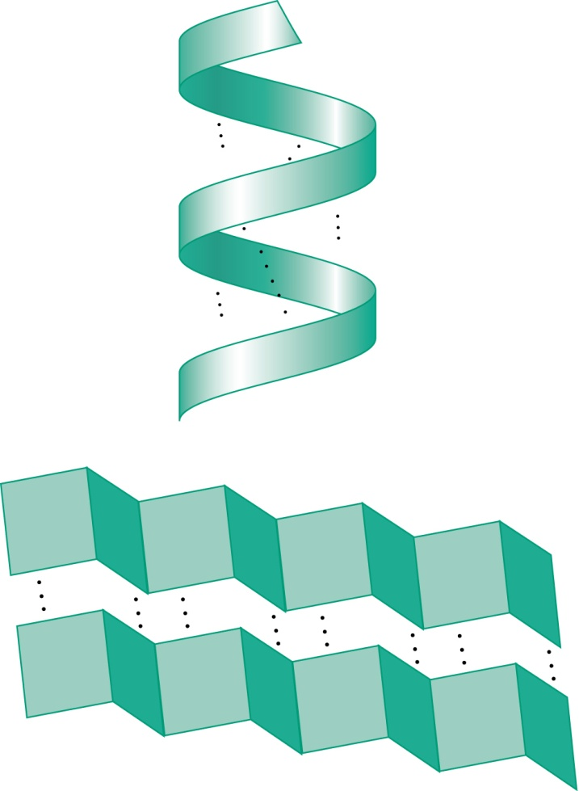
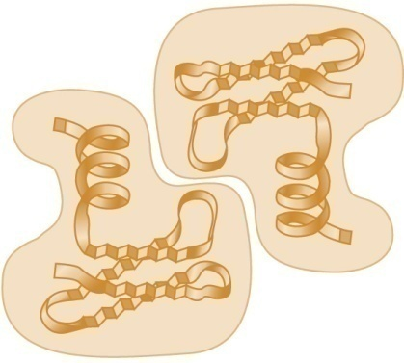
Structural levels of amino acid chains
a) Primary structure
b) Secondary structure
c) Tertiary structure
Sequence of amino.acids
Some regions may fold into
an α helix or β sheet.
Regions of secondary structure and irregularly shaped
regions fold into a three-dimensional conformation
NH₃⁺
C
H
Ala
C
N
C
C
H
O
O
N
COO–
Val
H
H
C
C
N
C
C
N
O
Phe
C
H
O
C
H
O
N
C
C
N
d) Quaternary structure
Glu
H
H
O
C
C
Two or more polypeptides
may associate with each other.
N
C
C
N
O
Tyr
O
α helix
Leu
O
COO–
C
C
H
O
H
O
NH₃⁺
Iso
C
N
C
C
N
C
C
H
O
H
H
O
H
C
C
N
C
C
C
N
C
C
O
H
C
C
C
NH₃⁺
Ala
O
O
H
O
N
C
H
O
C
COO–
C
C
C
C
N
C
H
O
C
H
O
H
O
C
H
C
N
C
N
C
H
O
C
H
O
C
C
C
H
O
C
β sheet
2 polypeptides make up
Subunits of a protein complex
Brooker, Fig 15.7
Copyright ©The McGraw-Hill Companies, Inc. Permission required for reproduction or display

Slide 5
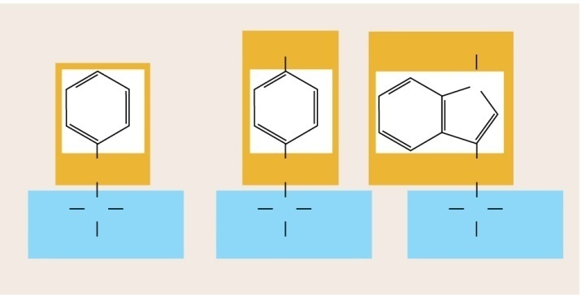
Each amino acid contains a different side chain (R group)
(a) Nonpolar, aliphatic amino acids
CH₃
CH₃
CH₃
CH₃
S
CH₃
CH₃
CH
CH₂
CH₂
SH
CH₂
H
CH₃
CH
CH₂
CH₃
CH
CH₂
CH₂
CH₂
CH₂
+
+
+
+
+
+
+
+
H₃N
C
COO–
H₃N
C
COO–
H₃N
C
COO–
H₃N
C
COO–
H₃N
C
COO–
H₃N
C
COO–
H₃N
C
COO–
H₃N
C
COO–
H
H
H
H
H
H
H
H
Glycine (Gly)
G
Alanine (Ala)
A
Valine (Val)
V
Leucine (Leu)
L
Isoleucine (Ile)
I
Proline (Pro)
P
Cysteine (Cys)
C
Methionine (Met)
M
(b) Aromatic amino acids
OH
H
Nonpolar amino acids are hydrophobic
They are often buried within the interior of a folded protein
N
CH₂
CH₂
CH₂
+
+
+
H₃N
C
COO–
H₃N
C
COO–
H₃N
C
COO–
H
H
H
Phenylalanine (Phe)
F
Tyrosine (Tyr)
Y
Tryptophan (Trp)
W
Brooker, Fig 15.5 a and b
Copyright ©The McGraw-Hill Companies, Inc. Permission required for reproduction or display

Slide 6
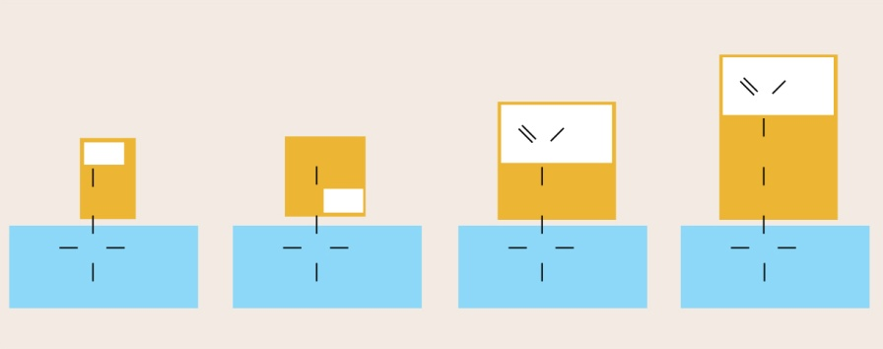
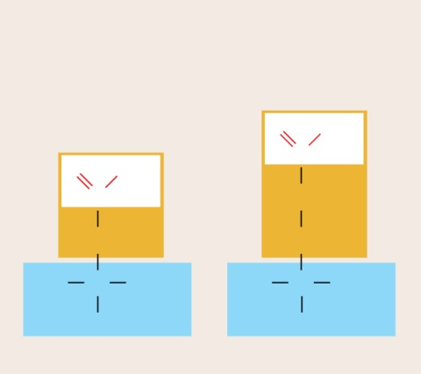
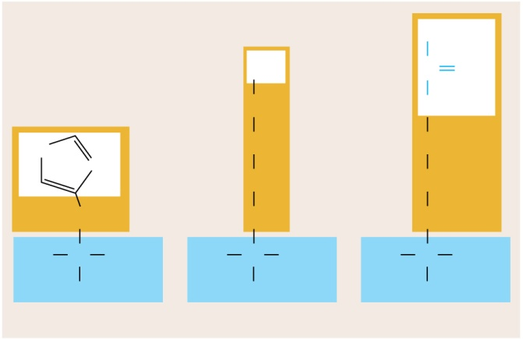
Amino Acids, cont.
(c) Polar, neutral amino acids
Polar and charged amino acids are hydrophilic (more likely to be on the surface of a protein)
O
NH₂
O
NH₂
C
OH
CH₃
C
CH₂
CH₂
HCOH
CH₂
CH₂
+
+
+
+
H₃N
C
COO–
H₃N
C
COO–
H₃N
C
COO–
H₃N
C
COO–
H
H
H
H
Serine (Ser)
S
Threonine (Thr)
T
Asparagine (Asn)
N
Glutamine (Gln)
Q
(d) Polar, acidic amino acids
(e) Polar, basic amino acids
NH₂
+
+
NH₃
C
NH₂
O
O
–
CH₂
NH
O
O
–
C
HN
+
CH₂
CH₂
C
CH₂
NH
CH₂
CH₂
CH₂
CH₂
CH₂
CH₂
CH₂
+
+
+
+
+
H₃N
C
COO–
H₃N
C
COO–
H₃N
C
COO–
H₃N
C
COO–
H₃N
C
COO–
H
H
H
H
H
Aspartic acid (Asp)
D
Glutamic acid (Glu)
E
Histidine (His)
H
Lysine (Lys)
K
Arginine (Arg)
R
Brooker Fig 15.5 c, d, and e
Copyright ©The McGraw-Hill Companies, Inc. Permission required for reproduction or display

Slide 7
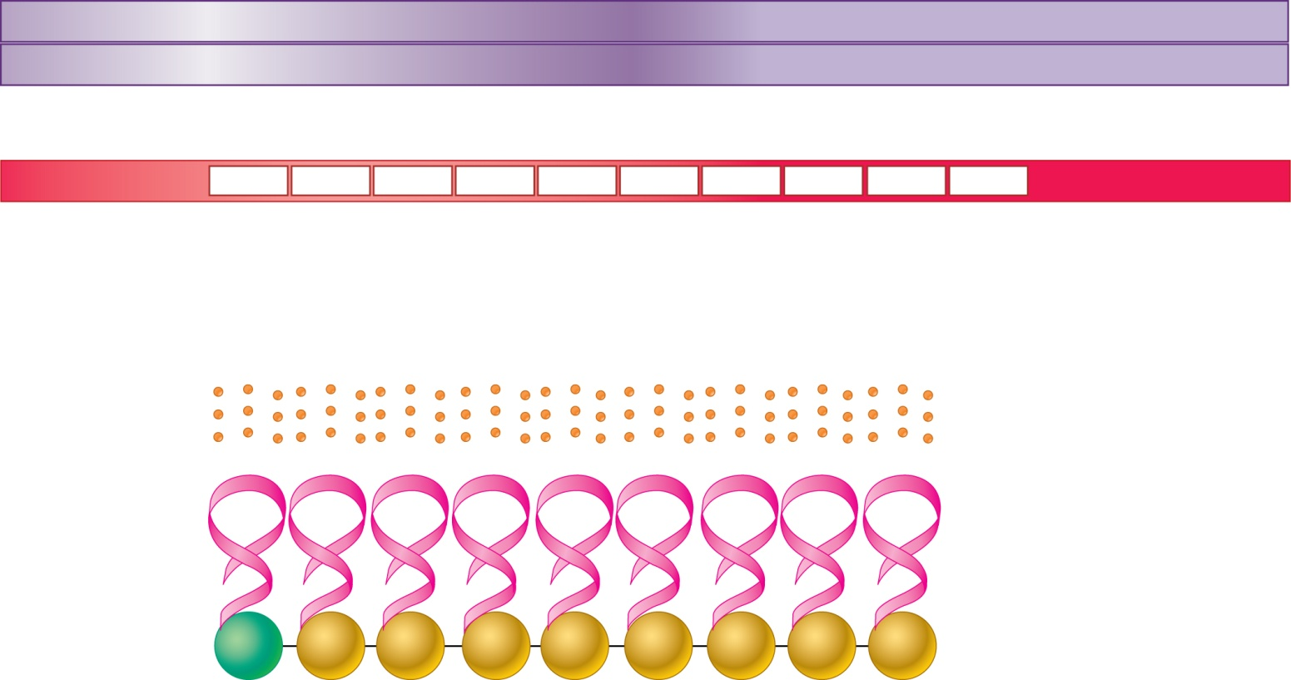
Open Reading Frames (ORF)
Coding strand
DNA
5′
A
C
T
G
C
C
C
A
T
G
A
G
C
G
A
C
C
A
C
T
T
G
G
G
G
C
T
C
G
G
G
G
A
A
T
A
A
C
C
G
T
C
G
A
G
G
3′
3′
T
G
A
C
G
G
G
T
A
C
T
C
G
C
T
G
G
T
G
A
A
C
C
C
C
G
A
G
C
C
C
C
T
T
A
T
T
G
G
C
A
G
C
T
C
C
5′
Transcription
Template strand
5′
A
C
U
G
C
C
C
A
U
G
A
G
C
G
A
C
C
A
C
U
U
G
G
G
G
C
U
C
G
G
G
G
A
A
U
A
A
C
C
G
U
C
G
A
G
G
3′
mRNA
5′ − UTR
Start
codon
Codons
Anticodons
Stop
codon
3′ − UTR
Translation
UAC
UCG
CUG
GUG
A AC
CCC
GAG
CCC
CUU
Polypeptide
tRNA
5′
3′
Met
Ser
Asp
His
Leu
Gly
Leu
Gly
Glu
Note that the start codon sets the reading frame for all remaining codons
Brooker, Fig 15.3
Copyright © The McGraw-Hill Companies, Inc. Permission required for reproduction or display.

Slide 8
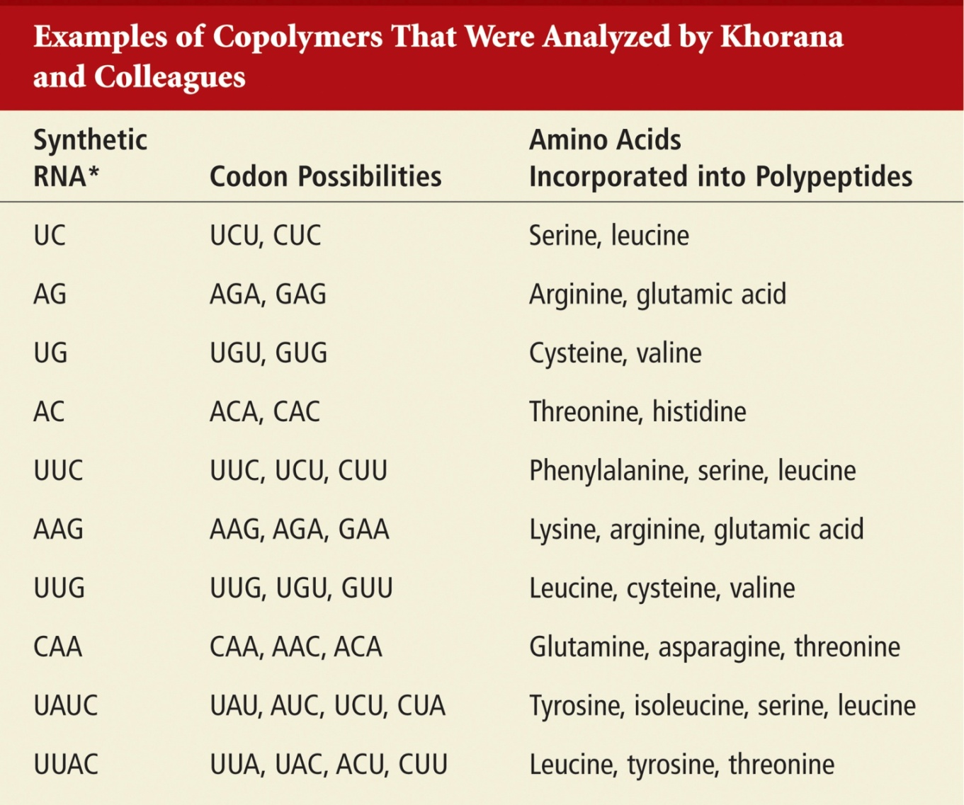
Figuring out the genetic code with synthetic RNAs
Brooker, Table 15.4

Slide 9
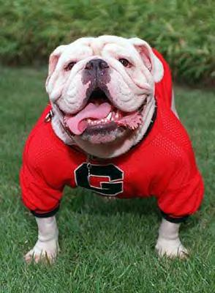
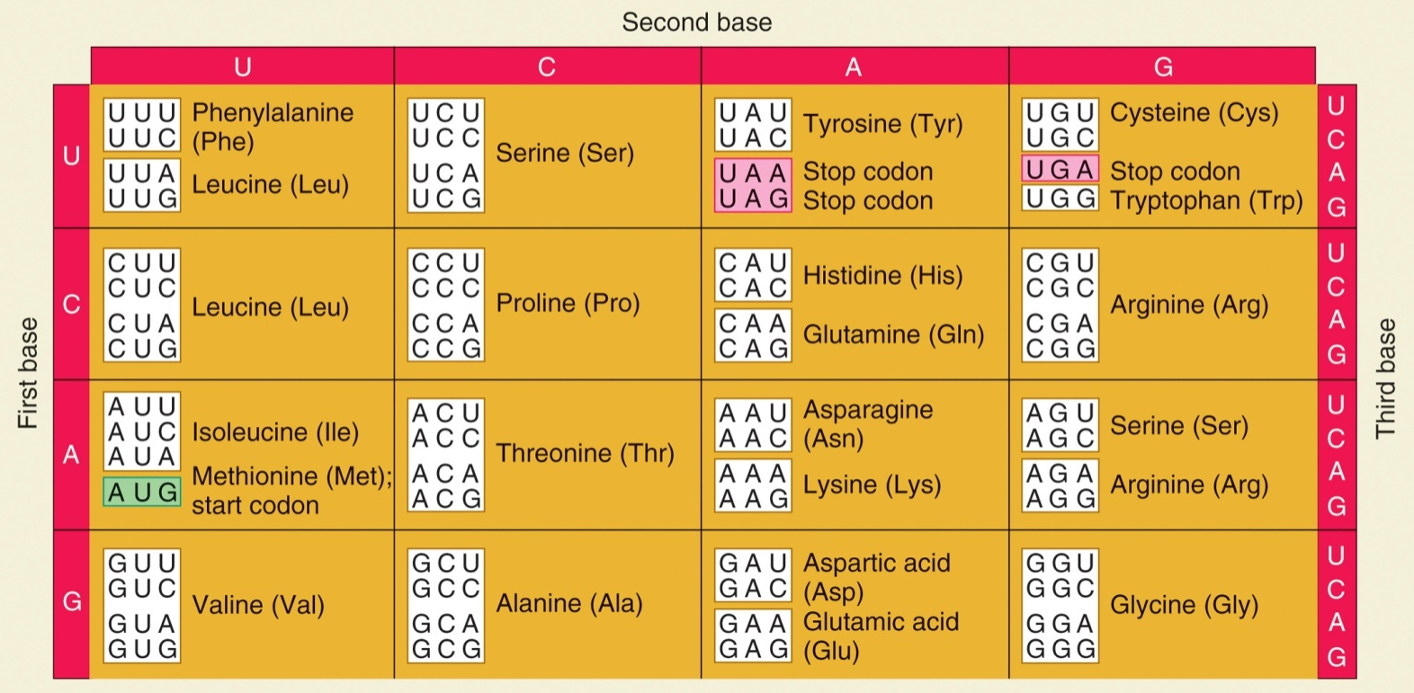
The Genetic Code
Yo, they named a Stop codon after me….
Brooker, Table 15.1

Slide 10
Published gene sequences are the non-template strand for ease of translating the sequence into protein
http://www.ncbi.nlm.nih.gov/entrez/query.fcgi?db=OMIM
http://www.ncbi.nlm.nih.gov/entrez/query.fcgi?db=OMIM

Slide 11
Published strand of the cystic fibrosis gene (CFTR-7q31.2). Sequence corresponds to its RNA sense strand.
1 5’AATTGGAAGC AAATGACATC ACAGCAGGTC AGAGAAAAAG GGTTGAGCGG CAGGCACCCA
61 GAGTAGTAGG TCTTTGGCAT TAGGAGCTTG AGCCCAGACG GCCCTAGCAG GGACCCCAGC
121 GCCCGAGAGA CCATGCAGAG GTCGCCTCTG GAAAAGGCCA GCGTTGTCTC CAAACTTTTT
181 TTCAGCTGGA CCAGACCAAT TTTGAGGAAA GGATACAGAC AGCGCCTGGA ATTGTCAGAC
241 ATATACCAAA TCCCTTCTGT TGATTCTGCT GACAATCTAT CTGAAAAATT GGAAAGAGAA
301 TGGGATAGAG AGCTGGCTTC AAAGAAAAAT CCTAAACTCA TTAATGCCCT TCGGCGATGT
361 TTTTTCTGGA GATTTATGTT CTATGGAATC TTTTTATATT TAGGGGAAGT CACCAAAGCA
421 GTACAGCCTC TCTTACTGGG AAGAATCATA GCTTCCTATG ACCCGGATAA CAAGGAGGAA
481 CGCTCTATCG CGATTTATCT AGGCATAGGC TTATGCCTTC TCTTTATTGT GAGGACACTG
541 CTCCTACACC CAGCCATTTT TGGCCTTCAT CACATTGGAA TGCAGATGAG AATAGCTATG
601 TTTAGTTTGA TTTATAAGAA GACTTTAAAG CTGTCAAGCC GTGTTCTAGA TAAAATAAGT
661 ATTGGACAAC TTGTTAGTCT CCTTTCCAAC AACCTGAACA AATTTGATGA AGGACTTGCA

Slide 12
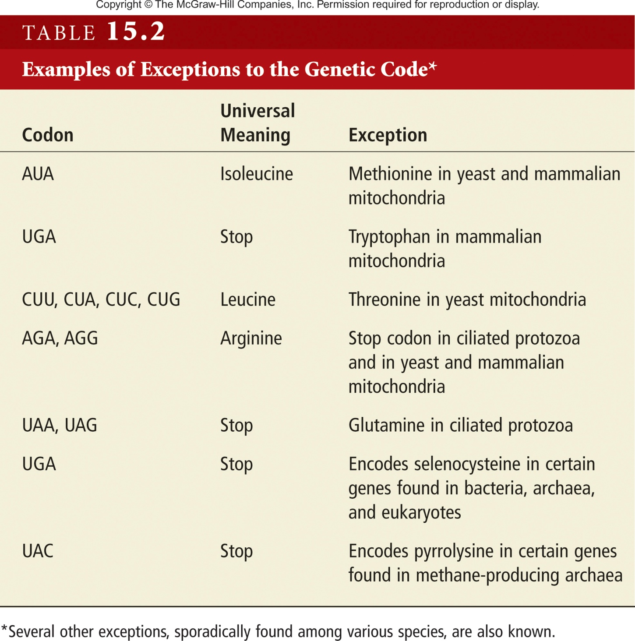
The Genetic Code is almost universal
UAG
Brooker, Table 15.2

Slide 13
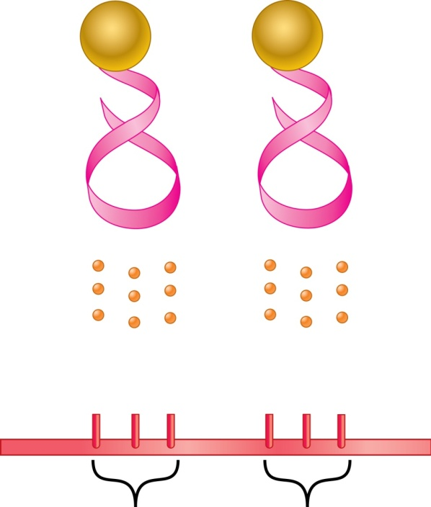
Recognition Between tRNA and mRNA
During mRNA-tRNA recognition, the anticodon in tRNA binds to a complementary codon in mRNA
tRNAs are named according to the amino acid they bear
Phe
Pro
tRNA^{Phe}
5′
5′
tRNA^{Pro}
A
A
G
G
G
C
The anticodon is anti-parallel to the codon
Phenylalanine
anticodon
Proline
anticodon
U
U
C
C
C
G
5′
3′ mRNA
Phenylalanine
codon
Proline
codon
Brooker, Fig 15.10
Copyright ©The McGraw-Hill Companies, Inc. Permission required for reproduction or display

Slide 14
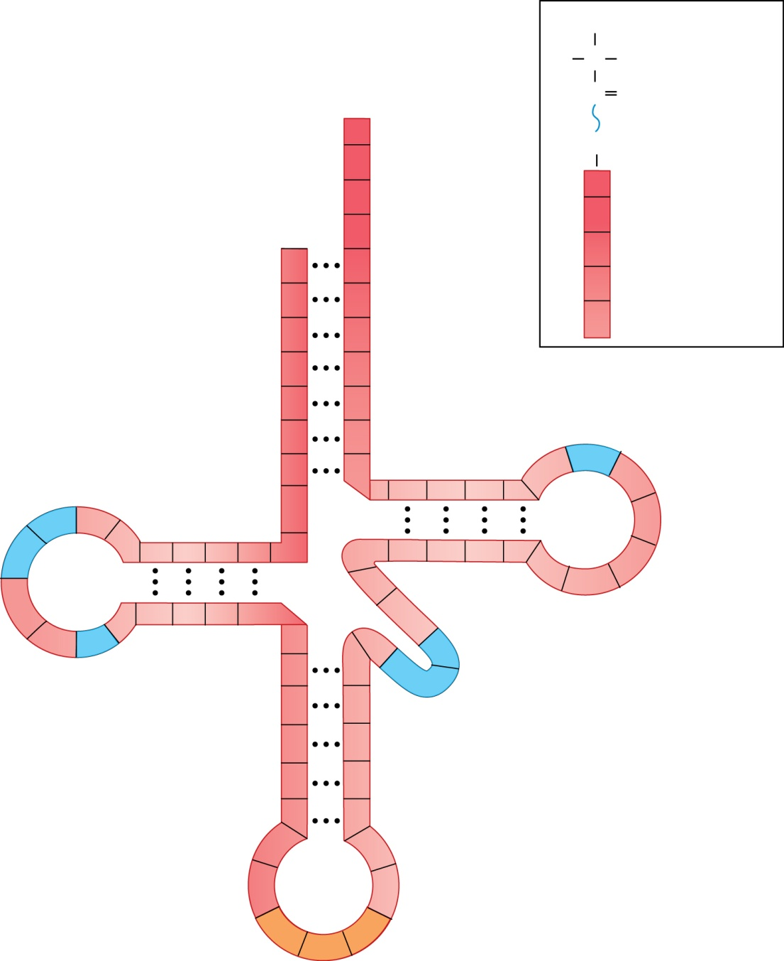
tRNA Structure
NH₃⁺
H
C
R
3′
C
O
Invariant positions: (found in all tRNAs)
A
O
H
O
Covalent
bond
between
tRNA
and an
amino
acid
C
A
C
C
5′
Acceptor stem
C
PO₄
70
Stem–loop
60
U
U
A
Variable positions (not found in all tRNAs)
shown in blue
UH₂
G
10
U
G
C
A
C
50
T
P
G
A
m₂G
G
UH₂
UH₂
19
30
40
The modified bases are:
I = inosine
mI = methylinosine
T = ribothymidine
UH₂ = dihydrouridine
m₂G = dimethylguanosine
P = pseudouridine
U
P
U
mI
I
G
C
Anticodon
Brooker, Fig 15.11
Copyright © The McGraw-Hill Companies, Inc. Permission required for reproduction or display.

Slide 15
Charging of tRNAs with a.a.
Aminoacyl-tRNA
Synthetase (enzyme)
Specific
amino acid
An amino acid and ATP bind to the enzyme.
P
P
P
A
ATP
A
AMP is covalently bound to the amino acid, and pyrophosphate is released.
P
P
P
Pyrophosphate
3′
tRNA
5′
3′
The correct tRNA binds to the enzyme. The amino acid becomes covalently attached to the 3′ end of the tRNA. AMP is released.
5′
P
A
AMP
5′
3′
The “charged” tRNA is released.
Brooker, Fig 15.12
Copyright © The McGraw-Hill Companies, Inc. Permission required for reproduction or display.

Slide 16
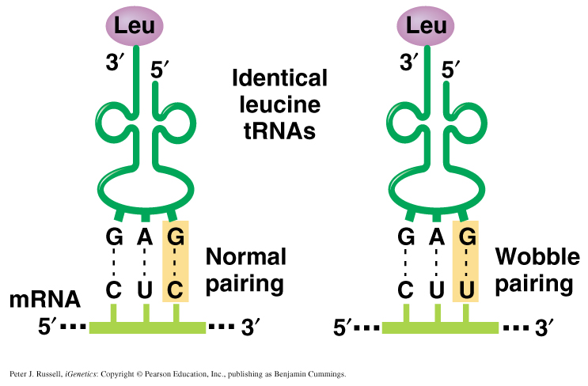
Some codon: anti-codon pairing can tolerate mismatches
Example of base-pairing wobble
Similar to Brooker, fig 15.13
Peter J. Russell, iGenetics: Copyright © Pearson Education, Inc., publishing as Benjamin Cummings.

Slide 17
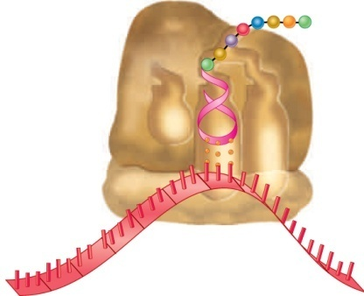
Model for bacterial ribosome structure
Polypeptide
tRNA
E
P
A
50S (large subunit)
30S (small subunit)
mRNA
5′
3′
Brooker, Fig 15.14c
Copyright ©The McGraw-Hill Companies, Inc. Permission required for reproduction or display

Slide 18
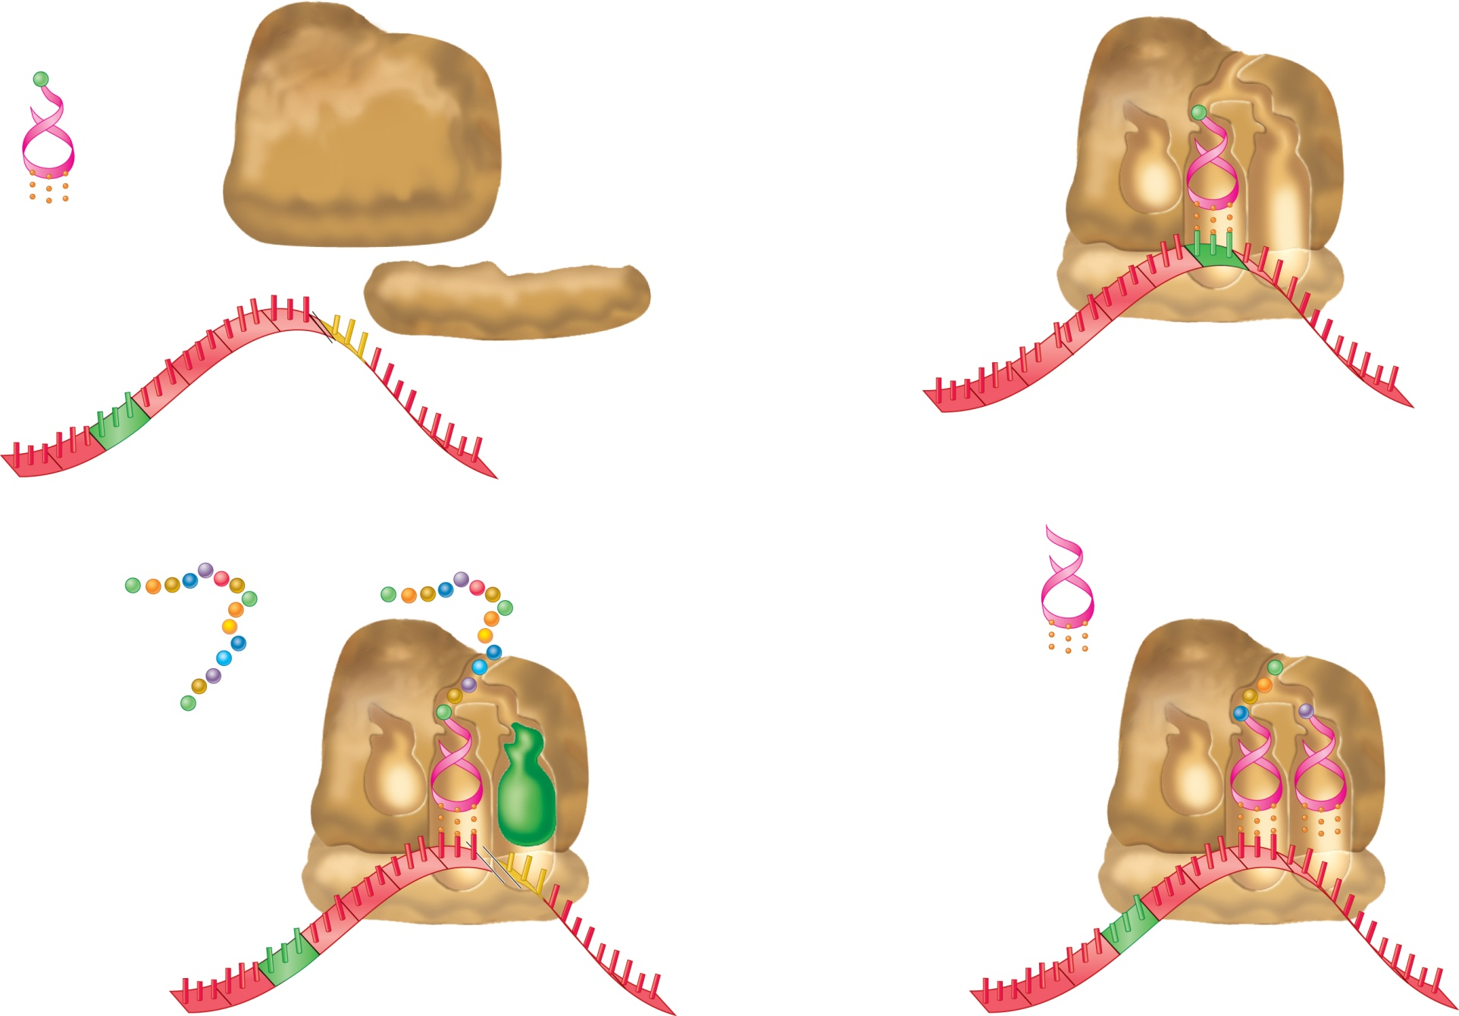
Overview of Translation
Initiator tRNA :
tRNA with first
amino acid
aa₁
aa₁
E
P
A
Ribosomal
subunits
Initiation
UAC
Anticodon
AUG
Start codon
mRNA
UAG
Stop codon
3′
5′
5′
AUG
Start codon
3′
Elongation
(This step
occurs many
times.)
Recycling of translational
components
aa₁
aa₂
aa₃
aa₄
Release
factor
Completed
polypeptide
aa₅
E
P
A
E
P
A
Termination
UAG
Stop codon
5′
3′
5′
3′
Brooker, Fig 15.15
Copyright ©The McGraw-Hill Companies, Inc. Permission required for reproduction or display

Slide 19
Initiation
IF1 and IF3 bind to the 30S subunit.
IF3
30S subunit
IF1
The mRNA binds to the 30S subunit.
The Shine-Dalgarno sequence is
complementary to a portion of the
16S rRNA.
Portion of
16S rRNA
IF3
IF1
Start
codon
Shine-
Dalgarno
sequence
(actually 9
nucleotides long)
5′
3′
Brooker, Fig 15.16
Copyright ©The McGraw-Hill Companies, Inc. Permission required for reproduction or display

Slide 20
Initiation, cont.
tRNA^{fMet}
IF2, which uses GTP, promotes
the binding of the initiator tRNA
to the start codon in the P site.
Initiator tRNA
GTP
IF2
IF3
IF1
5′
3′
IF1 and IF3 are released.
IF2 hydrolyzes its GTP and is released.
The only charged tRNA that enters through the P site
The 50S subunit associates.
70S initiation complex
tRNA^{fMet}
All others enter through the A site
(end of initiation stage)
E
P
A
70S
initiation
complex
5′
3′
Brooker, Fig 15.16
Copyright ©The McGraw-Hill Companies, Inc. Permission required for reproduction or display

Slide 21
Termination
tRNA in P site carries
Completed polypeptide
E
P
A
Stop codon in A site
5′
mRNA
3′
A release factor (RF)
binds to the A site.
E
P
A
5′
3′
The polypeptide is cleaved from the
tRNA in the P site. The tRNA is
then released.
5′
3′
+
The ribosomal subunits, mRNA, and
release factor dissociate.
Brooker, Fig 15.19
3′
5′

Slide 22
Animation of translation
http://vcell.ndsu.nodak.edu/animations/
http://vcell.ndsu.nodak.edu/animations/

Slide 23
Predict the amino acid sequence produced during translation by the following short theoretical mRNA sequences. Note that the second sequence was formed from the first by a deletion of only one nucleotide.
AUG CCG GAU UAU AGU UGA
AUG CCG GAU UAA GUU GA

Slide 24
Predict the amino acid sequence produced during translation by the following short theoretical mRNA sequences. Note that the second sequence was formed from the first by a deletion of only one nucleotide.
AUG CCG GAU UAU AGU UGA
Met Pro Asp Tyr Ser STOP
AUG CCG GAU UAA GUU GA
Met Pro Asp STOP

