Slide 1
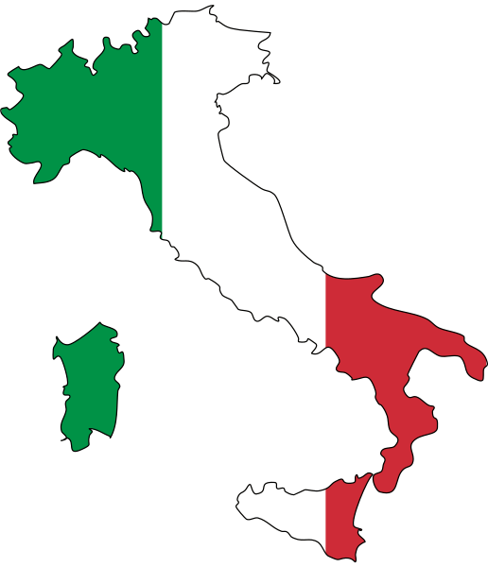
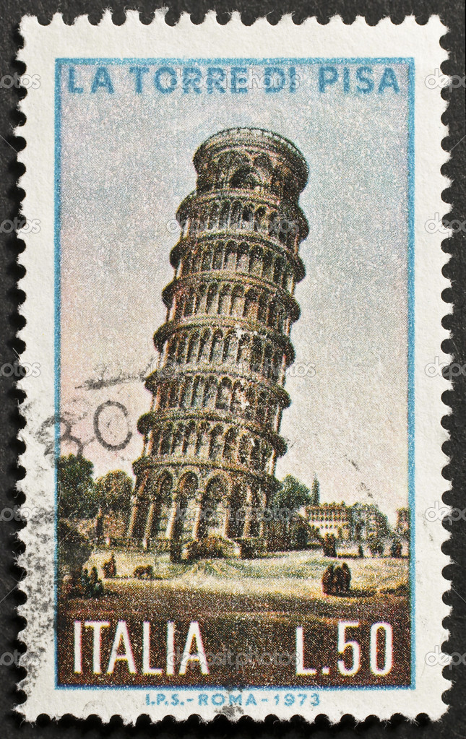
Live to Learn…
Five weeks
in Montepulciano, a beautiful medieval/Renaissance hilltop town overlooking a Tuscan landscape of olive orchards
and grape vineyards.
Five+ Field Adventures
Siena
Perugia
Orvieto
Lake Trasimeno
Florence (2 trips)
Rome (overnight)
And weekends free to
travel to destinations beyond!
Five Great Reasons
Immerse yourself in a new culture in the safety of a small town
Learn through experience while earning 6 credit hours
Experience masterpieces of art and great historic venues
Build your resume
Make new friends
Five K*
The $5400 program fee includes:
All housing
Round-trip airfare
Three-course dinners four nights a week
Program related field trips including admissions, museum entry fees, transportation, etc.
… Art, Science, History, Literature, Geography, theatre, Political Science, and More
by taking
Two Courses
in either of the two sessions:
Session 1: May 14 – June 18
Development and Sustainability
Introduction to Sociology in Italy
Playing in the Piazza: Poets, Lovers, and Clowns
Science, Society, and
the Environment II
Introduction to International Studies
Sociology of Modern Italy
The Art of Theatre
The Art of Science
Session 2: June 25 – July 30
17th Century Italian Painting
Introduction to Sociology
Principles of Public Speaking
Natural Hazards and Disasters
World Literature
The Arts in Society
Sociology of Food in Italy
Travel Writing
Weather and Climate
*Kennesaw State students are eligible for the $800 Global Learning Scholarship.
Montepulciano
Italy Summer 2020
For more info and to sign up: http://dga.kennesaw.edu/educationabroad/index.php

