Slide 1
Pop quiz!

Slide 2
Answer the following questions
Describe the ethical and socio-economic implications of the ‘@’ character
In your own words, describe the economic impact the increase of water-resistant phones has had to the manufacturers
Compare and contrast Apple’s iOS and Google’s Android OS. Be sure to include at least six peer reviewed articles and site all sources in MLA format.
Using the materials found under your seat, design and implement your own cloud service platform. Your platform should have dynamic content, be capable of supporting at least 10-30,000 people, and include automatic user telemetry.
Black and White are considered colors, but black and white television is different from color television. Discuss.
List the models of Raspberry Pi in chronological order
List 3 models of the Windows phone and their specifications
List all versions of Microsoft Windows in chronological order
Has the concept of “Power over ethernet” changed the mesh density of the existing Wi-Fi implementations
IOT devices are often described as “edge devices.” What is the difference between aa “Sharp” edge device and a “dull” edge device
List 10 of the ~40 system calls for the Linux Kernel and describe their behavior
You can stop reading now. Seriously, there are no more real questions after this
The following text is just here to make this slide look really small and scary.
There really isn’t any additional content that follows.
I’m just typing nonsense from now on. It’s not like anybody is going to read this far.
The moon landing was faked by NASA. Nobody really went to the moon.
I just need to fill up the rest of the white space on this slide so everyone will think there is actually some content here
I wonder if anyone is actually able to read this text and if anyone is actually going to read fast enough to get down this far. I hope not, then I’ll have to explain what all of this means
It is a universally accepted truth that any man with a good fortune must be in want of a wife. I find the sited evidence for this theorem lacking at best and I will need to see several more case studies carried out before I subscribe to this theory.
I think this is enough text now. I’ll just past some question from the final exam in. I’m sure nobody will notice.
How many permission bits does each file have in a Linux/Unix system have?
Where is the user account passwords stored in a Linux system?
What does IOT stand for?
What is meant by a “micro-kernel” architecture
What is the purpose of a SQL injection attack?
What does SQL stand for?
List 3 of the 7 SQL commands
Describe Mete Character Filtering
What method of attach involves execution of an attacker's code within a victim's browser?
List and describe one of the three cross site scripting attack types
What is the difference between cross site scripting and cross site request forgery?
What are some methods that might help prevent a cross site request forgery attack?
Describe how an HTTP GET request encodes its arguments?

Slide 3
Contractually obligated “Happy Halloween”

Slide 4
Wireless Security

Slide 5
Wireless Communication
Wireless technology started in the early 1970s.
Wireless technology is one of the fastest developing technologies of the communication industry.
  Very popular
It is based on wireless networking technology that includes WLAN, Wireless WAN, Web and an industry of wireless communication devices.

Slide 6
Wireless Communication
In its simplest form, wireless technology is based on a concept of a cell
That is why wireless communication is sometimes referred to as cellular communication.
The wireless infrastructure, because of distance problems, is in most parts supported and complemented by other wired and other communication technologies such as satellite, infrared, microwave, and radio.

Slide 7
Wireless Communication
Data is transmitted over a dedicated bandwidth.
This bandwidth is split into several segments called cells
  Cells are permanently assigned to small geographical regions
Cells are roughly ten square miles or less depending on the density of cellular phones in the geographical cell.
Each cell has, at its center, a communication tower called the base station (BS)
The BS receives and sends data usually via a satellite. Each BS operates two types of channels:
  The control channel which is used in the exchange when setting up and maintaining calls
  The traffic channel to carry voice/data.

Slide 8


Elements of a wireless network
wireless hosts
laptop, smartphone
run applications
may be stationary (non-mobile) or mobile
  wireless does not always mean mobility
network
infrastructure

Slide 9

Elements of a wireless network
base station
typically connected to wired network
relay - responsible for sending packets between wired network and wireless host(s) in its “area”
  e.g., cell towers, 802.11 access points
network
infrastructure

Slide 10
Elements of a wireless network
wireless link
typically used to connect mobile(s) to base station
also used as backbone link
multiple access control (MAC) protocol coordinates link access
various data rates, transmission distance
network
infrastructure

Slide 11
Elements of a wireless network
infrastructure node
base station connects mobiles into wired network
handoff: mobile changes base station providing connection into wired network
network
infrastructure

Slide 12
Elements of a wireless network
ad hoc mode
no base stations
nodes can only transmit to other nodes within link coverage
nodes organize themselves into a network: route among themselves

Slide 13
Wireless network taxonomy
single hop
multiple hops
host connects to
base station (WiFi,
WiMAX, cellular)
which connects to
larger Internet
host may have to
relay through several
wireless nodes to
connect to larger
Internet: mesh net
infrastructure
(e.g., APs)
no base station, no
connection to larger
Internet. May have to
relay to reach other
wireless nodes:
MANET, VANET
no
infrastructure
no base station, no
connection to larger
Internet (Bluetooth,
ad hoc nets)

Slide 14
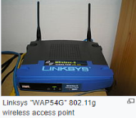
Access Point (AP)
An AP connects directly to a wired Ethernet connection and the AP then provides wireless connections using radio frequency links for other devices to utilize that wired connection.
Most APs support the connection of multiple wireless devices to one wired connection.
Modern APs are built to support a standard for sending and receiving data using these radio frequencies, use IEEE 802.11 standards.

Slide 15
802.11
Provides several distinct radio frequency ranges:
  900 MHz
  2.4 GHz
  5 GHz
  5.9 GHz
  60 GHz
A (US) standard speed Wi-Fi signal typically occupies five out of a possible 13 channels in the 2.4 GHz band
Notes:
Countries apply their own regulations to the allowable channels, allowed users and maximum power levels within these frequency ranges. The ISM band ranges are also often used.
Any two channel numbers that differ by five or more, such as 2 and 7, do not overlap (no adjacent-channel interference). The oft-repeated adage that channels 1, 6, and 11 are the only non-overlapping channels is, therefore, not accurate.
However, many 2.4 GHz 802.11b and 802.11g access-points default to the same channel on initial startup, contributing to congestion on certain channels. These issues can become a problem in high-density areas, such as large apartment complexes or office buildings with many Wi-Fi access points.
Other devices use the 2.4 GHz band: microwave ovens, ISM band devices, security cameras, ZigBee devices, Bluetooth devices, video senders, cordless phones, baby monitors, and, in some countries, amateur radio, all of which can cause significant additional interference.

Slide 16
Wireless Security Overview
Concerns for wireless security are similar to those found in a wired environment
Security requirements are the same:
  confidentiality, integrity, availability, authenticity, accountability
  most significant source of risk is the underlying communications medium
Notes:
The concerns for wireless security, in terms of threats, and countermeasures, are
similar to those found in a wired environment, such as an Ethernet LAN or a wired
wide-area network. The security requirements are the same in both environments:
confidentiality, integrity, availability, authenticity, and accountability. However,
some of the security threats are exacerbated in a wireless environment and some are
unique to the wireless environment. The most significant source of risk in wireless
networks is the underlying communications medium. In addition, there have
traditionally been security risks in wireless protocols that have only been addressed
in relatively recent generations of these protocols.

Slide 17
Wireless Security
Key factors contributing to higher security risk of wireless networks compared to wired networks include:
  Channel
    Wireless networking typically involves broadcast communications, which is far more susceptible to eavesdropping and jamming than wired networks
    Wireless networks are also more vulnerable to active attacks that exploit vulnerabilities in communications protocols
  Mobility
    Wireless devices are far more portable and mobile, thus resulting in several risks
  Resources
    Some wireless devices, such as smartphones and tablets, have sophisticated operating systems but limited memory and processing resources with which to counter threats, including denial of service and malware
  Accessibility
    Some wireless devices, such as sensors and robots, may be left unattended in remote and/or hostile locations, thus greatly increasing their vulnerability to physical attacks
Notes:
Wireless networks, and the wireless devices that use them, introduce a host of security
problems over and above those found in wired networks. Some of the key factors
contributing to the higher security risk of wireless networks compared to wired
networks include the following [MA10]:
• Channel: Wireless networking typically involves broadcast communications,
which is far more susceptible to eavesdropping and jamming than wired networks.
Wireless networks are also more vulnerable to active attacks that
exploit vulnerabilities in communications protocols.
• Mobility: Wireless devices are, in principal and usually in practice, far more
portable and mobile than wired devices. This mobility results in a number of
risks, described subsequently.
• Resources: Some wireless devices, such as smartphones and tablets, have
sophisticated operating systems but limited memory and processing resources
with which to counter threats, including denial of service and malware.
• Accessibility: Some wireless devices, such as sensors and robots, may be left
unattended in remote and/or hostile locations. This greatly increases their vulnerability
to physical attacks.

Slide 18
Wireless Network Threats
accidental association
malicious association
ad hoc networks
nontraditional networks
identity theft (MAC spoofing)
man-in-the middle attacks
denial of service (DoS)
network injection
Notes:
[CHOI08] lists the following security threats to wireless networks:
• Accidental association: Company wireless LANs or wireless access points to
wired LANs in close proximity (e.g., in the same or neighboring buildings) may
create overlapping transmission ranges. A user intending to connect to one
LAN may unintentionally lock on to a wireless access point from a neighboring
network. Although the security breach is accidental, it nevertheless exposes
resources of one LAN to the accidental user.
• Malicious association: In this situation, a wireless device is configured to
appear to be a legitimate access point, enabling the operator to steal passwords
from legitimate users and then penetrate a wired network through a legitimate
wireless access point.
• Ad hoc networks: These are peer-to-peer networks between wireless
computers with no access point between them. Such networks can pose a
security threat due to a lack of a central point of control.
• Nontraditional networks: Nontraditional networks and links, such as personal
network Bluetooth devices, barcode readers, and handheld PDAs pose a
security risk both in terms of eavesdropping and spoofing.
• Identity theft (MAC spoofing): This occurs when an attacker is able to
eavesdrop on network traffic and identify the MAC address of a computer
with network privileges.
• Man-in-the middle attacks: This type of attack is in
the context of the Diffie-Hellman key exchange protocol. In a broader sense,
this attack involves persuading a user and an access point to believe that they
are talking to each other when in fact the communication is going through an
intermediate attacking device. Wireless networks are particularly vulnerable
to such attacks.
• Denial of service (DoS): In the context of a wireless network, a DoS attack occurs when an
attacker continually bombards a wireless access point or some other accessible
wireless port with various protocol messages designed to consume
system resources. The wireless environment lends itself to this type of attack,
because it is so easy for the attacker to direct multiple wireless messages at
the target.
• Network injection: A network injection attack targets wireless access points
that are exposed to non-filtered network traffic, such as routing protocol
messages or network management messages. An example of such an attack is
one in which bogus reconfiguration commands are used to affect routers and
switches to degrade network performance.

Slide 19

Wireless Security Techniques
use encryption
allow only specific computers to access your wireless network
use anti-virus and anti-spyware software and a firewall
change your router’s pre-set password for administration
turn off identifier broadcasting
change the identifier on your router from the default
Notes:
[CHOI08] recommends the following techniques
for wireless network security:
1. Use encryption. Wireless routers are typically equipped with built-in
encryption mechanisms for router-to-router traffic.
2. Use anti-virus and anti-spyware software, and a firewall. These facilities
should be enabled on all wireless network endpoints.
3. Turn off identifier broadcasting. Wireless routers are typically configured to
broadcast an identifying signal so that any device within range can learn of
the router’s existence. If a network is configured so that authorized devices
know the identity of routers, this capability can be disabled, so as to thwart
attackers.
4. Change the identifier on your router from the default. Again, this measure
thwarts attackers who will attempt to gain access to a wireless network using
default router identifiers.
5. Change your router’s pre-set password for administration. This is another
prudent step.
6. Allow only specific computers to access your wireless network. A router
can be configured to only communicate with approved MAC addresses.
Of course, MAC addresses can be spoofed, so this is just one element of a
security strategy.

Slide 20
Security Threats
Lack of physical security controls
Use of untrusted networks
Use of untrusted mobile devices
Use of applications created by unknown parties
Interaction with other systems
Use of untrusted content
Use of location services
Notes:
If a mobile device is used on premises, it can
connect to organization resources over the organization’s own in-house wireless
networks. However, for off-premises use, the user will typically access organizational
resources via Wi-Fi or cellular access to the Internet and from the Internet to the
organization. Thus, traffic that includes an off-premises segment is potentially
susceptible to eavesdropping or man-in-the-middle types of attacks. Thus, the
security policy must be based on the assumption that the networks between the
mobile device and the organization are not trustworthy.
Use of Applications Created by Unknown Parties By design, it is easy to find
and install third-party applications on mobile devices. This poses the obvious risk of
installing malicious software. An organization has several options for dealing with
this threat, as described subsequently.
Interaction with other Systems A common feature found on smartphones
and tablets is the ability to automatically synchronize data, apps, contacts, photos,
and so on with other computing devices and with cloud-based storage. Unless an
organization has control of all the devices involved in synchronization, there is
considerable risk of the organization’s data being stored in an unsecured location,
plus the risk of the introduction of malware.
Use of Untrusted Content Mobile devices may access and use content that other
computing devices do not encounter. An example is the Quick Response (QR) code,
which is a two-dimensional barcode. QR codes are designed to be captured by a mobile
device camera and used by the mobile device. The QR code translates to a URL, so
that a malicious QR code could direct the mobile device to malicious Web sites.
Use of Location Services The GPS capability on mobile devices can be used
to maintain a knowledge of the physical location of the device. While this feature
might be useful to an organization as part of a presence service, it creates security
risks. An attacker can use the location information to determine where the device
and user are located, which may be of use to the attacker.
Mobile Device Security Strategy
With the threats listed in the preceding discussion in mind, we outline the principal
elements of a mobile device security strategy. They fall into three categories: device
security, client/server traffic security, and barrier security (Figure 24.2).
Device Security A number of organizations will supply mobile devices for
employee use and pre-configure those devices to conform to the enterprise security
policy. However, many organizations will find it convenient or even necessary to
adopt a bring-your-own-device (BYOD) policy that allows the personal mobile
devices of employees to have access to corporate resources. IT managers should be
able to inspect each device before allowing network access. IT will want to establish
configuration guidelines for operating systems and applications.

Slide 21
Notes:
With the threats listed in the preceding discussion in mind, we outline the principal
elements of a mobile device security strategy. They fall into three categories: device
security, client/server traffic security, and barrier security (Figure 24.2).

Slide 22
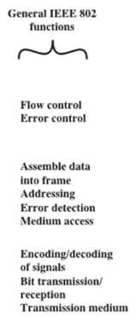
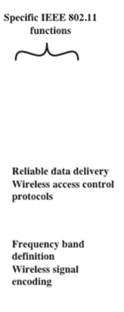
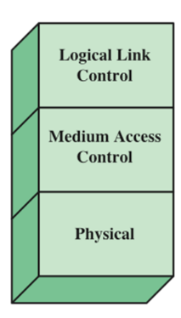
IEEE 802 Protocol Architecture
Notes:
Before proceeding, we need to briefly preview the IEEE 802 protocol architecture.
IEEE 802.11 standards are defined within the structure of a layered set
of protocols. This structure, used for all IEEE 802 standards, is illustrated in
Figure 24.2 .
The lowest layer of the IEEE 802 reference model is the
physical layer , which includes such functions as encoding/decoding of signals and
bit transmission/reception. In addition, the physical layer includes a specification of
the transmission medium. In the case of IEEE 802.11, the physical layer also defines
frequency bands and antenna characteristics.
All LANs consist of collections of devices that share
the network’s transmission capacity. Some means of controlling access to the
transmission medium is needed to provide an orderly and efficient use of that
capacity. This is the function of a medium access control (MAC) layer. The MAC
layer receives data from a higher-layer protocol, typically the logical link control
(LLC) layer, in the form of a block of data known as the MAC service data unit
(MSDU) . In general, the MAC layer performs the following functions:
• On transmission, assemble data into a frame, known as a MAC protocol data
unit (MPDU) with address and error-detection fields.
• On reception, disassemble frame, and perform address recognition and error
detection.
• Govern access to the LAN transmission medium.

Slide 23
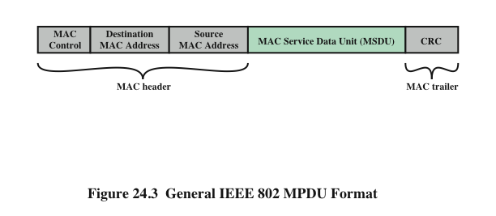
General IEEE 802 MPDU Format
MAC Protocol Data Unit
Notes:
The exact format of the MPDU differs somewhat for the various MAC protocols
in use. In general, all of the MPDUs have a format similar to that of Figure 24.3 .
The fields of this frame are as follows:
• MAC Control: This field contains any protocol control information needed
for the functioning of the MAC protocol. For example, a priority level could
be indicated here.
• Destination MAC Address: The destination physical address on the LAN for
this MPDU.
• Source MAC Address: The source physical address on the LAN for this
MPDU.
• MAC Service Data Unit: The data from the next higher layer.
• CRC: The cyclic redundancy check field, also known as the Frame Check
Sequence (FCS) field. This is an error-detecting code, such as that which is
used in other data-link control protocols. The CRC is calculated based on the
bits in the entire MPDU. The sender calculates the CRC and adds it to the
frame. The receiver performs the same calculation on the incoming MPDU
and compares that calculation to the CRC field in that incoming MPDU. If the
two values don’t match, then one or more bits have been altered in transit.
The fields preceding the MSDU field are referred to as the MAC header , and
the field following the MSDU field is referred to as the MAC trailer . The header
and trailer contain control information that accompany the data field and that are
used by the MAC protocol.

Slide 24
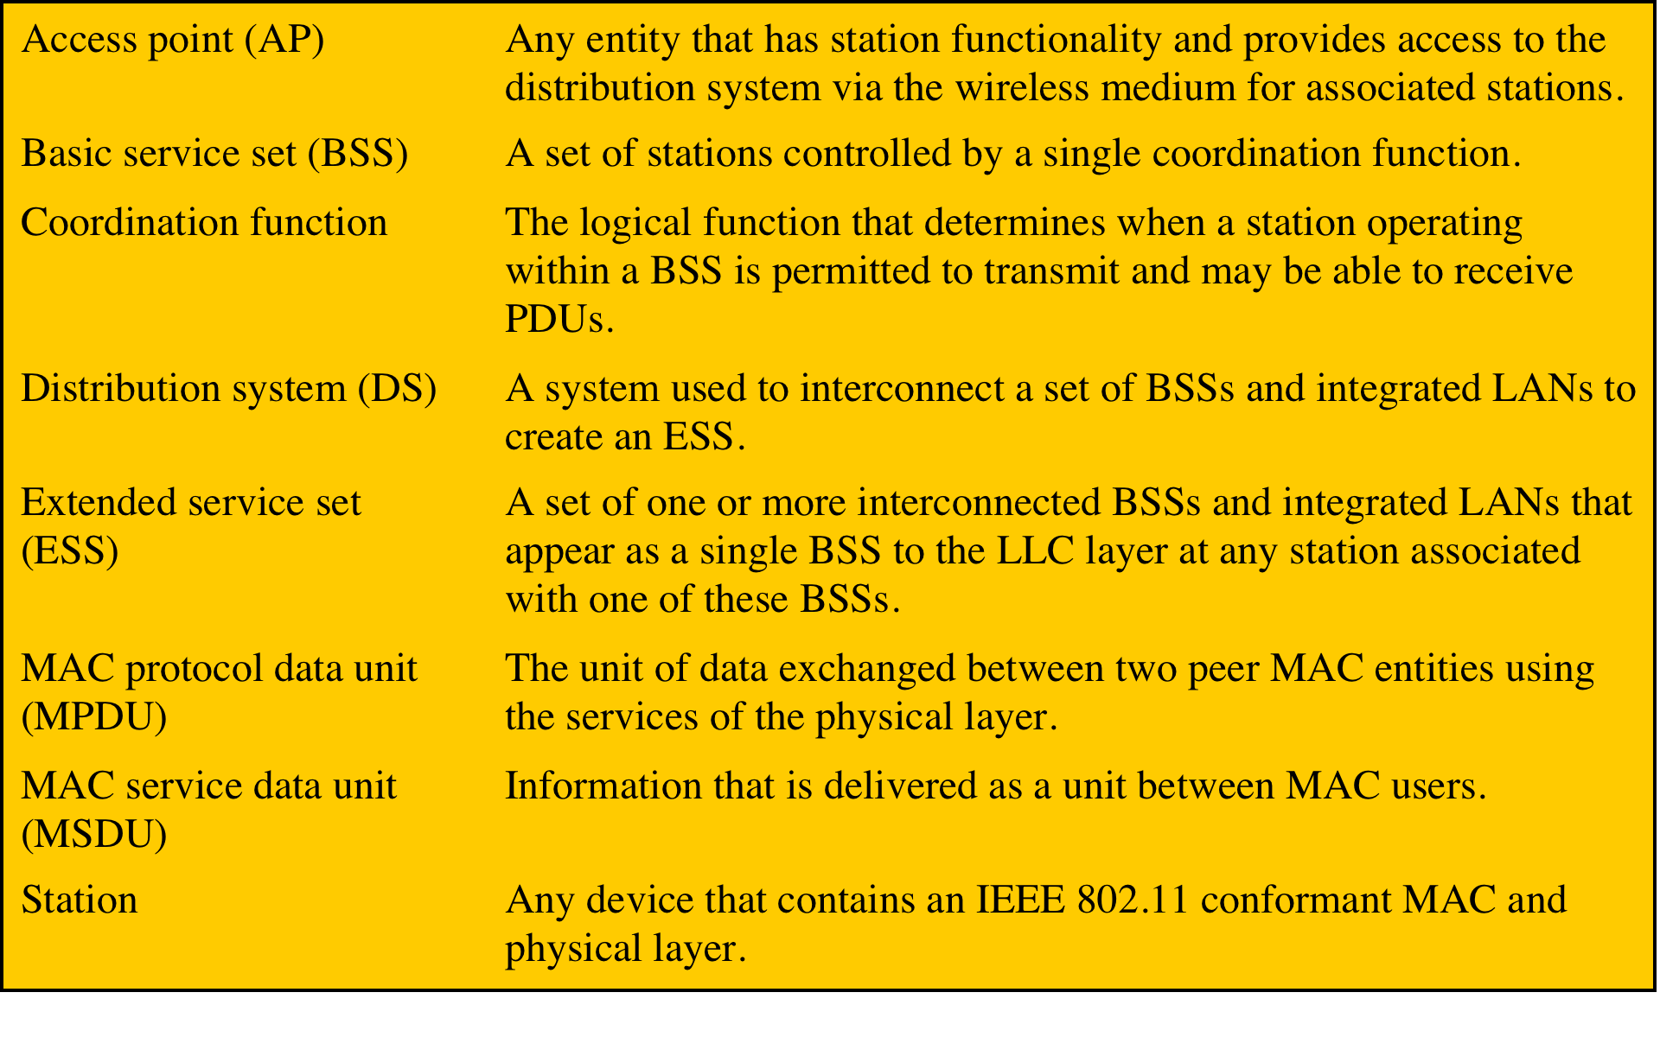
IEEE 802.11 Terminology
Notes:
IEEE 802 is a committee that has developed standards for a wide range of local area
networks (LANs). In 1990, the IEEE 802 Committee formed a new working group,
IEEE 802.11, with a charter to develop a protocol and transmission specifications
for wireless LANs (WLANs). Since that time, the demand for WLANs at different
frequencies and data rates has exploded. Keeping pace with this demand, the IEEE
802.11 working group has issued an ever-expanding list of standards. Table 24.1
briefly defines key terms used in the IEEE 802.11 standard.

Slide 25
Basic 802.11b Overview
802.11b was IEEE approved in 1999
Infrastructure Mode or Ad Hoc
Utilizes 2.4GHz band on 15 different channels (only 11 in US)
11mbit shared among all users on access point
Cheap!!!

Slide 26
Wired Equivalent Protocol (WEP)
Primary built for 802.11 protocol
Uses 40bit RC4 encryption
Intended to make wireless as secure as a wired network
Unfortunately, since ratification of the 802.11 standard, RC4 has been proven insecure, leaving the 802.11 protocol wide open for attack

Slide 27
A closer look at WEP
Weakness in RC4 lies within the Initialization Vector (IV)
The IV is a random 24bit number (2^24)
Packets sent over the network contain the IV followed by the encrypted data
RC4 combines the IV and the 40-bit key to encrypt the data
  Now 64-128 bits
Two known attacks against this:

Slide 28
Numerical Limitation Attack
IV’s are only 24bit, and thus there are only 16,777,216 possible IV’s
A busy network will repeat IV’s often
By listening to the encrypted traffic and picking out the duplicate IV’s, it is possible to infer what parts of the WEP key are
Enough duplicate IV’s and you can figure out the whole WEP key
This attack is not used in practice

Slide 29
The Weak IV attack
Some IV’s do not work well with RC4
Using a formula, one can take a weak IV and infer part of the WEP key
Once again, passively monitoring the network for a few hours can be enough time to gather enough weak IV’s to figure out the WEP key
Airsnort and variants use this attack

Slide 30
Looking back on WEP
WEP is flawed by a technology weakness, and there is no simple solution to fix it
Increasing key length will only help against a brute force attack (trying to guess the key). The IV is the weakness in this protocol, so increasing key length is going to help minimally (the difficulty of cracking the key increases linearly as apposed to exponentially)
Attacks against WEP are passive and extremely difficult to detect

Slide 31
Wpa
Wi-Fi Protected Access
  Upgrade to WEP
  Designed to run on the same hardware
    Except the Access Points
Implements Temporal Key Integrity Protocol (TKIP)
  Where WEP uses a 64-128 bit key that does not change
  TKIP employs a per-packet key, meaning that it dynamically generates a new 128-bit key for each packet
Notes:
WPA could be implemented through firmware upgrades on wireless network interface cards designed for WEP that began shipping as far back as 1999. However, since the changes required in the wireless access points (APs) were more extensive than those needed on the network cards, most pre-2003 APs could not be upgraded to support WPA.
WPA also includes a Message Integrity Check, which replaces the cyclic redundancy check (CRC) that was used by the WEP standard. Researchers have since discovered a flaw in WPA that relied on older weaknesses in WEP and the limitations of the message integrity code hash function, named Michael, to retrieve the keystream from short packets to use for re-injection and spoofing.

Slide 32
WPA2
Update to WPA
  Improves upon WPA security
  Capable of using TKIP or AES
Comes in two flavors:
  Personal
  Enterprise
WPA-Personal
  WPA-PSK (pre-shared key)
  Designed for home and small office networks
  Doesn't require an authentication server
  Each device encrypts the network traffic by deriving its 128-bit encryption key from a 256-bit shared key
WPA-Enterprise
  WPA-802.1X
  Designed for enterprise networks
  Requires a RADIUS authentication server
  Provides protection against dictionary attacks
Notes:
WPA-Personal
This key may be entered either as a string of 64 hexadecimal digits, or as a passphrase of 8 to 63 printable ASCII characters.

Slide 33
WPA3
January 2018, the Wi-Fi Alliance announced WPA3
  Replacement to WPA2
Uses an equivalent 192-bit cryptographic strength algorithm
  Enterprise Mode
Still mandates the use of AES-128 in CCM mode as the minimum encryption algorithm
  Personal mode.
Replaces the pre-shared key with Simultaneous Authentication of Equals (SAE)
Notes:
The Wi-Fi Alliance also claims that WPA3 will mitigate security issues posed by weak passwords and simplify the process of setting up devices with no display interface.

Slide 34
Security beyond 802.11 specifications
For a secure wireless network, you MUST go above and beyond the 802.11a/b/g security measures.
At this point, there are many measures you can take to secure a wireless network. All have their pro’s and con’s, and of course some work better than others
The Goal: a secure network that is easy to deploy and maintain.

Slide 35
Hiding the SSID
As stated earlier, the SSID is by default broadcast every few seconds.
Turning it off makes it harder to figure out a wireless connection is there
Reading raw packets will reveal the SSID since even when using WEP, the SSID is in plain text
Increases deployment difficulty

Slide 36
MAC address filtering
MAC address filtering works by only allowing specific hardware to connect to the AP
Management on large networks unfeasible
Using a packet sniffer, one can very easily find a valid MAC address and modify their OS to use it, even if the data is encrypted
May be good for small networks

Slide 37
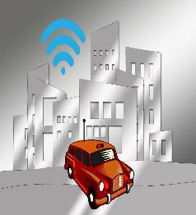
Wardrivng
The concept of war driving is simple: Using:
  a device capable of receiving an 802.11b signal
  a device capable of locating itself on a map
  And logging software
The hacker moves from place to place, letting these devices do their job
The hacker gets a database comprising the network name, signal strength, location, and ip/namespace in use.
http://searchitchannel.techtarget.com/feature/Securing-wireless-access-points-War-driving-and-war-walking
Notes:
The concept of war driving is simple: Using a device capable of receiving an 802.11b signal, a device capable of locating itself on a map, and software that will log data from the second when a network is detected by the first, the hacker moves from place to place, letting these devices do their job. Over time, the hacker builds up a database comprising the network name, signal strength, location, and ip/namespace in use.

Slide 38
Wardrivng - prevention
Don’t broadcast your SSID.
  If you don’t broadcast your SSID, it will be difficult to detect (but not impossible).
Change the default password.
  The make of the router can be seen by wardriver software such as netstumbler.
http://www.streetdirectory.com/travel_guide/2139/computers_and_the_internet/what_is_wardriving_and_how_can_you_prevent_it.html

Slide 39
Wardrivng - prevention
Encrypt your wireless communication.
  Enable encryption and enter a key.
  WPA2 > WPA > WEP
Filter the MAC addresses that are allowed to connect to your router.
  This would require that you enter your router configuration and input the MAC address of each wireless card you have.
  This will restrict access so that only your computers can connect to the router.
http://www.streetdirectory.com/travel_guide/2139/computers_and_the_internet/what_is_wardriving_and_how_can_you_prevent_it.html

