Slide 1
Computers and random numbers

Slide 2
37

Slide 3
Random numbers
Two types:
  “True” random numbers
  Pseudorandom numbers
True random is hard, so we’ll start with pseudorandom first

Slide 4
Pseudorandom
Generated algorithmically
  But are predictable
For example:
  159265?
    What comes next?

Slide 5
Pseudorandom
Generated algorithmically
  But are predictable
For example:
  1592653
    Of course
    How did I know?

Slide 6
Pseudorandom
Generated algorithmically
  But are predictable
For example:
  1592653
  3.141592653…

Slide 7
“True” Random
To generate a “true” random number, the computer measures some type of physical phenomenon
  The computer could measure the radioactive decay of an atom
    According to quantum theory, there’s no way to know for sure when radioactive decay will occur, so this is essentially “pure randomness” from the universe
  The computer could use the exact time you press keys on your keyboard

Slide 8
Why is this relevant?
Modern x86_64 CPUs use thermal "noise" to very rapidly offer high-entropy pseudorandom numbers
This is supposed to be fairly failsafe
  CPU instruction: RDRAND
  There's also a "carry bit" in the return value to let the calling application know if the RNG was unable to generate a sufficiently random number.
Notes:
https://arstechnica.com/gadgets/2019/10/how-a-months-old-amd-microcode-bug-destroyed-my-weekend/

Slide 9
But….
Unpatched Ryzen 3000
  Says "yes" to the CPUID 01H call
  Sets the carry bit indicating RNG was successful
  Returns the most artisanal, organic high-quality random number possible...

Slide 10
But….
Unpatched Ryzen 3000
  Says "yes" to the CPUID 01H call
  Sets the carry bit indicating RNG was successful
  Returns the most artisanal, organic high-quality random number possible...
  Gives you a 0xFFFFFFFF for the "random" number, every single time.

Slide 11
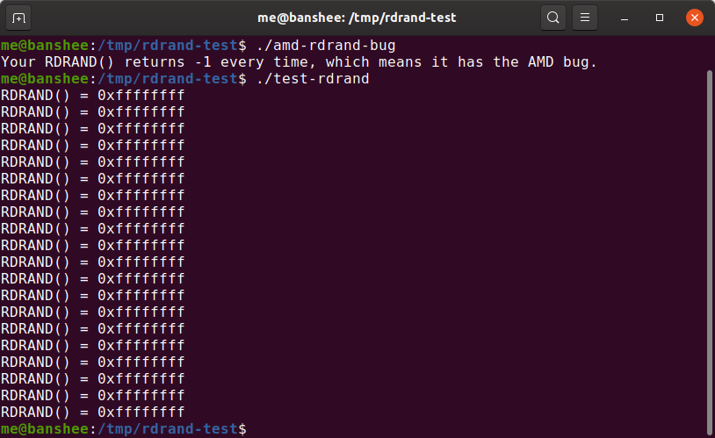

Slide 12
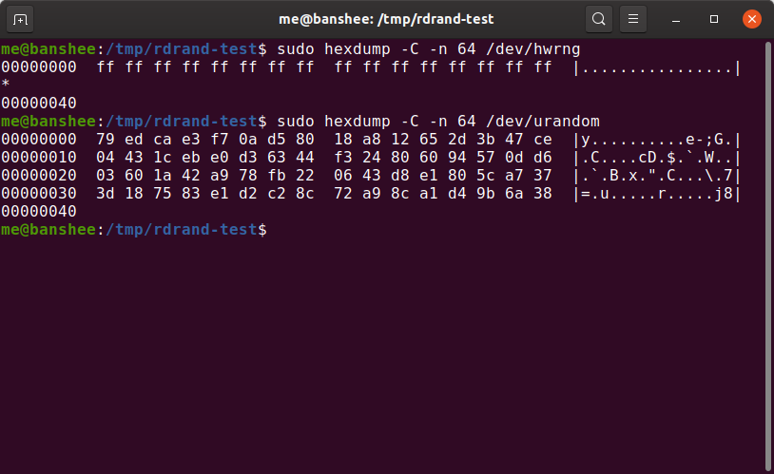

Slide 13



Slide 14
Intrusion detection and prevention

Slide 15
Situational Awareness
Being aware of what is happening around you
  In an Internet-connected enterprise with millions of packets crossing the perimeter per second, this can be extremely challenging
  Intrusion detection and prevention are ways of improving situational awareness

Slide 16
Intrusion Detection
Intrusion Detection System (IDS)
  A software/application that monitors network or system activities for malicious activities or policy violations
Two types of IDS based on action
  Passive: sensor detects a potential security breach, logs the information and signals an alert on the console and/or owner
  Active: auto-responds to the suspicious activity by resetting the connection or by reprogramming the firewall to block network traffic from the suspected malicious source
Notes:
The following definitions from RFC 2828 (Internet Security Glossary) are relevant to our discussion:
Security Intrusion: A security event, or a combination of multiple security events, that constitutes a security incident in which an intruder gains, or attempts to gain, access to a system (or system resource) without having authorization to do so
Intrusion Detection: A security service that monitors and analyzes system events for the purpose of finding, and providing real-time or near-real- time warning of, attempts to access system resources in an unauthorized manner

Slide 17


IDS vs IPS
IDS
IPS

Slide 18
Intrusion Detection (IDS)
IDS
Host Based
network based
monitors characteristics of events on a single host
monitors characteristics of events on the network
Notes:
Intrusion detection systems (IDSs) can be classified as follows:
Host-based IDS: Monitors the characteristics of a single host and the events occurring within that host for suspicious activity
Network-based IDS: Monitors network traffic for particular network segments or devices and analyzes network, transport, and application protocols to identify suspicious activity

Slide 19
Intrusion Detection
Two major types of IDS based on the location
  Host-based IDS: Monitors and analyzes the internals of a computing system
  Network-based IDS: discovers unauthorized activities to a computer network by analyzing traffic
Notes:
The following definitions from RFC 2828 (Internet Security Glossary) are relevant to our discussion:
Security Intrusion: A security event, or a combination of multiple security events, that constitutes a security incident in which an intruder gains, or attempts to gain, access to a system (or system resource) without having authorization to do so
Intrusion Detection: A security service that monitors and analyzes system events for the purpose of finding, and providing real-time or near-real- time warning of, attempts to access system resources in an unauthorized manner

Slide 20
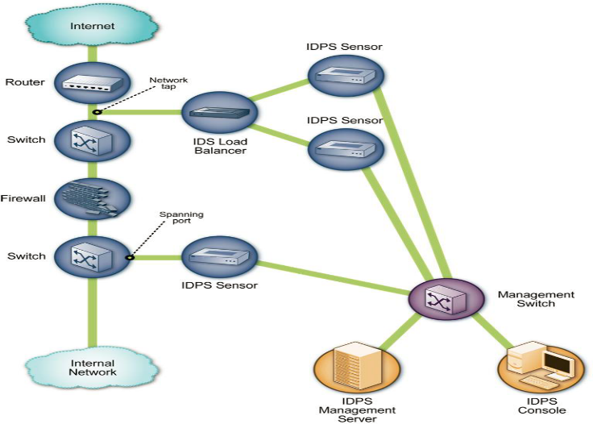
Host-based IDS Architecture
Notes:
Src: http://csrc.nist.gov/publications/nistpubs/800-94/SP800-94.pdf

Slide 21
IDS Components
Sensors
collect data
Analyzers
analyze the collected data to see if an intrusion has occurred
User Interface
enables a user to view the sensor output and the completed analysis output
Notes:
An IDS comprises three logical components:
Sensors: Sensors are responsible for collecting data. The input for a sensor may be any part of a system that could contain evidence of an intrusion. Types of input to a sensor include network packets, log files, and system call traces. Sensors collect and forward this information to the analyzer.
Analyzers: Analyzers receive input from one or more sensors or from other analyzers. The analyzer is responsible for determining if an intrusion has occurred. The output of this component is an indication that an intrusion has occurred. The output may include evidence supporting the conclusion that an intrusion occurred. The analyzer may provide guidance about what actions to take as a result of the intrusion.
User interface: The user interface to an IDS enables a user to view output from the system or control the behavior of the system. In some systems, the user interface may equate to a manager, director, or console component.

Slide 22
IDS Components: Sensor
Types of input data is collected from various sources including network packets, log files, and system call traces
Examples of data collection for Host-based IDS
Identifying Hosts: An IDS can create a list of hosts on the organization’s network arranged by IP address or MAC address
Identifying Operating Systems: An IDS can identify the OSs and OS versions used by the hosts
Identifying Applications: An IDS can identify the application versions in use by keeping track of which ports are used and monitoring certain characteristics of application communications
Notes:
An IDS comprises three logical components:
Sensors: Sensors are responsible for collecting data. The input for a sensor may be any part of a system that could contain evidence of an intrusion. Types of input to a sensor include network packets, log files, and system call traces. Sensors collect and forward this information to the analyzer.

Slide 23
IDS Components: Sensor
Examples of data collection for Network-based IDS
Timestamp (usually date and time)
Session ID (typically a unique number assigned to each TCP connection or like groups of packets for connectionless protocols)
Source and destination IP addresses
Source and destination TCP or UDP ports
Number of bytes transmitted over the connection
State-related information (e.g., authenticated username)

Slide 24
Organization
IDS/IPS can be a simple, monolithic system or a distributed set of sensors feeding a central analysis and correlation engine
Critical to any design is placing the sensors so that they have appropriate visibility of the traffic to be monitored

Slide 25
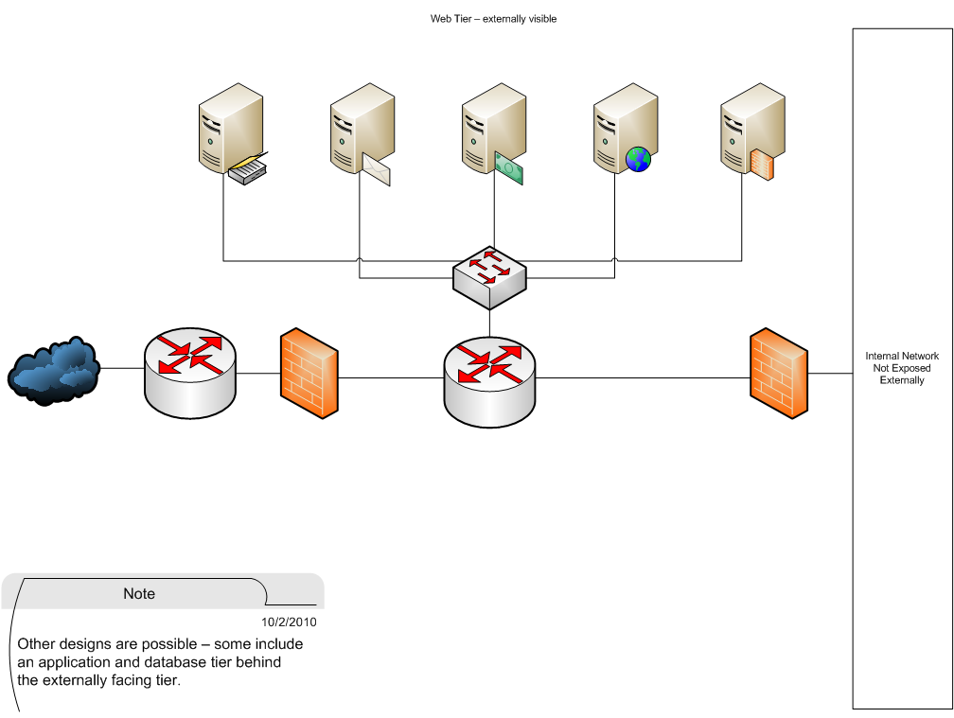
Sensor Placement
What would a sensor at each arrow be able to observe?
Types of traffic
Volume of traffic

Slide 26
Visibility
IDS/IPS should have visibility to the traffic
  SPAN
  TAP
  Consider the volume of traffic before choosing a technology
    SPAN aggregates multiple ports onto a single monitor port
      What might be the problem with mirroring 4 gigabit Ethernet ports onto a single monitor port?

Slide 27
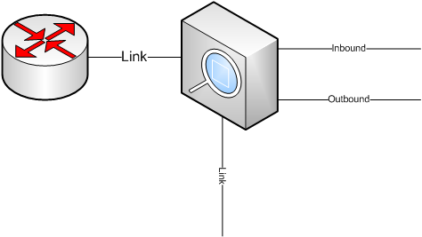
TAP
A non-aggregating tap produces two monitor streams
  Inbound
  Outbound
These streams may need to be recombined for analysis
  An aggregating tap produces a single monitor stream
A server running an IDS behind a tap must be multi-homed
  Two NIC’s for the monitor ports (inbound and outbound)
  One NIC to allow transmission of alerts/logs/etc

Slide 28
IDS Components: Analysis
Analyzers receive input from one or more sensors and responsible for determining if an intrusion has occurred. The output of this component is an indication that an intrusion has occurred
Two types of analysis for detecting intrusion: Signature-based and anomaly-based
Signature-based: A network IDS signature is a pattern that we want to look for in traffic
Anomaly-based: input data is analyzed to see if it differs from normal pattern significantly
Notes:
Analyzers: Analyzers receive input from one or more sensors or from other analyzers. The analyzer is responsible for determining if an intrusion has occurred. The output of this component is an indication that an intrusion has occurred. The output may include evidence supporting the conclusion that an intrusion occurred. The analyzer may provide guidance about what actions to take as a result of the intrusion.

Slide 29
Technologies
Signature based (e.g., SNORT)
  Pattern-matches traffic against known bad traffic
  Weaknesses
    Malicious traffic may morph
      New XOR encoder
    Traffic must be known before a signature can be written
Anomaly based (e.g., BRO)
  Compares traffic to “normal” baseline

Slide 30
IDS Components: Analysis
Signature-based attack detection examples
A TCP packet with the SYN and FIN flags set (a violation of RFC 793, you cannot start a connection and finish the connection at the same packet)
Packet with an illegal TCP flag combination. For example known bad flag combinations (X-mas attack)
TCP packet with an acknowledgement value set to a non-zero number, but the acknowledgment flag is not set
For more examples of signatures please see the document at
http://www.symantec.com/connect/articles/network-intrusion-detection-signatures-part-one
http://www.symantec.com/connect/articles/network-intrusion-detection-signatures-part-two

Slide 31
IDS Components: Analysis
Signatures are expressed in terms of rules
An example of rule (Snort tool)
alert tcp any any -> 192.168.1.0 111
(content:"|00 01 86 a5|"; msg: "mountd ";)
This rule describes an alert generated when Snort matches a network packet with all of the following attributes:
  TCP packet
  Source from any IP address on any port
  Destined to the IP address 192.168.1.0 on port 111.
The word(s) before the colons in the rule options section are called option keywords.
  The rule is triggered if the content of packet includes the hexa-decimal numbers sequence or mountd command

Slide 32
Problem
False positives
  Detecting malicious network traffic is difficult and for that reason rule sets tend toward the paranoid
  This leads to the situation where normal traffic may be labeled as suspicious
    telnet is a disallowed protocol within the DMZ
    A hapless web server administrator uses telnet to connect to a server while troubleshooting a problem
Triage, event correlation, etc are critical steps in any incident detection strategy

Slide 33
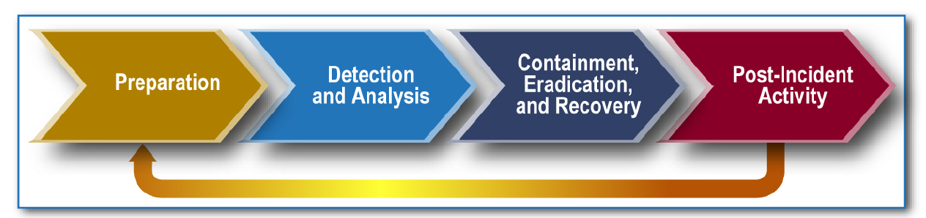
ID&R
An IDS can be a useful component of an incident detection methodology
There must be an incident response plan to spell out the actions to be taken when an incident is detected
Security programs muse be measured in order to evaluate their effectiveness
Notes:
From NIST 800-61

Slide 34
IDS Components: Analysis
Anomaly detection starts with profiling normal behavior of traffic or data.
An alarm is generated if there is a deviation of traffic data from the normal pattern.
Anomaly-based attack detection examples
  TCP SYN attack: connection attempt from a fixed IP address having SYN flag set and coming at a faster rate than normal (e.g., more than 60 connection requests per minute)
  Excessive number of login attempt to a service (SSH login)
  Login attempt beyond normal work hours (e.g., 1AM)
  Excessive bandwidth usage (could mean that one or most host is infected with worms)

Slide 35
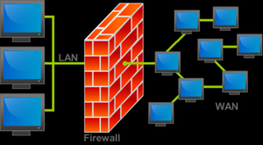
Firewalls
a firewall is a software system that controls the incoming and outgoing network traffic by analyzing the data packets and determining whether they should be allowed through or not, based on a rule set.
Notes:
The firewall is an important complement to host-based security services such as intrusion detection systems. Typically, a firewall is inserted between the premises network and the Internet to establish a controlled link and to erect an outer security wall or perimeter. The aim of this perimeter is to protect the premises network from Internet-based attacks and to provide a single choke point where security and auditing can be imposed.
The firewall provides an additional layer of defense, insulating the internal systems from external networks. This follows the classic military doctrine of "defense in depth," which is just as applicable to IT security.

Slide 36
Firewall: packet filter
Packet filters act by inspecting the "packets" which transfer between computers on the Internet.
If a packet matches with the packet filter's set of rules, the packet filter will drop (silently discard) the packet, or reject it (discard it, and send "error responses" to the source).
Developed in 1988 by Digital Equipment Corporation (DEC)
Notes:
Firewalls have their limitations, including the following:
1. The firewall cannot protect against attacks that bypass the firewall. Internal systems may have dial-out capability to connect to an ISP. An internal LAN may support a modem pool that provides dial-in capability for traveling employees and telecommuters.
2. The firewall may not protect fully against internal threats, such as a disgruntled employee or an employee who unwittingly cooperates with an external attacker.
3. An improperly secured wireless LAN may be accessed from outside the organization. An internal firewall that separates portions of an enterprise network cannot guard against wireless communications between local systems on different sides of the internal firewall.
4. A laptop, PDA, or portable storage device may be used and infected outside the corporate network, and then attached and used internally.

Slide 37
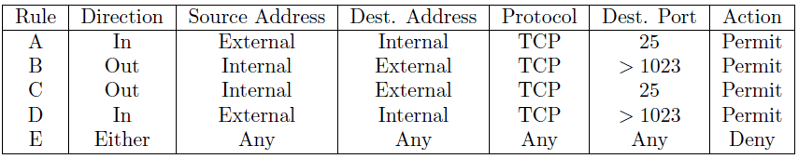
Firewall: packet filter rule
Rules A and B allow inbound SMTP connections (incoming email).
Rules C and D allow outbound SMTP connections (outgoing email).
Rule E is the default rule that applies if all else fails.
Firewall examines the rules in order, i.e., it starts at the top until it ends a rule that matches the packet, then in takes the action specified
Notes:
Firewalls have their limitations, including the following:
1. The firewall cannot protect against attacks that bypass the firewall. Internal systems may have dial-out capability to connect to an ISP. An internal LAN may support a modem pool that provides dial-in capability for traveling employees and telecommuters.
2. The firewall may not protect fully against internal threats, such as a disgruntled employee or an employee who unwittingly cooperates with an external attacker.
3. An improperly secured wireless LAN may be accessed from outside the organization. An internal firewall that separates portions of an enterprise network cannot guard against wireless communications between local systems on different sides of the internal firewall.
4. A laptop, PDA, or portable storage device may be used and infected outside the corporate network, and then attached and used internally.

Slide 38
Packet Filtering Firewalls
Advantages:
  its simple to write rules
  very fast to evaluate
  Disadvantages:
    cannot prevent attacks to application specific vulnerabilities
    vulnerable to attacks that take advantage of problems within TCP/IP
Notes:
One advantage of a packet filtering firewall is its simplicity. Also, packet filters typically are transparent to users and are very fast. [WACK02] lists the following weaknesses of packet filter firewalls:
Because packet filter firewalls do not examine upper-layer data, they cannot prevent attacks that employ application-specific vulnerabilities or functions. For example, a packet filter firewall cannot block specific application commands; if a packet filter firewall allows a given application, all functions available within that application will be permitted.
Because of the limited information available to the firewall, the logging functionality present in packet filter firewalls is limited. Packet filter logs normally contain the same information used to make access control decisions (source address, destination address, and traffic type).
Most packet filter firewalls do not support advanced user authentication schemes. Once again, this limitation is mostly due to the lack of upper-layer functionality by the firewall.
Packet filter firewalls are generally vulnerable to attacks and exploits that take advantage of problems within the TCP/IP specification and protocol stack, such as network layer address spoofing. Many packet filter firewalls cannot detect a network packet in which the OSI Layer 3 addressing information has been altered. Spoofing attacks are generally employed by intruders to bypass the security controls implemented in a firewall platform.
Finally, due to the small number of variables used in access control decisions, packet filter firewalls are susceptible to security breaches caused by improper configurations. In other words, it is easy to accidentally configure a packet filter firewall to allow traffic types, sources, and destinations that should be denied based on an organization's information security policy.
Some of the attacks that can be made on packet filtering firewalls and the appropriate countermeasures are the following:
IP address spoofing: The intruder transmits packets from the outside with a source IP address field containing an address of an internal host. The attacker hopes that the use of a spoofed address will allow penetration of systems that employ simple source address security, in which packets from specific trusted internal hosts are accepted. The countermeasure is to discard packets with an inside source address if the packet arrives on an external interface. In fact, this countermeasure is often implemented at the router external to the firewall.
Source routing attacks: The source station specifies the route that a packet should take as it crosses the Internet, in the hopes that this will bypass security measures that do not analyze the source routing information. The countermeasure is to discard all packets that use this option.
Tiny fragment attacks: The intruder uses the IP fragmentation option to create extremely small fragments and force the TCP header information into a separate packet fragment. This attack is designed to circumvent filtering rules that depend on TCP header information. Typically, a packet filter will make a filtering decision on the first fragment of a packet. All subsequent fragments of that packet are filtered out solely on the basis that they are part of the packet whose first fragment was rejected. The attacker hopes that the filtering firewall examines only the first fragment and that the remaining fragments are passed through. A tiny fragment attack can be defeated by enforcing a rule that the first fragment of a packet must contain a predefined minimum amount of the transport header. If the first fragment is rejected, the filter can remember the packet and discard all subsequent fragments.

Slide 39
Firewall: Stateful packet filtering
A traditional packet filter makes filtering decisions on an individual packet basis and does not take into consideration any higher layer context.
A stateful firewall keeps track of the state of network connections (such as TCP streams, UDP communication) traveling across it.
The firewall is programmed to distinguish legitimate packets for different types of connections.
Only packets matching a known active connection will be allowed by the firewall; others will be rejected.
A connection state table is needed to perform stateful inspection.
Notes:
Firewalls have their limitations, including the following:
1. The firewall cannot protect against attacks that bypass the firewall. Internal systems may have dial-out capability to connect to an ISP. An internal LAN may support a modem pool that provides dial-in capability for traveling employees and telecommuters.
2. The firewall may not protect fully against internal threats, such as a disgruntled employee or an employee who unwittingly cooperates with an external attacker.
3. An improperly secured wireless LAN may be accessed from outside the organization. An internal firewall that separates portions of an enterprise network cannot guard against wireless communications between local systems on different sides of the internal firewall.
4. A laptop, PDA, or portable storage device may be used and infected outside the corporate network, and then attached and used internally.

Slide 40
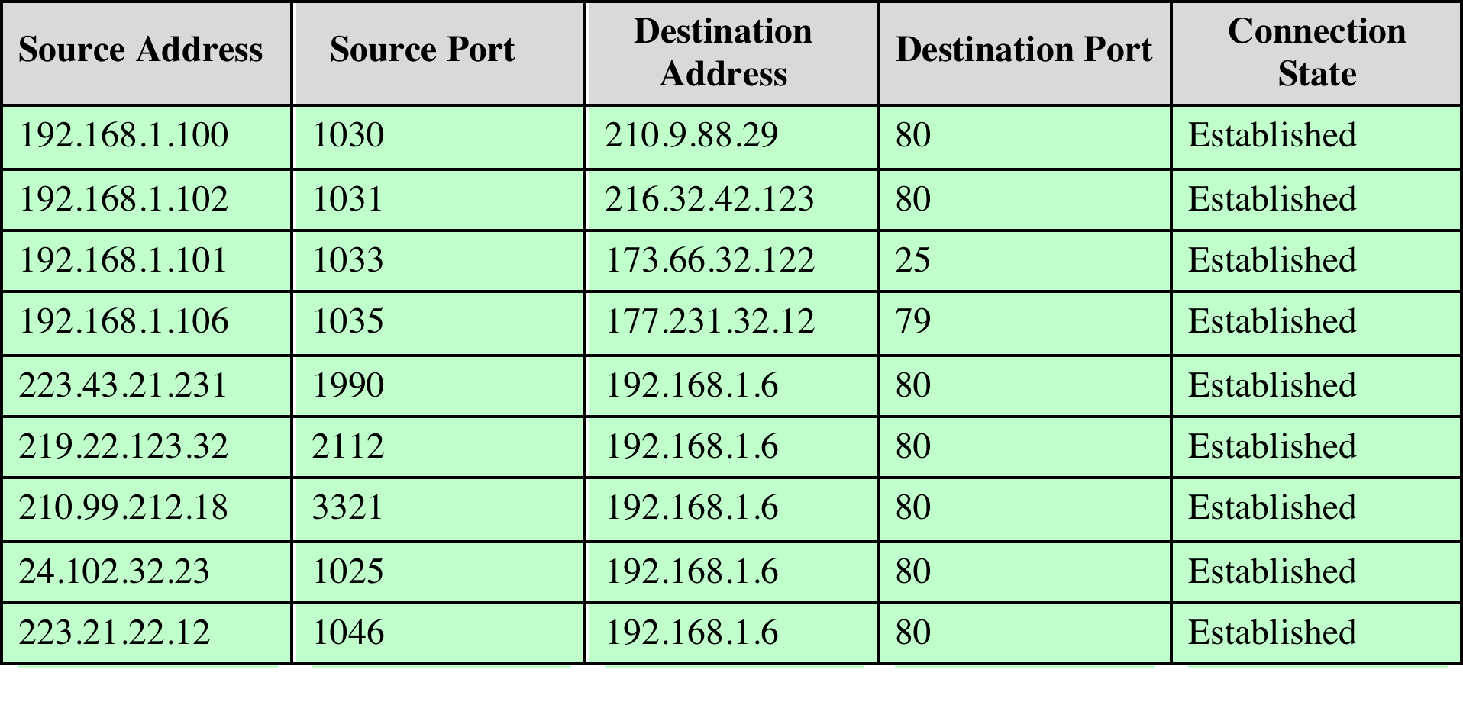
Stateful Firewall Connection
State Table
Notes:
Stateful Inspection Firewalls
A traditional packet filter makes filtering decisions on an individual packet basis and does not take into consideration any higher layer context. To understand what is meant by context and why a traditional packet filter is limited with regard to context, a little background is needed. Most standardized applications that run on top of TCP follow a client/server model. For example, for the Simple Mail Transfer Protocol (SMTP), e-mail is transmitted from a client system to a server system. The client system generates new e-mail messages, typically from user input. The server system accepts incoming e-mail messages and places them in the appropriate user mailboxes. SMTP operates by setting up a TCP connection between client and server, in which the TCP server port number, which identifies the SMTP server application, is 25. The TCP port number for the SMTP client is a number between 1024 and 65535 that is generated by the SMTP client.
In general, when an application that uses TCP creates a session with a remote host, it creates a TCP connection in which the TCP port number for the remote (server) application is a number less than 1024 and the TCP port number for the local (client) application is a number between 1024 and 65535. The numbers less than 1024 are the "well-known" port numbers and are assigned permanently to particular applications (e.g., 25 for server SMTP). The numbers between 1024 and 65535 are generated dynamically and have temporary significance only for the lifetime of a TCP connection.
A simple packet filtering firewall must permit inbound network traffic on all these high-numbered ports for TCP-based traffic to occur. This creates a vulnerability that can be exploited by unauthorized users.
A stateful inspection packet firewall tightens up the rules for TCP traffic by creating a directory of outbound TCP connections, as shown in Stallings DCC9e Table 24.2. There is an entry for each currently established connection. The packet filter will now allow incoming traffic to high-numbered ports only for those packets that fit the profile of one of the entries in this directory.
A stateful packet inspection firewall reviews the same packet information as a packet filtering firewall, but also records information about TCP connections (Figure 24.7c). Some stateful firewalls also keep track of TCP sequence numbers to prevent attacks that depend on the sequence number, such as session hijacking. Some even inspect limited amounts of application data for some well-known protocols like FTP, IM and SIPS commands, in order to identify and track related connections.

Slide 41
Firewall: Stateful packet filtering
A stateful inspection packet firewall creates a directory of outbound TCP connections.
There is an entry for each currently established connection.
Some stateful firewalls keep track of TCP sequence numbers to prevent attacks that depend on the sequence number, such as session hijacking.
Notes:
Firewalls have their limitations, including the following:
1. The firewall cannot protect against attacks that bypass the firewall. Internal systems may have dial-out capability to connect to an ISP. An internal LAN may support a modem pool that provides dial-in capability for traveling employees and telecommuters.
2. The firewall may not protect fully against internal threats, such as a disgruntled employee or an employee who unwittingly cooperates with an external attacker.
3. An improperly secured wireless LAN may be accessed from outside the organization. An internal firewall that separates portions of an enterprise network cannot guard against wireless communications between local systems on different sides of the internal firewall.
4. A laptop, PDA, or portable storage device may be used and infected outside the corporate network, and then attached and used internally.

Slide 42
Firewall Limitations
May not fully protect against internal threats
Cannot guard against wireless communications between local systems on different sides of the internal firewall
Cannot protect against mobile devices that plug directly into the internal network
Notes:
Firewalls have their limitations, including the following:
1. The firewall cannot protect against attacks that bypass the firewall. Internal systems may have dial-out capability to connect to an ISP. An internal LAN may support a modem pool that provides dial-in capability for traveling employees and telecommuters.
2. The firewall may not protect fully against internal threats, such as a disgruntled employee or an employee who unwittingly cooperates with an external attacker.
3. An improperly secured wireless LAN may be accessed from outside the organization. An internal firewall that separates portions of an enterprise network cannot guard against wireless communications between local systems on different sides of the internal firewall.
4. A laptop, PDA, or portable storage device may be used and infected outside the corporate network, and then attached and used internally.

Slide 43
Honeypot
A honeypot is a computer system set up to act as a decoy.
Generally, it simulates the behavior of a real system that appears to be part of a network but is actually isolated and closely monitored.
All communications with a honeypot are considered hostile
Viewing and logging this activity can provide an insight into the level and types of threat a network infrastructure faces while distracting attackers away from assets of real value.
Notes:
All communications with a honeypot are considered hostile, as there's no reason for legitimate users to access a honeypot.
Viewing and logging this activity can provide an insight into the level and types of threat a network infrastructure faces while distracting attackers away from assets of real value.
http://searchsecurity.techtarget.com/definition/honey-pot

Slide 44
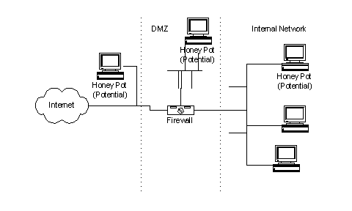
Honeypot

Slide 45
Honeypot
Remember that Honey Pots do not replace other traditional Internet security systems; they are an additional level or system.
Honey Pots can be setup inside, outside or in the DMZ of a firewall design although they are most often deployed inside of a firewall for control purposes.
Notes:
Honey Pot Systems are decoy servers or systems setup to gather information regarding an attacker or intruder into your system.
It is important to remember that Honey Pots do not replace other traditional Internet security systems; they are an additional level or system.
Honey Pots can be setup inside, outside or in the DMZ of a firewall design or even in all of the locations although they are most often deployed inside of a firewall for control purposes.
They are variants of standard Intruder Detection Systems (IDS) but with more of a focus on information gathering and deception.
https://www.sans.org/security-resources/idfaq/what-is-a-honeypot/1/9

Slide 46
Honeypot
The common line of thought in setting up Honey Pot systems - it is acceptable to use lies or deception when dealing with intruders
This means goals must be considered
  The Honey Pot system should appear as generic as possible
  You need to be careful in what traffic you allow the intruder to send back out to the Internet
  You will want to make your Honey Pot an interesting site by placing "Dummy" information or make it appear as though the intruder has found an "Intranet" server
Notes:
The Honey Pot system should appear as generic as possible. If you are deploying a Microsoft NT based system, it should appear to the potential intruder that the system has not been modified or they may disconnect before much information is collected.
You need to be careful in what traffic you allow the intruder to send back out to the Internet for you do not want to become a launch point for attacks against other entities on the Internet. (One of the reasons for installing a Honey Pot inside of the firewall!)
You will want to make your Honey Pot an interesting site by placing "Dummy" information or make it appear as though the intruder has found an "Intranet" server, etc. Expect to spend some time making your Honey Pot appear legitimate so that intruders will spend enough time investigating and perusing the system so that you are able to gather as much forensic information as possible.

Slide 47
Honeypot
The information provided on an intruder depends on the levels of tracking that you have enabled on your Honey Pot.
Common tracking levels include the firewall, system logs on the Honey Pot and sniffer-based tools
  Most firewalls provide activity-logging capabilities which can be used to identify how an intruder is attempting to get into a Honey Pot
  Firewall logs and router logs can both trap and save packets of a pre-determined type
Reviewing the order, sequence, time stamps and type of packets used by an intruder to gain access to you Honey Pot will help you identify the tools, methodology being used by the intruder and their intentions (vandalism, data theft, remote launch point search, etc.)
  Most firewalls can be configured to send alerts by email or text to notify you of traffic going to or from your Honey Pot
Notes:
Levels or Layers of Tracking
The information provided on an intruder depends on the levels of tracking that you have enabled on your Honey Pot.
Common tracking levels include the firewall, system logs on the Honey Pot and sniffer-based tools.
Firewall Logs
Most firewalls provide activity-logging capabilities which can be used to identify how an intruder is attempting to get into a Honey Pot.
Firewall logs to router logs; they can both be set to trap and save packets of a pre-determined type. Remember that when setting up the firewall, you would normally want to log ALL packets going to the Honey Pot system, as there should be no legitimate reason for traffic going to or from the Honey Pot.
Reviewing the order, sequence, time stamps and type of packets used by an intruder to gain access to you Honey Pot will help you identify the tools, methodology being used by the intruder and their intentions (vandalism, data theft, remote launch point search, etc.).
Another useful function of many firewalls is their notification capabilities. Most firewalls can be configured to send alerts by email or pager to notify you of traffic going to or from your Honey Pot. This can be extremely useful in letting you review intruder activity near real time.

Slide 48
Honeypot
Unix and Microsoft operating systems have logging capabilities
Some of their out-of-the box logging capabilities include:
Microsoft
  Security: Available from Event Viewer
  User Management: Needs to be enabled through User Manager
  Running Services: Netsvc.exe needs to be manually run and compared to baseline.
Unix
  User activity logs: utmp, wtmp, btmp, lastlog, messages
  Syslogd

Slide 49
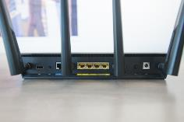
Routers
Routers link devices together in the internet
Manu consumer routers come with insecure default configurations
Some of these can't be fixed by users
Notes:
Routers link devices together in the internet, so it has a highly privileged position that hackers can exploit.
Unfortunately many consumer and small-business routers come with insecure default configurations, have undocumented backdoor accounts, expose legacy services and have firmware that is riddled with basic flaws.
Some of these problems can't be fixed by users, but there are many actions that can be taken to at least protect these devices from large-scale, automated attacks
http://www.pcworld.com/article/3093362/how-to-secure-your-router-and-home-network.html

Slide 50
Routers
Be cautious of routers supplied by ISPs
  They often have hard-coded remote support credentials that users can't change and patches for their customized firmware versions lag behind patches for the same flaws released by router manufacturers
Change the default admin password
  Many routers come with default administrator passwords and attackers constantly try to break into devices using these publicly known credentials.
The router's web-based management interface should not be reachable from the internet

Slide 51
Routers
Change the SSID
  Your devices might automatically connect to similarly named networks (e.g. "linksys")
  Also so you don't give hackers more of a clue to your router model
Notes:
http://lifehacker.com/the-most-important-security-settings-to-change-on-your-1573958554

Slide 52
Some Technology

Slide 53


SNORT
Signature-based IDS/IPS
SNORT itself is Open Source BUT the SourceFire Vulnerability Research Team (VRT) rulesets are subscription-based
  There are also community rules which are contributed under the GPL

Slide 54
Introduction to Snort Analysis
Snort
  Widely used, open-source, network-based intrusion detection system capable of performing real-time traffic analysis and packet logging on IP networks
  Performs protocol analysis and content matching to detect a variety of attacks and probes such as: buffer overflows, stealth port scans, CGI attacks, SMB probes, OS fingerprinting attempts, and more

Slide 55
Modes of Operation
Snort can be configured to run in the following modes:
  Packet Sniffer
  Packet Logger
  Network Intrusion Detection System
  Inline
    Allows SNORT to function as an IPS by dropping suspicious traffic

Slide 56
Features of Snort
Features of Snort:
  Protocol analysis
  Content searching/matching
  Real-time alerting capability
  Can read a Tcpdump trace and run it against a rule set
  Flexible rules language
Snort can be configured to watch a network for a particular type of attack profile
  It can alert the incident response team as soon as the attack takes place

Slide 57
Snort Tools
IDS Policy Manager
  Written to manage Snort IDS sensors in a distributed environment
Snort Rules Subscription
  Sourcefire, the company behind Snort, uses a registration and subscription model for distribution of new rules
Honeynet Security Console
  Analysis tool to view events on a personal network or honeynet

