Slide 1
Ethical Hacking
Module 2

Slide 2
Thinking About Security
[Do not fall into] the classic security misapprehension error: the idea that either you’re “secure” or you’re not.
The real question, as we all know, should be, “against what sort of attacks am I vulnerable?”
–Curt Sampson
Notes:
Security people call “what sort of attacks” a threat profile.

Slide 3
Organizational Security Policy
Every organization needs a written security policy document…
…to define acceptable behavior, expected practices, and responsibilities
makes clear what is protected and why
articulates security procedures / controls
states responsibility for protection
provides basis to resolve conflicts
Notes:
A written security policy document is fundamental to define acceptable behavior, expected practices, and responsibilities. Without written policies, users and administrators are left to decide important security-related issues for themselves. The policy document also provides valuable support for IT staff and lower-level managers in convincing higher-level managers of the need for a particular expenditure or commitment of resources.
A security policy plays four important roles:
1. makes clear what is being protected and why.
2. articulates the security procedures, controls, and standards used in the organization.
3. clearly states the responsibility for that protection.
4. provides basis on which to interpret and resolve any later conflicts that may arise.
To fulfill these roles, the security policy must reflect security decisions made by executive management. Hence, decision makers must:
1. Identify sensitive information and critical systems.
2. Incorporate local / national laws; contractual obligations, relevant ethical standards.
3. Define institutional security goals and objectives.
4. Set a course for accomplishing these goals and objectives
5. Ensure have necessary mechanisms for accomplishing the goals and objectives.

Slide 4
Policies and Mechanisms
Policy says what is, and is not, allowed
What must happen, what may happen, what must not happen.
This defines “security” for the site/system/etc.
Mechanisms enforce policies
Application of mechanism in the absence of supporting policy could be detrimental to security!
Notes:
Policy: may be expressed in
natural language, which is usually imprecise but easy to understand;
mathematics, which is usually precise but hard to understand;
policy languages, which look like some form of programming language and try to balance precision with ease of understanding
Mechanisms: may be
technical, in which controls in the computer enforce the policy; for example, the requirement that a user supply a password to authenticate herself before using the computer
procedural, in which controls outside the system enforce the policy; for example, firing someone for ringing in a disk containing a game program obtained from an untrusted source
The composition problem requires checking for inconsistencies among policies. If, for example, one policy allows students and faculty access to all data, and the other allows only faculty access to all the data, then they must be resolved (e.g., partition the data so that students and faculty can access some data, and only faculty access the other data).

Slide 5
Properties of Information Security
Confidentiality
Keeping data and resources hidden from unauthorized personnel
Integrity
Data integrity (integrity)
Origin integrity (authentication)
Availability
Enabling access to data and resources when and where they are needed.
Notes:
Confidentiality: a good example is cryptography, which traditionally is used to protect secret messages. But cryptography is traditionally used to protect data, not resources. Resources are protected by limiting information, for example by using firewalls or address translation mechanisms.
Integrity: a good example here is that of an interrupted database transaction, leaving the database in an inconsistent state (this foreshadows the Clark-Wilson model). Trustworthiness of both data and origin affects integrity, as noted in the book’s example. That integrity is tied to trustworthiness makes it much harder to quantify than confidentiality. Cryptography provides mechanisms for detecting violations of integrity, but not preventing them (e.g., a digital signature can be used to determine if data has changed).
Availability: this is usually defined in terms of “quality of service,” in which authorized users are expected to receive a specific level of service (stated in terms of a metric). Denial of service attacks are attempts to block availability.

Slide 6
Assets to be Protected
Hardware
Software
Data
Infrastructure (including communications facilities)
People

Slide 7
The Attacker’s Triad: DAD
Disclosure: compromises confidentiality
Outside attackers
Insiders
Programming or other errors
Alteration: compromises integrity
Accidental or malicious alteration
Programming or equipment failure
Denial: compromises availability
Deliberate attacks
Failures of systems or environment

Slide 8
Vulnerabilities, Threats, Risks
Vulnerability: a weakness that could allow a system to enter a state not permitted by policy.
Exploit: a mechanism for taking advantage of a vulnerability.
Threat: a circumstance that could allow a vulnerability to be taken advantage of.
Risk: the circumstance that both a threat and a corresponding vulnerability exist. Risk is the probability of the threat being realized.

Slide 9
Goals of Information Security
Prevention
Prevent attackers from violating security policy
Detection
Detect attackers’ violation of security policy
Response and Recovery
Stop attack, assess and repair damage
Continue to function correctly even if attack succeeds
Return system to a state consistent with policy
Notes:
Prevention is ideal, because then there are no successful attacks.
Detection occurs after someone violates the policy. The mechanism determines that a violation of the policy has occurred (or is underway), and reports it. The system (or system security officer) must then respond appropriately.
Recovery means that the system continues to function correctly, possibly after a period during which it fails to function correctly. If the system functions correctly always, but possibly with degraded services, it is said to be intrusion tolerant. This is very difficult to do correctly; usually, recovery means that the attack is stopped, the system fixed (which may involve shutting down the system for some time, or making it unavailable to all users except the system security officers), and then the system resumes correct operations.

Slide 10
Information Risk
Use of information technology creates risk to
Confidentiality
Integrity
Availability
of information assets
Risk may be direct (to the asset itself)
Or indirect (business interruption, damage to reputation, legal liability, etc.)

Slide 11
Identification and Authentication
Identification: Who are you? (User ID)
Authentication: Prove it!
Something you know (e.g. password)
Something you have (e.g. smart card)
Something you are (e.g. fingerprint.)
For real security, authenticators
Must be changeable (rules out biometrics, maybe)
Must not be researchable (rules out SSN, etc.)

Slide 12
Ok, so on to some specifics
Tcp/ip

Slide 13
The TCP/IP Stack
Layer 5 Application Layer
HTTP SMTP DNS SSH …
Layer 4 Transport Layer
TCP UDP SCTP
Layer 3 Network (Routing) Layer
IP ICMP DHCP ARP
Layer 2 Data Link Layer
Depends on underlying network.
Layer 1 Physical Layer
Depends on underlying network.
Notes:
In computer networking, the Stream Control Transmission Protocol (SCTP) is a Transport Layer protocol, serving in a similar role to the popular protocols Transmission Control Protocol (TCP) and User Datagram Protocol (UDP). It provides some of the same service features of both: it is message-oriented like UDP and ensures reliable, in-sequence transport of messages with congestion control like TCP.
http://en.wikipedia.org/wiki/Stream_Control_Transmission_Protocol

Slide 14
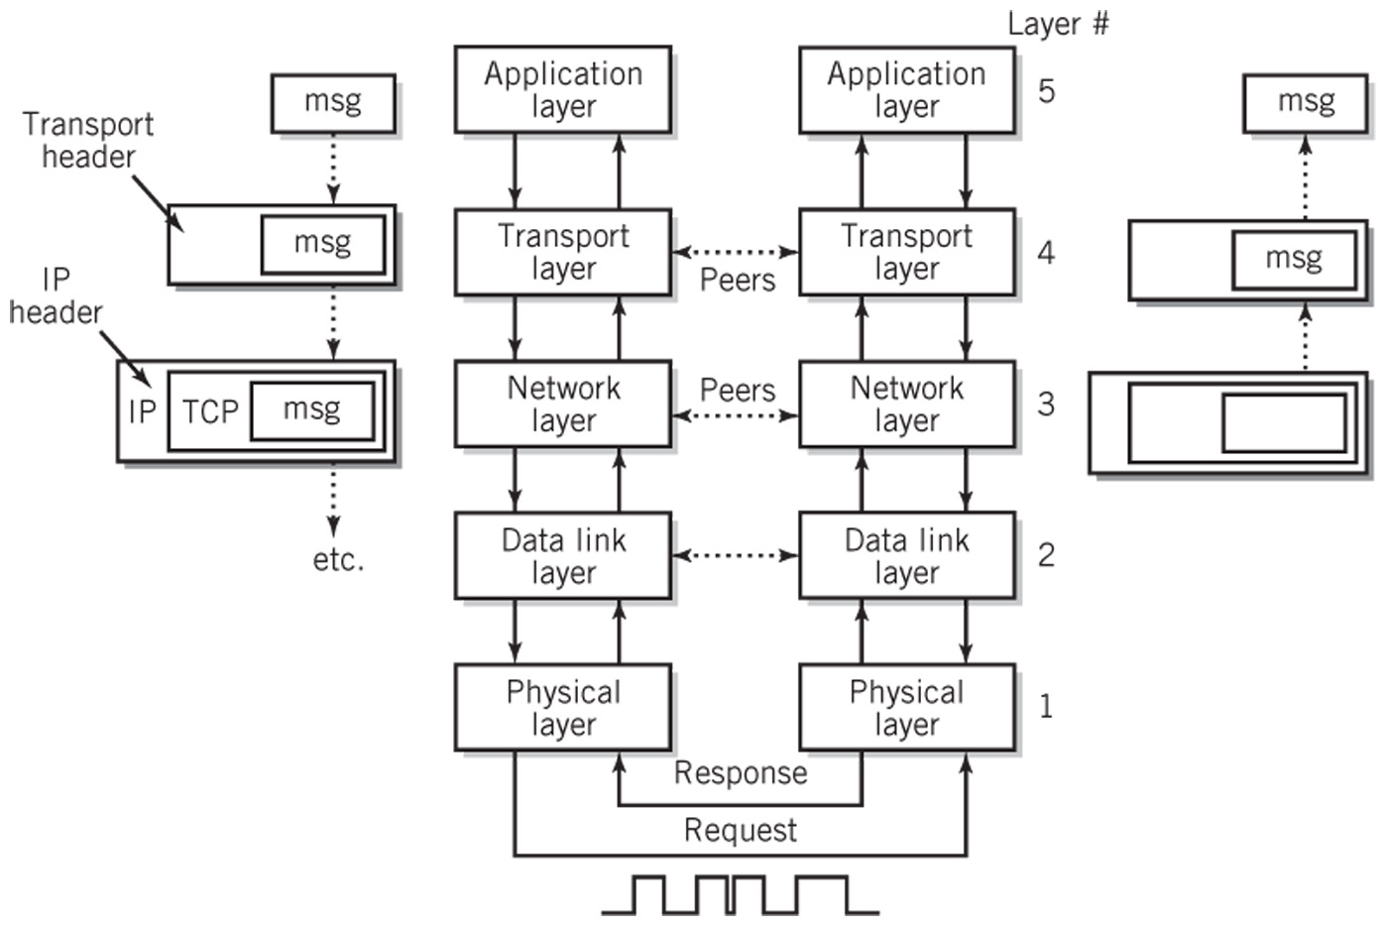
Operation of TCP/IP Model
Ethernet
NIC / Wires
Underlying Network
Notes:
Doesn’t have to be Ethernet. Could be token ring, 802.11 radio, etc. Wires could be fiber or radio waves, etc.

Slide 15
Application Layer (Layer 5)
Layer where message is created
Includes any application that provides software that can communicate with the network layer
Sockets
Originated with BSD UNIX
Provide the interface between the application layer and transport layer
Used by applications to initiate connections and to send messages through the network
A means for adding new protocols and keeping the network facilities current in their offering.

Slide 16
Transport Layer (Layer 4)
Provides services that support reliable end-to-end communications
Generates the final address of the destination
Responsible for all end-to-end communication facilities
Packetization of the message, breaking up of the message into packets of reasonable size takes place at this level
Two major protocols:
TCP
UDP
Notes:
SCTP: Stream-control transmission protocol -- byte streams, e.g. telephone. See p. 392

Slide 17
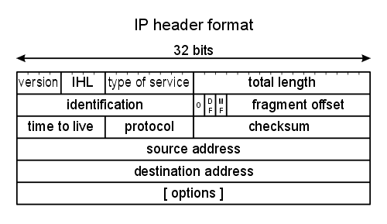
IPv4 Header

Slide 18
We’re Out of IPv4 Addresses
IPv4 addresses are 32 bits. There are (about) 2³² of them or around four billion.
Conserving addresses
Gateways, reserved addresses and NAT
Classless addresses (CIDR)
ICANN ran out of large IPv4 address blocks in spring, 2011.
Regional registrars and ISPs still have addresses available.

Slide 19
IPv6
IPv6 standard published in 1998.
128-bit addresses, so 2¹²⁸ of them: enough to assign an address to every grain of sand on the planet.
Addresses are eight groups of four hex digits: 2001:db8:85a3:0:0:8a2e:370:7334
But, not interoperable with IPv4! Effectively creates a new, parallel network.
So, IPv4 remains the most common addressing format.

Slide 20
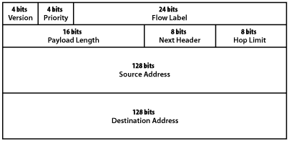
IPv6 Header

Slide 21
Transport Layer Protocols
TCP (Transmission Control Protocol)
Reliable delivery service
Sending and receiving TCP node each create a socket
Control packets are used to create a full duplex connection between the sockets
A single TCP service can create multiple connections that operate simultaneously by creating additional sockets as needed
Routing is the responsibility of the network layer (layer 3)
UDP (User Datagram Protocol)
Unreliable, connectionless service
No acknowledgment of receipt by receiving node
Example: streaming video

Slide 22
“Reliable” and “Unreliable”
The Postal Service: Reliable or not?
In “unreliable” network communication, the protocol provides no indication of delivery. (IP, UDP)
In “reliable” communication, the protocol does provide feedback.
TCP is a reliable protocol in that packets are acknowledged by sequence number.

Slide 23
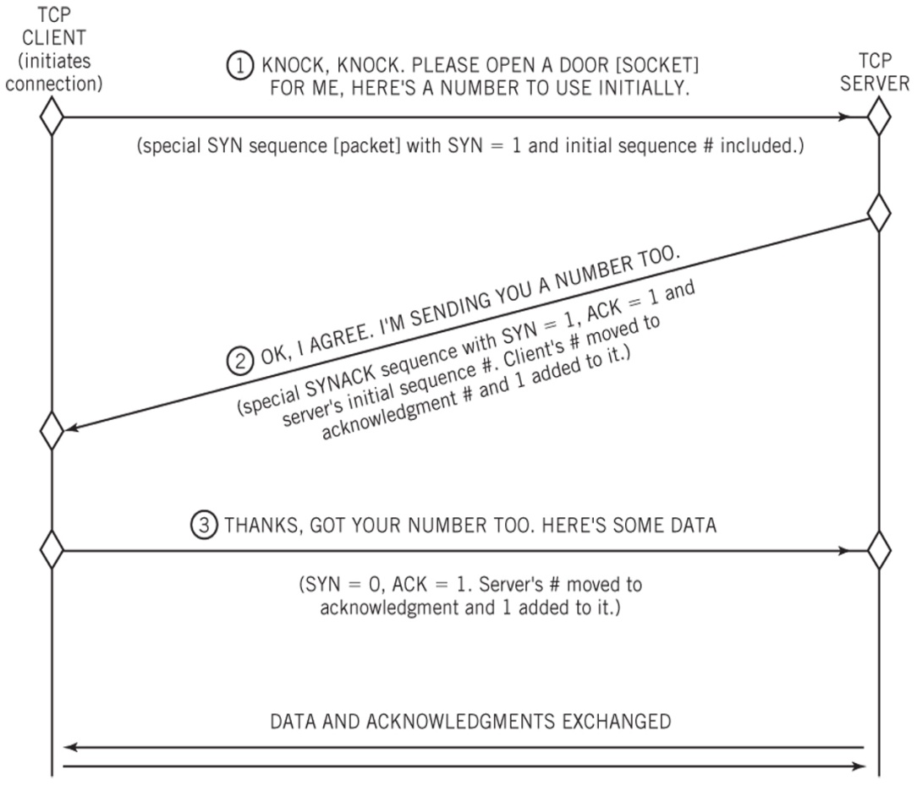
Three-Way TCP Connection Handshake

Slide 24
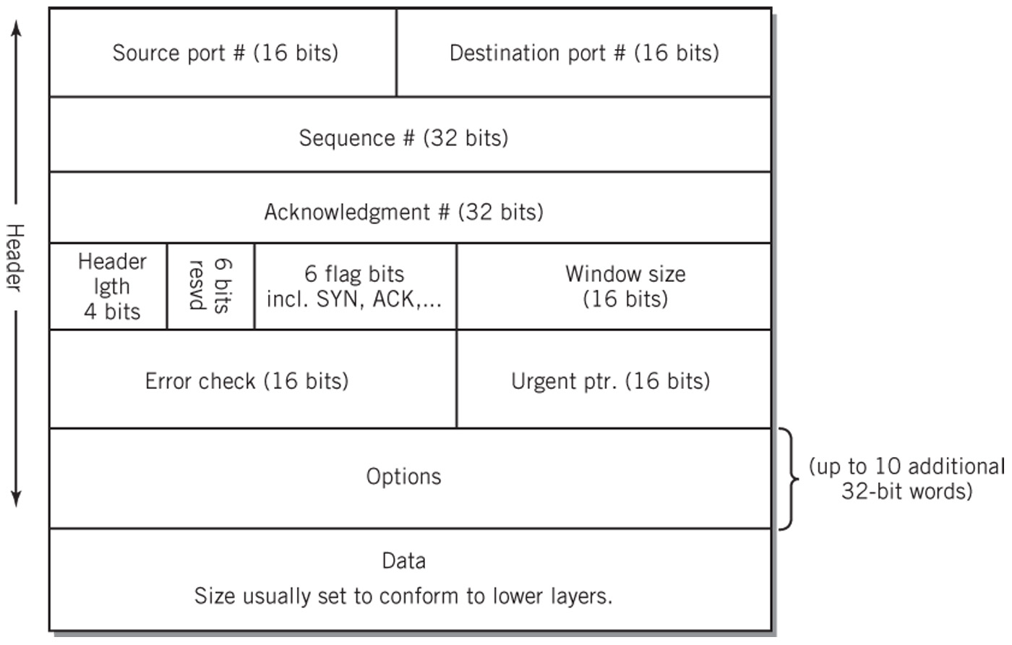
TCP Segment Format

Slide 25
Network Layer (Layer 3)
The TCP/IP network layer is also called the internetworking layer or the IP layer
Responsible for the addressing and routing of packets to their proper and final destination
IP (not TCP) provides unreliable, connectionless, packet switching service
Does not guarantee delivery nor check for errors
Routers and gateways are sometimes referred to as level 3 switches to indicate the level at which routing takes place

Slide 26
Data Link Layer (Layer 2)
Responsible for the reliable transmission and delivery of packets between two adjacent nodes on the local network.
Packets at this layer are called frames
Often divided into the following two sublayers:
Software logical link control sublayer
Error correction, flow control, retransmission, packet reconstruction and IP datagram/frame conversions
Numbers frames and reorders received frames to recreate the original message
Rarely used
Hardware medium-access control sublayer
Defines procedures for access the channel and detecting errors
Responsible for services such as data encoding, collision handling, synchronization, and multiplexing

Slide 27
Physical Layer (Layer 1)
Layer at which communication takes place as a bare stream of bits
Primarily implemented in hardware by a network interface controller (NIC)
Physical Medium Access Control protocol includes
Definition of the medium
Signaling method, signal parameters, carrier frequencies, lengths of pulses, synchronization and timing issues
Method used to physically connect the computer to the medium

Slide 28
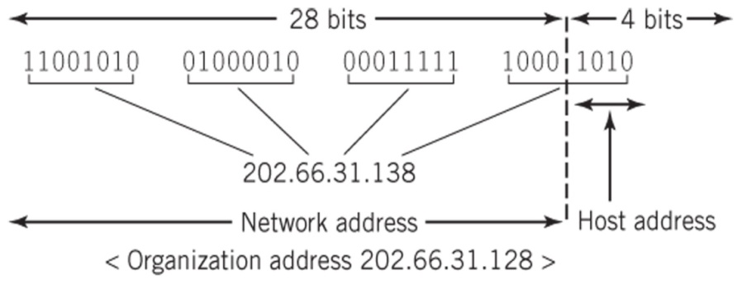
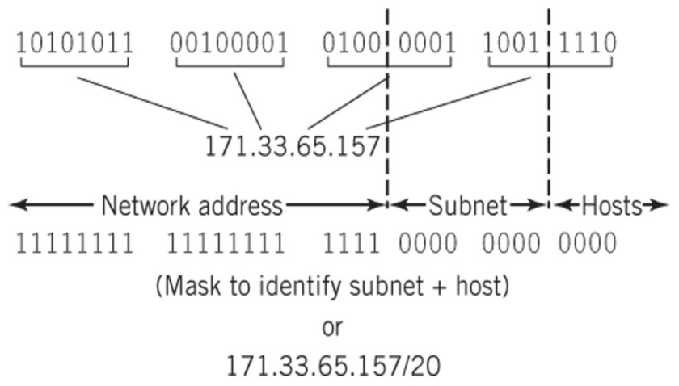
IPv4 Address Formats
IP Block Addresses
IP Hierarchy and Subnet Mask

Slide 29
Attacks on tcp/ip layer

Slide 30
Ip-spoofing
Forging or falsifying the source IP address in IP packets
Mitigations:
Input access lists
Filter on source AND destination IP addresses
Unicast Reverse Path Forwarding
Discards IP Packets that lack a verifiable IP source address in the IP Routing Table
Notes:
IP Source Guard is a Layer 2 security feature that prevents IP spoofing attacks by restricting IP traffic on untrusted Layer 2 ports to clients with an assigned IP address.

Slide 31
Routing attack
Routing Information Protocol (RIP)
Distributes routing information
Mitigations:
Use the latest version
IPSec VPN
Notes:
Distributes routing information within a network
Shortest paths
Routes out
Often used without verification
Version 2 has password authentication
IPSec VPN encrypts all traffic

Slide 32
ICMP attack
Internet Control Message Protocol
Used as an error reporting tool
Used for one-way messages
Ping Flood
Mitigations:
Firewalls within the network
Configure ICMP to only respond to specific requests
Notes:
No authentication
Can be used for DoS attacks
Ping of death- Create IP datagram with more than 65536 bytes
Teardrop- Insert false offset information to packet headers

Slide 33
Packet sniffing
Any packet transmitted is ‘heard’ by anyone on that collision domain
Packet data is often transmitted in plain text
Mitigations:
Authentication
Cryptography
Switched infrastructure
‘anti-sniffer’ tools

