Slide 1
Ethical Hacking
Module 3

Slide 2
Malicious Logic
Set of instructions that cause site security policy to be violated

Slide 3
viruses
Self replicating program code
Becoming quite rare in the real world
Notes:
The definition of a “virus” changes depending on it’s behavior
Boot sector infectors
Executable infectors (cavity viruses)
TSR viruses
Stealth viruses
Encrypted viruses
Polymorphic viruses
Macro viruses
Multipartite viruses

Slide 4
Boot Sector virus
Infects the Boot Sector
Part of the MBR/GPT

Slide 5
Boot Sector virus
Infects the Boot Sector
Part of the MBR/GPT
Also infect floppy disk boot sectors!!!!!!!!!!!!!!!!!!!!!!!!

Slide 6
Boot Sector virus
Infects the Boot Sector
Part of the MBR/GPT
Also infect floppy disk boot sectors!!!!!!!!!!!!!!!!!!!!!!!!
…But seriously
Any removable media (USB, SD, CF, etc.)

Slide 7
Master Boot Record (MBR)
An MBR is at the very beginning of partitioned mass storage devices
The MBR holds:
Information about logical partitions
executable code to function as a loader for the installed operating system
The organization limits the maximum addressable storage space of a disk to 2 TiB
MBR-based partitioning scheme is being superseded by GUID Partition Table (GPT)
Notes:
A GPT can coexist with an MBR in order to provide some limited form of backward compatibility for older systems.

Slide 8
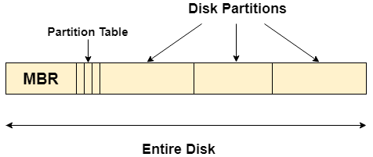
Master Boot Record (MBR)

Slide 9
GUID Partition Table (GPT)
The GPT uses globally unique identifiers (GUIDs)
The MBR partitioning scheme is limited to 32 bits for block addresses and related information.
GPT uses 64 bits for logical block addresses, allowing a maximum disk size of 264 sectors.
Notes:
For hard disks with 512-byte sectors, the MBR partition table entries allow a maximum size of 2 TiB
GPT uses 64 bits for logical block addresses, allowing a maximum disk size of 264 sectors. For disks with 512-byte sectors, the maximum size is 9.4 ZB (9.4 × 1021 bytes) or 8 ZiB (264 sectors × 29 bytes per sector).

Slide 10
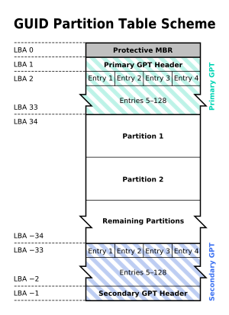
GUID Partition Table (GPT)

Slide 11
FAT

Slide 12
mitigations
Can only spread if system is booted from an infected disk
Or if boot sector code is executed before disk is checked
OS writers got a clue…
OS protects boot sector
MBR is encrypted and checksummed

Slide 13
Addendum
Another tactic is to attack the BIOS

Slide 14
Addendum
Another tactic is to attack the BIOS
BIOS- Basic Input Output System
Firmware used to perform hardware initialization during the booting process (power-on startup), and to provide runtime services for operating systems and programs.

Slide 15
Originally, BIOS firmware was stored in a ROM chip on the PC motherboard
In modern computer systems, the BIOS contents are stored on flash memory so it can be rewritten without removing the chip from the motherboard

Slide 16
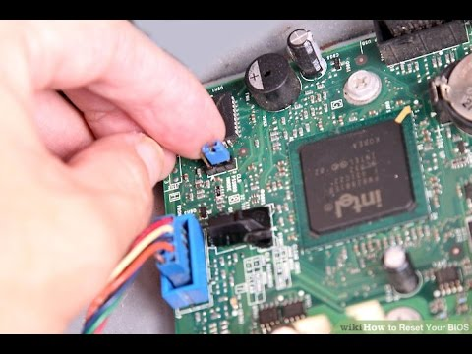
Hardware write protect

Slide 17
Cavity virus
EXEs and other executables can contain unused space
Cavity viruses insert themselves into the free space
But don’t change the overall file size

Slide 18
Portable executables
In Windows: “.exe”
A PE file consists of headers and sections that show how to map the exe file into memory.
An executable image consists of several different regains
Each of which require different memory protection
Because of this, the start of each section must be aligned to a page boundary

Slide 19
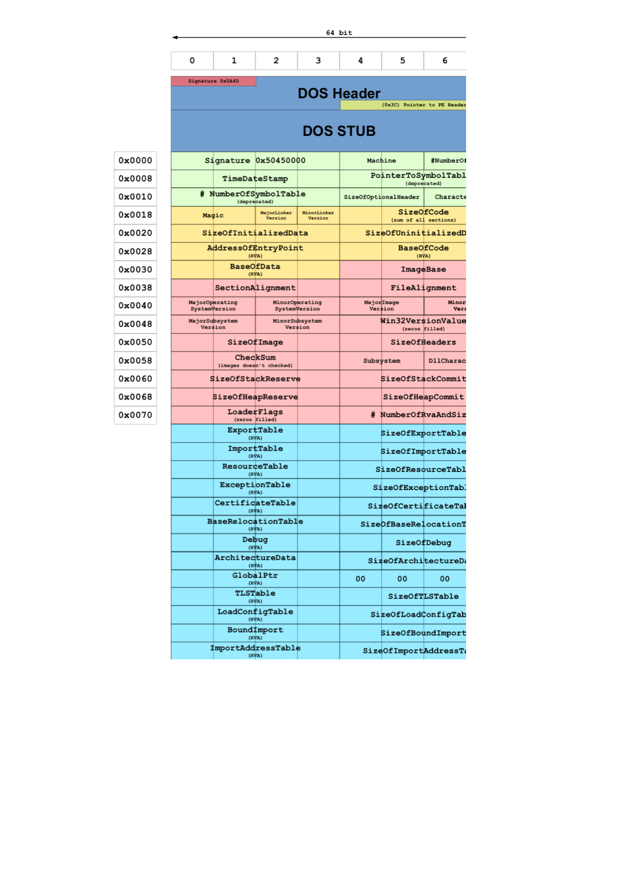
Notes:
CC BY 4.0, https://commons.wikimedia.org/w/index.php?curid=51026079

Slide 20
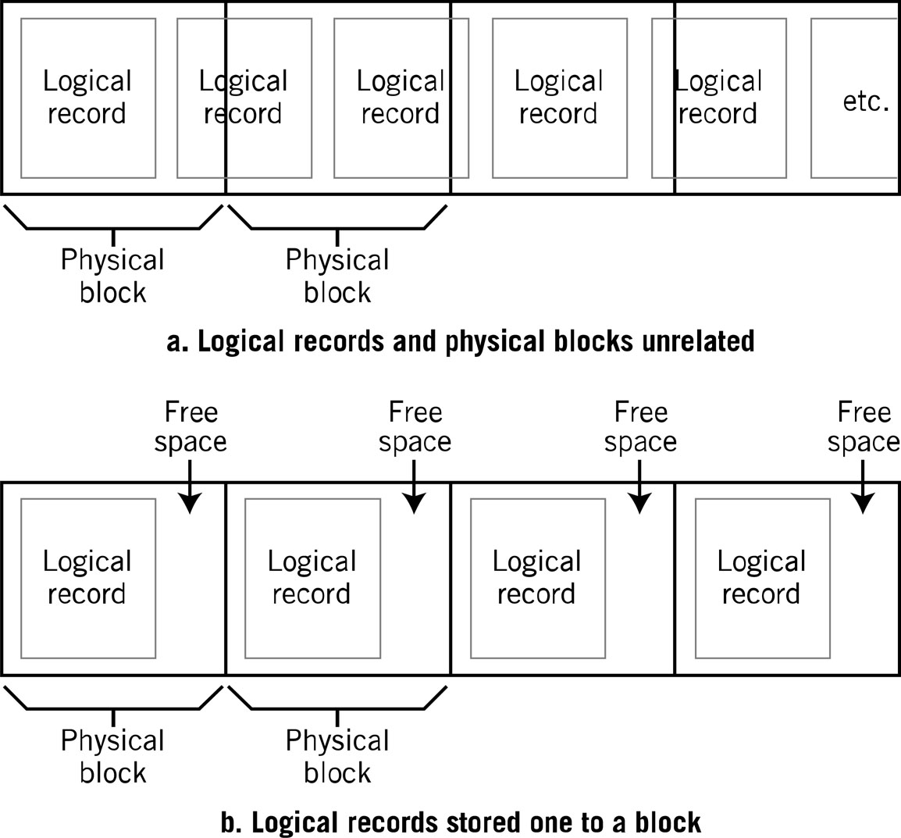
Logical View vs. Physical View

Slide 21
mitigations
Checksumming
Verifying section boundaries
Initializing all areas that are not supposed to have runnable code or data

Slide 22
TSR viruses
Terminate and Stay Resident
Program returns control of the computer to the operating system
But stays resident in memory
Waiting to be reactivated by a hardware or software interrupt
Basically nonexistent nowadays
Notes:
This was an early programming trick to get ”concurrency” out of single thread OS (like DOS). With modern OSs’ providing facilities for milti-tasking and concurrent processes, vanilla TSR are no longer needed

Slide 23
Macro virus
Virus written in macro language
Word *
Excel **
Since they are application dependent, they can infect multiple operating systems
Assuming the application runs on that operating system
*Other word processors are available
**Other spreadsheets are available

Slide 24
Mitigation
This is why Word/Excel disable macros by default
Have a look at any macros before enabling them

Slide 25
Stealth viruses
Viruses that hide
From you
From the OS
From anti-virus applications
Some are capable of changing their “fingerprint” to appear benign
Notes:
Some stealth viruses have the ability to change their appearance to that of a normal “data” file and not an executable, then changing back just in time for execution

Slide 26
Encrypted virus
Originally, viruses were identified by their “signature”
A characteristic series of bytes

Slide 27
Hiding signatures
Make different viruses
Sometimes difficult
Similar logic will result in similar signature
Encrypt virus’s executable
Virus decrypts itself
Does naughty things
Re-encrypts itself

Slide 28
Polymorphic virus
Encryption done better
Allows a virus to change its own source code
Thus emanating a different signature
Each time the infected file is accesses

Slide 29
mitigations
Computers can’t be random
Use that to our advantage
It just takes more computer power
Trick the virus
Emulate an execution environment with strict control
When the virus decrypts itself, scan it

Slide 30
Metamorphism
Similar to polymorphism, except…
Not only does the virus signature change
…But the functionality does too
Virus carries it’s source code with it
If it can find a compiler on the host machine, it compiles a new version of itself
Very good technique on Linux/Unix machines

Slide 31
stealth
In the virus world, stealth is survival
Multiple methodologies are used:
Camouflage
Redirection
Interception

Slide 32
interception
Programs looking over your shoulder
Key loggers
Send keystrokes to remote machine
Email indexers

Slide 33
redirection
A boot sector virus might keep a copy of the uninfected boot sector
Any attempts by the OS to “look” will be redirected to the clean copy
This is why…
As your module reading says:

Slide 34
“Stealth is one more reason you should always boot from a clean, write-protected boot diskette prior to running a DOS virus scan”

Slide 35
rootkits
Originated from Unix/Linux tools to give users ”root” level access
Rootkits allow (malicious) access to areas where other software is not allowed
Primary weapon is stealth
Very hard to remove…or even detect

Slide 36
Trojan horse
Notes:
Trojan war (Greeks invading Troy)

Slide 37
Trojan malware
Typically non-replicating
Pretend to be legitimate applications

Slide 38
Trojan malware

Slide 39
worms
Considered a subdivision of viruses
Self replicate automatically
Do not infect individual files

Slide 40
ransomware
Software that encrypts you stuff
Don’t worry, they’ll send you the key

Slide 41
ransomware
Software that encrypts you stuff
Don’t worry, they’ll send you the key
…If you pay the ransom

Slide 42
ransomware
Software that encrypts you stuff
Don’t worry, they’ll send you the key
…If you pay the ransom
…Maybe

Slide 43
Notes:
By Unknown criminal - https://cdn.securelist.com/files/2017/05/wannacry_05.pngDownloaded from :https://securelist.com/blog/incidents/78351/wannacry-ransomware-used-in-widespread-attacks-all-over-the-world/, Public Domain, https://en.wikipedia.org/w/index.php?curid=54032765

Slide 44
WannaCry
May 2017 ransomware attack
Targeted Windows operating systems
Windows XP
Server 2003
Windows 8
Used an exploit in Microsoft’s Server Message Block (SMB) protocol
Protocol to provides shared access to files & printers
Notes:
The attack began on Friday, 12 May 2017
The initial infection was likely through an exposed vulnerable SMB port rather than email phishing.
Within a day the code was reported to have infected more than 230,000 computers in over 150 countries
The day after the initial attack Microsoft released out-of-band security updates for end of life products
It was discovered that Windows encryption APIs used by WannaCry may not completely clear the prime numbers used to generate the payload's private keys from the memory, making it potentially possible to retrieve the required key if they had not yet been overwritten or cleared from resident memory. The key is kept in the memory if the WannaCry process has not been killed and the computer has not been rebooted after being infected

Slide 45
Who was affected?
200,000 across 150 countries
One example:
England & Scotland National Health Service
70,000 devices including:
Computers
MRI Scanners
Blood-storage refrigerators
Operating room equipment
Notes:
In 2016, thousands of computers in 42 separate hospitals in England were reported to be still running Windows XP.
In 2018 a report by Members of Parliament concluded that all 200 NHS hospitals or other organizations checked in the wake of the WannaCry attack still failed cyber security checks.

Slide 46
Atlanta Ransomware Attack
Began in March 2018
A January 2018 audit found 1,500 to 2,000 vulnerabilities in the city's systems
Virus name was SamSam
SamSam is special….

Slide 47
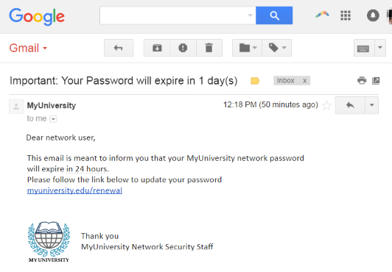
Most ransomware relies on “phishing”

Slide 48
Most ransomware relies on “phishing”
….SamSam relies on brute force
What does that say about the externally visible infrastructure?

Slide 49
response
City shut down many digital services
Including court system database
Online bill paying tools
Pot-hole & graffiti reporting services
Public Wi-Fi at the airport

Slide 50
Why is this important
The largest successful breach of security for a major American city by ransomware

Slide 51
Why is this important
The largest successful breach of security for a major American city by ransomware
Not even the government can be “secure”

