Slide 1
Ethical Hacking
Module 4

Slide 2
Denial of Service

Slide 3
Denial of Service (DOS)
An attack on a computer or network that prevents legitimate use of its resources

Slide 4
Udp flood
A large number of UDP packets are sent to a targeted server with the aim of overwhelming that device’s ability to process and respond
May also overwhelm the firewall

Slide 5
Udb moa
Under normal conditions when a server receives a UDP packet at a particular port, it goes through two steps in response:
The server first checks to see if any programs are listening at the specified port
If no programs are receiving at that port, the server responds with a ICMP packet that the destination was unreachable
Notes:
Under normal conditions, when a server receives a UDP packet at a particular port, it goes through two steps in response:
The server first checks to see if any programs are running which are presently listening for requests at the specified port.
If no programs are receiving packets at that port, the server responds with a ICMP (ping) packet to inform the sender that the destination was unreachable.

Slide 6
mitigations
Most operating systems limit the response rate of ICMP packets
Notes:
Most operating systems limit the response rate of ICMP packets in part to disrupt DDoS attacks that require ICMP response. One drawback of this type of mitigation is that during an attack legitimate packets may also be filtered in the process.
If the UDP flood has a volume high enough to saturate the state table of the targeted server’s firewall, any mitigation that occurs at the server level will be insufficient as the bottleneck will occur upstream from the targeted device.

Slide 7
Icmp flood
Very similar to UDP flood
Except uses ICMP protocol

Slide 8
mitigations
Disable ICMP
Or specific messages (e.g. ping)

Slide 9
Ping of death
We’ve talked this one to death…

Slide 10
Syn flood
Uses the TCP protocol
Takes advantage of the “three-way handshake”

Slide 11
details
TCP Messages are broken into segments
Each segment has a segment number for easy identification
When a client attempts to start a TCP connection, the client and server exchange a series of messages:
SYN
SYN + ACK
ACK

Slide 12
Three-way handshake
Step 1 (SYN) : The client wants to establish a connection, so it sends a segment which informs the server that client is likely to start communications
Step 2 (SYN + ACK): Server responds to the client request with SYN-ACK
Step 3 (ACK) : The client acknowledges the response of server and they both establish a reliable connection
Notes:
Step 1 (SYN) : In the first step, client wants to establish a connection with server, so it sends a segment with SYN(Synchronize Sequence Number) which informs server that client is likely to start communication and with what sequence number it starts segments with
Step 2 (SYN + ACK): Server responds to the client request with SYN-ACK signal bits set. Acknowledgement(ACK) signifies the response of segment it received and SYN signifies with what sequence number it is likely to start the segments with
Step 3 (ACK) : In the final part client acknowledges the response of server and they both establish a reliable connection with which they will start the actual data transfer

Slide 13
However…
A SYN flood attack does not respond to the server with the expected ACK code
The malicious client does not send the expected ACK, or spoofs the source IP address
The server will wait for the acknowledgement for some
Network congestion could also cause the missing ACK

Slide 14
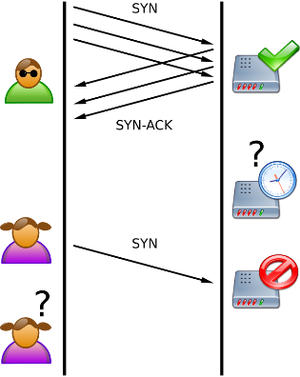
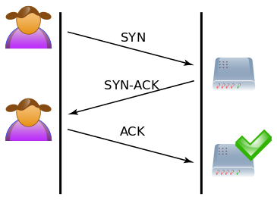
Notes:
https://en.wikipedia.org/wiki/File:Tcp_normal.svg#metadata
https://en.wikipedia.org/wiki/File:Tcp_synflood.png

Slide 15
slowloris
Little bit of background…
Most web servers have a software limit to the maximum number of open connections
Each connection has a maximum idle time before it is automatically closed
Used to handle ungraceful disconnects by clients
Each of these has a default
And are widely known

Slide 16
slowloris
Slowloris opens as many connections as possible
Keeps each one open by carefully subverting the timeout
https://www.youtube.com/watch?v=XiFkyR35v2Y
Notes:
Slowloris tries to keep many connections to the target web server open and hold them open as long as possible. It accomplishes this by opening connections to the target web server and sending a partial request. Periodically, it will send subsequent HTTP headers, adding to—but never completing—the request. Affected servers will keep these connections open, filling their maximum concurrent connection pool, eventually denying additional connection attempts from clients

Slide 17
http flood
Volumetric distributed denial-of-service (DDoS) attack
Designed to overwhelm a web server with HTTP requests

Slide 18
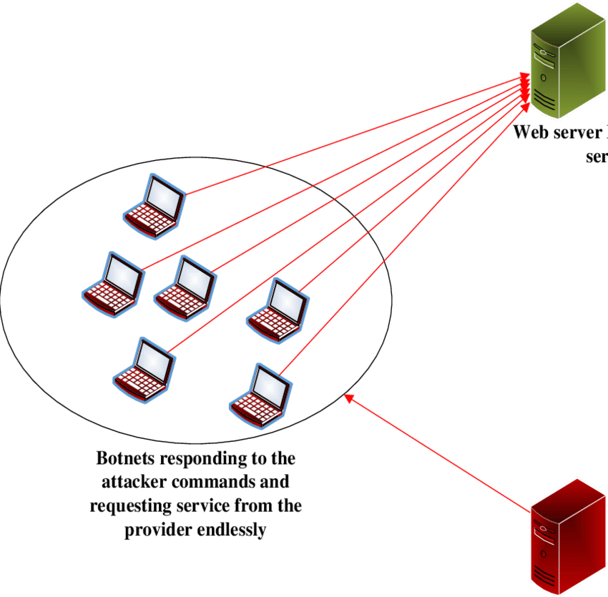
http flood
Notes:
https://www.cloudflare.com/learning/ddos/http-flood-ddos-attack/

Slide 19
Compare/contrast
A
B
UDP flood
ICMP flood
SYN flood
HTTP flood
Ping of death
Slowloris

Slide 20
DOS vs DDOS
Denial of Service (DoS)
Distributed Denial of Service (DDoS)
Large-scale, coordinated attack
Launched indirectly through many compromised computers on the Internet
Know as “zombies”

Slide 21
Three types of Ddos
Volume Based Attacks
Goal: Use up the bandwidth
All protocols obeyed
UDP Flood, ICMP Flood
Protocol Attacks
Goal: Consume all the resources
Cause as much backed overhead as possible
SYS Flood, Ping of Death, Smurf DDoS
Application Layer Attacks
Goal: Annoy the application SO much, that it crashes
Or just doesn’t respond
Slowloris

Slide 22
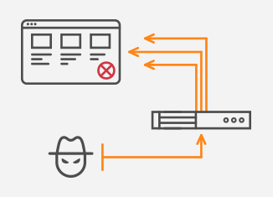
Amplification
Amplification attacks exploit a disparity in bandwidth consumption between an attacker and the targeted web resource
I.e. Small queries → Large responses
Notes:
https://www.noction.com/blog/ddos-amplification-attacks

Slide 23
reflector
A server that is reachable from the Internet
It offers a service to clients (DNS, NTP, SNMP, gaming, etc.)
Maybe a misconfigured DNS server
or left in a default state
A public DNS server intentionally configured to provide open recursion for clients in the Internet
A reflector has no intention to be part of the DDoS attack

Slide 24
process
Attackers launch a DDoS attack flooding a reflector with queries that seem to be a legitimate request for service
However, the network traffic contains a spoofed source IP address of a victim
A query response sent from a reflector to the victim is significantly larger than an original query request
Notes:
Think of a malicious teenager calling a restaurant and saying “I’ll have one of everything, please call me back and tell me my whole order.” When the restaurant asks for a callback number, the number given is the targeted victim’s phone number. The target then receives a call from the restaurant with a lot of information that they didn’t request.

Slide 25
Example: DNS Amplification
The attacker uses a compromised endpoint to send UDP packets with spoofed IP addresses to a DNS resolver
The spoofed address on the packets points to the real IP address of the victim
Each one of the UDP packets makes a request to a DNS resolver
Often passing an argument such as “ANY” in order to receive the largest response possible
After receiving the requests, the DNS resolver sends a large response to the spoofed IP address
The IP address of the target receives the response and the surrounding network infrastructure becomes overwhelmed with the deluge of traffic, resulting in a denial-of-service

Slide 26
mitigations
Access Control List
Scrutinizes inbound traffic before it can hit your IT infrastructure
Rate Limiting
Separate servers physically

Slide 27
mitigations
Reduce the total number of open DNS resolvers
By having poorly configured DNS resolvers exposed to the Internet, all an attacker needs to do to utilize a DNS resolver is to discover it
Ideally, DNS resolvers should only provide their services to devices that originate within a trusted domain
Source IP verification – stop spoofed packets leaving network
Reject any internal traffic with spoofed IP addresses
If a packet is being sent from inside the network with a source address that makes it appear like it originated outside the network, it’s likely a spoofed packet and can be dropped
For an individual or company running a website or service, mitigation options are limited
The Internet Service Provider (ISP) or other upstream infrastructure providers may not be able to handle the incoming traffic and as a result, the ISP may blackhole all traffic to the targeted victim’s IP address

Slide 28
Now consider
Most of the above attach focus on the underlying network or it’s components
However, there are many other that attack the applications, or underlying operating system
Consider….

Slide 29
In linux…
Processes are running programs
Processes can be in the “foreground” or “background”
For each running process Linux stores:
Process id
Process owner
Process priority
Environment variables for each process
The parent process
Pointers to the executable machine code of a process.

Slide 30
Linix (and unix)
Has a system call: fork()
Used to create processes.
If a process calls fork(), it creates a new process, which becomes the child process of the caller
Both processes will execute the next instruction following the fork() system call

Slide 31
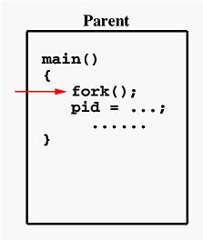
example
Notes:
http://www.csl.mtu.edu/cs4411.ck/www/NOTES/process/fork/create.html

Slide 32
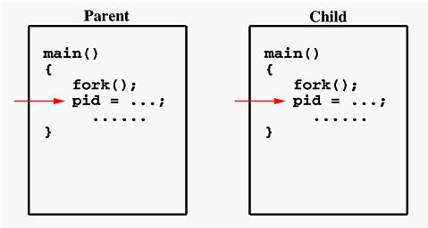
example
Notes:
http://www.csl.mtu.edu/cs4411.ck/www/NOTES/process/fork/create.html

Slide 33
Given the following
How many process will be created?
#include <stdio.h>
#include <string.h>
#include <sys/types.h>
void main(void)
{
while(1 == 1){
fork();
}
}

Slide 34
OS to the rescue
Linux has a soft process cap:
cat /proc/sys/kernel/threads-max
System wide limit on processes
Is this a good thing?
From who’s perspective?

