Slide 1
Ethical Hacking
Module 4

Slide 2
Additional footprinting
Previously we discussed the overview of footprinting
nmap example
But there are other less “high-tech” ways of learning about your victim
Notes:
The end goal of footprinting is to gain as much information without giving yourself away

Slide 3
Look in the news
Are there any news articles that provide information about their security?

Slide 4
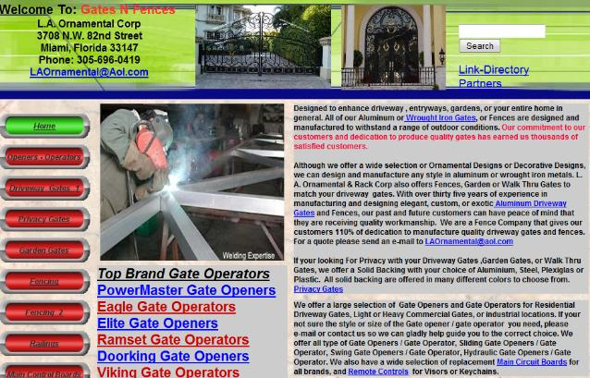
Really look at the website
The overall quality of a website can also speak volumes

Slide 5
Try to recognize templates

Slide 6
Look at their website content
Official websites often give helpful details about an organization
Company organization
Locations
Staff names/contacts
Privacy or security policies
Links to other web servers for the organization
Notes:
Don’t try and take on the organization as a whole
Maybe pick one department or team, and go from there
Often the website lays out the organization

Slide 7
Look at the raw source code
HTML is a programming language
A specialized one
Is it compiled or interpreted?
Notes:
wget example
Chrome example

Slide 8
php
Recursive acronym for PHP: Hypertext Preprocessor
Widely-used open source general-purpose scripting language
Especially suited for web development
Can be embedded into HTML
Is this knowledge useful for us?

Slide 9
php
Recursive acronym for PHP: Hypertext Preprocessor
Widely-used open source general-purpose scripting language
Especially suited for web development
Can be embedded into HTML
Is this knowledge useful for us?
What if I told you that as of August 2019, 79% of websites are using PHP

Slide 10
Well…
The PHP Extension and Application Repository (PEAR)
a framework and distribution system that allows anyone to search and download free packages written in PHP
PHP’s equivalent of apt
In January 2019, maintainers at PEAR took down the official website. Why?
Hackers replaced the legitimate PHP PEAR package manager with a malicious version

Slide 11
This is bad
But it gets worse…
Guess how long this breach went unnoticed:

Slide 12
This is bad
But it gets worse…
Guess how long this breach went unnoticed:
Only about 6 months…

Slide 13
cookies
HTTP cookies were design as a reliable mechanism for websites to preserve “state” information, e.g. :
Items in a shopping cart
Pages visited in the past
Data previously entered into forms

Slide 14
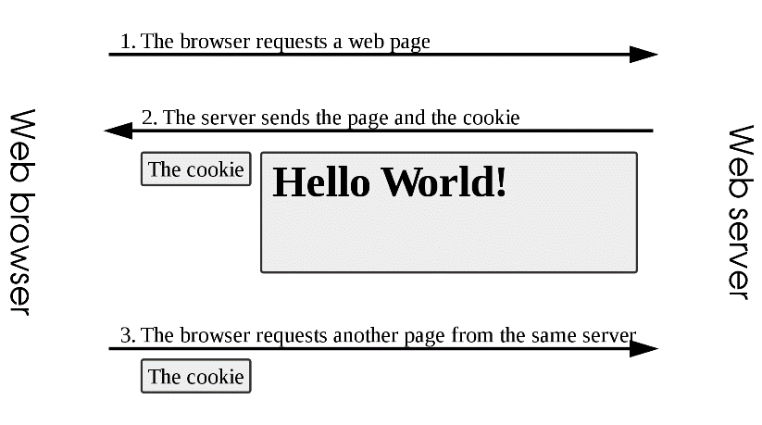
cookies
Notes:
By Tizio - Own work, CC BY-SA 3.0, https://commons.wikimedia.org/w/index.php?curid=1577024

Slide 15
implementation
For browsers to support cookies they:
Can support cookies as large as 4,096 bytes in size.
Can support at least 50 cookies per domain (i.e. per website).
Can support at least 3,000 cookies in total.

Slide 16
structure
A cookie consists of the following components:
Name
Value
Zero or more attributes (name/value pairs)
Attributes store information such as the cookie's expiration, domain, and flags (such as Secure and HttpOnly).

Slide 17
Many different cookies
Sugar
Chocolate chip
Oatmeal raisin
Cinnamon

Slide 18
Many different web cookies
Session cookie
Persistent cookie
Secure cookie
HTTP-only cookie
Third-party cookie

Slide 19
Session cookie
Also called “in-memory cookie”
Exist only while the user browses the site
Do not have an expiration date
Notes:
Unlike other cookies, session cookies do not have an expiration date assigned to them, which is how the browser knows to treat them as session cookies.

Slide 20
Persistent cookie
Has a specific expiration date
Continue to exists even after the user leaves the site or closes the web browser
Also know as “tracking cookies”
Notes:
tracking cookies can be used by advertisers to record information about a user's web browsing habits over an extended period of time.
Can be used for "legitimate" reasons (such as keeping users logged into their accounts on websites, to avoid re-entering login credentials at every visit).

Slide 21
Secure cookie
Can only be transmitted over HTTPS
Makes the cookies less venerable to theft

Slide 22
HTTP only cookie
Cannot be accessed by client-side APIs
JavaScipt
PHP
Prevents other sites/applications from reading the cookie and gathering information from it

Slide 23
Third-party cookies
First-party cookies belong to the domain shown in the address bar
Third-part cookies belong to a different domain
Can occur anytime a website features content from external sites
Advertisements
Embedded videos

Slide 24
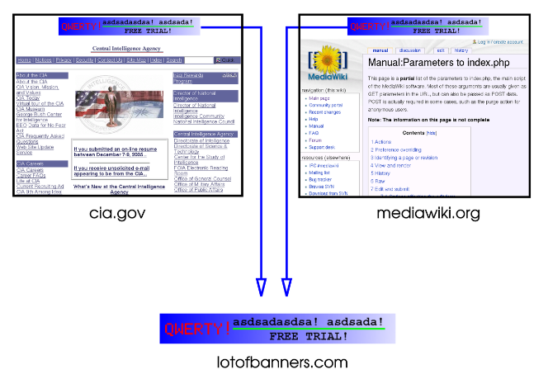
Notes:
By Tizio - Own work, derived from cia.gov website (PD) and mediawiki.org (GFDL) web sites (File:Third party cookie.svg), CC BY-SA 3.0, https://commons.wikimedia.org/w/index.php?curid=32263731

Slide 25
Legitimate uses
Session Management
Do you really want to log into D2L every time you load a new page?
Personalization

Slide 26
Not so legitimate uses
Session hijacking
If the cookie is used to identify a user and their state…
If you take their cookie…then are you them?
Cookie theft
If a website can access cookies that don’t belong to it
What information can it obtain?
Cookie harvesting
Large scale cookie theft
An attacker can try to impersonate a website by accepting cookies from the users
Once the attacker gets the cookies, he can use these harvested cookies for websites that accept third-party cookies
Possible Main-In-The-Middle attack

Slide 27
firesheep
Back in 2010
Yes that was 10 years ago now…
Websites encrypted the login process
To protect usernames and passwords
But didn’t bother to encrypt the session cookies
To increase awareness, Eric Butler released Firesheep
Notes:
Websites like Facebook, Twitter, Google

Slide 28
firesheep
Firesheep was a Firefox plugin
Eavesdropped on Wi-Fi communications, listening for session cookies
When it detected a session cookie, the victim's session is taken over by the attacker

Slide 29
End result…
Session cookies became secure cookies
Only transmitted over HTTPS

Slide 30
Alternatives to cookies
JSON Web Tokens
Self contained packets to store authentication information
Not automatically attached to HTTP requests
HTTP authentication
The browser remembers your login credentials
Sends them with each new request
IP address
Instead of tracking a session cookie, track an IP address
Is the reliable?
Notes:
JWT- Must be explicitly attached to the HTTP request by the application

Slide 31
Alternatives to cookies
URL strings
Attach unique IDs to every query
Easy transfer of preferences, just use the same URL
But it’s a double edged sword
Hidden form fields
HTTP equivalent of invisible ink
Data placed in HTML body and not the URL
Your average user wouldn’t notice…

Slide 32
Alternatives to cookies
Identifier for advertisers
Apple assigns a unique identifier to every user that buys an Apple iOS device
This identifier is then used by to determine the ads that individuals are viewing and responding to
Web storage
Store the pages locally
No new requests are necessary

