Slide 1
So…why?

Slide 2
Buffer overflow attacks

Slide 3
Buffer overflow
A buffer is a temporary area for data storage.
When more data (than was originally allocated to be stored) gets placed by a program or system process, the extra data overflows
It causes some of that data to ‘leak’ out into other memory addresses, which can corrupt or overwrite whatever data they were holding
A controlled, deliberate corruption of memory

Slide 4
RAM
0xffff…f
0x0000…0

Slide 5
RAM
Kernel
0xffff…f
0x0000…0
Notes:
Kernel is arguments, environment variables, kernel functions

Slide 6
RAM
Kernel
0xffff…f
Text
0x0000…0
Notes:
Text is the code of the program

Slide 7
RAM
Kernel
0xffff…f
Data
Text
0x0000…0
Notes:
Data- Initialized/uninitialized variables

Slide 8
RAM
Kernel
0xffff…f
Heap
Data
Text
0x0000…0
Notes:
Large area of memory used for big things
Heap must be manually allocated by the programmer
More flexible memory sizes

Slide 9
RAM
Kernel
0xffff…f
Stack
Heap
Data
Text
0x0000…0
Notes:
Stack holds local variables for functions

Slide 10
RAM
Kernel
0xffff…f
Stack
Heap
Data
Text
0x0000…0
Notes:
Stack holds local variables for functions

Slide 11
RAM
Kernel
0xffff…f
Stack
Heap
Data
Text
0x0000…0
Notes:
Stack holds local variables for functions

Slide 12
RAM
Kernel
Stack
Heap
Data
Text
Notes:
Stack holds local variables for functions

Slide 13
0x0000…0
Low memory
0xffff…f
High Memory
Stack
Notes:
Stack holds local variables for functions

Slide 14
0x0000…0
Low memory
0xffff…f
High Memory
Stack
Notes:
Stack holds local variables for functions

Slide 15
0x0000…0
Low memory
0xffff…f
High Memory
Stack
Notes:
Stack holds local variables for functions

Slide 16
0x0000…0
Low memory
0xffff…f
High Memory
Stack
Notes:
Stack holds local variables for functions

Slide 17
0x0000…0
Low memory
0xffff…f
High Memory
Stack
Notes:
Stack holds local variables for functions

Slide 18
function
Functions are "self contained" modules of code that accomplish a specific task
The program comes to a line of code containing a "function call"
The program enters the function (starts at the first line in the function code)
All instructions inside of the function are executed from top to bottom
The program leaves the function and goes back to where it started from

Slide 19
Consider…
int main(int argc, char** argv){
char buffer[500];
strcpy(buffer, argv[1]);
printf("String copied into buffer\n"); return 0;
}

Slide 20
0x0000…0
Low memory
0xffff…f
High Memory
Stack

Slide 21
0x0000…0
Low memory
0xffff…f
High Memory
Stack
ARG1
ARG0
Main()
Notes:
Main is the calling program and ARG0 and ARG1 are parameters to the function main is calling

Slide 22
0x0000…0
Low memory
0xffff…f
High Memory
Stack
RETURN
ARG1
ARG0
Main()
Notes:
Return is for Main to know where to go after it finishes

Slide 23
0x0000…0
Low memory
0xffff…f
High Memory
Stack
Base Pointer
RETURN
ARG1
ARG0
Main()
Notes:
Base pointer points to previous function (don’t worry about it for now)

Slide 24
0x0000…0
Low memory
0xffff…f
High Memory
Stack
buffer
Base Pointer
RETURN
ARG1
ARG0
Main()
500
Notes:
Buffer is a local variable for the called function

Slide 26
Ok…
So we can change return values on the stack
What good does this do us?

Slide 27
Ok…
So we can change return values on the stack
Well…What if we didn’t put “junk” in the buffer?

Slide 28
0x0000…0
Low memory
0xffff…f
High Memory
Stack
buffer
Base Pointer
RETURN
ARG1
ARG0
Main()
Malicious Code
500

Slide 29
0x0000…0
Low memory
0xffff…f
High Memory
buffer
Base Pointer
RETURN
ARG1
ARG0
Main()
Malicious Code
0x?????

Slide 30
Assembly to the rescue
Remember…
Every program is eventually reduced to a series of discrete finite steps
IE:
ADD
SBB
INC
DEC
MOV
JMP

Slide 31
Depending on the processor type, the available operations change
For example
X86 – 1,279^{*1}
ARM – 50^{*2}
*¹- Depending on how you look at it
*²- See ^{*1}

Slide 32
BUT!
There is one instruction that all processors have
In some way shape or form
NO-OP – “No Operation”

Slide 33
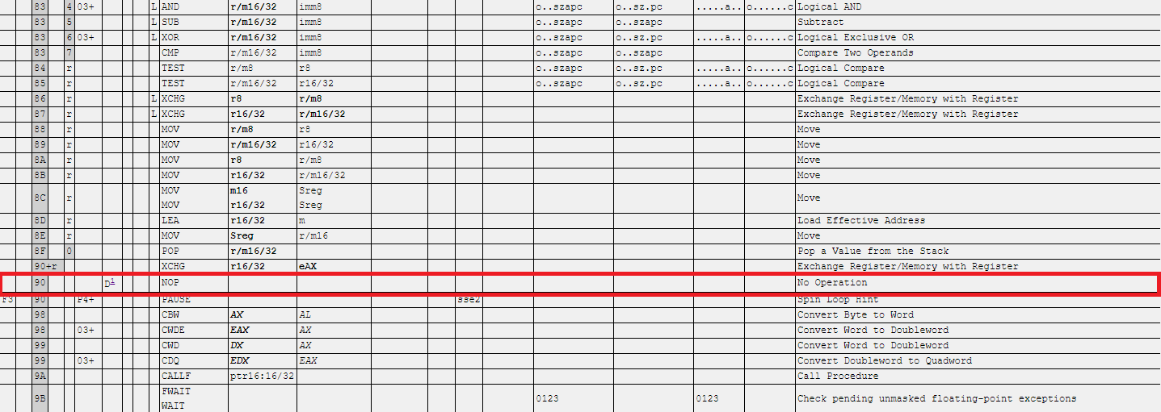

Slide 34
0x0000…0
Low memory
0xffff…f
High Memory
buffer
Base Pointer
RETURN
ARG1
ARG0
Main()
Malicious Code

Slide 35
0x0000…0
Low memory
0xffff…f
High Memory
buffer
Base Pointer
RETURN
ARG1
ARG0
Main()
NO OP
Malicious Code

Slide 36
0x0000…0
Low memory
0xffff…f
High Memory
buffer
Base Pointer
RETURN
ARG1
ARG0
Main()
NO OP
Malicious Code

