Slide 1
Operating system security

Slide 2
Problem
Client / Server infrastructure very common among most organizations
Clients provide access to system
Servers run the systems
Software vulnerabilities (e.g. buffer overflow) and malware need to be considered
Follow a framework detailed by NIST (National Institute of Standards and Technology) to provide a secure environment, even when we know it is not there

Slide 3
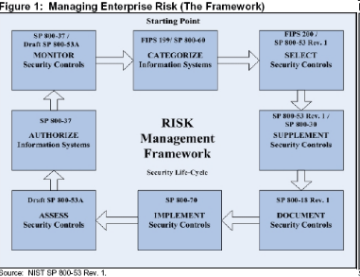
NIST Approach Phases
Planning
Installation
Configuration
Update
Maintenance
Consider the OS layered model, each layer needs to be properly secured, and it may be attacked from layers bellow

Slide 4
OS Layered Model
User Space
Services / Hypervisor
System Calls
Device Drivers / Hardware Abstraction Layer (HAL)
Kernel / BIOS
Instruction Set Architecture
Hardware
Physical World

Slide 5
System Security Planning
Identify risks, along with their likelihood and what impact they could have
Also identify how to prevent and mitigate these risks
Such process will drive what you need for establishing a secure system (personnel for installing, OS, hardware, apps, etc.)

Slide 6
Things to keep in mind
Purpose of the system, type of information stored, applications and services provided
Users of the system and their privileges
How are users authenticated
How information on system is managed
What other hosts / DBs are accessed by system
Who will manage system and how (remote or local)
Additional measures such as: firewall, anti-virus, logging

Slide 7
Hardening the OS
Default OS configurations are for ease of use
Measures must be done at all stages
Installing and patching
Configuring
Remove unnecessary applications, services and protocols
Users, groups, controls and privileges
Install additional software (anti-virus, firewall, intrusion detection system, etc.)
Test Security

Slide 8
Installing and Patching
Installation
Machines should not connect to network until secured
However removable media may be infected as well
Limited network (firewall) is acceptable, ideally:
No inbound connections
Only out to certain sites
Install only required services and drivers (from trusted sources)
Set up automatic updates (only if update time is not an issue)
Booting
Protect BIOS changes with password
Disable some bootable media
Cryptographic hard drives? Pros and Cons

Slide 9
Remove Unnecessary Support
Software has vulnerabilities, hence more software = more vulnerabilities
Better to not install it at all
Uninstallers sometimes fail to clean all dependency
Disabled software may be enabled by an attacker upon control acquisition

Slide 10
Configure U/G Authentication
Define user types and privileges
Admin (ideally only temporary)
Normal
Limited
Authentication
Force default password change
Password definition
Password lifespan
Remove or disable old accounts
Allow for remote connections?

Slide 11
Additional Security and Testing
Anti-virus
Firewalls, IDS, IPS
White list
If attackers manage to install a program what will happen?
Run some test cases which attempt to break security (stress testing), good hackers make a lot of money here

Slide 12
Application Security
Configure applications properly
Use encryption when possible as seen earlier
For storing
For transmit (SSH connections)
Limit privileges for users
Applications may provide backdoors if not configured properly

Slide 13
Maintenance
Now that system is set, keep it secure
This involves
Monitoring and analyzing logging information
Performing regular backups
Recovering from security compromises
Regular testing of security
Patch, update, and revise critical software

Slide 14
Logging
Keep a record of important events in the computer
Problems
Need to make sure to have enough space
Manual analysis is hard, so these logs should contain a format that a program can parse

Slide 15
Data Backup
Should the backup be kept online or offline?
Online makes easier access, faster recover
Offline is more secure, harder to recover
Why not both?: Users should keep their own offline backups, in case online backup gets removed
How long do you keep the backups?
Is there a legality component?
Data may be lost accidentally (hardware failures, human mistake) or intentionally

Slide 16
Automatic updates
Required by Windows
Can be configured in Unix/Linux
Is this a good thing?

Slide 17
Linux / Unix Security Permissions
Each file has 9 permission bits, which are divided into 3 sets
(In order): Owner, Group, Others
Each permission set has 3 kinds of permissions
(In order): r (read), w (write), x (execute)
For each permission bit, “-” means denied
Example: rwxr-x--
Each user fits into only one of the three permission sets. The permissions used are those that are most specific.
The “root” user has read and write permissions for all files, regardless how their permissions are set.
Permissions are not inheritable

Slide 18
Permission effects
Symbol | File | Directory | Symbolic Link
R | View Content | Read file names only in the directory | Permissions are determined by its linked target file
W | Change Content | Create, delete, move, rename files if "x" is granted | ^ |
X | Execute binary or script files | Can be accessed, entered or passed through (cd), can access its files (inode information) | ^ |

Slide 19
Permission representation
Octal Value | Binary Format | Symbolic Value | Permission
0 | 000 | --- | None
1 | 001 | --x | Execute only
2 | 010 | -w- | Write only
3 | 011 | -wx | Write and execute
4 | 100 | r-- | Read only
5 | 101 | r-x | Read and execute
6 | 110 | rw- | Read and write
7 | 111 | rwx | All granted

Slide 20
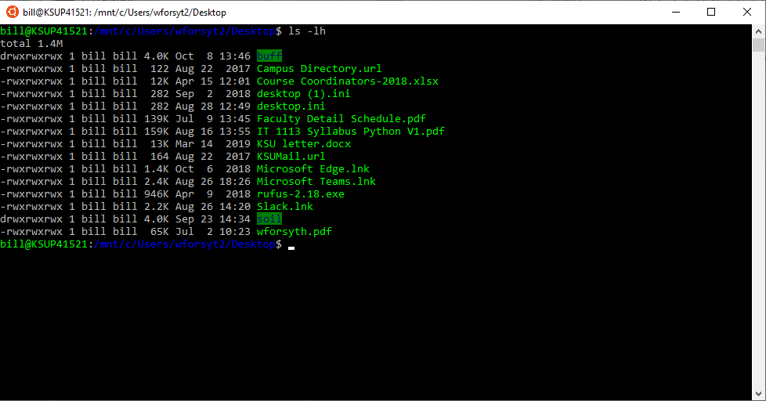

Slide 21
Linux / Unix Security Permissions
Commands
chmod: change file mode
rwx rwx rwx (groups of tree bits)
Each octal represents a group, bit 1 means grant right, bit 0 means remove/reject right
getfacl/setfacl: get/set file access control list
chown: changes file owner
chgrp: changes file group
groups <username>: shows a list of groups to which username or current belong to, equivalent to cat /etc/groups | grep <username>
There are other commands which start with ch and help with other things, use auto-complete feature (tab) for a complete list
Access Control List (more on man setfacl)
setfacl -m u:lisa:r file

Slide 22
Linux / Unix Security Remote Access
Configure firewalls to prevent remote access
Commands:
/etc/hosts.allow and /etc/hosts.deny files
iptables
Filter by protocol
Filter by source/destination
Filter by rule (i.e. in, out, forward)
For consistency should log into /dev/log
openlog()
syslog()
closelog()
logger command
lsof: list open files
lsof | egrep log
ps -efawww | egrep syslog
chroot jail: set temporary a new root directory such that services if they get hijacked do not give access to all the system (system call: chroot)

Slide 23
Windows Security
Use automatic updates specially for
Windows
Adobe Acrobat Reader and Flash Plugin
Java
Users are defined with a Security ID (SID) and information such as passwords may be stored at Security Account Manager (SAM)
System restore
User Account Control to treat users with admin only as admin when required, otherwise as normal

Slide 24
Windows Registry
What is the registry?

Slide 25
Windows Registry
What is the registry?
The Registry is a hierarchical database that stores low-level settings
The kernel, device drivers, services, Security Accounts Manager, and user interface can all use the registry
In simple terms, the registry or Windows Registry contains information, settings, options, and other values for programs and hardware installed.

Slide 26
Windows Registry
Hard to maintain
Easy to access
May use a specific application hiding complex information from administrator
May use regedit to see everything
Useful to have an application that queues and monitors registry changes, such that they need to get approved before proceeding

Slide 27
Addendum, Mac OS “registry”
~/Library/Preferences

Slide 28
Virtual Machines
Hardware plus operating system constitutes a virtual machine…Why?
…Because it exposes services not provided by the hardware alone.
Example: The same hardware with different software could be a Windows machine or a Linux machine.
What if hardware and software could expose more than one set of services at the same time?
We get multiple virtual machines on one hardware machine!
Notes:
Virtualization refers to a technology that provides an abstraction of the computing
resources used by some software, which thus runs in a simulated environment
called a virtual machine (VM). There are many types of virtualization; however, in
this section we are most interested in full virtualization. This allows multiple full
operating system instances to execute on virtual hardware, supported by a hypervisor
that manages access to the actual physical hardware resources. Benefits arising
from using virtualization include better efficiency in the use of the physical system
resources than is typically seen using a single operating system instance. This is particularly
evident in the provision of virtualized server systems.

Slide 29
Some Other Kinds of Virtualization
You’ve learned about virtual memory.
Storage virtualization allows one storage array to serve many CPUs.
Application virtualization allows applications to run on other than their native operating systems.
Virtual networking allows separation of network traffic without duplicating links.
Virtual private networks keep traffic on public networks confidential through encryption.
Each of these has limitations.

Slide 30
Terminology
Virtual machine: A simulated physical computer, capable of running an operating system and applications.
Physical machine: The actual hardware.
Hypervisor (virtual machine manager): Software that provides the simulation to enable one or more virtual machines.
Host operating system: An operating system that runs directly on the hardware and supports a VMM.
Guest operating system: An operating system running on a virtual machine.

Slide 31
Two Kinds of Virtual Machines
Type I or Native
The hypervisor (virtual machine manager) runs directly on the hardware.
The hypervisor instantiates two or more virtual machines by abstracting the hardware interfaces.
Used mainly on servers
Type II or Hosted
The virtual machine manager runs as an application of some other operating system
Used mostly on clients
We discuss Type II first.

Slide 32
Type II (Hosted) Virtualization
A standard operating system provides the hardware interface and may run other applications.
Hypervisor (Virtual Machine Manager) runs as an application and virtualizes additional machines.
User Applications and Utilities
User Applications and Utilities
Guest OS (Windows Server)
Guest OS (Red Hat Linux)
Native OS User Applications and Utilities
Hypervisor / VMM
Host OS, e.g. Windows, Windows Server or RHEL
Firmware
Physical Hardware
Notes:
Hosted virtualization systems are more common in clients, where they run along side other applications on the host OS, and are used to support applications for alternate operating system versions or types. As this approach adds additional layers with the host OS under, and other host applications beside, the hypervisor, this may result in increased security concerns.
In virtualized systems, the available hardware resources must be appropriately shared between the various guest OSs. These include CPU, memory, disk, network,
and other attached devices. CPU and memory are generally partitioned between
these, and scheduled as required. Disk storage may be partitioned, with each guest
having exclusive use of some disk resources. Alternatively, a “virtual disk” may be
created for each guest, which appears to it as a physical disk with a full file-system,
but is viewed externally as a single “disk image” file on the underlying file-system.
Attached devices such as optical disks or USB devices are generally allocated to a
single guest OS at a time. Several alternatives exist for providing network access.
The guest OS may have direct access to distinct network interface cards on the
system; the hypervisor may mediate access to shared interfaces; or the hypervisor
may implement virtual network interface cards for each guest, routing traffic
between guests as required. This last approach is quite common, and arguably the
most efficient since traffic between guests does not need to be relayed via external
network links. It does have security consequences in that this traffic is not subject
to monitoring by probes attached to networks, such as we discussed in Chapter 9 .
Hence alternative, host-based probes would be needed in such a system if such
monitoring is required.

Slide 33
Advantages of Type II Virtualization
When most applications are for the underlying OS, they can run without the overhead of virtualization.
The same hardware can still support other operating systems and applications that require them.
Example: A computer running Windows 7 also needs access to Windows XP, MS-DOS, or Linux applications.
Works best when the guest operating systems are lightly or infrequently used.

Slide 34
Type I (Native) Virtualization
Hypervisor (Virtual Machine Manager) runs as the operating system for the hardware.
Simulates (virtualizes) two or more computers, each of which can run its own operating system.
User Applications and Utilities
User Applications and Utilities
User Applications and Utilities
Guest OS (Windows Server)
Guest OS (Windows Server)
Guest OS (Red Hat Linux)
Hypervisor / VMM
Firmware
Physical Hardware
Notes:
Virtual systems may be divided into native virtualization systems, in which the hypervisor executes directly on the underlying hardware, as shown, and hosted virtualization systems, in which the hypervisor executes as just another application on a host OS that is running on the underlying
hardware, as in the next slide.
Native virtualization systems are typically seen in servers, with the goal of improving the execution efficiency of the hardware.
They are arguably also more secure, as they have fewer additional layers than the alternative hosted approach.
The firmware is not visible to application programs, but is necessary for booting the system, and may include functions used by the operating system or hypervisor.

Slide 35
Advantages of Type I Virtualization
Potentially more efficient because one less layer of software is needed.
A single hardware platform can support several operating systems, alike or different.

Slide 36
Uses
Implement multiprogramming: multiple single-user virtual machine instances. IBM System/370 used this approach to provide time-sharing behavior with each VM running a simple single-user OS (Conversational Monitor System or CMS)
Multiple single-application VMs: Dedicates a VM for each application program, uses a general purpose OS.
Multiple secure environments: VM creates sandbox to isolate environments and security domains.
Manage application environment: Install core applications in one VM then create per user VMs for them to load their own apps.
Mixed-OS environments: Single hardware platform can support multiple Operating System environments.
Legacy applications: Dedicate VMs for legacy applications.
Multiplatform applications development: One hardware platform with VMs providing emulation of alternative hardware.

Slide 37
Uses
New system transition: Staged or gradual migration (opposite of legacy support).
System software development: For testing or developing new system software in a protected environment.
Operating system training: Run OS instance in a VM so parameter or configuration adjustments do not affect rest of system
Help desk support: Use VM to replicate user environment
Operating system instrumentation: Can monitor hardware access or low level software abstractions
Event monitoring: execution traces, machine state dumps and replaying of traces
System encapsulation: Check pointing system state and restarting on same or different machine.

Slide 38
Hypervisor Security
Like OS security
Install from private network, or clean media
Configure for automatic updates
Disable unused services and hardware
Restrict access to hypervisor
If there is remote access do it on a separate network (e.g. VLAN, VPN, etc.)

