Slide 1
Operating system security

Slide 2
Linux / Unix Security Permissions
Each file has 9 permission bits, which are divided into 3 sets
(In order): Owner, Group, Others
Each permission set has 3 kinds of permissions
(In order): r (read), w (write), x (execute)
For each permission bit, “-” means denied
Example: rwxr-x--
Each user fits into only one of the three permission sets. The permissions used are those that are most specific

Slide 3
Permission effects
Symbol | File | Directory | Symbolic Link
R | View Content | Read file names only in the directory | Permissions are determined by its linked target file
W | Change Content | Create, delete, move, rename files if "x" is granted | ^ |
X | Execute binary or script files | Can be accessed, entered or passed through (cd), can access its files (inode information) | ^ |

Slide 4
Permission representation
Octal Value | Binary Format | Symbolic Value | Permission
0 | 000 | --- | None
1 | 001 | --x | Execute only
2 | 010 | -w- | Write only
3 | 011 | -wx | Write and execute
4 | 100 | r-- | Read only
5 | 101 | r-x | Read and execute
6 | 110 | rw- | Read and write
7 | 111 | rwx | All granted

Slide 5
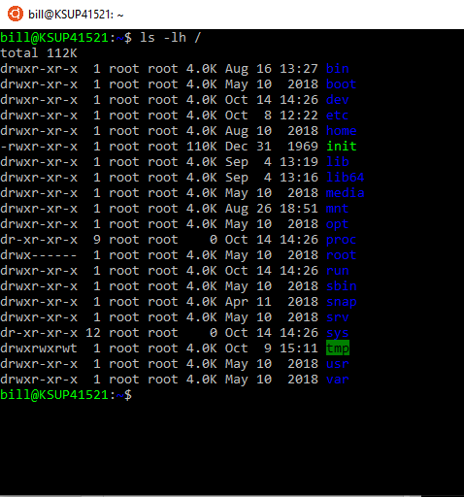

Slide 6
basics
Linux/Unix is a multi-user environment
Built around the concept of ‘groups’
A group is a collection of users
Has a unique identifier (Group IDs or GIDs)
Users
A username for login
A user ID (UID) for internal use

Slide 7
root
System administrator
Also called “super user”
Can:
Access all files
Files, directories, devices, etc..
Permissions? What permissions?
RWX do not apply
Home directory is /root
Not /usr/root or /home/root

Slide 8
Storing user information
Linux follows the Unix convention of keeping user data in plain text files
These files are:
/etc/group
/etc/passwd
/etc/shadow

Slide 9
Storing user information
/etc/group
Stores group information and group members

Slide 10
Storing user information
/etc/passwd
Stores user information
Login
Encrypted password
UID
Default group
Home directory
Default shell
/etc/shadow
Keeps encrypted passwords and password policies

Slide 11
Storing user information
/etc/passwd
Stores user information
Login
Encrypted password
UID
Default group
Home directory
Default shell
/etc/shadow
Keeps encrypted passwords and password policies
Why?

Slide 12
/etc/group
Each line represents a group
Unique Group Name
GID
certusers:*:29:root,_jabber,_postfix,_cyrus,_calendar,_dovecot
Groups have no password
Group members, separated by ‘,’

Slide 13
User information
Username
Usually use lowercase – this is case sensitive
Use letters, numbers, _ and -
UID
A unique numeric value for a user
"root" is always 0
Home directory
"root” user - /root
Other users - /home/[username]
This is a convention; it can be somewhere else which another name
Login Shell
The default shell that greets you when you log in
Use “/bin/false” to deny shell login

Slide 14
/etc/passwd
Each line of the file represents a user
Each field is delaminated by a colon
Username
UID
GID
Home Directory
root:*:0:0:System Administrator:/var/root:/bin/sh
daemon:*:1:1:System Services:/var/root:/usr/bin/false
Default Shell
Encrypted password
X or * means shadow passwords are used
User’s Full Name

Slide 15
/etc/shadow
Each line represents a user
Login name
Encrypted Password
Password policies
Encrypted Password
it4423:$1$P7reyv5G$1xl68rfB/tReTFpGSg/9X.:15712:0:99999:7:::
Username
Password Expiration

Slide 16
Quick tangent
Why the shadow file?
-rw-r--r-- 1 root root 1.6K Aug 10 2018 /etc/passwd
-rw-r----- 1 root shadow 973 Aug 10 2018 /etc/shadow

Slide 17
Quick tangent
Linux password management
Notice the plaintext password is not saved
Also its not “encrypted” its “encoded”
it4423:$1$P7reyv5G$1xl68rfB/tReTFpGSg/9X.:15712:0:99999:7:::
Notes:
If you ask a cryptography expert, however, he or she will tell you that the password is actually in an encoded rather than encrypted format because when using crypt(3), the text is set to null and the password is the key.
The algorithm used to encode the password field is technically referred to as a one way hash function. This is an algorithm that is easy to compute in one direction, but very difficult to calculate in the reverse direction. More about the actual algorithm used can be found in section 2.4 or your crypt(3) manual page.

Slide 18
defaults
/etc/skel
Defines default files created in new user’s home directory
Modifications to this file only effect new users
/etc/default/useradd
Default values for new user accounts

Slide 19
Switch user
su
Switch to another user without logging out
If no username is given, su defaults to super user
To log out of selected user, use the “exit” command
sudo
Super User DO
Elevate current user to root for that command only
User must be in the “sudoers” file
/etc/sudoers

Slide 20
Pop quiz
Given what we know about the /etc/passwd & /etc/shadow files, without knowing the password, how could I “hack” into the root account?

Slide 21
Get User/Group info
id
Get UIG, GID, and group information
groups
Get a user’s groups

Slide 22
limitations
Linux permission system is file oriented, not user oriented
Only one user and group can be granted access to a file or directory at a time

