Slide 1
Building a Scalable Model for Direct Assessment in General Education
October 20, 2026
7:30–7:50 a.m.
Dr. Chris Dockery, Director of General Education

Slide 2
Institutional Context
Total Enrollment:
51,375 students
46,069 undergraduates
5,306 graduates
Student Demographics:
93.6% of enrolled students reside within Georgia.
39.5% White, 27.8% Black/African American, 15.8% Hispanic/Latino, 5.9% Asian, 11% Other
50.8% Female, 49.2% Male
Roughly 22% of the student body enroll exclusively in online degree pathways or distance learning courses

Slide 3
General Education Structure
Throughout the University System of Georgia, the core curriculum consists of 42 credit hours through 7 content area domains represented in the acronym IMPACTS.
  I – Institutional Priority. 5 credit hours.
  M – Mathematics & Quantitative Skills. 3 credit hours.
  P – Political Science and U.S. History. 6 credit hours.
  A – Arts, Humanities & Ethics. 6 credit hours.
  C – Communication in Writing. 6 credit hours.
  T – Technology, Mathematics & Sciences. 10 credit hours.
  S – Social Sciences. 6 credit hours.
Systemwide Orienting Questions, Learning Outcomes, and Career-Ready Competencies must be centerpieces of Core IMPACTS courses and must be clearly listed in the syllabus for each instance of a Core IMPACTS course.
Notes:
.

Slide 4
Domain Structure Example
M – Mathematics & Quantitative Skills (3 Credit Hours)
Orienting Question: How do I measure the world?
Learning Outcome: Students will apply mathematical and computational knowledge to interpret, evaluate, and communicate quantitative information using verbal, numerical, graphical, or symbolic forms.
Career- Ready Competencies: Information Literacy, Inquiry and Analysis, and Problem Solving
Select one course from the following:
      MATH 1001: Quantitative Reasoning
      MATH 1111: College Algebra ​
      MATH 1113: Precalculus ​
      MATH 1190: Calculus I ​
      STAT 1401: Elementary Statistics ​
Notes:
.

Slide 5
Guiding Principles. The model should:
Generate a single institutional data stream for course, domain, and campus level reporting
Easily scale with changes in course offerings or reporting guidelines
Standardize campus terminology around student proficiency
Be manageable for students and faculty yet meaningful for the University
Cover all of the IMPACTS domain learning outcomes
Prioritize high-enrollment courses
Qualtrics was selected based on campus availability and embedded features

Slide 6
Engaging the Discipline Experts
Summer 2025 Assessment Workshop:
Funded by academic affairs
$1500 stipend per assessment x 31 courses/areas
Deliverables included
  draft questions/prompts/artifacts,
  answers,
  written justification as to how each question aligned with the learning outcome, and
  proficiency scoring rubrics
Challenges Encountered:
Domain learning outcome proficiency is evidence of the general-education outcome, not a claim that the student mastered the course learning outcomes
Course learning outcome assessments are not always transferrable
Alignment had to be explicit and defensible
ENGL 1102 required a hybrid approach and a faculty scored rubric for student writing artifacts

Slide 7
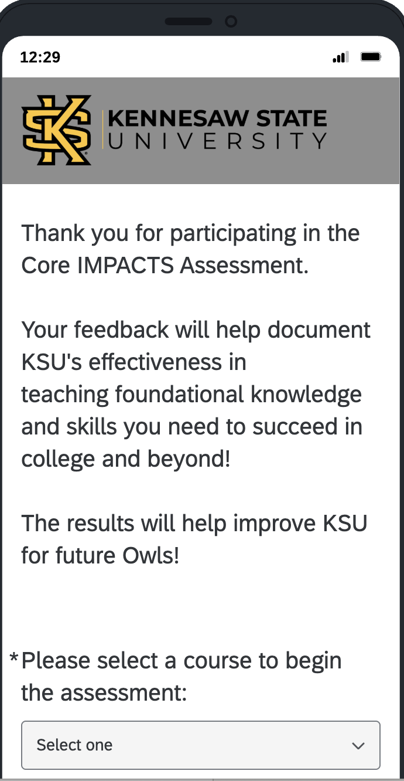

Designing in Qualtrics
Conference Demo. Scan to explore!

Slide 8
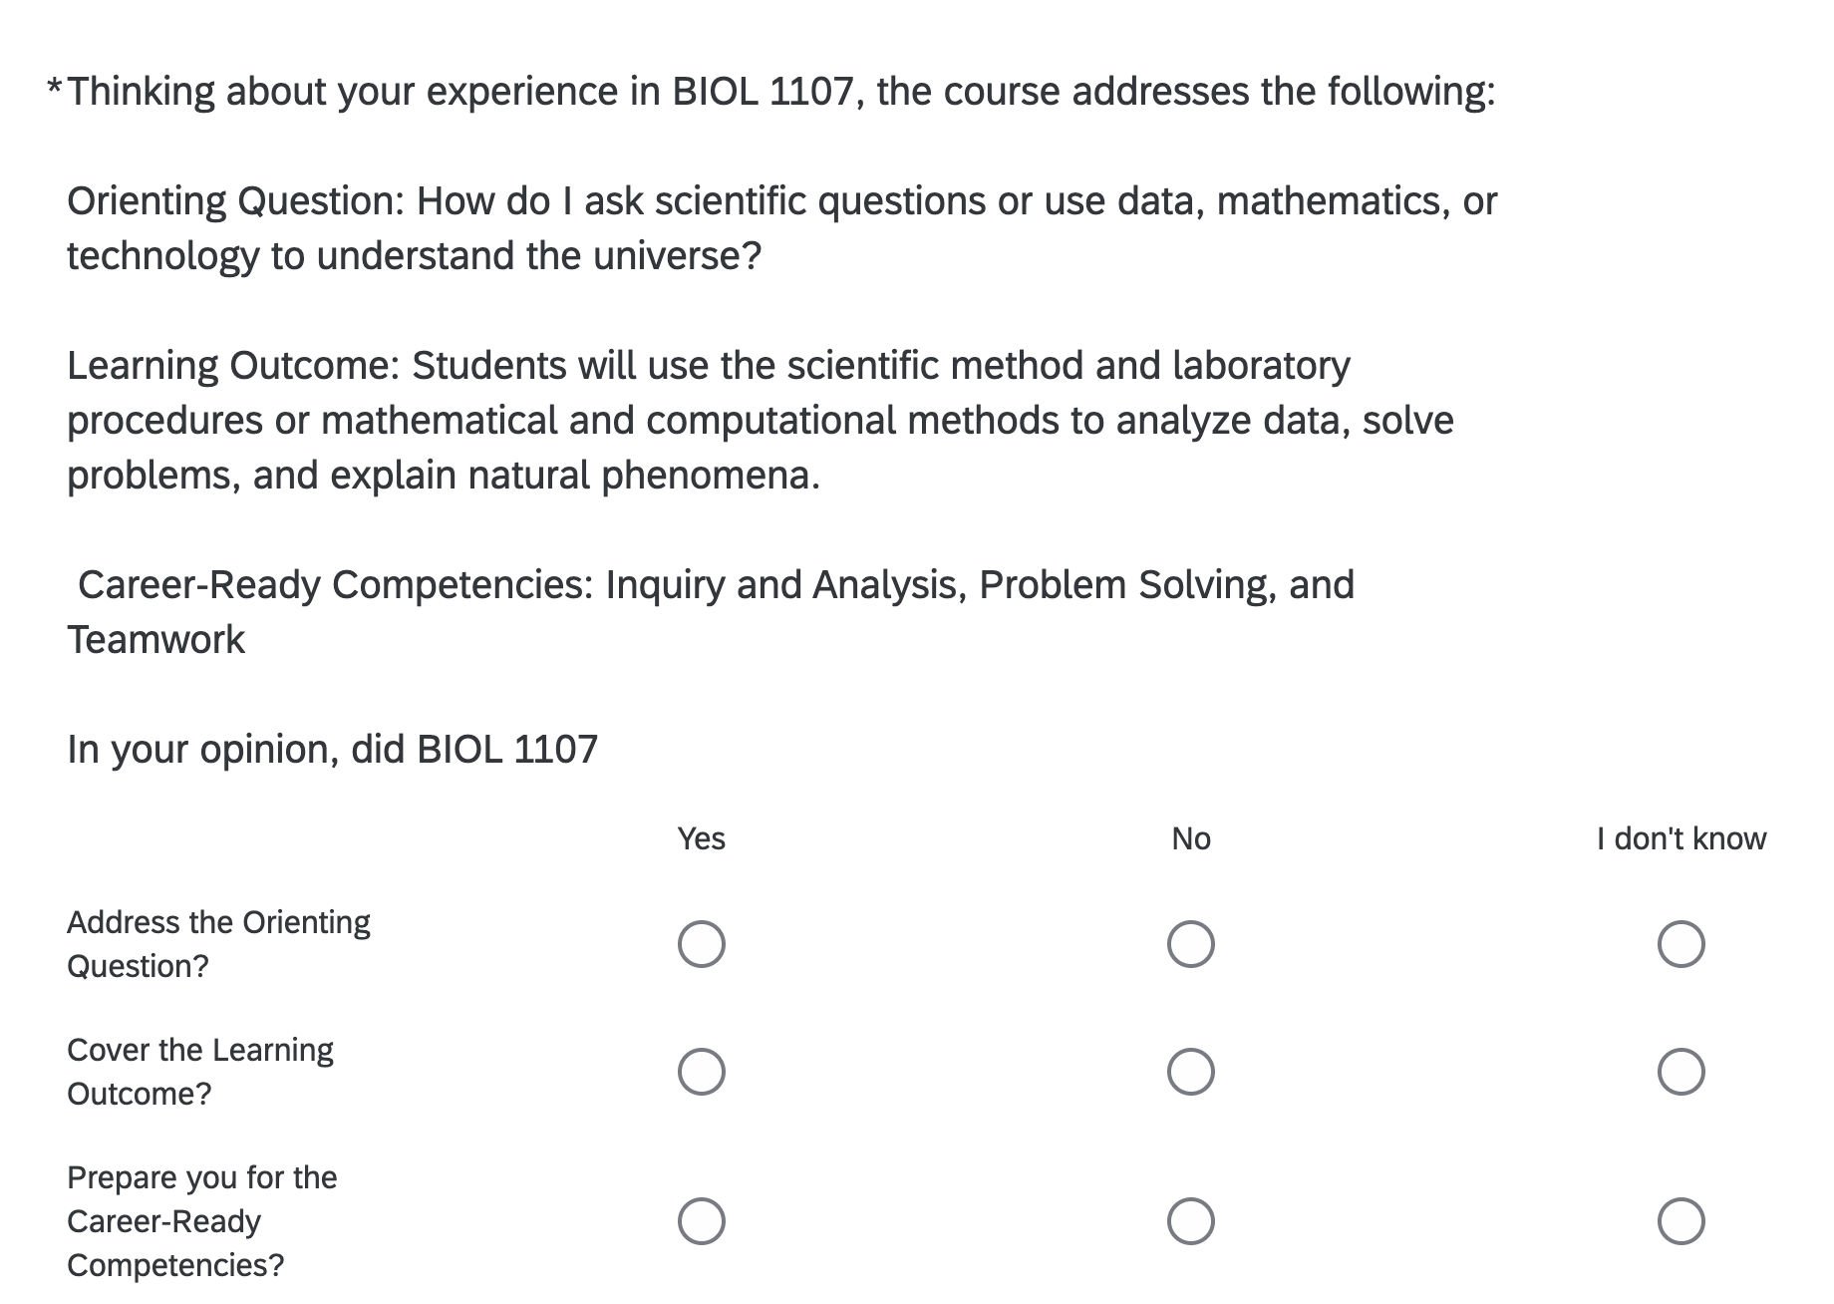
Incorporating Student Perception
Perception items provide indirect evidence and are reported alongside but not combined with direct proficiency results.

Slide 9
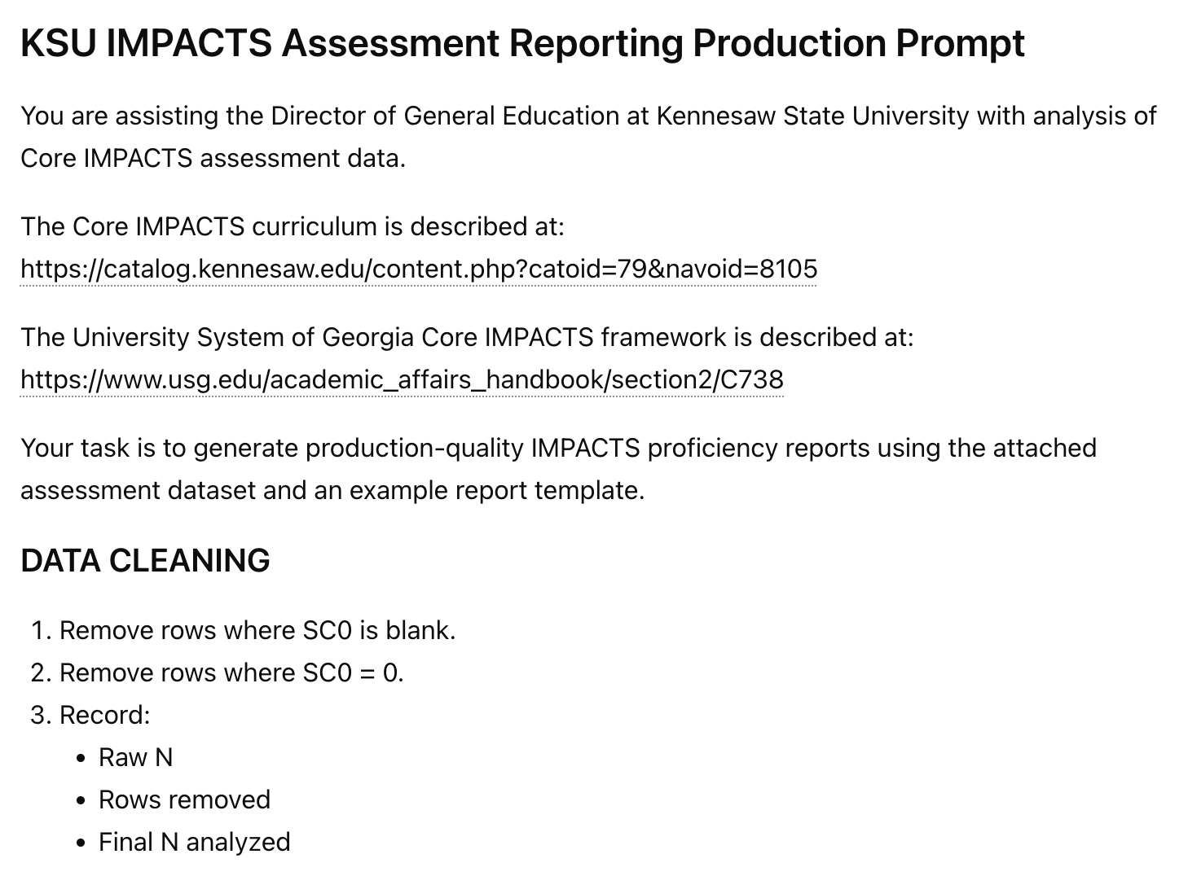
Automating the Workflow
The Qualtrics output generates 479 columns x ~7000 rows of data per semester
AI prompts
Clean and sort the .csv data file
Score rows using faculty generated rubrics. Scoring rules are deterministic; AI does not judge student proficiency
Normalize by proficiency level
Summarize course and domain level results
Preserve common visual branding
  Faculty defined the assessment items, rubrics, thresholds, and meaning. AI/Python automated repeatable cleaning, scoring, visualization, and reporting. Outputs were reviewed and verified before release.

Slide 10
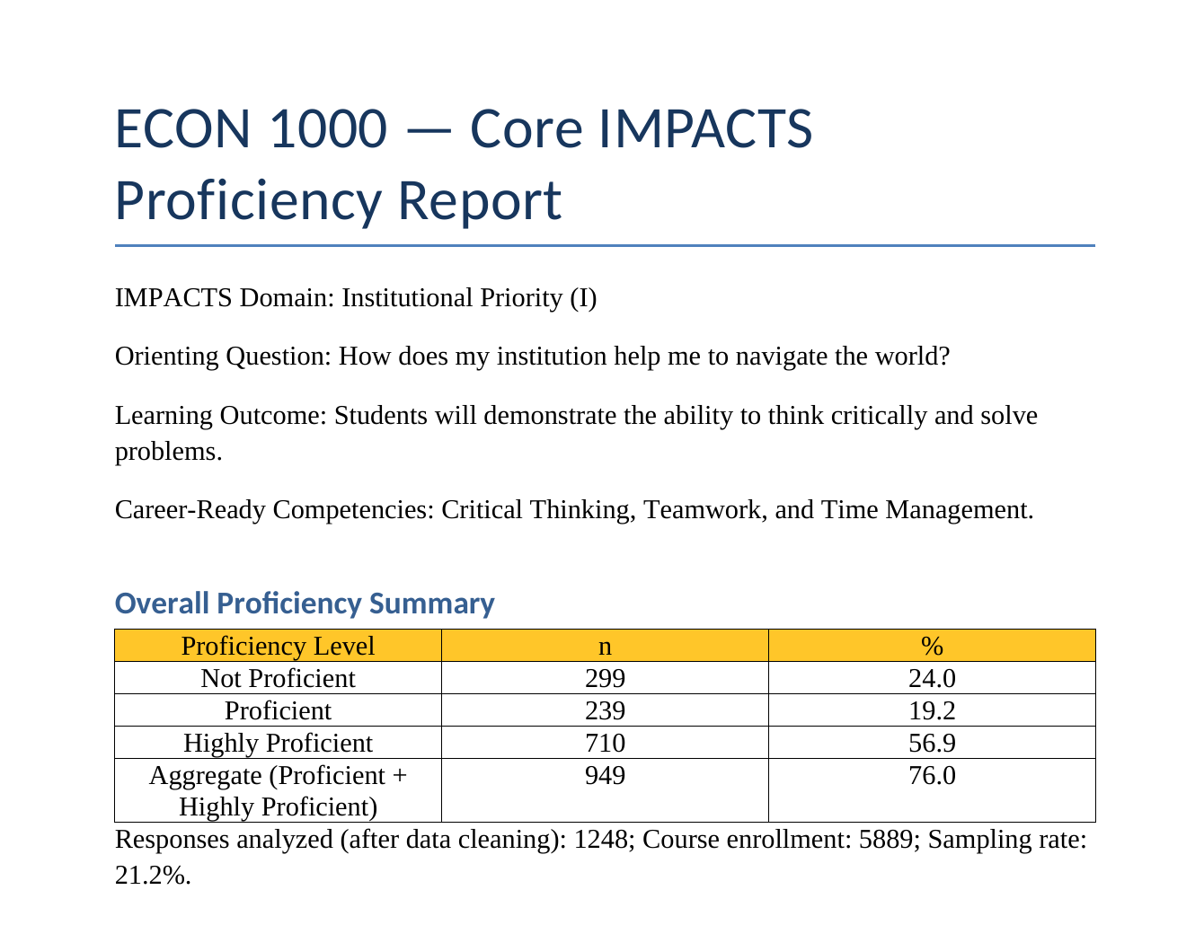
Course Level Data Example
AT A GLANCE
1,248
responses analyzed
5,889
course enrollment
21.2%
sampling rate
76.0%
aggregate proficiency
The course level reports provide proficiency distribution, subgroup/perception results, and quality-control details in one faculty-ready document.
  Response Rate Goal: ≥ 10%. Aggregate Proficiency Goal: ≥ 70%

Slide 11
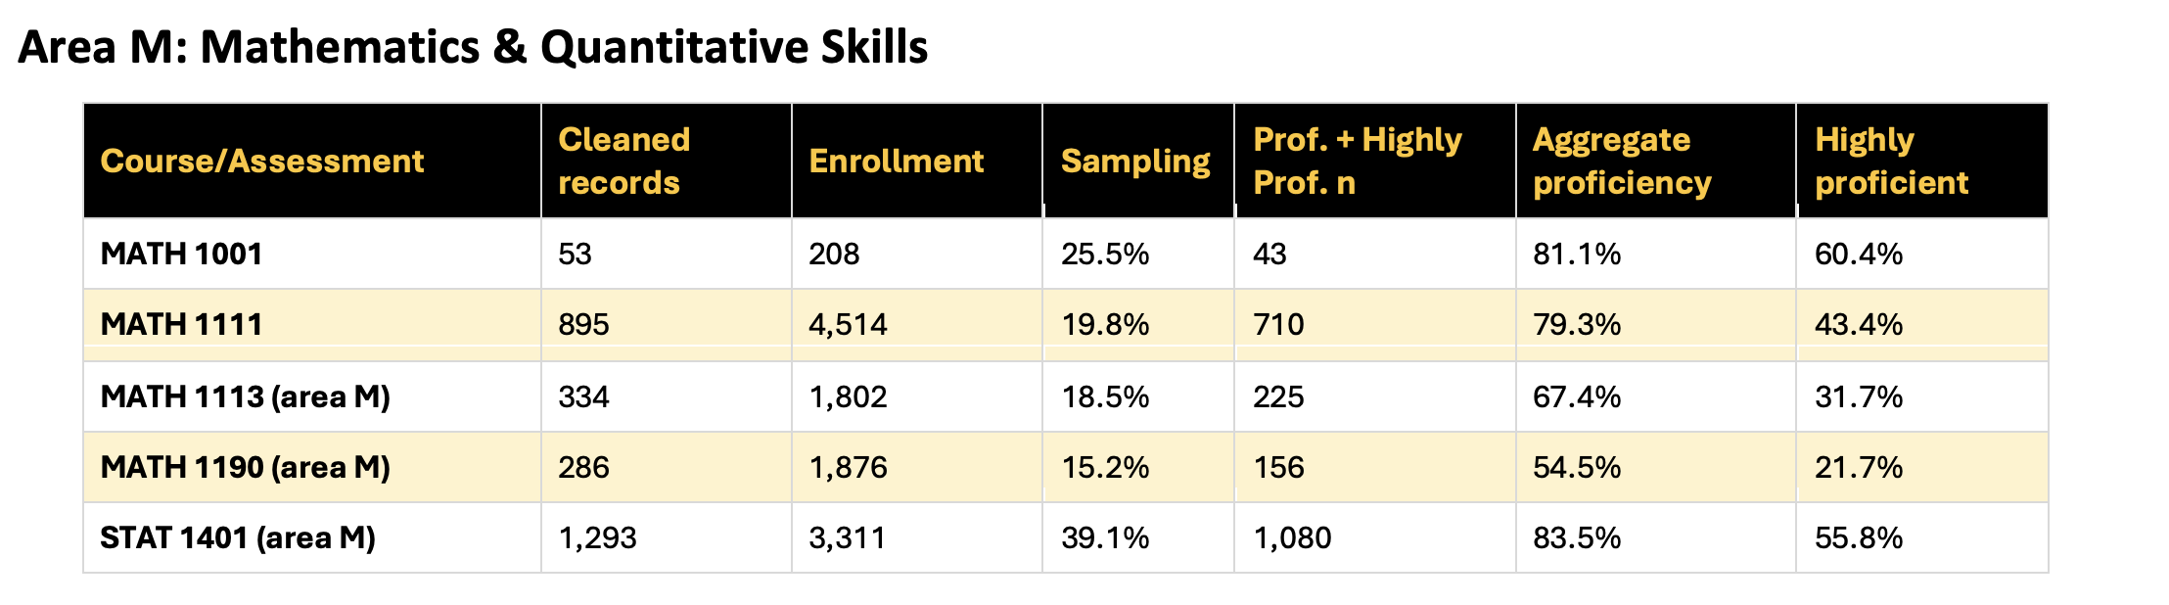
Domain Level Data Example
Area M includes five course/area reports and 2,861 cleaned assessment records. The weighted aggregate proficiency rate is 77.4%. Domain results are weighted by cleaned assessment records rather than calculated as a simple average of the five course percentages.

Slide 12
Campus Level Data Example
CORE IMPACTS ASSESSMENT
I
M
P
A
C
T
S
Direct measures across all seven domains reveal where students are demonstrating proficiency and where faculty can support continuous improvement and student success.
78.5%
13,677
Overall institutional proficiency
Assessment records across 31 course/area reports and 28 courses
Students may be enrolled in more than one IMPACTS course. Therefore, this does not represent unduplicated student headcount.
Aggregate student proficiency by domain.
  Response Rate Goal: ≥ 10%. Aggregate Proficiency Goal: ≥ 70%

Slide 13
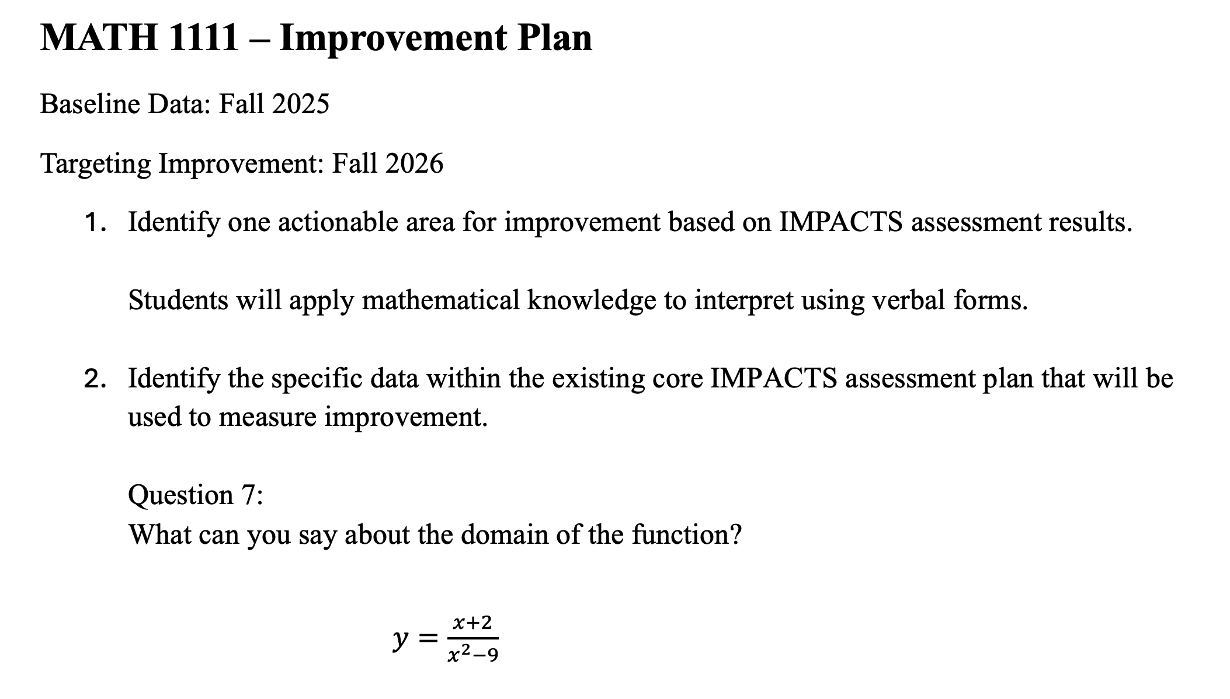
Templated Approach to Continuous Improvement
FIVE REQUIRED PROMPTS
1
Identify one actionable area from the results.
2
Identify the existing assessment data that will measure improvement.
3
Develop an intervention intended to drive improvement.
4
Define a goal / benchmark and indicator of success.
5
Explain how the plan will be communicated to the next instructors.
Baseline 65% → Question 7 → Targeted Intervention → 70% goal → Communication Plan →
Reassess Fall 2026

Slide 14
Implement + plan
Closing the Loop
The next cycle will show implemented improvement plans, document what changed, and outline what faculty decide to do next.
FALL 2026
SPRING 2027
NEXT REPORTING
Implement + analyze
Reassess + close the loop
Carry out I/M/P/A improvement plans. Document changes,
Submit C/T/S improvement plans,
Strengthen participation.
Carry out C/T/S improvement plans,
Strengthen participation.
Compare year 2 with baseline data,
Record status of improvement targets,
Document the cycle of continuous improvement into year 3.

Slide 15
Conclusions
Designed a common system-level assessment platform across a large, distributed general-education curriculum.
Standardized the assessment architecture while maintaining academic freedoms in disciplinary teaching.
Faculty experts created defensible measures and proficiency rules.
Common collection and AI assisted/semi-automated workflow make the work scalable.
Evidence moves from course diagnosis, to domain synthesis, to institutional reporting, and finally back to faculty through a process of continuous improvement.

Slide 16
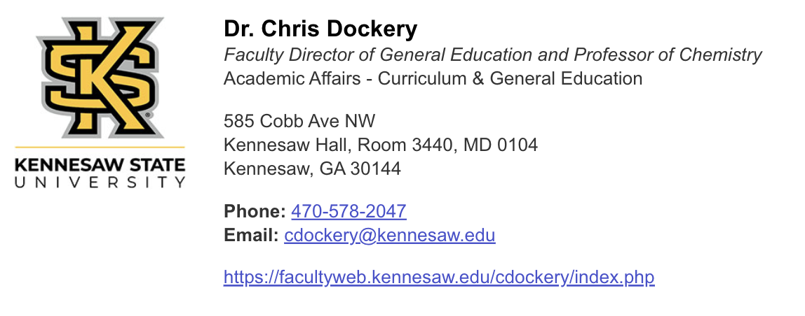
Questions and Additional Resources
https://facultyweb.kennesaw.edu/cdockery/assessment.php
https://kennesaw.co1.qualtrics.com/jfe/form/SV_0iEzZ1zZUZpvIz4

