Slide 1
Getting Comfortable with the Uncomfortable
A Teambuilding Discussion to Benefit You, Your Team, and Your University Partners

Slide 2
Higher Ed Responsive Web Design is more than putting a Web site on a phone. It is a complicated process that requires complex practices and solutions.
So,…what exactly are we going to be talking about today?

Slide 3
Today’s Outline
Recap Our Prior Session (April 10th)
Getting Uncomfortable with the Uncomfortable
• What Does This Mean at Work
• Strategies to Adapt and Combat
• Aligning with Team Values
• Reframing the Uncomfortable as Possibility
The LARGER Picture and Future Discussions

Slide 4
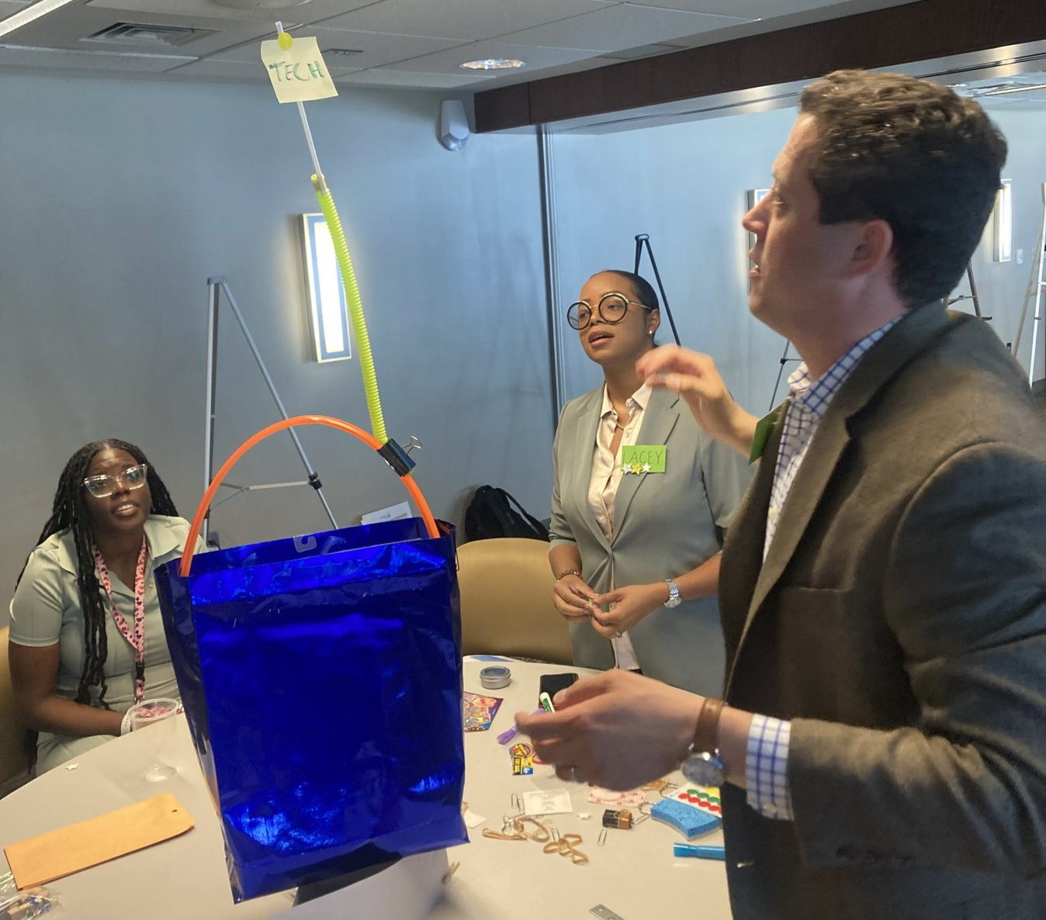
Prior Session
Recap

Slide 5
Prior Session Recap
The Guess the Logo Game
Office Shark Tank
Taking Notes (Sales Flyer / TPiR)
Tallest Tech Tower

Slide 6
Getting Comfortable with the Uncomfortable.

Slide 7
A Few Notes / Caveat
Today is less about fun games but having a discussion (and learning how to team-build through communication).
We all have unique experiences that help frame what is uncomfortable and how to manage.
Chris is trying something new today. Embrace the challenge of growth in the uncomfortable.

Slide 8
What does being uncomfortable look like at work?
But before we answer that…

Slide 9
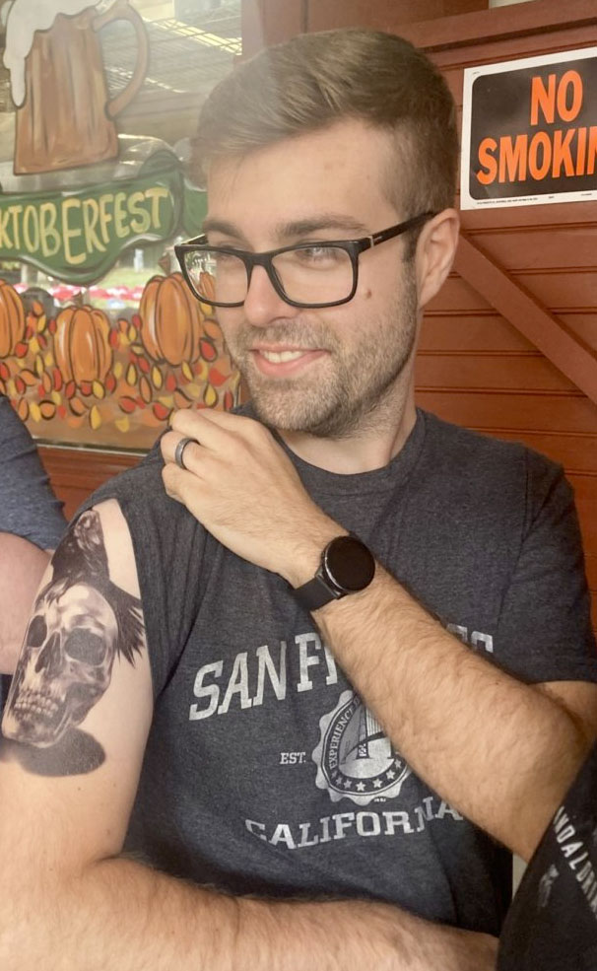
This is Kevin.
KSU Lead Web Developer
I asked Kevin this same question last week and he did that thing he is best at; he answered it immediately and it was incredibly accurate and insightful…

Slide 10
What does being uncomfortable look like at work?

Slide 11
UNCERTAINTY!

Slide 12
Chris has a real-life example from this past week

Slide 13
BREAKOUT #1
What are the things at work that make you uncomfortable?
Share a gif in the Teams chat that represents what makes you uncomfortable at work.

Slide 14
Good job, everyone!
The first step in managing the uncomfortable is identifying what makes us uncomfortable.

Slide 15
Strategies to combat the uncomfortable (uncertainty / fear / lack of communication) at work?

Slide 16
Chris continues his real-life examples.
Most of mine come from gaps in communication.

Slide 17
BREAKOUT #2
What are examples of strategies you use to overcome being uncomfortable / uncertain?
Share a fictional character whose characteristics you take on when overcoming adversity.

Slide 18
Outstanding job!
We can take steps to mitigate the uncomfortable at work.

Slide 19
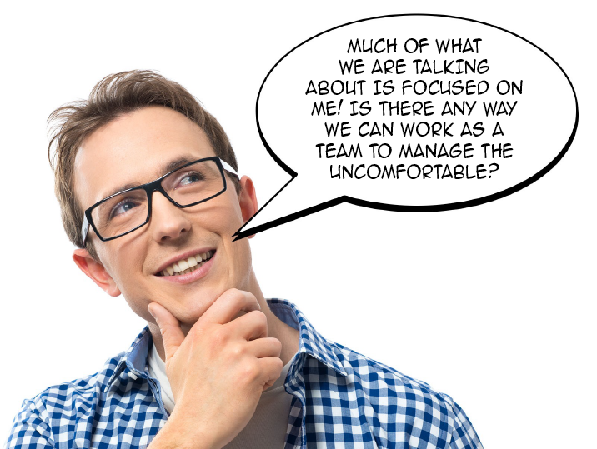

Slide 20
Realistic strategies to collaboratively manage the uncomfortable within teams.

Slide 21
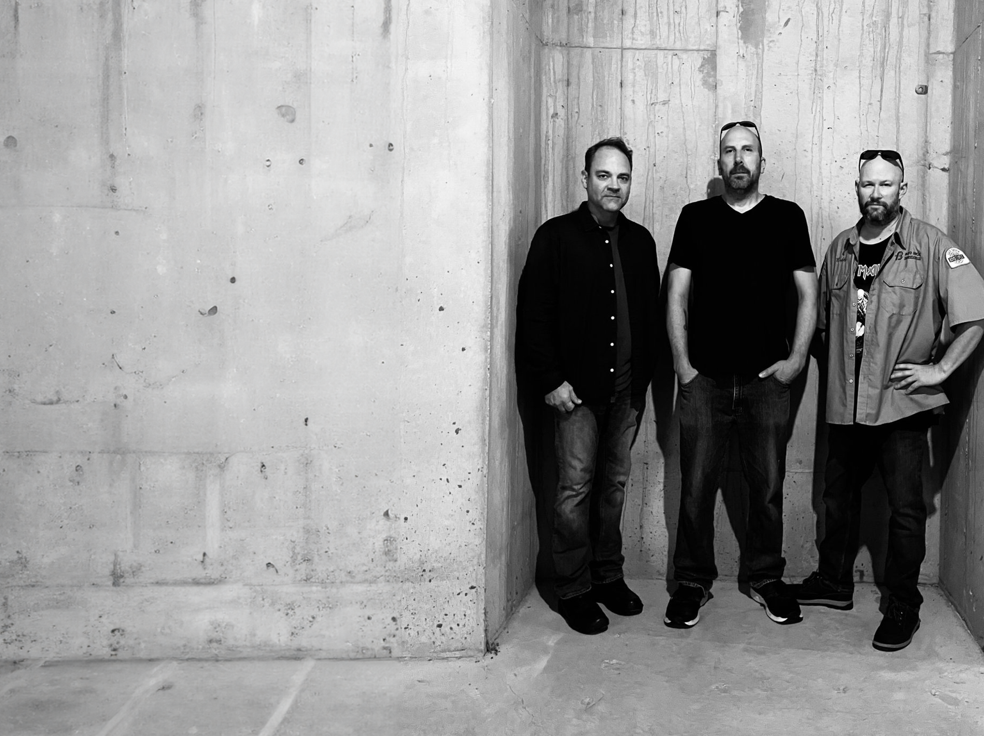
Chris continues his real-life examples.
This is my band. We have been working collaboratively since 1989.

Slide 22
BREAKOUT #3
For each value, what might make you uncomfortable and how can you manage that uncertainty together as a team?

Slide 23
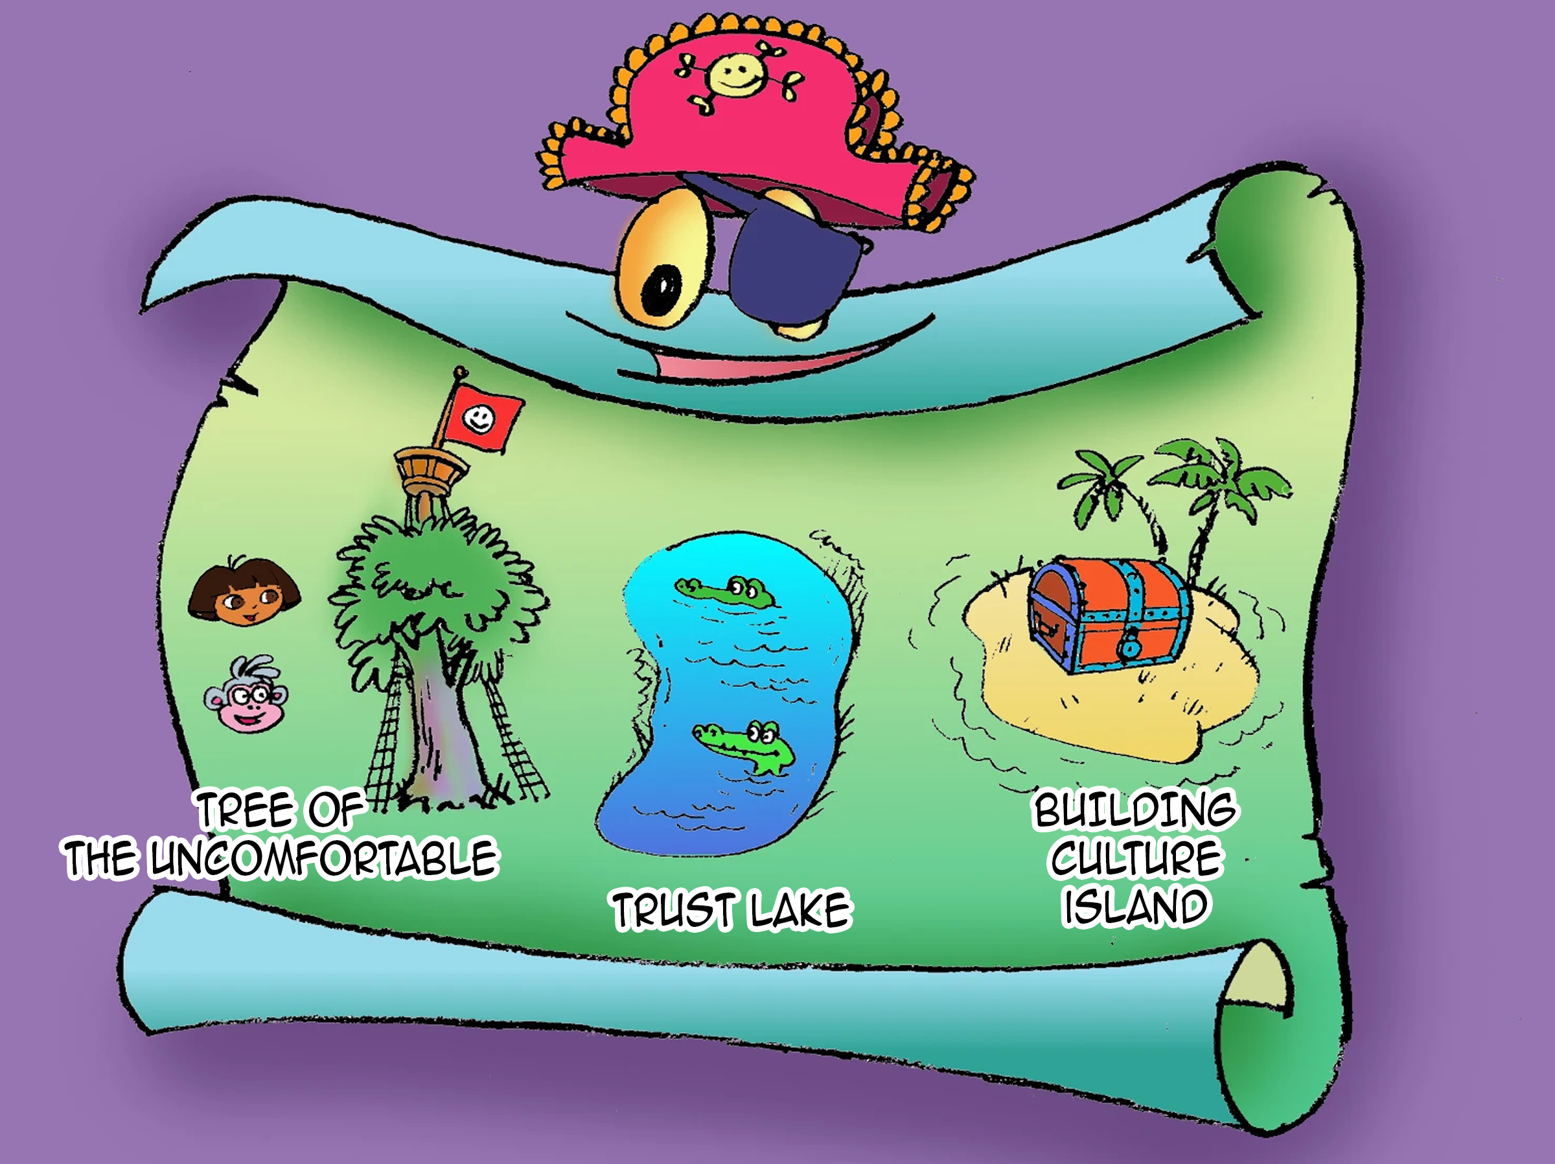

Slide 24
Reframe the uncomfortable as possibility.

Slide 25
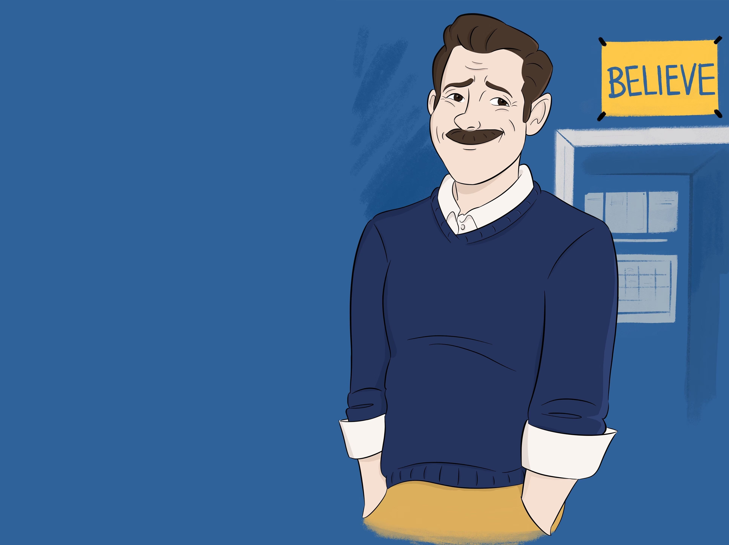
Questions, Discussions, Thoughts, Comments, Takeaways,and All-Around Wrap-Up.

