Slide 1
The Future is Coming: A Discussion on the Inevitable Collision of AI and Your University's Website

Slide 2
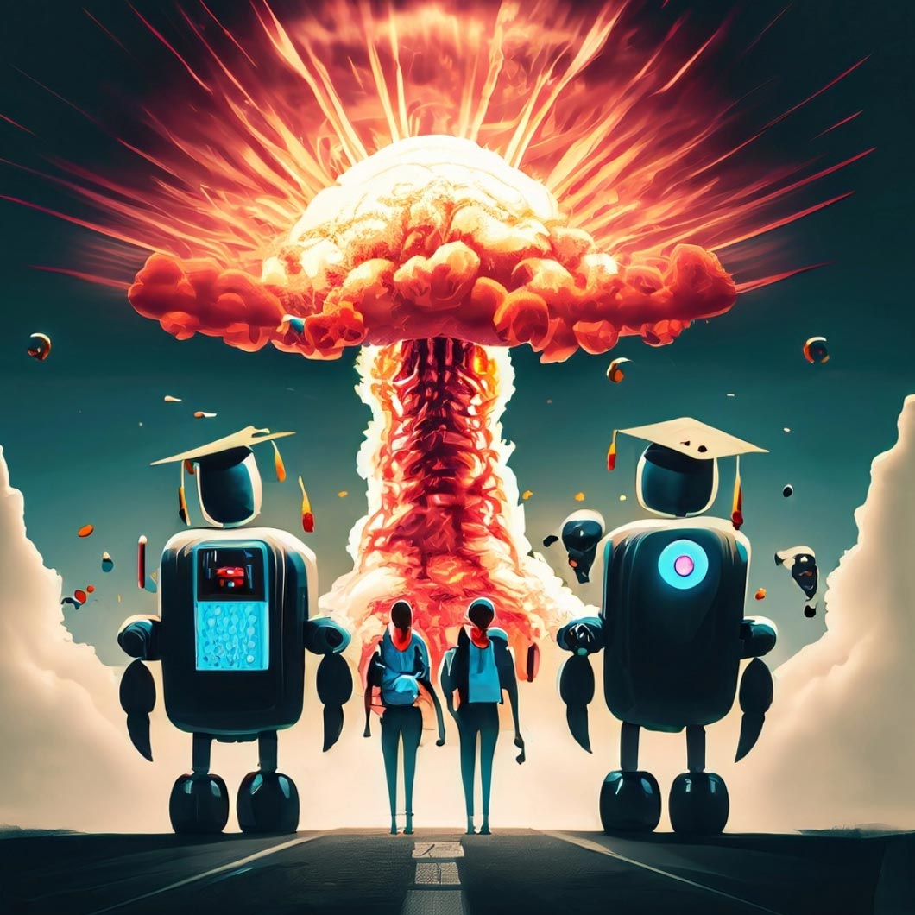
A couple of quick notes before we start:
We are going to try and do this presentation without going to the dystopian future where robots have taken all our jobs and humanity has devolved into Wall-E.

Slide 3
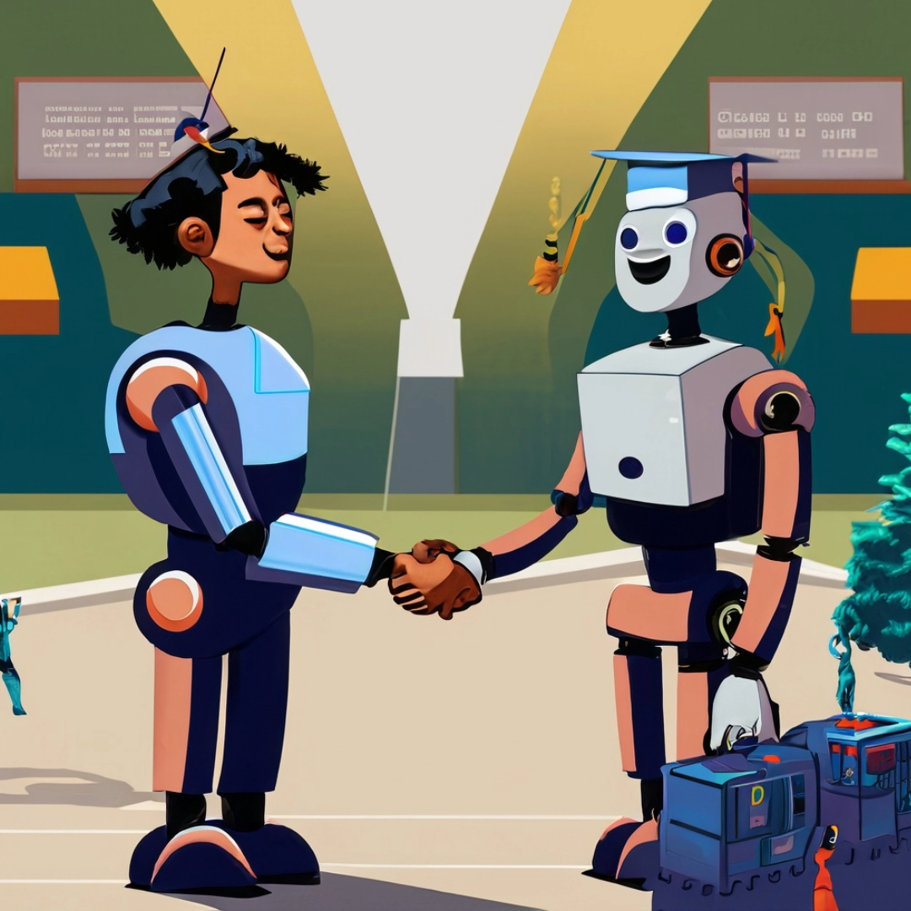
A couple of quick notes before we start:
We are going to try and stay "grounded” and work in the realm of "realistic ideas." We will try to avoid "AI insanity,” general handwringing, and anxiety-inducing trauma.

Slide 4
Who We Are And What We Do
Manage University CMS
Web Development
Search Engine / Forms
Web Accessibility
Kennesaw State UITS WebGroup

Slide 5
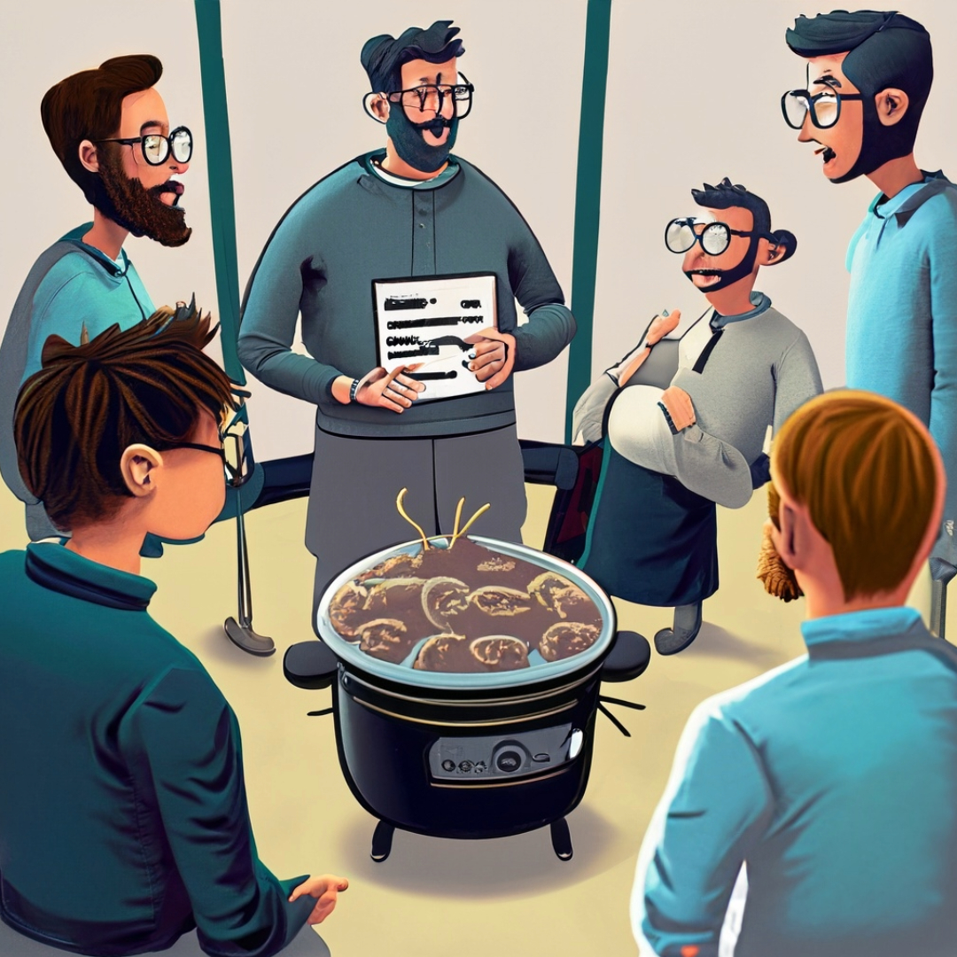
Who We Are And What We Do
We are creatively collaborative and enjoy the value of engaging in a good discussion about technology and the future of the web

Slide 6
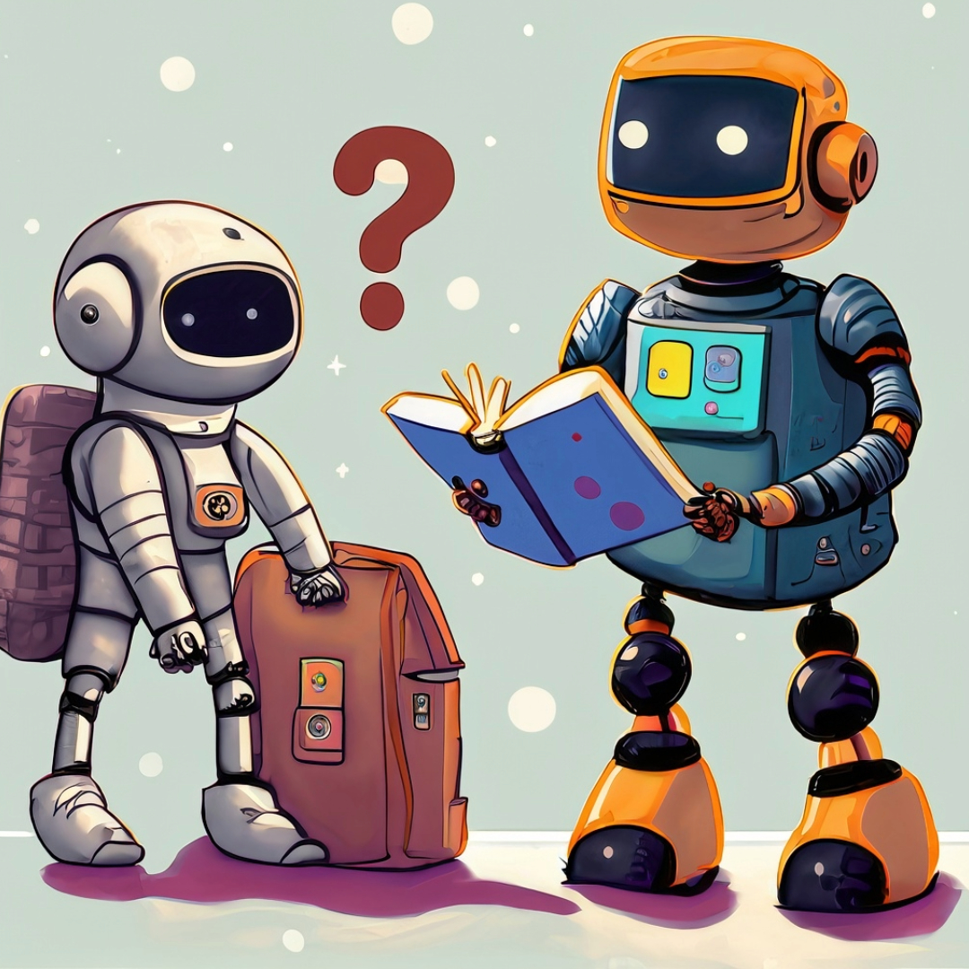
Let’s establish a Baseline - What is AI and what do we need to know for today's discussion?

Slide 7
What is AI? (Artificial Intelligence)
Artificial intelligence (AI) is the simulation of human intelligence by machines, such as computers or robots. AI uses real-time data to replicate human discernment and make decisions.
AI can be used for expert systems, natural language processing, speech recognition, and machine vision.

Slide 8
What is Generative AI?
Generative AI is a subset of AI that focuses on creating new content, such as text, images, sound, and videos.
Generative AI works by learning from a large dataset of existing content. Once the model is trained, it will use the patterns and relationships to create new content similar to the dataset’s content.

Slide 9
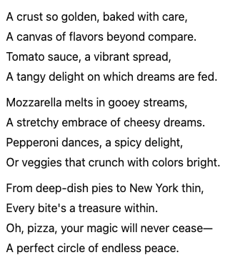
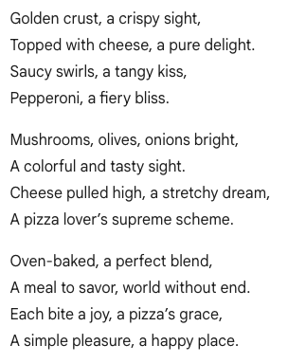
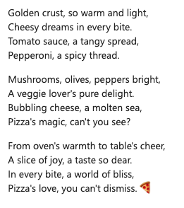
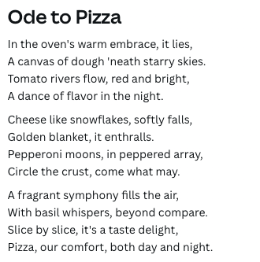
AI Text Generation
Generate a 12-line poem about pizza
OpenAI ChatGPT
Microsoft Copilot
Google Gemini
Canva Magic Write

Slide 10
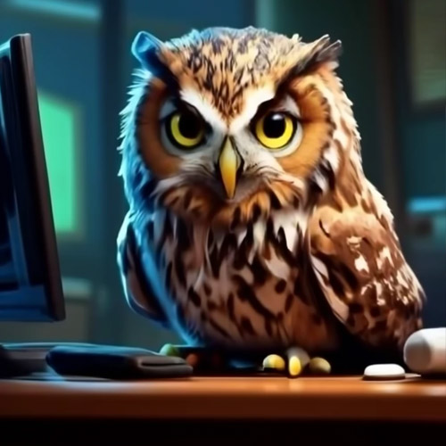
AI Image Generation
An owl using a computer
Google Gemini
OpenAI OpenArt
Craiyon
Adobe Firefly 2
Microsoft Copilot

Slide 11
What We Need to Know for Today Regarding AI:
Basically…enter a prompt, wait anywhere from seconds to a minute and content will be returned.

Slide 12
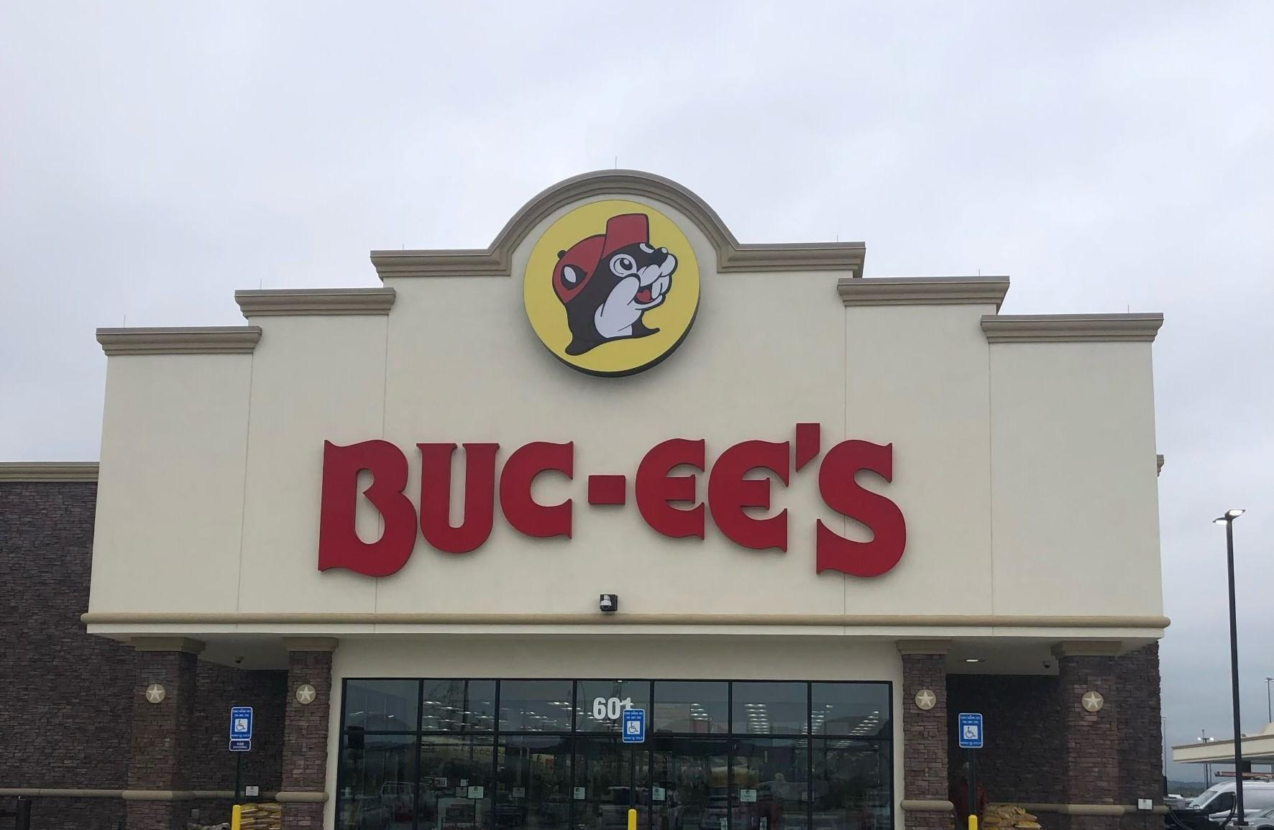
Our Day Which Shall Live In Infamy December 16, 2022
This was the day we had our first “A-HA!” moment with AI and proceeded to talk about it and its implications for websites for years to come.

Slide 13
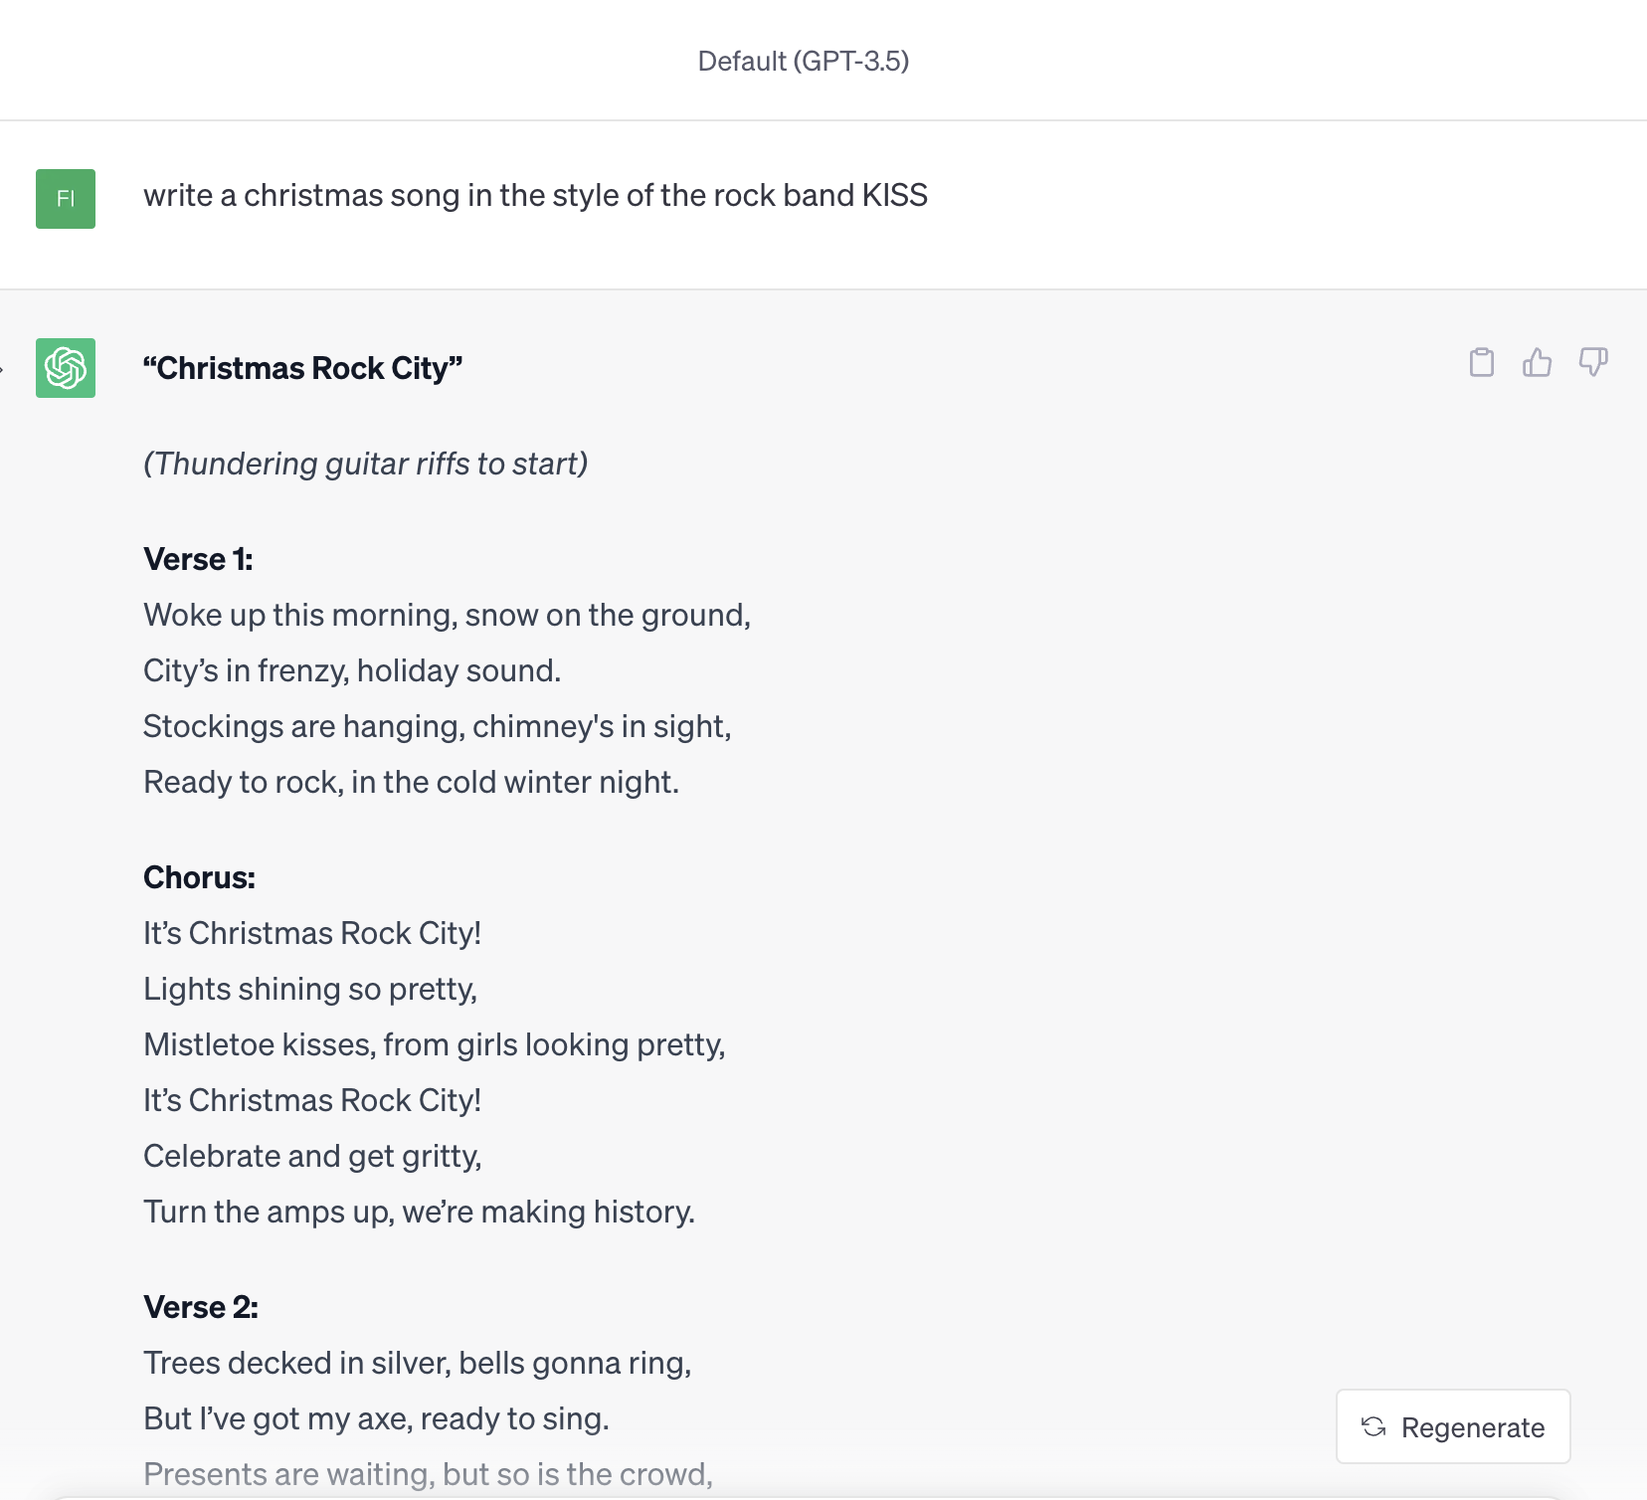
Our Day Which Shall Live In Infamy December 16, 2022
“Write a Christmas song in the style of the rock group KISS.”

Slide 14
Our Day Which Shall Live In Infamy December 16, 2022
What will it mean for the future of the web if content can be generated – about ANYTHING – instantly?
How will this affect web pages, websites, and entire domains?
Will websites stop being “websites” and become search boxes?
When are we going to feel the AI shift in higher education?

Slide 15
So…a little background is in order

Slide 16
Amongst the four WebGroupers, we have over 45 years of web development experience.
Unequivocally, the hardest (and longest) part of getting a website built is getting the content.

Slide 17
Hmmm….
What would it be like if INSTEAD of building and managing thousands of webpages, the website literally generated content and “built” itself based on the user’s wants and needs?

Slide 18
First, we’d have to determine AI’s text capabilities and what it can do well.
(As well as where we might run into some struggles.)

Slide 19
After playing science experiments* with ChatGPT for dozens of hours and feeding it hundreds of prompts this is our takeaway about the content it can generate.
* Roughly 99.9% of our generative text AI experiments and web development have been done with OpenAI’s API.

Slide 20
VERY difficult to differentiate from actual human writing
Almost limitless options to generate a variety of text-based content
Chat GPT favors taking "the high road"
Weirdly "creative"

Slide 21
It was very early on that we made the connection it could seamlessly “combine” ideas into coherent output.

Slide 22
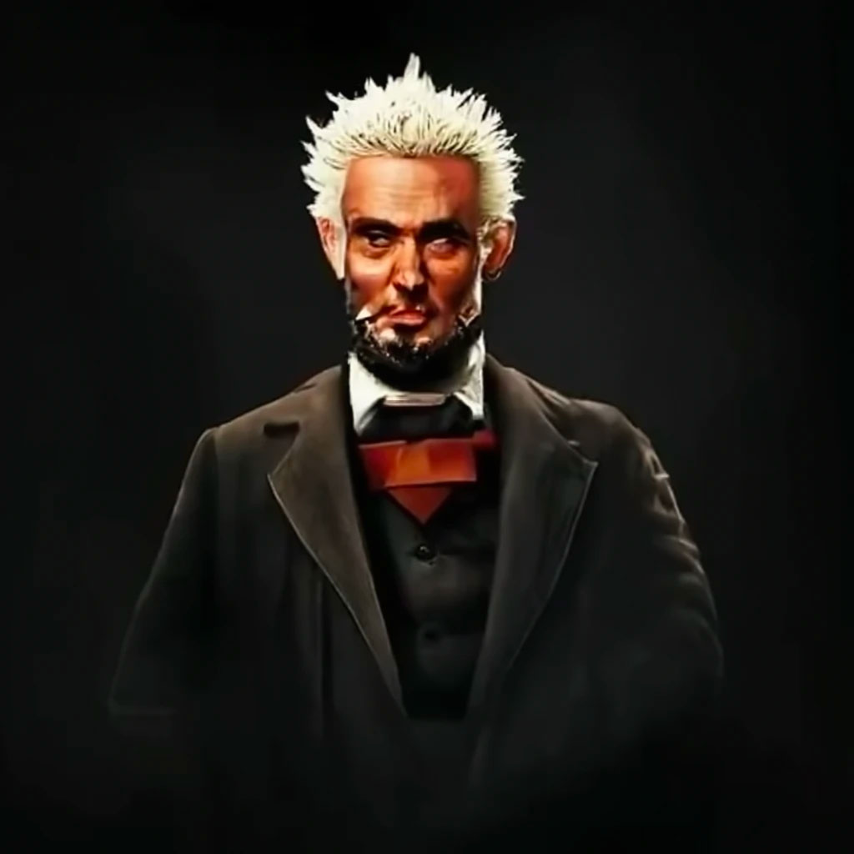
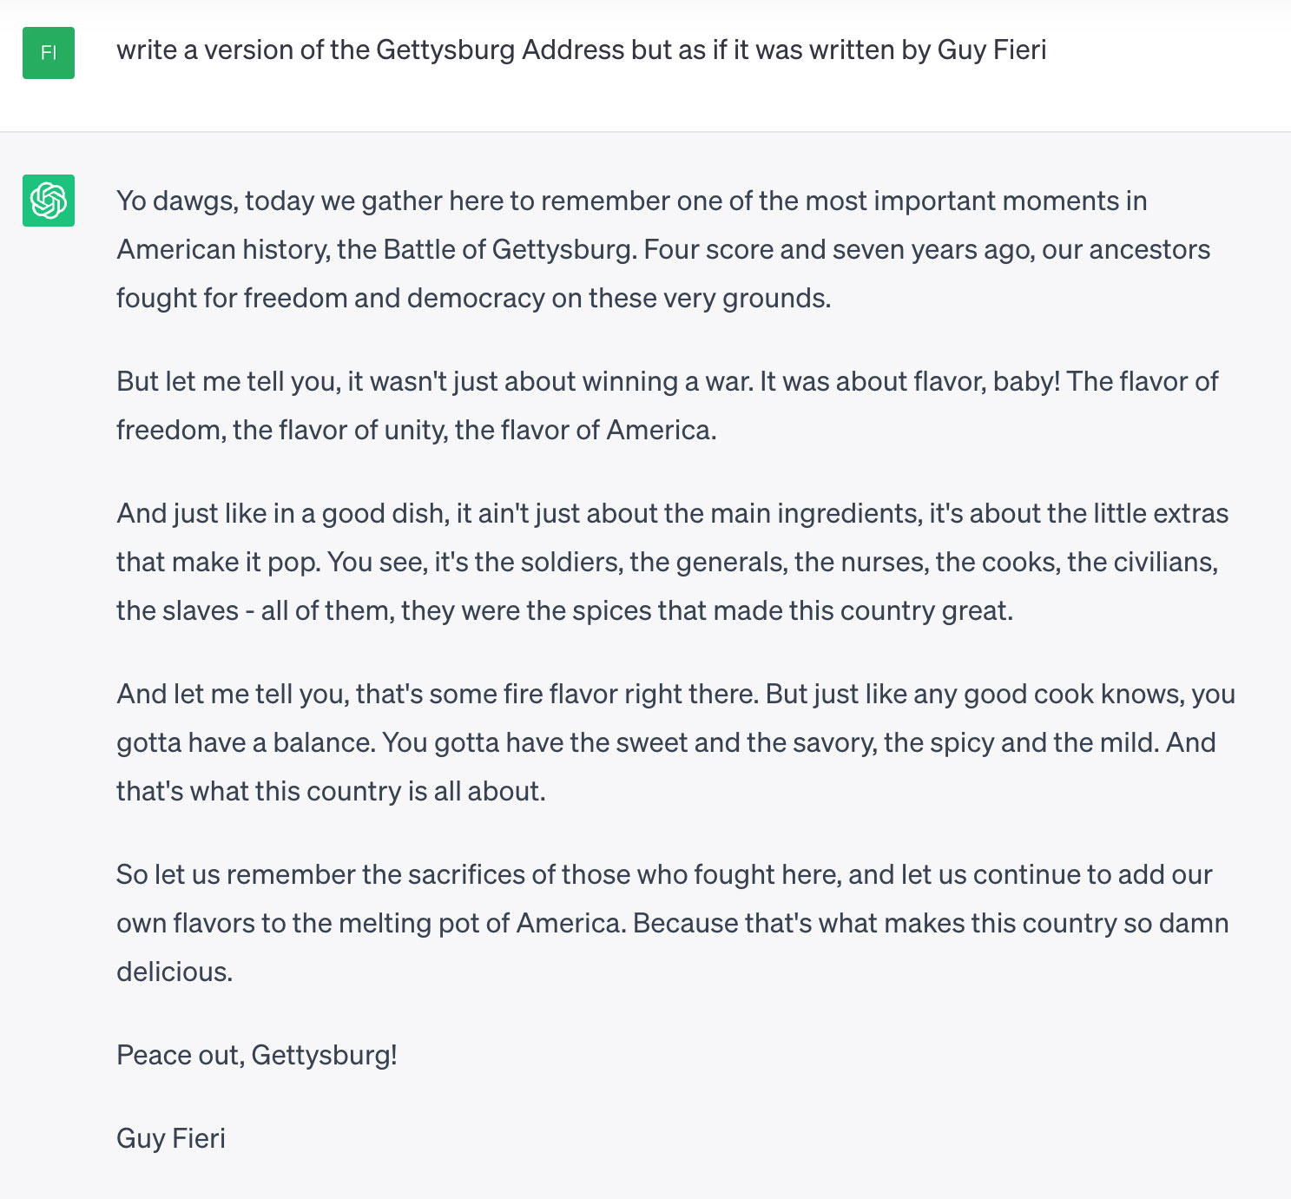

Slide 23
Well…that’s good.
But how does all of this actually apply to higher ed and OUR websites?

Slide 24
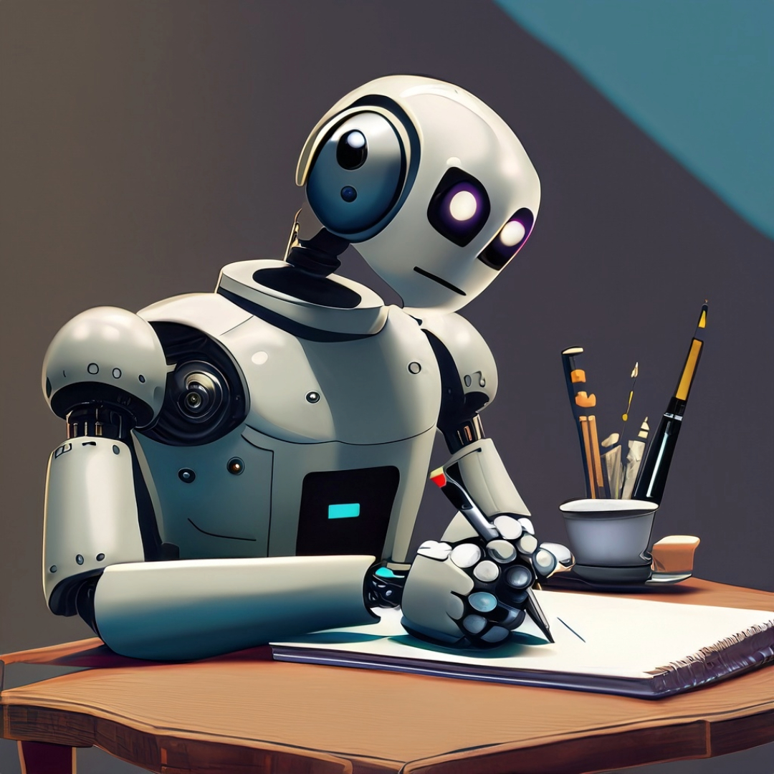
ChatGPT Takeaway #1:
While not 100% perfect, the output from ChatGPT is generally both grammatically correct and free of spelling errors. (More like 99.9% right.)

Slide 25
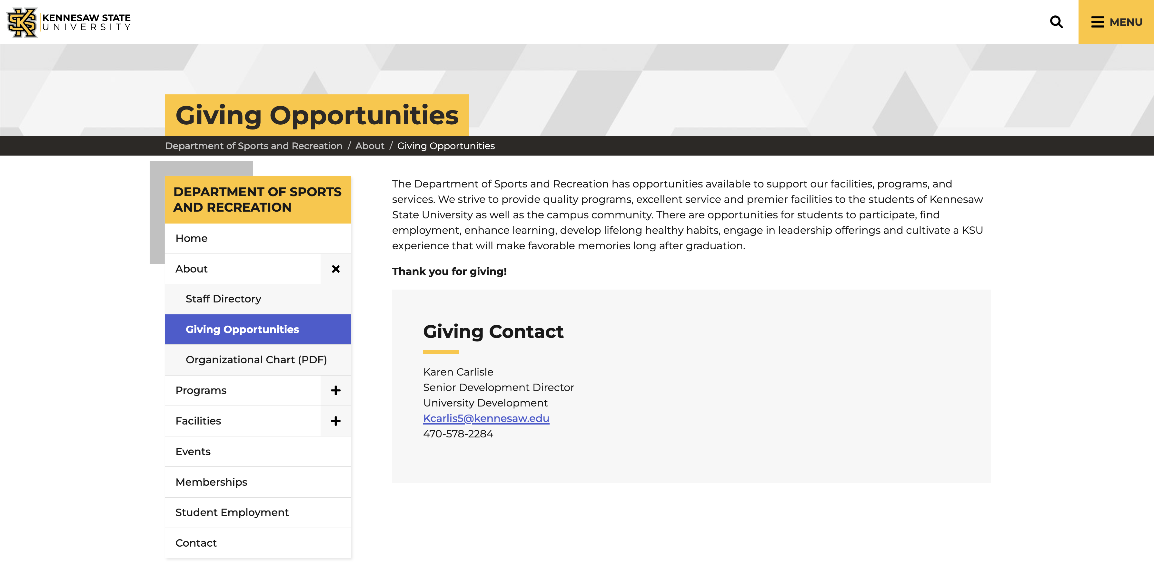

Slide 27
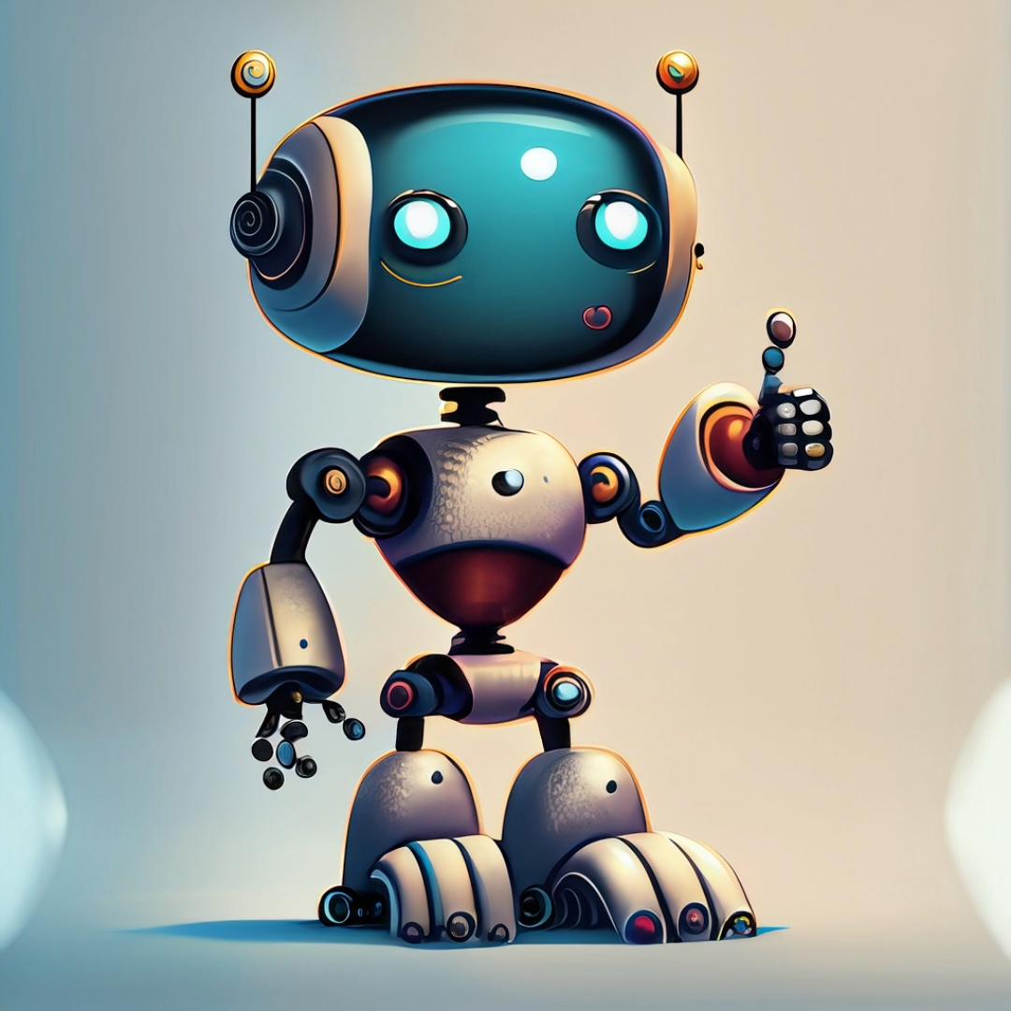
ChatGPT Takeaway #2:
ChatGPT is incredibly adept at taking sizeable amounts of information from multiple sources and condensing it in a way that makes it concise and “more to the point.”

Slide 29
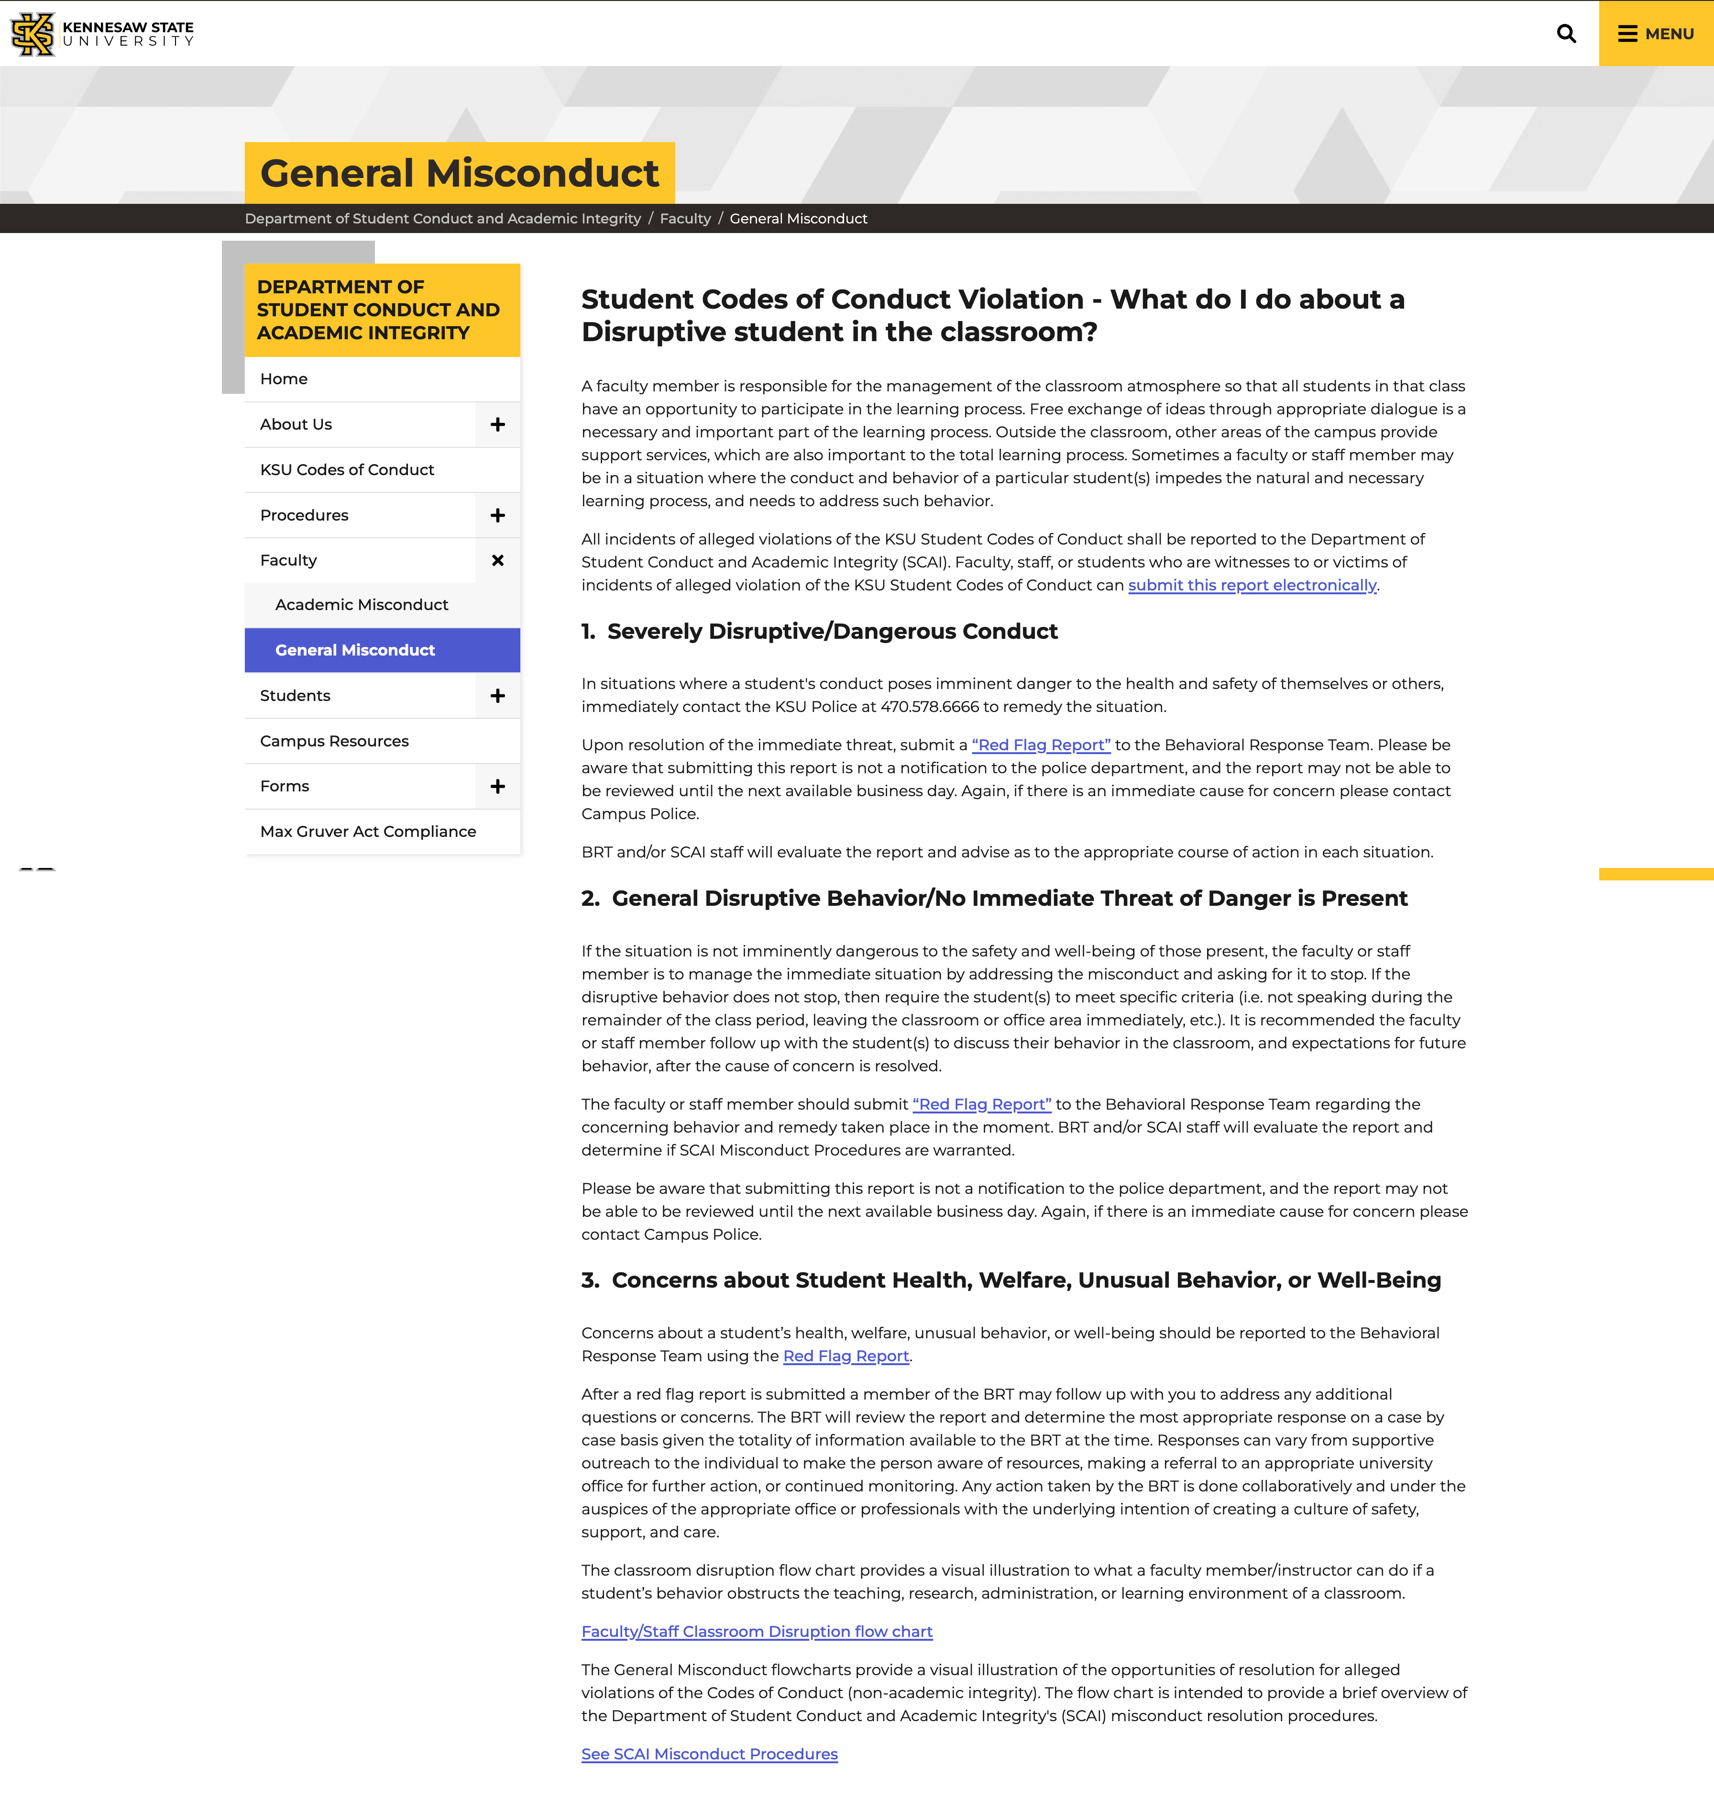

Slide 31
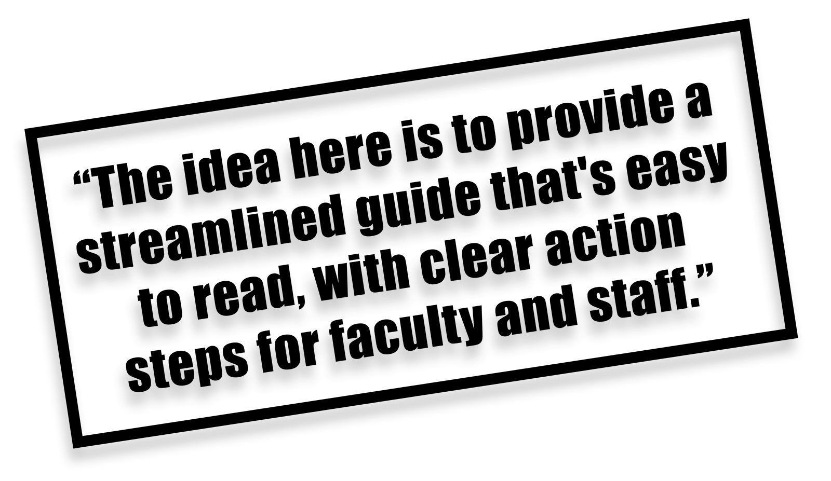

Slide 32
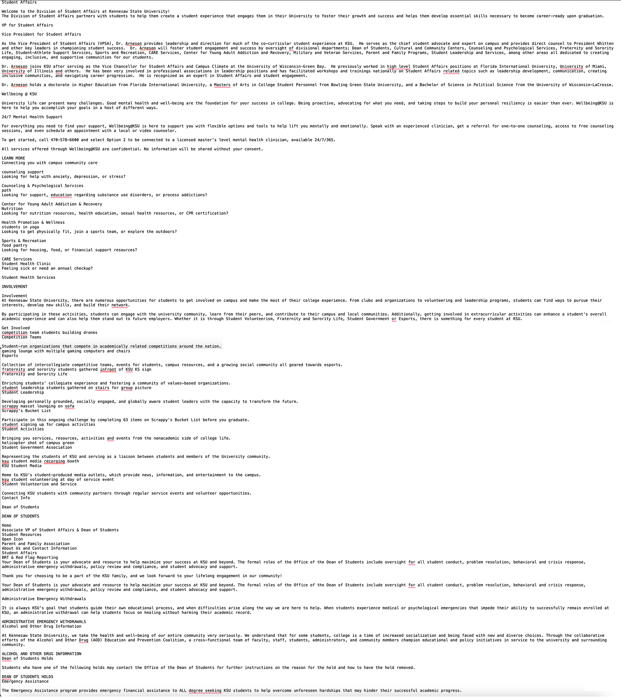
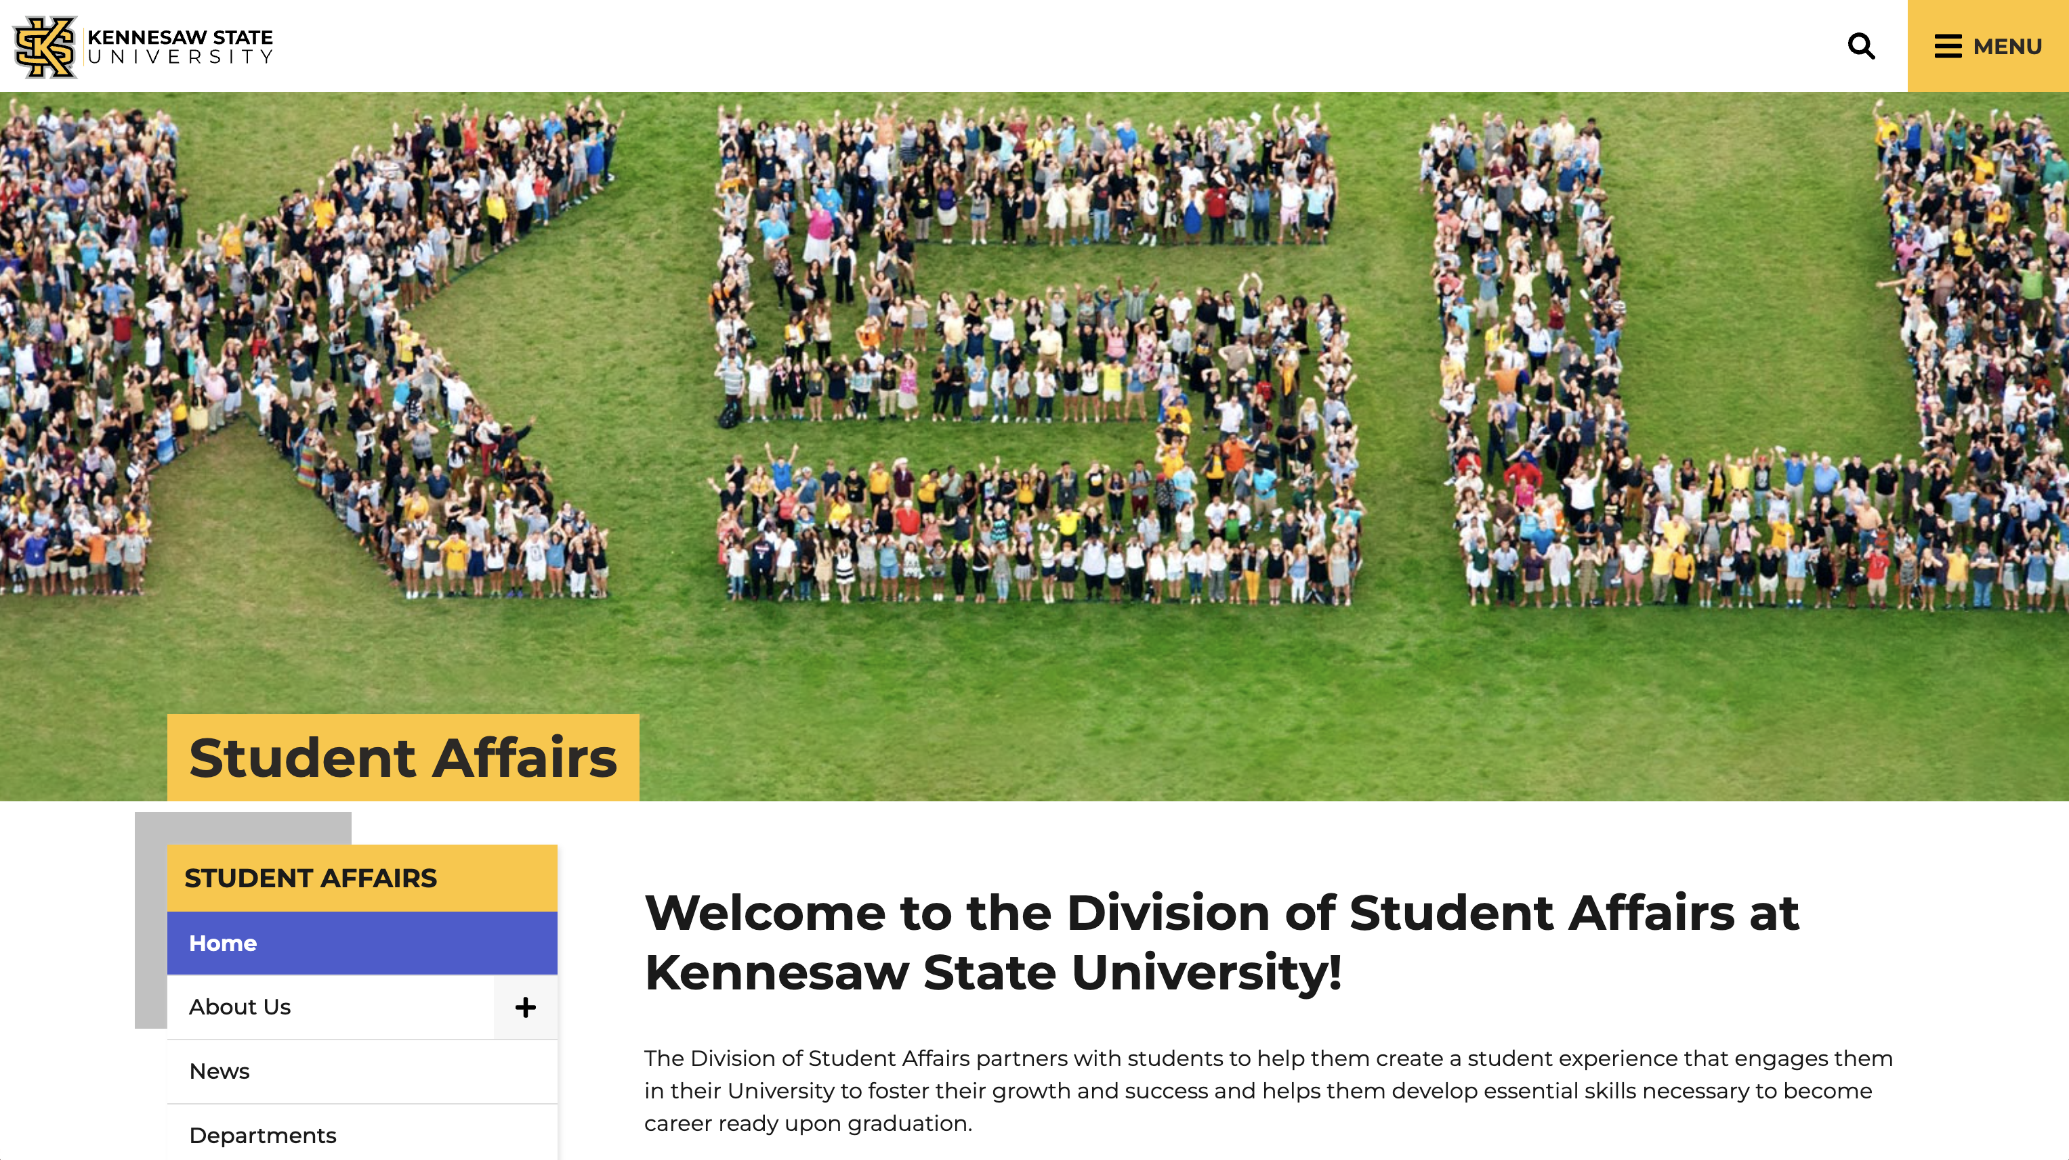
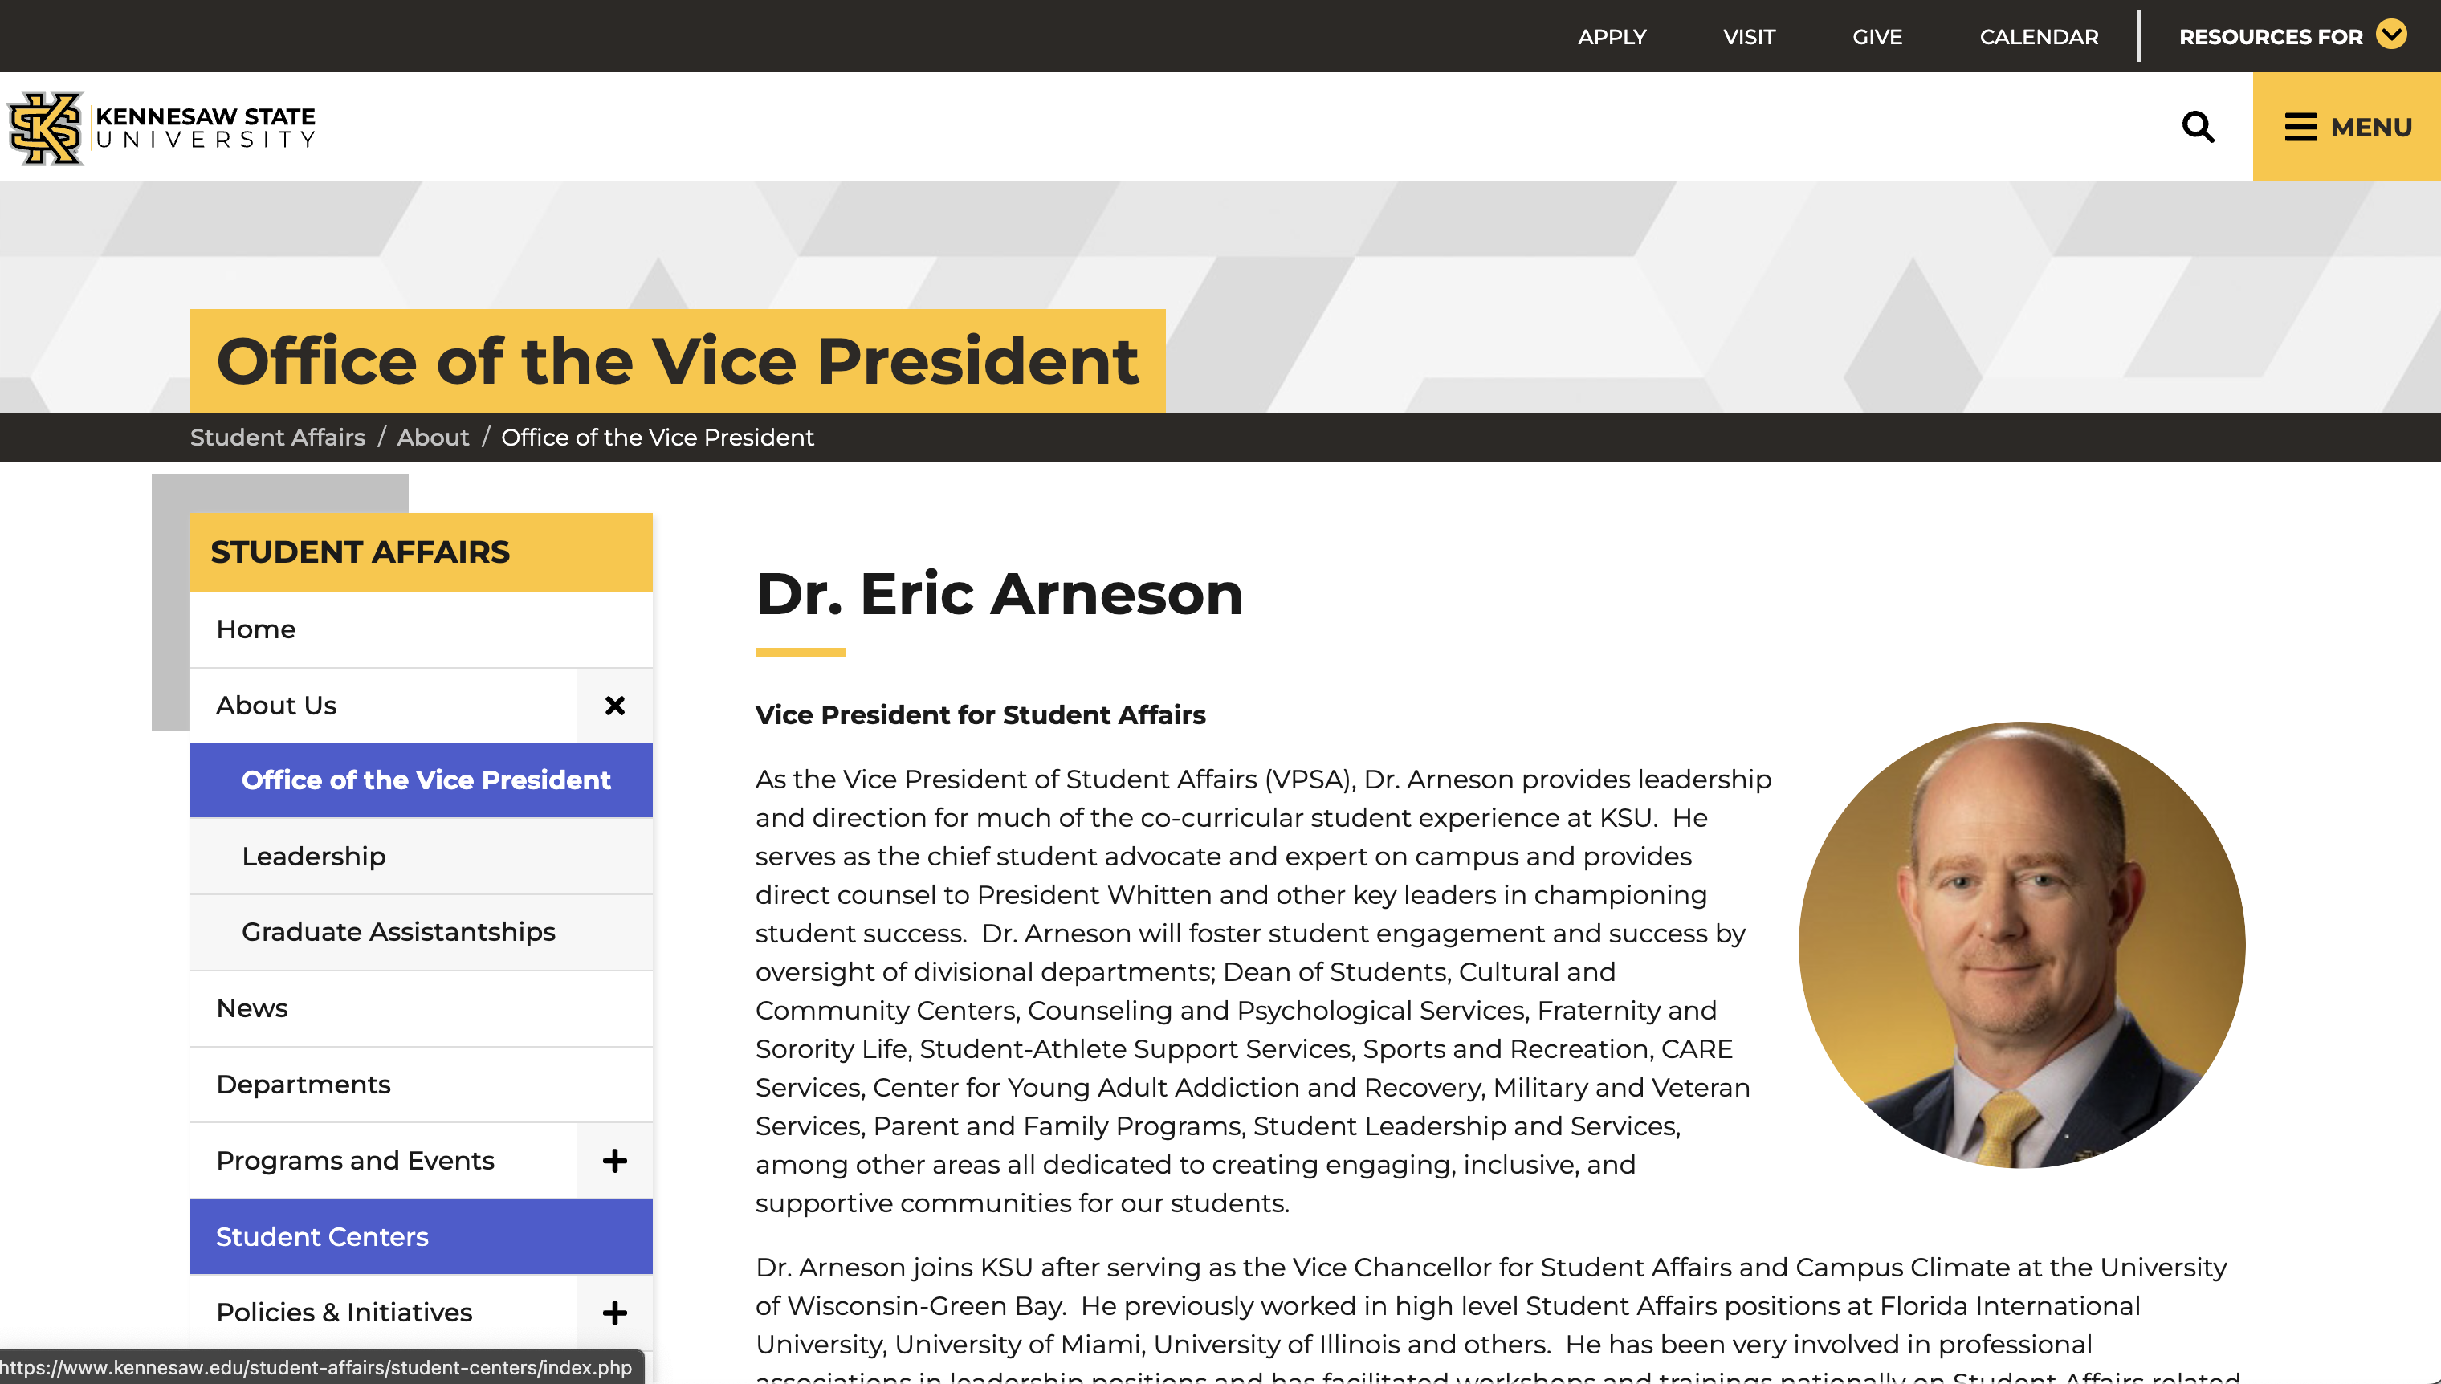
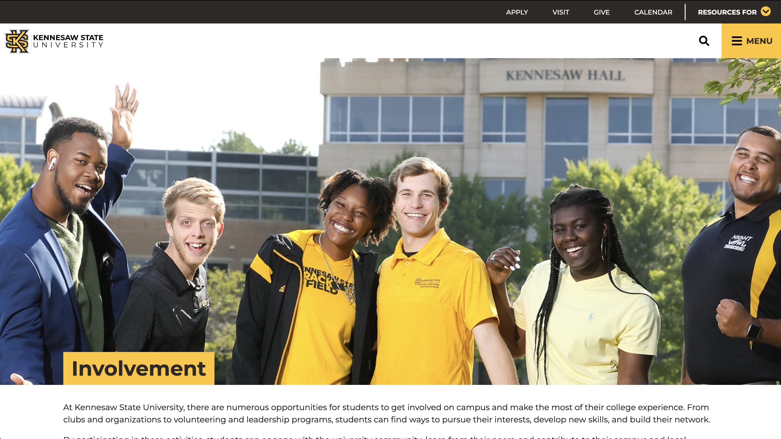

Slide 33
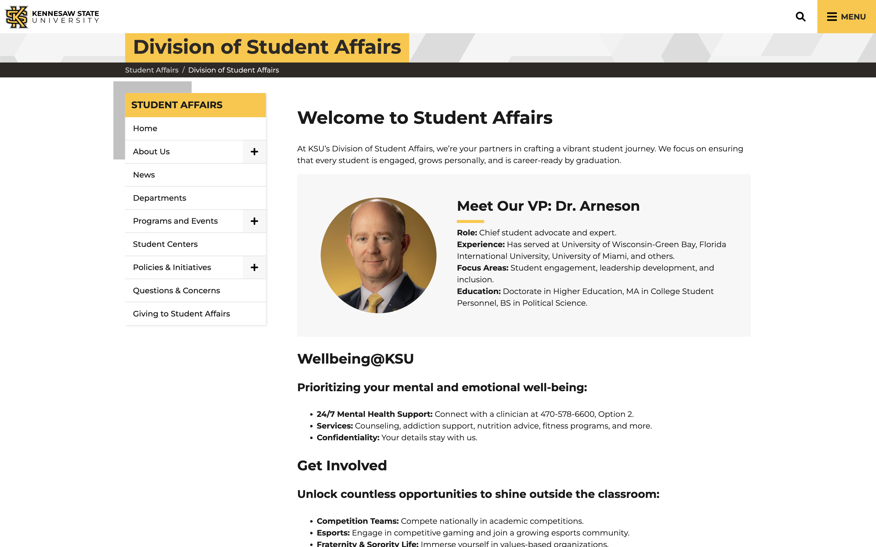

Slide 34
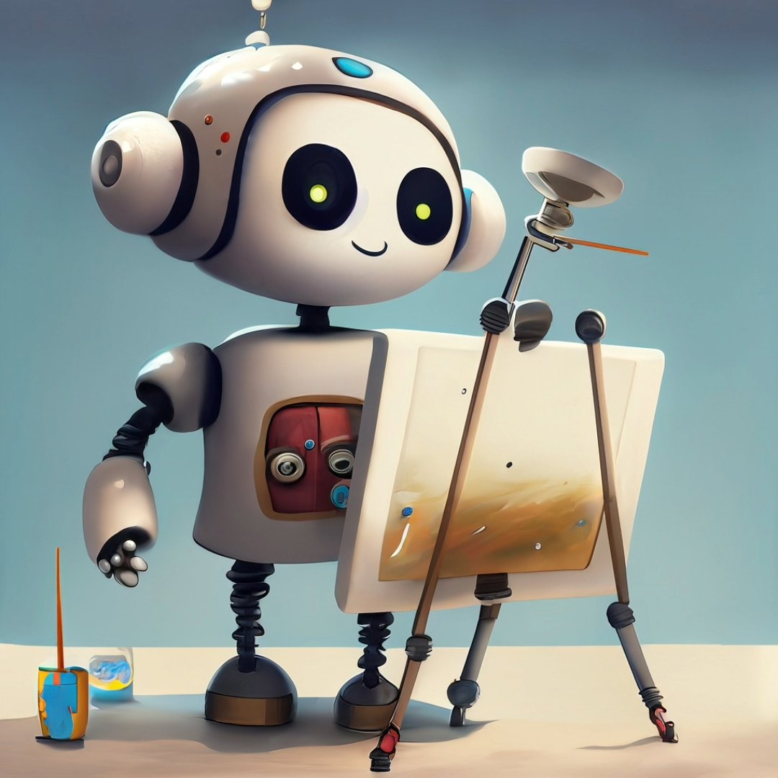
ChatGPT Takeaway #3:
It is easy to get lost in the discussion of AI mimic vs. invention.
The better (more creative) the prompt, the better the output!

Slide 35
“I need fantastical content for a website at Kennesaw State University. We are going to have a new academic program for our new campus on the moon. Tell me all about it - student life, academics, athletics. And remember it is for a webpage. The content needs to be structured for the web and speak to 18-22 year olds.”

Slide 36
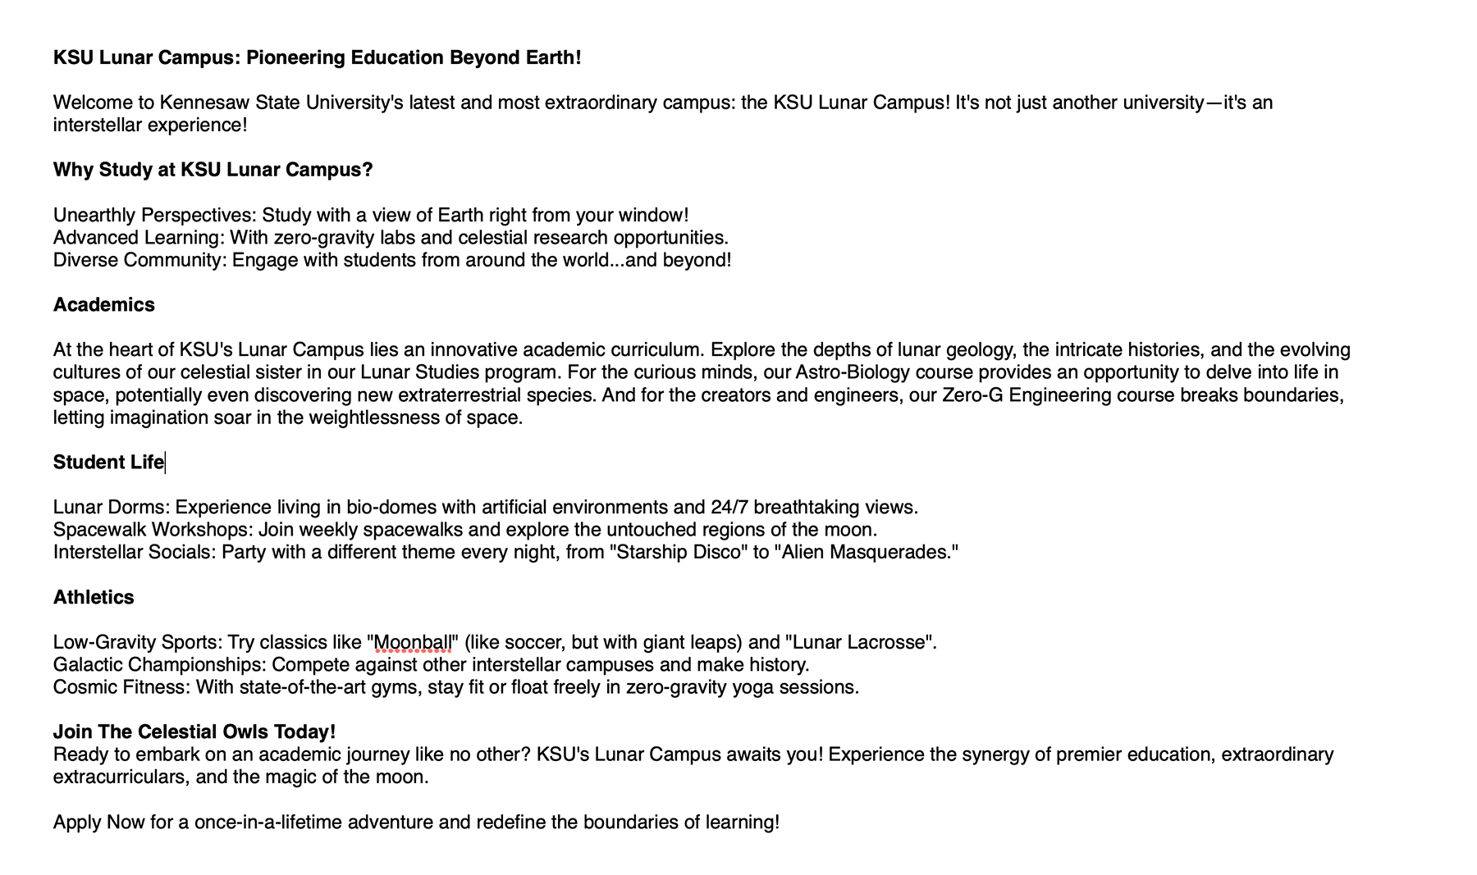

Slide 37
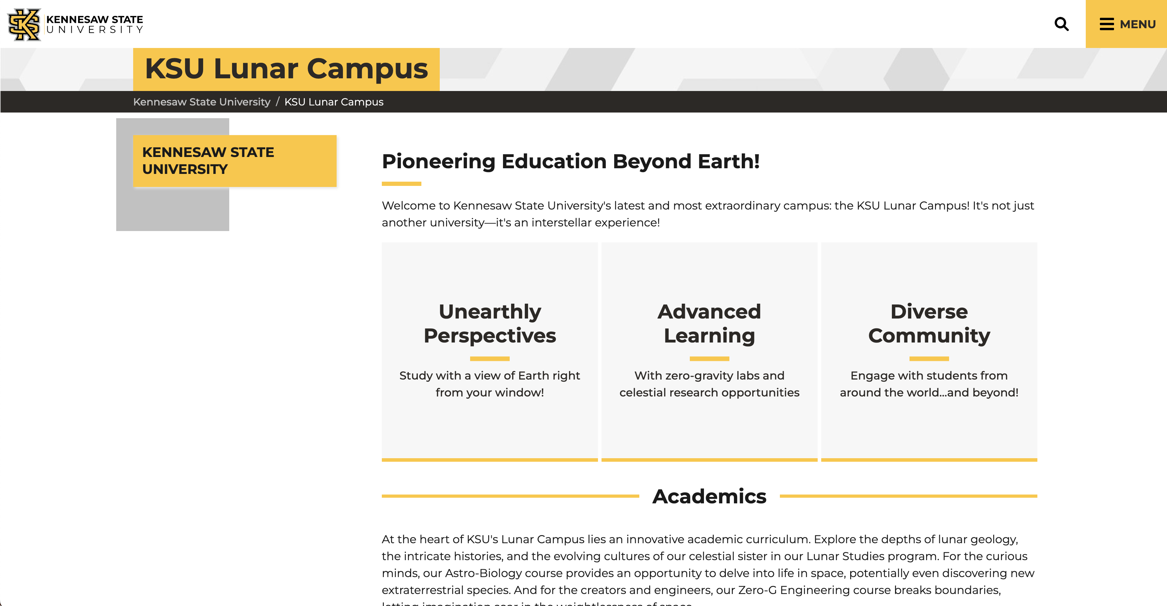

Slide 38
Now…let’s try something fantastical but something we can actually use on our website.

Slide 39
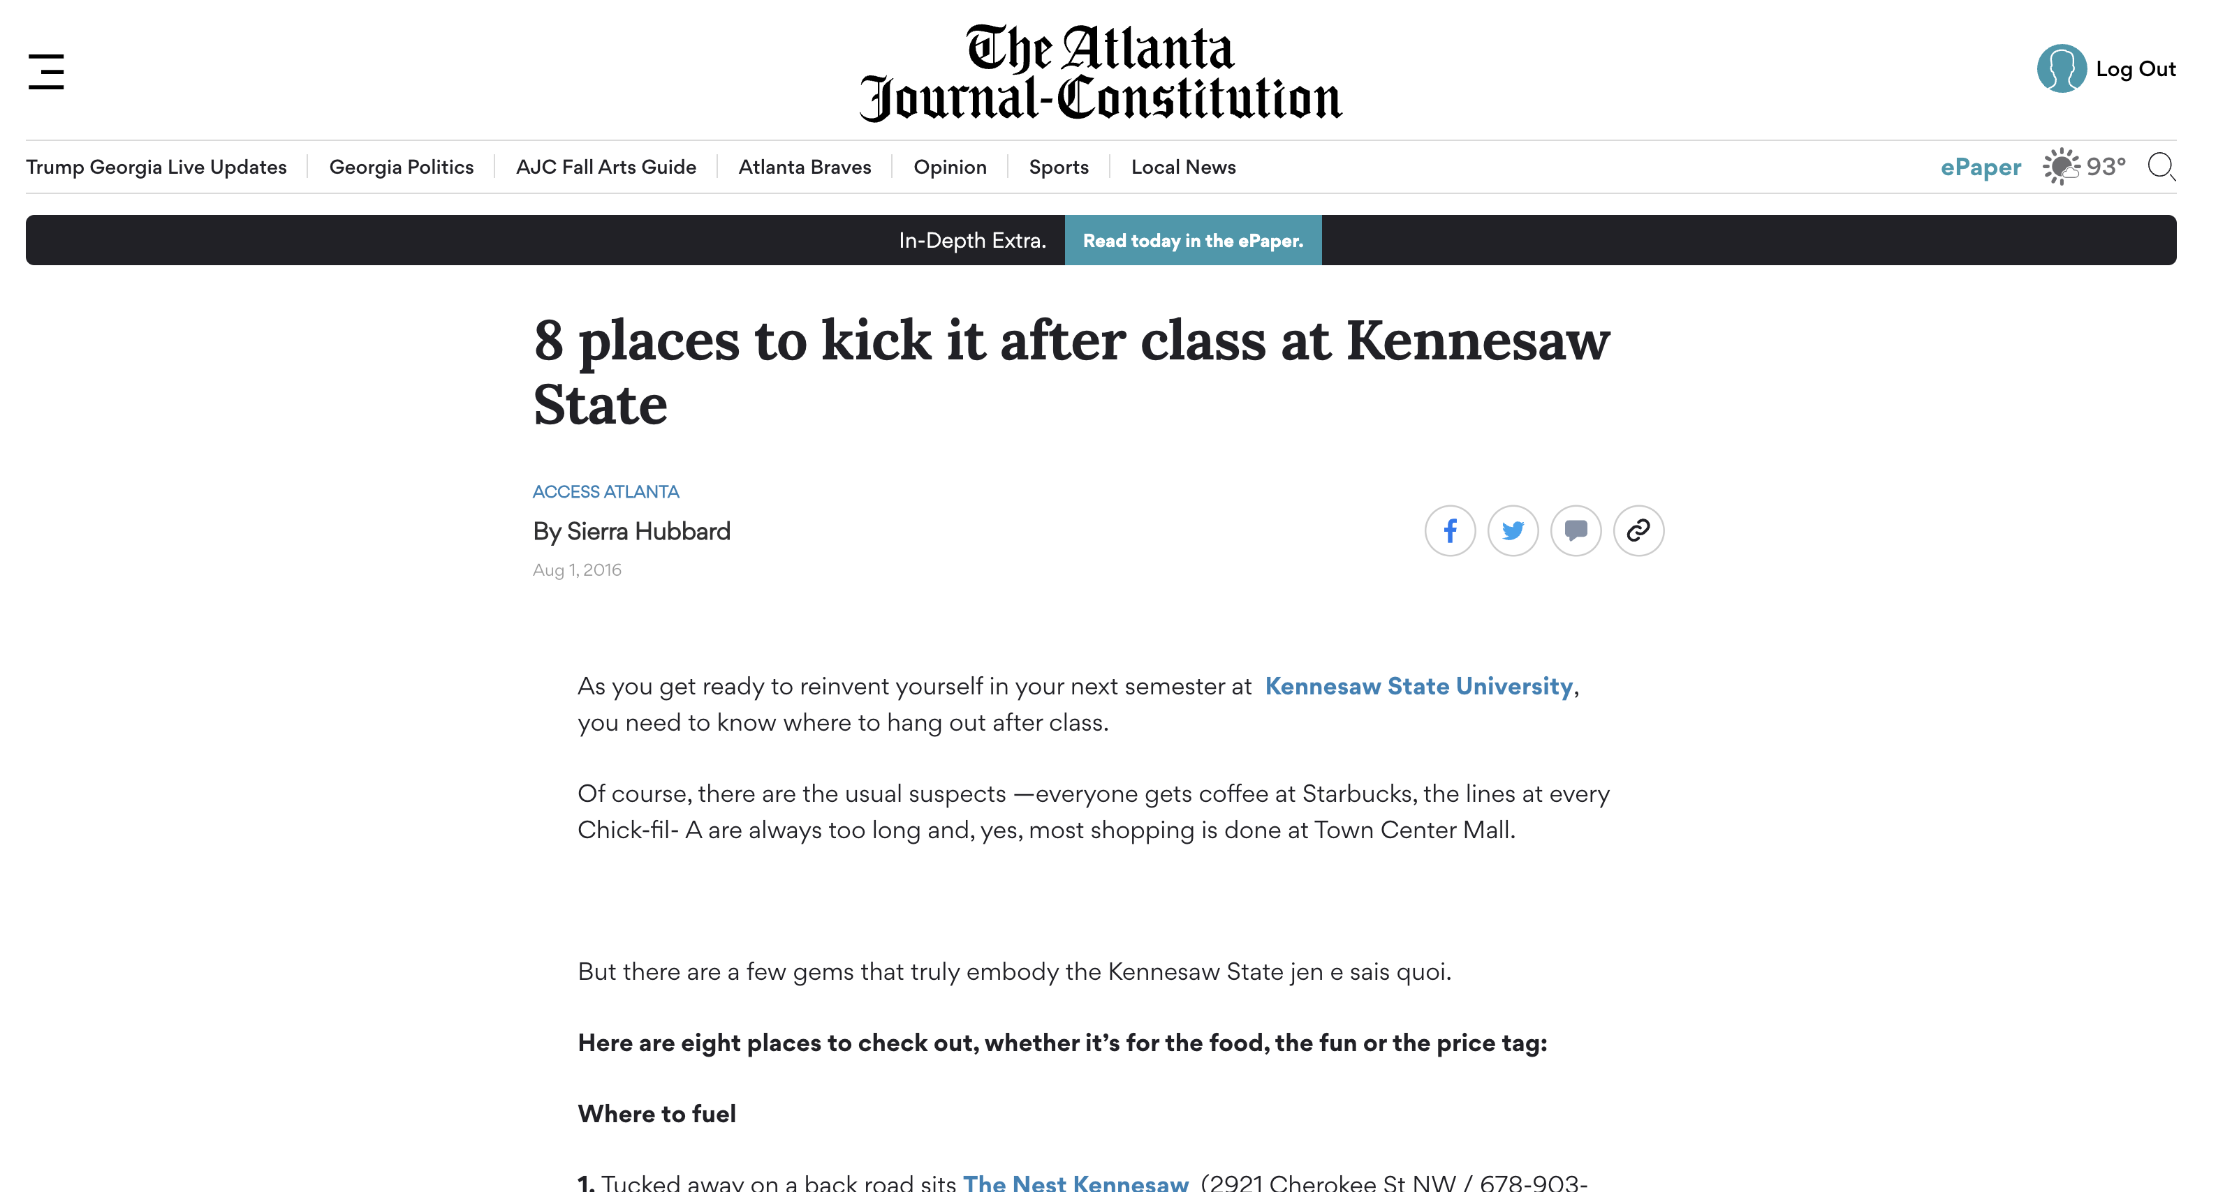
AI Text Generation
“We are going to generate a fun 3-4 paragraphs about a day in the life of Scrappy the Owl at Kennesaw State University.”

Slide 40
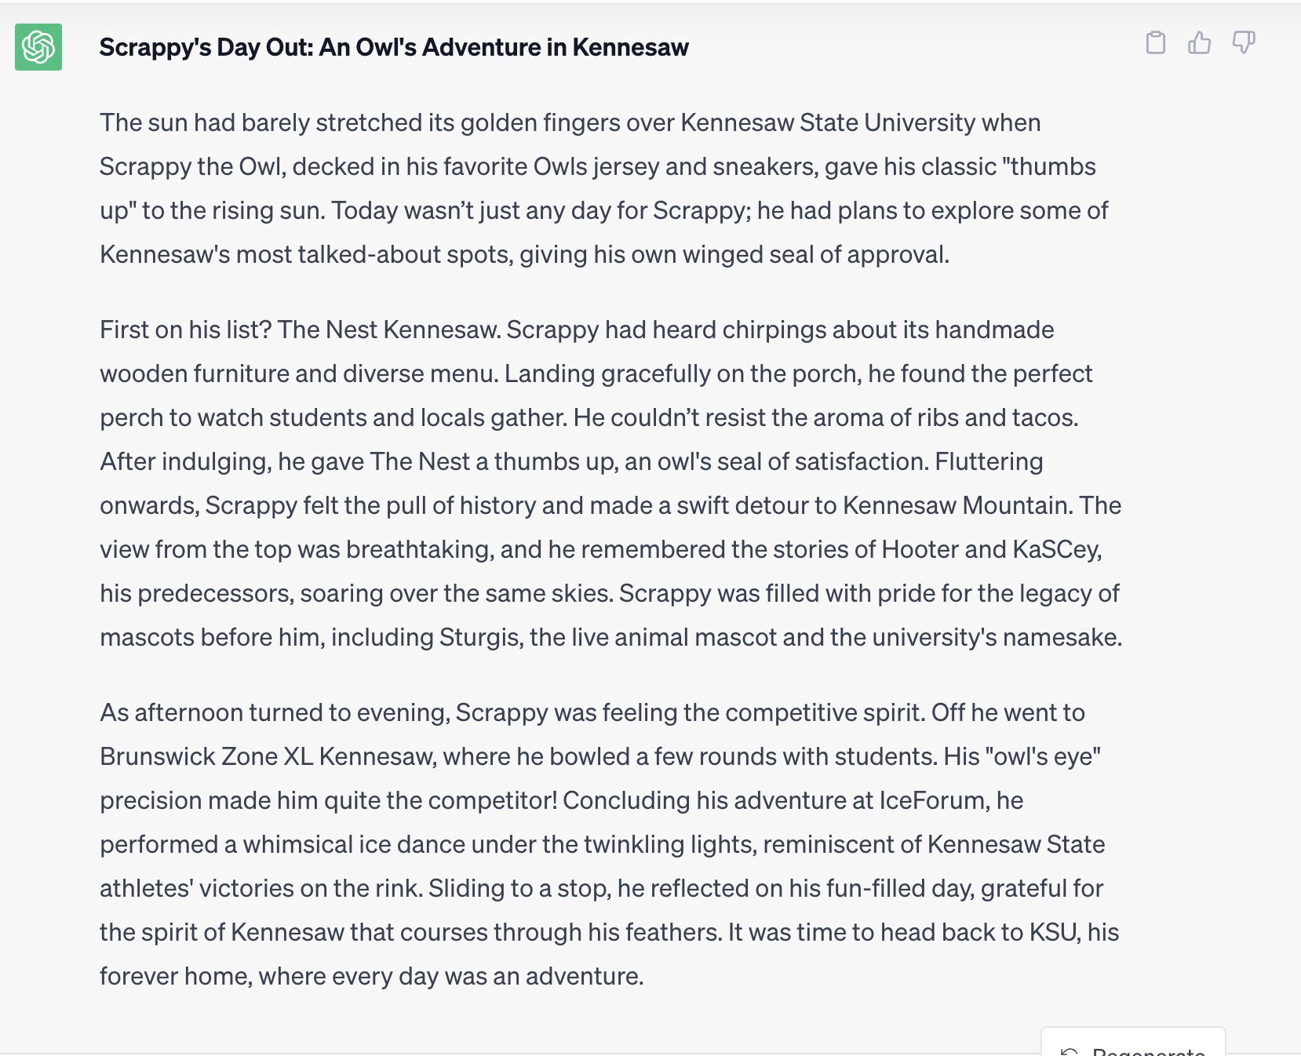
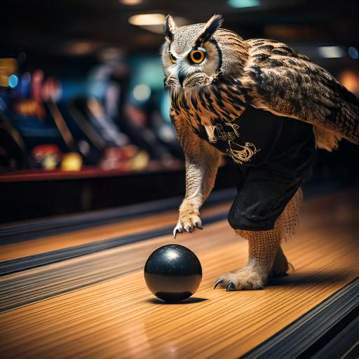

Slide 41
But...hold on a sec.
While AI’s capabilities are powerful and seemingly limitless, there are some real complex problems about how it will affect our websites and can be implemented responsibly.

Slide 42
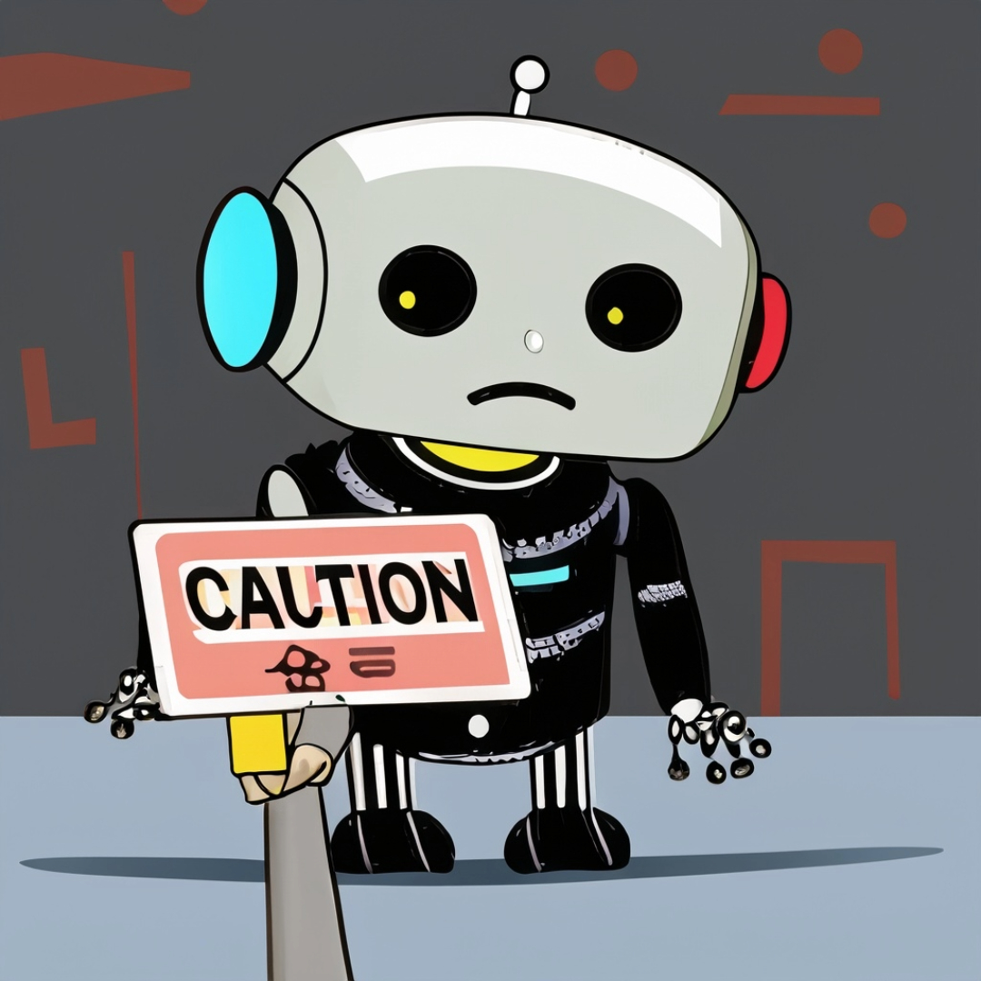
THING TO THINK ABOUT #1: In this era of information insanity, how can we be sure that the AI content is factual and accurate?!?!

Slide 43
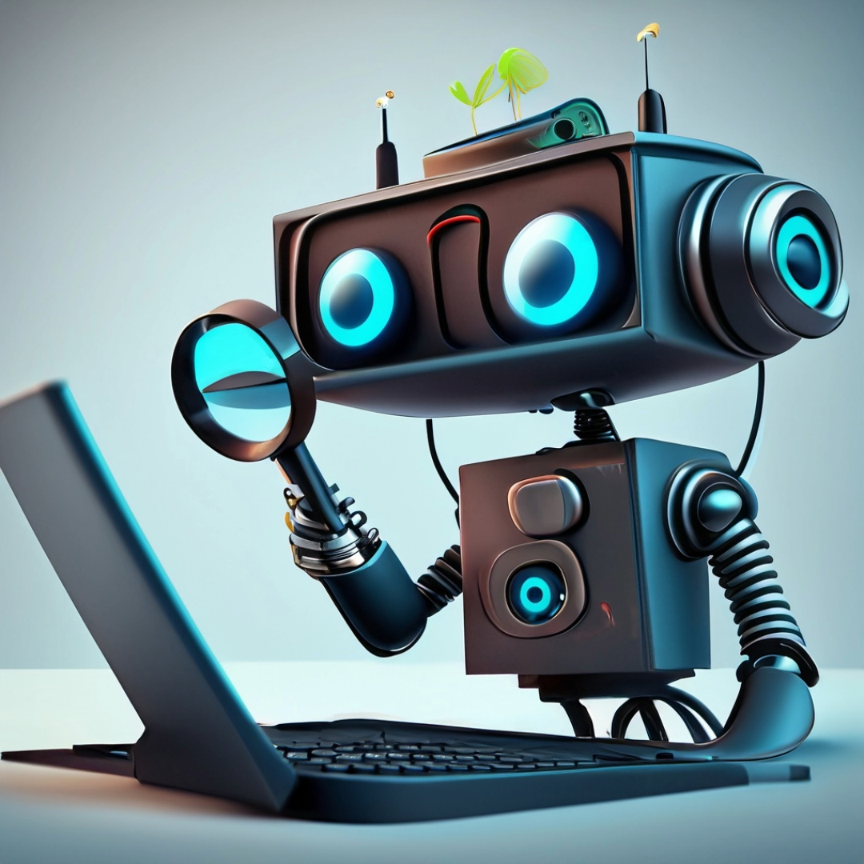
Let's take a look at Google's Generative AI and how it is generating content.
(And determine what it perceives as factual.)

Slide 44
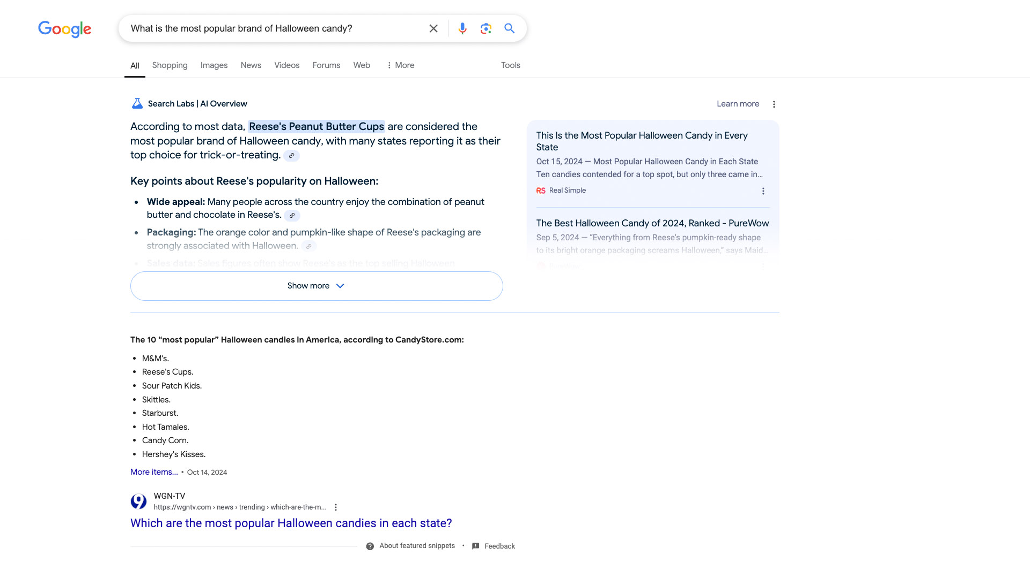

Slide 45
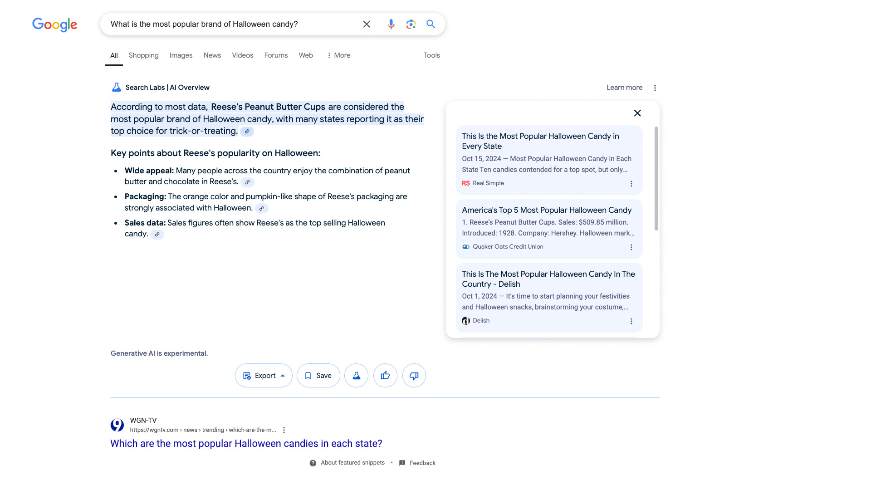

Slide 46
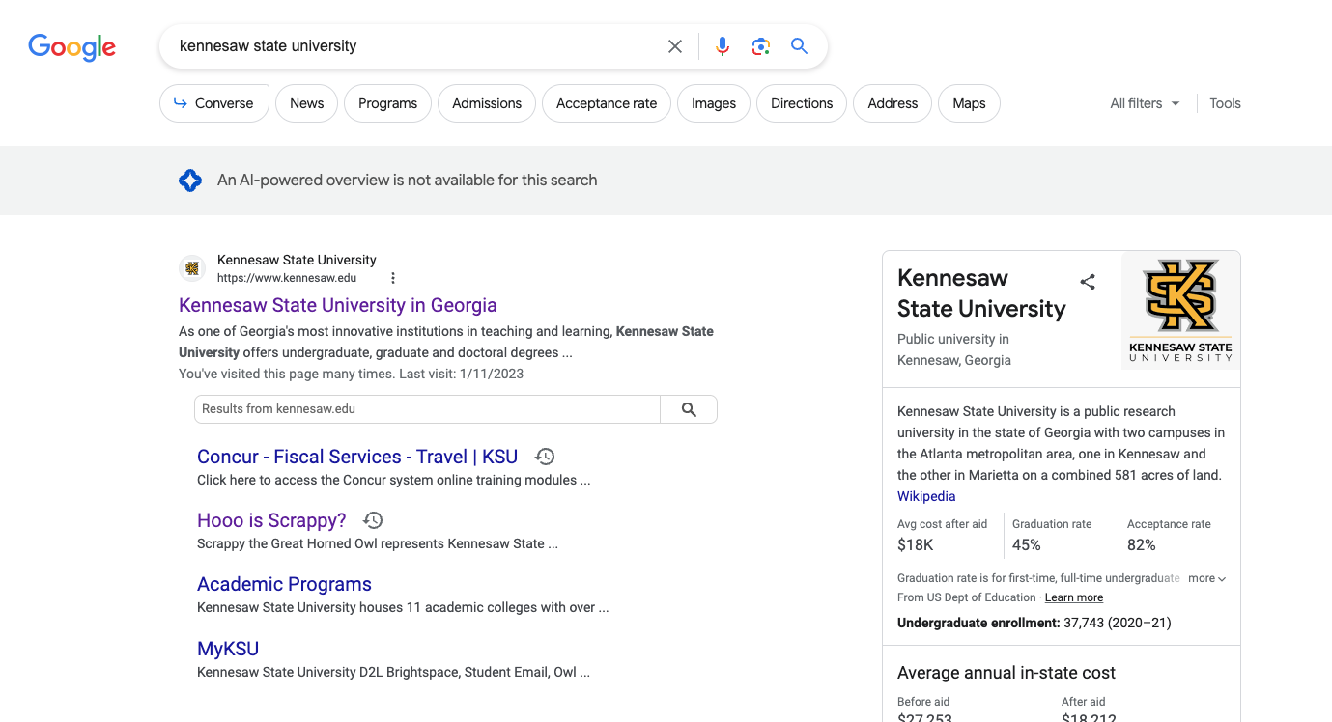

Slide 47
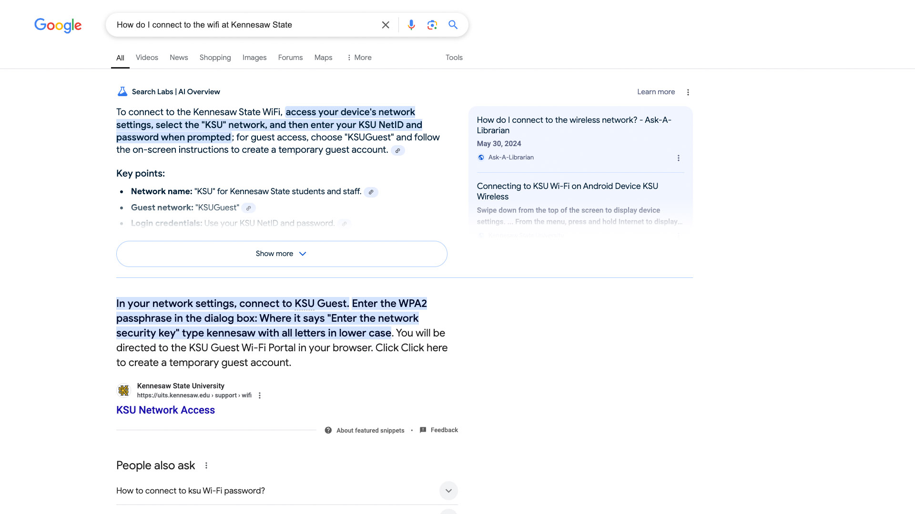

Slide 48
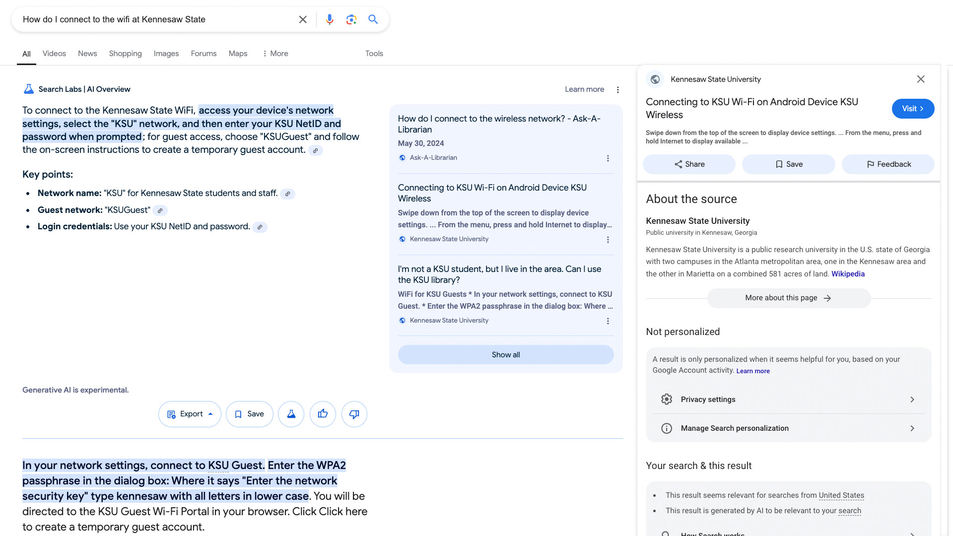

Slide 49
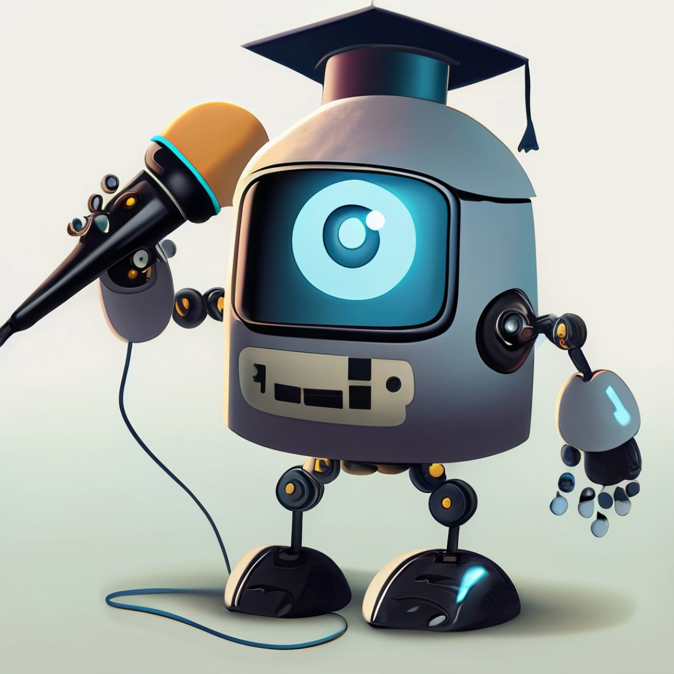
THING TO THINK ABOUT #2: How can we take Google's Generative AI example (the future) and translate it to higher ed?

Slide 50
Google basically uses the Internet for its source of verifiable facts.
Where is a higher ed's source of verifiable facts if the future web is generated dynamically?

Slide 51
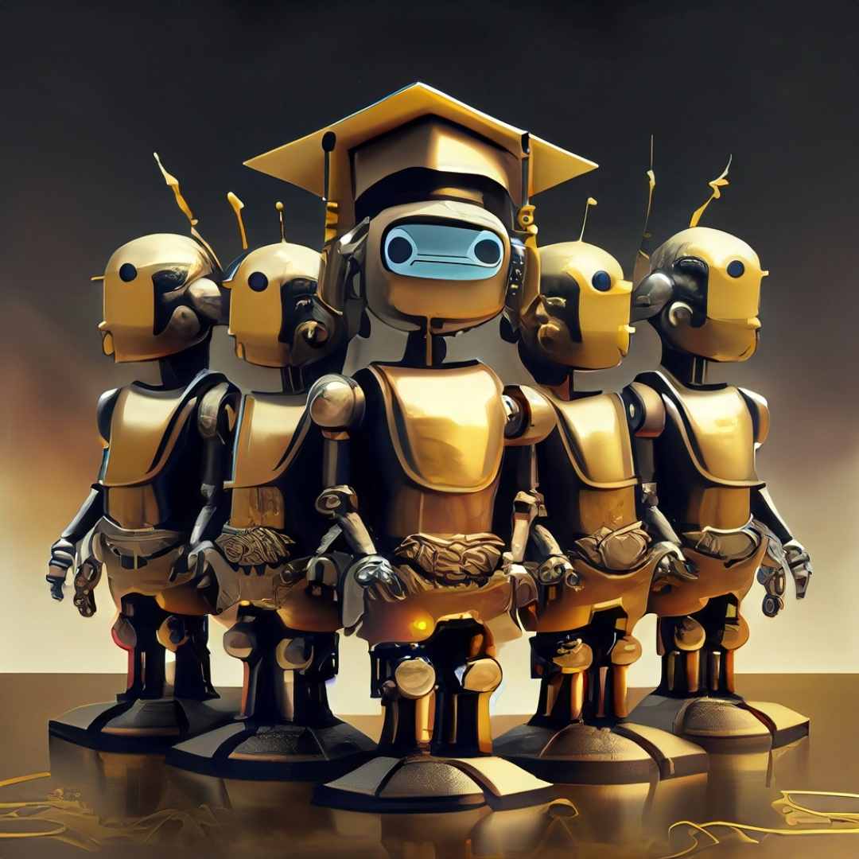
Generating AI web content for our institutions would require managing a centralized source of truth.

Slide 52
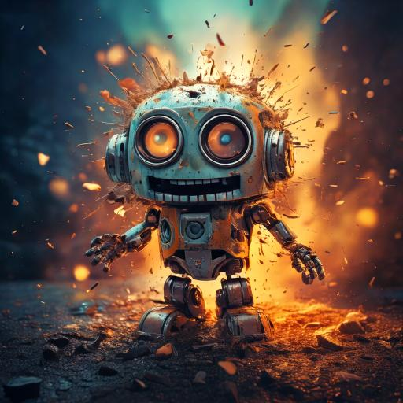
Have seen this methodology before (sorta) when we implemented a 2019 Admissions chatbot.
It was overwhelming because we were managing paragraphs not data and facts.

Slide 53
The future of the dynamic higher ed web will be about managing the source of truth and not about managing 20,000 webpages

Slide 54
THING TO THINK ABOUT #3:
How will Generative AI affect our CMSs and user experience?
(i.e. how we build and manage websites?)

Slide 55
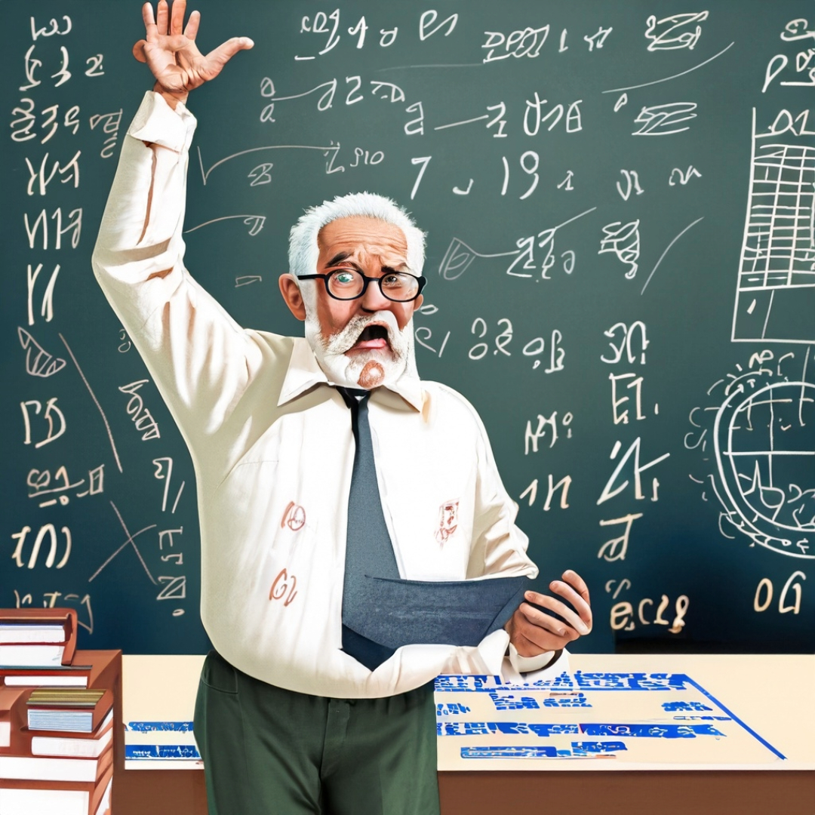
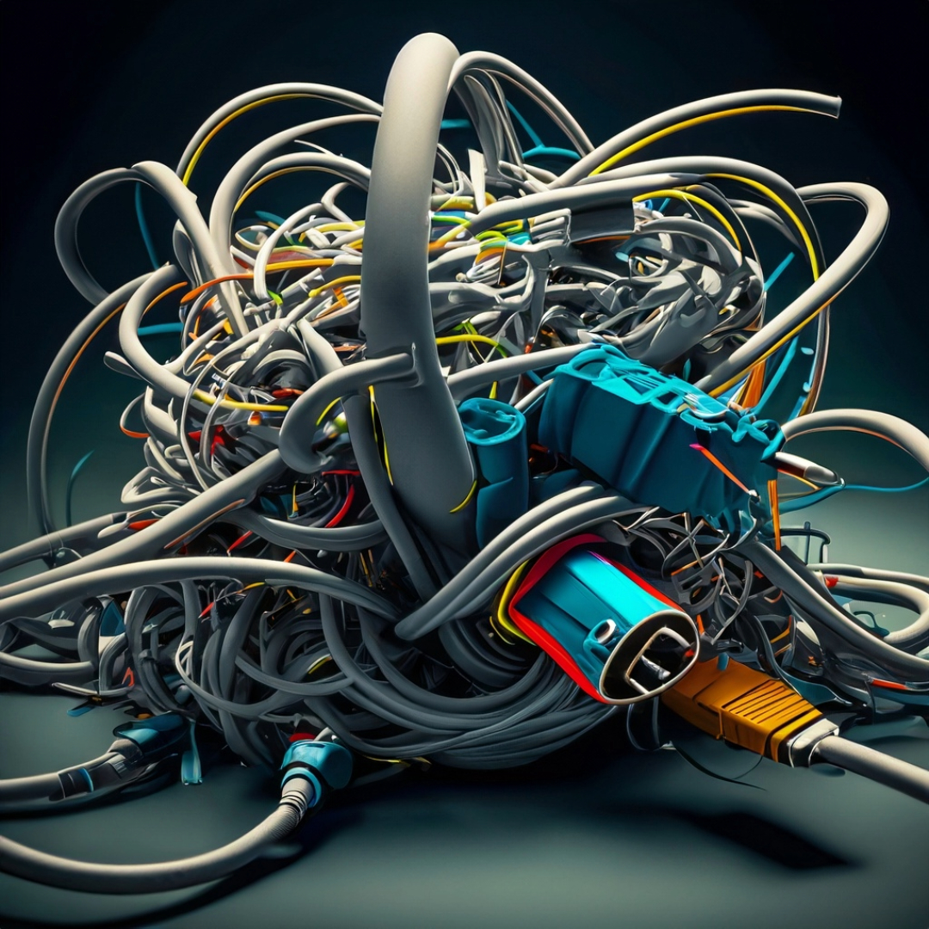
Buckle Up.
It is time for a Website Development History Lesson.

Slide 56
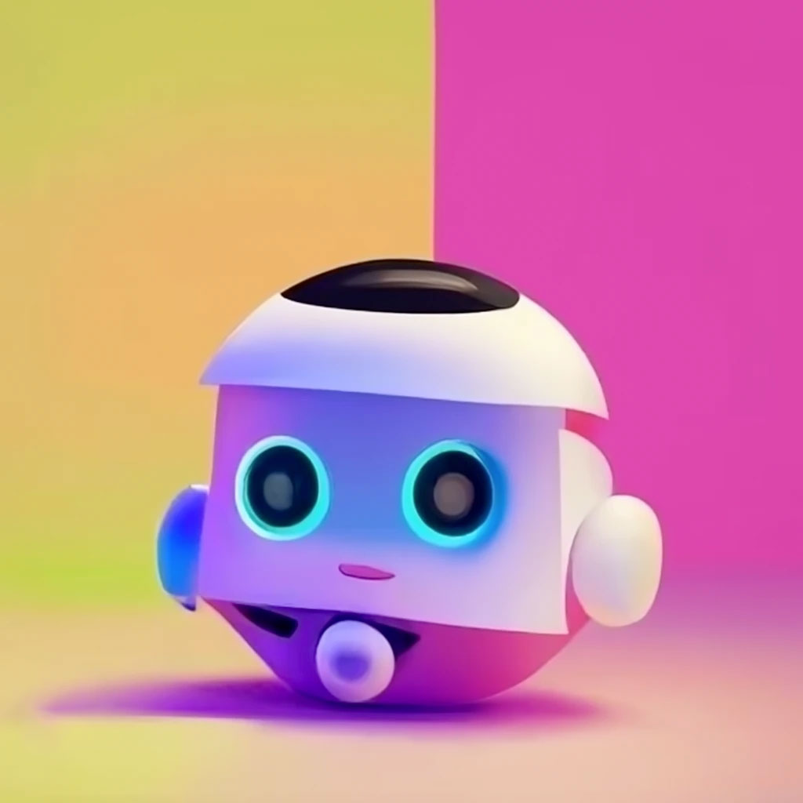
Website Development History – The 90s
Basic Design & Limited Interactivity
HTML-centric Development
Manual Site Management

Slide 57
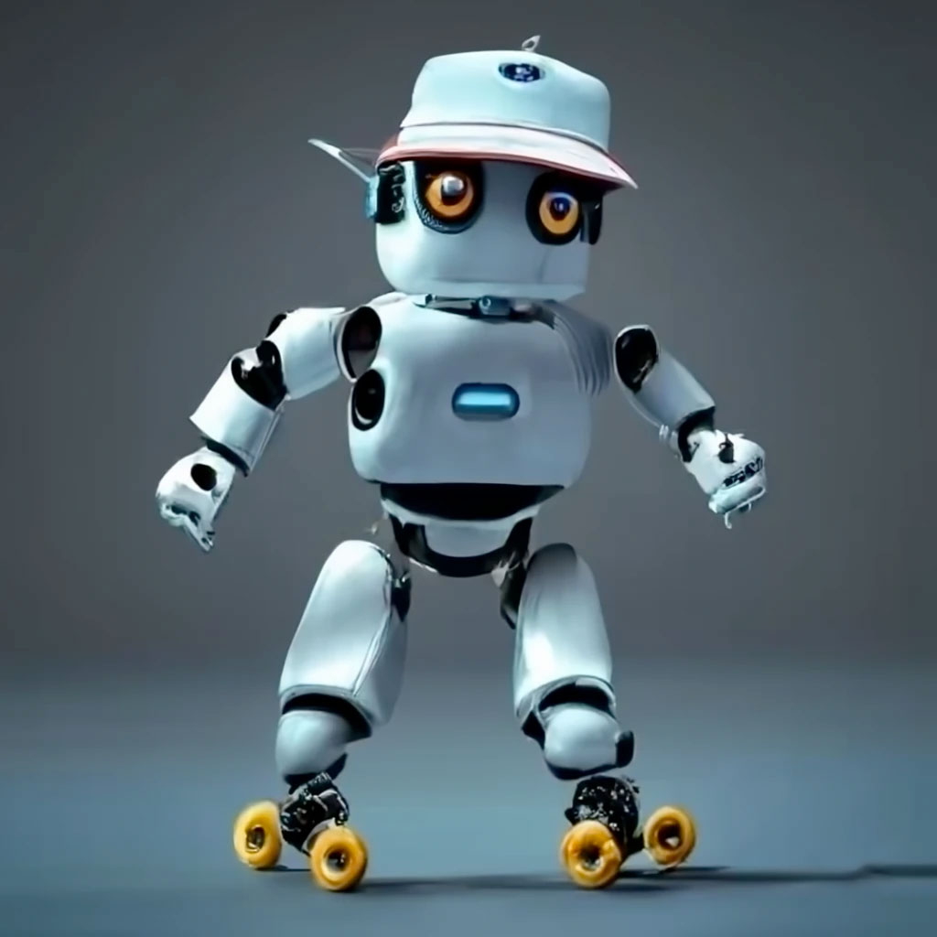
Website Development History – The 00s
Rise of Dynamic & Interactive Content
Emergence of CMS & Web Platforms
Focus on Design & User Experience (CSS)

Slide 58
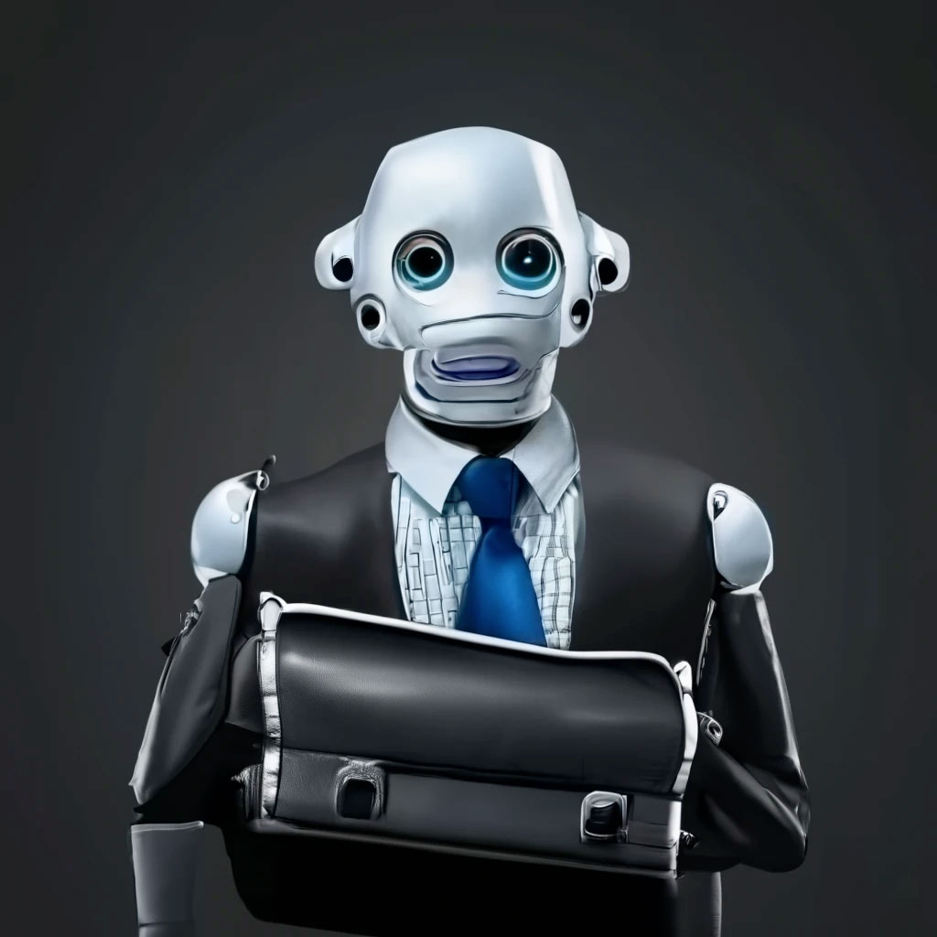
Website Development History – The 10s
Mobile-First & Responsive Design
Single Page Applications & Modern Frameworks
API-Driven & Modular Development

Slide 59
These changes over the last twenty-five years have dramatically affected how we build and maintain our university sites and domains…we see the change and know it is coming!

Slide 60
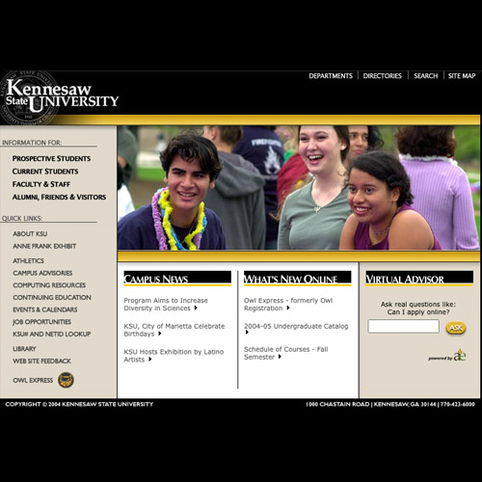
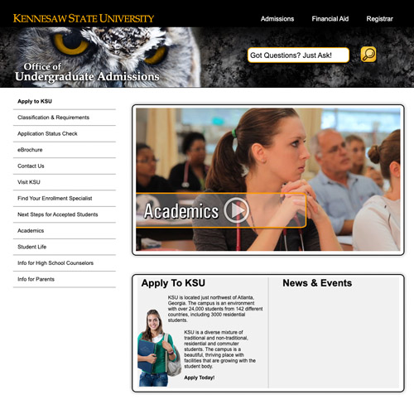
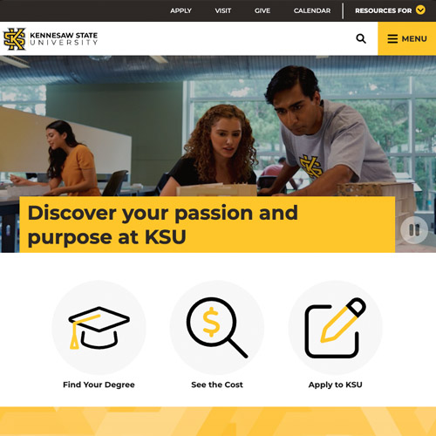
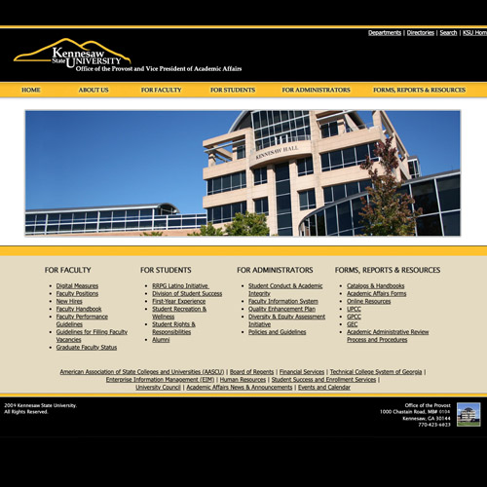
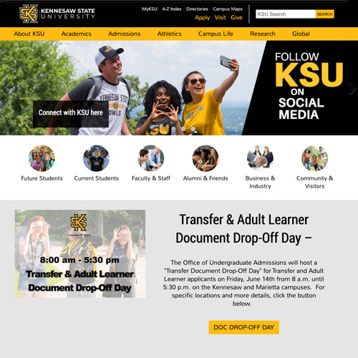
Our Path to Innovation
(Based on the collective 45 years of experience)
Dreamweaver (2000)
AI (202?)
Responsive Web (2012)
CMS (2007)
Accessibility (2018)

Slide 61
How This Usually Shakes Out
(Based on the collective 45 years of experience)
Great Idea
The Rest of Higher Ed
Notre Dame
The Real World
Web Hosting

Slide 62
How This Usually Shakes Out
(Based on the collective 45 years of experience)
Great Idea
The Rest of Higher Ed
Notre Dame
The Real World
Web Hosting

Slide 63
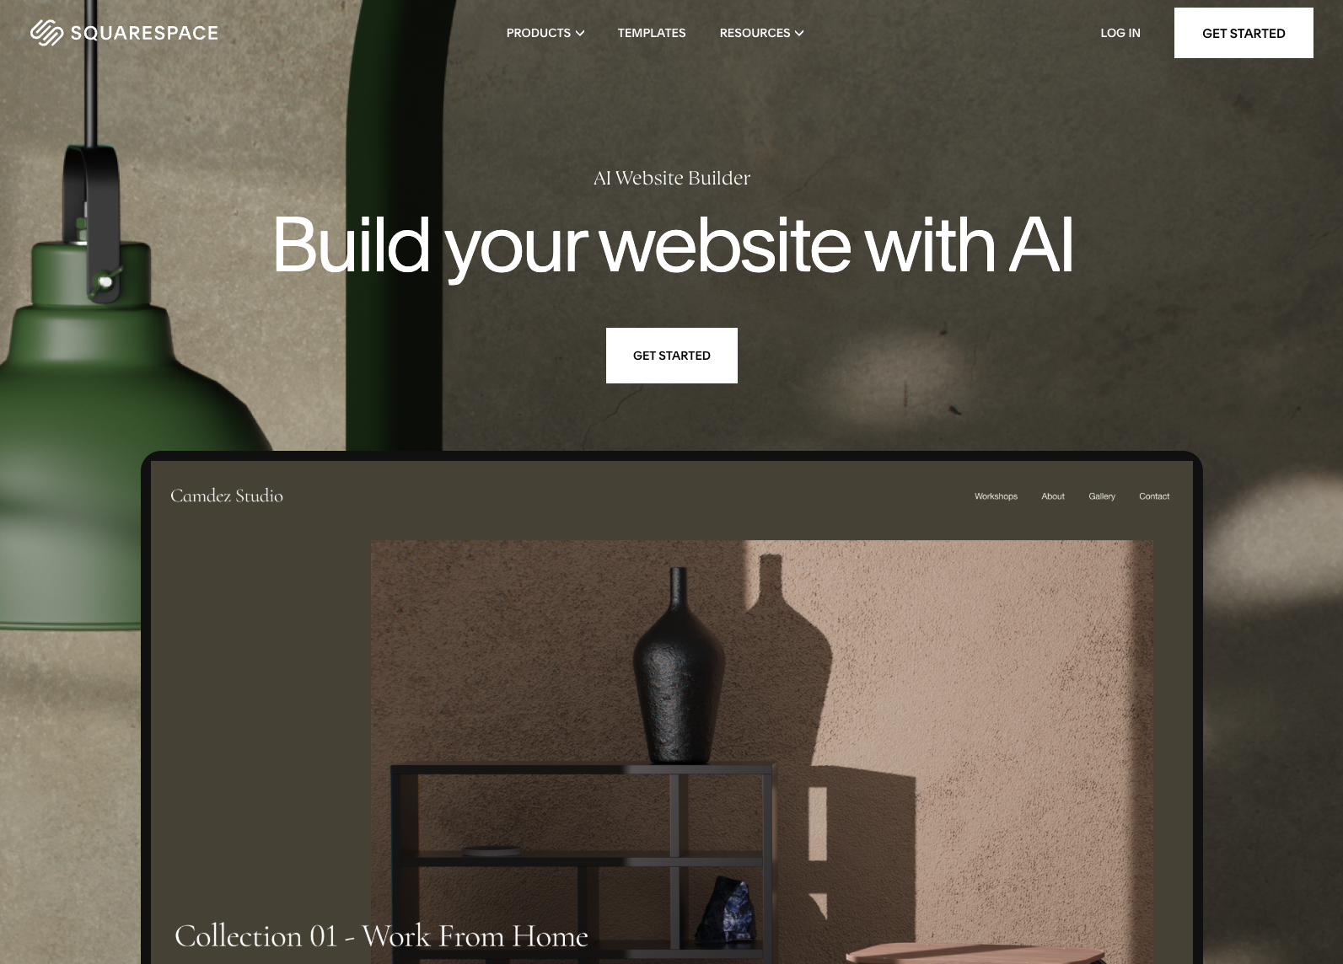

Slide 64
* Original Sept. 2023 Slide
What happens when GoDaddy (or Squarespace, or Web.com) adds the prompt and submit button to generate an entire website in a matter of seconds?

Slide 65
* Updated Nov. 2024 Slide
What happens when our users expect our CMS to be like GoDaddy (or Squarespace, or Web.com) and they can hit a button to generate an entire website in a matter of seconds?

Slide 66
Marty...
it's time to head to the future.

Slide 67
More Future Implications and Questions
Shift in skill requirements in content creation positions
Quality assurance adheres to standards, accuracy, and removing biases
Evolving roles of web designers and SEO
How ALL of this interacts with Google (and if they still want to drive traffic to sites)

Slide 68
Further Discussion and Questions

