Slide 1
Chapter 7
Energy
Energy and persistence conquer all things. -Benjamin Franklin

Slide 2
What are the different types of Energy?
Mechanical Energy
Kinetic Energy
Mechanical Potential Energy
Electrical Energy
Electrical Potential Energy
Thermal Energy
Chemical Potential Energy
Mass Energy
Electromagnetic Energy
Nuclear Energy
Sound Energy

Slide 3
So what really is Energy?
Energy is present throughout the universe in different forms . Every physical process somehow involves energy. Energy can be transferred but can not be created or destroyed (Conservation of Energy).
Ex. When you turn on the TV, we transform electrical energy into sound, light, and heat energy

Slide 4
One of the most basic forms of energy is Mechanical Energy, or work.
What is work?
Mechanical Energy applied through a force
F
F_{N}
M
Δx
θ
F

Slide 5
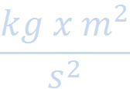
In order to determine how much work is done on the block we will use this equation:
W = abs(F Δx)
Note: When the absolute value of a vector is multiplied by a number, we get a scalar number
Note: The unit for work is Newton x meter or
This is also the unit for Energy (J)

Slide 6
The trick to make vector calculations easier:
In order to obtain a scalar product, two vectors are multiplied. This process is called the Dot Product.
Instead of using an x to multiply we use a dot
Ex. A B = C (C= scalar number)
abs(A B) = C
Commutative Associative
C (A B) = CA B A ( B + C) = AB + AC
= A CB

Slide 7
So what is the θ of a vector multiplied by a perpendicular vector? Zero
( A A) = abs(A) abs(A) = abs(A²)
( A B) → when A and B are perpendicular to each other they equal zero
In order to observe this they have to be broken down into their components:
A → (a_{x}i, a_{y}j, a_{z}k)
B → (b_{x}i, b_{y}j, b_{z}k)

Slide 8
We can observe this property of Dot Products by taking the equation in component form:
A · B = (a_{x}x, a_{y}y, a_{z}z) · (b_{x}x, b_{y}y, b_{z}z)
=a_{x}b_{x}(x·x) + a_{y}b_{y}(y·y) + a_{z}b_{z}(z·z) + a_{x}b_{y}(x·y) + a_{x}b_{z}(x·z) + a_{y}b_{z}(y·z)
+ a_{y}b_{x}(y·x) + a_{z}b_{x}(z·x) + a_{z}b_{y}(z·y)

Slide 9
So the parallel parts can be multiplied by the perpendicular parts will equal zero. We can observe this with the Dot Product equation:
A B = (a_{x}x, a_{y}y, a_{z}z) (b_{x}x, b_{y}y, b_{z}z)
=a_{x}b_{x}xx + a_{y}b_{y}yy + a_{z}b_{z}zz + a_{x}b_{y}xy + a_{x}b_{z}xz + a_{y}b_{z}yz
+ a_{y}b_{x}yx + a_{z}b_{x}zx + a_{z}b_{y}zy
=a_{x}b_{x}xx + a_{y}b_{y}yy + a_{z}b_{z}zz
=a_{x}b_{x} + a_{y}b_{y} + a_{z}b_{z} = A B

Slide 10
So when should I use a certain equation?
If you have the length of a Vector and θ use:
Abs( A B) = A B
If you do not have θ use:
(a_{x}b_{x} + a_{y}b_{y} + a_{z}b_{z})

Slide 11
An example:
Given: F = 40 N West, Δx = 5m 30° NW
What equation would you use and solve?

Slide 12
An example:
Given: F = 40 N West, Δx = 5m 30° NW
We know: W = F Δx
(40N)(5m) cos30 = 173 N m

Slide 13
An example:
Given: F = (10 Ni, 5 Nj, 2 Nk)
Δx = (2 mi, -6 mj, -4 mk)
What equation would you use and solve.

Slide 14
An example:
Given: F = (10 Ni, 5 Nj, 2 Nk)
Δx = (2 mi, -6 mj, -4 mk)
F Δx = (10N x 2m) + (5N x -6m) + (2N x -4m)
= -18 J
So what does it mean when the energy is +/-?
… it tells you whether the object gave or received energy from the force…

Slide 15
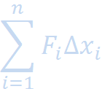
Using these equations requires a constant force, so what if the force isn’t constant?
Split them into sums… and an integral if needed.
W=

Slide 16
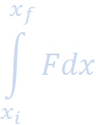
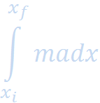
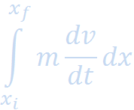
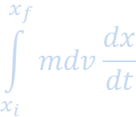
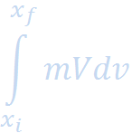
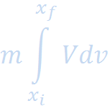
How much work is required to move an object at rest?
= = = =
= = ½ m v²

Slide 17
We know for an object that is in motion, that is called kinetic energy. We can use part of the equation previously used to obtain the equation for KE
KE =

Slide 18
Something that needs to be understood is that mechanical energy is not proportional to speed
Ex. Cars on a highway
40 mph 30 mph
The relative speed would be 10 mph because they are going in the same direction
So KE = ½ m (10)²

Slide 19
What if the cars had a head on collision?
40 mph 30 mph
The KE = ½ m (70)²
What if a car hits a person going 60 mph?
The KE = ½ m (60) ²

Slide 20
Another form of Energy: Potential (Gravitational) Energy
=
=
=
mg x vertical = mgh
So if an object is falling? The object is gaining Kinetic Energy and loosing potential energy
Note: this is an example of transferring energy from one form to another…

