Slide 1
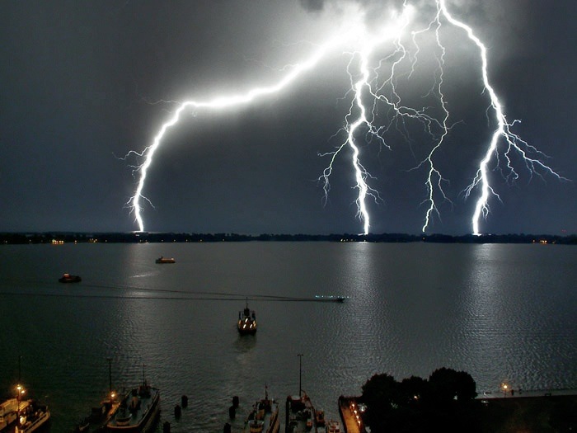
Electric Field
Physics 2212

Slide 2
Chapter 23
Properties of Electric Charges
Charging Objects by Induction
Coulomb’s Law
The Electric Field
Electric Field of continuous Charge distribution
Electric Field Lines
Motion of a charge particle in a uniform electric field

Slide 3
Charge Properties
Positive (+)
Negative (-)
Neutral (0)
Charges of the same sign repel
Charges of opposite sign attract

Slide 4
Electric Charge
The total electric charge of the universe is a constant:
  Electric charge is conserved
  Electric charge is quantized
  When an atom loses electron it becomes positively charged – Positive Ion
  An atom that has gained an electron is now negatively charge – negative ion

Slide 5
Electric Charge
All elections have the same charge
  In a cloud surrounding the nucleus
Charge on Proton has the same magnitude with opposite sign
  Proton charge is in inside the Nucleus

Slide 6
Charging objects by Induction
Conductors : Materials in which some of the electrons are free electrons that are not bound to individual atoms and can move relatively freely through the material. Most metals are conductors.
Insulators are materials in which electrons are bound to individual atoms and cannot move freely through the material. Most insulators are non-metals.

Slide 7
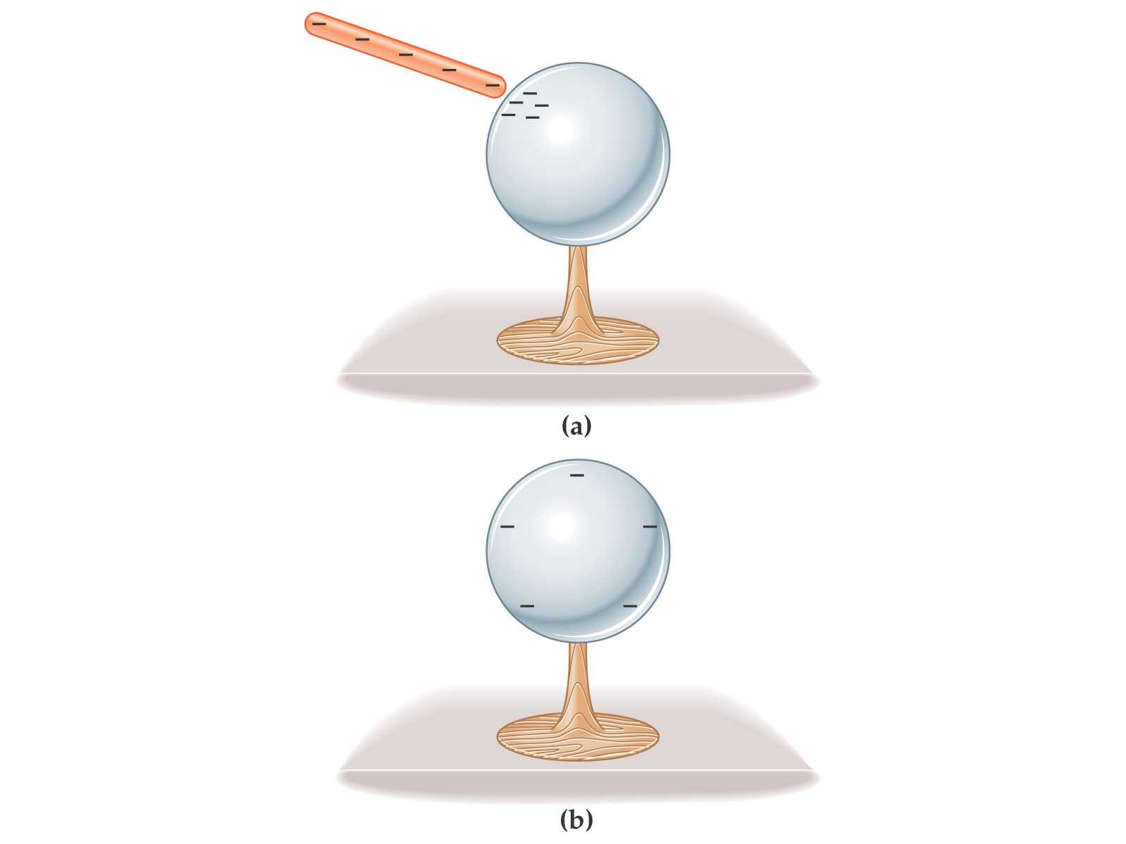
Insulators and Conductors
When conductors carry excess charge, the excess is distributed over the surface of the conductor.
Insulators do not allow the movement of charge.
Semiconductors allow movement of charge in some cases but not others.

Slide 8
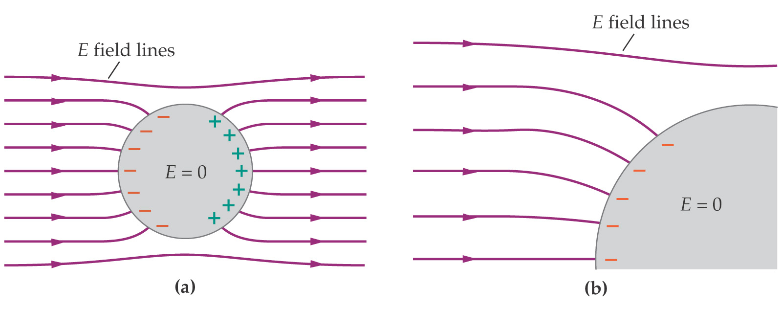
Charging by Induction
Electric Charges are at rest when the electric field within a conductor is zero.
The electric field is always perpendicular to the surface of a conductor – if it were not, the charges would move along the surface.

Slide 9
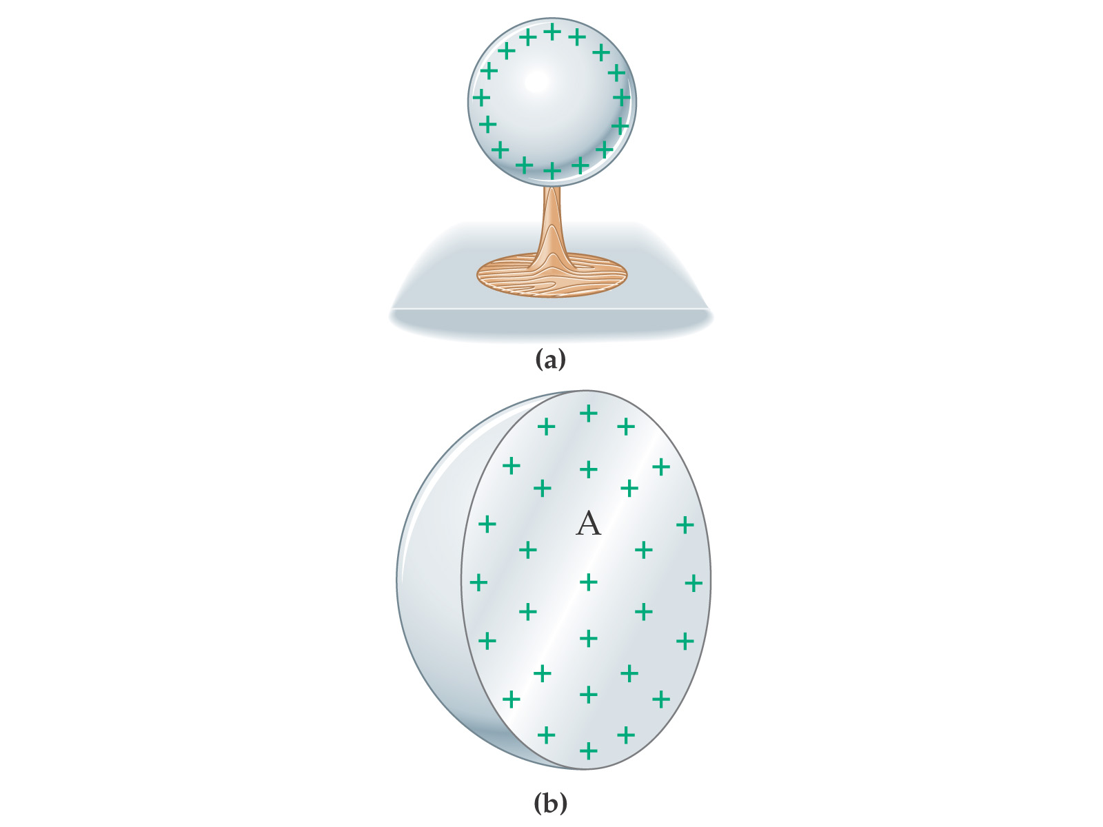
Charging by Induction
Excess charge on a conductor is free to move, the charges will move so that they are a far apart as possible. The excess charge on a conductor will reside on the surface.

Slide 10
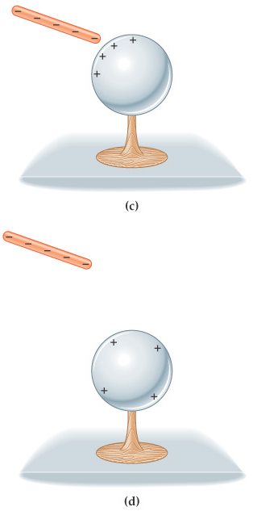
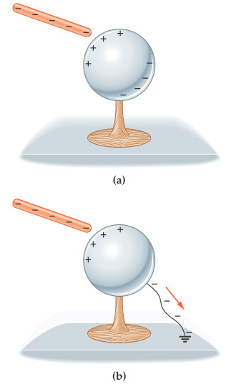
Charging by Induction
Conductor must be grounded
Charges leave the conductor if conductor isolated by the rod is removed, only the excess charge remains

Slide 11
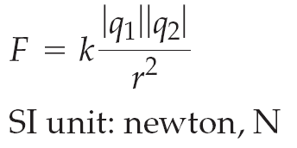
Coulomb’s Law
Coulombs Law states that the electric force exerted by a point charge q1 on a second charge q2 is
r^₁₂
Where r is the distance between two charges and r^₁₂ is a unit vector directed form q₁ toward q₂.

Slide 12
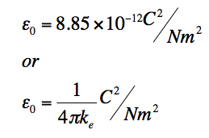
Coulomb’s Law Continued
Coulomb constant
  k_{e} = 8.99 x 10⁹ N•m²/C²
  K_{e} = 1/4πε₀
Permittivity of free space
  ε₀ = 8.8542 x 10⁻¹² C²/N•m²
Electric Force

Slide 13
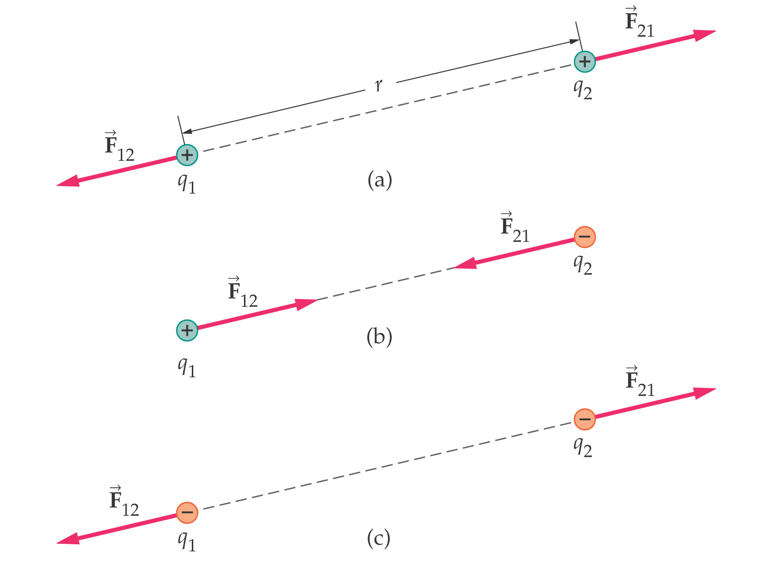
Coulomb’s Law
Force on the two charges are action-reaction forces

Slide 14
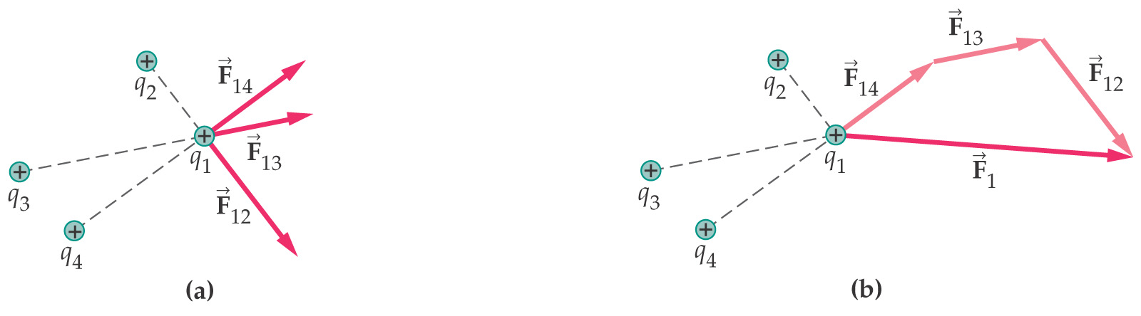
Coulomb’s Law
In the case of multiple point charges the forces add by superposition; in general you must break vectors into their components to add the forces.

Slide 15
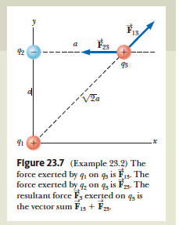
Find the Resultant Force
Consider three point charges located at the corners of a right triangle, where q₁= q₃ =5.00 μC, q₂ = 22.00 μC, and a=0.100 m. Find the resultant force exerted on q_{3.}

Slide 16
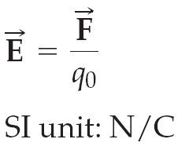
Electric Field
The Electric field E at some point in space is defined as the electric force F_{e} that acts on a small positive charge placed at that point. The field is the force experience by the charge divided by the magnitude of the test charge q₀

Slide 17
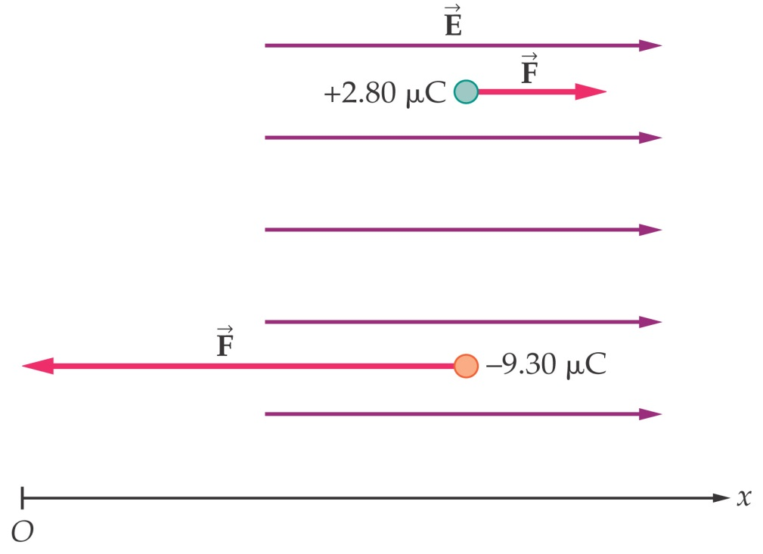
Electric Fields
Force on charge
The direction of the force depends on the sign of the charge – in the direction of the field for a positive charge, opposite to it for a negative one.

Slide 18

Charge distributions
The electric field at some point near to a continuous charge distribution can be calculated as the sum (or integral) of the field from each piece of the distribution.

Slide 19

Electric Field of a continuous charge distribution
Volume Charge density
  ρ≡Q/V
Surface Charge density
  σ=Q/A
Linear Charge Density
  λ=Q/l

Slide 20
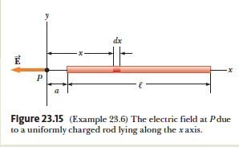
Electric Field Due to Charged Rod
A rod of length L has a uniform positive charge per unit length λ and a total charge Q. Calculate the electric field at a point P that is located along the long axis of the rod and a distance a from one end.

Slide 21
Electric Field Lines
Rules:
The lines must begin on a positive charge and terminate on a negative charge. In the case of an excess of one type of charge, some lines will begin or end infinitely far away.
The number of lines drawn leaving a positive charge or approaching a negative charge is proportional to the magnitude of the charge.
No two field lines can cross.
Field lines are more dense where the field is stronger

Slide 22
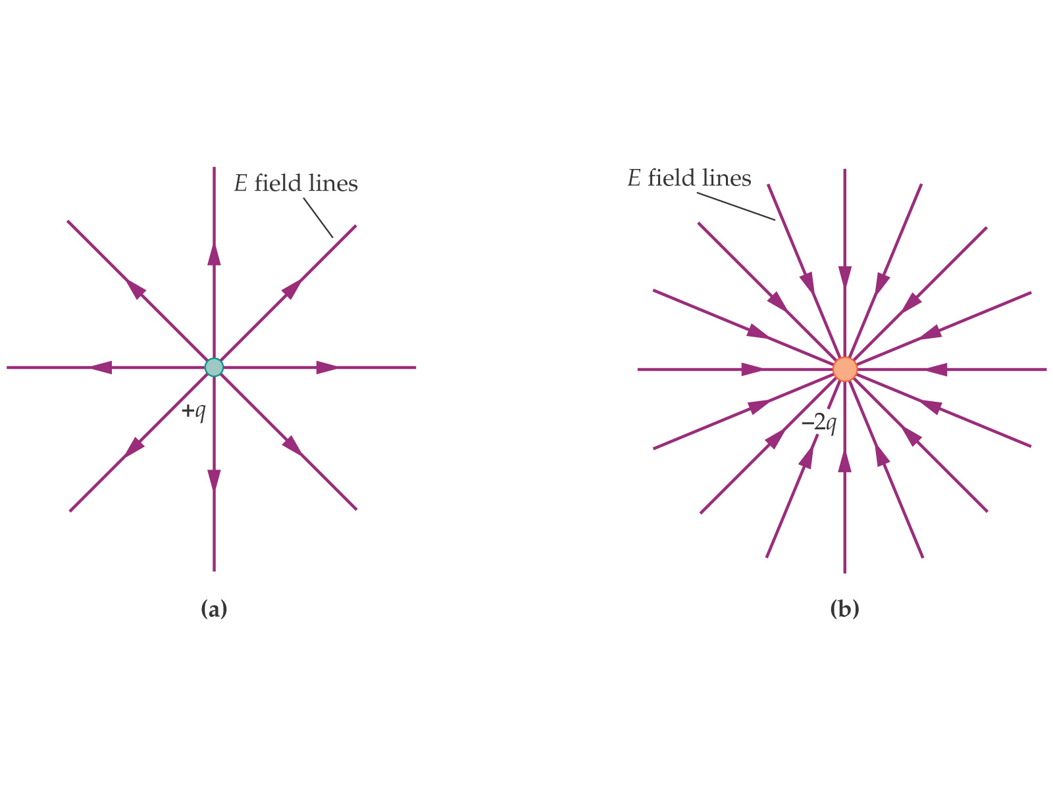
Electric Field Lines
Positive Point Charge field lines are outward
Negative Point Charge field lines are inward

Slide 23
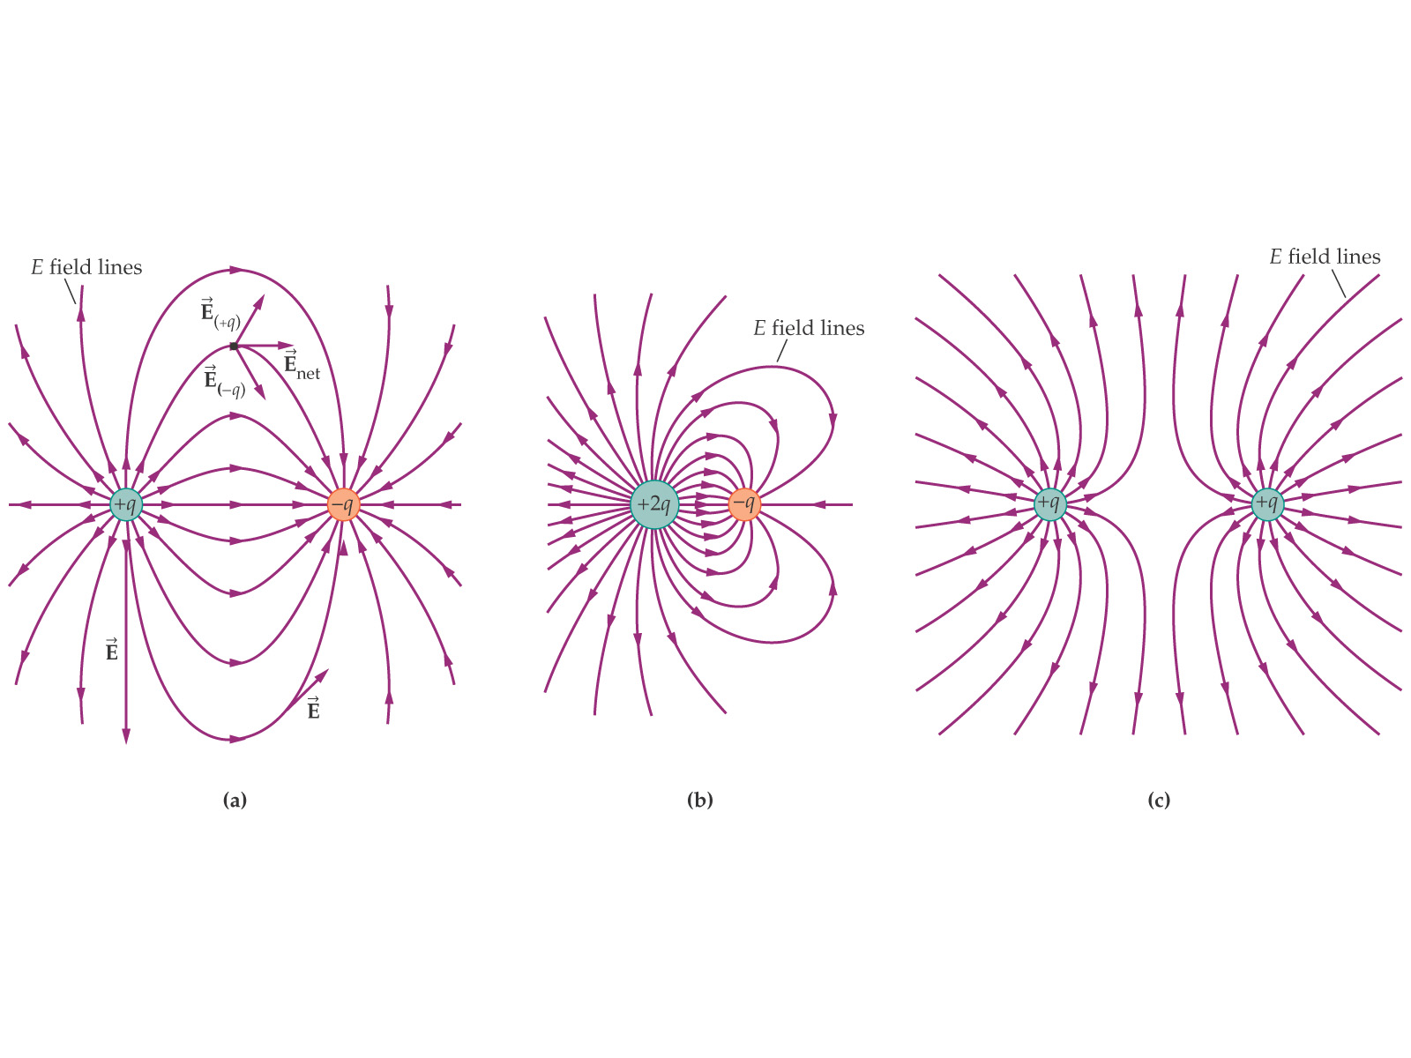

Slide 24
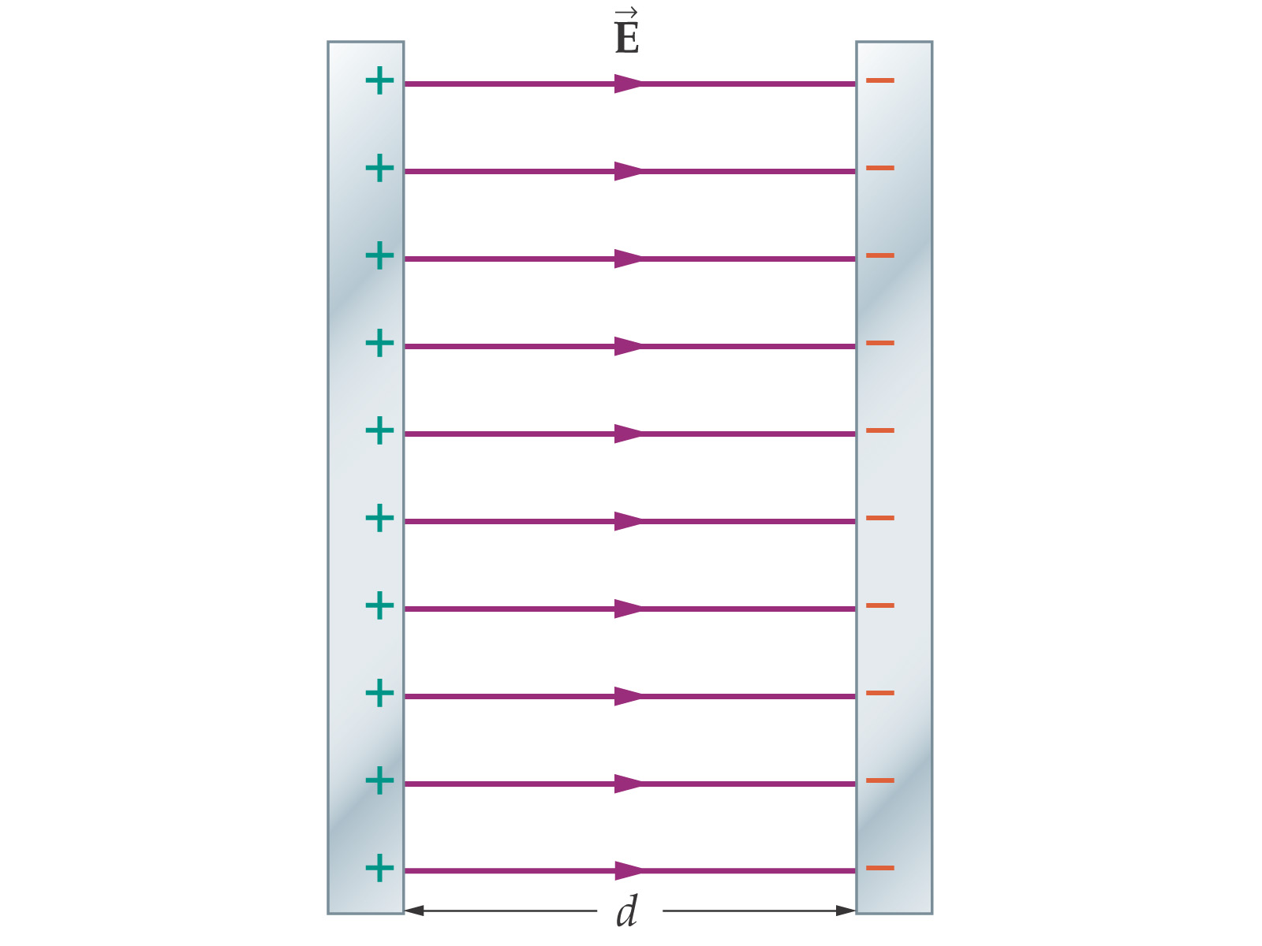
Electric Field Lines
A parallel-plate capacitor consists of two conducting plates with equal and opposite charges

Slide 25
Motion of charge Particle Uniform Electric Field
  Acceleration according to the particle under a net force model:
F_{e} = qE = ma
  F_{e} and a are vectors
Acceleration of a particle
a =qE/M
  a is vector

Slide 26
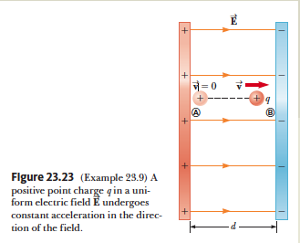
An Accelerating Positive Charge
A uniform electric field E is directed along the x axis between parallel plates of charge separated by a distance d as shown in. A positive point charge q of mass m is released from rest at a point A next to the positive plate and accelerates to a point B next to the negative plate.
Find the speed of the particle at B by modeling it as a particle under constant acceleration.

