Slide 1
The Maxwell Equations
And the fun stuff you can do with them

Slide 2
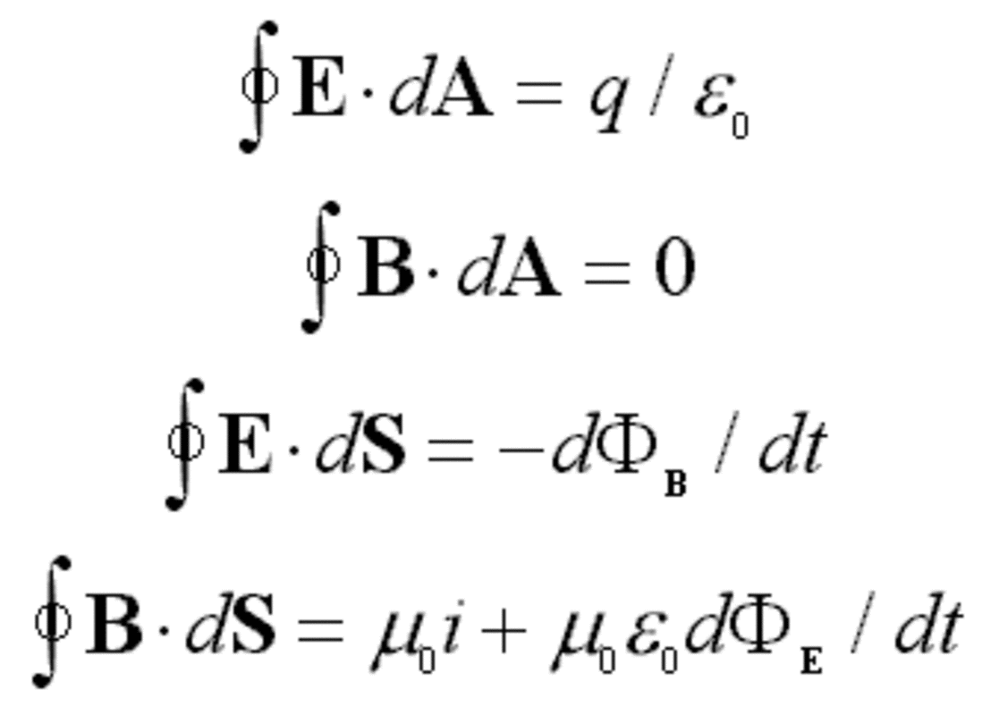
So we have these 4 Equations:

Slide 3
Implications:
→Electric and magnetic fields are intimately connected
→Electromagnetic Waves

Slide 6
Other way gives

Slide 9
OR

Slide 10
OR C= The Speed of Light

Slide 11
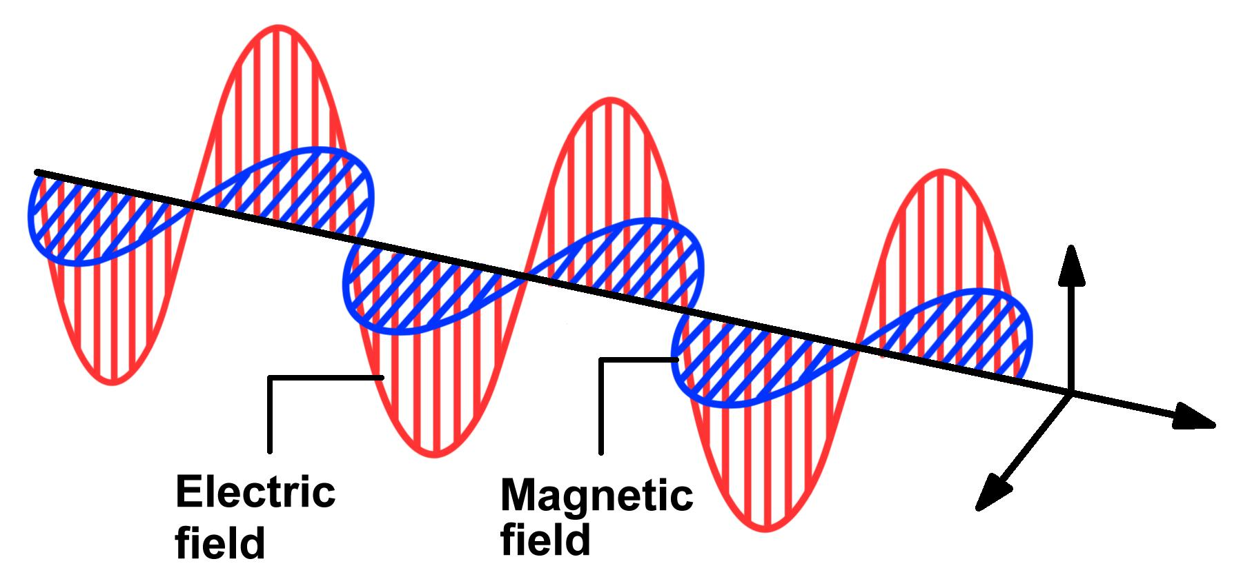
Electromagnetic Rays

Slide 12
Right Hand Rule:

