Slide 1
LM 10. Wireless Security Audit
IT4833 Dr. Lei Li

Slide 2
Learning Objectives
After this module, student will be able to:
Explain what is security audit
Identify the types of security audit
Discuss the best practices for security audit
Discuss the purpose of security audit
Discuss the tools used for security audit

Slide 3
Security Audit
Systematic evaluation of the security
Identify security problems and gaps, as well as system weaknesses
Establish a security baseline that future audits can be compared with
Comply with internal organization security policies
Comply with external regulatory requirements
Determine if security training is adequate
Identify unnecessary resources

Slide 4
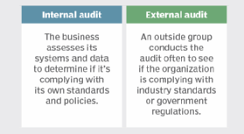
Types of Security Audit
Image source: https://searchcio.techtarget.com/definition/security-audit

Slide 5
Systems an Audit Cover
Network vulnerabilities
Security controls
Encryption
Software systems
Architecture management capabilities
Telecommunications controls
Systems development audit
Information processing

Slide 6
Steps Involved in a Security Audit
Agree on goals
Define the scope of the audit
Conduct the audit and identify threats
Evaluate security and risks
Determine the needed controls

Slide 7
Test vs. Assessment vs. Audit
An audit – validation
Test – check a specific system
Assessment – a planned test

Slide 8
Wireless Security Audit
Layer 1 Audit
Layer 2 Audit
WLAN Security Audit
Wired Infrastructure Audit
Social Engineering Audit
Wireless Intrusion Prevention System (WIPS) Audit

Slide 9
Layer 1 & 2 Auditing Tool
Layer 1 Audit – determine RF coverage
Layer 2 Audit – detect rogue device
Tools
Protocol sniffers/analyzers (ex. Wireshark)
2.4/5 GHz signal injectors.
Offensive tools (mdk3, Void11, Bugtraq, IKEcrack, FakeAP, etc.)

Slide 10
WLAN Security Audit Tool
How a WLAN may be compromised
Protocol sniffers/analyzers (ex. Wireshark).
Wireless discovery tools (ex. NetStumbler, Kismet, Win Sniffer, WiFiFoFum, etc.).
Encryption/Authentication breaking (testing) tools (aircrack-ng, custom scripts, all kinds of cryptoanalysis tools).

Slide 11
Wired Infrastructure Audit
Inspection of the firewall used to restrict WLAN user access to certain network resources.
Switchport interfaces that are unused should be disabled.
A strong password should be used, and protocols with built-in encryption should be used (HTTPS, SSH), if possible.

Slide 12
Social Engineering Audit
Uses non-technical approaches
Security awareness campaigns

Slide 13
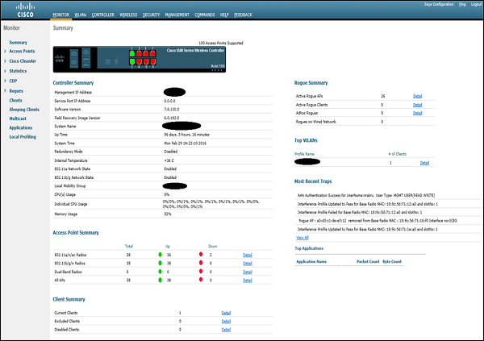
Wireless Intrusion Prevention Systems
Detecting and preventing the usage of unauthorized wireless devices
A set of dedicated passive sensors
Image source: https://www.tutorialspoint.com/wireless_security/wireless_security_tools.htm

Slide 14
References
https://searchsecurity.techtarget.com/IT-security-auditing-Best-practices-for-conducting-audits
https://www.tutorialspoint.com/wireless_security/wireless_security_tools.htm

