Slide 1
LM 7. Mobile Network Overview
Dr. Lei Li

Slide 2
Road Map
Introduction
WLAN
Security
Mobile
Security
Security Auditing & Risk Analysis
Evolution of Wireless Network
WLAN
Overview
Mobile Network
Overview
Infor. Security
Essentials
WLAN Threats
& Vulnerabilities
Cellular Network
Security
WLAN
Security
Mobile Security
Threats
WLAN
Security Tools
Mobile Devices
Security

Slide 3
Learning Outcomes
After this module, a student will be able to:
Describe the basics of cellular network.
Discuss the evolution of cellular network
Describe 2G, 3G, and 4G cellular network architecture
Discuss mobile IP

Slide 4
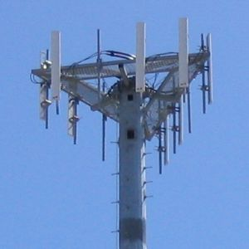
Cellular Network
Also called mobile network
Cellular radio system
  Divide a land area into cells
  Frequency reuse
Mobile device & base station

Slide 5
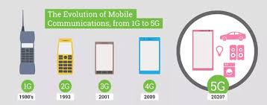
Evolution of Cellular Network
Image source:https://www.quora.com/What-are-the-differences-between-1G-2G-3G-4G-and-5G

Slide 6
1G
Introduced around 1980’s
Analogous techniques
Advanced mobile phone system (AMPS)
Only for voice communication

Slide 7
2G
1990s
Digital network
GSM/CDMA/Edge
Enhanced spectrum efficiency
Better data service
  Text messaging
  Web browing
Roaming between different networks

Slide 8
3G
2005
Digital network
UMTS
Features – universal calling, video calling

Slide 9
4G -LTE
2011
Supporting high speed and high number of users
HD video streaming
Worldwide roaming

Slide 10
5G
Currently under development
Faster data rate
Higher connection density
Lower latency

Slide 11
Comparison of 1G-4G

Slide 12
2G Architecture

Slide 13
3G Architecture

Slide 14
4G LTE Architecture

Slide 15
Mobile IP
Allow mobile device to move from one network to another while maintaining permanent IP address
Mobile IPv4, Mobile IPv6.
Seamless and continuous Internet connectivity.

Slide 16
Reference
https://en.wikipedia.org/wiki/Cellular_network
https://www.google.com/url?sa=t&rct=j&q=&esrc=s&source=web&cd=12&ved=0ahUKEwizqvSLws7ZAhXiwVQKHR6SDI0QFghpMAs&url=https%3A%2F%2Fedupediapublications.org%2Fjournals%2FIJR%2Farticle%2Fdownload%2F2521%2F2416&usg=AOvVaw2L_BSCuGBIXmTVN2C7JRl9
https://en.wikipedia.org/wiki/Mobile_IP

