Slide 1
LM 10. Mobile Device Security
IT4833/6833
Dr. Lei Li
Note: The content of this slides are adapted from La Polla et. al, 2013

Slide 2
Learning Objectives
After this module, student will be able to:
  Describe the Google Android security architecture
  Discuss Android security challenges
  Discuss the exploitation tools for Android
  Describe Apple iOS security architecture
  Discuss iOS security challenge
  Discuss BYOD and its security implication

Slide 3
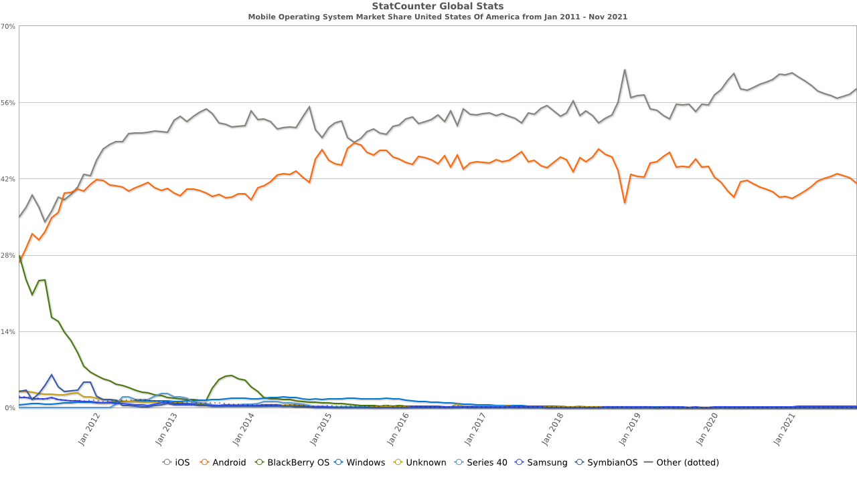
Mobile OS Market Share
Data & image source: https://gs.statcounter.com/os-market-share/mobile/united-states-of-america/#monthly-201101-202111

Slide 4
Android Framework
Image source: https://source.android.com/security/

Slide 5
Android Security Program
Design review
Penetration testing and code review
Open source and community review
Incident Response
Monthly security updates

Slide 6
Android Platform Security Architecture
Robust security at the OS level through the Linux kernel
Mandatory application sandbox for all applications
Secure interprocess communication
Application signing
Application-defined and user-granted permissions

Slide 7
Android Security Challenge
Fragmentation
Malware
Management tool selection
User behavior
Compartmentalization

Slide 8
Android Exploitation Tools
Android SDK
AdroRAT
Android framework for exploitation

Slide 9
Apple iOS Security Architecture
Image source: https://www.apple.com/business/docs/iOS_Security_Guide.pdf

Slide 10
iOS Security Features
System security
Encryption and data protection
App security
Network security
Apple Pay
Internet services
Device controls
Privacy controls

Slide 11
iOS Security Challenges
Internal processes and the difficulties of maintaining security on multiple platforms (mobile or otherwise) with a common code base
Slow to offer patches for known vulnerabilities
Patches their own software flaws on different schedules for different platforms
Jailbreak of iOS relies on exploitation of security vulnerabilities

Slide 12
Bring Your Own Device
Devices at work vs. devices for work
Increased employee productivity
Greater employee satisfaction
Security measures to mitigate the risk involved

Slide 13
BYOD Security Policy
Essential policies
  Acceptable use
  Minimum required security controls for devices
  Company-provided components
  Company rights for altering the device
Specifying the permissible device types and establishing a stringent security policy
Outlining ownership of the apps and data
Employee exit
Disclosing risks, labilities, and disclaimers

Slide 14
BYOD Security Measures
Encryption for data at rest and in transit
Application installation control
Mobile device management
Containerization
Blacklisting/whitelisting

Slide 15
References
https://source.android.com/security/
https://searchmobilecomputing.techtarget.com/tip/Top-five-Android-device-management-security-challenges
Android SDK: https://developer.android.com/studio/index.html
AndroRAT: https://geekviews.tech/androrat/
Android Framework for Exploitation: http://airodump.net/android-framework-for-exploitation-afe-an-efficient-framework-for-anroid-exploitation/
https://www.apple.com/business/docs/iOS_Security_Guide.pdf
https://tidbits.com/2010/08/09/apples-ios-security-challenges-and-advantages/
https://digitalguardian.com/blog/ultimate-guide-byod-security-overcoming-challenges-creating-effective-policies-and-mitigating

