Slide 1
IT 6823 LM 4 – Information Security Policy & Access Control
Dr. Lei Li

Slide 2
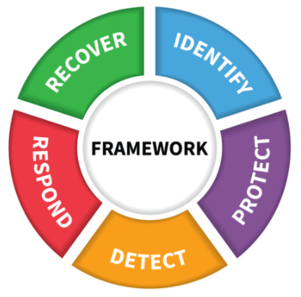
NIST Framework Core
Image source: https://www.nist.gov/document/cybersecurityframeworkv1-1presentationpptx

Slide 3
Learning Outcomes
Define information security policy Explain the risk management process
Explain the main components of information security policy framework
Describe the basics of Bell-LaPadula Model
Discuss different types of access control
Explain ACL and be proficient in changing permission in major OS

Slide 4
Information Security Policy
Aggregate of directives, regulations, rules, and practices that prescribes how an organization manages, protects, and distributes information
Important part of security program

Slide 5
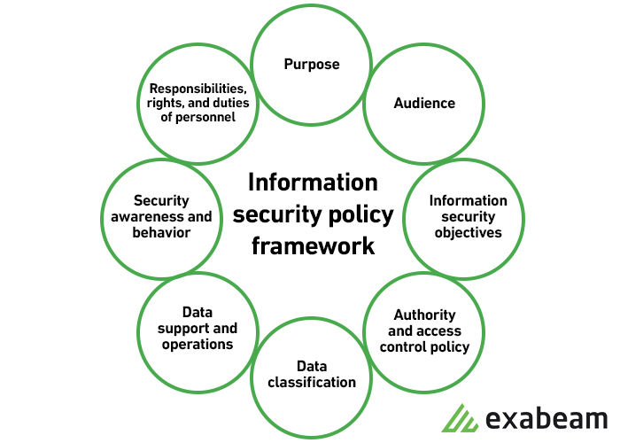
ISP Framework
Image source: https://www.exabeam.com/information-security/information-security-policy/

Slide 6
Purposes of ISP
Create an overall approach to information security.
Detect and preempt information security breaches such as misuse of networks, data, applications, and computer systems.
Maintain the reputation of the organization and uphold ethical and legal responsibilities.
Respect customer rights, including how to react to inquiries and complaints about non-compliance.

Slide 7
ISP Audience & Objectives
Whom the information security policy applies
Objectives
Confidentiality
Integrity
Availability

Slide 8
Data classification
Top secret
Secret
Confidential
Public

Slide 9
Other Elements
Authority and access control policy
Data support and operations
Security awareness and behavior
Responsibilities, rights, and duties of personnel

Slide 10
ISP Examples
Acceptable use policy
Access control policy
Incident response policy
Email/communication policy
More examples: https://www.csoonline.com/article/3263738/9-policies-and-procedures-you-need-to-know-about-if-youre-starting-a-new-security-program.html

Slide 11
Access Control
Discretionary Access Control (DAC)
Mandatory access control (MAC)
Role-Based Access Control (RBAC)
Rule-Based Access Control

Slide 12
Bell-LaPadula Model
One of principal foundations for authentication
Focus on confidentiality
Access Matrix
s = subject
o = object and
a = access rights associated with the subject.

Slide 13
Access Privileges
Read-Only
Append
Execute
Read-Write

Slide 14
Restrictions
Reading down
Write up
Image source: https%3A%2F%2Fwww.cs.utexas.edu%2F~byoung%2Fcs361%2Fslides2-policy-4up.pdf

Slide 15
Access Control List
A list of permissions associated with an object
Filesystem ACLs
Active Directory ACLs
Networking ACLs

Slide 16
Example of ACL Table
Image source: https://www.dokuwiki.org/acl

Slide 17
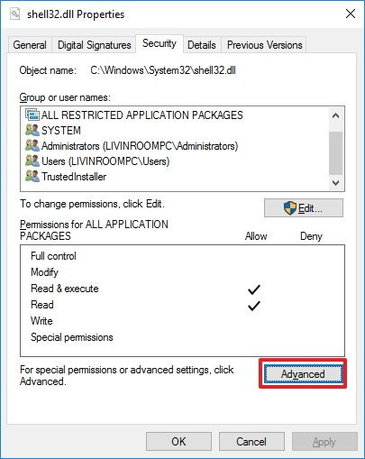
Change File Permission in Windows 10

Slide 18
Change File Permission in Windows 10
Command line utility – Icacls
Set, backup and restore ACL
Example: $> icacls "E:\Study2018" /t /grant:F

Slide 19
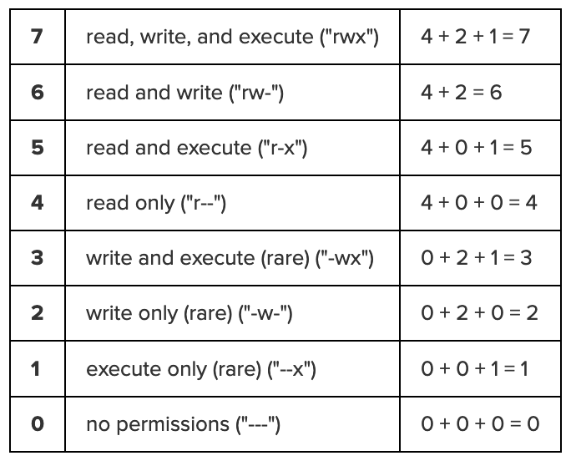
File Permission Numeric Table -Unix
Chmod

