Slide 1
LM11 Cloud Threats & Vulnerabilities
Dr. Liang Zhao

Slide 2
Road Map
Introduction
WLAN
Security
Mobile
Security
Security Auditing & Risk Analysis
Evolution of Wireless Network
WLAN
Overview
Mobile Network
Overview (optional)
Evolution of Cloud
Infor. Security
Essentials
WLAN Threats
& Vulnerabilities
Cellular Network
Security (optional)
Confidentiality and Integrity of Cloud
WLAN
Security
Mobile Security
Threats
Cloud Threats & Vulnerabilities
WLAN
Security Tools
Mobile Devices
Security (optional)
Cloud Security

Slide 3
Outline
Threats & Vulnerabilities in moving to the cloud
Threat modeling
Mitigating Cloud Vulnerabilities

Slide 4
Threats & Vulnerabilities
Threat is harm or unauthorized access that might occur due to vulnerability and destroy organization assets, organization operations or system information
Vulnerability is any weakness in information system, system security procedures, internal controls or implementation that could be exploited or triggered by a threat resources
The most significant threats that are related to the on-demand nature of cloud

Slide 5
Threats
Data lose or leakage (T1)
Account or service hijacking (T2)
Insecure interface (T3)
Denial of service (T4)
Malicious insider (T5)
Data breaches (T6)
Abuse of cloud services (T7)
Insufficient due diligence (T8)
Insecure VM migration (T9)

Slide 6
Vulnerabilities
Session riding (V1)
Virtual machine escape (V2)
Obsolete cryptography (V3)
Unauthorized access to management interface (V4)
Internet protocol (V5)
Data recovery (V6)
Metering and billing (V7)
Vendor lock-in (V8)

Slide 7
Threat modeling
Practical threat analysis: The Practical Threat Analysis (PTA) proposed a model to identify system vulnerabilities, map system assets, assess the risk of the threats and define an effective risk mitigation plan for a specific system architecture, functionality and configuration
Identifying assets and their financial values is done in the first step.
The second step represents system’s vulnerabilities on the base of architecture, functionality and different type of users. The effect of cost is calculated on the base of implementation cost.
In the last step, threat scenario has been built to identify various threat and level of damage.

Slide 8
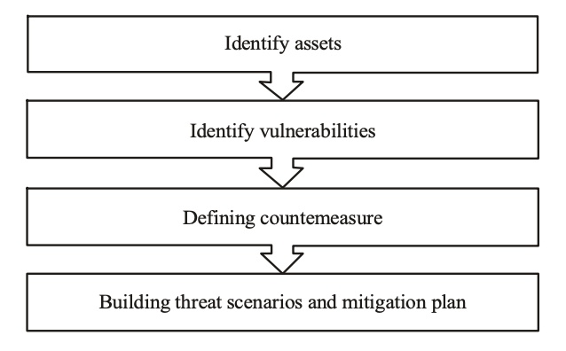
Threat modeling: PTA

Slide 9
Threat modeling
Threat modeling in pervasive computing paradigm: By cloud computing as an on-demand service, each user has multi identifies for different security domain so implementing security schema is a big challenge for cloud computing.
This model presented as a new threat modeling to incorporate the problem of pervasive computing environment
In the first step all user’s roles need to be established with their service usage and authentication mechanisms.
Identifying security domains that is mentioned in step two, presents the way that user interacts with applications inside the domain.
Various type of user same as authorized user, admin and unregistered user have different trust levels. Identifying trust level in the third level, assists user to access the resources depending upon its trust level

Slide 10
Threat modeling
In the next step, all vulnerabilities need to be detected. Known vulnerabilities can be eliminated and unknown vulnerabilities should be considered to protect system from harm attacks.
Risk evaluation as a fourth step, presents fair idea to avoid computing environment from threats.
Threats have been qualified on the base of cost expectancy that is involved restoration and replacement costs.
In the last step, new vulnerabilities and threats have been identified and post them to forth step for keeping system secure.

Slide 11
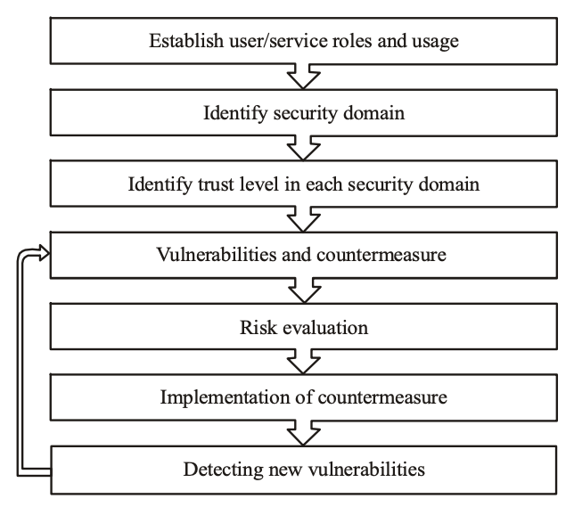
Threat modeling in pervasive computing paradigm

Slide 12
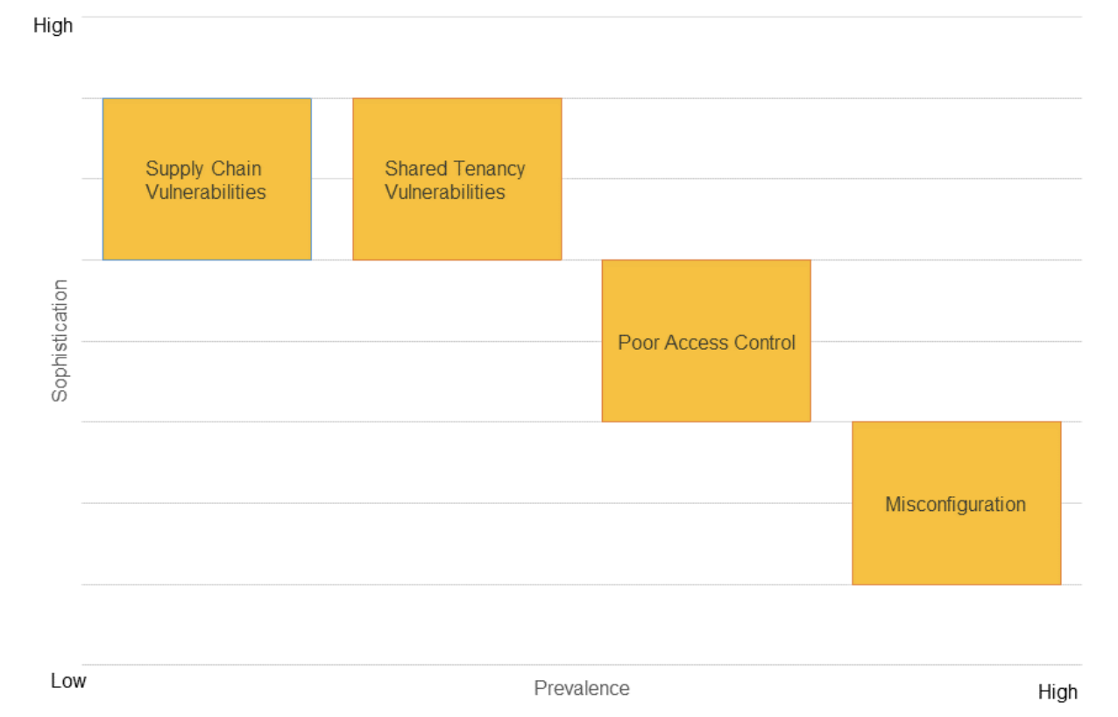
Mitigating Cloud Vulnerabilities

Slide 13
Mitigating Cloud Vulnerabilities
Misconfiguration
the most prevalent cloud vulnerability and can be exploited to access cloud data and services.
For organizations to enforce least privilege, administrators should:
Use cloud service policies to prevent users from sharing data publicly without a mission-justified role;
Use cloud or third-party tools to detect misconfigurations in cloud service policies;
Audit access logs with automated tools to identify overly-exposed data;
Restrict sensitive data to approved storage and use Data Loss Prevention solutions to enforce these restrictions.

Slide 14
Mitigating Cloud Vulnerabilities
Poor Access Control
occurs when cloud resources use weak authentication/authorization methods or include vulnerabilities that bypass these methods.
Poor access control can be mitigated by enforcing strong authentication and authorization protocols.
Use multi-factor authentication with strong factors and require regular re-authentication;
Use automated tools to audit access logs for security concerns;
Where possible, enforce multi-factor authentication for password resets;
Do not include API keys in software version control systems where they can be unintentionally leaked.

Slide 15
Mitigating Cloud Vulnerabilities
Shared Tenancy Vulnerabilities
Adversaries who are able to determine the software or hardware used in a cloud architecture could take advantage of vulnerabilities to elevate privileges in the cloud. Vulnerabilities in cloud hypervisors (i.e., the software/hardware that enables virtualization) or container platforms are especially severe due to the critical role these technologies play in securing cloud architectures and isolating customer workloads.

Slide 16
Mitigating Cloud Vulnerabilities
Mitigations for shared tenancy vulnerabilities involve separating organizational resources from other cloud tenants using mechanisms provided by the Cloud Service Provider (CSP)
Enforce encryption of data at rest and in transit with strong encryption methods and properly configured, managed and monitored key management systems;
For especially sensitive workloads, use dedicated, whole-unit, or bare-metal instances, reducing the risk of an adversary collocating and exploiting a hypervisor vulnerability to gain access to your resources;
Select cloud offerings that have had critical components evaluated against National Information Assurance Partnership (NIAP) Protection Profiles (PPs), particularly hypervisors that have been evaluated against the NIAP Server Virtualization PP.

Slide 17
References
See the references uploaded in LM11.
Threat Modeling Approaches for Securing Cloud Computing
Mitigating Cloud Vulnerabilities

Slide 18
