Slide 1
LM12 Cloud (Computing) Security
Dr. Liang Zhao

Slide 2
Road Map
Introduction
WLAN
Security
Mobile
Security
Security Auditing & Risk Analysis
Evolution of Wireless Network
WLAN
Overview
Mobile Network
Overview (optional)
Evolution of Cloud
Infor. Security
Essentials
WLAN Threats
& Vulnerabilities
Cellular Network
Security (optional)
Confidentiality and Integrity of Cloud
WLAN
Security
Mobile Security
Threats
Cloud Threats & Vulnerabilities
WLAN
Security Tools
Mobile Devices
Security (optional)
Cloud Security

Slide 3
Outline
Is Cloud Computing Secure?
Security Characteristics
Security Risks
Cloud Security Simplified

Slide 4
Is Cloud Computing Secure?
For most organizations, the journey to cloud is no longer a question of “if” but rather “when”, and a large number of enterprises have already travelled some way down this path.
Is cloud computing secure?
A simple answer is: Yes, if you approach cloud in the right way, with the correct checks and balances to ensure all necessary security and risk management measures are covered.

Slide 5
Is Cloud Computing Secure?
Companies ready to adopt cloud services are right to place security at the top of their agendas.
the consequences of getting your cloud security strategy wrong could not be more serious.
As many unwary businesses have found to their cost in recent high-profile cases, a single cloud-related security breach can result in an organization severely damaging its reputation – or, worse, the entire business being put at risk.

Slide 6
Is Cloud Computing Secure?
Those further along their cloud path are finding that, like all forms of information security, the question boils down to effective risk management.
we outlined the different layers in the cloud services stack:
Infrastructure-as-a-Service (IaaS)
Platform-as-a-Service (PaaS)
Software-as-a-Service (SaaS)
Business Process-as-a-Service (BPaaS).
These layers – and their associated standards, requirements and solutions – are all at different levels of maturity.

Slide 7
Is Cloud Computing Secure?
The world of business is becoming more uncertain, as with new system architectures come new cyber threats. No longer can the mechanisms deployed in the past be relied on for protection”
--Nick Gaines, Group IS Director, Volkswagen UK
Different types of cloud have different security characteristics. The table in next page shows a simple comparison. (The number of stars indicates how suitable each type of cloud is for each area.)
We choose to characterize these types as private, public and community clouds – or “hybrid” to refer to a combination of approaches.

Slide 8
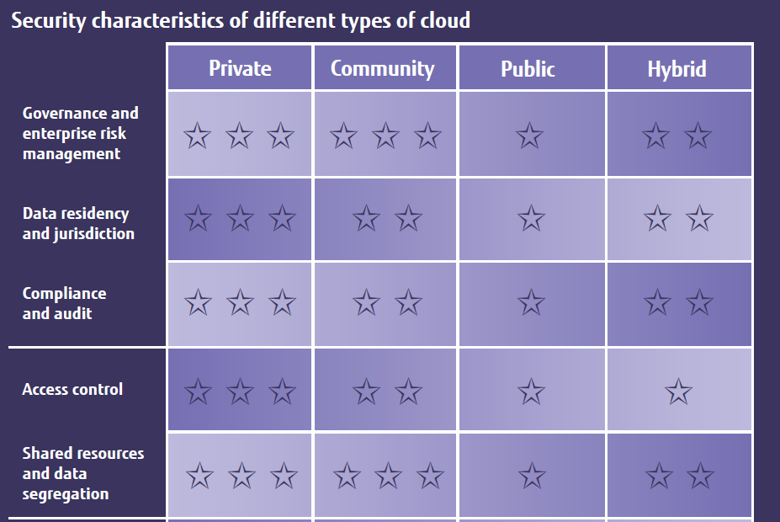
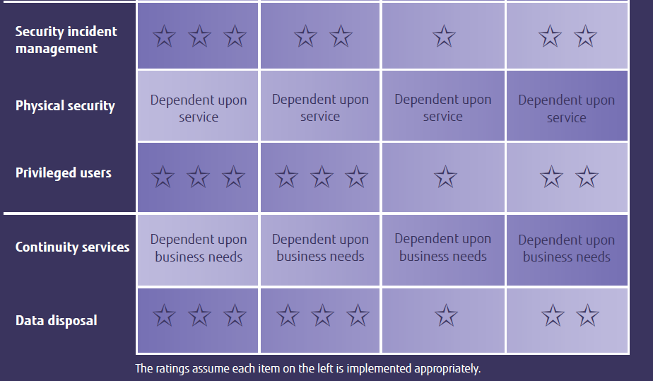
Security Characteristics

Slide 9
Security Risks
Organizations with defined controls for externally sourced services or access to IT risk-assessment capabilities should still apply these to aspects of cloud services where appropriate.
But while many of the security risks of cloud overlap with those of outsourcing and offshoring, there are also differences that organizations need to understand and manage.
“When adopting cloud services, there are four key considerations:
1. Where is my data?
2. How does it integrate?
3. What is my exit strategy?
4. What are the new security issues?”
--Tony Mather, CIO, Clear Channel International

Slide 10
Security Risks
Processing sensitive or business-critical data outside the enterprise introduces a level of risk because any outsourced service bypasses an organization's in-house security controls. With cloud, however, it is possible to establish compatible controls if the provider offers a dedicated service. An organisation should ascertain a provider’s position by asking for information about the control and supervision of privileged administrators.
Organizations using cloud services remain responsible for the security and integrity of their own data, even when it is held by a service provider. Traditional service providers are subject to external audits and security certifications. Cloud providers may not be prepared to undergo the same level of scrutiny.
When an organisation uses a cloud service, it may not know exactly where its data resides or have any ability to influence changes to the location of data.

Slide 11
Security Risks
Most providers store data in a shared environment. Although this may be segregated from other customers’ data while it’s in that environment, it may be combined in backup and archive copies. This could especially be the case in multi-tenanted environments.
Companies should not assume service providers will be able to support electronic discovery, or internal investigations of inappropriate or illegal activity. Cloud services are especially difficult to investigate because logs and data for multiple customers may be either co-located or spread across an ill-defined and changing set of hosts.
Organisations need to evaluate the long-term viability of any cloud provider. They should consider the consequences to service should the provider fail or be acquired, since there will be far fewer readily identifiable assets that can easily be transferred in-house or to another provider.

Slide 12
Cloud Security Simplified
As with all coherent security strategies, cloud security can seem dauntingly complex, involving many different aspects that touch all parts of an organization.
CIOs and their teams need to plot effective management strategies as well as understand the implications for operations and technology.
we outline the key considerations.
Management
Operation
Technology

Slide 13
Cloud Security Simplified
Management
Updated security policy
Cloud security strategy
Cloud security governance
Cloud security processes
Security roles & responsibilities
Cloud security guidelines
Cloud security assessment
Service integration
IT & procurement security requirements
Cloud security management
Notes:
l Updated security policy
Amendments to the organisation’s overarching security policy.
l Cloud security strategy
The organisation’s strategy for security with respect to cloud. This
should complement or be part of the organisation’s existing
overarching security strategy.
l Cloud security governance
The process for ensuring cloud security strategy and policy updates
are adhered to.
l Cloud security processes
The security processes associated specifically with cloud and/or the
amendments required to existing security processes in order to
incorporate cloud.
l Security roles & responsibilities
Who is responsible for what with respect to ensuring the different
elements of cloud security are implemented effectively.
l Cloud security guidelines
Advice and guidance provided to both business and IT teams
regarding all aspects of security that affect them.
l Cloud security assessment
The ability to objectively measure the effectiveness of a given
cloud service provider’s security.
l Service integration
The integration of several cloud services at a management level.
l IT & procurement security requirements
Specific cloud security requirements that would need to be
included in any procurement and/or IT project’s overall
requirements.
l Cloud security management
The overall day-to-day management of cloud security.

Slide 14
Cloud Security Simplified
Operation
Awareness & training
Incident management
Configuration management
Contingency planning
Maintenance
Media protection
Environmental protection
System integrity
Information integrity
Personnel security
Notes:
Operation
l Awareness & training
Educating employees about the security impact of cloud on their
individual functions and roles.
l Incident management
Managing cloud-related problems and incidents.
l Configuration management
Ensuring the configuration of an organisation’s service is
appropriate and secure.
l Contingency planning
A pre-planned approach to business continuity, disaster recovery
and the ongoing management (up and down) of cloud usage.
l Maintenance
The processes ensuring that anything in a cloud environment (or
consumed from a cloud environment) is properly maintained and
up to date.
l Media protection
Ensuring any data stored in a cloud environment is
managed appropriately.
l Environmental protection
Ensuring an organisation’s cloud service provider (and using that
provider rather than internal IT) improves that organisation’s
environmental credentials.
l System integrity
Ensuring all cloud systems remain secure.
l Information integrity
Ensuring all information stored in a cloud environment is secure.
l Personnel security
Ensuring all personnel (both internal staff and employees of the
cloud provider) are trustworthy and do not have the ability to
compromise the service.

Slide 15
Cloud Security Simplified
Technology
Access control
System protection
Identification
Authentication
Cloud security audits
Identity & key management
Physical security protection
Backup, recovery & archive
Core infrastructure protection
Network protection
Notes:
Technology
l Access control
Technology and software (including its configuration) that ensures
the right person has access to the right data (and only the right
data) for them.
l System protection
Technology to protect individual cloud systems from security risks
such as distributed denial-of-service (DDoS) attacks.
l Identification
Technology to identify employees and other authorised personnel
accessing a cloud service.
l Authentication
Technology to verify that an individual accessing a cloud system is
who they claim to be.
l Cloud security audits
The tools and processes by which organisations ensure security
(and associated systems and processes) are adequately
maintained.
l Identity & key management
The management of security keys (e.g. encryption keys, SSL keys)
and identities of the organisation’s personnel.
l Physical security protection
Ensuring a provider has appropriate security controls for access to
its buildings.
l Backup, recovery & archive
The tools and procedures for ensuring that data stored in a cloud
system is available in the event of a catastrophic failure on the part
of the provider.
l Core infrastructure protection
Protection of servers and other core infrastructure.
l Network protection
Protection of the internal network and the boundary of the
network (where it connects to a cloud environment).

Slide 16
Acknowledgement
This course is developed in non-textbook mode.
We acknowledge the idea, content, and structure from:
The white book of cloud Adoption
The white book of cloud Security
Mobile security for the rest of us
Mobile Security for Dummies
https://www.sfh-tr.nhs.uk/media/4866/information-security-mobile-security-for-dummies-ebook.pdf

