Slide 1
LM7. Mobile Network Security Threats & Vulnerabilities
Dr. Liang Zhao
Note: The content of this slides are adapted from La Polla et. al, 2013

Slide 2
Road Map
Introduction
WLAN
Security
Mobile
Security
Security Auditing & Risk Analysis
Evolution of Wireless Network
WLAN
Overview
Mobile Network
Overview (optional)
Evolution of Cloud
Infor. Security
Essentials
WLAN Threats
& Vulnerabilities
Cellular Network
Security (optional)
Confidentiality and Integrity of Cloud
WLAN
Security
Mobile Security
Threats
Cloud Threats & Vulnerabilities
WLAN
Security Tools
Mobile Devices
Security (optional)
Cloud Security

Slide 3
Learning Outcomes
After this module, a student will be able to:
Describe the security vulnerabilities present in 1G TWN
Describe the security architecture of GSM
Describe the existing issues in GSM security
Discuss the security improvement of 3G and 4G LTE network comparing to GSM
Describe the security features of UMTS (3G) and LTE (4G)
Briefly describe Network Access Security and Network Domain Security.
Discuss the attacks on 3G and 4G network

Slide 4
1G Cellular Network
Little to none Security
Electronic Serial Number (ESN) cloning: eavesdroppers with specialized equipment readily intercepted handset ESN and Mobile Directory Numbers (MDN or CTN, the Cellular Telephone Number) over the air

Slide 5
2G Cellular Network (GSM)
https://www.sans.org/reading-room/whitepapers/telephone/gsm-standard-an-overview-security-317

Slide 6
GSM Security Functions
Authentication of the registered subscribers only
Secure data transfer using encryption
Mobile phones are inoperable without a SIM
Duplicate SIMs are not allowed on the network
Securely stored K_{I} (the authentication key)

Slide 7
GSM - Authentication
Based on A3 algorithm
https://www.sans.org/reading-room/whitepapers/telephone/gsm-standard-an-overview-security-317

Slide 8
GSM- Anonymity
International Mobile Subscriber Identity (IMSI): uniquely identifies every user of a cellular network
Temporary Mobile Subscriber Identity (TMSI): randomly generated and replace IMSI. help preventing eavesdropper from identifying a GSM user by their IMSI
IMSI is rarely transmitted after authentication unless it’s absolutely necessary: Ex, cross the border, countries.

Slide 9
GSM – Encryption & Decryption
Authentication Algorithm A3
Ciphering Algorithm A5
Ciphering Key Generating Algorithm A8
https://www.sans.org/reading-room/whitepapers/telephone/gsm-standard-an-overview-security-317

Slide 10
GSM Security Challenges
Unilateral authentication and vulnerability to the man-in-the-middle attack
Flaws in implementation of A3/A8 algorithms
SIM card cloning: copying a secret key from the victim SIM card. Ex. Fraud card transaction detection.
Over-the-air cracking
Flaws in cryptographic algorithms
Absence of integrity protection: Although the GSM security architecture considers authentication and confidentiality, there is no provision for any integrity protection of information
Lack of user visibility
DoS attack

Slide 11
3G (UMTS) Security Improvement
Universal Mobile Telecommunications System
The extension of encryption and integrity protection
Protection of the signaling infrastructure in the core network.
The cryptographic keys derived on the User Services Identity Module (USIM, new SIM) are longer in UMTS (128-bits) than in GSM (64-bits).
Standard encryption algorithms used by 3G were openly published to be analyzed by larger community.
The definition of standard UMTS authentication algorithms avoiding vulnerabilities of insecure solutions (e.g. COMP128) chosen by mobile operators

Slide 12
3G Architecture
CS-CN: circuit-switched core network; PS-CN: packet-switched core network; RNC: radio network controller; MSC: mobile switching center; SGSN: serving GPRS support node
Image source: https://www.researchgate.net/publication/235339185_Security_of_3G_and_LTE

Slide 13
4G LTE Security Improvement
An extended key hierarchy: enables faster hand-overs and key changes, independent authentication and key agreement.
Use even longer cryptographic keys (256-bits) and the inclusion of better cryptographic ciphers.
Separation of control plane and user plane
Integrated inter-working security for legacy and non-3GPP networks.
Greater protection for back-haul link since the physical security of an eNB (base station) cannot be trusted.
Mutual authentication between a relay node and the network.
Requiring the use of the USIM and excluding the GSM SIM.

Slide 14
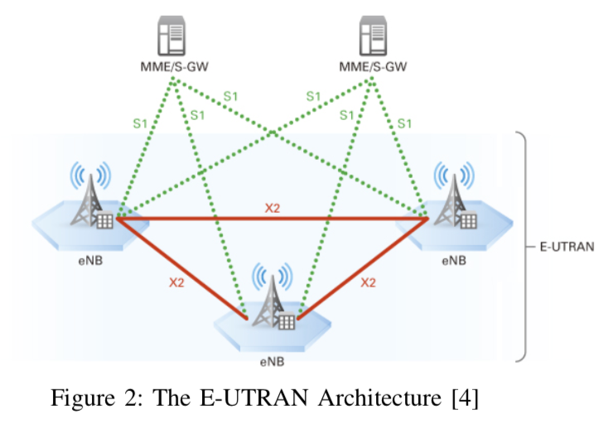
4G Architecture
a flat architecture by eliminating the RNCs that were needed to control all the radio resources and mobility over multiple NodeBs in hierarchical RAN.
Image source: https://www.researchgate.net/publication/235339185_Security_of_3G_and_LTE

Slide 15
3G & 4G Security Features
Network access security (NAS): enables users to securely access services provided by the network.
Network domain security (NDS): enables nodes in the provider domain to securely exchange signaling data, user data and prevent attacks on the wired network.
User domain security (UDS): enables a user to securely connect to mobile stations.
Application domain security (ADS): enables applications in the user domain and the provider domain to securely exchange messages.
Visibility and configurability of security: represents a set of features that enables the user to inform himself whether a security feature is in operation or not and whether the use and provision of services should depend on the security feature.

Slide 16
Network Access Security
User identity confidentiality: using a temporary identity for IMSI
Entity authentication and key agreement: a challenge response method using a secret key
Data confidentiality and integrity: a secret cipher key, an integrity algorithm and an integrity key

Slide 17
Network Domain Security
Security of the communication between network nodes, located either in the same or in different networks
Protect the core network signaling protocols
confidentiality, integrity, authentication and anti-replay protection
Standard procedures based on cryptographic techniques

Slide 18
Cyber Attacks to 3G & LTE
Crypto-attack
Denial of Service attack
Side-channel attack: side signals such as sound, frequency, or power consumptions. can recover the full cipher state in seconds, without the needing of any known keystreams
aLTEr: attack on data link layer and below of LTE. LTE user data is encrypted in counter mode (AES-CTR) but not integrity protected, which allows us to modify the message payload

Slide 19
Video Reference
How do SIM cards work?
How does Airplane wifi work?
Threats and risks----Wireless Networks Security(for whole list click here)
SMS / Text Explained
Wireless Security

Slide 20
Reference
https://books.google.com/books?id=IHg0JBShDhEC&pg=PA369&lpg=PA369&dq=security+in+first+generation+traditional+wireless+networks&source=bl&ots=l41aXRqaZG&sig=oovVfZ5rO0fHByWNvBH2gxi1eG4&hl=en&sa=X&ved=0ahUKEwj3ysn71-rUAhXLdj4KHc9lBI8Q6AEIMTAC#v=onepage&q=security%20in%20first%20generation%20traditional%20wireless%20networks&f=false
https://www.google.com/url?sa=t&rct=j&q=&esrc=s&source=web&cd=4&ved=0ahUKEwjz6t612-rUAhXHzz4KHV7FAksQFghBMAM&url=https%3A%2F%2Fwww.sans.org%2Freading-room%2Fwhitepapers%2Ftelephone%2Fgsm-standard-an-overview-security-317&usg=AFQjCNEVQqhFN991Ei5NxPmDY5V_wCnSiA&cad=rja (
https://arxiv.org/pdf/1002.3175.pdf
https://www.researchgate.net/publication/235339185_Security_of_3G_and_LTE

