Slide 1
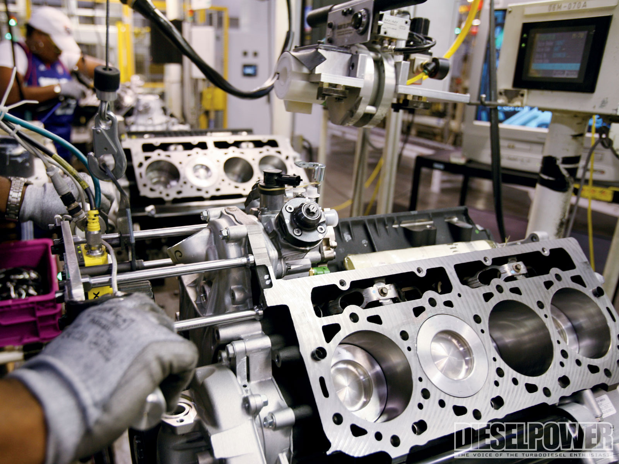
Welcome to Manufacturing Processes Online Class!
Dr Simin Nasseri (Ph.D., P.E.)
Southern Polytechnic College of Engineering and Engineering Technology
KSU

Slide 2
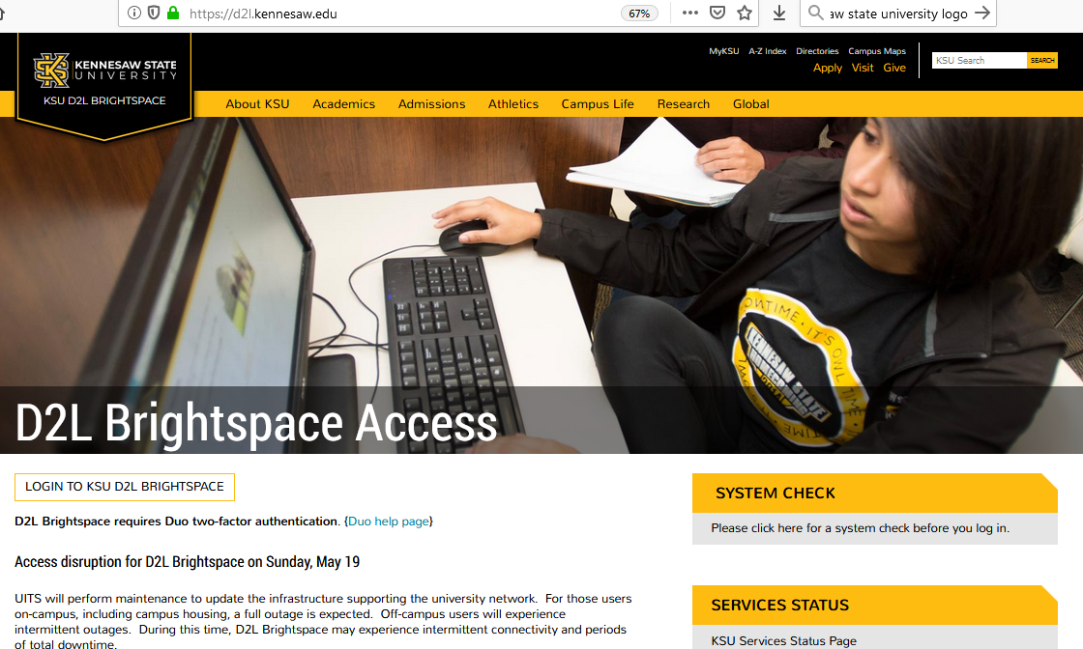
How to Start
Go to Desire to Learn or D2L: https://d2l.kennesaw.edu/
Use your university login/password to log in.
If you can not log in, contact the service desk:
470-578-3555 studenthelpdesk@kennesaw.edu

Slide 3
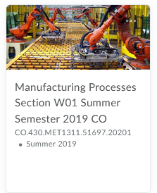
How to Start
Find the Manufacturing Processes (MET 1311), section W01 link and click on it.
The course content is based on “Introduction to Manufacturing Processes,”
textbook by Mikell Groover (which is optional to purchase).

Slide 4
Short Biography (http://facultyweb.kennesaw.edu/snasser1/)
Dr Simin Nasseri obtained her Ph.D. in Mechanical Engineering from Sydney University, Australia where she worked as a senior scientist. She joined SPSU/KSU in 2006, working at MET department from 2006 to 2015 and in the ME department from 2015 so far.
She has more than 22 years of academic/industry experience and has published about 30 books, book chapters, and papers (mainly in peer-reviewed journals). Besides, she has published a book titled: “Solving Mechanical Engineering Problems with MATLAB,” which is used in all sections of Matlab for Engineers and Engineering Computation courses at ME and MET departments.
She has industrial work experience related to design and manufacturing, has served as the SME faculty advisor from 2006, and has taught 15 undergraduate and graduate courses at KSU related to engineering mechanics, design, manufacturing, programming, etc.
Her research experience are related to Manufacturing, Rheology and viscoelasticity, Polymer processing, Biomechanical engineering (artificial organs and soft tissue rheology), Computational mechanics, Robotics, and Micromachinery. She has won many fellowships, awards and grants.
In 2019, she received the KSU distinguished professor award, for excellence in teaching, research and service.

Slide 5
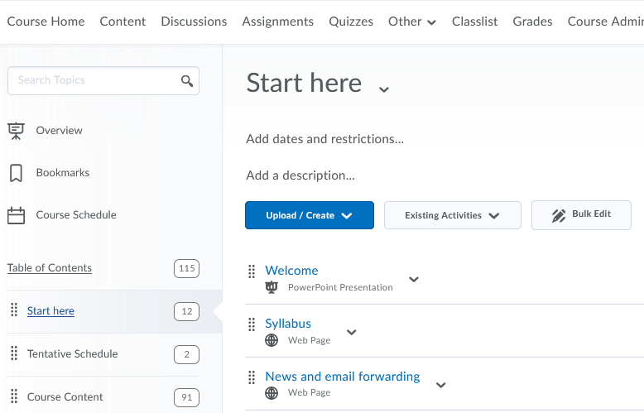
Syllabus
Click on CONTENT and START HERE to see some important files.
Read the course syllabus. It is consisted of all the information that you need to know about this course.
Remember that BUYING THE BOOK IS OPTIONAL.
Groover’s book is excellent and you can purchase any EDITION, if you want.
To do well in my class, it is sufficient to study the slideshows that I have prepared for you.

Slide 6
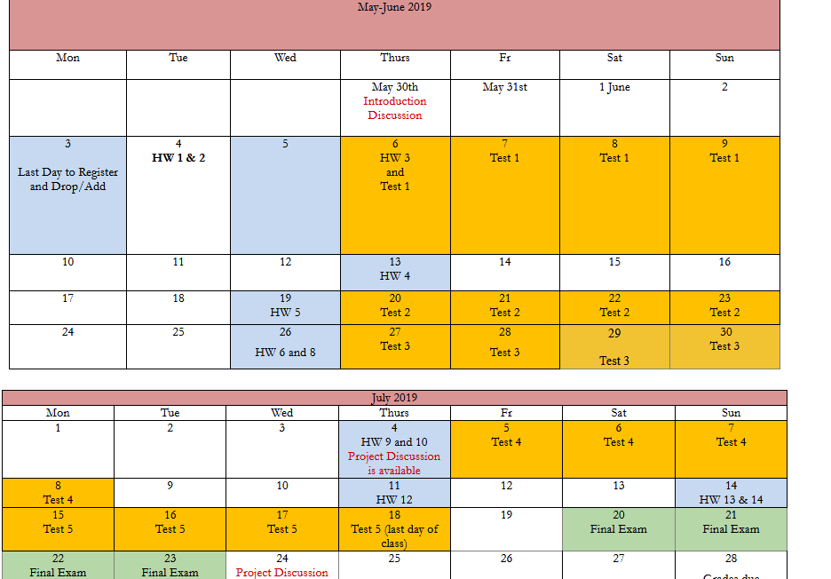
Calendar
Click on Tentative Schedule Module and print out the “Tentative Calendar” and keep it handy and always remember to check the dates for homework quizzes and tests.
Summer semesters are compact, so expect to spend more time on this course!
If you study gradually and do not miss any assessment, you will earn a high grade in this class.

Slide 7
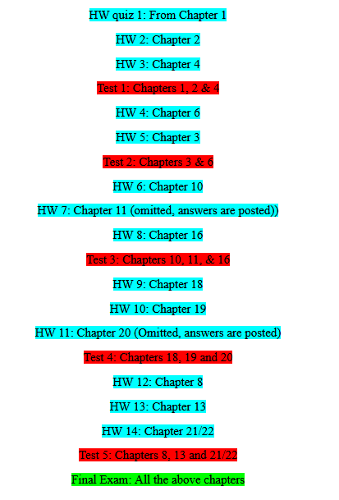
Chapters Taught
Click on Tentative Schedule Module and review the “Summary of all HW quizzes and Tests.”
The course materials are taught based on a special order. Metals and most of their processes will be taught and then polymers and their processes. Then at the end, some additional processes are taught.

Slide 8
News Forwarding
This is very important!
Check the News forwarding file and follow the instructions.
If you don’t do this, you will not receive the announcements that I post in D2L.

Slide 9
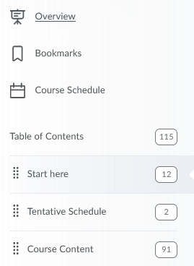
Course Content
Course content folder contains the weekly folders. Each folder contains the power point slide shows, solved problems for each chapter and some video clips.
Remember that the chapters are placed in the folders considering a certain order.
The calendar shows the order of chapters that you should study.

Slide 10
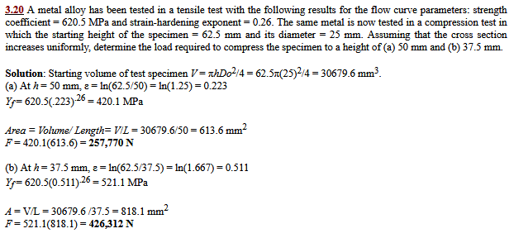
Weekly Modules
Each Module contains objectives, Power-Point shows, solved engineering problems and video clips.
You can download the files to your computer.

Slide 11
Discussions
Discussions have some weights on your final grade and you are to participate in them. Start the first discussion by introducing yourself as soon as you enter D2L. This is also important for reporting your attendance. Each discussion has a due date.

Slide 12
Quizzes
The assignments are in the form of quizzes with about 20 questions. You have certain amount of time to finish them. More info is given on each quiz when you click on it. The first HW Quizzes are due soon. So start to study the first two chapters.
They are consisted of multiple-choice or true-false questions.

Slide 13
Tests
Each TEST is open for minimum of 4 days. Each test has between 40 to 50 multiple-choice or true-false questions. There is a limited time for each one-attempt test. Don't forget to save the answers before submitting the test. There are 5 tests.
I will NOT open the assessments, under any circumstances, after their deadlines. So try not to miss them.

Slide 14
Final Exam
Final Exam is open for 4 days. It has 70 multiple-choice or true-false questions.
You have 2 hours to complete the exam (one attempt). Don't forget to save the answers before submitting it.
Try not to miss it, because it will not be available when it closes.

Slide 15
How It’s Made Projects
Project discussion is open for the last 4 weeks of the semester.
Detailed explanations are provided.
Try not to miss it, because it will not be available when it closes.

Slide 16
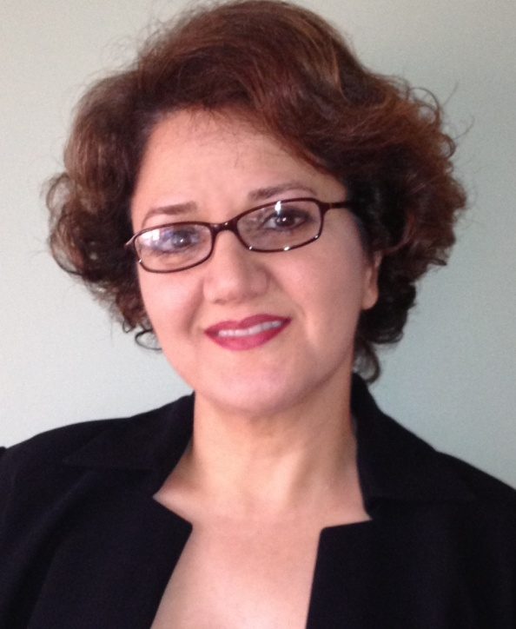
Contact me
Do not hesitate to email me (snasser1@kennesawedu) if you have any question or concern. You can also write your questions in discussion area: “Ask me questions.”
Good luck and I hope you enjoy this class and learn so much!

